Slide 1
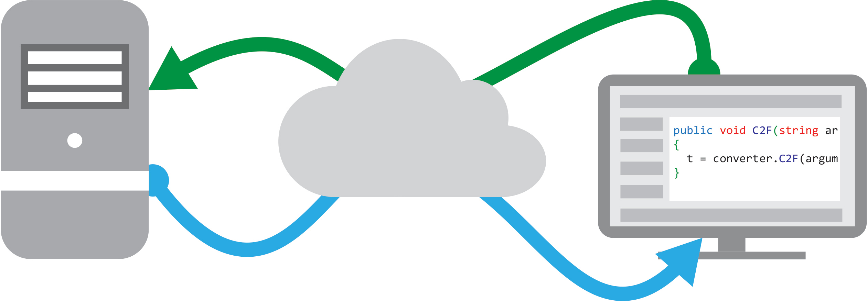
Consuming Web Services
CIS 399
Notes:
http://sqlite.org

Slide 2
Course Overview
Wk | Topic
1 | Intro, single-screen apps
1 | Activity Lifecycle, saving activity state
2 | Layouts + widgets, Event Handlers
2 | Themes + styles, Menu + settings
2 | Multi-screen apps
Wk | Topic
3 | Fragments
3 | Reading XML files, Asynch Tasks
3 | List Views
3 | SQLite Databases
4 | Consuming web services
4 | Geolocation

Slide 3

Intro to Web Services
Notes:
http://sqlite.org

Slide 4
How Web Services are Used
A Web Service provides information or computing services to other computers over a network
Client 1
consuming the service
Client 2 consuming the service
Client 3 consuming the service
A server
Provides a
Web Service

Slide 5
Advantages of Web Services
Allows computing services to be distributed across:
Multiple machines
Any distance
Provides a service that is:
OS independent
Language independent

Slide 6
Protocols
Two Main Standards:
REST: Representational State Transfer
Newer, simpler, client code easier to write
SOAP: Simple Object Access Protocol
Older, more complex, client harder to write
Lots of legacy SOAP services out there

Slide 7
REST Protocol

Slide 8
Code Tour
Using the Weather Underground REST API
Notes:
http://api.wunderground.com/weather/api/d/docs

Slide 9
SOAP Protocol
TheSimpleObjectAccessProtocol(SOAP)isaplatform-independentprotocolthatuses
XMLtomakeremoteprocedurecalls,typicallyoverHTTP.Eachrequestandresponseis
packagedinaSOAPmessage—anXMLmessagecontainingtheinformationthataweb
servicerequirestoprocessthemessage.SOAPmessagesarewritteninXMLsothatthey’re
computerreadable,humanreadableandplatformindependent.

Slide 10
WSDL
Web Services Description Layer
An XML document that describes a web service
The main elements in a WSDL document:
<types> Contains data type definitions
<message> Definition of the data being sent
<portType> List of operations
<binding> Protocol and data format for port type

Slide 11
SOAP Messages
Used for Request and Response
A SOAP message is an XML document (not a file) with these elements:
Header
Body
Fault
Envelope

Slide 12
Skeleton SOAP Message
<?xml version="1.0"?>
<soap:Envelope
xmlns:soap="http://www.w3.org/2001/12/soap-envelope"
soap:encodingStyle="http://www.w3.org/2001/12/soap-encoding">
<soap:Header>
...
</soap:Header>
<soap:Body>
...
<soap:Fault>
...
</soap:Fault>
</soap:Body>
</soap:Envelope>
(From w3schools)

Slide 13
Request Body
Contains the actual SOAP message.
Example request message (w3schools), requests the price of apples
<soap:Body>
<m:GetPrice xmlns:m="http://www.w3schools.com/prices">
<m:Item>Apples</m:Item>
</m:GetPrice>
</soap:Body>

Slide 14
Response Body
Response message example (w3schools), returns the price of apples
<soap:Body>
<m:GetPriceResponsexmlns:m="http://www.w3schools.com/prices">
<m:Price>1.90</m:Price>
</m:GetPriceResponse>
</soap:Body>

Slide 15
SOAP Service and Client
A SOAP client consists of:
A proxy that represents the web service
Client code that communicates with the proxy
Network
SOAP Web Service
Client code
Proxy object

Slide 16
Code Tour
Using the ksoap2-Android library
to consume a SOAP web service

Slide 17
Android Project Setup
Manifest <uses-permission android:name="android.permission.INTERNET"/>
Activity that contains the web service client
import org.ksoap2.SoapEnvelope; import org.ksoap2.serialization.SoapObject; import org.ksoap2.serialization.SoapSerializationEnvelope; import org.ksoap2.transport.HttpResponseException; import org.ksoap2.transport.HttpTransportSE;

Slide 18
Project Setup: Gradle (Module: app)
android { … defaultConfig { … } buildTypes { … } repositories { maven { url 'https://oss.sonatype.org/content/repositories/ksoap2-android-releases'} } } }
dependencies { compile 'com.android.support:support-v4:21.0.3' compile 'com.google.code.ksoap2-android:ksoap2-android:3.6.0' }
Add these lines

Slide 19
Creating a SOAP Request
Create an instance of the SoapObject class: SoapObject request = new SoapObject( http://ws.cdyne.com/WeatherWS/, "GetCityForecastByZIP");
Parameters:
URI of the web service
Name of the operation
Add a parameter (message part) Example: add a zip code parameter String zipCode = “97405”; request.addProperty("ZIP", zipCode);

Slide 20
Creating a SOAP Request (continued)
Create an Envelope: SoapSerializationEnvelope envelope = new SoapSerializationEnvelope(SoapEnvelope.VER12);
Pass the SOAP version, 1.2, to the constructor
Initialize the envelope:
dotNet property: Set to true if the web service you are consuming is written using .NET: envelope.dotNet = true;
setOutputSoapObject: pass in an instance of soapObject envelope.setOutputSoapObject(request);

Slide 21
Sending the SOAP Request
Instantiate an instance of HttpTrasportSE HttpTransportSE ht = new HttpTransportSE( Proxy.NO_PROXY, "http://wsf.cdyne.com/WeatherWS/ Weather.asmx", 60000);
Parameters: proxy, web service URI, timeout in milliseconds
Set the XML version and encoding ht.setXmlVersionTag( "<!--?xml version=\"1.0\" encoding= \"UTF-8\" ?-->");

Slide 22
Sending the SOAP Request (continued)
Make a call to the web service: ht.call( "http://ws.cdyne.com/WeatherWS/GetCityForecastByZIP", envelope);
First parameter: URI of SOAP endpoint for the operation
Second parameter: the SoapSerializationEnvelope
Now the request has been sent!

Slide 23
Receiving the Response
Multiple options:
Get the response from the SoapSerializationEnvelope object: SoapPrimitive resultsObject = (SoapPrimitive) envelope.getResponse();
Get the response from the HttpTransportSE object: String weatherXml = ht.responseDump;

Slide 24
Receiving the Response (continued)
Option 2, continued:
The responseDump method returns a text string containing the XML response envelope
This response string can be parsed using SAX or any other standard XML parser

Slide 25
Further kSOAP Reading
W3Schools SOAP tutorial http://www.w3schools.com/XML/xml_soap.asp
ksoap2-android home page: http://mosabua.github.io/ksoap2-android/index.html
ksoap2 API documentation: http://www.kobjects.org/ksoap2/doc/api/overview-summary.html
ksoap2-android tutorial http://code.tutsplus.com/tutorials/consuming-web-services-with-ksoap--mobile-21242

