Slide 1
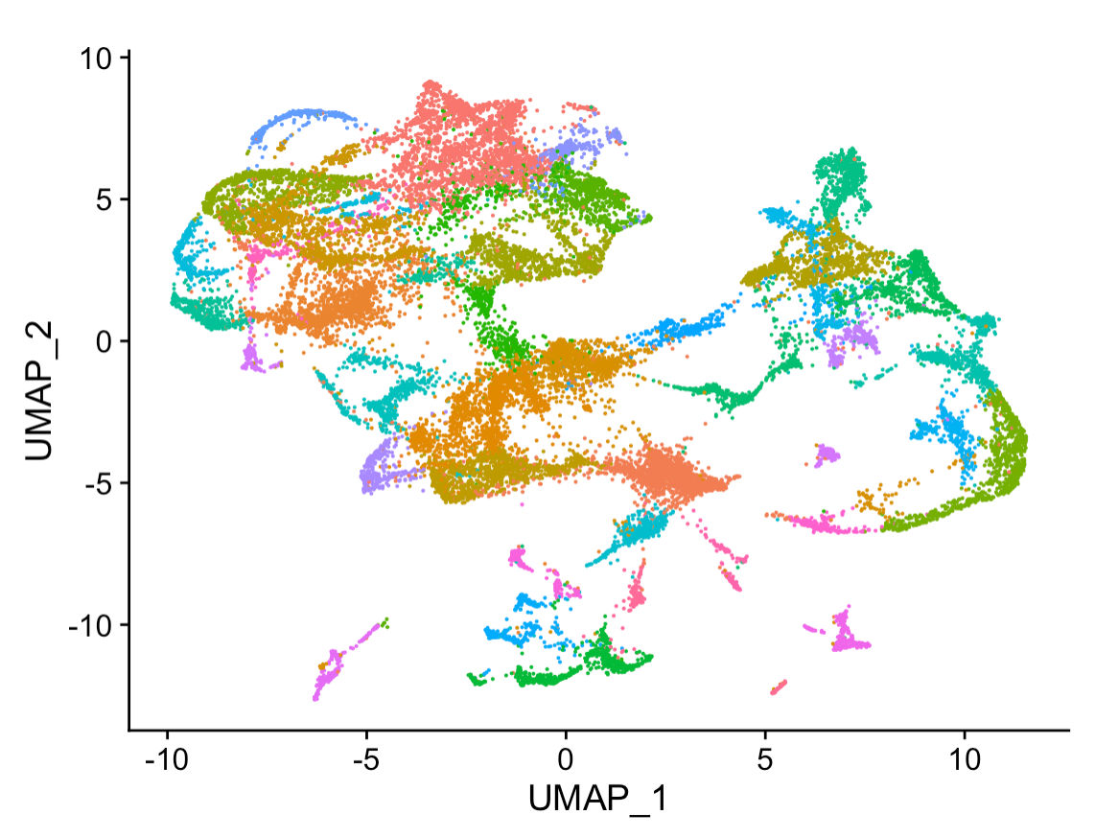
Good Data Practices
Data4ML
Summer 2022

Slide 2
It’s All About Data
Good Machine Learning starts with good datasets
What makes a dataset ‘good’
Reproducible
‘FAIR’ – Finable Accessible Interoperable and Reusable
How to plan out your data taking
What makes a data set ‘AI-Ready’

Slide 3
Reproducible research… what is it good for?
A published data analysis is reproducible if the analytic data sets and the computer code used to create the data analysis are made available to others for independent study and analysis.
This definition is sufficiently vague that it ultimately raises more questions than it answers. What is an “analytic data set“? What does it mean to be “available”? What is included with the “computer code”?
Peng and Hicks, 2021, Reproducible Research: A retrospective

Slide 4
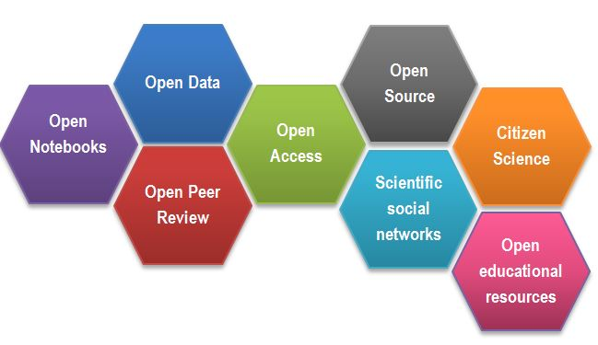
Open science: a new framework for research
Image credit G. de la Fuente

Slide 5
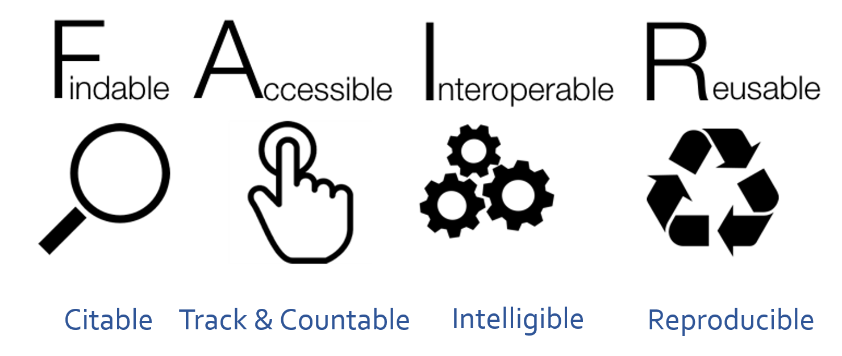
https://www.go-fair.org/fair-principles/

Slide 6
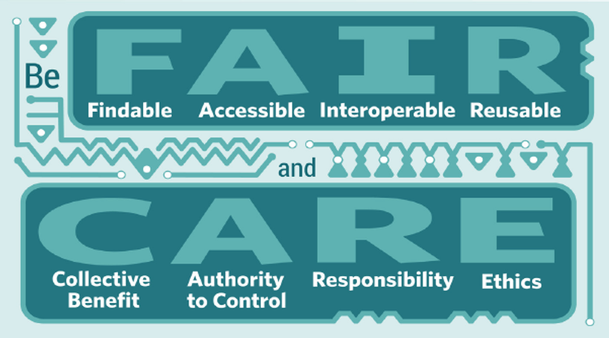
Global Indigenous Data Alliance
https://www.gida-global.org/

Slide 7
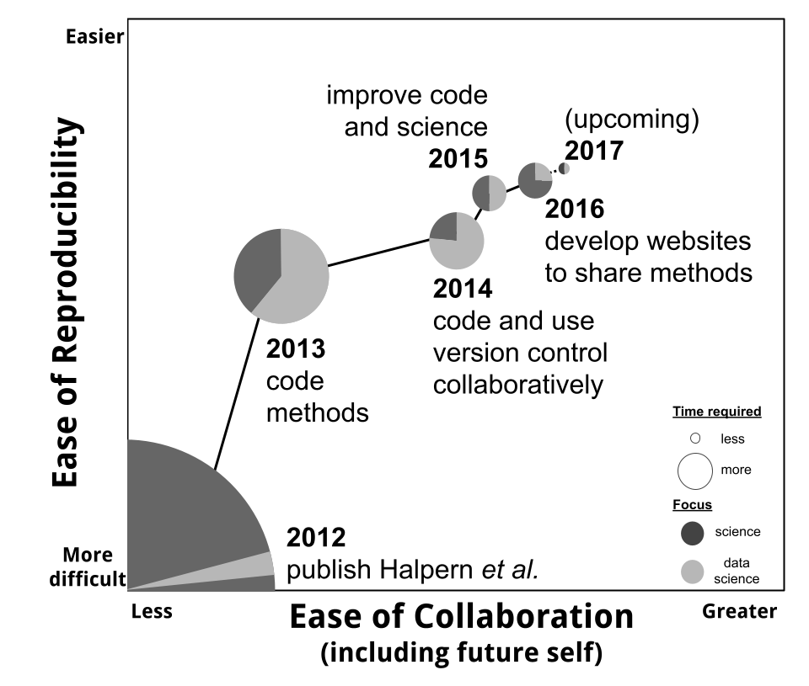
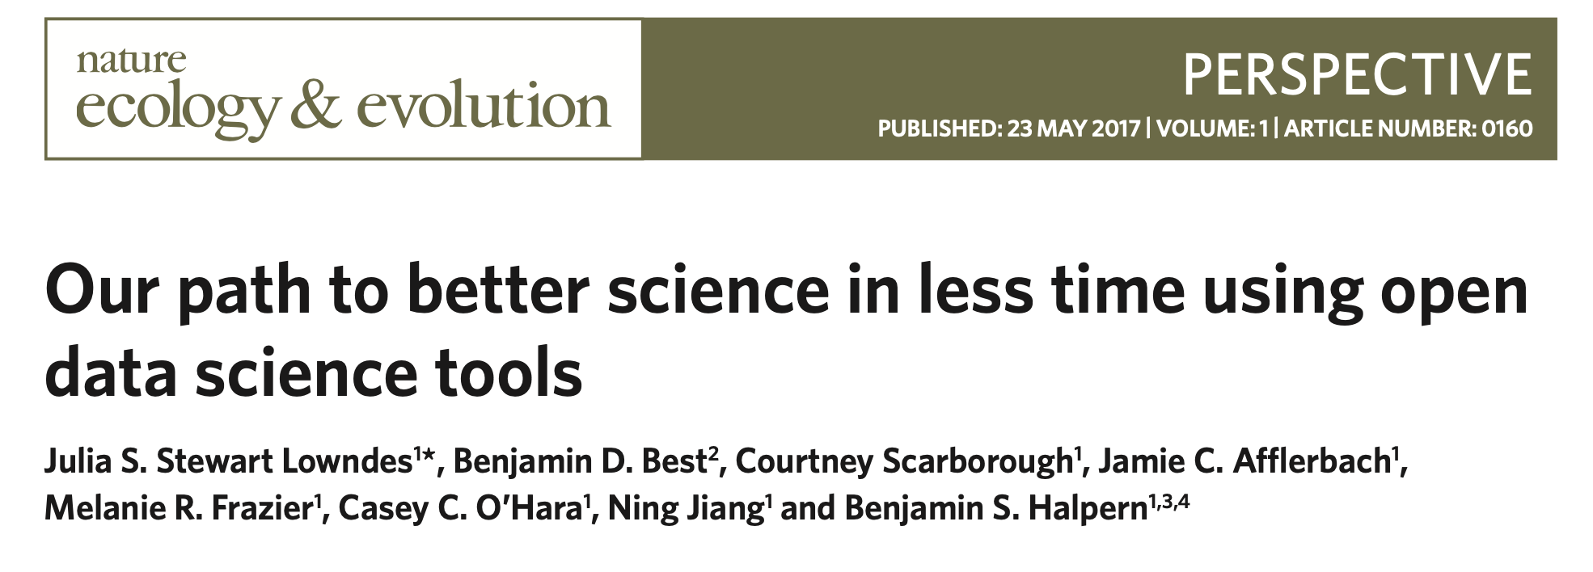
Reproducibility enhances collaboration
http://ohi-science.org/betterscienceinlesstime/

Slide 8
Research workflow
Published Dataset
Website, application, other output
Protocol
Figures
Tables
Numerical Summaries
Methodological code
Analytic Data
Computational Results
Measured Data
Published Article
Processing code
Analytic code
Visualization + presentation code
Adapted from R. Peng

Slide 9
How can we build a reproducible workflow?
Tools
Version control (e.g. Git)
Transparent collaboration (e.g. GitHub)
Documentation
Data repositories
Practices
Think about the whole workflow
Avoid doing things by hand
Use best practices for coding
Don’t save output
Be consistent + reduce decision fatigue

Slide 10
Collaboration exercise
Diagram (part of) your research workflow
Identify collaborators who contribute at different steps
Pick one step (e.g. moving from raw to processed data)
What access do your collaborators need to data, analysis, or products at this step? How do they contribute?
How do you maintain reproducibility with these collaborators at this step?
Don’t forget to include your future self as a collaborator!

Slide 11
Project-oriented workflows
Separate ‘workflow’ from ‘product’
Workflow = personal choices
Product = elements you want to reproduce
Avoid hard-wiring your workflow into your product
Organize work into ‘projects’
Measured Data
Analytic Data
Processing code
https://www.tidyverse.org/blog/2017/12/workflow-vs-script/
https://rstats.wtf/project-oriented-workflow.html

Slide 12
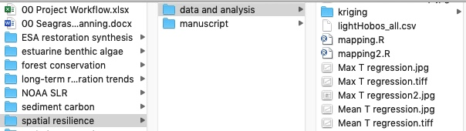
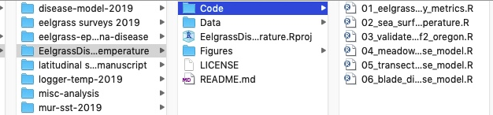
File and project organization
How can file organization enhance your research workflow?
VS

Slide 13
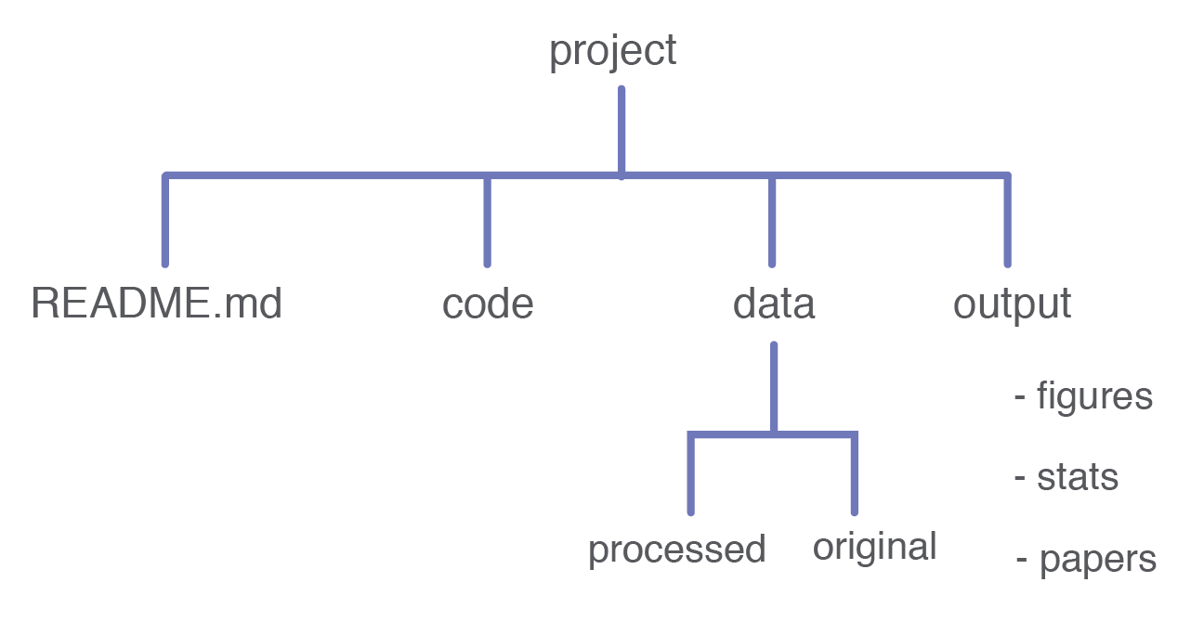
Best practices for project structure
Organize into projects + use relative paths
Keep outputs separate from inputs
Keep raw data safe
Adapted from https://reproducible-science-curriculum.github.io/

Slide 14
No one way to organize your research
Decide what works for you!
Aim for consistency
Automate?
Adapted from Helsinki University Library

Slide 15




Best practices for file and folder naming
Machine readable
Avoid spaces, special characters
Deliberate_delimiters
Human readable
CamelCase
more_deliberate-delimiters
01_first_script
10_tenth_script
2002-09-06_data.csv
2004-06-09_data.csv
Works well with default ordering
Adapted from J. Bryan

Slide 16
File Organization Exercise
1. Consider the files for (one of) your research projects. Diagram or screenshot your directory structure.
What works and what doesn’t work about this structure?
Who else might need access to these files?
2. Assess your naming scheme for the files related to this project.
What kinds of files do you create and in what formats?
What are the unique characteristics of these files? E.g. date created, experiment number, investigator, location
Use the unique identifiers to draft file names
3. Create a systemic folder hierarchy
How can you group the individual files into folders?
Can you improve the directory structure to address the needs you identified in (1)?
Adapted from MIT Libraries

Slide 17
Backups and Permissions
It’s always a good idea to keep a copy of your data as a backup
Hardware can fail
Running the wrong command can accidently delete data
It’s also a good idea to protect yourself from accidental code
All files have permissions that decide who can do what
read permissions let you look at file
write permissions let you change a file
execute permissions let you run a file
It’s a good idea to protect your raw data by removing all permissions but read
prevents accidentally changing the raw data

Slide 18
What Makes a Dataset AI Ready?
Clear Data Splits
Designate some examples as training data
Designate some examples as testing data
Structured Data is ‘Tidy’ - https://vita.had.co.nz/papers/tidy-data.pdf
Every column is a variable.
Every row is an observation.
Every cell is a single value.
The Dataset is Clean
No missing values or ‘Nans’
No ‘bad’ data
Consistent as Possible

Slide 19
Why do we split datasets?
Machine Learning Algorithms learn from data
Often powerful enough to ‘memorize’ or overfit data
You’re training ML models to work with new data
Memorizing training data isn’t good enough
Normally called generalization
We want models to learning something from the training data the applies to future data as well
How do we know if the model generalizes?
We check by splitting off some test data
In contests the testing labels aren’t published
In research settings we use testing data to compare models
In both cases it’s useful for the dataset creator to decide, so it’s consistent moving forward

Slide 20
Where do you make your data AI ready?
Published Dataset
Website, application, other output
Protocol
Figures
Tables
Numerical Summaries
Methodological code
Analytic Data
Computational Results
Measured Data
Published Article
Processing code
Analytic code
Visualization + presentation code
Adapted from R. Peng

Slide 21
Example Layouts
Example 1
Code
Step.1.clean
train_model
Data
Raw
Processed
ML_Ready
Training.csv
Testing.csv
Results
Example 1
Code
Step.1.clean
train_model
Data
Raw
Processed
ML_Ready
Training
labels.csv
Images
Img1.png
Img2.png
…
Testing
labels.csv
Images
Img100.png
Img201.png
…
Results
Example 2
Data
Raw
Processed
ML_Ready
Training
Cats
Img1.png
Img2.png
…
Dogs
Img1.png
Img2.png
Testing
…same layout as Training

Slide 22
Example Differences between Reproducible and AI-Ready
Blurry Image results from Bad Calibration
Useful for your future-self to debug
Not useful for training an ML model
An instrument is broken, so you’re missing a variable
Useful if you don’t need that variable
Not useful for training an ML model that needs that variable
Contaminated Sequences
Useful for your future-self to debug
Not useful for training an ML model
You switch units on an instrument
Useful it’s still the same data
Not useful for training an ML model you must convert to consistent units in advance
When taking data consider recording whether your confident if that data should be used for science or if there is a possibility something went wrong. This can help you clean your data for ML projects, can True/False, or more fine grained red/yellow/green.

Slide 23
Sometimes it’s ok to break the rules!
It’s often OK to break the rules when make AI-Ready Datasets. Just make sure you know why
Examples:
Some ML algorithms can handle missing values
Most can not, so make sure to check
There are other ways of validating ML models besides a training and test split
Cross validation - K-Folds, Leave one out
These are often computationally expensive, so generally they work with small models and small datasets where you want to use as much data as possible for training

Slide 24
Next Steps
Were going to practice moving files and setting up folders on the command line
We’ll get an existing dataset to be “AI-Ready”
Running and training ML algorithm will start here.

