Slide 1
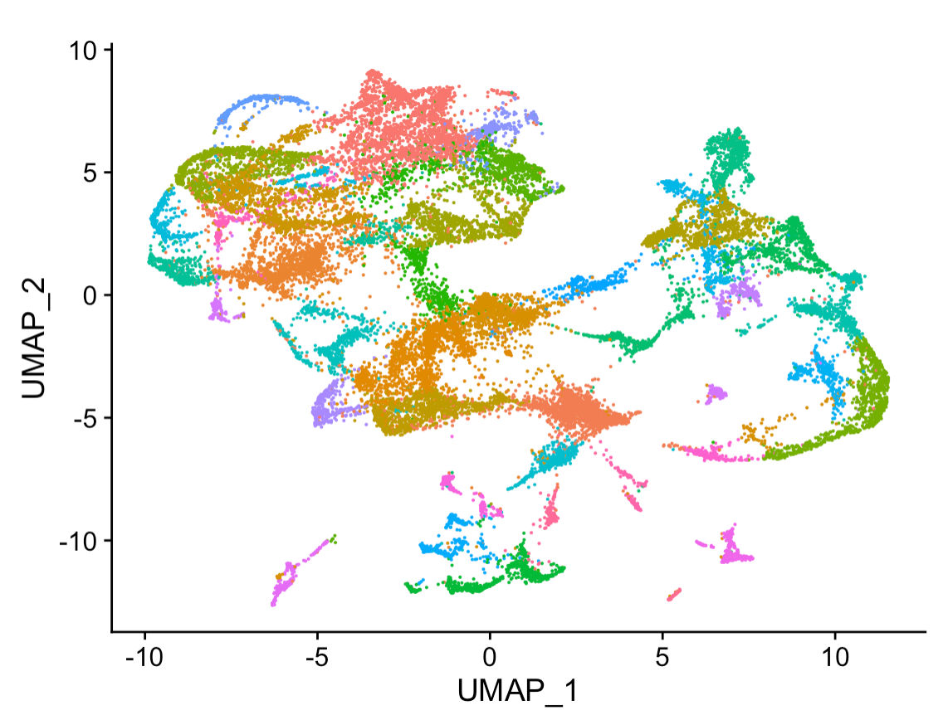
Basics of computational literacy Bridging the Bench-Machine Learning Gap
Dr. Emily A. Beck
Dr. Jake Searcy

Slide 2
How many of you are familiar with Unix?
What about Linux?

Slide 3
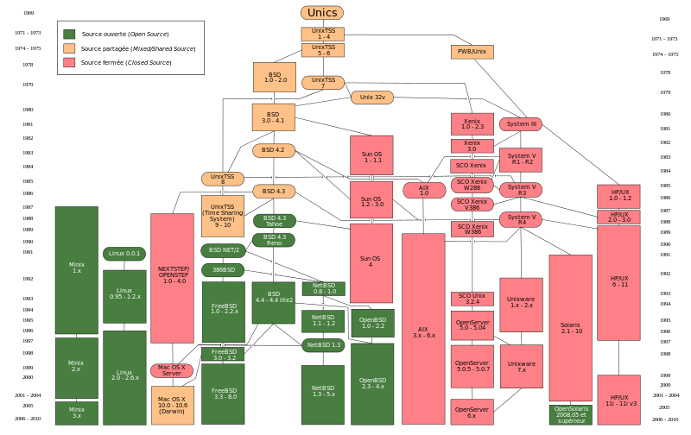
Unix has a long complicated history
1969 Ken Thompson and Dennis Ritchie write Unix/developed at Bell Laboratories
Thompson writes a new programming language called “B”
Ritchie improves on “B” to develop “C” to more fully develop Unix
Linux is created as an Open Source version on Unix

Slide 4
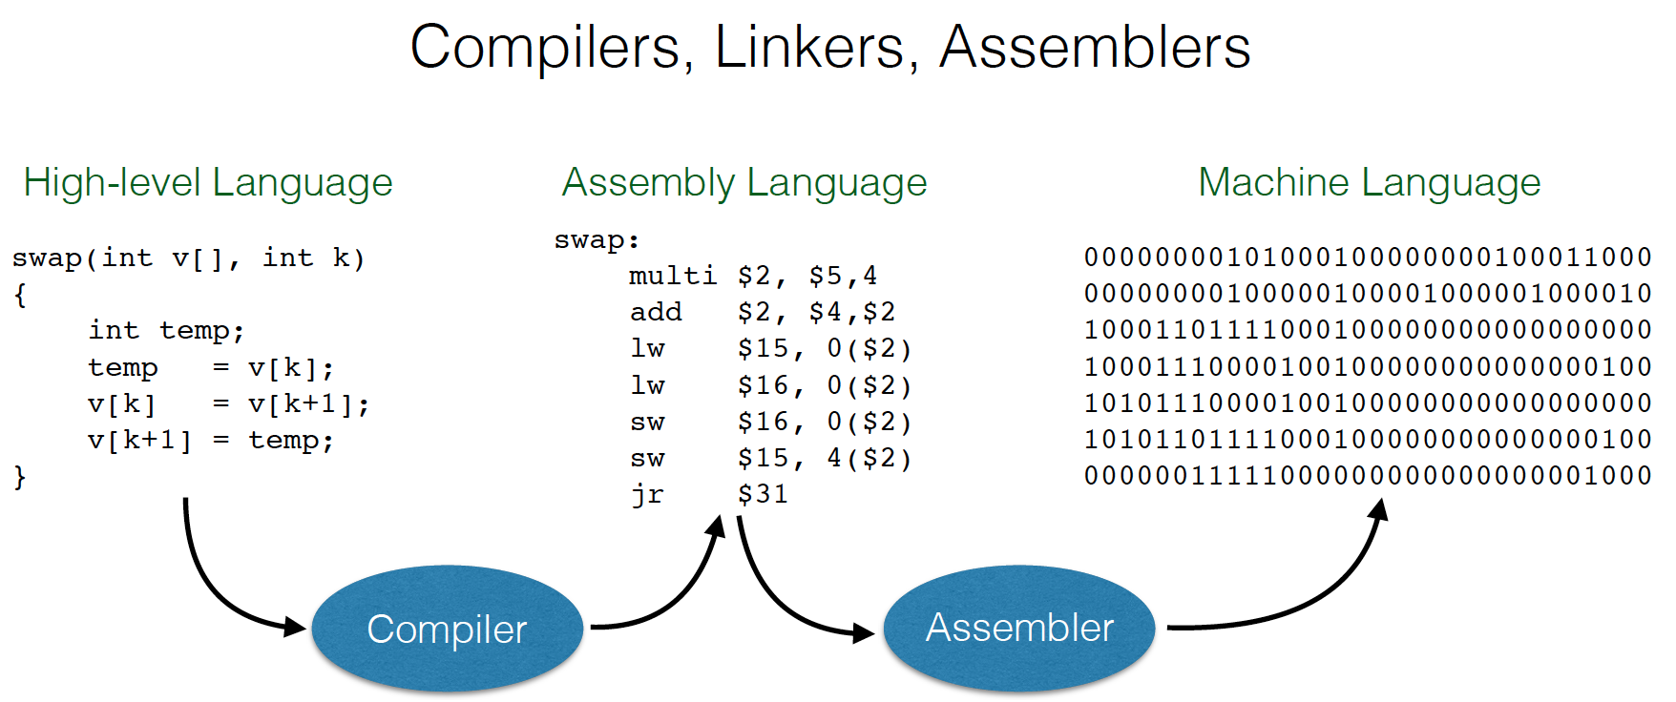
There are two “flavors” of code.
High-level Source code and Machine code.
How do these types of code work together?
Machine code (Binary) is made of 0s and 1s and is used to represent all types of characters.
This is important later when we talk about Bam (Binary Alignment Map) files.

Slide 5
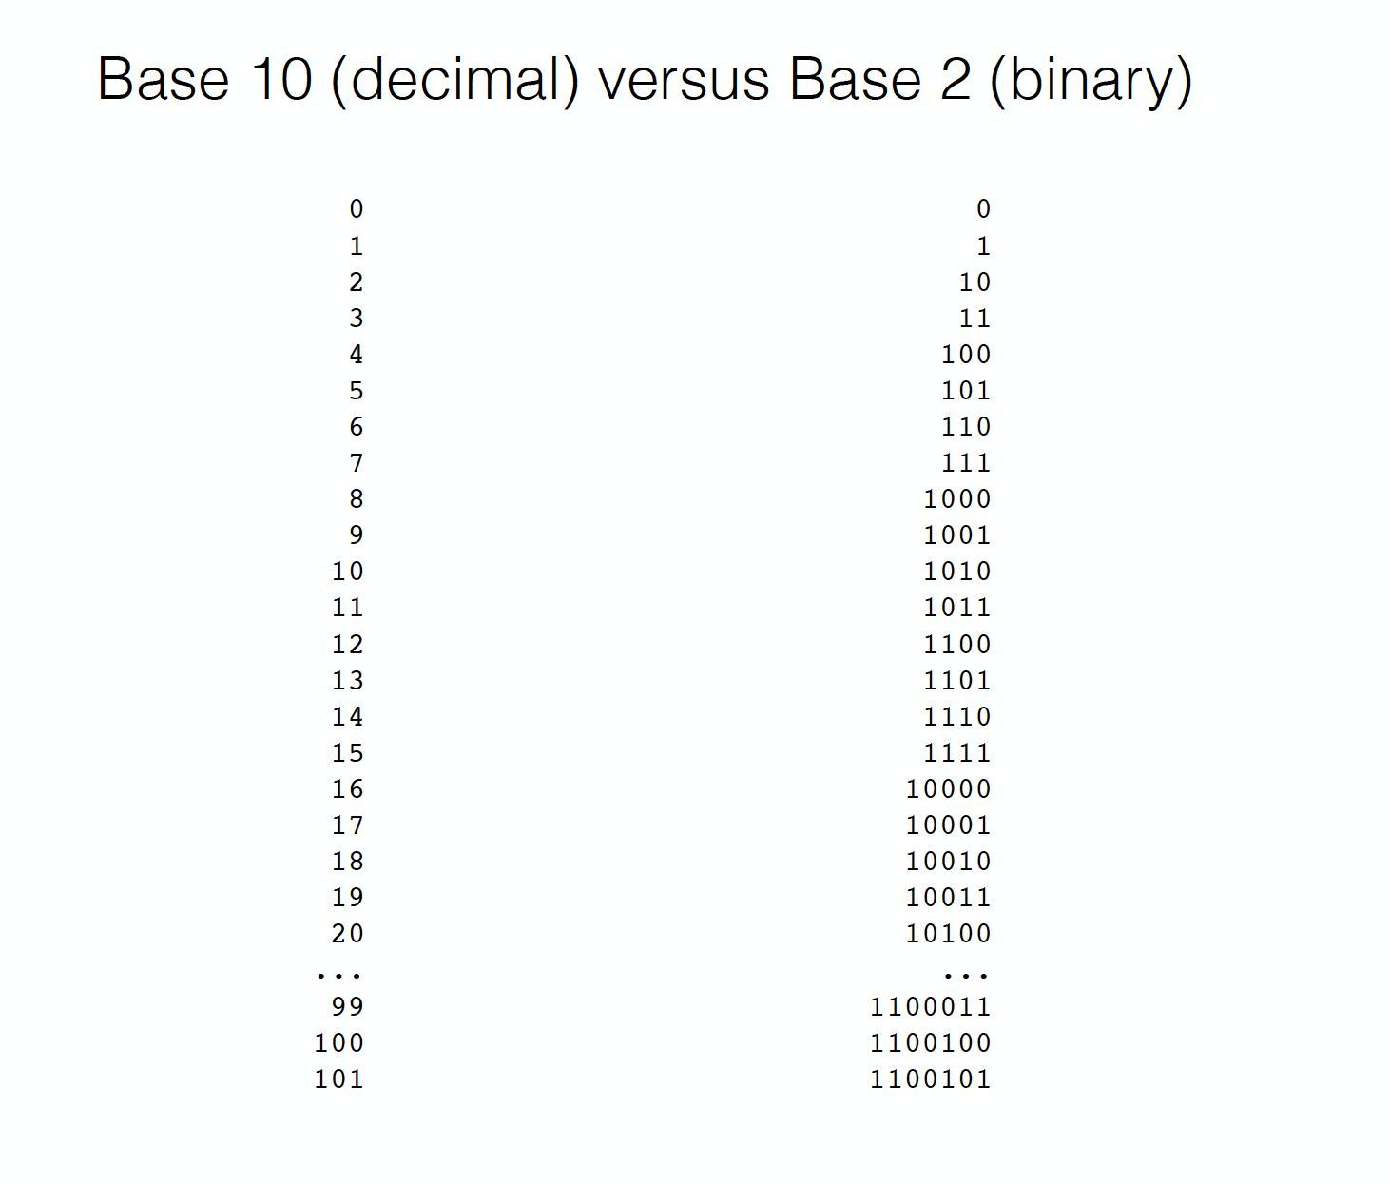

Slide 6
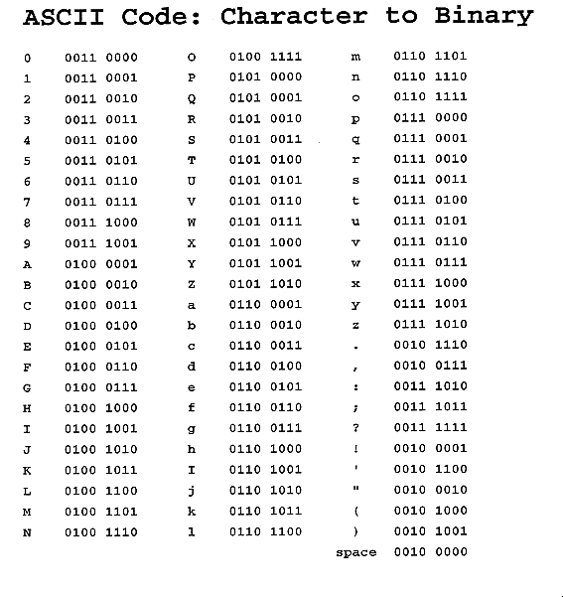
Ascii is used to represent text and can be easily converted into binary

Slide 7
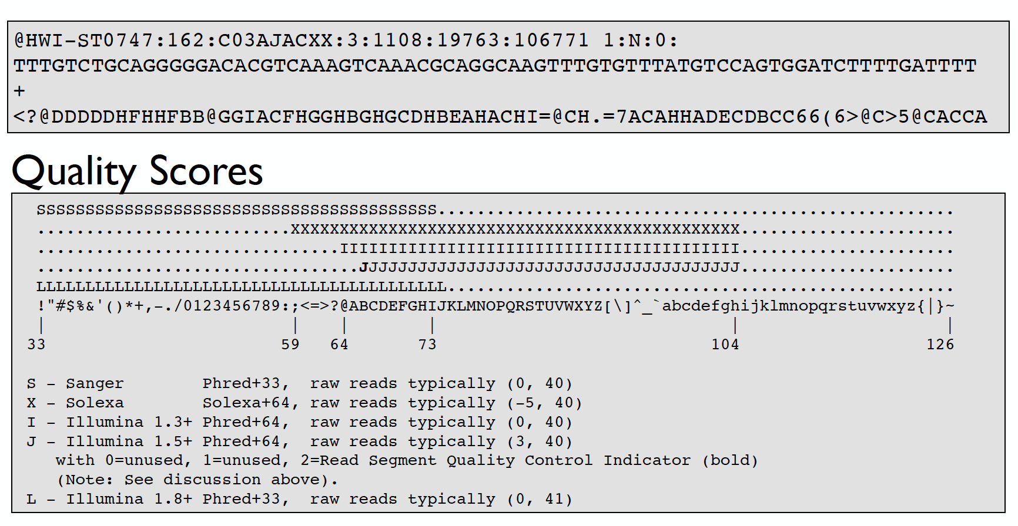
This will be important later because Fastq files use Ascii to encode quality scores!

Slide 8
For ”Gateway Week” we are going to focus on source code using Bash (Shell) and R
First, we will get oriented with the programs we will be using throughout the workshop series and then get started with Bash!

