Slide 1
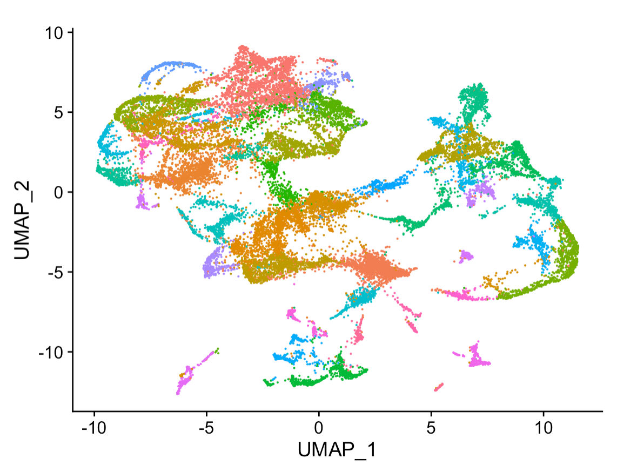
Introduction to Linux Part 2 Bridging the Bench-Machine Learning Gap
Dr. Emily A. Beck
Dr. Jake Searcy

Slide 2
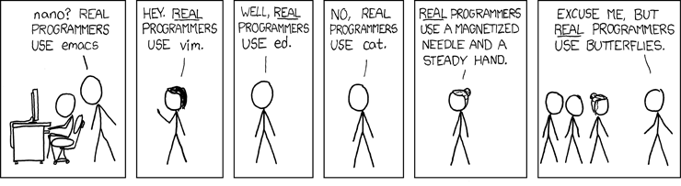
There are MANY ways to do a task and MANY tools to help you! Use what works for YOU.
Linux?
R
C
C++
Python
Today we are sticking with Linux and then we will learn alternatives in R later

Slide 3
Learning Objectives
Understand the value of regular expressions
Learn to parse and subset files
Learn to edit fields
Gain the confidence to learn any text manipulation your heart desires

Slide 4
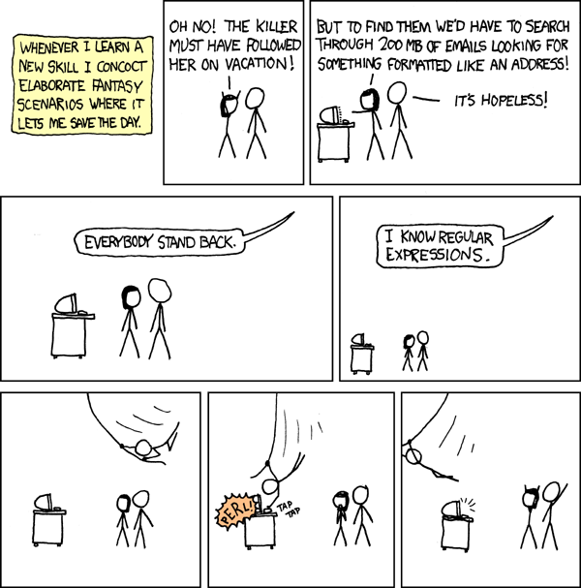

Slide 5
Regular expressions can be used to optimize searches
Use regular expressions to find patterns:
1. Something made of numbers
2. Something made of letters
3. A certain length
4. Containing special characters
5. Location in a line
Very useful when working with large text files

Slide 6
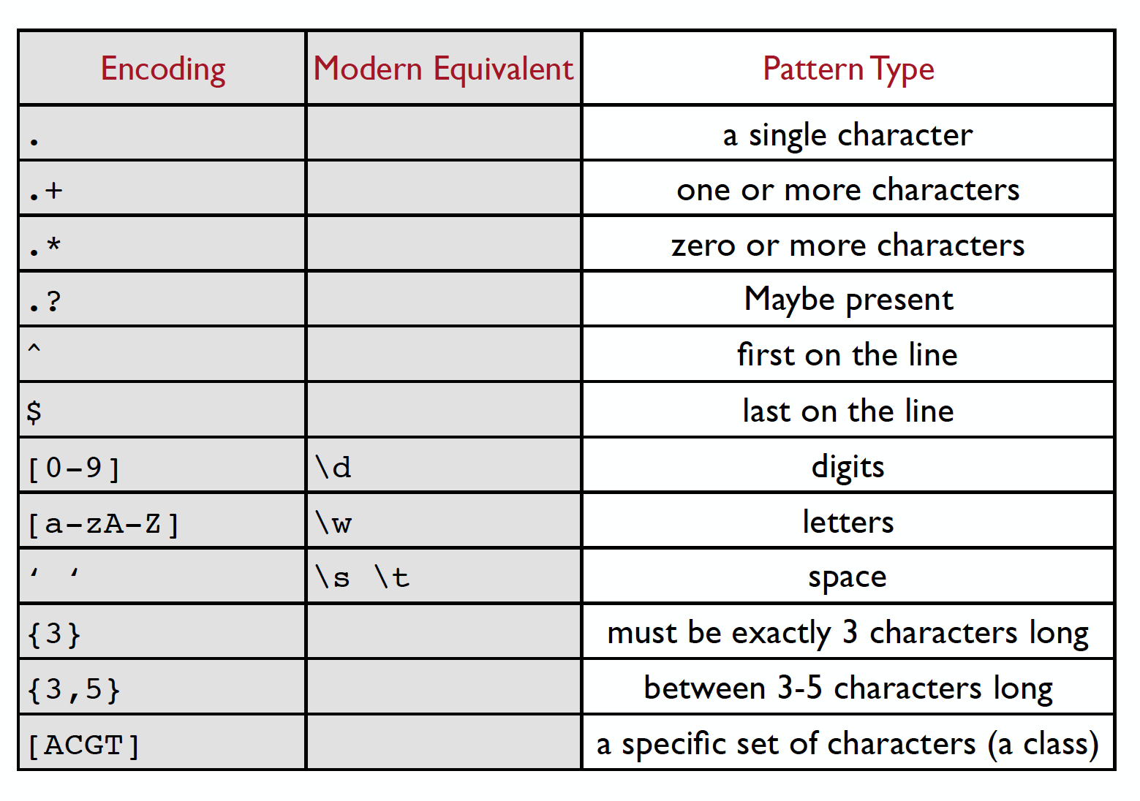
Useful cheat sheet for regular expressions
How would you represent:
A 7 digit number
A date using convention Month,YYYY
A phone number using convention ###-###-####

Slide 7
Useful cheat sheet for regular expressions
How would you represent:
A 7 digit number
A date using convention Month,YYYY
A phone number using convention ###-###-####
TRICKY!! Dashes are special characters. Can you find a workaround?

Slide 8
Useful cheat sheet for regular expressions
How would you represent:
A 7 digit number?
……. [0-9]{7}
A date using convention Month,YYYY
[a-zA-Z]+,[0-9]{4}
A phone number using convention ###-###-####
[0-9]{3}\-[0-9]{3}\-[0-9]4

Slide 9

Grep/Sed/Awk are three powerful tools to accomplish most common text manipulations in Linux

Slide 10
Grep/Sed/Awk are three powerful tools to accomplish most common text manipulations in Linux

Slide 11
Grep: A highly useful search tool
grep is the simplest of these three commands and differs from awk and sed in that it cannot be used to add, modify, or delete text.
Similar to the search function crtl-f that many are familiar with.
It can be used to print or count the desired text using various flags.
Useful grep flags:
grep -c (count)
grep -v (invert/everything but)
grep -n (show line numbers)
grep -i (ignore case)
How to use:
function -flag term <file>
grep -c ATGC sequence.fasta
Count the number of times “ATGC” appears in my sequence file

Slide 12
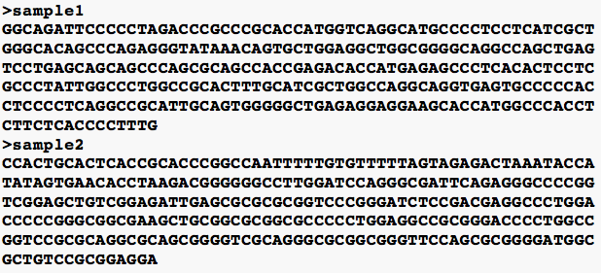
How can we use grep to obtain data about a fasta file.
How many sequences are in my file?
How many times does a particular sequence appear?
Where in my file is a specific sequence?

Slide 13
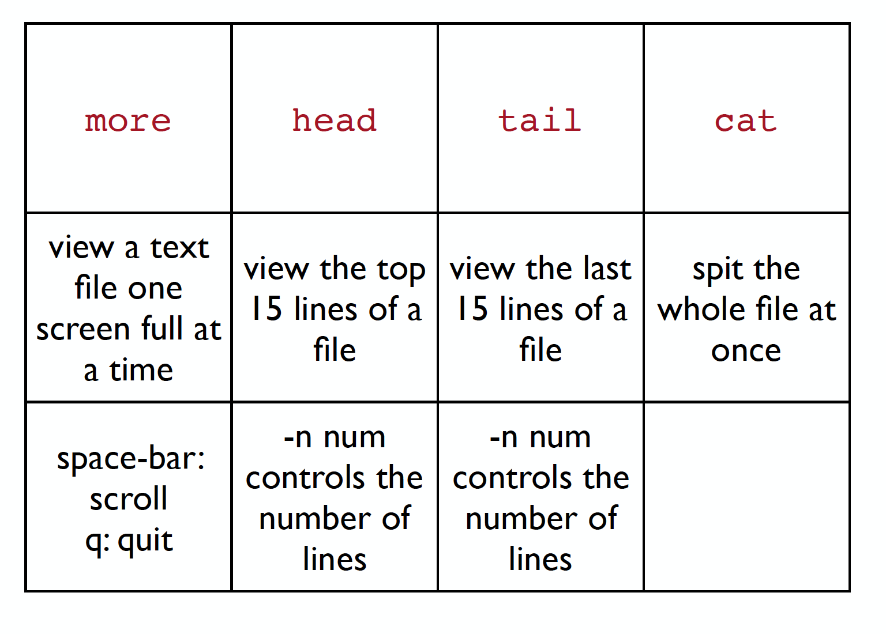
Interactive Exercise 1: Back to the Penguins!
Useful grep flags:
grep -c (count)
grep -v (invert/everything but)
grep -n (show line numbers)
grep -i (ignore case)
Use grep and other tools in your toolkit to do the following:
How many of each species of penguin are in the file penguins.csv?
How many male penguins are there? (Be careful!)
How many penguins are NOT from Biscoe?

Slide 14
Sed: The favorite child
sed can be used for text transformation on a specific term in a file
We are still following the basic formula of:
function -flag term <file>
sed uses a special structure encoded using slashes to denote different parts of the term following this formula for search and replace
‘s/pattern/replace/’
There are MANY variations on this function that allow you to do pretty much any manipulation you can think of (print, delete, change case, designate specific lines etc.

Slide 15
Sed: The favorite child
sed can be used for text transformation on a specific term in a file
We are still following the basic formula of:
function -flag term <file>
sed uses a special structure encoded using slashes to denote different parts of the term following this formula
‘s/pattern/replace/’
Today we will learn the basics so you are able to tackle new challenges on your own.

Slide 16
‘s/pattern/replace’
“s” indicates you are using the substitution function for editing
”pattern” is the search pattern you want to edit
“replace” is what you want to replace your pattern with
Example:
I want to replace “offive” with “office” in my file.txt
sed ‘s/offive/office’ file.txt
I think I made this mistake multiple times! Can I fix it everywhere?
Add “g” meaning global change
sed ‘s/offive/office/g’ file.txt

Slide 17
WARNING: sed will overwrite your existing file!
Good Data Practices would suggest that we want to keep intermediate files as we manipulate our data. How can we do this?
Whenever I am writing new code I like to create output files along the way so I can view them to make sure my code is doing what I think it is doing.
sed ‘s/offive/office/g’ file.txt > file_edited.txt
Using “> new_file_name” writes a new file with the changes I made

Slide 18
-n ‘;/pattern/p’
sed can also be a useful search and print function
Example: I have a large csv file and I want to make subsets of this file based on a specific term.
-n:
flag that disables automatic printing because we only want to print a part of the file
;
is a special character indicating the end of a function. In this case we aren’t doing anything special so the first segment is blank except the semicolon

Slide 19
Interactive Exercise 2: Cleaning up after messy penguins! Use: penguin_mess.csv
Replace all the spaces in the file with underscores.
(2) Replace all instances of “none” with “NA”
(3) Make a new file for each species

Slide 20
Tip! Copying headers is often important. Use sed -n ‘1p;/pattern/p This prints the first row in a file then perform the search and print function

Slide 21


