Slide 1
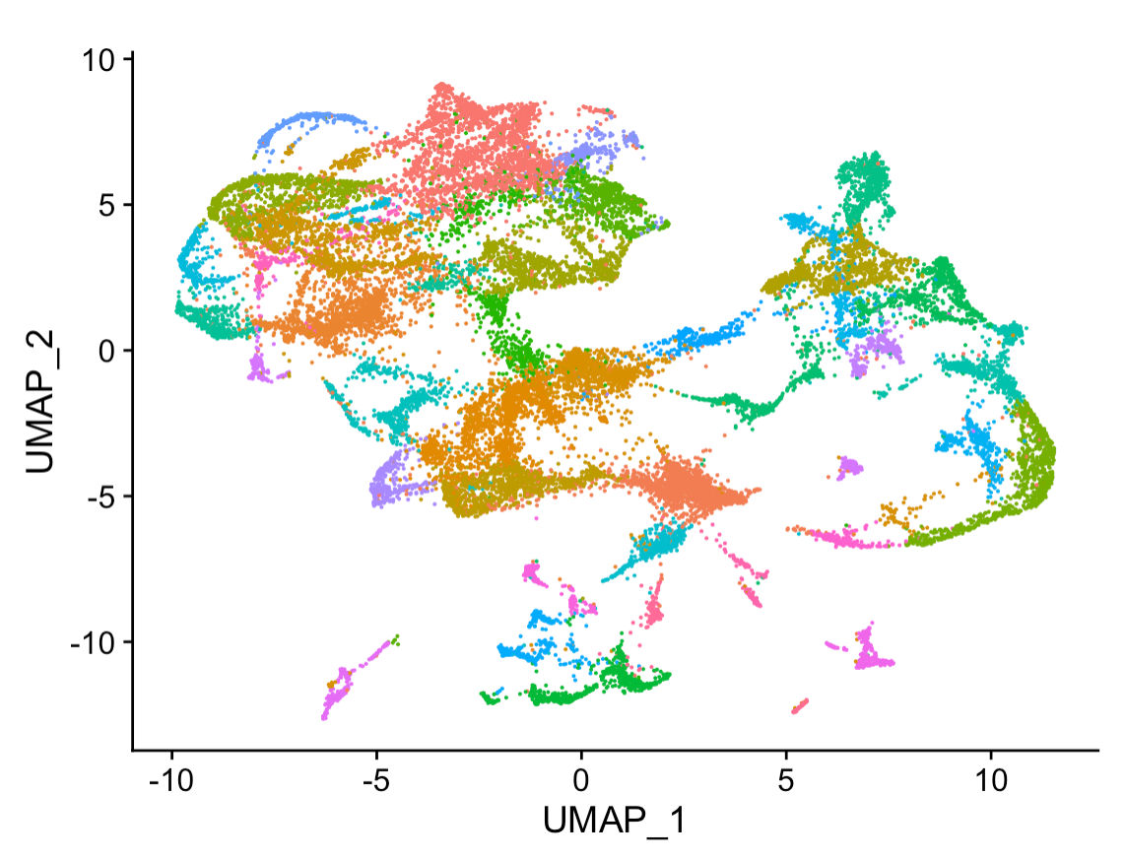
Bash Scripts + Git Programing Powerup
Data4ML
Summer 2022

Slide 2
Automating the Command Line
We’ve covered a lot of Linux commands to move files around and transform text data
What if you want to do run the same series for commands over and over again with different inputs
You could type out each command in your series one at a time for every input
Ok but time consuming and ERROR prone
It’s Better to automate the process with a bash ‘script’
A bash script is just a text file that has a list of commands that get run all together when you run the file

Slide 3
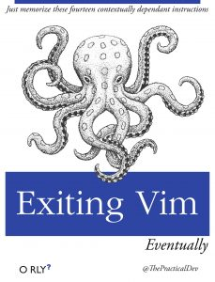
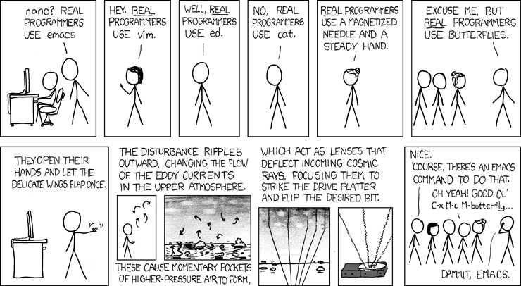
Writing in the Terminal
There is a surprisingly large number of ways to create a text file
Things like word that save *.docx file types won’t work to create bash scripts
Sometimes fancier tools use graphics that don’t work well over a remote connection
We’ll use nano which has familiar shortcuts like ctrl/cmd-c for copy and ctrl/cmd-v for paste
People joke around a lot about text editor choice, but use what works for you
https://xkcd.com/378/

Slide 4
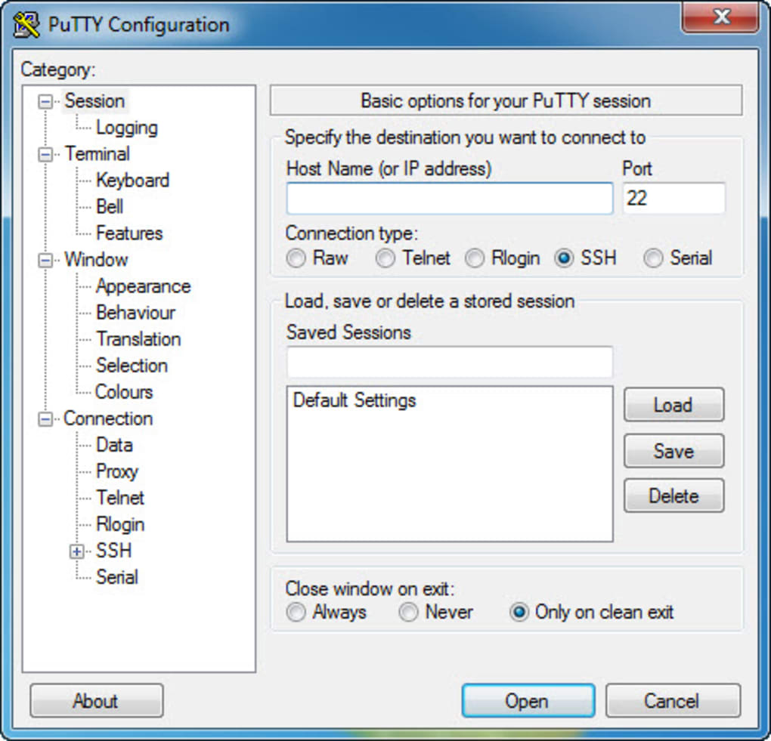
SSH
So far we’ve been working in Open On Demand. It’s more common to access machines using SSH (Secure Shell)
In a Linux or a mac machine just type this command in a terminal
ssh talapas-ln1.uoregon.edu
One a windows machine you’ll need to install Putty -https://www.putty.org/
talapas-ln1.uoregon.edu goes under Host Name

Slide 5
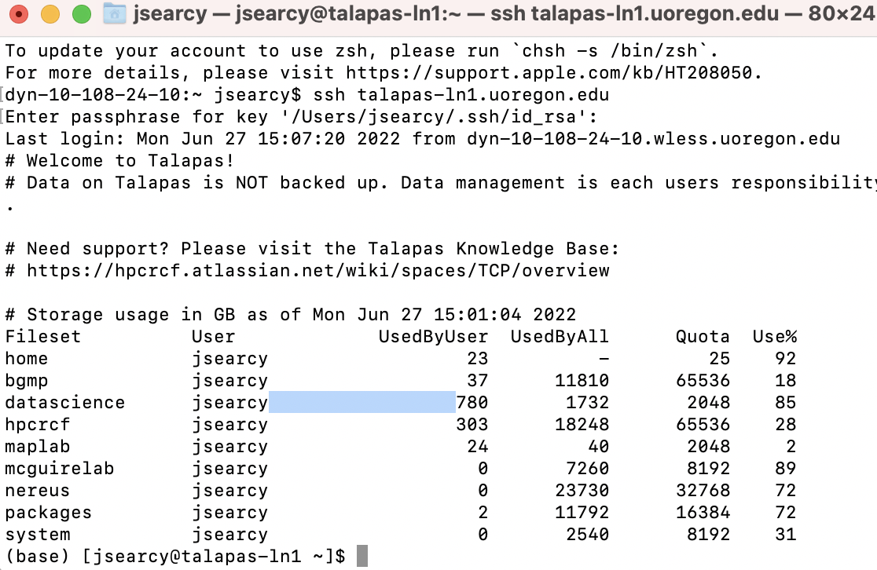

Slide 6
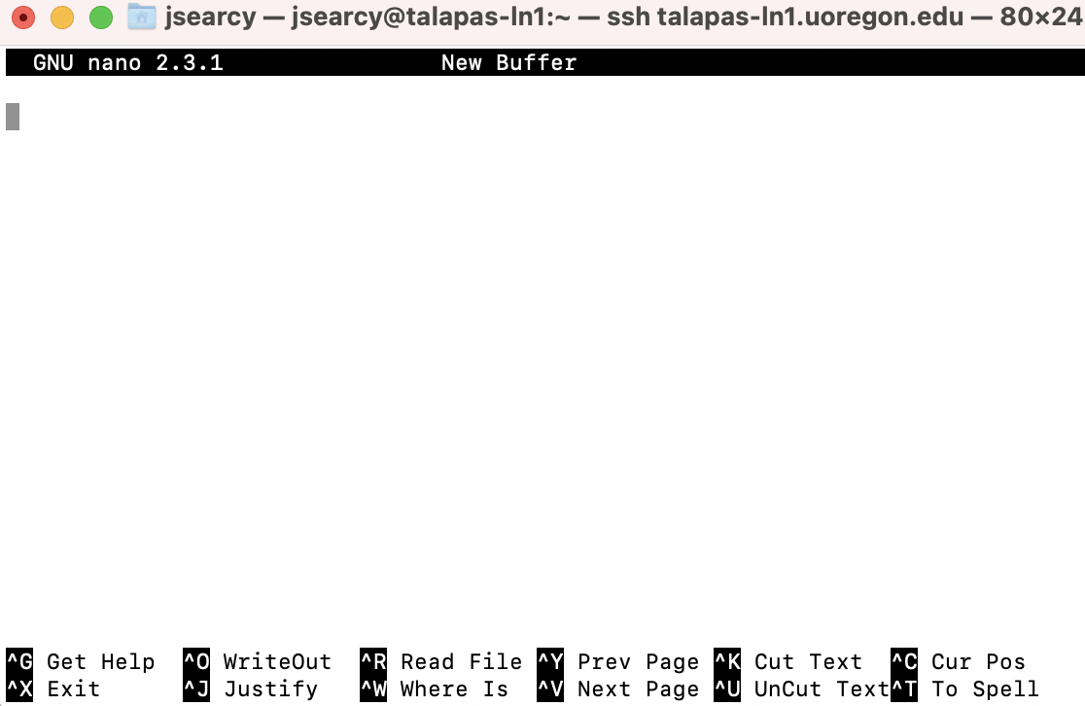
Nano
Type – nano

Slide 7
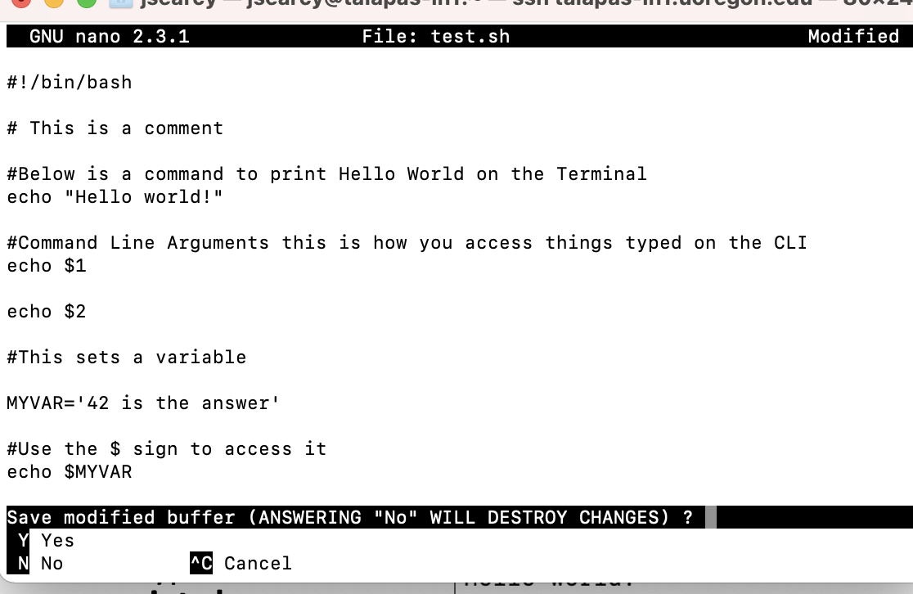
Anatomy of a Shell Script
Copy the following
#! – This is the first line it tells your computer what this file is (bonus you can modify this so it works for python scripts and R scripts too)
# without a ! is a comment, everything is interpreted.
$ this lets you access variables
$1 $2 lets you access command line arguments

Slide 8
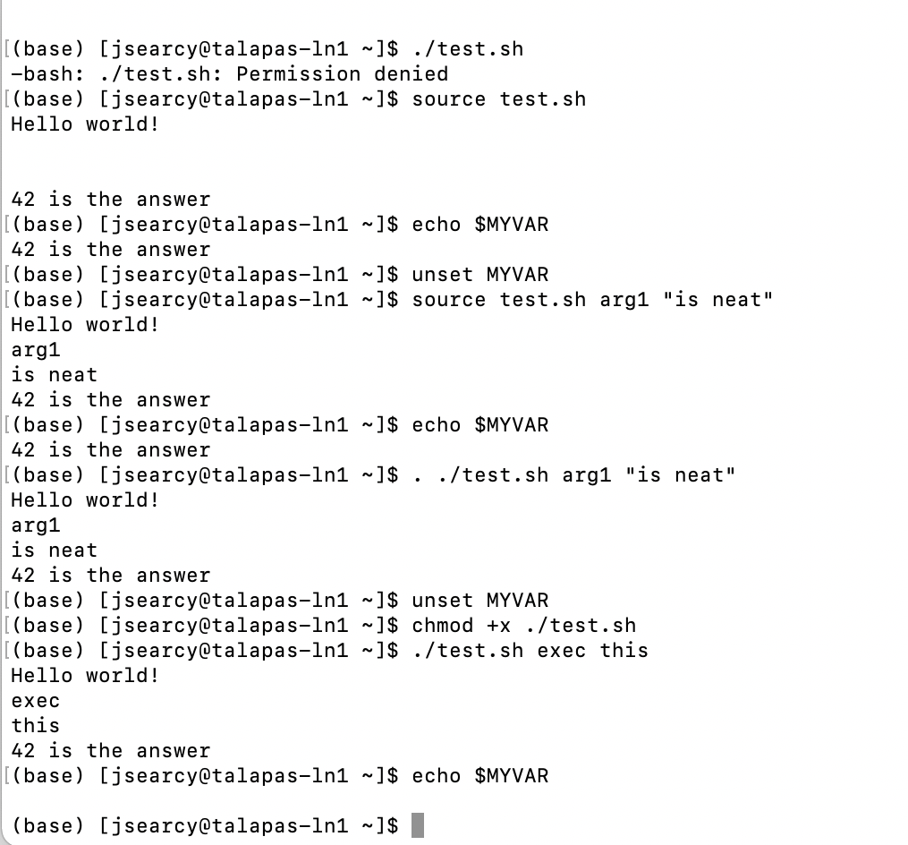
Running your Script
Running a script can be done it two ways
Executing it (this requires the file have execute permissions)
Runs in a new shell
No variable you set in your script are available after the script closes
Sourcing
Runs in your current environment, just like you typed it by hand
Your variables will live after the program exits
You can type source your_script.sh
Or
. your_script.sh

Slide 9
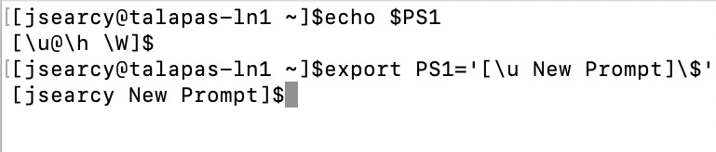
Everything’s a Variable
Pretty much everything in the shell is a variable and you can change it

Slide 10
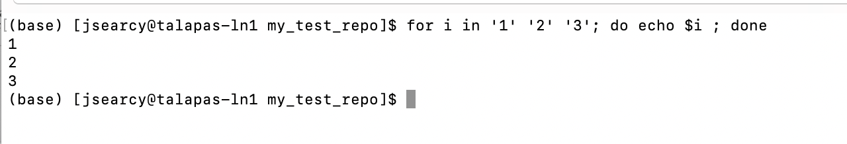
For loops
Loop Variable
for i in ‘1’ ‘2’ ‘3’
do
echo $i
done
Loop list
In your loop the loop variable takes on the values in your list

Slide 11
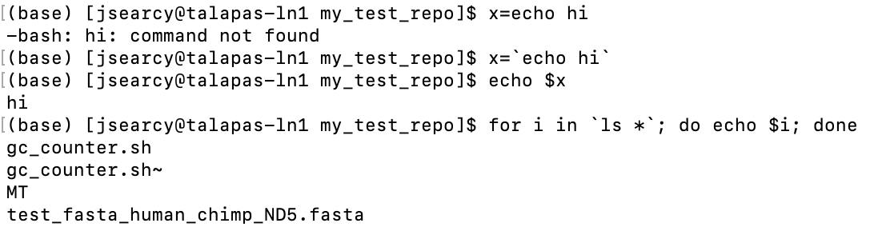
backticks
Sometimes you want to save the output of a command or use it as a loop list, you can do this with back ticks

Slide 12
Exercise
Make a directory called - my_test_repo
Copy this file into it
/projects/datascience/shared/Data4ML1_examples/test_fasta_human_chimp_ND5.fasta
Write a bash script called gc_counter.sh
Counts the number of C’s, G’s, and the number of all nucleotides each sequence
Prints each number to the screen
Bonus: divide to G and C percentates

Slide 13

Git and Git-hub
Your code python R etc. represents a large time investment, and it also a place where mistakes or changes can affect your science
It’s a good idea to track these changes we do this with something called version control
As a bonus it let’s you share and publish your code
Git is a kind of version control
GitHub is a service owned by Microsoft that lets you store a remote copy of your code and share it through there servers
It also lets you do things like build websites
https://github.com/

Slide 14
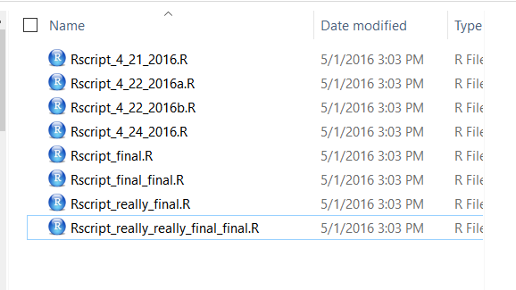
What is version control?
Version control is an organized way of maintaining a record of changes
Git is a system for distributed version control – not the only one, but popular among scientists
Enhance reproducibility
Fix mistakes by reverting to earlier versions
Improve project structure
Backup versions in remote repositories**
Facilitate collaboration**

Slide 15
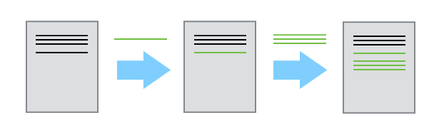
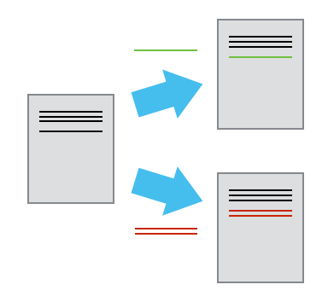
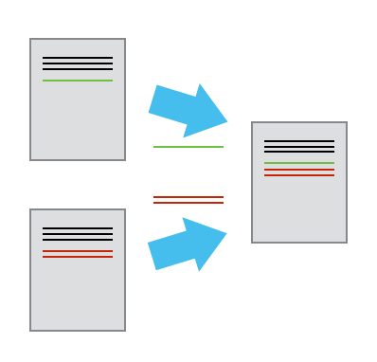
The mechanics of version control
Single user:
Multiple users:
Image credit: Software Carpentries

Slide 16
Some Git vocabulary
Repository/repo – the collection of files and directories associated with a project and tracked with version control
Commit – a snapshot of a repository’s history that is recorded by Git
Diff – Changes in the repository’s content associated with the commit
Branches – Concurrent work (changes to file content) can occur in parallel branches, so that you can focus on developing one aspect of the repository/project independently

Slide 17
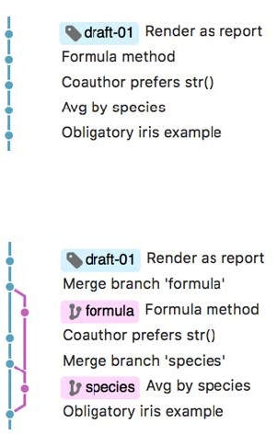
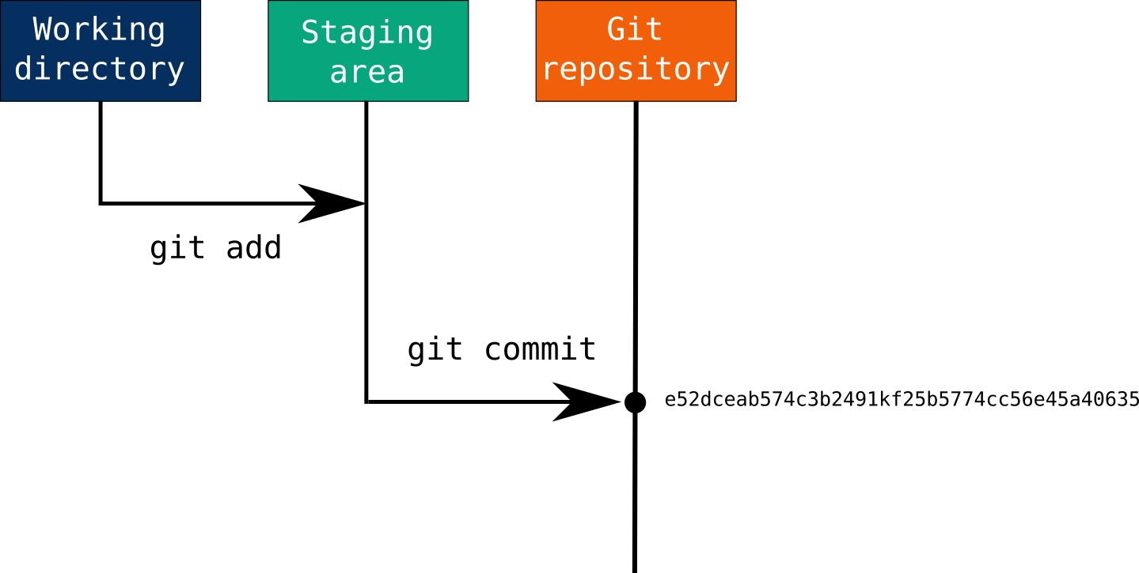
The basic Git workflow
Image credit: J. Bryan; M. Joseph

Slide 18

Use commits to anchor your code
if you make a mistake, you can’t fall past the previous commit.
Use more commits when you’re in uncertain or dangerous territory.
Commits are also helpful to others, because they show your journey, not just the destination.
Hadley Wickham, R Packages

Slide 19
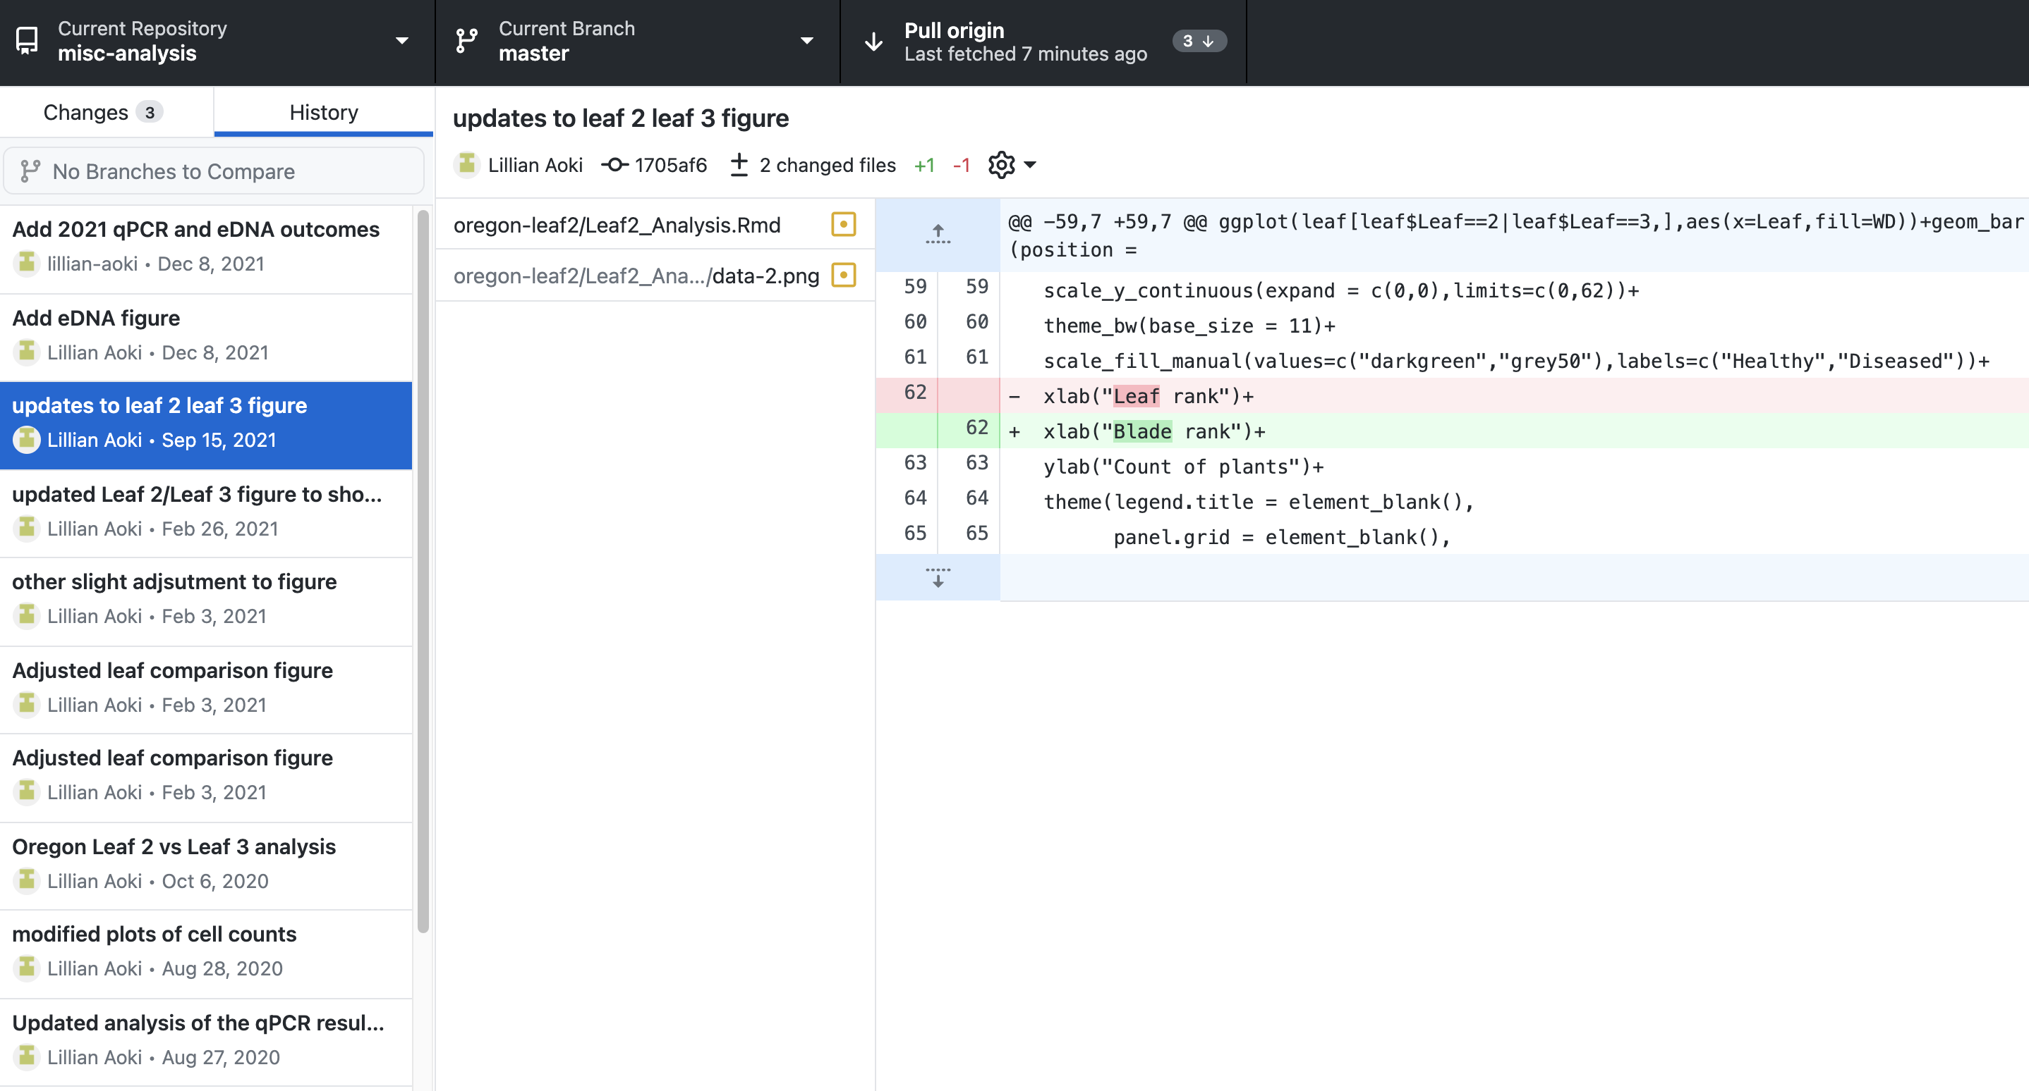
Command line vs. Git client

Slide 20
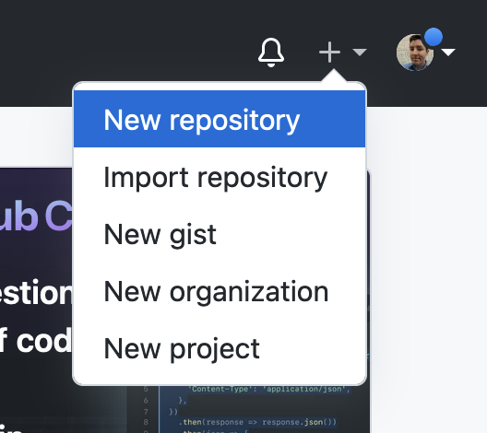
You’ll need a free github account for the following
https://github.com/ Sign-up or Sign in
Create a new repository

Slide 21
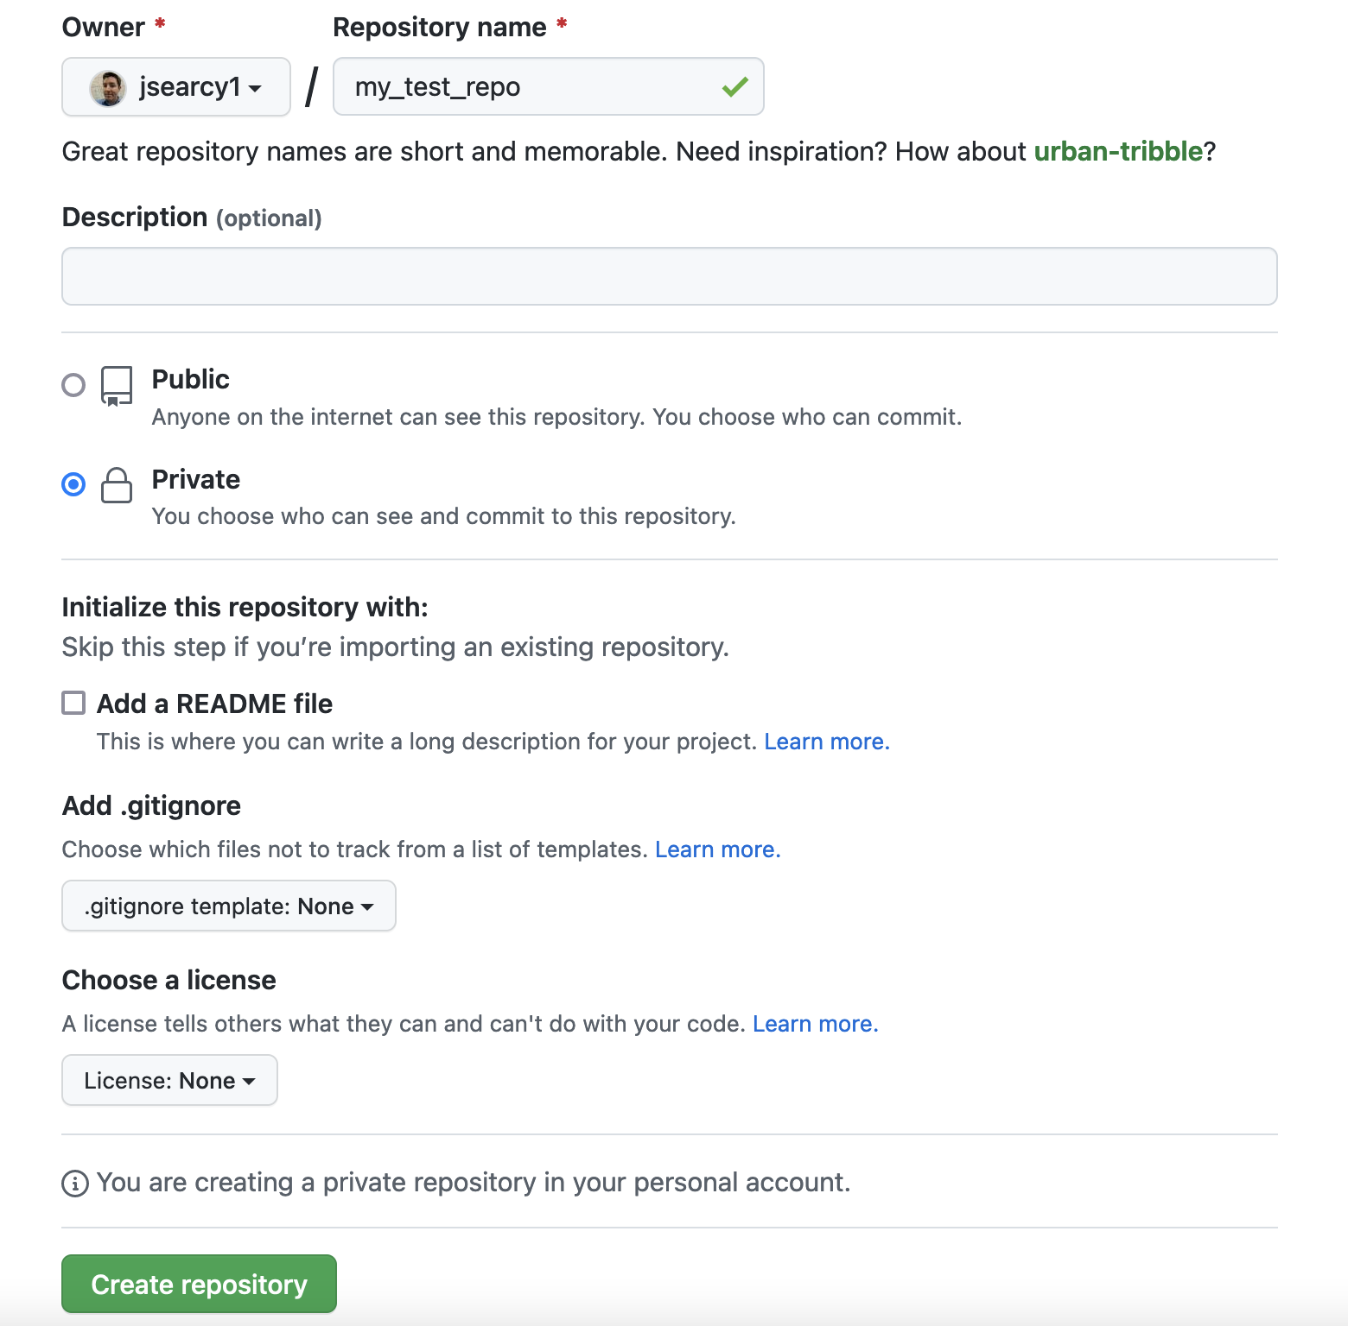

Slide 22
Tokens
Github won’t let you use your password to login when using applications or commands on the command line
You’ll need to generate a token
https://github.com/settings/tokens/new

Slide 23
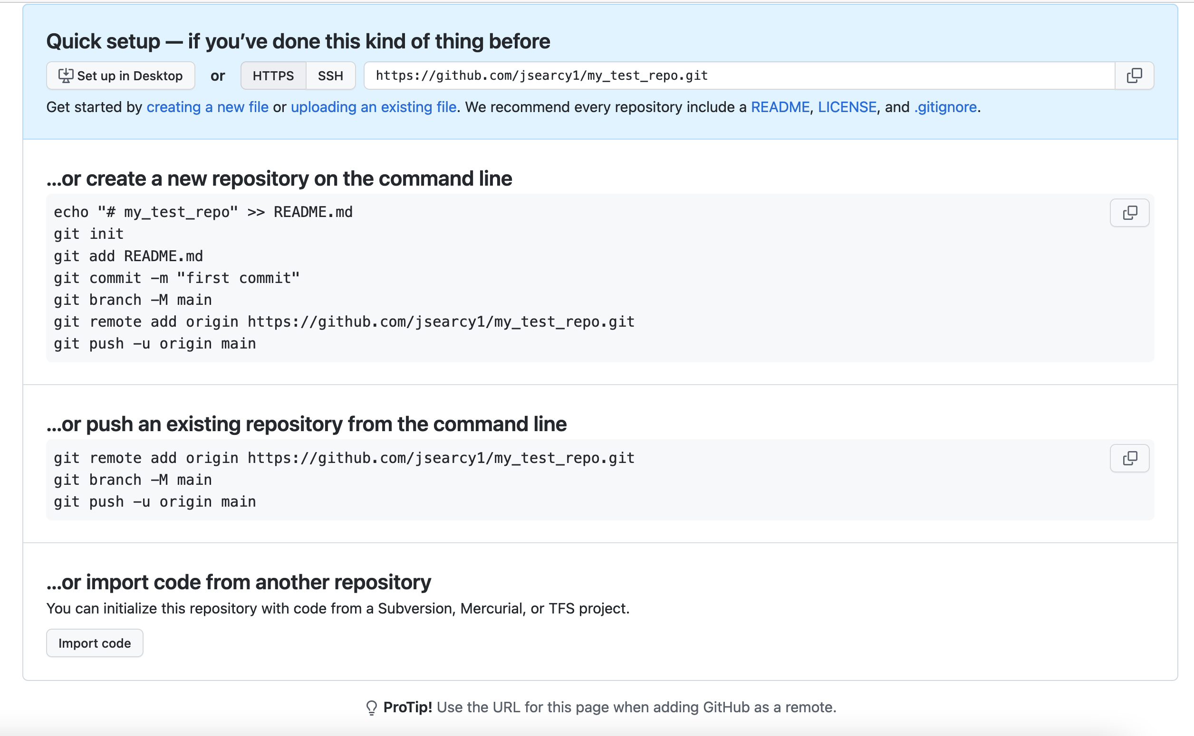

Slide 24
Your repo is setup
Everytime you make changes you want to keep
git add <files>
git commit –m “a message for everyone. I changed x for y reason”
git push
See what’s being tracked and what has changed
git status
git diff

