Slide 1
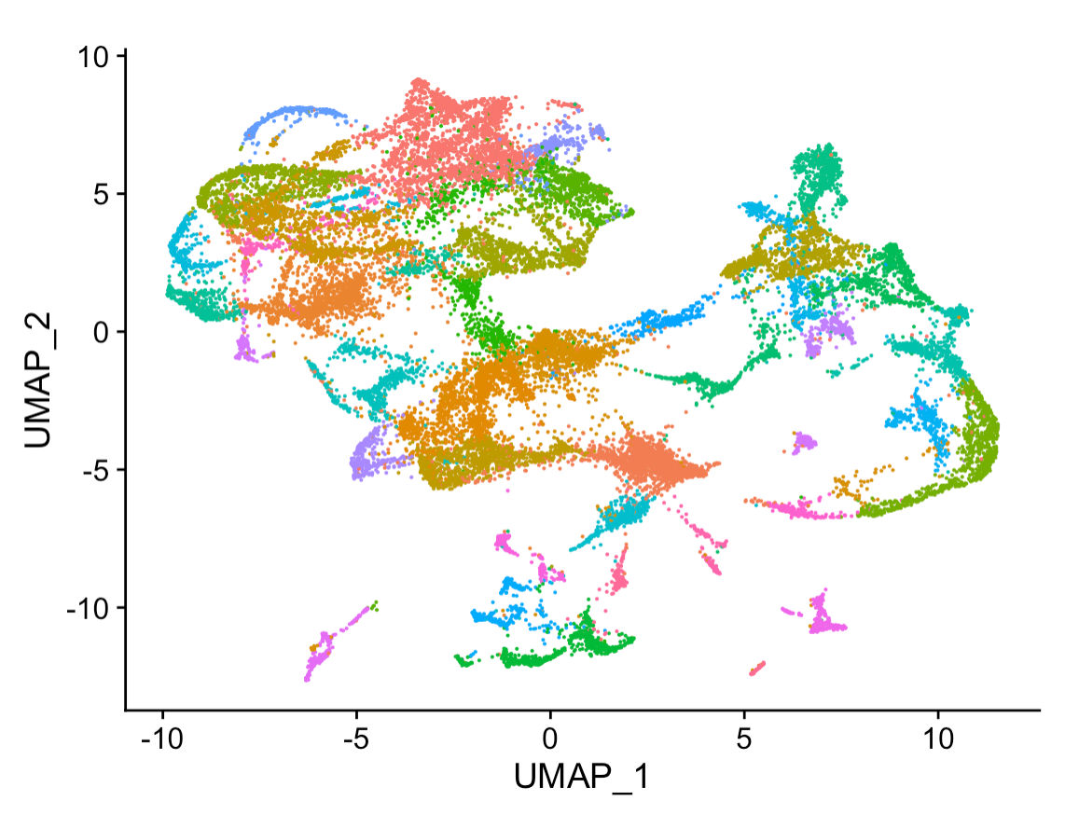
Welcome to “Gateway Week” Bridging the Bench-Machine Learning Gap
Dr. Emily A. Beck
Dr. Jake Searcy

Slide 2

What to expect from Gateway Week
We are assuming no coding experience so don’t stress! It isn’t a race to finish.
We will be using a color-coded post-it system during activities
I’m working along
HELP!
All done
Feel free to help each other, but…

Slide 3
Pre-Workshop Survey
Welcome to the pilot!
We sent out a pre-workshop survey
If you have not completed your survey please use some time during our first break to finish.
Also, please make sure you have provided us with a reliable contact email
We will be sending you a copy of your answers 6 months after completion of the workshop series and will also be contacting you for a long-term follow-up survey.

Slide 4
Outline for Monday
Morning Session 10:00-12:00pm
Introduction to the Workshop - 10:00am-10:15am [Emily]
Group Introductions - 10:15am-10:30am [All]
What is Machine Learning? - 10:30am-11:15am [Jake]
BREAK - 11:15am-11:30am
Computational Literacy - 11:30am-11:45am [Emily]
Setup and Software Installation - 11:45am-12:00pm [Emily and Jake]
Lunch 12:00-1:30pm
Afternoon 1:30-4:00pm
Good Data Practices - 1:30pm-2:20pm [Jake]
BREAK - 2:20pm-2:30pm
Terminal Lecture 1: Getting comfortable - 2:30pm-3:00pm [Emily]
BREAK - 3:00pm-3:10pm
Terminal Lecture 2: Bash scripting - 3:10pm-3:40pm [Emily]
Discussion - 3:40pm-4:00pm [All]
Homework-Linux!

Slide 5
Outline for Tuesday
Morning Session 10:30-12:00pm
Open Office Hours - 10:30am-12:00pm [Emily and Jake]
Lunch 12:00-1:30pm
Afternoon 2:00-4:00pm
Open Office Hours - 1:30-pm-2:00pm [Emily and Jake]
Guest Lecture - Bill Cresko "The good, the bad and the ugly of data visualization" 2:00pm-3:00pm
Open Office Hours and Answer Key - 3:00pm-4:00pm [Emily and Jake]

Slide 6
Outline for Wednesday
Morning Session 10:00-12:00pm
Terminal Lecture 3: Programming Power-Up - 10:00am-10:30am [Emily]
BREAK - 10:30am-10:45am
Introduction to R - 10:45am-12:00pm [Emily]
Lunch 12:00-1:30pm
Afternoon 1:30-4:00pm
Your first ML algorithm/ Classification - 1:30pm-3:00pm [Jake]
Datasets for ML Concepts pt 1 - 3:00pm-3:30pm [Jake]
Discussion - 3:30pm-4:00pm
Homework-Penguin ML!

Slide 7
Outline for Thursday
Morning Session 10:30-12:00pm
Open Office Hours - 10:30am-11:00am [Emily and Jake]
Guest Lecture - Lillian Aoiki "R Markdown: USE IT" 11:00am-12:00pm
Lunch 12:00-1:30pm
Afternoon 1:30-3:30pm
Guest Lecture-Lillian Aoiki "Marine disease detection and surveillance with in situ and machine learning methods" 1:00pm-2:00pm
Open Office Hours - 2:00pm-3:30pm [Emily and Jake]

Slide 8
Outline for Friday
Morning Session 10:00-12:00pm
Unsupervised Learning ML Concepts pt 2 - 10:00am-11:00am [Jake]
BREAK - 11:00am-11:15am
Clustering example - 11:15am-12:00pm [Jake]
Lunch 12:00-1:30pm
Afternoon 1:30-4:00pm
ML Algorithms - 1:30pm-2:30pm [Jake]
BREAK - 2:30pm-2:45pm
Genetics for ML Concepts - 2:45pm-3:00pm [Emily]
Images for ML Concepts - 3:00pm-3:15pm [Emily]
Discussion - 3:15pm-4:00pm

