Slide 1
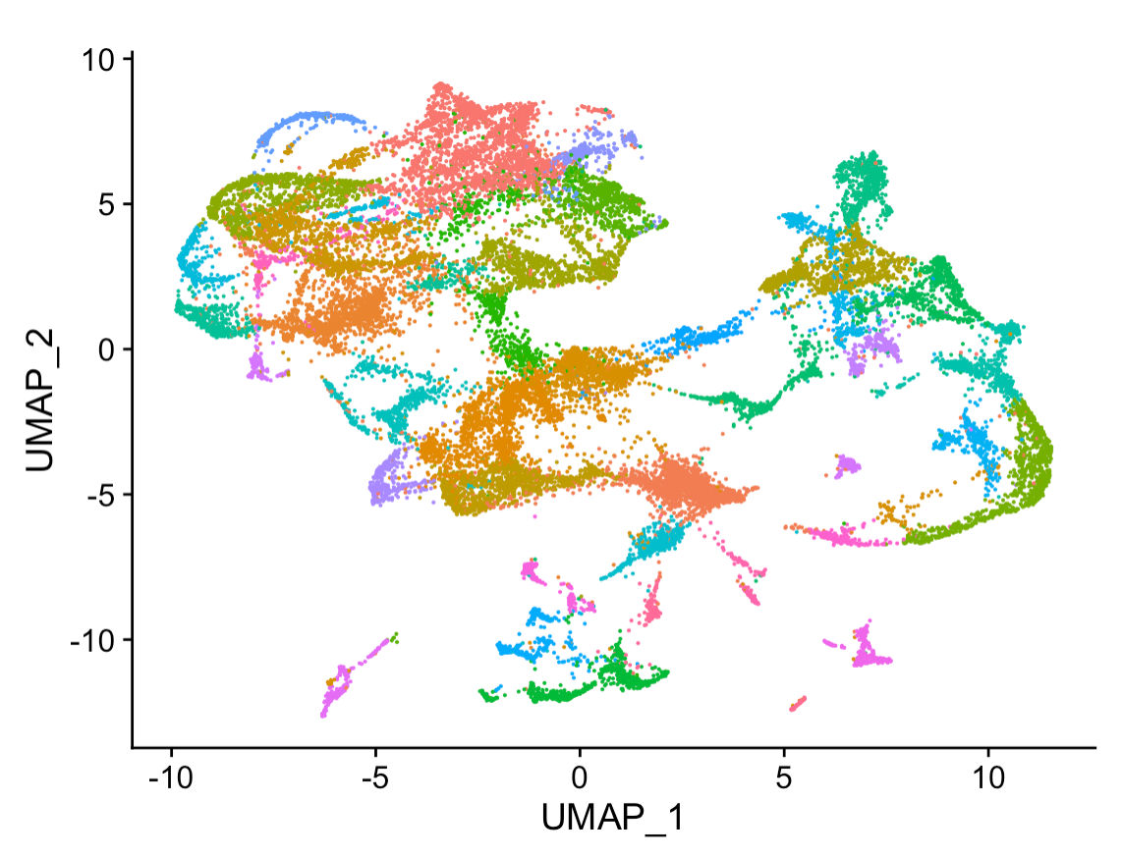
Introduction to Linux Part 3 Programming Power-Up Bridging the Bench-Machine Learning Gap
Dr. Emily A. Beck
Dr. Jake Searcy

Slide 2
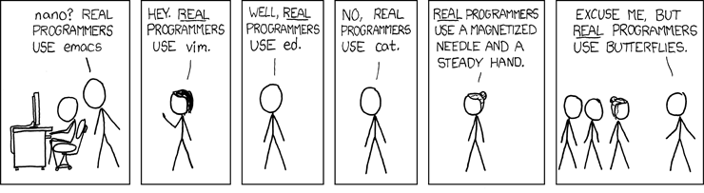
There are MANY ways to do a task and MANY tools to help you! Use what works for YOU.
Grep?
Sed
Cat
Head
Head

Slide 3
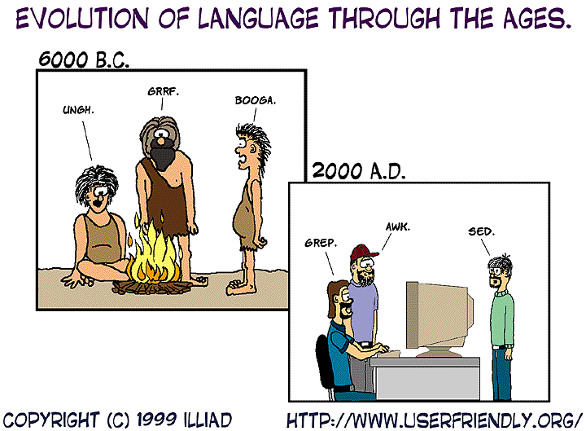
Grep/Sed/Awk are three powerful tools to accomplish most common text manipulations in Linux

Slide 4
Learning Objectives
Become comfortable with Awk for data frame manipulation
Learn useful tips and tricks for programming more efficiently
How to parallelize programs to be more efficient
How to use pipes to streamline your code

Slide 5
Awk: an excellent extraction tool
awk can be used for searches, printing, and manipulations commonly needed when looking at large files. Can commonly replace grep and sed.
Similar to grep but with additional built in additional functions and a slightly different syntax
‘{print(x)}’- print a field
‘{length(x)}’- print the length of a field
‘{sub(/x/,y)}’- substitute y for x (first occurrence)
‘{gsub(/x/,y}’ – global substitution y for x
Also built in mathematical functions:
‘{sqrt(x)}’ – calculate the square root of X

Slide 6
Awk is great for working with data frames
Example:
If I have a large tsv file and I only want columns 1, 3, and 7 I can use awk
awk ‘{print $1, $3, $7}’ large_file.tsv > subset.tsv
If we are working with other file types (for example csv) we need to note what the field separator is:
–F fs where fs is the field separator
Csv example:
–F ,
Sort is another useful command sort <file.txt>
-k indicate specific column
-t fs indicate a field separator
-r sort in reverse alphabetical order
-n sort numerically

Slide 7
Pipes: Useful when performing multiple steps
Sometimes you want the output of one process to be the input of another
Program 1
Program 2
Input 1
Output 1
=
Input 2
Output 2
You could run program 1 , wait and run program 2.
OR you could use a Pipe using | vertical line on your keyboard
Example:
I once again have a large file addresses.csv
Name, address, city, state, phone number
I want a new file sorted alphabetically by State with just names, city, state.
cat addresses.csv|sort –t, -k4|awk –F, ‘{print $1,$3,$4} > subset.csv

Slide 8

Let’s play around with pipes
Think of some fun manipulations for the penguin.csv file and try to make your own pipe

Slide 9
Awk: an excellent extraction tool
awk can be used for searches, printing, and manipulations commonly needed when looking at large files. Can commonly replace grep and sed.
Similar to grep but with additional built in additional functions and a slightly different syntax
‘{print(x)}’- print a field
‘{length(x)}’- print the length of a field
‘{sub(/x/,y)}’- substitute y for x (first occurrence)
‘{gsub(/x/,y}’ – global substitution y for x
Also built in mathematical functions:
‘{sqrt(x)}’ – calculate the square root of X

Slide 10
Screens: Useful when running long programs
Sometimes things take a while to run especially when working with large files
Maybe you want to run a program on a lot of files at the same time?
You could open a bunch of terminal windows all at once and have them run at the same time or you could set a screen!
Screens allow for programs to run in the background. You can detach from screens to let programs run and reattach to check on how things are going

Slide 11
How to set, detach, reattach, and kill screens
To view a list of existing screens:
screen –ls
To set a new screen:
screen –S name
*Try to get in the habit of naming your screens something useful. You will thank yourself later when you have 10 things going at once and you want to check in on the right screen without having to check all ten
To detach from a screen:
Crtl a+d
To reattach to a screen:
screen -r name
To kill a screen: (When you are done and no longer want to use the screen)
screen kill –S –X name

Slide 12
Let’s play around with screens!
Make some screens, attach, reattach, kill them etc.

Slide 13
How to set, detach, reattach, and kill screens
To view a list of existing screens:
screen –ls
To set a new screen:
screen –S name
*Try to get in the habit of naming your screens something useful. You will thank yourself later when you have 10 things going at once and you want to check in on the right screen without having to check all ten
To detach from a screen:
Crtl a+d
To reattach to a screen:
screen -r name
To kill a screen: (When you are done and no longer want to use the screen)
screen kill –S –X name

Slide 14


