Slide 1
Good Enough Software Engineering for Scientists

Slide 2
Software Engineering Practices
For this lecture you should think of everything you write to analyze and produce your data as software, and as software there are some guidelines to:
Be more efficient
Avoid duplication
Make it easier for others or your future self to take advantage of in the future.
Be less error prone
Find bugs before your publication goes out
Avoid chasing weird results that are caused by error
These are good practices that can help with reproducibility, but should be considered in addition to what we’ve already talked about

Slide 3
Principles
3 (more) R’s (https://hdsr.mitpress.mit.edu/pub/f0f7h5cu/release/2)
Readability- software is written to promote understanding by others (this includes your future self)
Resilient - Resilience requires testing for common error conditions (e.g., good unit tests). Resilience is required to give users and developers confidence that they can rely on the software.
Reusable. We mean that others (and your future self) can make use of the code as is, without extensive rewriting. Requires that software be modular.
Also see: https://arxiv.org/abs/1609.00037 that provided many of these recommendations

Slide 4
Vocab
Script: Code that runs your analysis or other scripts often specific to an analysis/project
Rmarkdown
Python scripts
Shell scripts
Etc.
Program: Not the clearest distinction but think of this as pieces of code that you intend to use again.
This could be your code or others
it could be software you’ll load like library(tidyverse)

Slide 5
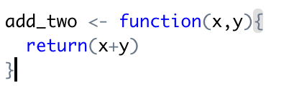
Vocab
Function – This is a re-useable chunk of code that you plan on using over again.
Arguments – These are the inputs to functions
Return value – Value a function returns are the inputs to functions
Function
Arguments

Slide 6
Note Scripts Can Also Have Arguments
Almost always run on the command line
>> Rscript 01_do_cool_analysis.R input_file1.csv input_file2.cv
>> python make_neat_plot.py input.csv output_file.csv
This is a common way to use a cluster, write one script then run it on many different files in parallel then combine the results

Slide 7

Vocab: Variable Scopes
Global – variables that are visible to everything in your script
Local – variables inside functions that can only been see withing that function
Namespaces – When you use other scripts in your scripts their global, local variables and functions can get wrapped in a “namespace” which just means

Slide 8
Vocab
Class – this is a programming object that’s helpful when you want something more complicated than a function to group your code normally composed of:
Members
These are the variables that your class has (which can include other classes)
Methods
These are functions that your class has
Almost always has a function to initialize it
These are important if you want to reuse a more complicate piece of code that relies on interactions between lots of variables of functions
i.e. the results of a fit in R or python

Slide 9
Live Coding Examples

Slide 10
Best Practice: Reusability
Decompose programs into functions that are no more than ~ 60 lines
“Anything that you do more than twice has to be automated.”
Do not use global variables - global constants are OK
A Constant is a value that does not change, some languages enforce this
some languages rely on you to not modify them, and denote them with style normally using all caps for a constant value
Ie. THIS_IS_A_CONSTANT vs. this_is_a_variable
Be ruthless about eliminating duplication
Write and re-use functions instead of copying and pasting source code
The easiest code to debug and maintain is code someone else maintains before writing new code yourself look for existing well used/tested

Slide 11
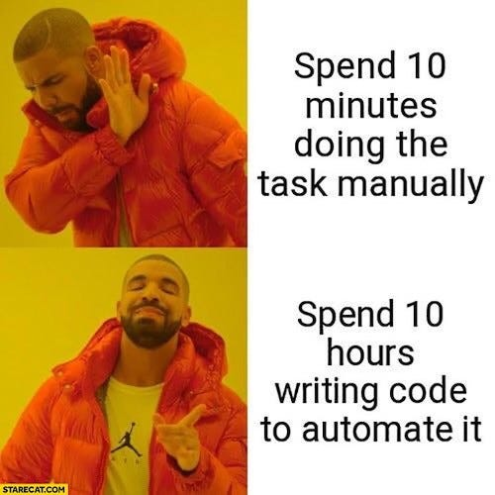
A Word of Caution
Programing can be fun!
You’ll see advice like “Anything that you do more than twice has to be automated.”
It’s worth thinking about if you’ll really need to do something enough times in the future to justify automating it

Slide 12


Packaging
This is pretty different between programming languages, but all provide some way of packing up your code for later use.
You can do this too!
A package is just a folder with your code in a specific place and some files that contain some meta-data about what’s in your package
Lots of resources online to do this: i.e:
https://tinyheero.github.io/jekyll/update/2015/07/26/making-your-first-R-package.html
https://www.freecodecamp.org/news/build-your-first-python-package/
These packages can also normally be installed via github

Slide 13
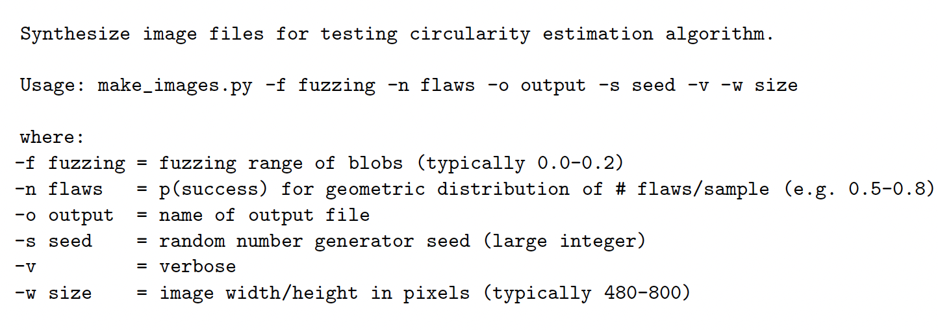
Readability
https://arxiv.org/abs/1609.00037
Place a brief explanatory comment at the start of every program, function, and class,
no matter how short it is. That comment should include at least one example of how the code is used: remember, a good example is worth a thousand words.

Slide 14
Readability
Give functions and variables meaningful names
Use a style guide i.e
https://peps.python.org/pep-0008/
http://adv-r.had.co.nz/Style.html
Normally more than 3 characters
Use delimitators (which ones can be found in your style guide)
CamelCase
under_scores
CONSTANTS_IN_CAPS
Style guides will also often mention things like
Classes start with capital letters
functions start with underscores
The closer you follow these rules the easier it will be for someone who know these rules to understand your code

Slide 15
Resilient
What do you need to do in-order to run your code?
How easy is it to do wrong?
i.e Do not comment and uncomment sections of code to control a program’s behavior - Instead, put if/else statements in the program to control what it does
Similarly try to avoid editing your script every time you need to run something new
Remember scripts can use arguments
Consider loading your options from another file
How do you know your code is working
Provide a simple example or test data set
Write down the expected value of the code
When you make changes run your test and make sure you get the same answer
Check for anything you take as given
If your code needs names to be in lower case add an if statement that will raise an error in the input name isn’t in lower case (or have your code fix that mistake on the fly)

Slide 16
Reproducible Inputs and logs
When coming back to a result you want to understand think about:
How do you know what data it was run on?
If there are options/arguments what were they when the code was run
A simple solution is to print the value of all your inputs and configurable and save the output with the results
Better is to use a file to configure your job and save a copy of that file along with your results

Slide 17
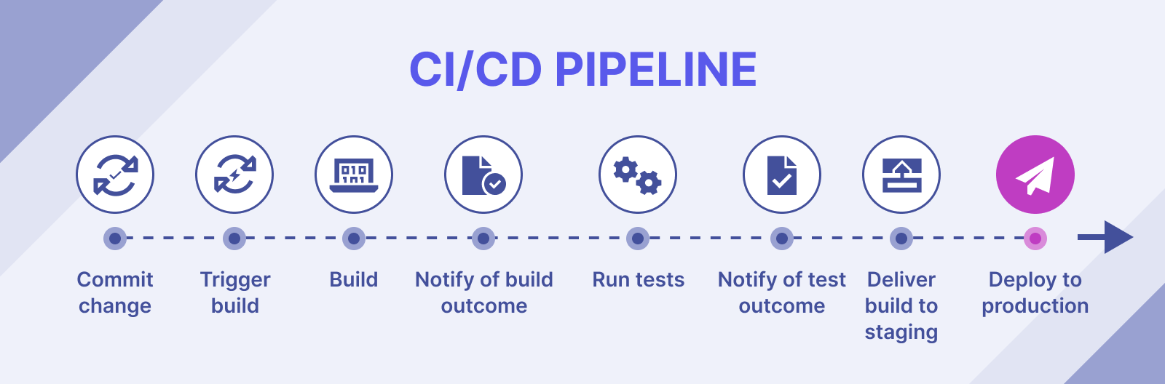
Continuous Integration and Continuous Deployment (CI/CD)
CI/CD is a set of tools and principals that help this software development testing and using process
It’s rare you’ll be in a project that needs this, but it does come up particularly if you have complicated data process needs and are continuously taking data

Slide 18
CI/CD example
Locally make a change to a file on your computer and commit it to github
i.e. change your data normalization from 0 to 1 to -1 to 1
Github actions will run all your tests automatically and if they fail reject your commit
i.e. did you change something important on accident?
Once accepted another job will start that reprocesses all the downstream data and adds tracking metadata into a database.
Here are your new results with this update
Add to production
All new data coming from this machine will in the future be normalized from -1 to 1
Old data will be reprocessed with new code
These system can be very helpful, but as always ask if it’s worth it
It takes a fair bit of work to create such a system, once you’ve created it you might already be done with your project, make sure you and other will be able to get value out of it

Slide 19
Summary
Try to avoid writing code that requires manual manipulation to use
Make sure to save what you need to rerun your code to get a result along with the results
Break your code into small pieces that you can reuse
Use existing code when possible
Be wary of ‘innocuous’ changes, it’s easy to change something you didn’t mean to
Test to see what effect even small changes have to your results
Do your best to write code that is readable by others and your future self.

