Slide 1
Good Data Science Practices
Net Neuro
Summer 2024

Slide 2
Welcome – Best Practices
Schedule
Lectures
~ 1 hour, but we’ve blocked out 2 for extended discussions/office hours
Coding Circles
Co-working time me us and your cohort to build skills and work on your coding projects
Ask everyone what they intend to work on
Either your Project
Programing Powerups
https://uo-data-science.github.io/NetNeuro2024/
Tasks to build some concrete skills and knowledge
(i.e. submit a pull request to the github that hosts the website)
Don’t hesitate to use the Data Science channel in slack to ask for questions/help
Website – https://uo-data-science.github.io/NetNeuro2024/
Schedules, Resources, Programming Powerups
Today
Talk about best practices to give you some ideas of what to work on in your program circles
Notes:
Purpose:
Slack Avoid Direct Messages to me or Lillian

Slide 3
Data Science Project Stages
Defining your Project
What am I doing, who is helping, and how do we know if it worked?
Gathering your Data
Downloading/Recording
Exploratory Data Analysis
Outlier and quality checks?
What interesting features does my data have?
Data Processing?
Analysis/Modeling
Statistical Tests?
Machine Learning?
Reporting
Publish/Share?
Notes:
Want to set yourself up for success and plan for these stages in advance

Slide 4
Some Reasons for Good Practices
Produce High Quality Results
Reduce bias (i.e. avoid accidental p-hacking)
Reduce mistakes (and catch them when they happen)
Reproducible by other researchers
Increase Efficiency
Coding less by reusing your code
Increase the Impact of your work
Allow for reuse and interoperability of your work
There is no one set of best practices!
Notes:
It’s best to use this intentionally with some thought, instead of following automatically
Why is this practice useful?
If it’s Efficiency is this practice really helping me be efficient
How often will I use it
How long will it take me to learn?
If it High Quality Results are the practices the ones acknowledged by my field

Slide 5
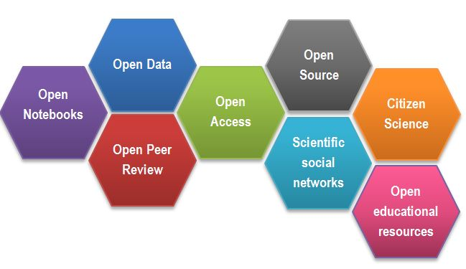
Open science: a new framework for research
Image credit G. de la Fuente
Notes:
An Example set of ideals for best practices in an open science framework
Share everything
Transparency - Peer Review
Collaboration
Argument is that this produces better science
Community can judge articles and quality of review themselves
Data and code can be run by anyone
Ideas flow within a social networks

Slide 6
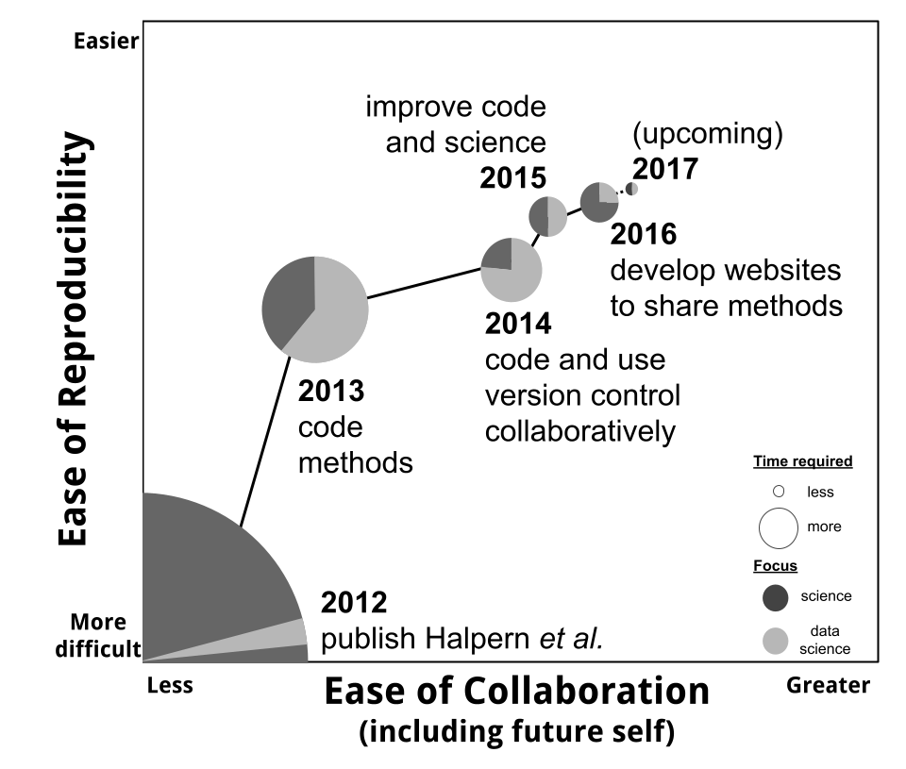
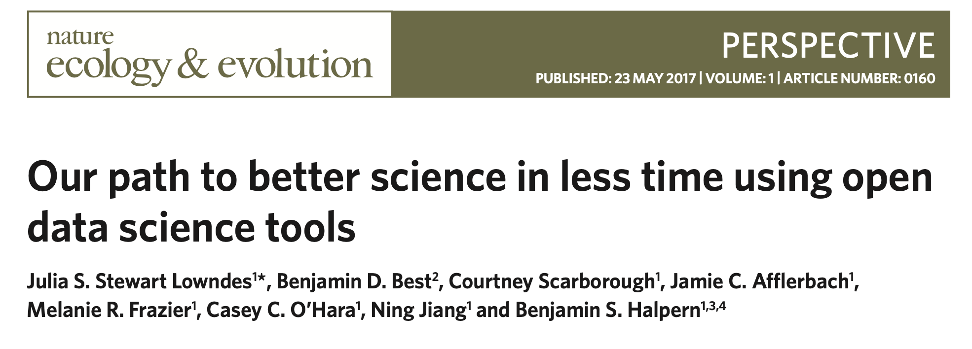
Reproducibility enhances collaboration
http://ohi-science.org/betterscienceinlesstime/
Notes:
High Quality Results from more involvement
It is not an argument that this is more efficient for you
All these steps take time
Sometimes harder to stand out
It

Slide 7
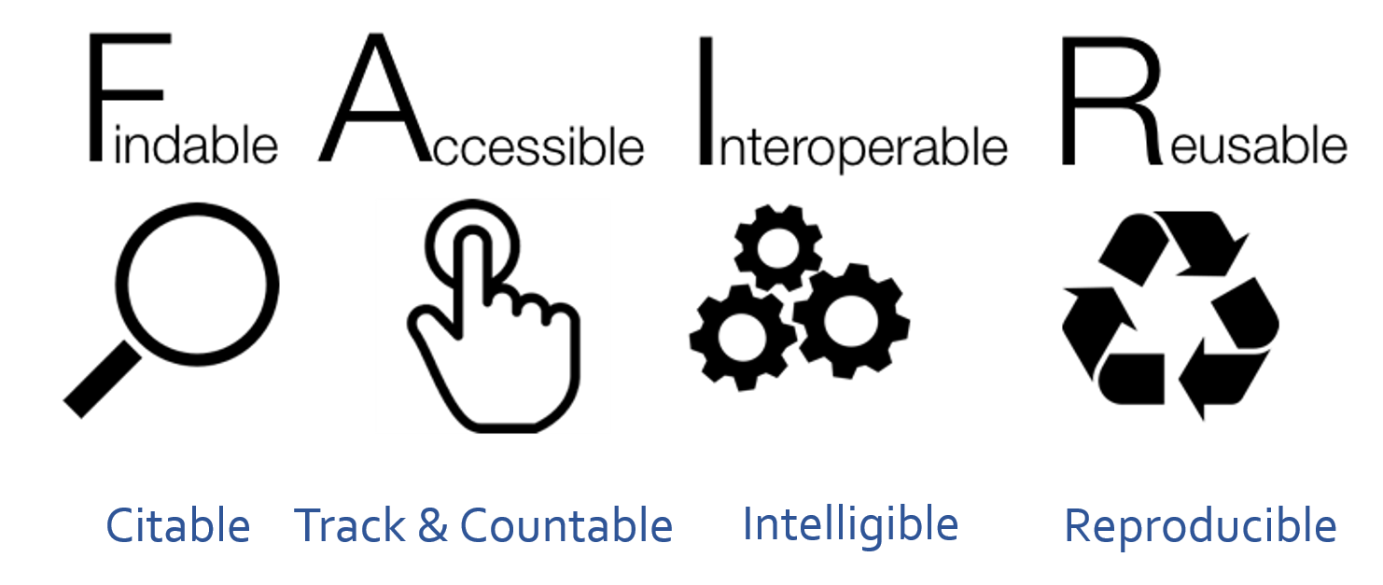
https://www.go-fair.org/fair-principles/
Notes:
Can people use your data?
is also does not argue for
Subject Privacy
Ethical/controlled use of tools
Collective benefit (except for consumers of science as a whole)
Interoperable – Common Structures
Reusable – Licenses etc.

Slide 8
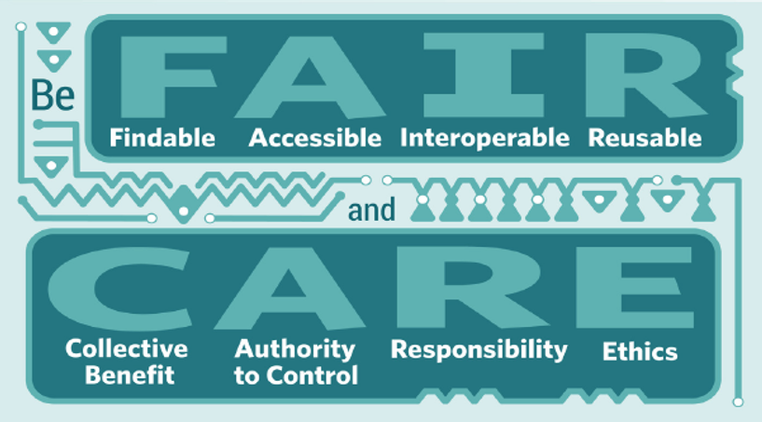
Global Indigenous Data Alliance
https://www.gida-global.org/
Notes:
The open science framework doesn’t for example have built in
Who is benefiting from the science being done?
Should data be made public?
Is the it ethical to release results?

Slide 9
Good Practices
A Foolish Consistency is the Hobgoblin of Little Minds – PEP 8 Python Style Guide (also Ralph Waldo Emerson)
Reproducibility
Project Readability/Usability – Code/Data
Recovery - Accidental or Hardware Failure
Easier Collaboration
Warning
It may not make sense to follow every practice we’re going to discuss from here on out, but it’s worth picking your goals or breaking these rules with intention
Some practices at times maybe in direct conflict! Subject confidentiality and open principals aren’t always possible to satisfy at the same time.
Notes:
Repeat
Some Practices we’ll discuss
Everything we’re talking about has a purpose, some have several it’s worth giving a fair bit of thought
* Note it’s often best if you can to do this once and stick with it until you find a reason to change

Slide 10
Reproducible research… what is it good for?
A published data analysis is reproducible if the analytic data sets and the computer code used to create the data analysis are made available to others for independent study and analysis.
This definition is sufficiently vague that it ultimately raises more questions than it answers. What is an “analytic data set“? What does it mean to be “available”? What is included with the “computer code”?
Peng and Hicks, 2021, Reproducible Research: A retrospective
Notes:
What Do we mean by Reproducible Research
Other scientists will be not be able to re-collect your data
Technical reproducibility - given the same data you should be able to arrive a the same conclusions
Exact reproducibility- given the same data you should be able to arrive at the exact same results
Scientific generalization – a person should be able to collect their own data use your methods and arrive at the same conclusions
All of these are a little bit different – most of what we’re discussing here is referring to reproducibility in the technical sense not the scientific generalization sense.

Slide 11
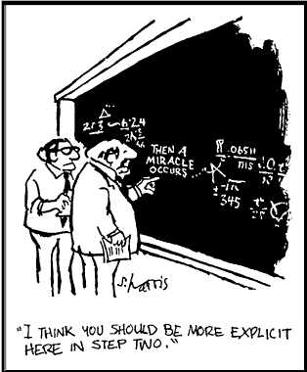
Defining your Project
Start with the Big Picture
What question do I want to answer
How will I know when I’ve succeeded
Who else is going to help
What do you need and where to get it?
Collect/Retrieve Data ?
What analyses do you want to try?
What steps need to happen to your data?
Start with either downloading or collecting
End with your paper being published
How are you going to do each step
What code do you need to write
Who needs to write it
Where is your data stored
Where are you running your code
Notes:
The first step to building a reproducible workflow, and going through really any computational project is figuring out what your workflow will be and how data will flow through it.
Data will be involved in every step of your study in some form or another
It’s okay to say I’m not sure! Make sure to budget some time to figure out how to do a step and decided whether it will work or not

Slide 12
How can we build a reproducible workflow?
Practices
Think about the whole workflow
Avoid doing things by hand
Workflow shouldn’t have you opening files editing its code and re-running
Use best practices for coding
See end of talk
Limit saving outputs
Every time code is changed its outputs need to be rerun to be consistent, too many output files can lead to mistakes when the files you have don’t correspond to the code that’s been written
If you need many intermediate files pick a data versioning scheme
Be consistent + reduce decision fatigue
Tools
Version control (e.g. Git)
Transparent collaboration (e.g. GitHub)
Documentation
Data repositories
Notes:
You’ll often have a parallel sets of requirement’s
Practices and the tools to help you do them – we’ll disucss practices today and get into the tools in the programming powerups and following lectures

Slide 13
Project-oriented workflows
Workflow code
Random script to check an instrument problem I’m debugging
Separate ‘workflow’ from ‘product’
Workflow = personal choices
The name of your home directory.
The R code you ran before lunch.
Product = elements you want to reproduce
The raw data.
The R code someone needs to run on your raw data to get your results
Avoid hard-wiring your workflow into your product
setwd("C:\Users\jenny\path\that\only\I\have")
should not be in the code someone else needs to run to get you results
Organize work into ‘projects’
Self contained
Preforms a specific piece of work
Analysis for a paper
Processing code for instrument data you’ll use in several papers
Data Products
Measured Data
Analytic Data
Processing code
Code Products
Your working directory
https://www.tidyverse.org/blog/2017/12/workflow-vs-script/
https://rstats.wtf/project-oriented-workflow.html
Workflow choices

Slide 14
Research Diagram
Published Dataset
Website, application, other output
Protocol
Figures
Tables
Numerical Summaries
Methodological code
Analytic Data
Computational Results
Measured Data
Published Article
Processing code
Analytic code
Visualization + presentation code
Adapted from R. Peng

Slide 15
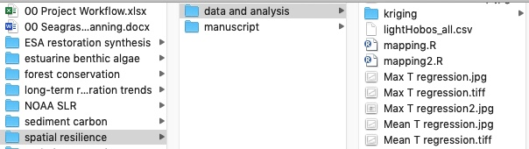
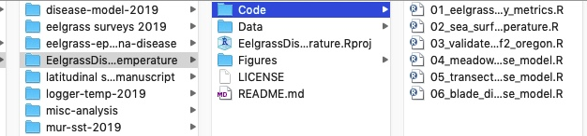
File and project organization
How can file organization enhance your research?
VS

Slide 16
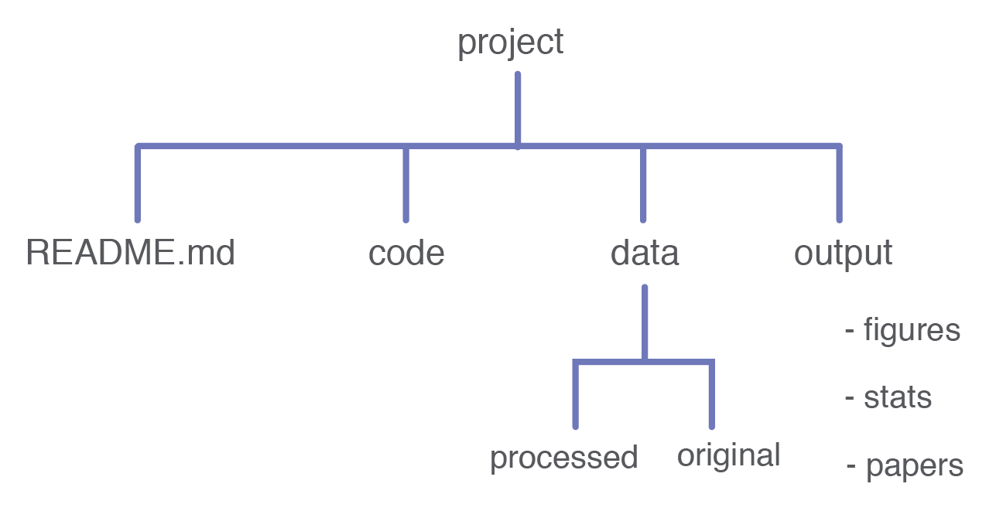
Best practices for project structure
Organize into projects + use relative paths
Keep outputs separate from inputs
Keep raw data safe
Adapted from https://reproducible-science-curriculum.github.io/

Slide 17




Best practices for file and folder naming
Machine readable
Avoid spaces, special characters
Deliberate_delimiters
Human readable
CamelCase
more_deliberate-delimiters
01_first_script
10_tenth_script
2002-09-06_data.csv
2004-06-09_data.csv
Works well with default ordering
Adapted from J. Bryan

Slide 18
Exercise ~ 15 Minutes
Work on a Diagram of the project you want to work on
What are the code and data products of this study
What do you want to share if anything
Feel free to ask questions
Report out Question Answer one of the following:
Are there any steps you’re stuck on, or don’t know how to do?
How are you collecting your data?
Tell us one thing your excited about doing in you workflow?
What identifiers are you using in your study?

Slide 19
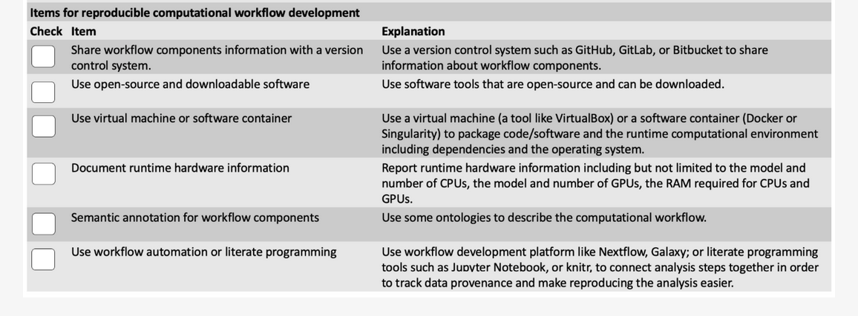
Example Reproducibility Checklist
https://www.mdpi.com/2218-1989/12/1/87
Notes:
Now lets talk about some standards, these also can vary from journal to journal, but these are some common element

Slide 20
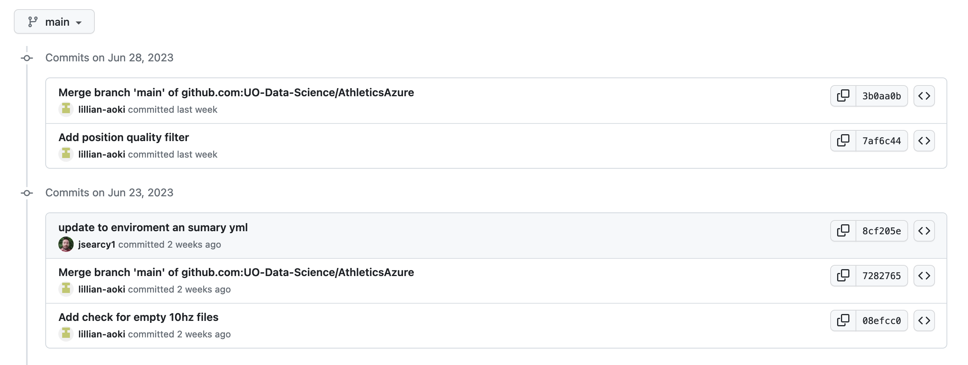
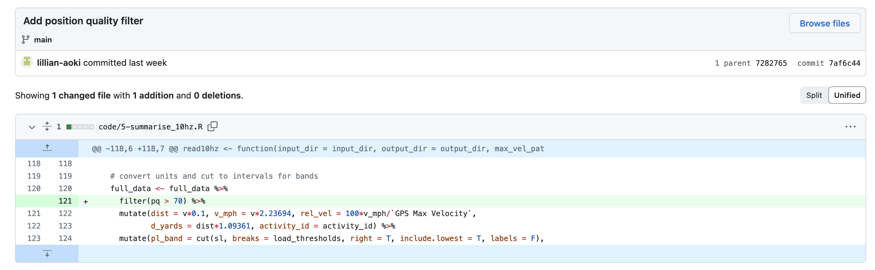
Version Control
What changed in your code and when?
We’ll dive into this more next lecture
Did your results change? Version control can help you figure out why?
Lots of other side benefits, like sharable code easy display of results etc.
Notes:
Tool to help you keep track of all of the changes s you’ve made, useful for others too
This result looks weird, what happened when it changed

Slide 21
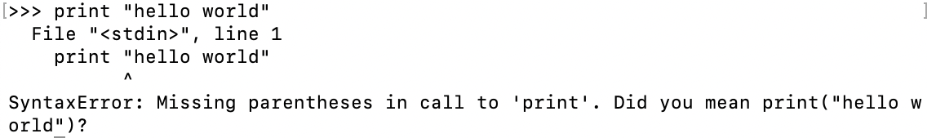
Environments Virtual Machines or other Containers
Some-times the same line of code doesn’t do the same thing because the underlying software may have changed.
Python 2.*
Python 3.*
All the software and settings that run your code is often called an ‘environment’ there are lots of tools that let you create an isolated environment for each or your projects, and share that environment with others.

Slide 22
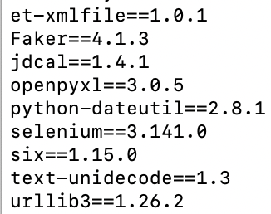

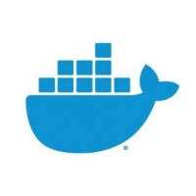

Good/Better/Best for reproducible environments
Good – A list of of all the packages your code is using and their versions
>> pip freeze
Better – Use a package manager that isolates and creates a space for your code and packages
Python – conda, venv
R – renv, packrat
Let’s you switch between environments
Best – Use a virtual machine or container. This saves and records all software including the operating system and all system packages, not just your R or python code.
Examples: Docker, Singularity
Takes the most work to build but gives the best guarantees. Requires some specialized software on the host machine.

Slide 23
Open-source Downloadable Software
You’ve gone through the work of documenting your environment and you want to share it.
Whoever you are sharing it with, will need to be able to obtain the same software
Open software makes this particularly easy
Proprietary software can change without letting you know
Can also add extra costs to your collaborators
Web base software is particularly bad about making changings without letting you know
Not always possible, and particularly common tools like MATLAB or Mathematica are frequently documented by just the versions

Slide 24
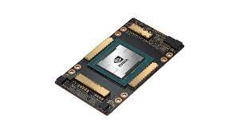
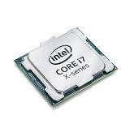
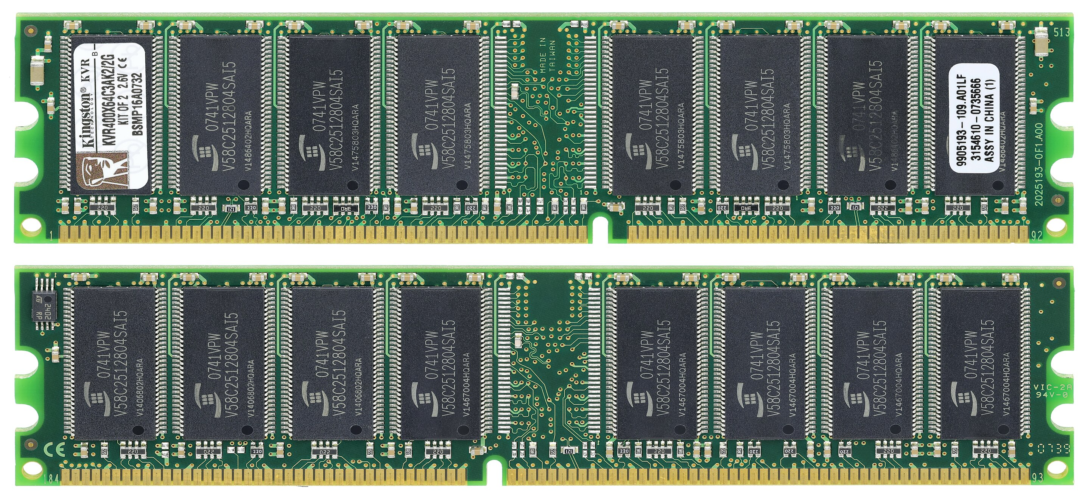
Hardware
Rarer but some code will behave and yield different results if you use different hardware
GPU vs CPU
One versus many CPUs that are useful for people to know
Other requirements (if more than a normal laptop is needed)
How long the code takes to run
Amount of RAM on the machine
Good practice best to document and include running time if long.
Not all cores are equal some are faster, but generally more is better Laptop ~ 4-8 cores. HPC Node ~ 28-80+ cores
RAM Good Laptop ~ 16 GB
HPC Node ~ 128 GB
Large Memory Nodes ~ 5 TB
All computers have one, but only higher end ones useful for accelerating workflows. Generally, these have more cores and memory

Slide 25
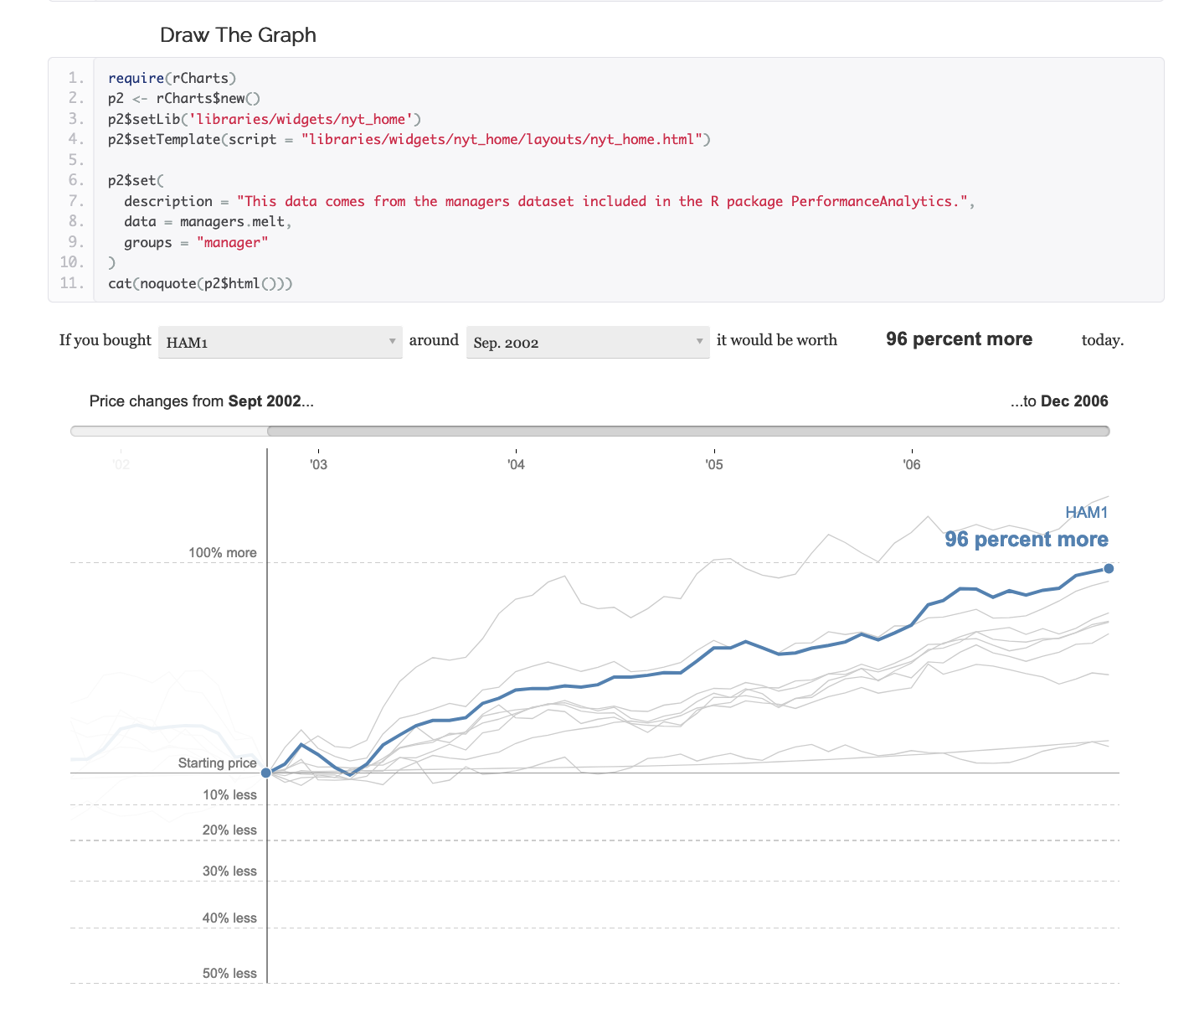
Workflow automation or ‘literate’ programming
You’ll often have many steps in an analysis
Running each step by hand can be error prone
Solution is to run them all at once into a document
Jupyter Notebooks
R-Markdown
If that isn’t possible have code that runs each step for you
Snakemake-https://snakemake.readthedocs.io/en/stable/
Airflow https://airflow.apache.org/
http://timelyportfolio.github.io/rCharts_nyt_home_price/

Slide 26
Best Practices Coding
Style guides
Good coding style is like correct punctuation: you can manage without it, butitsuremakesthingseasiertoread. (tidyverse)
There are different opinions, but it helps to pick one and stick with it for your project
https://peps.python.org/pep-0008/
https://style.tidyverse.org/index.html
There are tools you can use to check your code
https://pypi.org/project/pylint/
https://cran.r-project.org/web/packages/lintr/readme/README.htm
Testing
There are lots of opinions on how to do this, but it comes down to. Does my code do what I think it should?
Programmatic Tests - if your data should be normalized between -1 and 1 make a function that throws an error if data is outside this range.
Visual inspection – if your data should be normalized between -1 and 1 make a histogram to check
Consider making some pseudo-data to test your statistical tests
Psuedo Data Tests-

Slide 27
Documentation
Many of the coding standards say how you should document code
Where the comments go
What should have comments (functions, classes, modules etc.)
Often stay silent on what should be in the documentation
Think about what you would want to know in the future (i.e. after you get back reviewer comments)
What can I change in my code and what should happen
Is a line of code confusing or take awhile to get correct add a comment for that
Did you think hard about the right way to do something add a comment for that
Besides your code you should also think about
Writing down what all your variables in your data mean and where the came from
The steps you used to run all of your code
Think about a lab notebook to go along with your tests, what did you try? and did it work or not?

Slide 28
Best Practice: Backups and Permissions
It’s always a good idea to keep a copy of your data as a backup
Hardware can fail
Running the wrong command can accidently delete data
It’s also a good idea to protect yourself from accidental code
All files have permissions that decide who can do what
read permissions let you look at file
write permissions let you change a file
execute permissions let you run a file
It’s a good idea to protect your raw data by removing all permissions but read
prevents accidentally changing the raw data

Slide 29
Exercise
Are you following these practices?
Notes:
Have everyone read this table. Ask them a process they are using, or if they aren’t using any what do they think is most important and why.

Slide 30
Best Practices Collaboration
Many of the things we’ve discussed enable collaboration
Version control and git-hub
Documentation and meta-data etc.
Data Sharing
This is often not enough by itself to enable collaboration
Very useful to setup a plan on how to collaborate
If you working on code together with someone else how will you merge your changes?
How will make sure you’re working on the same datasets, and using the same processing steps?

Slide 31
Some things to think about?
Your future self is your best collaborator, how are you helping them out?
2. What are some workflow challenges when collaborating on code?
3. What are some non-coding practices that can help collaboration?
Notes:
1. Documentation, - remember you’ll need to resond to your reviewers commtns
2. How are you naming data, are you consistent, can you all access data locations
Publication stuff
Communication methods
Workflows

Slide 32
Exercise
Fill out survey
https://oregon.qualtrics.com/jfe/form/SV_8zTL8tPYZ749mnA
Plan out your programming Circles!
For the next 3 programming circles Set a goal to accomplish for one of your projects or Pick a topic to work on here https://uo-data-science.github.io/NetNeuro2024/
Report out

