Slide 1
ProfeNolohicimos
Sprint 1: VR fishing game

Slide 2
Develop team
Raúl Alonso García – Coordinador and Project Manager
Antonio Suarez Crespo – Game Writer and Technical Artist
Alba Aparicio Pérez
Pelayo Cifuentes Fernández
Eric Almeda Tomás
Víctor Suárez Sierra

Slide 3
Game design
Game Genre
Character(s)
World/Levels
Gameplay & Mechanics
Sound Effects

Slide 4
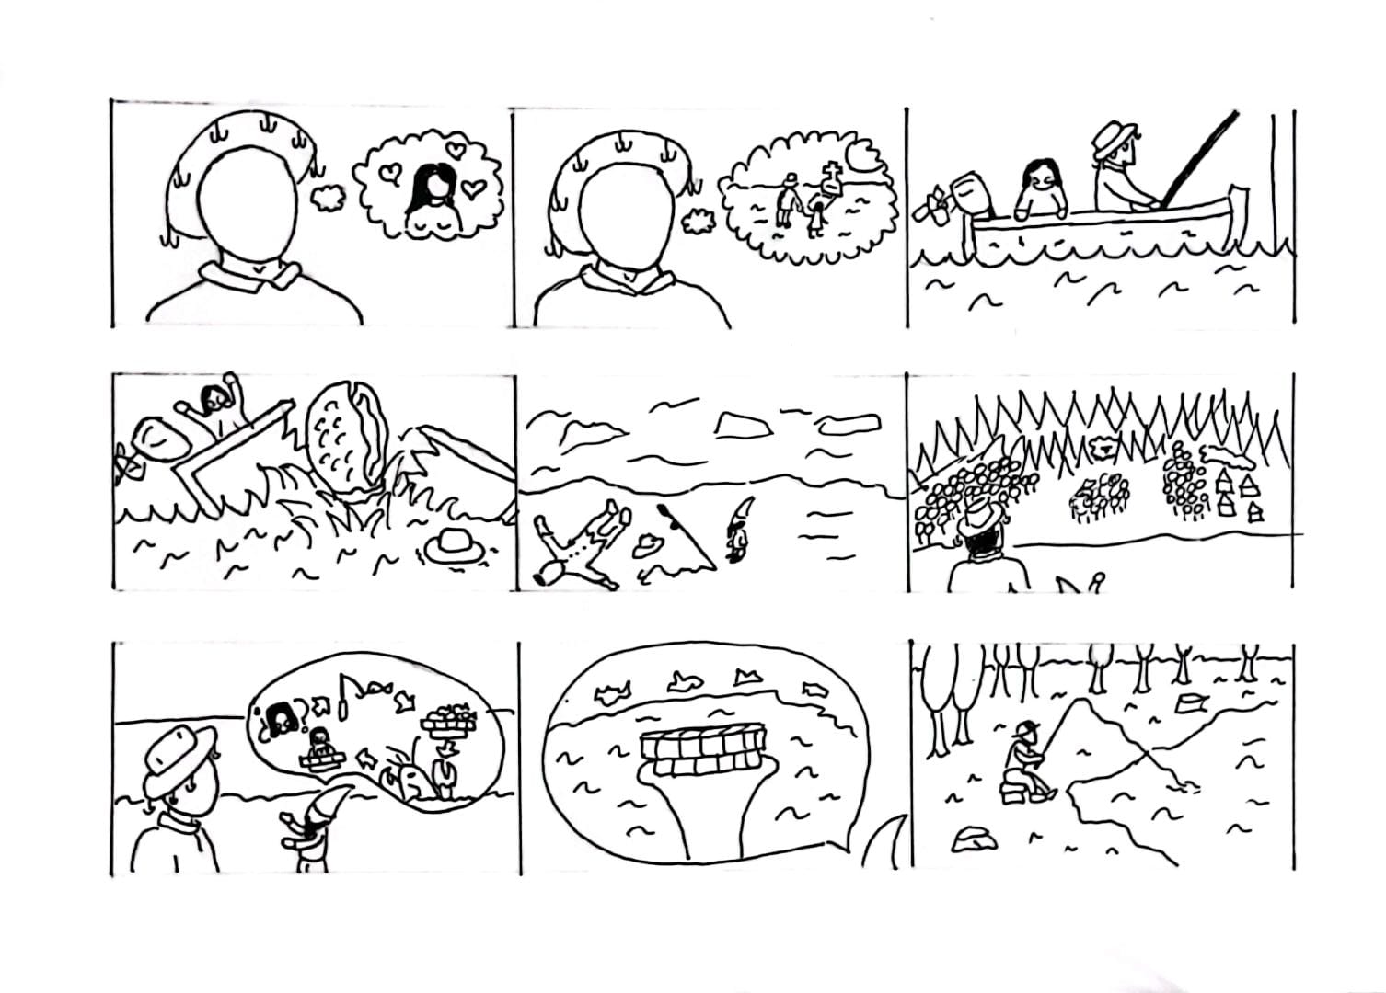
StoryBoard
Designed by Antonio Suarez Crespo

Slide 5
Game development planning
Sprint 2: Prueba functional de
Sprint 3
Sprint 4

