Slide 1
ProfeNolohicimos
Sprint 1: VR fishing game

Slide 2
Develop team
Raúl Alonso García – Coordinador and Project Manager
Antonio Suarez Crespo – Game Writer and Technical Artist
Alba Aparicio Pérez
Pelayo Cifuentes Fernández
Eric Almeda Tomás
Víctor Suárez Sierra

Slide 3
Game design
Game Genre
Character(s)
World/Levels
Gameplay & Mechanics
Sound Effects

Slide 4
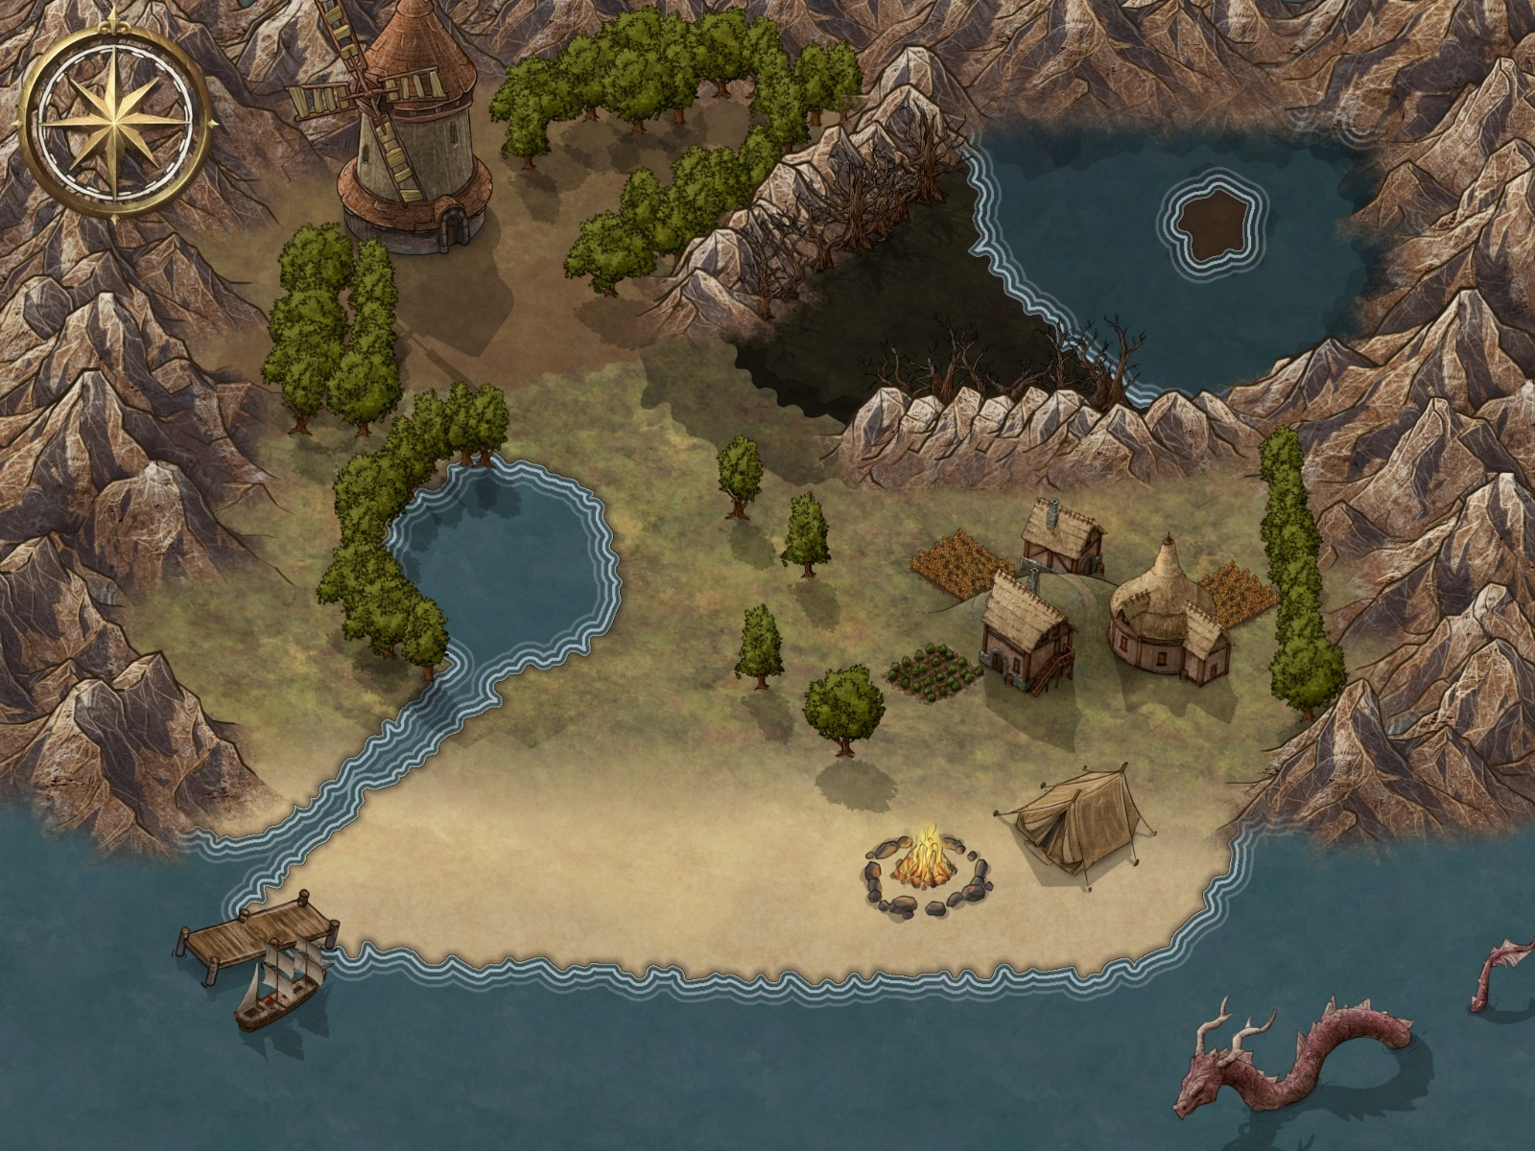
WORLD

Slide 5
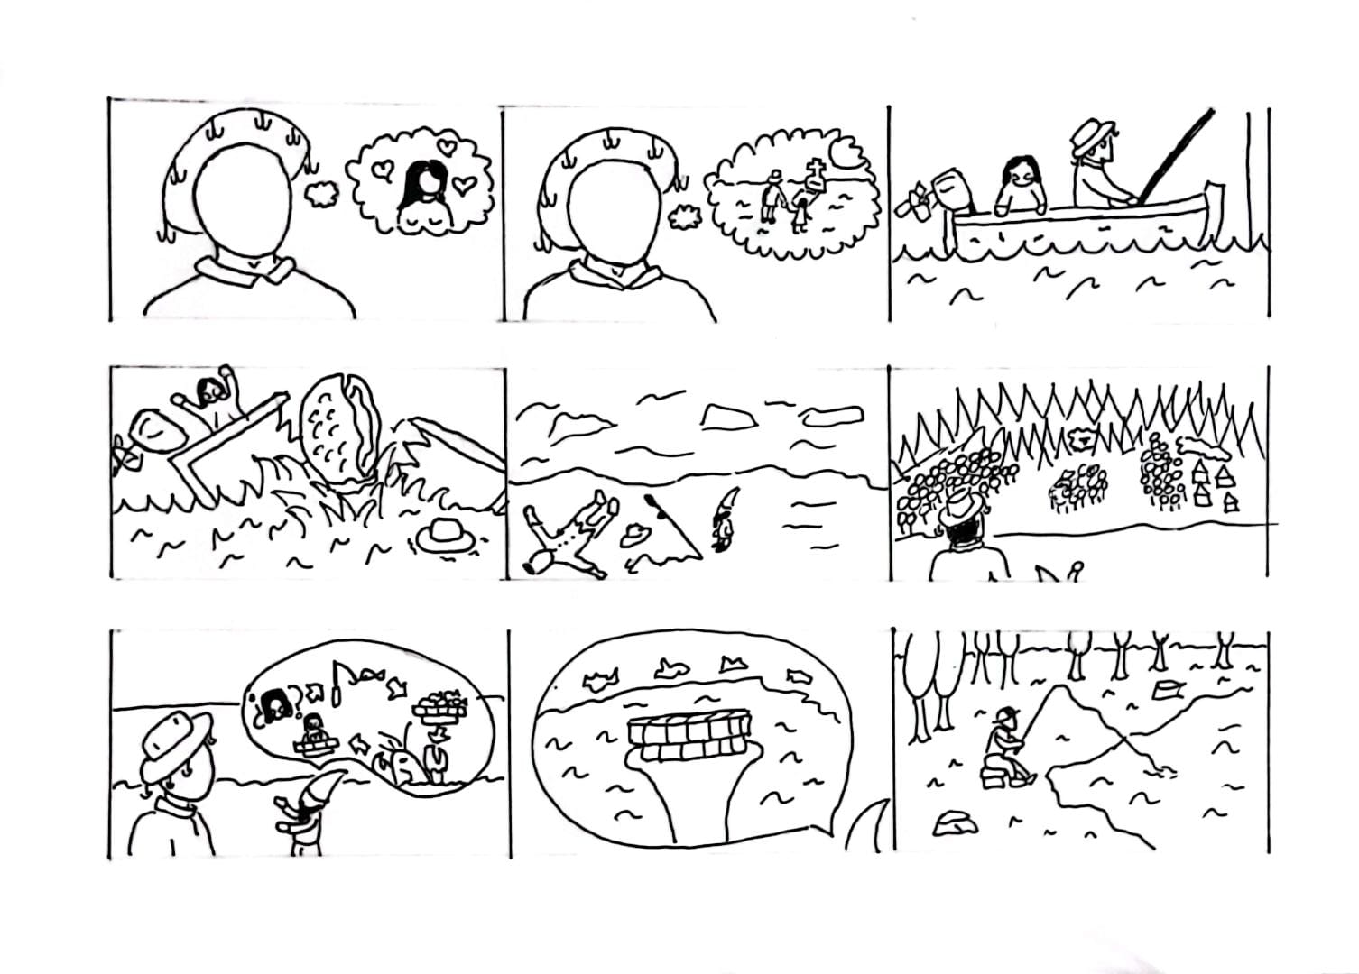
StoryBoard

Slide 6
Game development planning
Sprint 2: Mecánica de pesca y el mapa
Sprint 3: NPC’s y Las misiones (niveles)
Sprint 4: Retoques finales e historia

