Slide 1

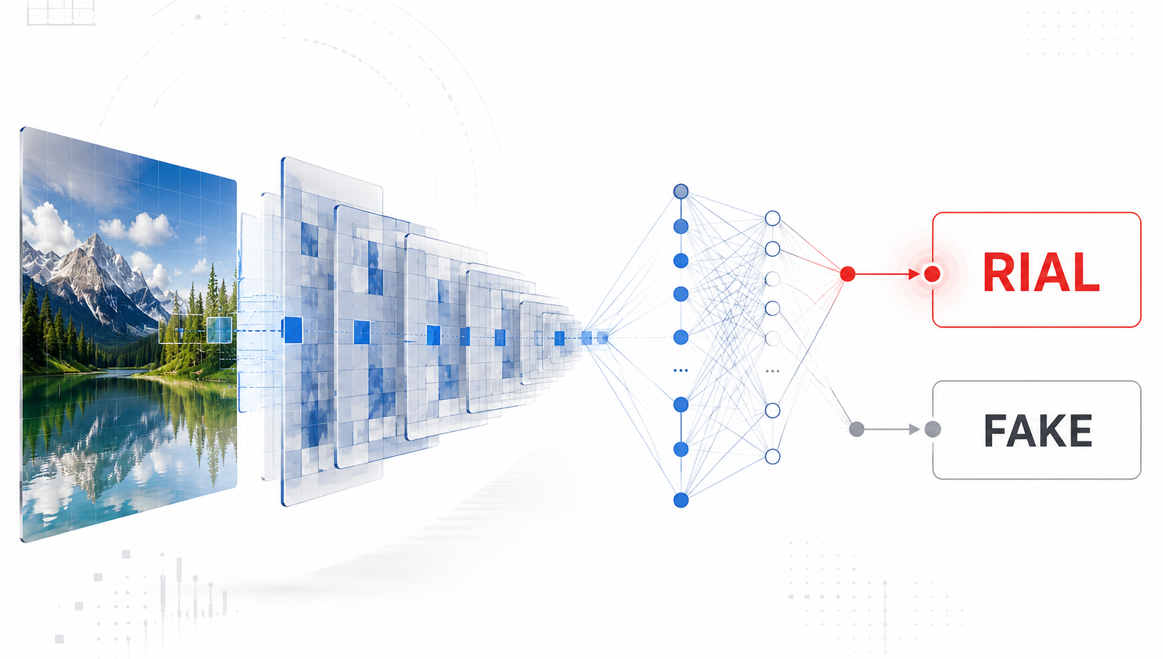
Project 2: Joint Detection of AI-Generated Images and Post-Processing Alterations in Real-World Scenarios
JOAQUIN AVILES DE LA FUENTE
(MÁLAGA)
CARLOS FERNÁNDEZ FERNÁNDEZ
(GIJÓN)
ALBERTO RIVAS CASAL
(OVIEDO)
2247473
2247701
2247719
1/15

Slide 2


00
Outline
1
2
3
4
5
6
›
›
›
›
›
Problem
State of
the Art
Method
Dataset
Setup
Results
…then Ablation, Conclusions & References.
2/15

Slide 3





01
Problem Statement
Detectors break in the wild
THE CHALLENGE
Trained on clean images — they fail on real ones.
Spot AI images that
stay reliable in the
real world.
Edits hide the clues
Compression & re-photos erase AI fingerprints.
Two questions at once
Is it fake? And what was done to it?
Lab accuracy isn't real-world robustness.
3/15

Slide 4

02
State of the Art
Forensic cues
Deep detectors
Robustness tests
Compression grids, FFT & noise signatures.
CNNs & transformers learn AI fingerprints.
RRDataset stresses models with real edits.
Our gap: high lab accuracy, but breaks in the wild.
4/15

Slide 5

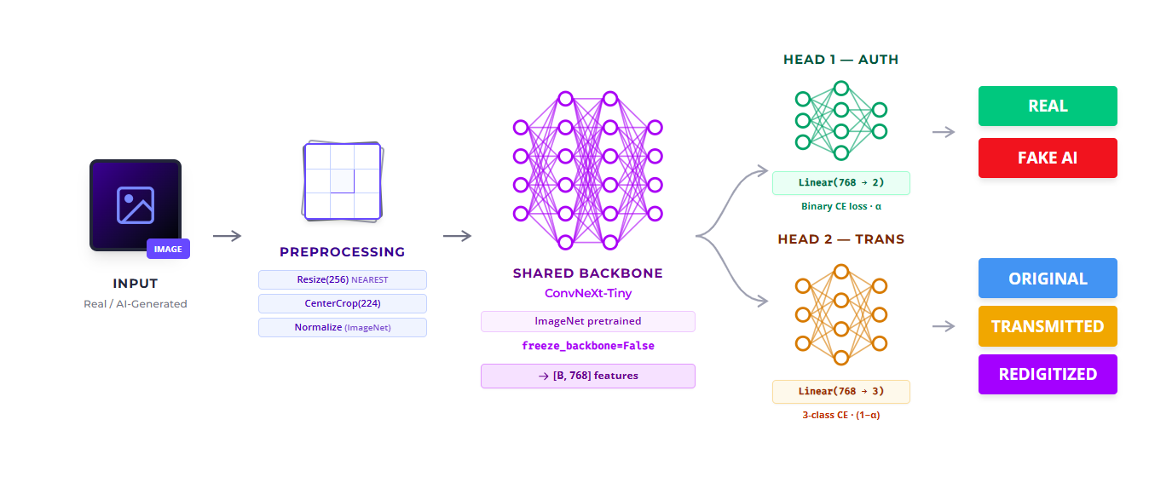

03
Proposed method: ConvNext-Tiny Multi-task
5/15

Slide 6
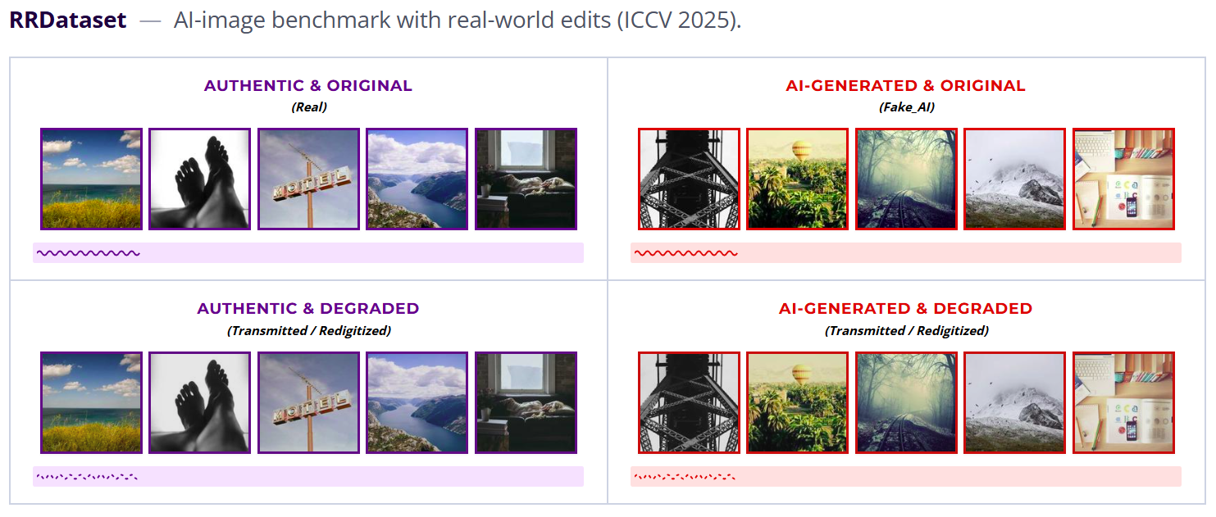
04
Dataset
Subsampled dataset containing 7,500 balanced images
6 distinct classes mapping Authenticity(Real vs Fake_AI) across Trasnformations(Original,Transmitted,Redigitized)
Balanced splits for robust evaluation(80% Train / 10% Validation / 10% Test
6/15

Slide 7
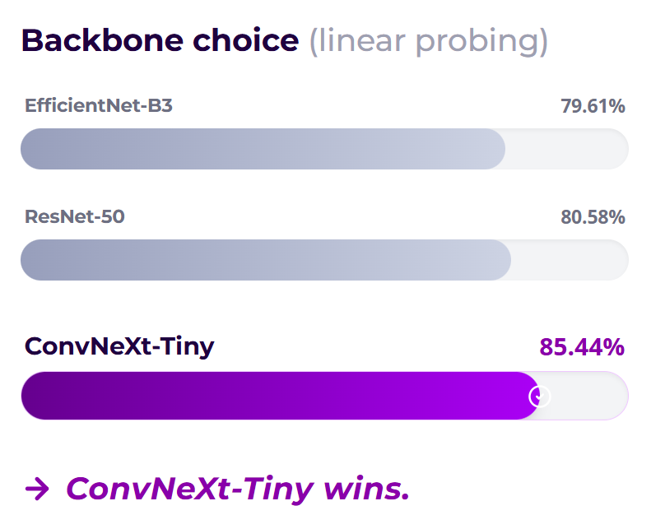
05
Experimental Setup
Transfer learning
ImageNet backbone, heads from scratch
Differential LRs
Backbone 10× slower than heads
Training
20 epochs · batch 32 · LR 1e-4 · cosine
Forensic preprocess
Nearest-neighbor · RandomErasing
7/15

Slide 8





06
Metrics
Global Accuracy: Ratio of correctly predicted authentic and generated images
Precision:Minimizes false accusations of AI
Recall:Minimizes undetected AI fakes
F1:Harmonic mean for balance
AUC-ROC:separablity accross thresholds
8/15

Slide 9


07
Metrics
Multi-class Accuracy: The proportion of perfectly classified degradation layers
Macro F1-Score:Computes F1 independently for each class(C) and averages them equally
Why Macro Averaging?
Unlike Micro-F1(biased by majority classes), Macro-F1 evaluates, Original,Transmitted and Redigitized with equal weight. THis ensures performance isn’t artificially iflated by simply learning the most common transformation
9/15

Slide 10

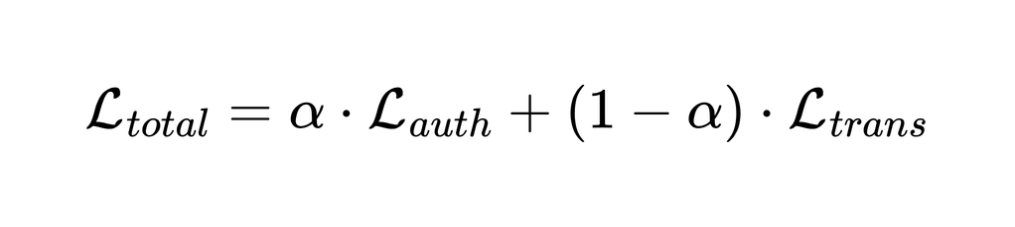




08
Model Evaluation
Main Formula:
Transformation Baseline
Joint Multi-Task Learning
Authenticity Baseline
Post-processing classification:
Original
Transmitted
Redigitalized
Balanced loss weighting (50 /50 split) during backpropagation.
accuracy never drops below 91%.
Real vs. Fake_AI classification.
10/15

Slide 11
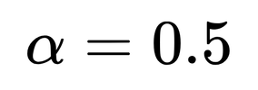







08
Model Evaluation ( )
Real/Fake accuracy:
Real/Fake AUC:
Transform accuracy:
93.7%
0.988
94.4%
Robustness — Real/Fake accuracy stays high under every edit
Fake
Real
100
92.0%
91.2%
96.8%
96.8%
92.8%
92.8%
Transmission does not hurt detection.
80
60
40
accuracy never drops below 91%.
20
0
Original
Transmitted
Redigitalized
11/15

Slide 12
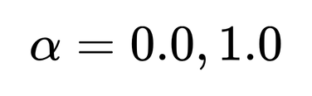







08
Model Evaluation ( )
Real/Fake accuracy ( )
Transform accuracy ( )
93.7%
90.9%
Robustness — Real/Fake and Transform accuracy stays higher with
100
93.7%
93.7%
94.4%
90.9%
Multi-task synergy improves robustness
80
60
45.6%
40
34.2%
Shared features, superior results
20
0
Real/Fake
Transform
12/15

Slide 13

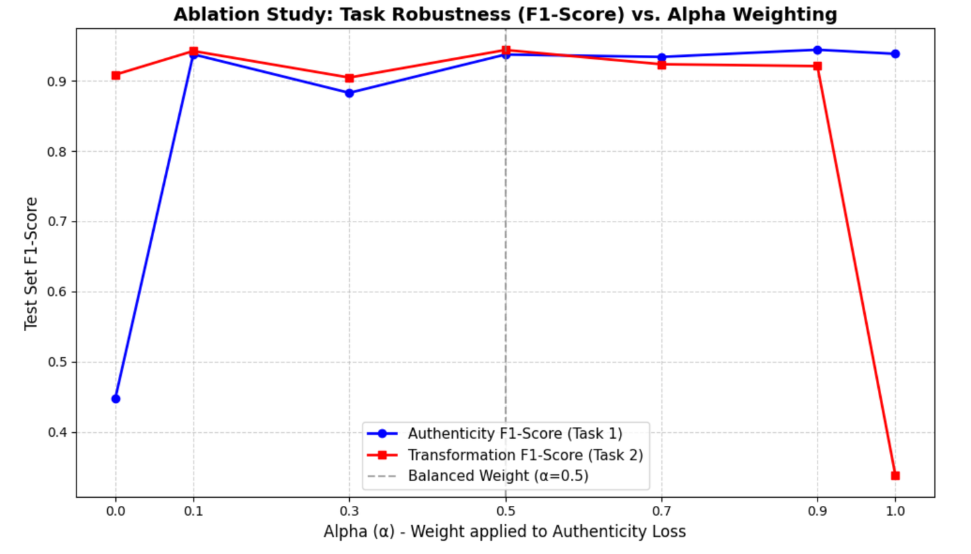
09
Ablation — Loss Weight α(alpha)
Accuracy vs. α (weight on the Real/Fake loss)
Sweeping α shows whether the two tasks compete for the shared backbone.
Tasks complement — not compete.
• α = 0.5 is the sweet spot: both heads peak together.
• Joint even beats the transform baseline (94.4% vs 90.9%).
13/15

Slide 14



10
Conclusions & Future Work
One model, two answers
FUTURE WORK
93.7% real/fake · 94.4% transform accuracy.
• Full RRDataset test split
• Unseen generators
• Stronger transform head
• Explainability (Grad-CAM)
Transmission ≠ weakness
Detection stays robust under real-world edits.
Tasks complement each other
Joint training beats both single-task baselines.
14/15

Slide 15
11
References
RRDataset (benchmark)
ResNet
Li, C. et al. (2025). Bridging the Gap Between Ideal and Real-world Evaluation: Benchmarking AI-Generated Image Detection in Challenging Scenarios. ICCV. arXiv:2509.09172.
He, K. et al. (2016). Deep Residual Learning for Image Recognition. CVPR.
Media manipulation
EfficientNet
Shao, R., Wu, T. & Liu, Z. (2023). Detecting and Grounding Multi-Modal Media Manipulation. CVPR.
Tan, M. & Le, Q. (2019). EfficientNet: Rethinking Model Scaling for Convolutional Neural Networks. ICML.
ConvNeXt (backbone)
Multi-task learning
Liu, Z. et al. (2022). A ConvNet for the 2020s. CVPR.
Ruder, S. (2017). An Overview of Multi-Task Learning in Deep Neural Networks. arXiv:1706.05098.
15/15

