Slide 1
Selection Feb. 9, 2015
HUGEN 2022: Population Genetics
J. Shaffer
Dept. Human Genetics
University of Pittsburgh

Slide 2
Objectives:
after this lecture you will need to be able to:
1. calculate and interpret fitness and selection coefficients
2. explain the qualitative (long-term) effects of different types of selection (dominant, recessive, over-dominant, under-dominant) and of the combination of selection and mutation
3. calculate change in allele frequency
4. calculate over- and under-dominant equilibria
5. interpret and make predictions about simulation plots

Slide 3
Hardy-Weinberg assumptions
diploid organism
sexual reproduction
nonoverlapping generations
random mating
large population size
equal allele frequencies in the sexes
no migration
no mutation
no selection

Slide 4
The big picture: Evolution
Definition:
change in the genetic composition (allele frequencies) of a population across successive generations
Evolution vs. Hardy-Weinberg
the H-W Law tells us that if the assumptions are met, genotype and allele frequencies do NOT change from one generation to the next
for evolution to occur, H-W assumptions must be violated
Which processes drive evolution?
mutation
natural selection
genetic drift

Slide 5
Definitions
Selection - differing viability and/or fertility of different genotypes
Viability - some genotypes do not survive to birth or maturation
Fertility - some genotypes do not reproduce (as much)
This is an artificial division because ‘maturation’ can include fertility.

Slide 6
Mathematical notation - fitness coefficients
w_{AA} = P(AA individual reproduces)
w_{Aa} = P(Aa individual reproduces)
w_{aa} = P(aa individual reproduces)

Slide 7
Mathematical notation - fitness coefficients
w_{AA} = P(AA individual reproduces)
w_{Aa} = P(Aa individual reproduces)
w_{aa} = P(aa individual reproduces)
We can’t really measure all three of these uniquely, so we usually set one of the w’s equal to 1, for example
w_{AA} = 1
w_{Aa} = P(Aa reproduces) / P(AA reproduces)
w_{aa} = P(aa reproduces) / P(AA reproduces)
You can choose any of the three genotypes as the “reference.”

Slide 8
Equivalently - selection coefficients
the selection coefficient, s, describes the degree of selection against the aa genotype
s = 1 – (w_{aa} / w_{AA})
the dominance coefficient, h, describes the degree of dominance.
h ͯ s = 1 – (w_{Aa} / w_{AA})
You can use either the w’s or h and s, and you should be able to translate back and forth freely.

Slide 9
Example
Example 1
Recessive mutation (aa) that causes death in infancy
w_{AA} = 1 (unaffected)
w_{Aa} = 1 (unaffected)
w_{aa} = 0 (die)
s = 1 – (w_{aa} / w_{AA}) = 1 – (0 / 1) = 1
= 100% selection against aa
hs = 1 – (w_{Aa} / w_{AA}) = 1 – (1 / 1) = 0
= 0% selection against Aa
=> h = 0

Slide 10
Example
Example 1
Recessive mutation (aa) that causes death in infancy
w_{AA} = 1 (unaffected)
w_{Aa} = 1 (unaffected)
w_{aa} = 0 (die)
s = 1 – (w_{aa} / w_{AA}) = 1 – (0 / 1) = 1
= 100% selection against aa
hs = 1 – (w_{Aa} / w_{AA}) = 1 – (1 / 1) = 0
= 0% selection against Aa
=> h = 0

Slide 11
Example
Example 1
Recessive mutation (aa) that causes death in infancy
w_{AA} = 1 (unaffected)
w_{Aa} = 1 (unaffected)
w_{aa} = 0 (die)
s = 1 – (w_{aa} / w_{AA}) = 1 – (0 / 1) = 1
= 100% selection against aa
hs = 1 – (w_{Aa} / w_{AA}) = 1 – (1 / 1) = 0
= 0% selection against Aa
=> h = 0

Slide 12
Example
Example 2
Aa mild disfigurement, extreme in aa
- both have reduced rate of reproduction
w_{AA} = 1 (unaffected)
w_{Aa} = 0.9
w_{aa} = 0.2
s = 1 – (w_{aa} / w_{AA}) = 1 – (0.2 / 1) = 0.8
= 80% selection against aa
hs = 1 – (w_{Aa} / w_{AA}) = 1 – (0.9 / 1) = 0.1
= 10% selection against Aa
=> h = 1/8

Slide 13
Example
Example 2
Aa mild disfigurement, extreme in aa
- both have reduced rate of reproduction
w_{AA} = 1 (unaffected)
w_{Aa} = 0.9
w_{aa} = 0.2
s = 1 – (w_{aa} / w_{AA}) = 1 – (0.2 / 1) = 0.8
= 80% selection against aa
hs = 1 – (w_{Aa} / w_{AA}) = 1 – (0.9 / 1) = 0.1
= 10% selection against Aa
=> h = 1/8

Slide 14
Example
Example 2
Aa mild disfigurement, extreme in aa
- both have reduced rate of reproduction
w_{AA} = 1 (unaffected)
w_{Aa} = 0.9
w_{aa} = 0.2
s = 1 – (w_{aa} / w_{AA}) = 1 – (0.2 / 1) = 0.8
= 80% selection against aa
hs = 1 – (w_{Aa} / w_{AA}) = 1 – (0.9 / 1) = 0.1
= 10% selection against Aa
=> h = 1/8

Slide 15
Example
Example 3
Huntington’s Disease - late onset! (Say “a” is the risk alllele.)
w_{AA} = 1
w_{Aa} = 1
w_{aa} = 1
What if genetic testing?

Slide 16
Example
Example 3
Huntington’s Disease - late onset! (Say “a” is the risk alllele.)
w_{AA} = 1
w_{Aa} = 1
w_{aa} = 1
What if genetic testing?

Slide 17
Example
Example 4: over-dominance
Sickle-cell anemia: aa: most die without treatment
w/ malaria Aa: survive malaria, unaffected by sickle-cell
AA: some do not survive malaria
w_{AA} = 0.8
w_{Aa} = 1
w_{aa} = 0.1
s = 1 – (w_{aa} / w_{AA}) = 1 – (0.1 / 0.8) = 0.875
= 88% selection against aa
hs = 1 – (w_{Aa} / w_{AA}) = 1 – (1 /0.8) = -0.25
= 25% selection in favor of Aa
=> h = -0.286
What if there is no malaria?

Slide 18
Example
Example 4: over-dominance
Sickle-cell anemia: aa: most die without treatment
w/ malaria Aa: survive malaria, unaffected by sickle-cell
AA: some do not survive malaria
w_{AA} = 0.8
w_{Aa} = 1
w_{aa} = 0.1
s = 1 – (w_{aa} / w_{AA}) = 1 – (0.1 / 0.8) = 0.875
= 88% selection against aa
hs = 1 – (w_{Aa} / w_{AA}) = 1 – (1 /0.8) = -0.25
= 25% selection in favor of Aa
=> h = -0.286
What if there is no malaria?

Slide 19
Example
Example 4: over-dominance
Sickle-cell anemia: aa: most die without treatment
w/ malaria Aa: survive malaria, unaffected by sickle-cell
AA: some do not survive malaria
w_{AA} = 0.8
w_{Aa} = 1
w_{aa} = 0.1
s = 1 – (w_{aa} / w_{AA}) = 1 – (0.1 / 0.8) = 0.875
= 88% selection against aa
hs = 1 – (w_{Aa} / w_{AA}) = 1 – (1 /0.8) = -0.25
= 25% selection in favor of Aa
=> h = -0.286
What if there is no malaria?

Slide 20
Example
Example 4: over-dominance II
Sickle-cell anemia: aa: most die without treatment
w/ malaria Aa: survive malaria, unaffected by sickle-cell
AA: some do not survive malaria
w_{AA} = 1
w_{Aa} = 1.25
w_{aa} = 0.125
s = 1 – (w_{aa} / w_{AA}) = 1 – (0.125 / 1) = 0.875
= 88% selection against aa
hs = 1 – (w_{Aa} / w_{AA}) = 1 – (1.25 /1) = -0.25
= 25% selection in favor of Aa
=> h = -0.286
What if there is no malaria?

Slide 21
Special Example
Example 5: X-linked
Females diploid: three genotype fitness coefficients
Males haploid two allele fitness coefficients
females males
w_{AA} == 1 w_{A} == 1
w_{Aa} = 1 - hs_{f} w_{a} = 1 - s_{m}
w_{aa} = 1 - s_{f}
s_{f} = 1 – (w_{aa} / w_{AA}) s_{m} = 1 – (w_{a} / w_{A})
hs_{f} = 1 – (w_{Aa} / w_{AA})
assuming W_{AA} and W_{A} are
reference fitness coefficients
X-linked genotype freq
p_{f}p_{m}, p_{f}q_{m}+p_{m}q_{f}, q_{f}q_{m}
p_{f}, q_{f}
Comments:
any combinations of fitness scenarios are possible among females (i.e. recessive, over-
dominant, etc.) which can occur in conjunction with two scenarios in males (equal/unequal).
Equilibria for X-linked fitness scenarios are outside the scope of this class; equilibria for
diploid scenarios of over-/under-dominance and mutation-selection generally do not hold.

Slide 22
Clinical vs. Fitness disease types
Clinical Selection
Huntington’s Disease dominant none
Sickle cell (w. malaria) recessive over-dominant
Sickle cell (w/o. malaria) recessive recessive
Hemochromatosis recessive none
Achondroplasia dominant intermediate
Cystic Fibrosis recessive intermediate

Slide 23
Clinical vs. Fitness disease types
Clinical Selection
Huntington’s Disease dominant none
Sickle cell (w. malaria) recessive over-dominant
Sickle cell (w/o. malaria) recessive recessive
Hemochromatosis recessive none
Achondroplasia dominant intermediate
Cystic Fibrosis recessive intermediate

Slide 24
Clinical vs. Fitness disease types
Clinical Selection
Huntington’s Disease dominant none
Sickle cell (w. malaria) recessive over-dominant
Sickle cell (w/o. malaria) recessive recessive
Hemochromatosis recessive none
Achondroplasia dominant intermediate
Cystic Fibrosis recessive intermediate

Slide 25
Clinical vs. Fitness disease types
Clinical Selection
Huntington’s Disease dominant none
Sickle cell (w. malaria) recessive over-dominant
Sickle cell (w/o. malaria) recessive recessive
Hemochromatosis recessive none
Achondroplasia dominant intermediate
Cystic Fibrosis recessive intermediate

Slide 26
Clinical vs. Fitness disease types
Clinical Selection
Huntington’s Disease dominant none
Sickle cell (w. malaria) recessive over-dominant
Sickle cell (w/o. malaria) recessive recessive
Hemochromatosis recessive none
Achondroplasia dominant intermediate
Cystic Fibrosis recessive intermediate

Slide 27
Clinical vs. Fitness disease types
Clinical Selection
Huntington’s Disease dominant none
Sickle cell (w. malaria) recessive over-dominant
Sickle cell (w/o. malaria) recessive recessive
Hemochromatosis recessive none
Achondroplasia dominant intermediate
Cystic Fibrosis recessive intermediate

Slide 28
Clinical vs. Fitness disease types
Clinical Selection
Huntington’s Disease dominant none
Sickle cell (w. malaria) recessive over-dominant
Sickle cell (w/o. malaria) recessive recessive
Hemochromatosis recessive none
Achondroplasia dominant intermediate
Cystic Fibrosis recessive intermediate

Slide 29
Selection - major qualitative results
For dominant, recessive, or intermediate trait selection, the “risk” allele is eventually eliminated.
But, elimination is much quicker for dominant “risk” allele than recessive.
Recessive diseases are eliminated slowly because most “risk” alleles are in the heterozygotes, and there is no selection against them.
For over-dominance, an allele is not eliminated.
If we have ongoing new mutation, will an allele be eliminated?

Slide 30
Selection: quantitative stuff
# A alleles in the next generation
think HWE freq.
times fitness
p₁ =
total # alleles in the next generation
(p₀²)(W_{AA}) + (1p₀q₀)(W_{Aa})
p₁ =
denominator =
average fitness of
the population
(p₀²)(W_{AA}) + (2p₀q₀)(W_{Aa}) + (q₀²)(W_{aa})
This formula is for the allele frequency, p₁, of the “A” allele after exactly ONE generation. Can be recursively applied to calculate P(“A”) after more than one generation.

Slide 31
Selection: quantitative stuff
There is no simple formula for p_{t} in terms of p₀
Approximations:
Allele frequency after t generations
ln(p_{t}/q_{t}) + (1/q_{t}) ≈ ln(p₀/q₀) + 1/q₀ + st 100% dominant
ln(p_{t}/q_{t}) ≈ ln(p₀/q₀) + st/2 exactly additive
ln(p_{t}/q_{t}) - (1/p_{t}) ≈ ln(p₀/q₀) - 1/p₀ + st 100% recessive
NOTE: these approximations assume that the average fitness is very close to 1, e.g., (p₀²)(W_{AA}) + (2p₀q₀)(W_{Aa}) + (q₀²)(W_{aa}) ≈ 1. Therefore, they are valid if there is extreme selection against rare genotypes, or light selection against common genotypes.

Slide 32
Selection: quantitative stuff
What a genotype frequencies?
if random mating H-W assumption is held:
P(AA)_{t} = p_{t}²
P(Aa)_{t} = 2p_{t}q_{t}
P(aa)_{t} = q_{t}²
as functions of allele frequencies, the genotype frequencies will change over time if allele frequencies change over time

Slide 33
Selection: quantitative stuff
X-linked genotype frequencies:
women:
AA: p_{f}p_{m}
Aa: p_{f}q_{m}+p_{m}q_{f}
aa: q_{f}q_{m}
haplotypes in men:
A: p_{f}
a: q_{f}
change after one generation:
p_{f0}p_{m0}W_{AA} + (1/2)(p_{f0}q_{m0}+p_{m0}q_{f0})W_{Aa}
p_{f0}W_{A}
p_{f1} =
p_{m1} =
p_{f0}p_{m0}W_{AA} + (p_{f0}q_{m0}+p_{m0}q_{f0})W_{Aa}+ q_{f0}q_{m0}W_{aa}
p_{f0}W_{A} + q_{f0}W_{a}

Slide 34
Quantitative selection example
Example
W_{AA} = 1
W_{Aa} = 1
W_{aa} = 0
recessive lethal disease, q₀ = 0.04:
Question: what are p₁ and q₁ in the next generation?

Slide 35
Quantitative selection example
Example
W_{AA} = 1
W_{Aa} = 1
W_{aa} = 0
recessive lethal disease, q₀ = 0.04:
Question: what are p₁ and q₁ in the next generation?
(p₀²)(W_{AA}) + (1p₀q₀)(W_{Aa})
p₁ =
(p₀²)(W_{AA}) + (2p₀q₀)(W_{Aa}) + (q₀²)(W_{aa})

Slide 36
Quantitative selection example
Example
W_{AA} = 1
W_{Aa} = 1
W_{aa} = 0
recessive lethal disease, q₀ = 0.04:
Question: what are p₁ and q₁ in the next generation?
(p₀²)(W_{AA}) + (1p₀q₀)(W_{Aa})
p₁ =
(p₀²)(W_{AA}) + (2p₀q₀)(W_{Aa}) + (q₀²)(W_{aa})
(0.96²)(1) + (0.96)(0.04)(1)
p₁ =
(0.96²)(1) + (2)(0.96)(0.04)(1) + (0.04²)(0)

Slide 37
Quantitative selection example
Example
W_{AA} = 1
W_{Aa} = 1
W_{aa} = 0
recessive lethal disease, q₀ = 0.04:
Question: what are p₁ and q₁ in the next generation?
(p₀²)(W_{AA}) + (1p₀q₀)(W_{Aa})
p₁ =
(p₀²)(W_{AA}) + (2p₀q₀)(W_{Aa}) + (q₀²)(W_{aa})
(0.96²)(1) + (0.96)(0.04)(1)
p₁ =
(0.96²)(1) + (2)(0.96)(0.04)(1) + (0.04²)(0)
p₁ =
0.9615

Slide 38
Quantitative selection example
Example
W_{AA} = 1
W_{Aa} = 1
W_{aa} = 0
recessive lethal disease, q₀ = 0.04:
Question: what are p₁ and q₁ in the next generation?
(p₀²)(W_{AA}) + (1p₀q₀)(W_{Aa})
p₁ =
(p₀²)(W_{AA}) + (2p₀q₀)(W_{Aa}) + (q₀²)(W_{aa})
(0.96²)(1) + (0.96)(0.04)(1)
p₁ =
(0.96²)(1) + (2)(0.96)(0.04)(1) + (0.04²)(0)
p₁ =
0.9615
Comments
very strong selection against aa, but allele frequency of a changes very little
most “risk” alleles are in heterozygotes
frequency of A allele is high
q₁ = 1 – 0.9615 =
0.0385

Slide 39
Selection: changes in allele frequencies
Two questions to explore:
how fast is an allele eliminated by selection?
what happens if there is over- or under-dominance?

Slide 40
How fast is an allele eliminated?
Change in allele frequencies over time depends on fitness or selection coefficients. In general…
- Stronger selection = faster elimination of risk allele
- Dominant disease = faster elimination of risk allele
- Recessive disease = slow elimination of risk allele
(risk alleles “hiding” in heterozygotes)

Slide 41
How fast is an allele eliminated?
0.12
W_{AA} = 1
W_{aa} = 0.95
0.10
risk allele frequency
0.08
0.06
0.04
recessive
0.02
additive
dominant
0.00
0
100
200
300
400
500
generations

Slide 42
Selection: changes in allele frequencies
Thwo questions to explore:
how fast is an allele eliminated by selection?
what happens if there is over- or under-dominance?

Slide 43
Overdominance
Overdominance: w_{AA} < w_{Aa} > w_{aa}
human example:
sickle cell trait w/ malaria
Overdominance equilibrium (under selection):
If start at p = 0 then…
stay at p = 0
unstable equilibrium
p = 1 then…
stay at p = 1
If start “in the middle”, 0 < p < 1
w_{Aa} – w_{aa}
p_{eq}(A) =
stable equilibrium
2w_{Aa} – w_{AA} – w_{aa}

Slide 44
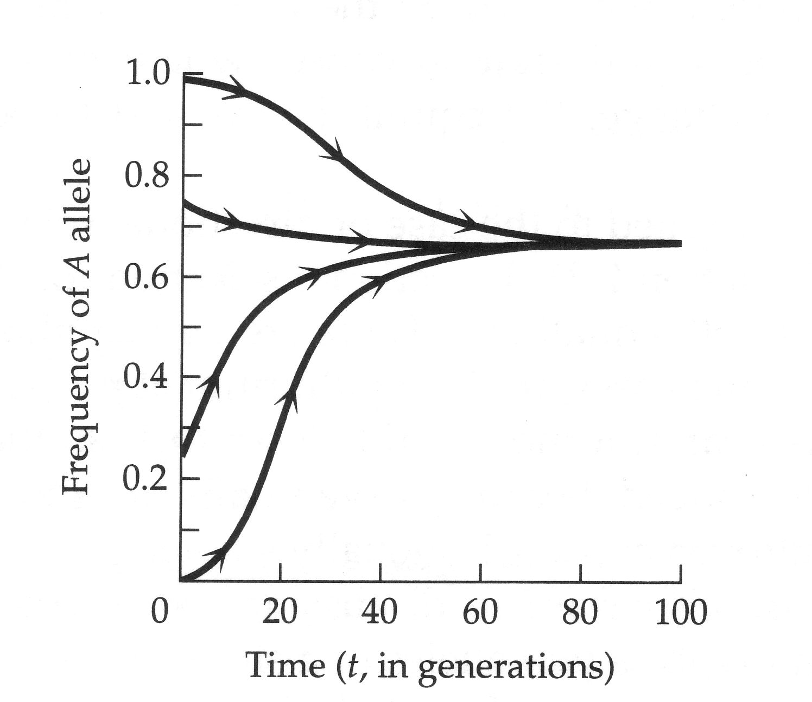
Overdominance
p₀(A) = 1
0 < p₀(A) < 1
stable equilibrium
p₀(A) = 0

Slide 45
Overdominance example
Warfarin: anti-coagulant used as rat-killer in WWII era
After many generations, the rats became resistant due to a mutation - resistant allele “R”; normal (wild-type) allele “S”
Given the following fitnesses of the different genotypes, what is the equilibrium frequency of “S”?
SS SR RR
Fitness 0.68 1.0 0.37
in the presence of warfarin
w_{Aa} – w_{aa}
p_{eq}(A) =
2w_{Aa} – w_{AA} – w_{aa}
1 – 0.37
p_{eq}(A) =
= 0.66
2(1) – 0.68 – 0.37

Slide 46
Underdominance
No good examples in humans
possibly rh factor
few examples in nature
lizard size
finches beak size
Underdominance: w_{AA} > w_{Aa} < w_{aa}
1.0 0.5 0.9
Underdominance equilibrium:
If start at p = 0 then…
stay at p = 0
stable
p = 1 then…
stay at p = 1
If start “in the middle”, 0 < p < 1
w_{Aa} – w_{aa}
p_{eq}(A) =
unstable
2w_{Aa} – w_{AA} – w_{aa}
If you start at the ‘middle’ equilibrium point, you stay there, otherwise you will go to p = 0 or p = 1

Slide 47
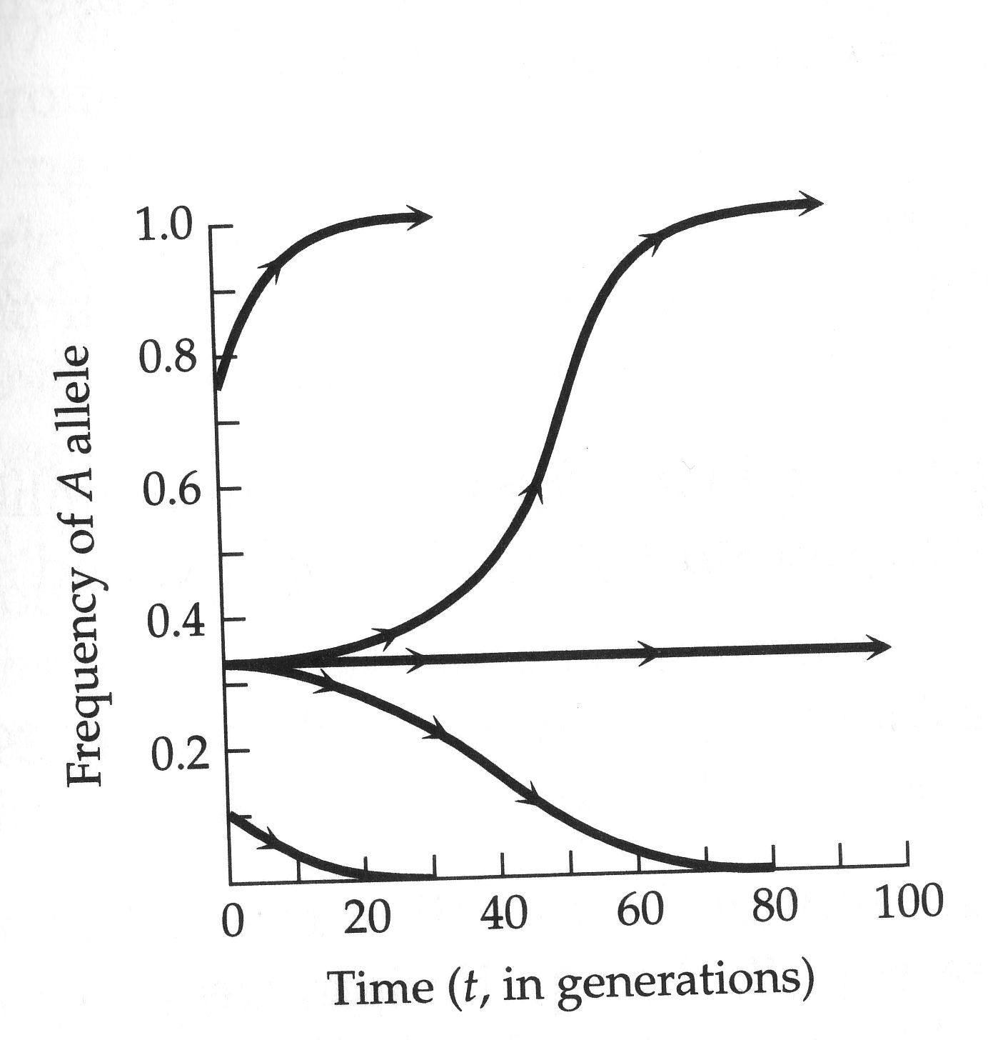
Underdominance
p₀(A) = 1
0 < p₀(A) < 1
unstable equilibrium
p₀(A) = 0

Slide 48
Selection - things to know
calculation and interpretation of fitness and selection coefficients (w, s, h)
qualitative (long-term) effects of different types of selection (dominant, recessive, over-dominant, under-dominant) and of the combination of selection and mutation
calculation of change in allele frequency using:
calculation of over-dominant and under-dominant equilibria
p₁ =
(p₀²)(W_{AA}) + (1p₀q₀)(W_{Aa})
(p₀²)(W_{AA}) + (2p₀q₀)(W_{Aa}) + (q₀²)(W_{aa})
w_{Aa} – w_{aa}
p_{eq}(A) =
2w_{Aa} – w_{AA} – w_{aa}

