Slide 1
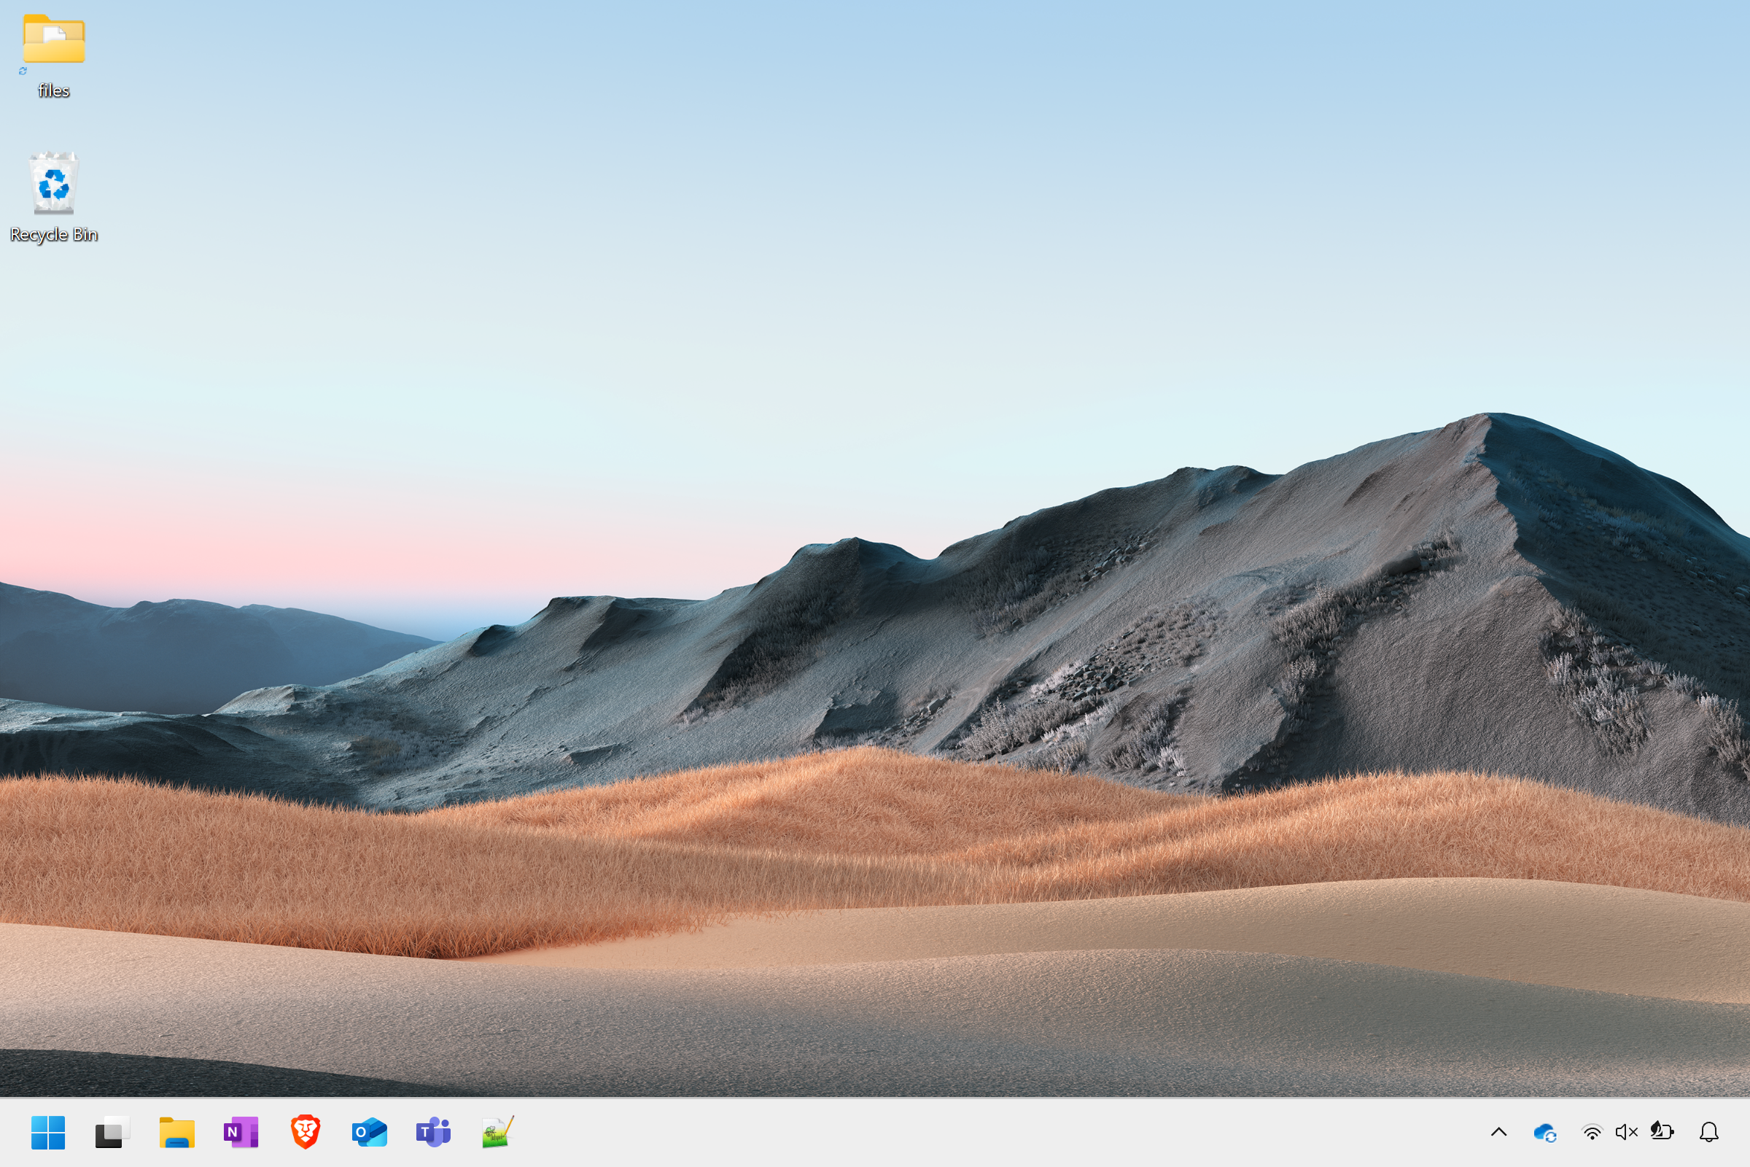

Slide 2
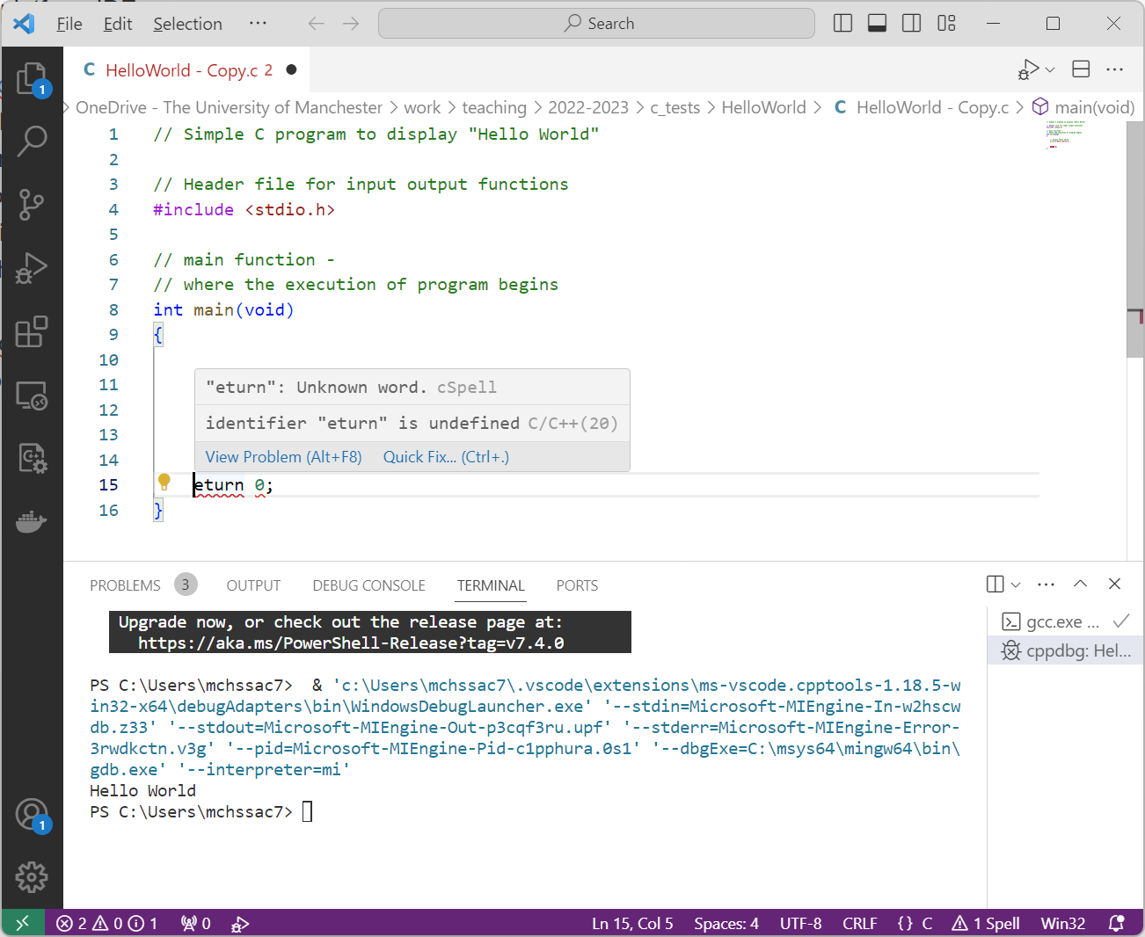
A simple typo detected to
avoid us wasting time
compiling something which
will fail

Slide 3
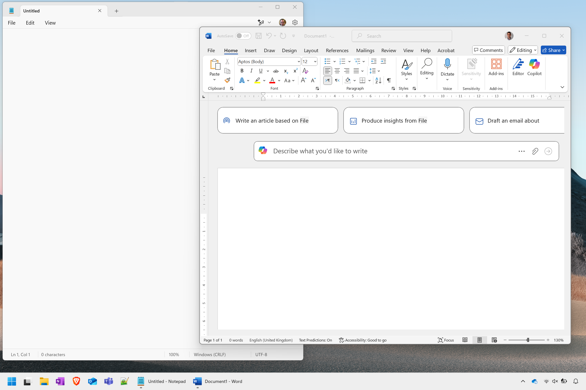
Second window
Interface button
Window
Text entry area

Slide 4
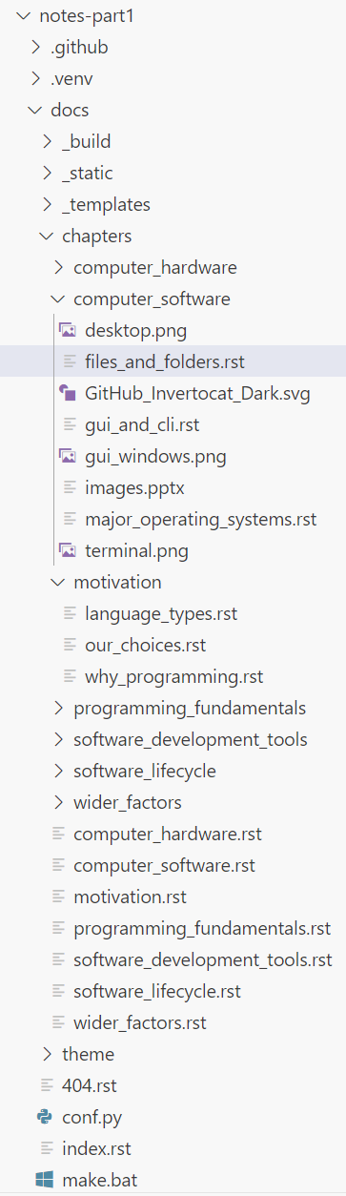

Slide 5
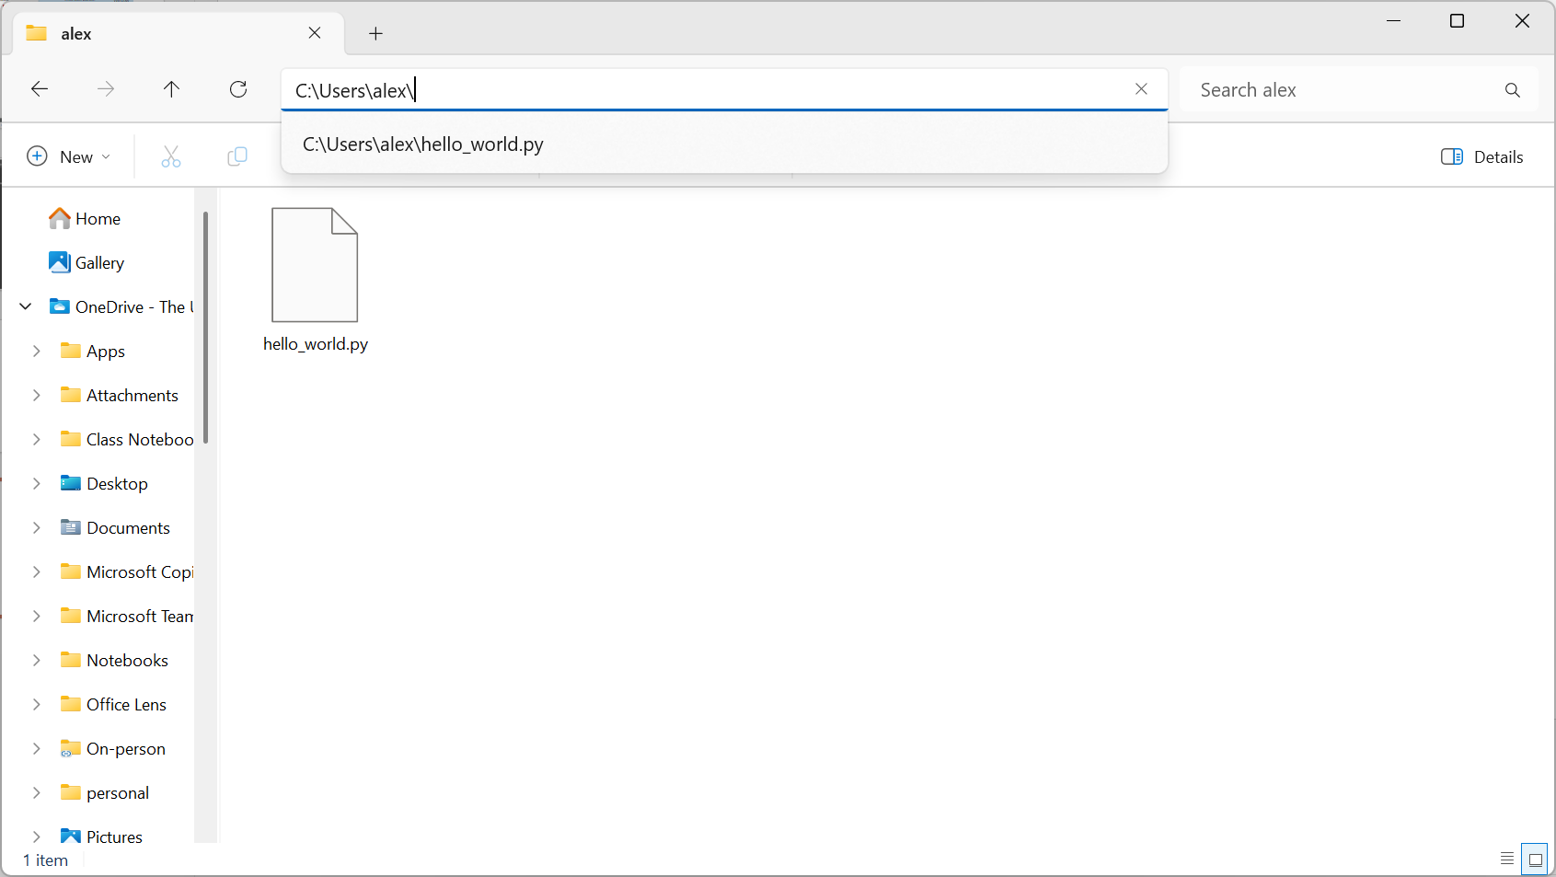

Slide 6
Desktop
Start button
Taskbar

Slide 7

Desktop
Menu button
Taskbar

Slide 8
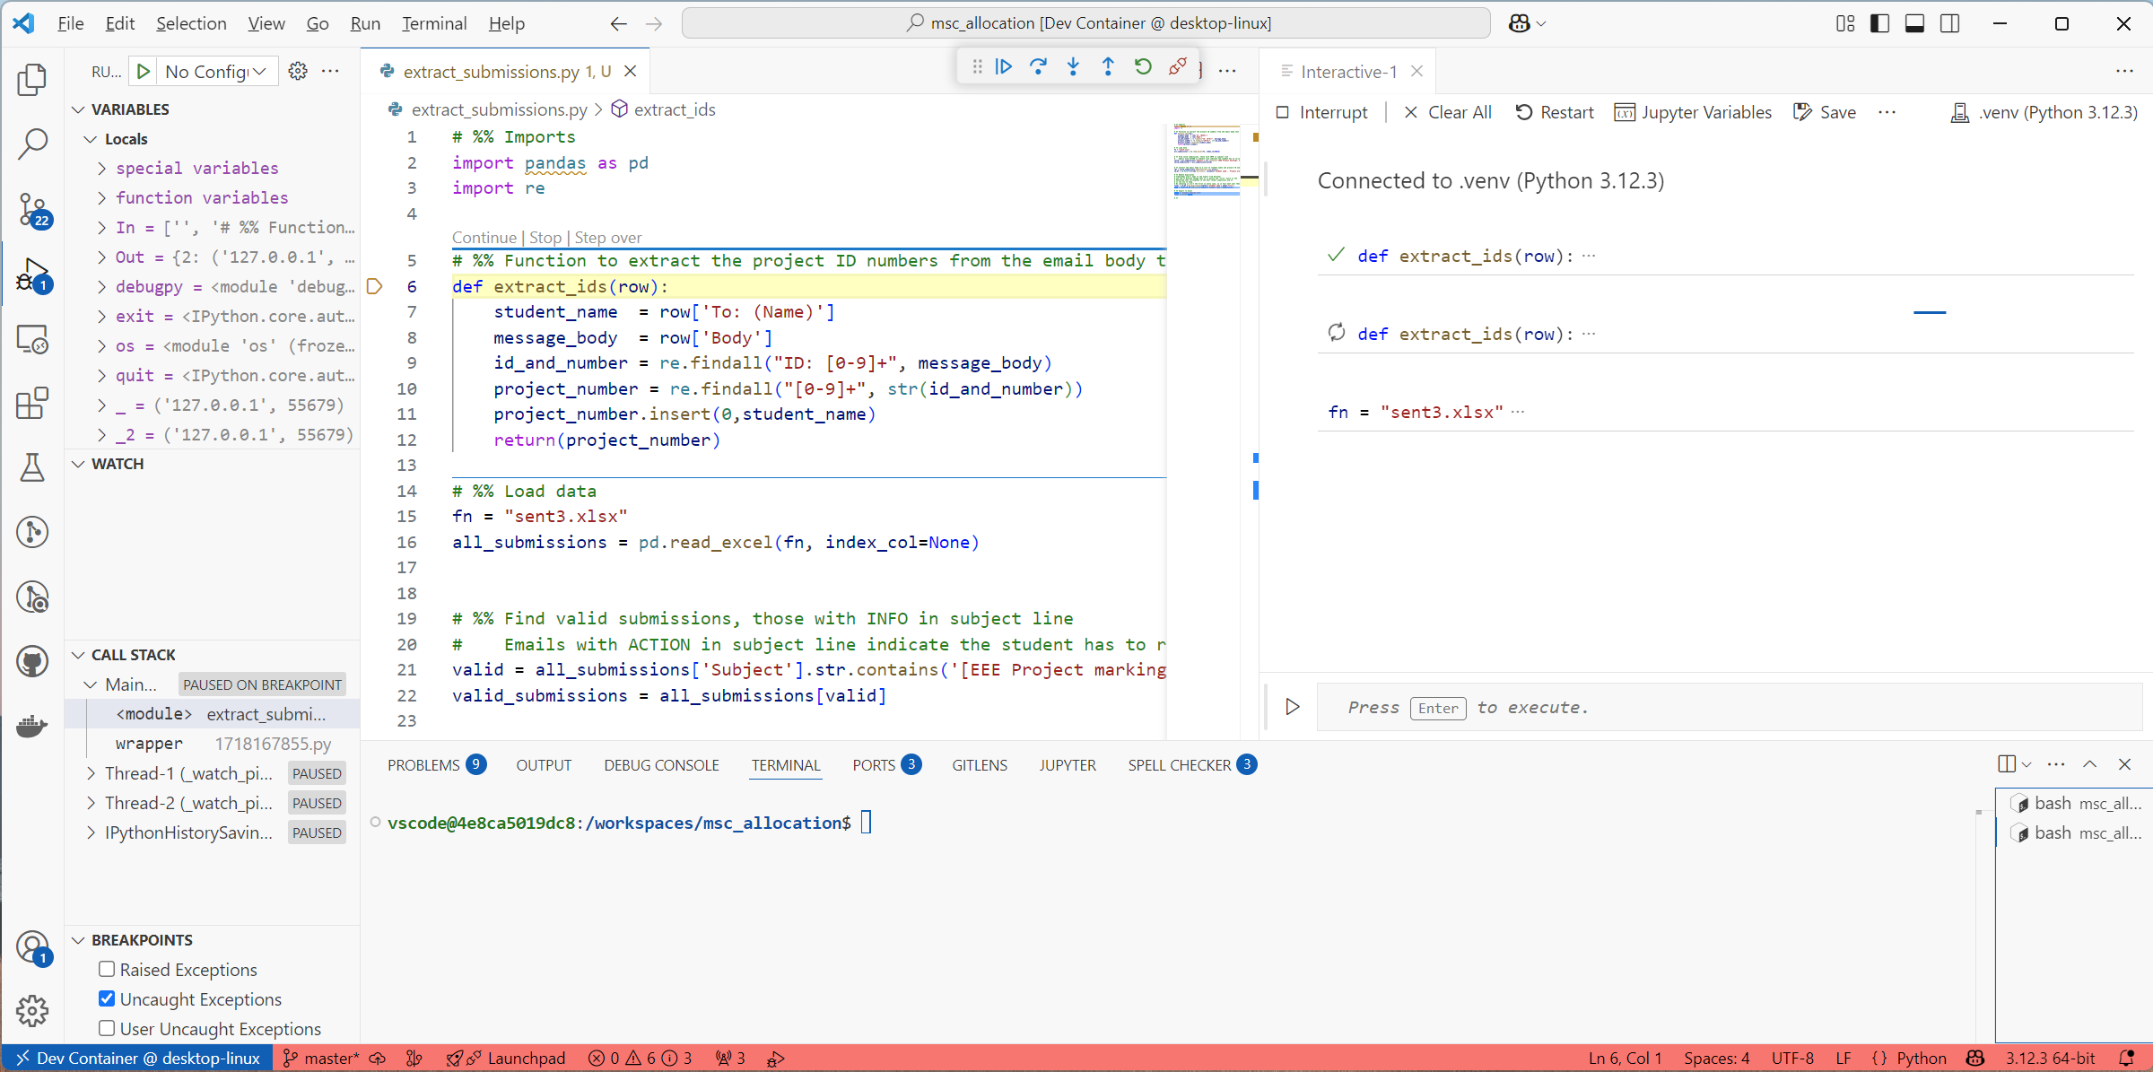
GUI for running code
Code file for editing
GUI for analysing code
CLI for running code
CLI for interacting with computer

Slide 9
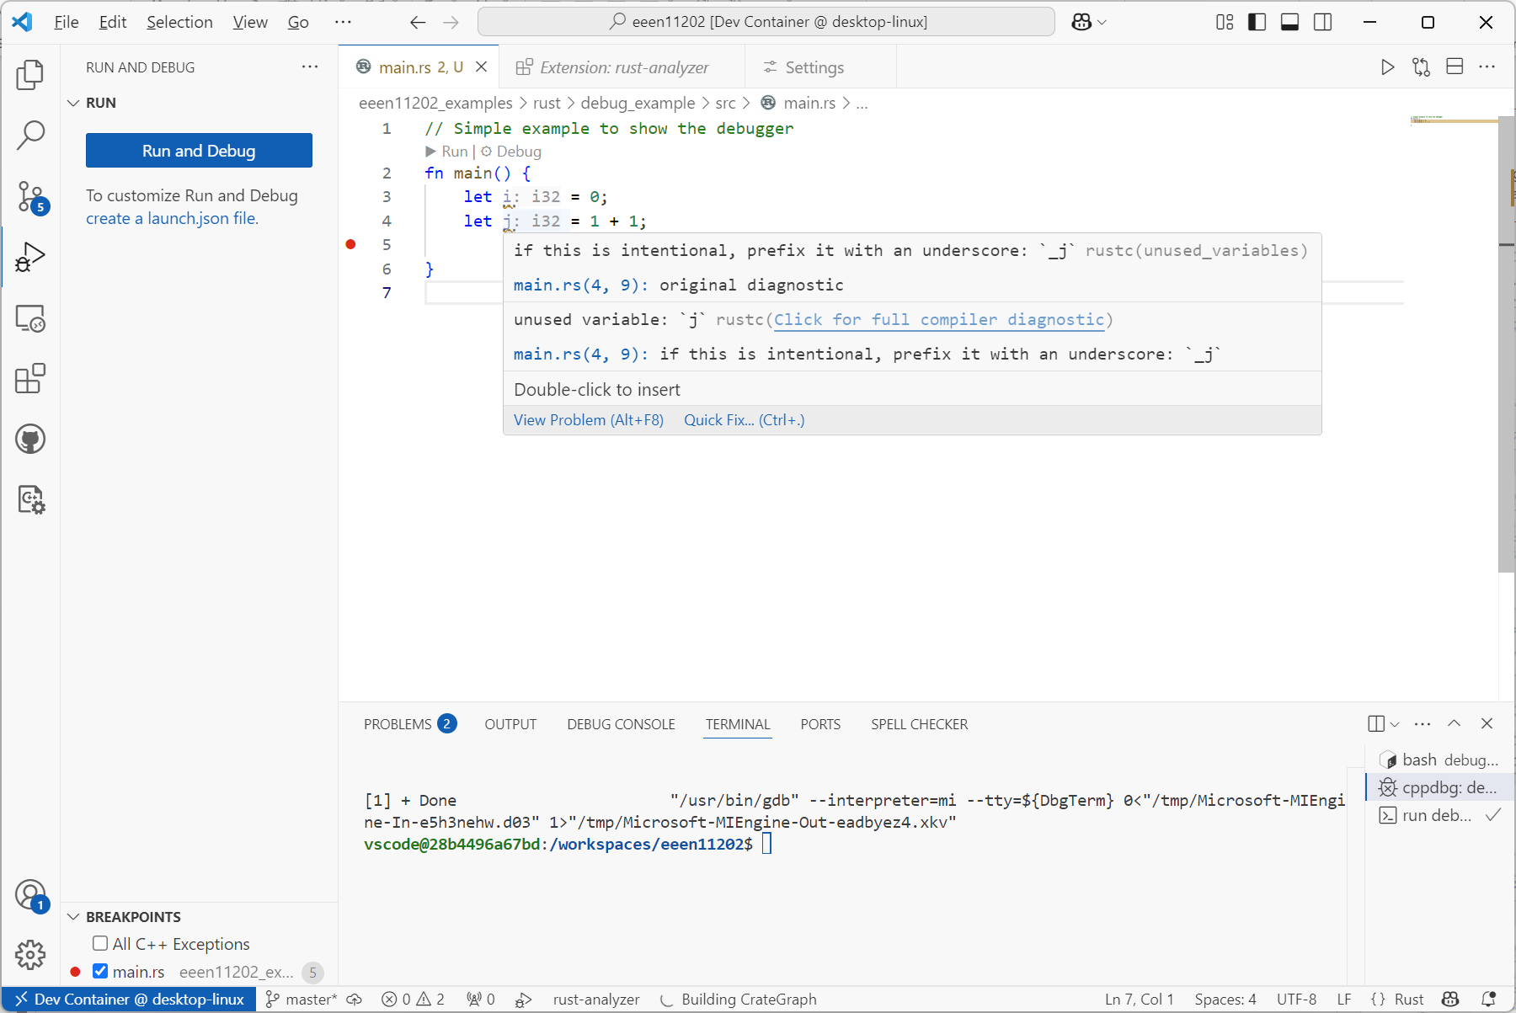
Potential issue in code underlined
Issue explained, and possible fix suggested

Slide 10
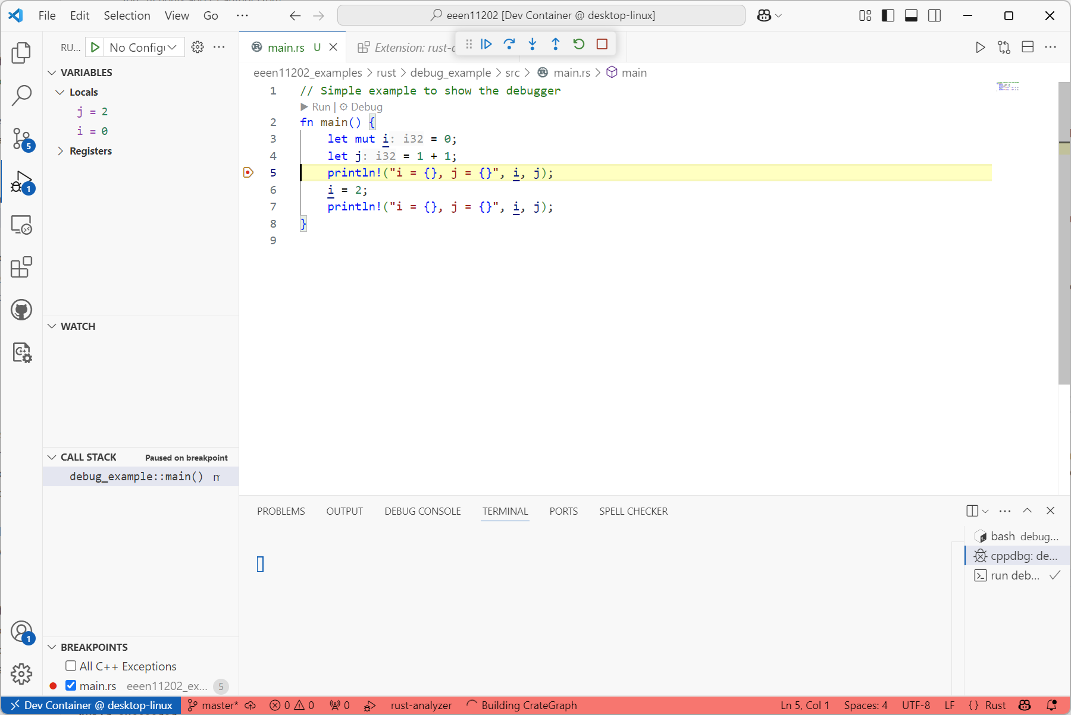
Buttons to step the code forwards,
one line at a time
Code execution paused before this line is run
Display of variables in the code
Break point added by clicking next to line number

Slide 11
GUI button to interact with version control

Slide 12
Remote repository
Fork
Clone (for initial set up)
Pull (to get updates)
Push
New copy of the project to develop separately
Local repository
Branch
Revert or Reset (to previous committed version)
Stage, then
Commit changes
Alternative development tree, to merge with main branch later
The main branch
Open in File Explorer (etc) as usual
Merge
Your files to work on
Will get a Conflict to resolve if the same code has been edited in two places

Slide 13
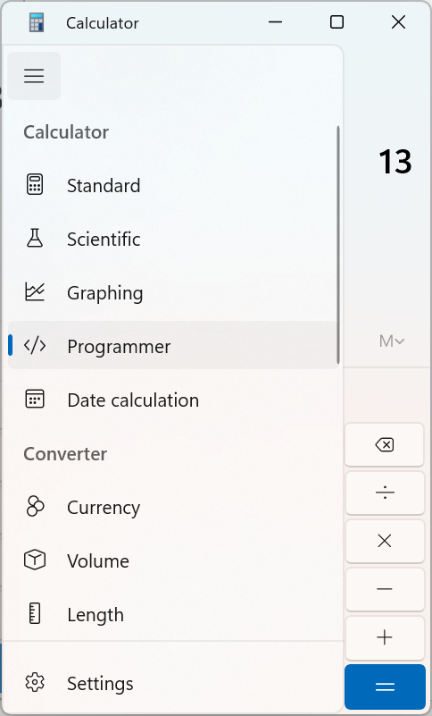
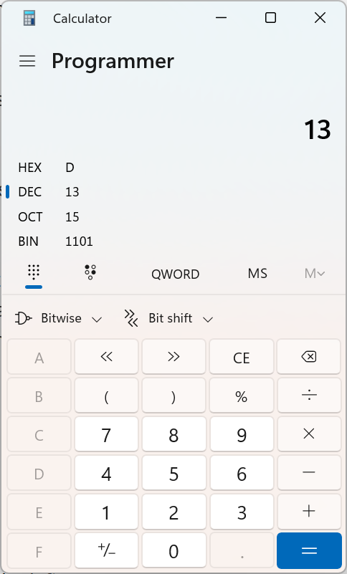

Slide 14
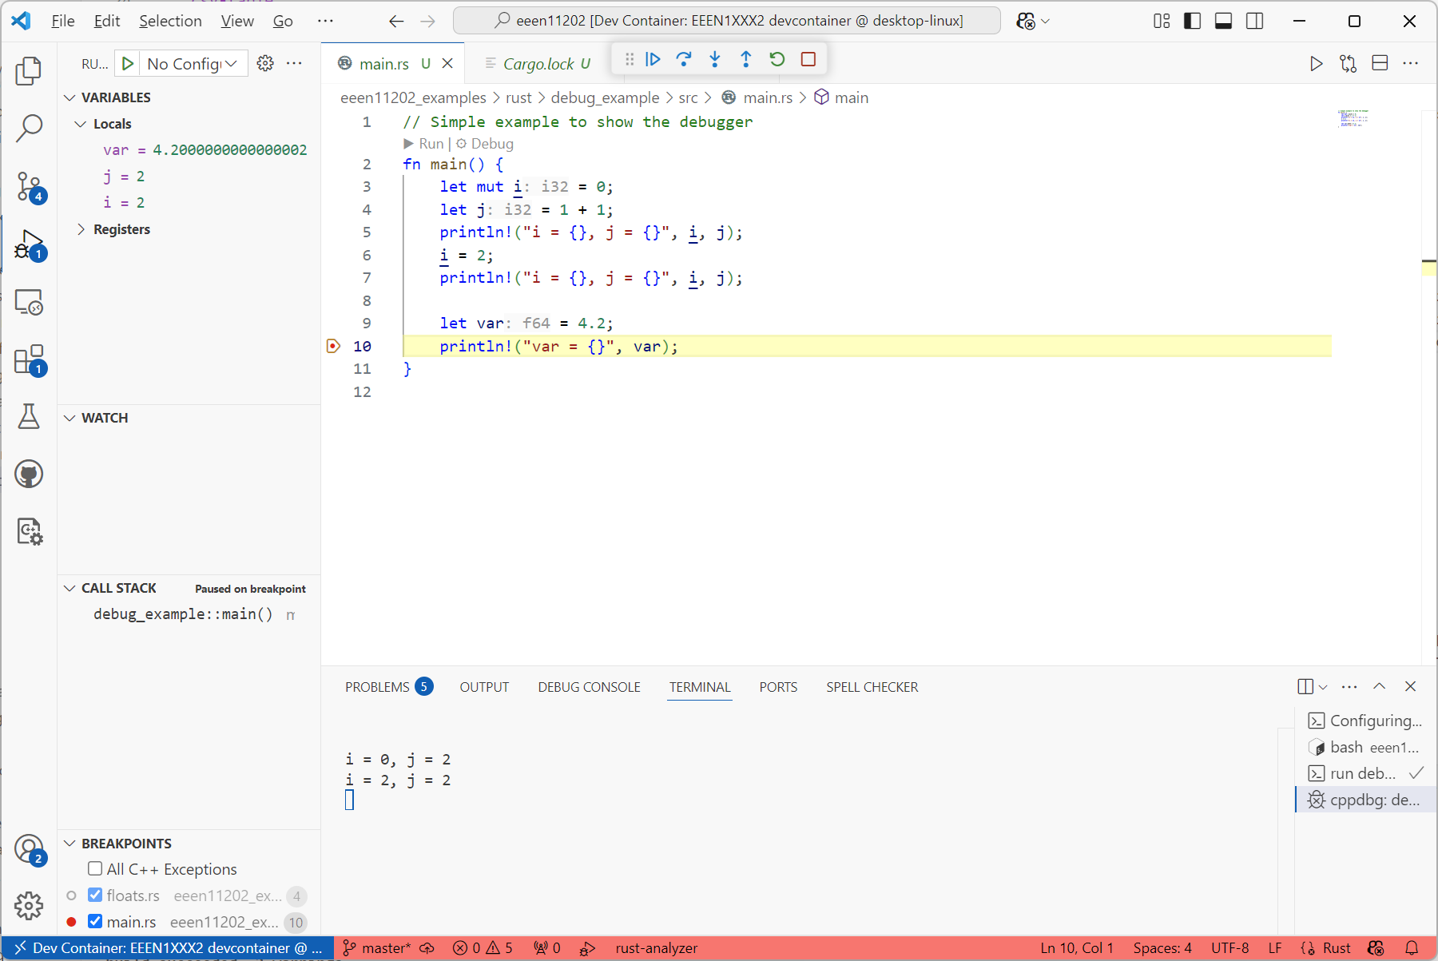
Actual value stored, isn’t quite 4.2
4.2, asked to be stored as a double

Slide 15
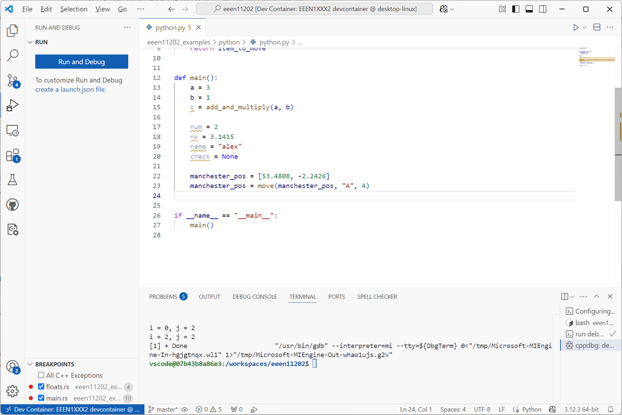
Text encoding system is highlighted

Slide 16
Human readable names for your code:
p
i
What the computer sees after compilation:
1
10101010

Slide 17
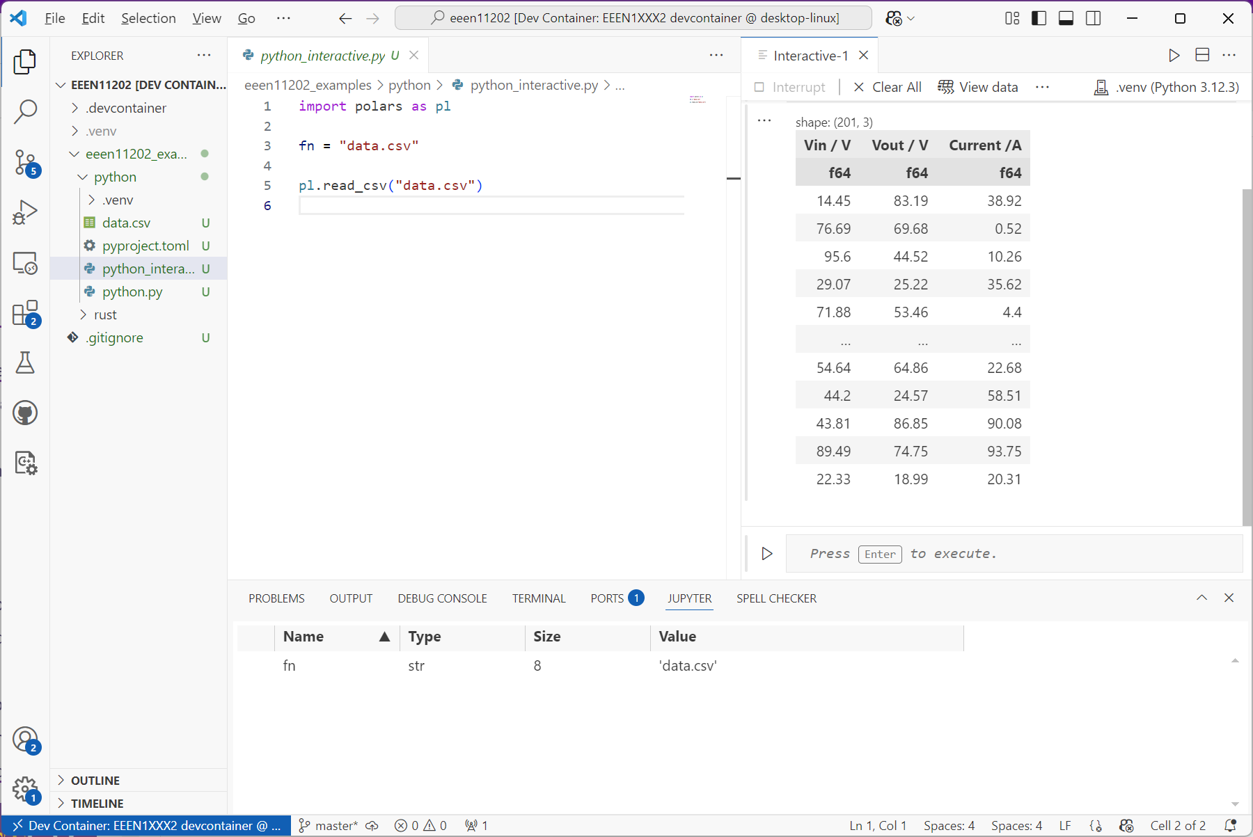
Dataframe view, a bit like a table or spreadsheet
Data file loaded

Slide 18
Address
Data at that address
5
5
5
4
4
4
Next free
location
d = 'g'
3
Next free
location
3
Next free
location
3
c = 'f'
c = 'f'
c = 'f'
2
2
2
j = 10
j = 10
j = 10
1
1
1
i = 9
i = 9
i = 9
0
0
0
Example starting stack
New item pushed to the stack
Top item popped from the stack

Slide 19
[0,1,2]
[3,4,5]
[6,7,8]
a
Rather than actually copying the data, items in b just point to the original items in a
b

Slide 20
[1,1,2]
[3,4,5]
[6,7,8]
[9,10, 11]
a.append([9, 10, 11])
Changing an item in a means b is automatically updated, but adding an item to a doesn’t automatically add it to b
b

Slide 21

Seat number
Name of student in that seat
Lecture theatre A
Lecture theatre B
20
M
21
N
22
O
23
P
24
Q
25
E
26
AE
27
AF
28
AG
29
AH
210
AI
211
AK
10
G
11
H
12
I
13
J
14
K
15
L
16
Y
17
Z
18
AA
19
AB
110
AC
111
AD
00
A
01
B
02
C
03
D
04
E
05
F
06
S
07
T
08
U
09
V
010
W
011
X
Lecturer pointing at a seat (11). Student H is in this seat

Slide 22
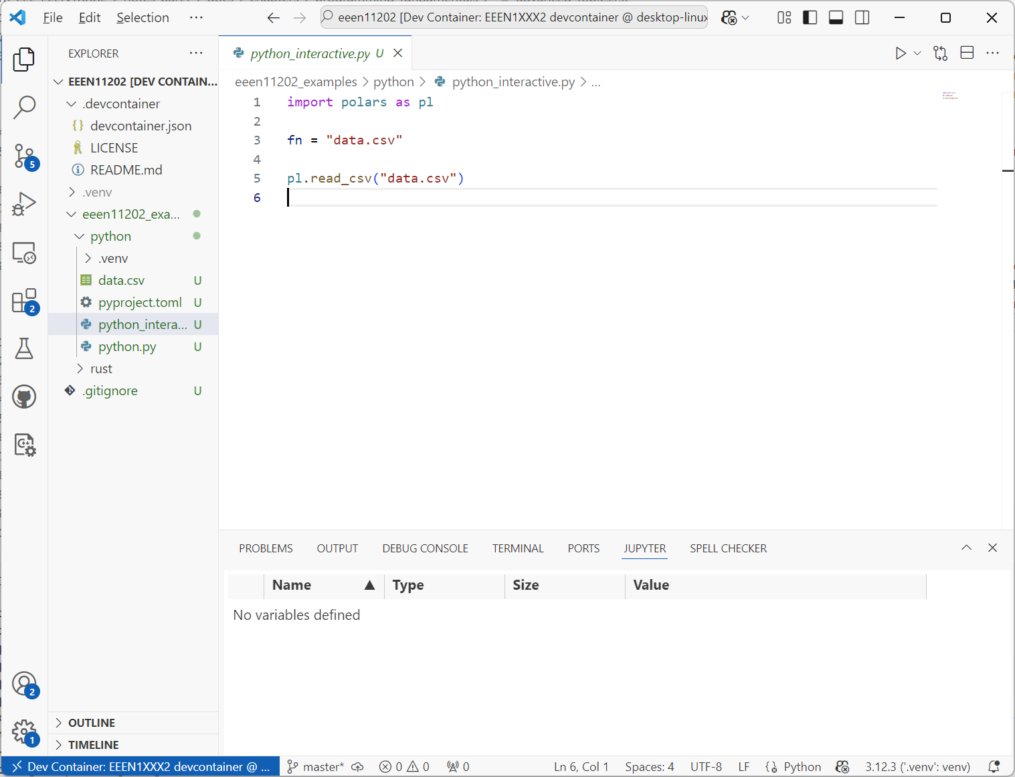
Click to change line endings

Slide 23
Start
Load data
Filter to remove outliers
Relax filtering rule
Are >200 records available?
No
Yes
Calculate sum of squares
Display result

