Slide 1
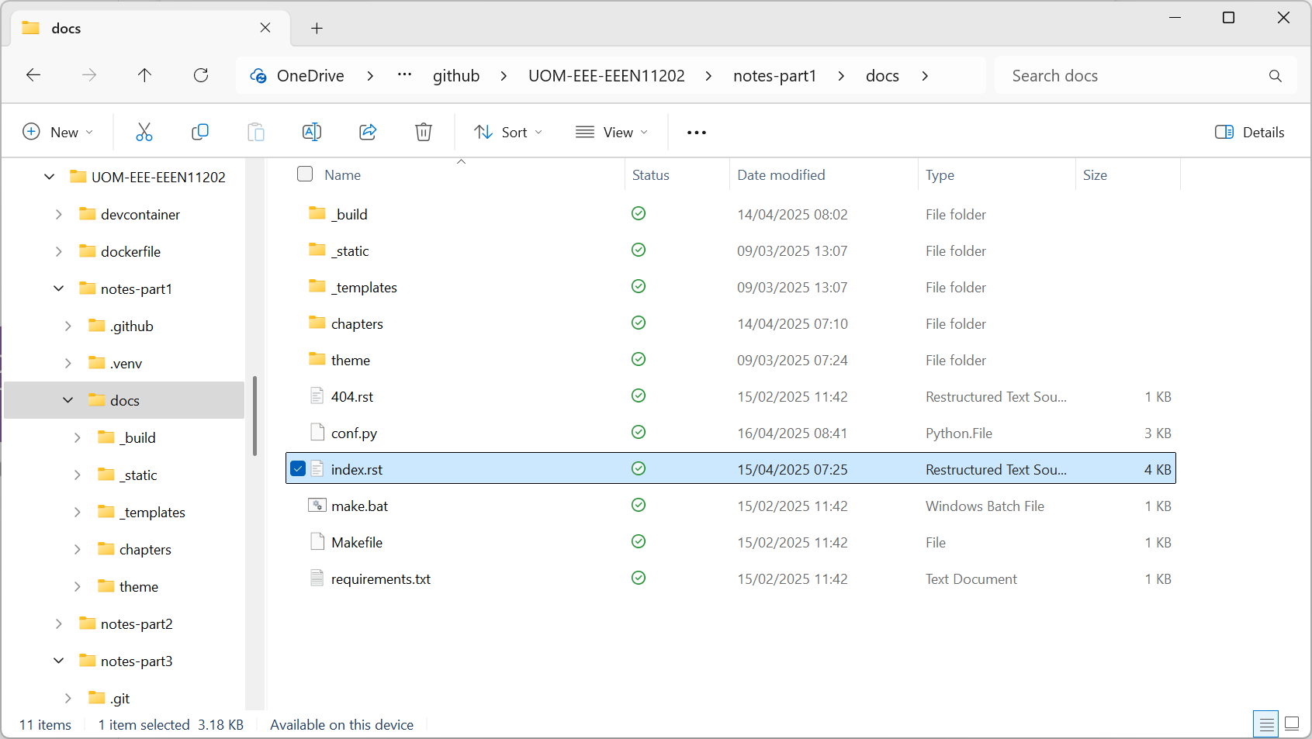
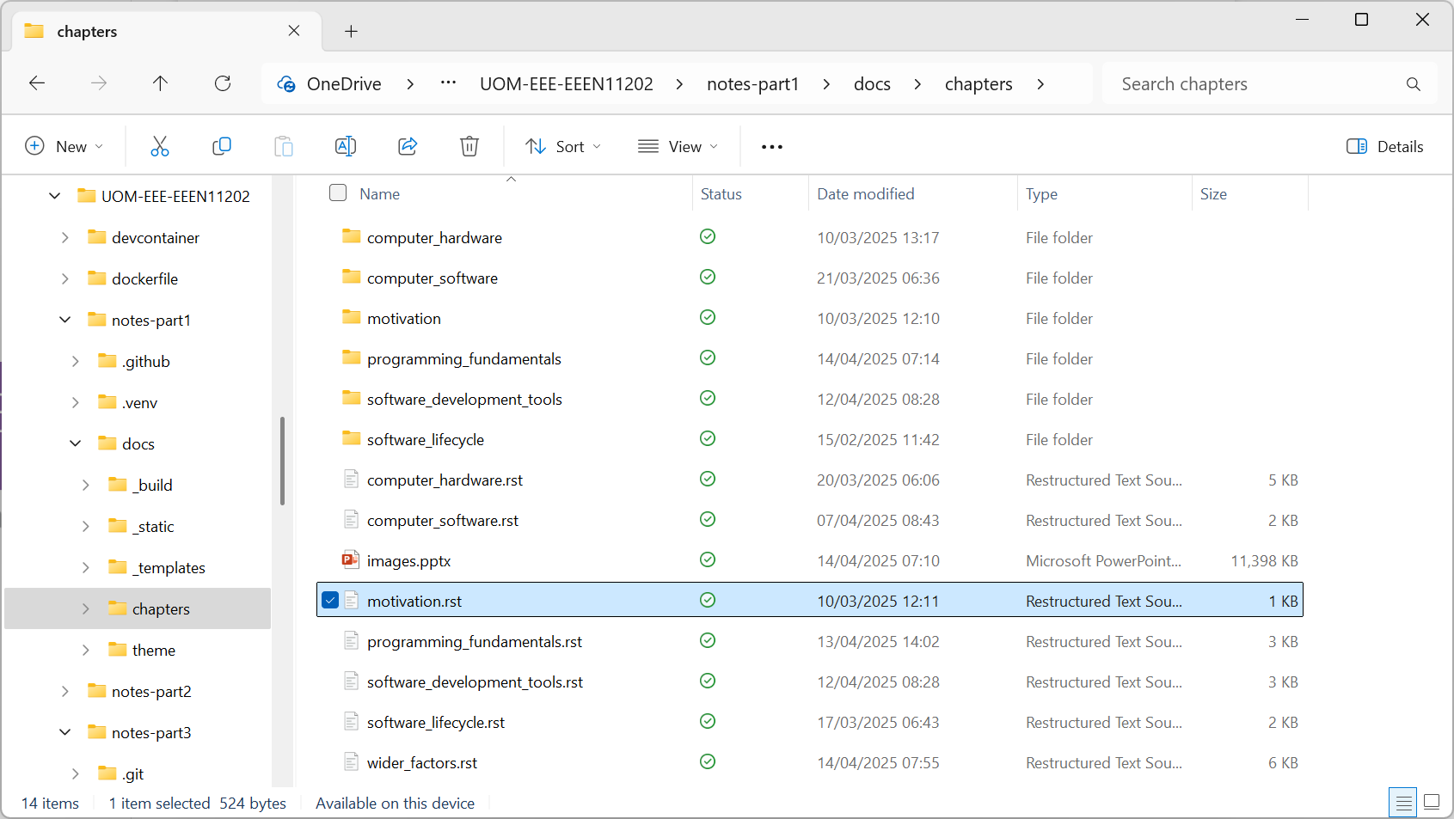

Slide 2
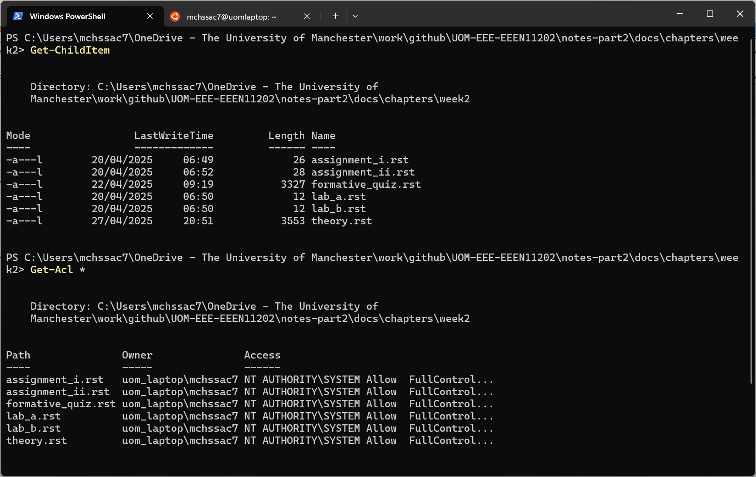
Command to display files in this folder
File names displayed
Command to display files permissions
Security permissions. Syntax is not important here

Slide 3
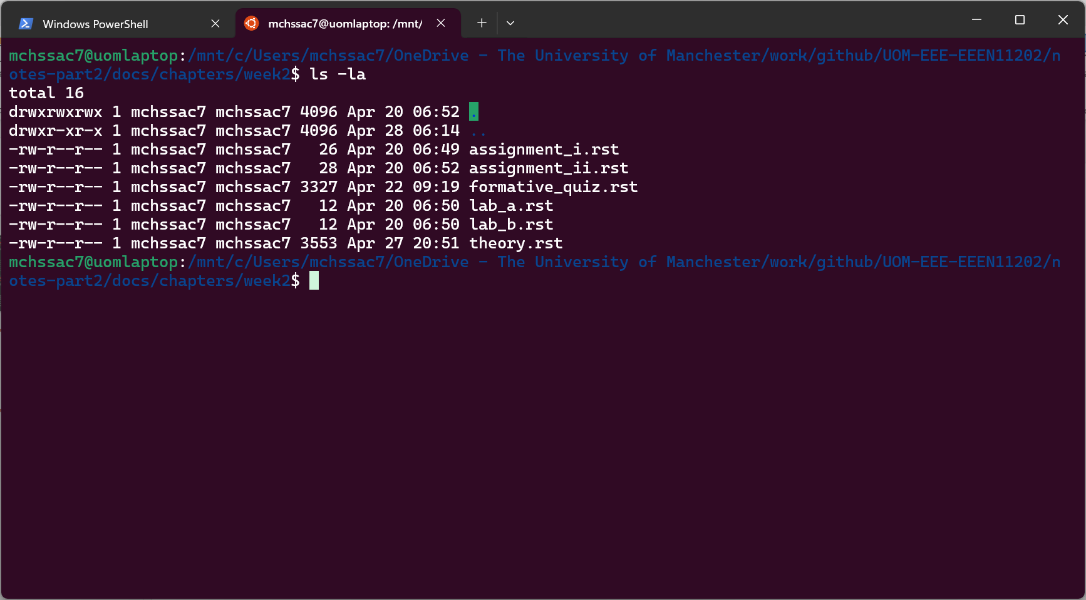
Command to display files in this folder
Security permissions. Syntax is not important here

Slide 4
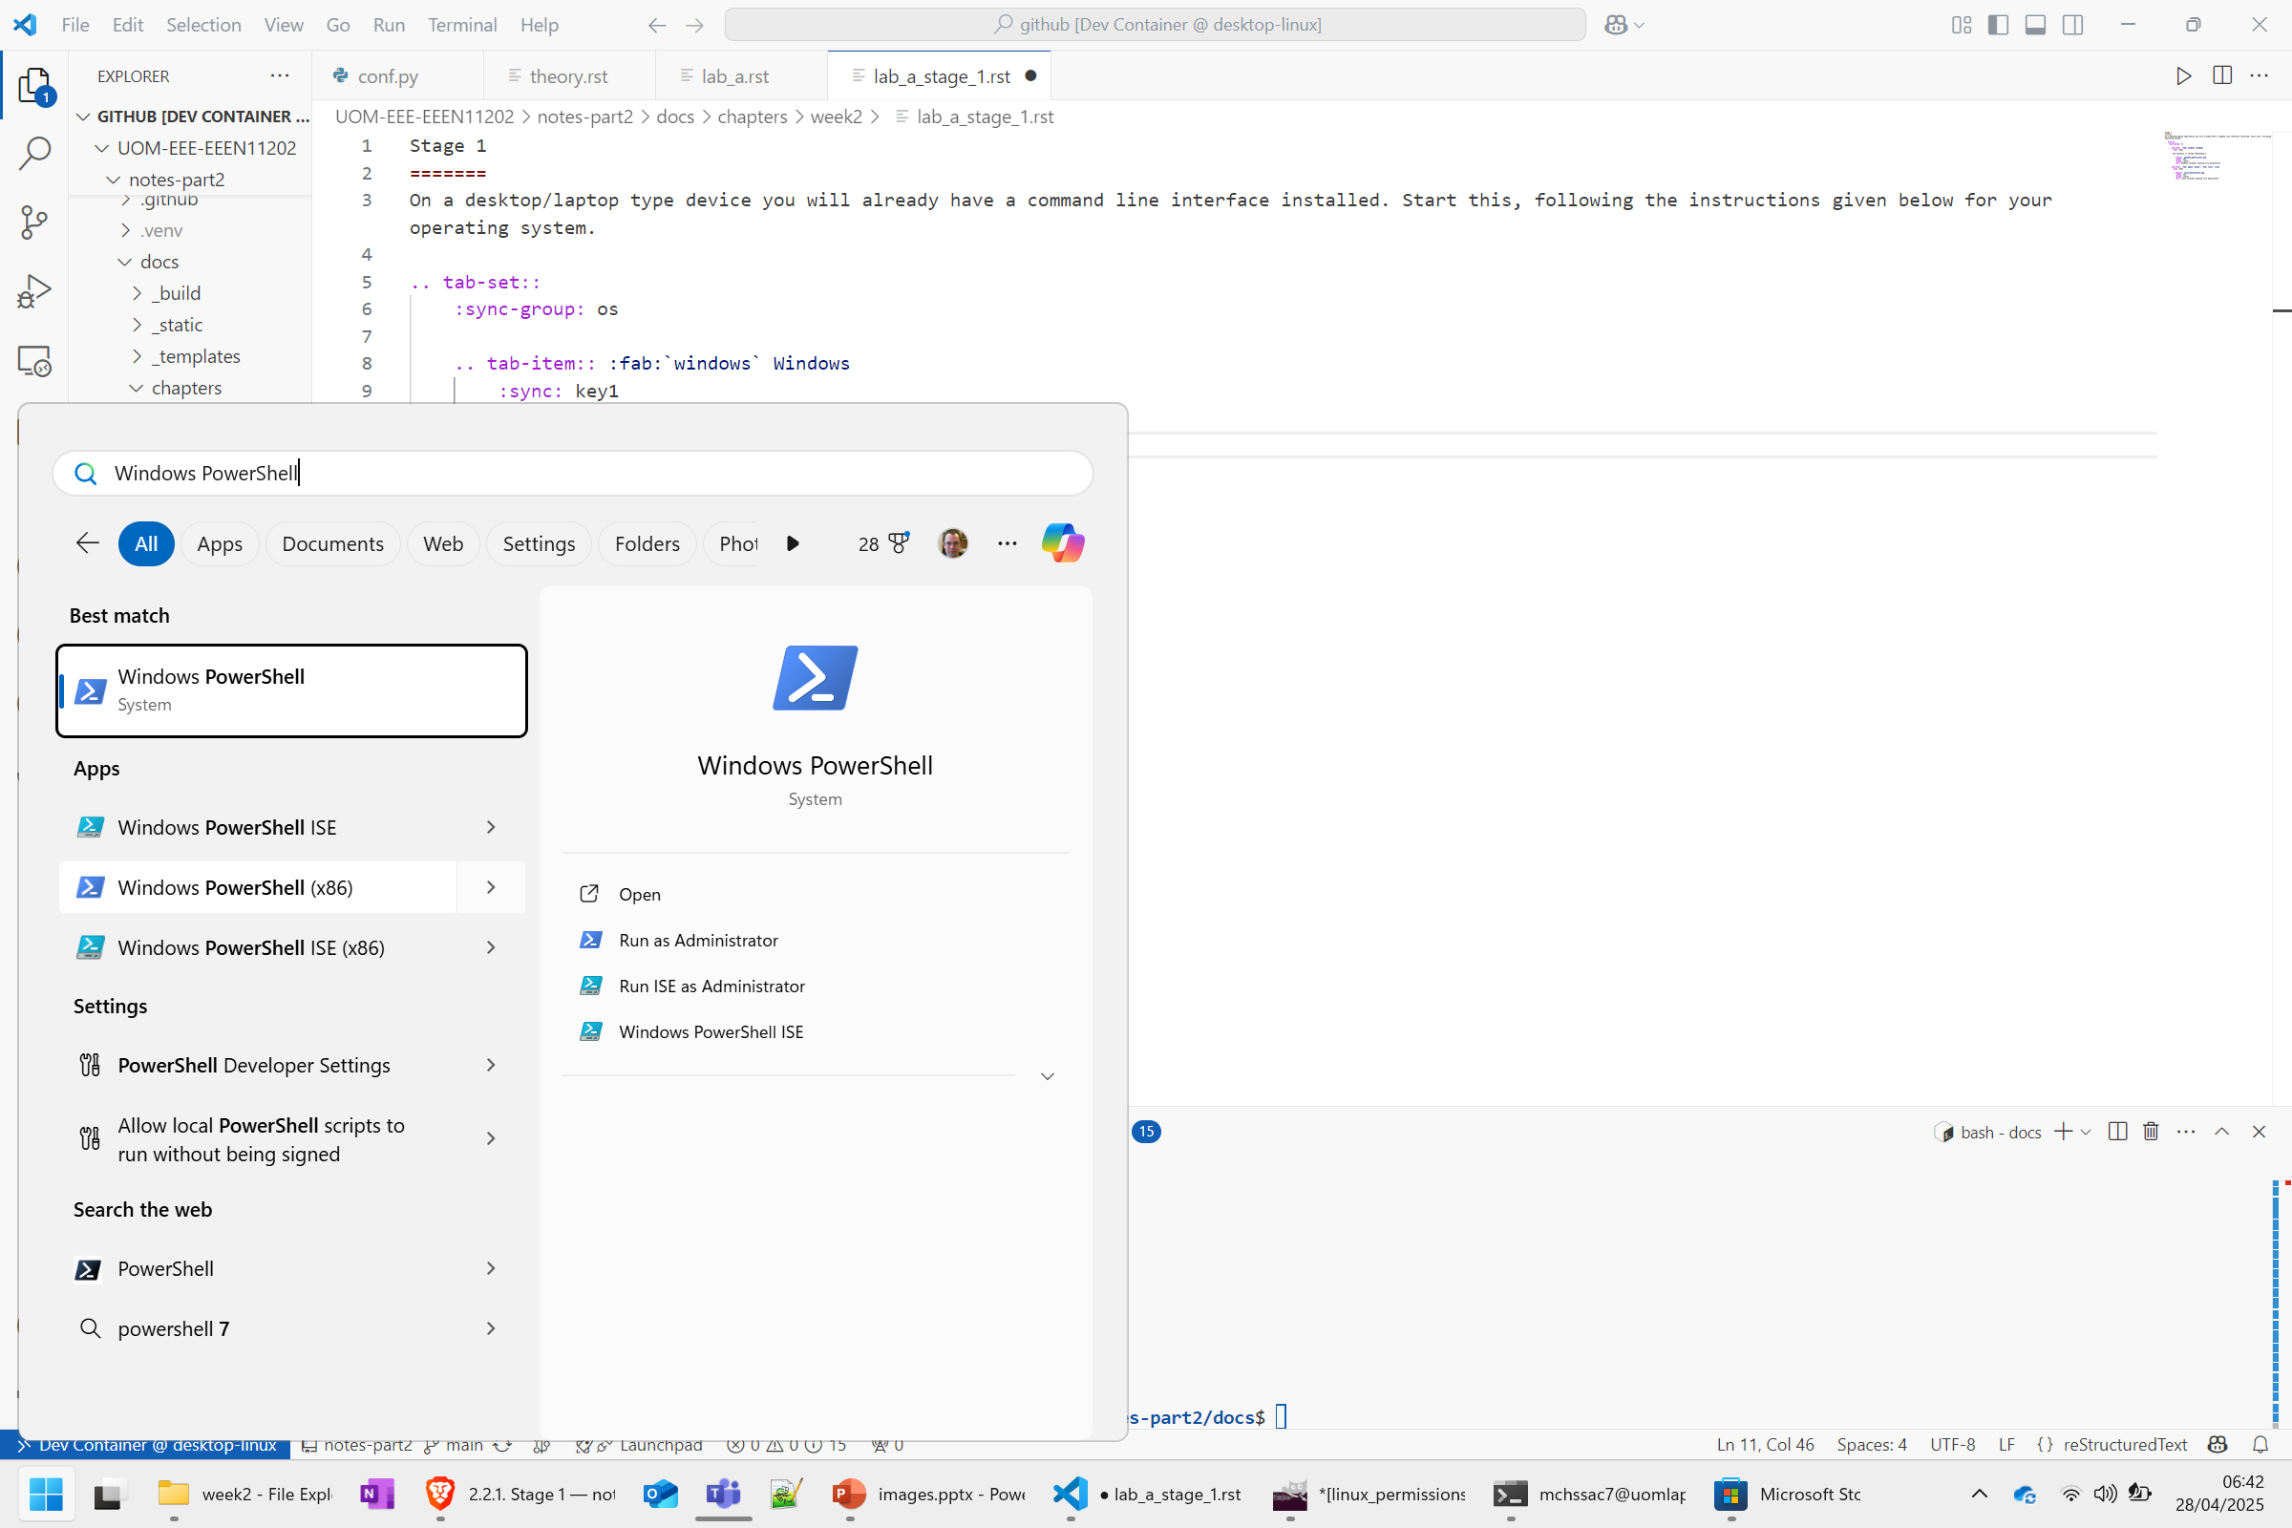

Slide 5
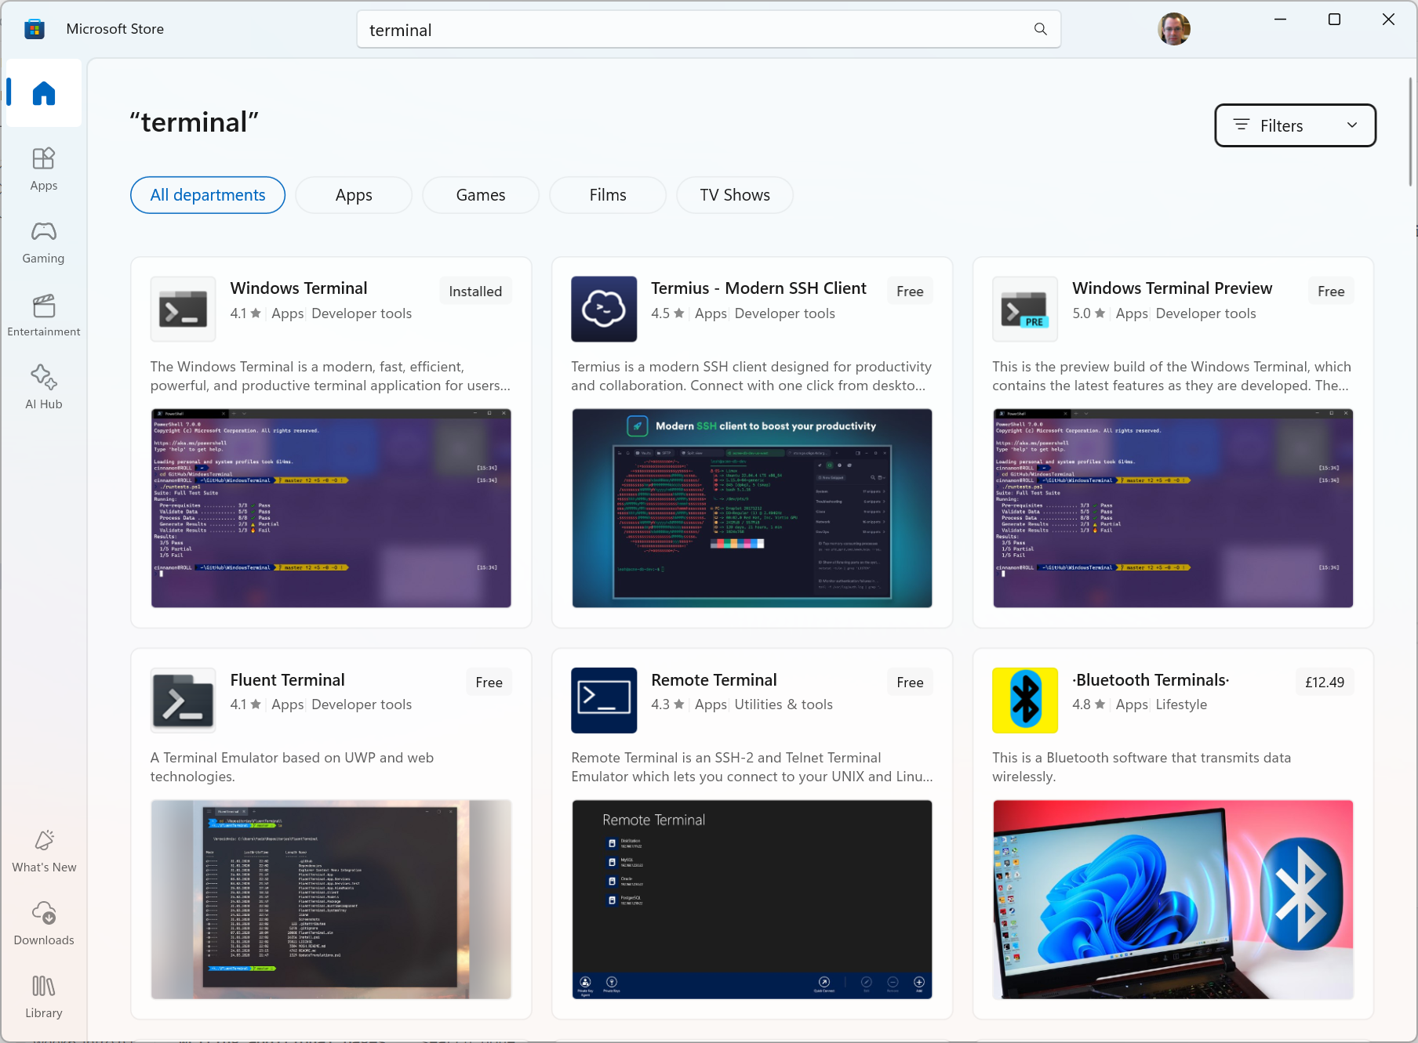

Slide 6
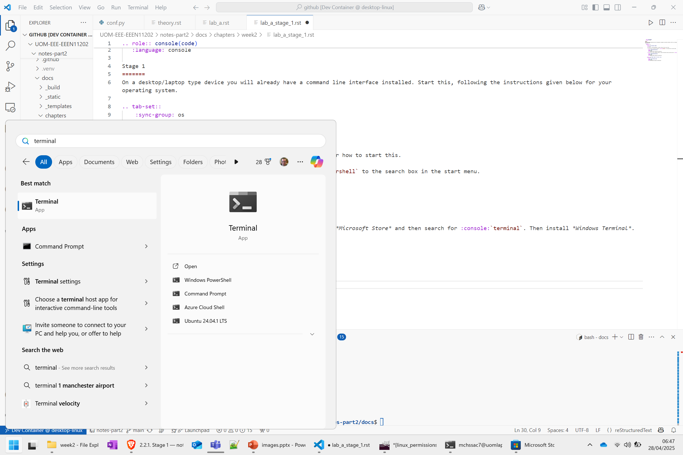

Slide 7
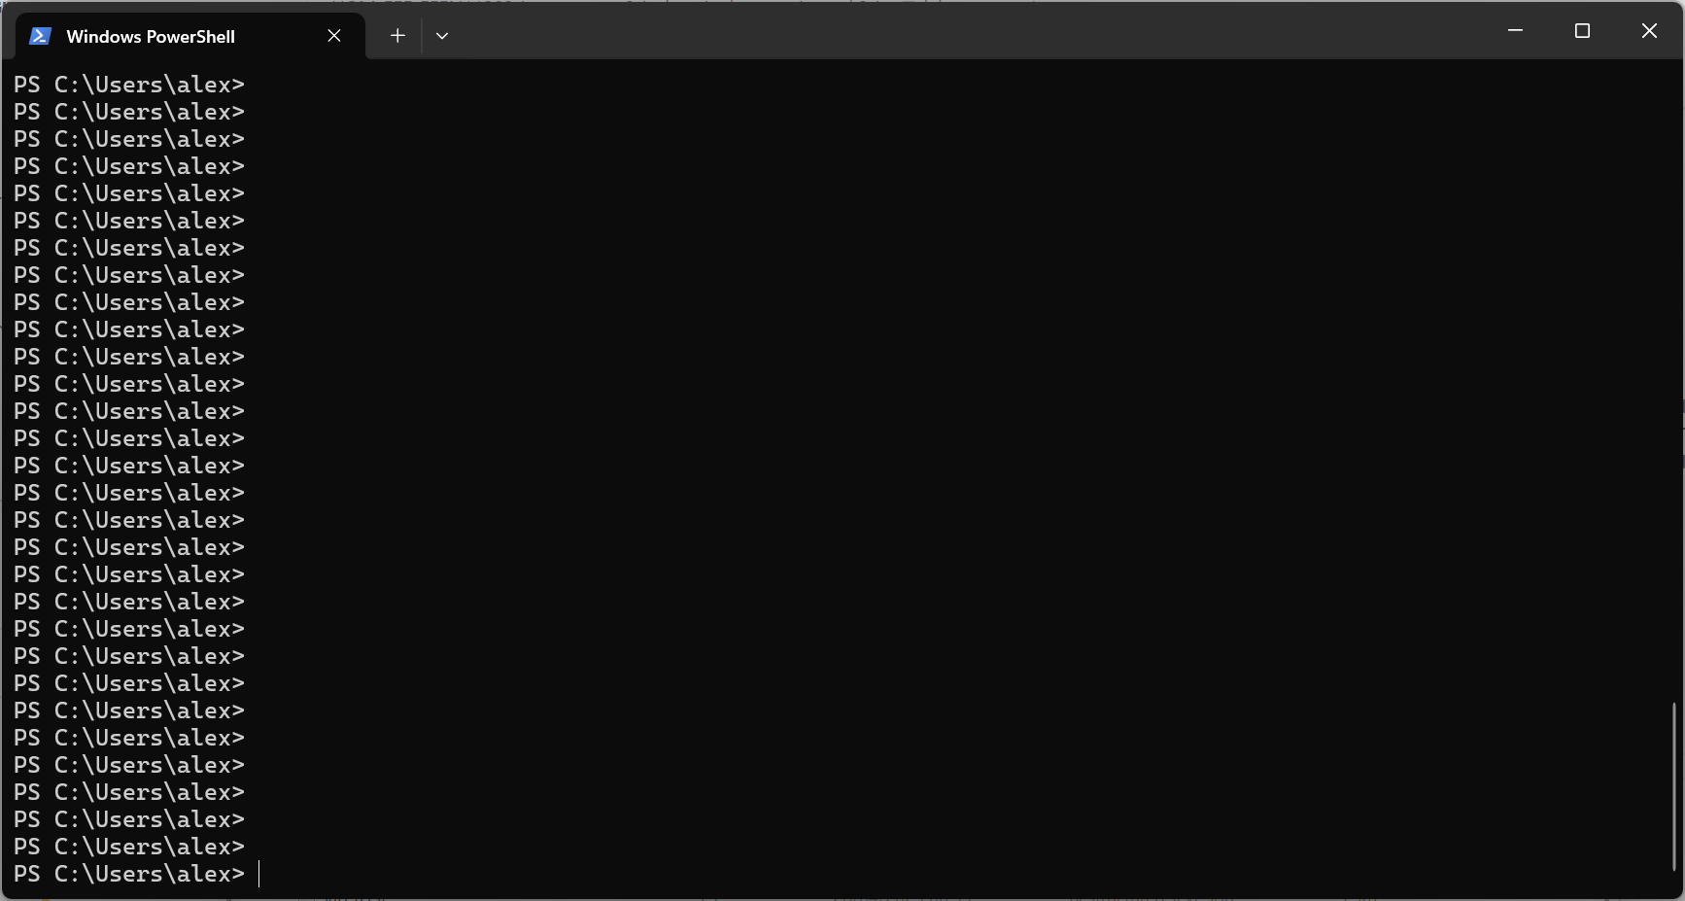
Prompt showing where to type commands

Slide 8
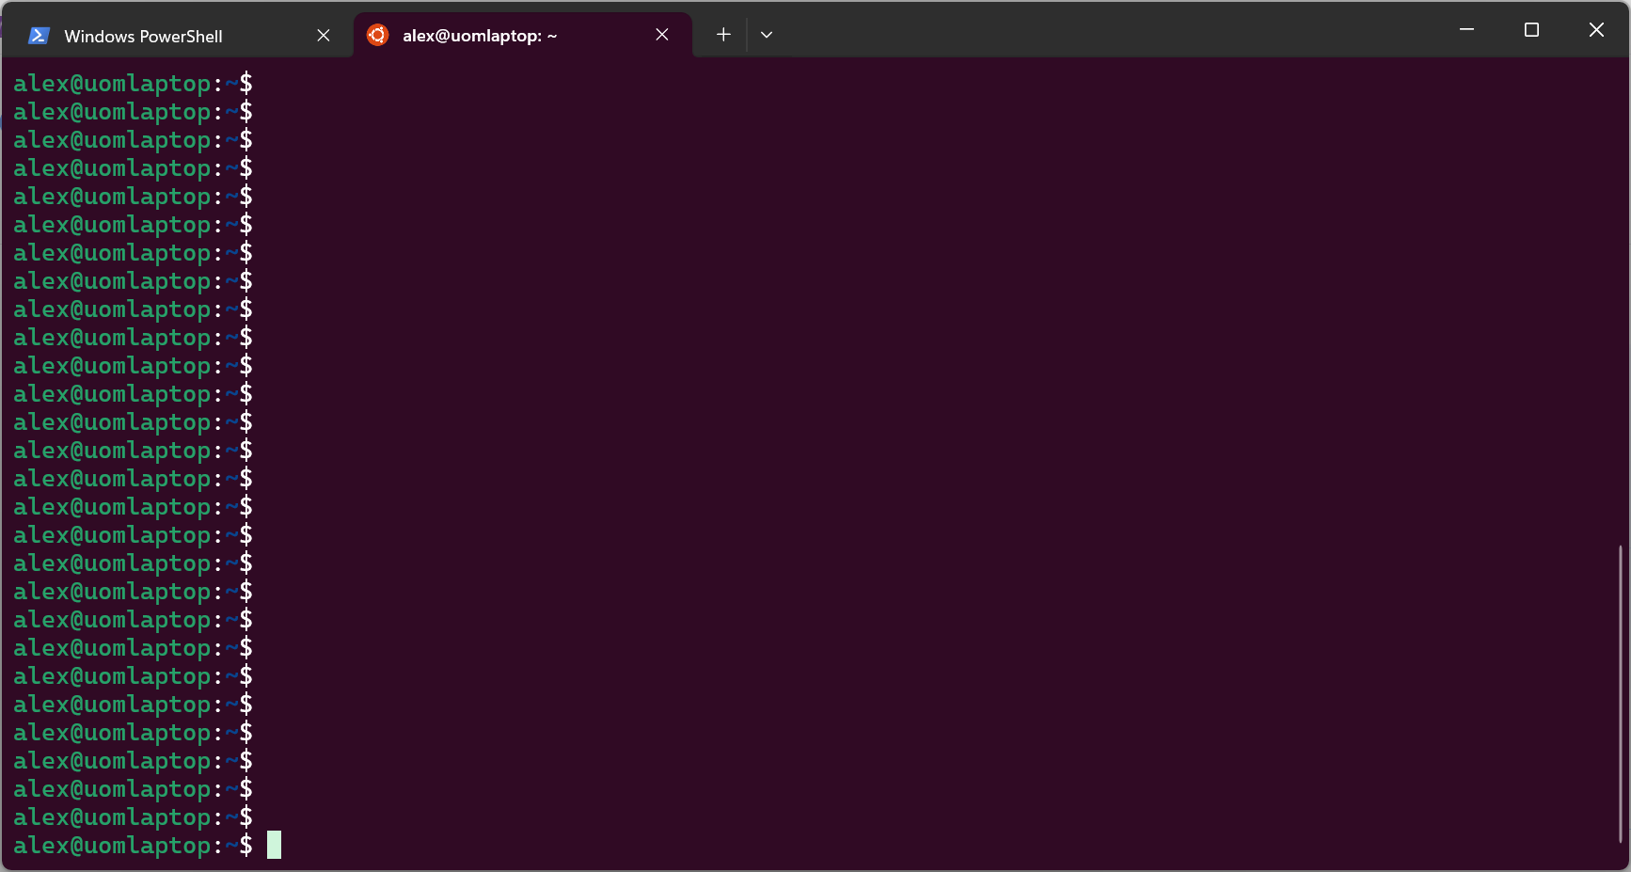
Prompt showing where to type commands

Slide 9
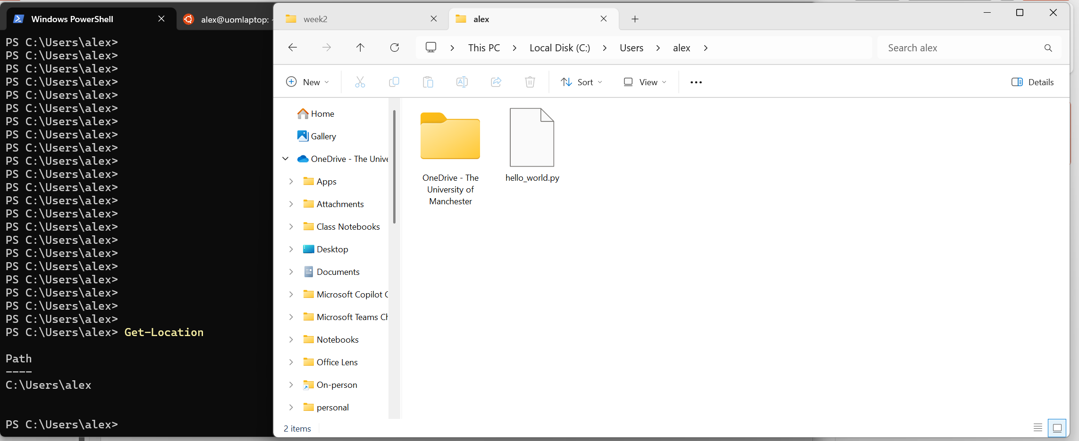
Same location shown graphically in the File Explorer
Command input
Command output
Next prompt

Slide 10
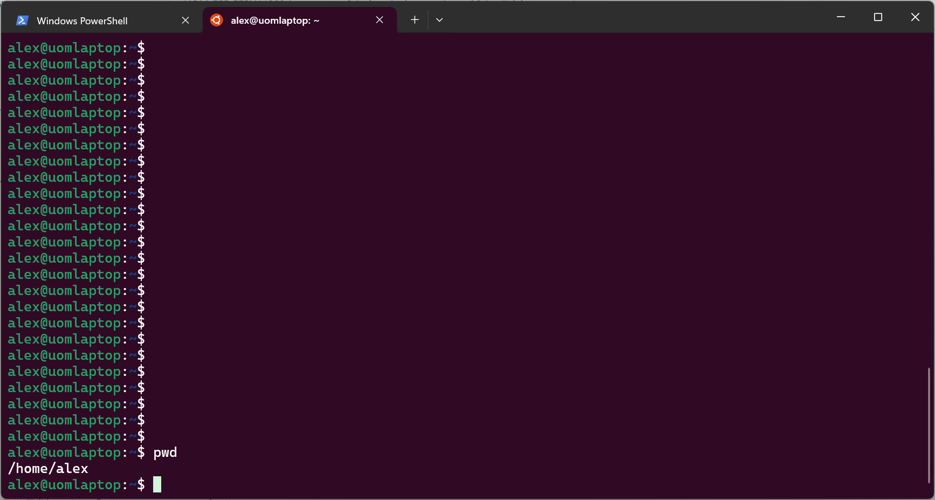
Command input
Command output

Slide 11
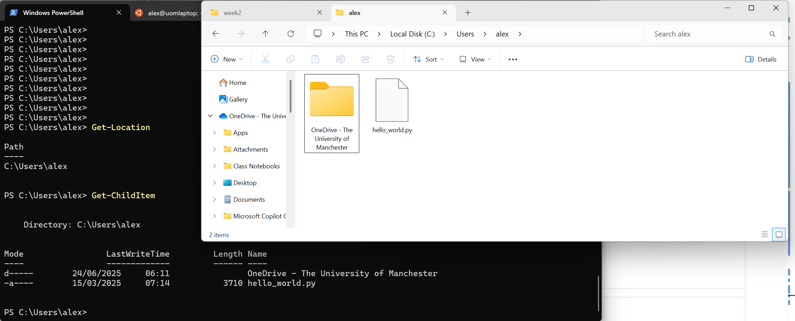
Same files shown graphically in the File Explorer
Command input
Command output

Slide 12
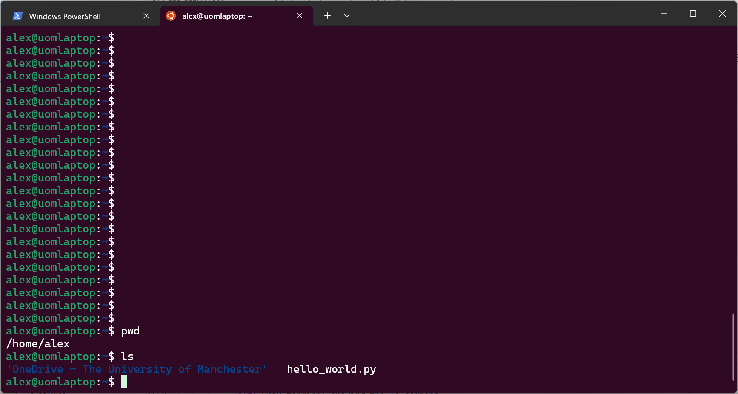
Command input
Command output

