Slide 1
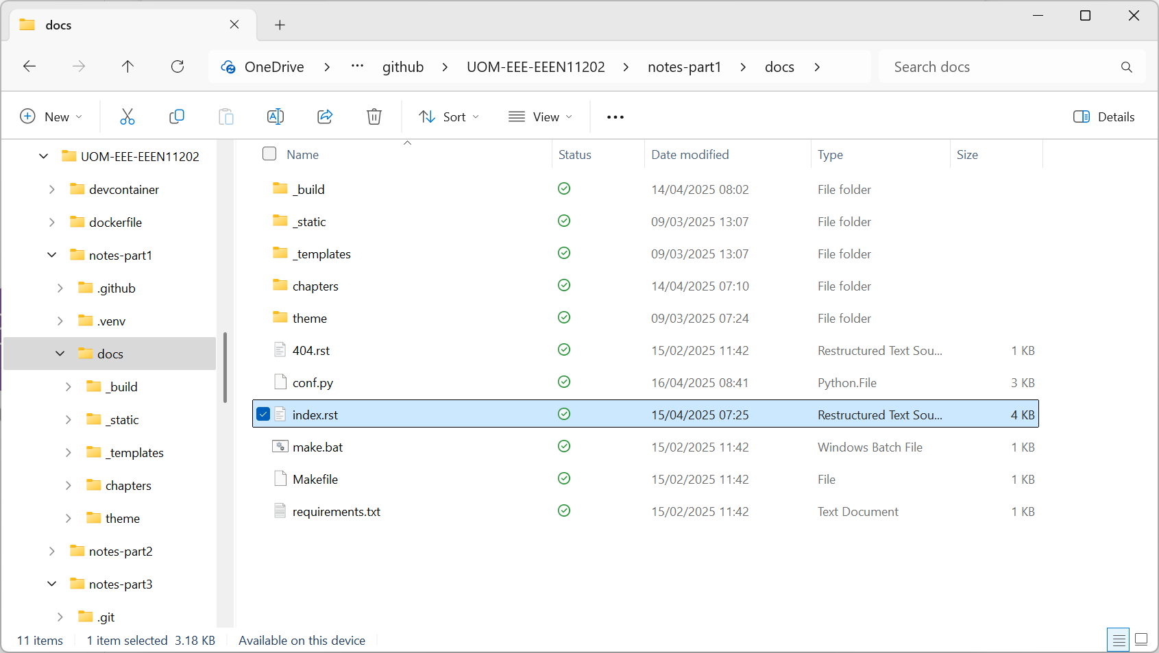
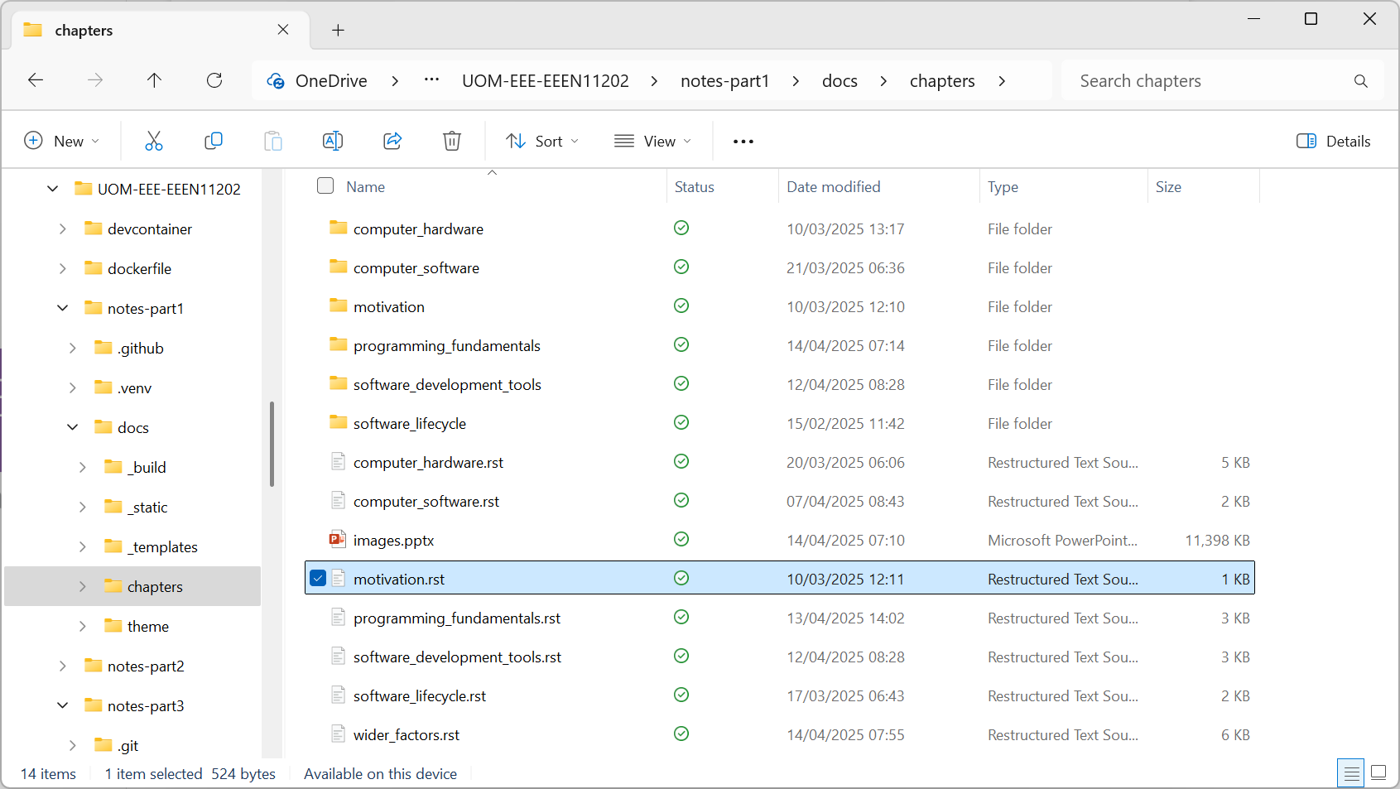

Slide 2
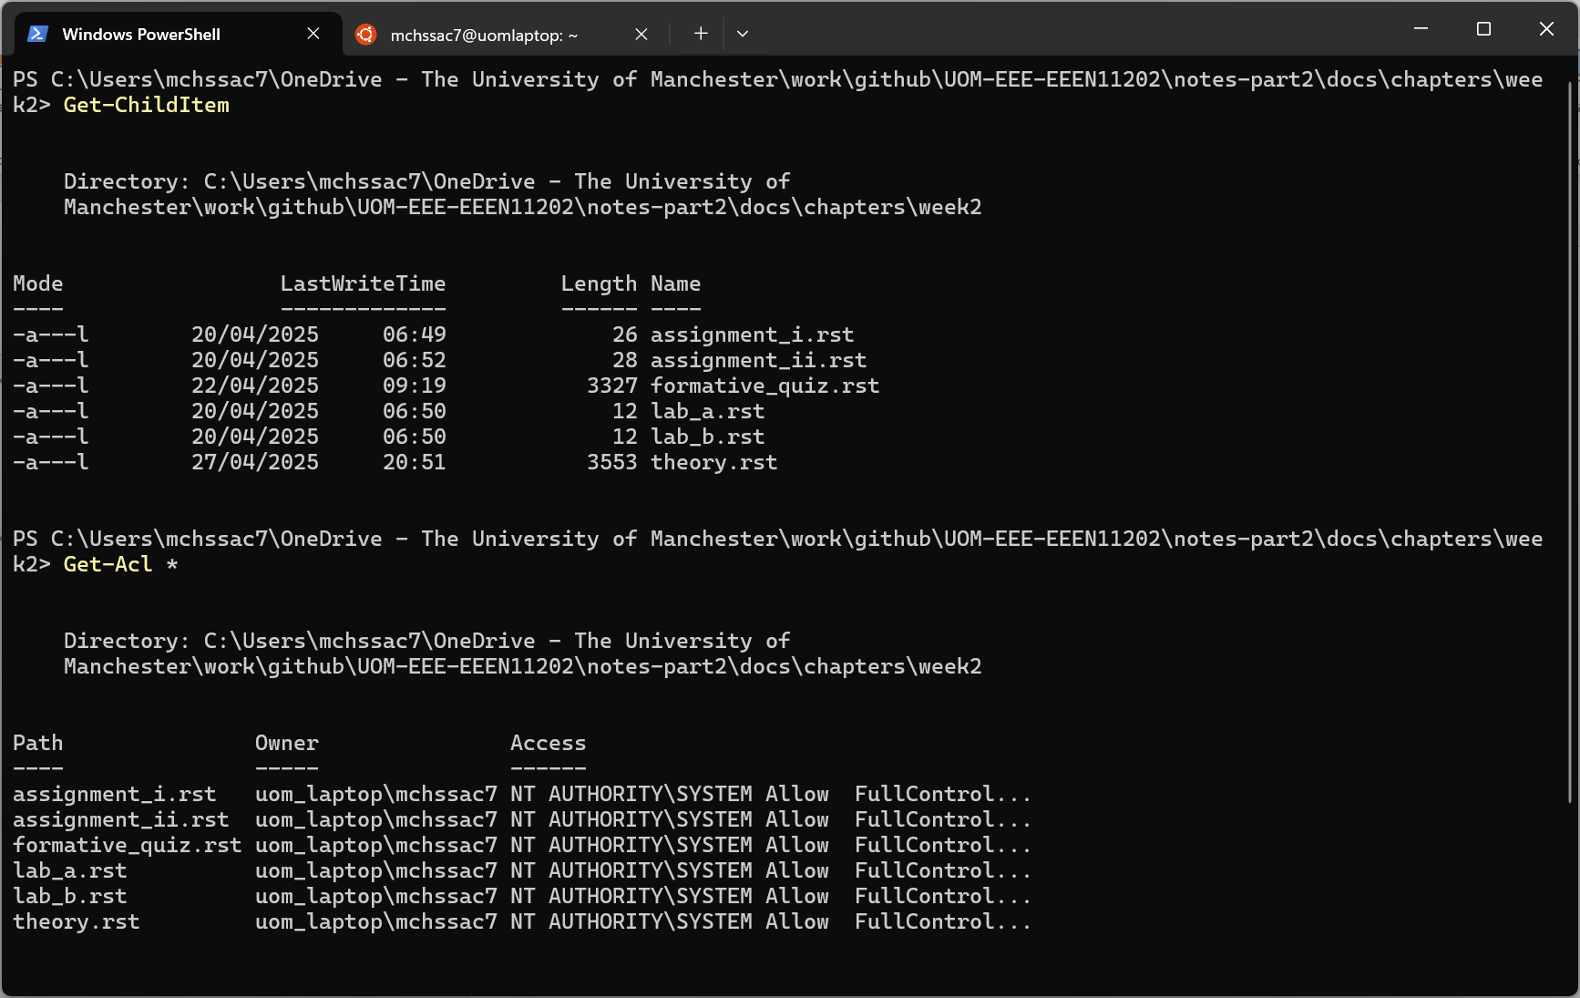
Command to display files in this folder
File names displayed
Command to display files permissions
Security permissions. Syntax is not important here

Slide 3
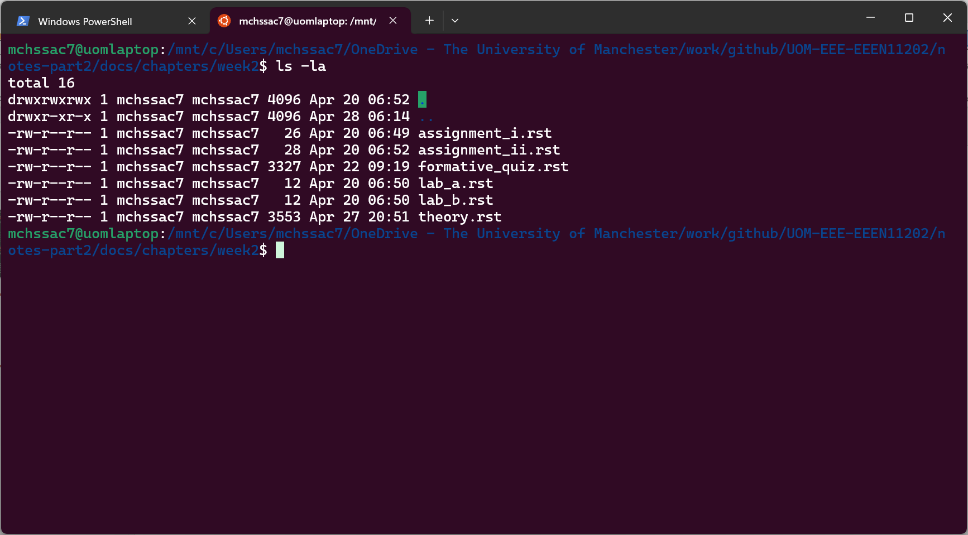
Command to display files in this folder
Security permissions. Syntax is not important here

Slide 4
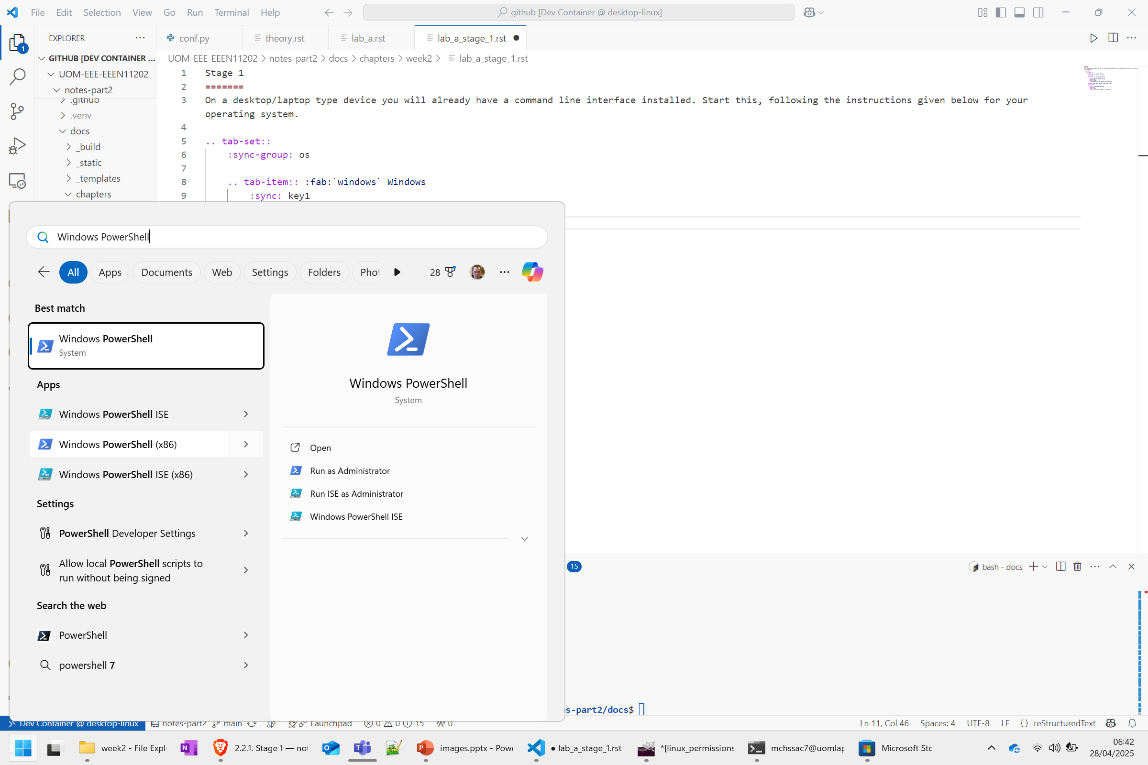

Slide 5
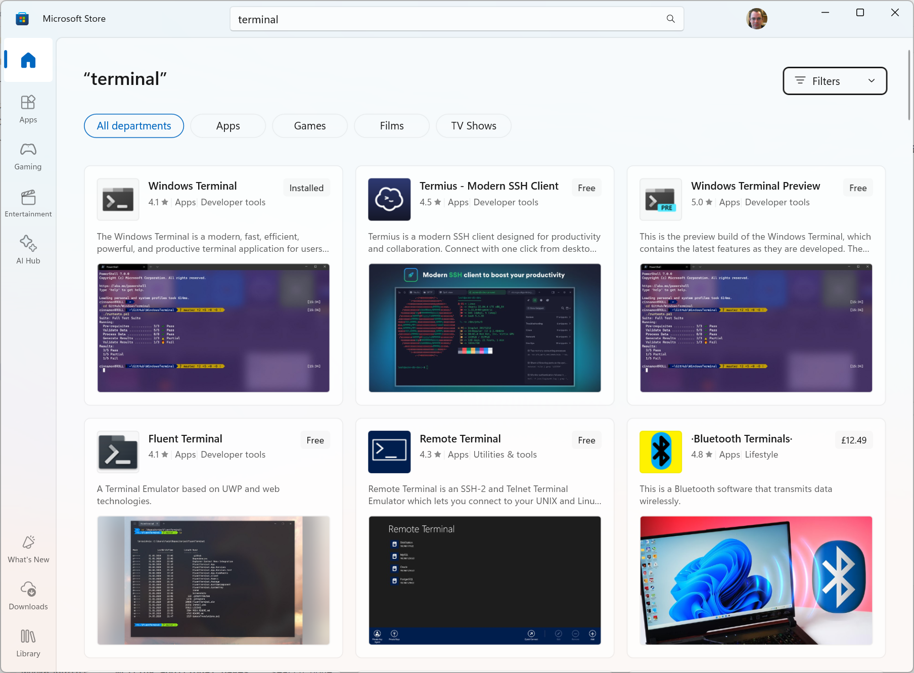

Slide 6
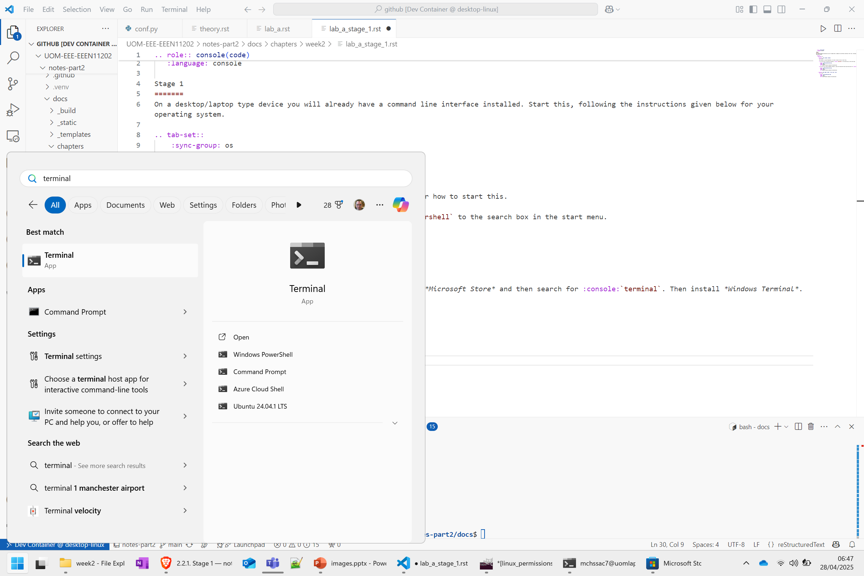

Slide 7
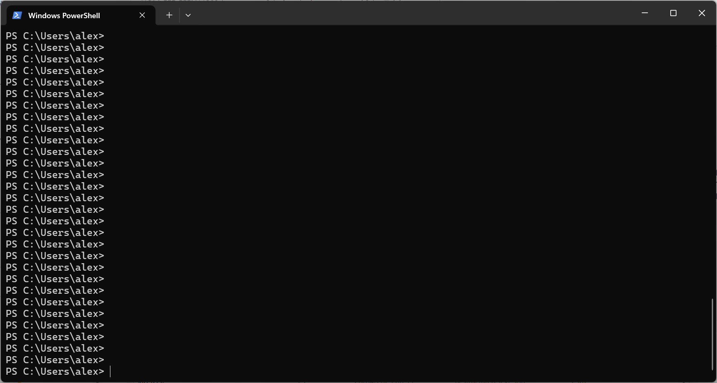
Prompt showing where to type commands

Slide 8
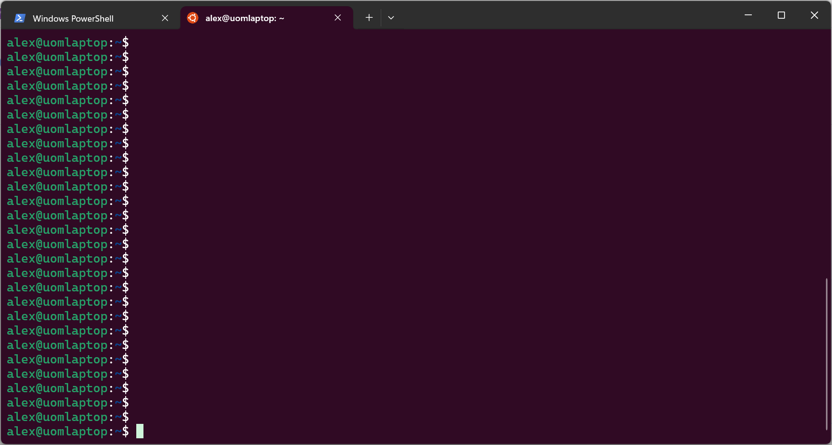
Prompt showing where to type commands

Slide 9
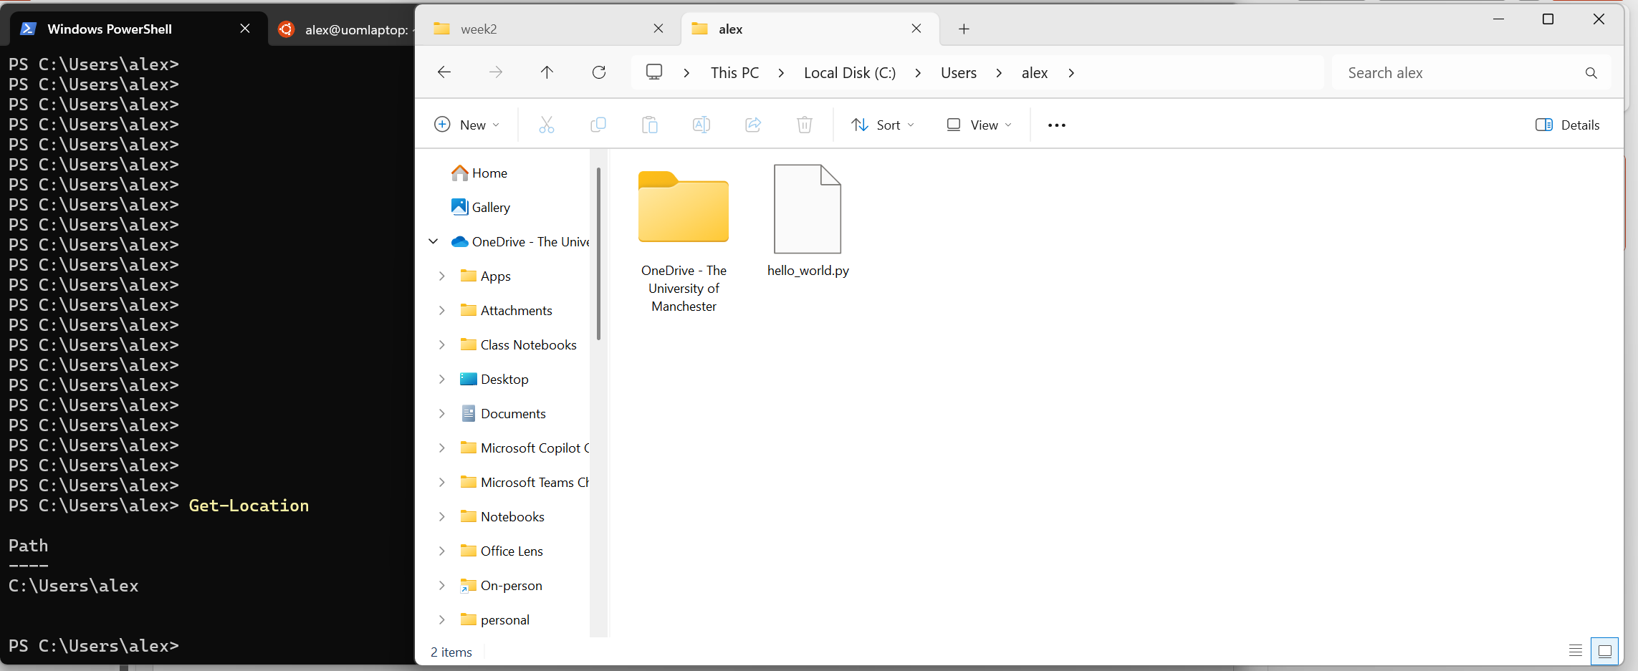
Same location shown graphically in the File Explorer
Command input
Command output
Next prompt

Slide 10
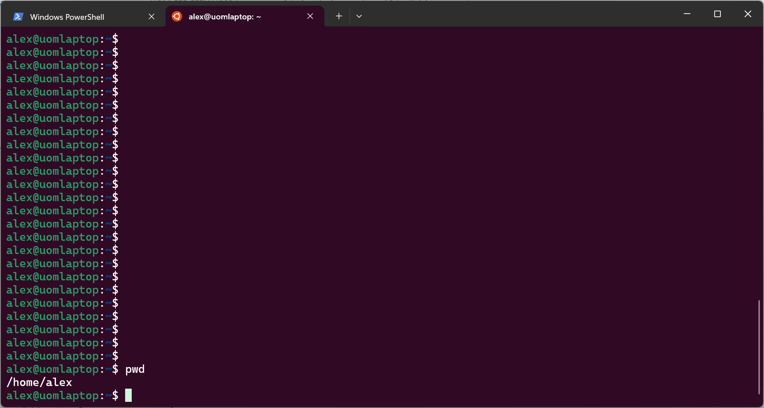
Command input
Command output

Slide 11
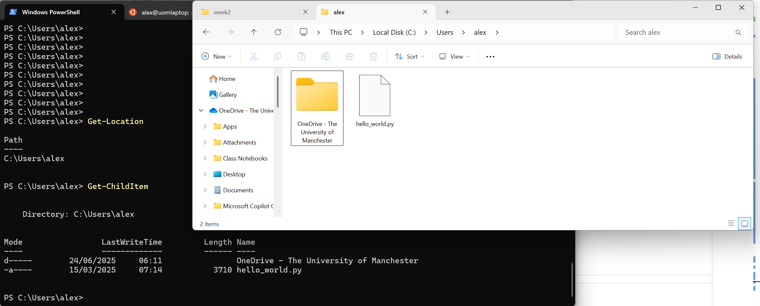
Same files shown graphically in the File Explorer
Command input
Command output

Slide 12
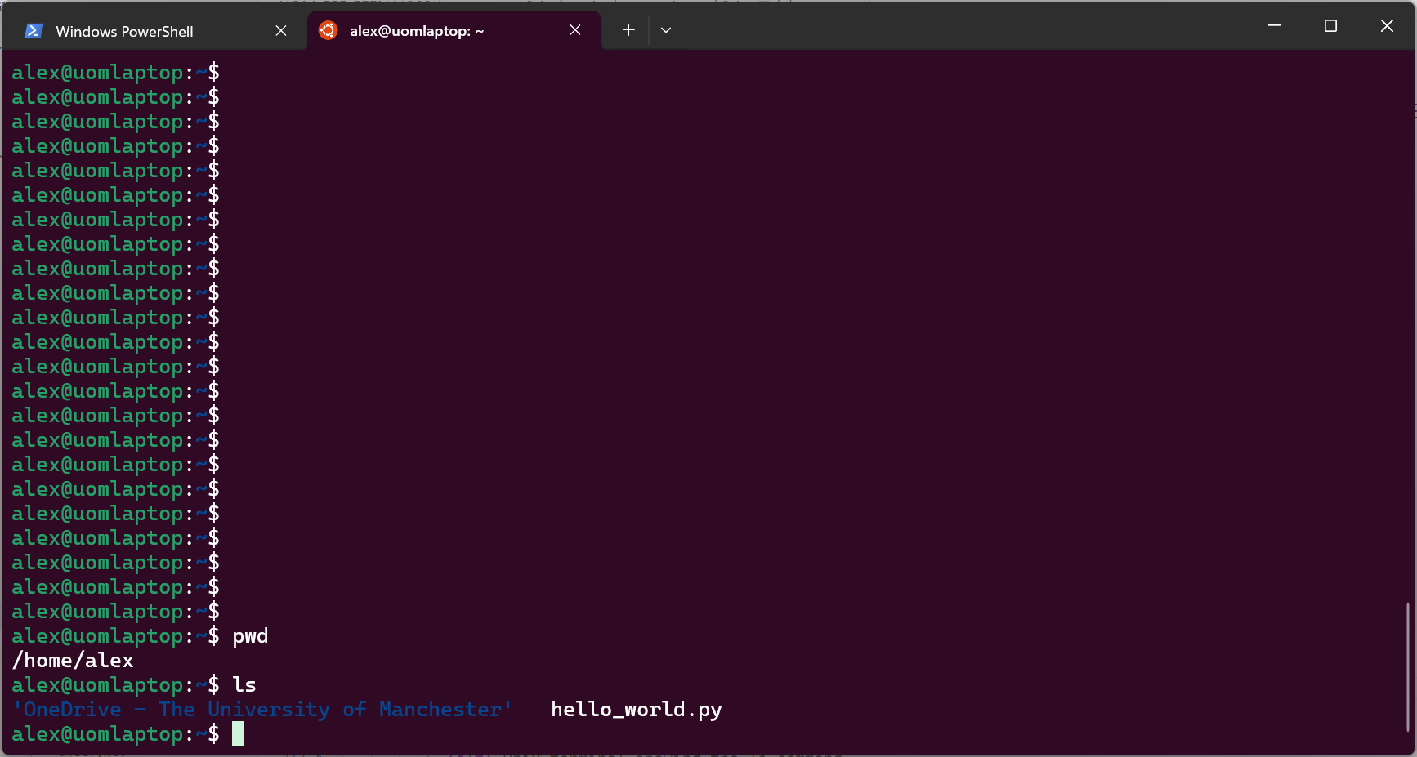
Command input
Command output

Slide 13
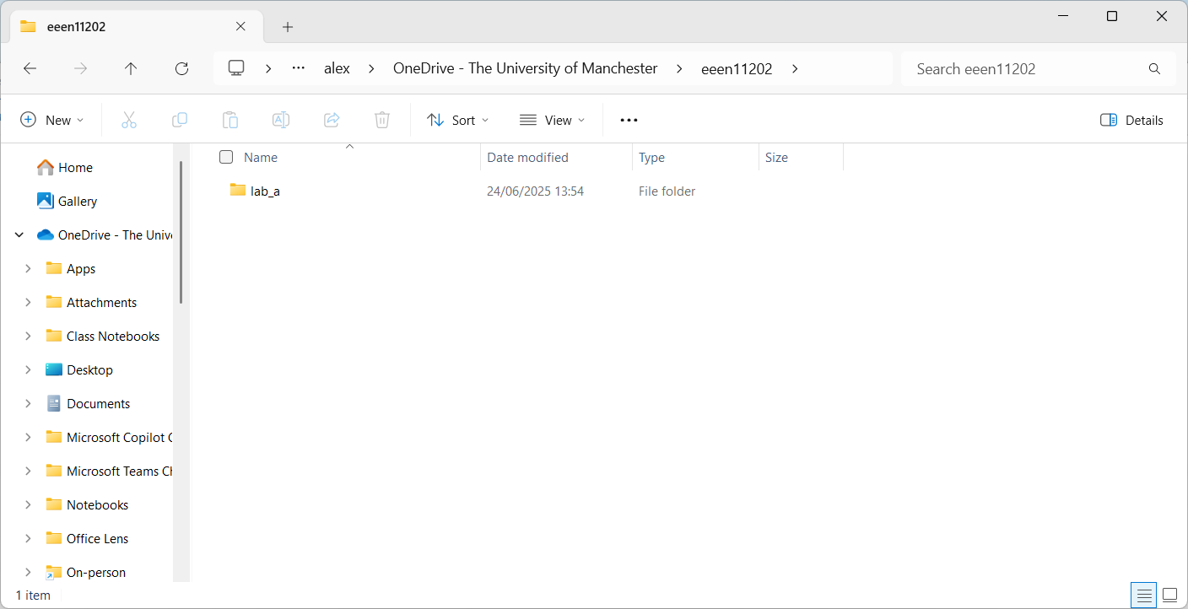

Slide 14
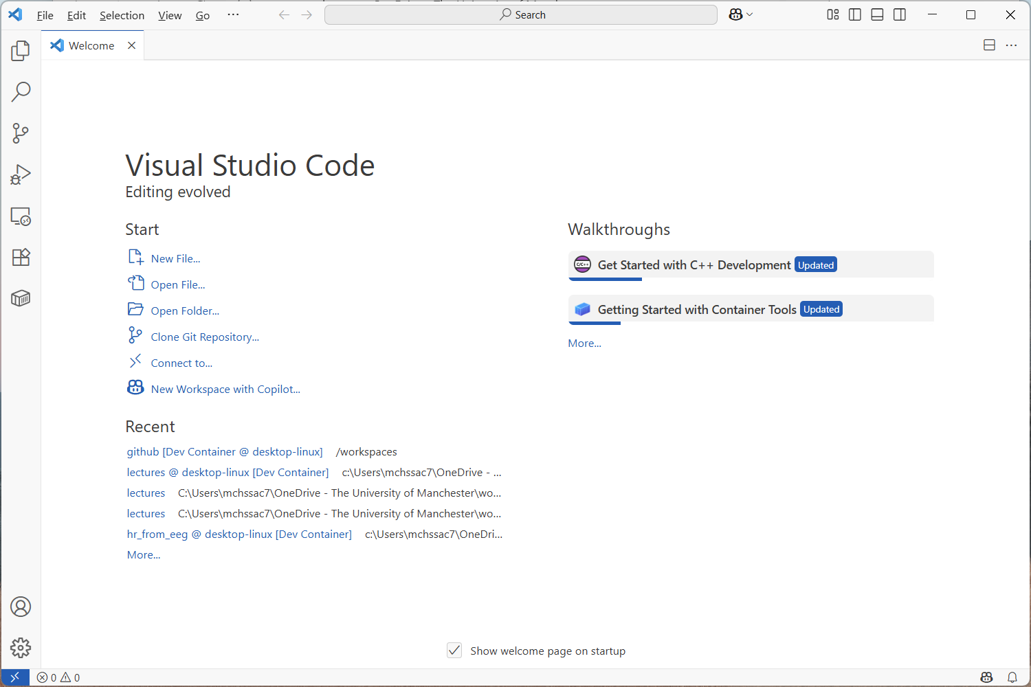

Slide 15
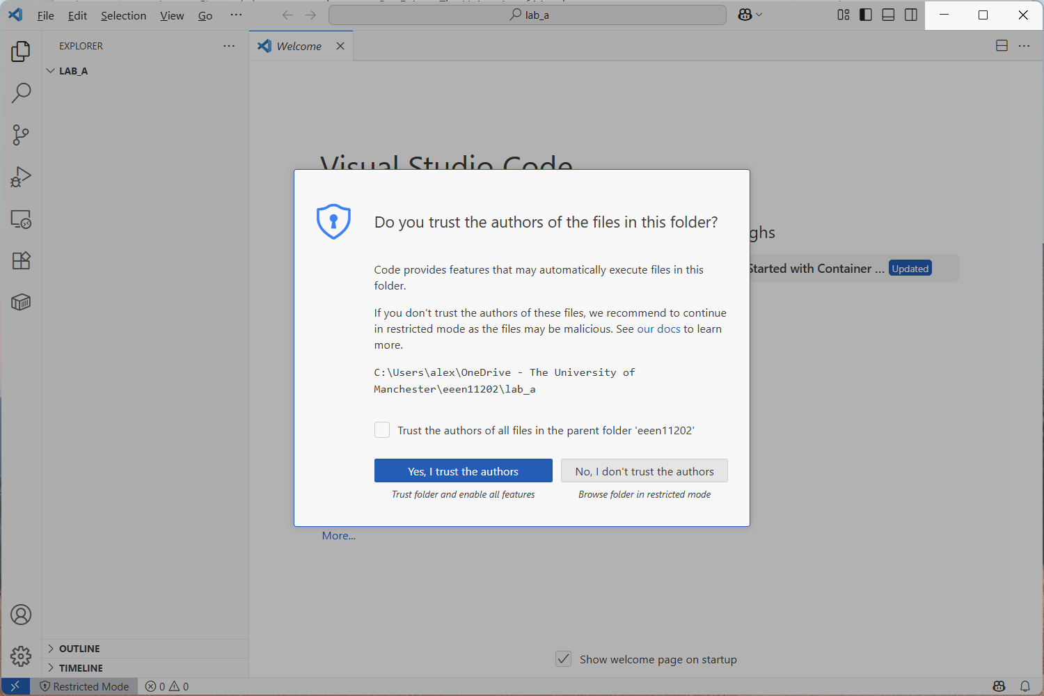

Slide 16
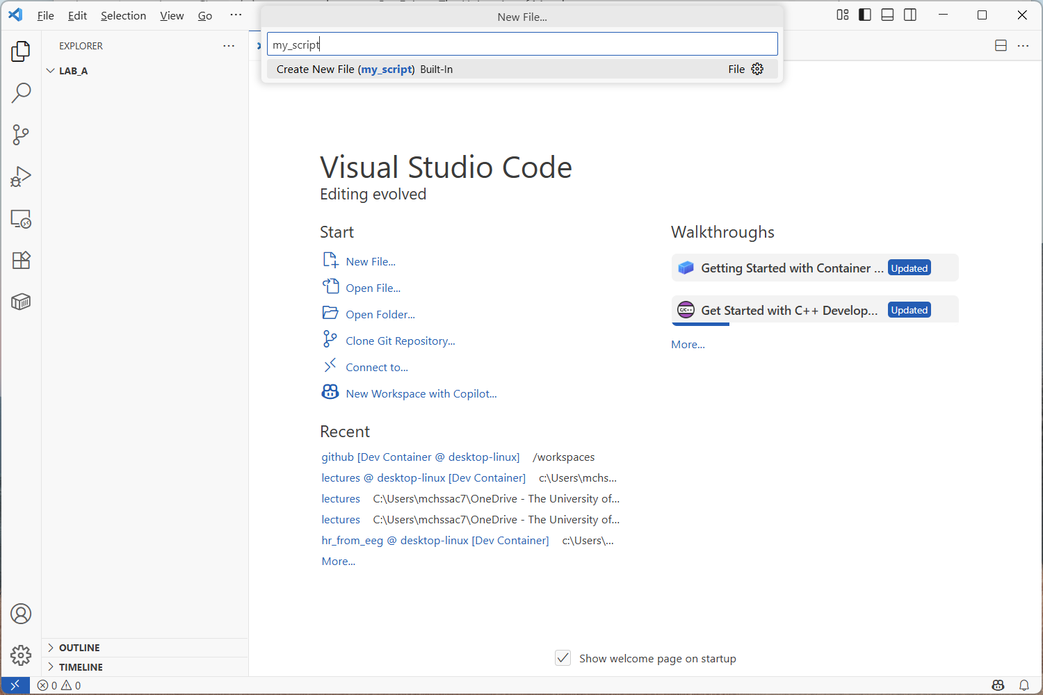
2. Enter file name here (it will appear after you click New File…)
Remember to include the extension
Name of the folder that’s been opened
Files in the folder (if any) will appear here
1. Click New File…

Slide 17
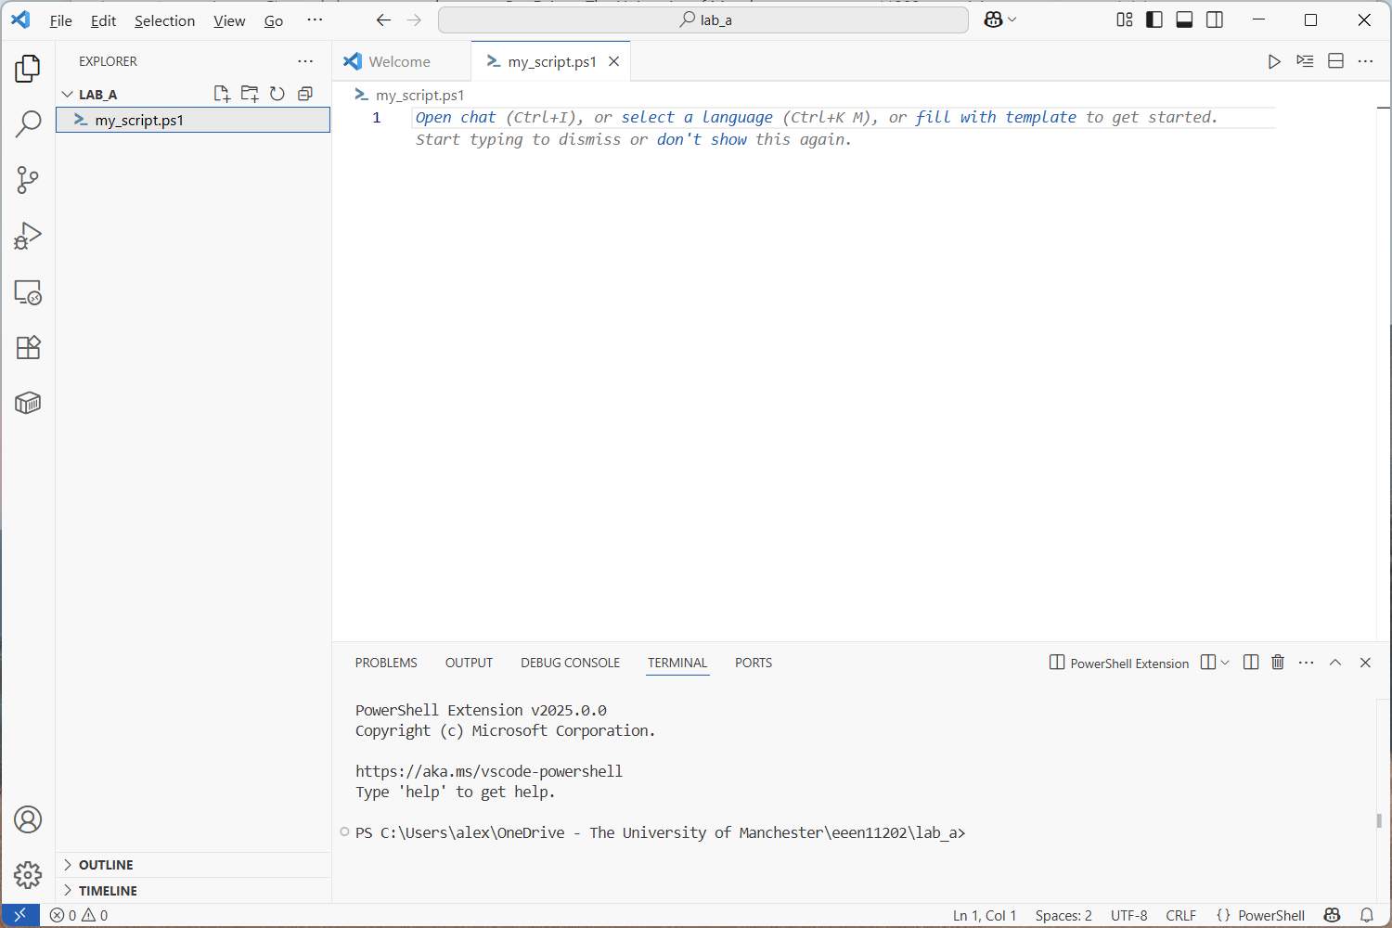
Area to start entering commands
Built in terminal prompt

