Slide 1
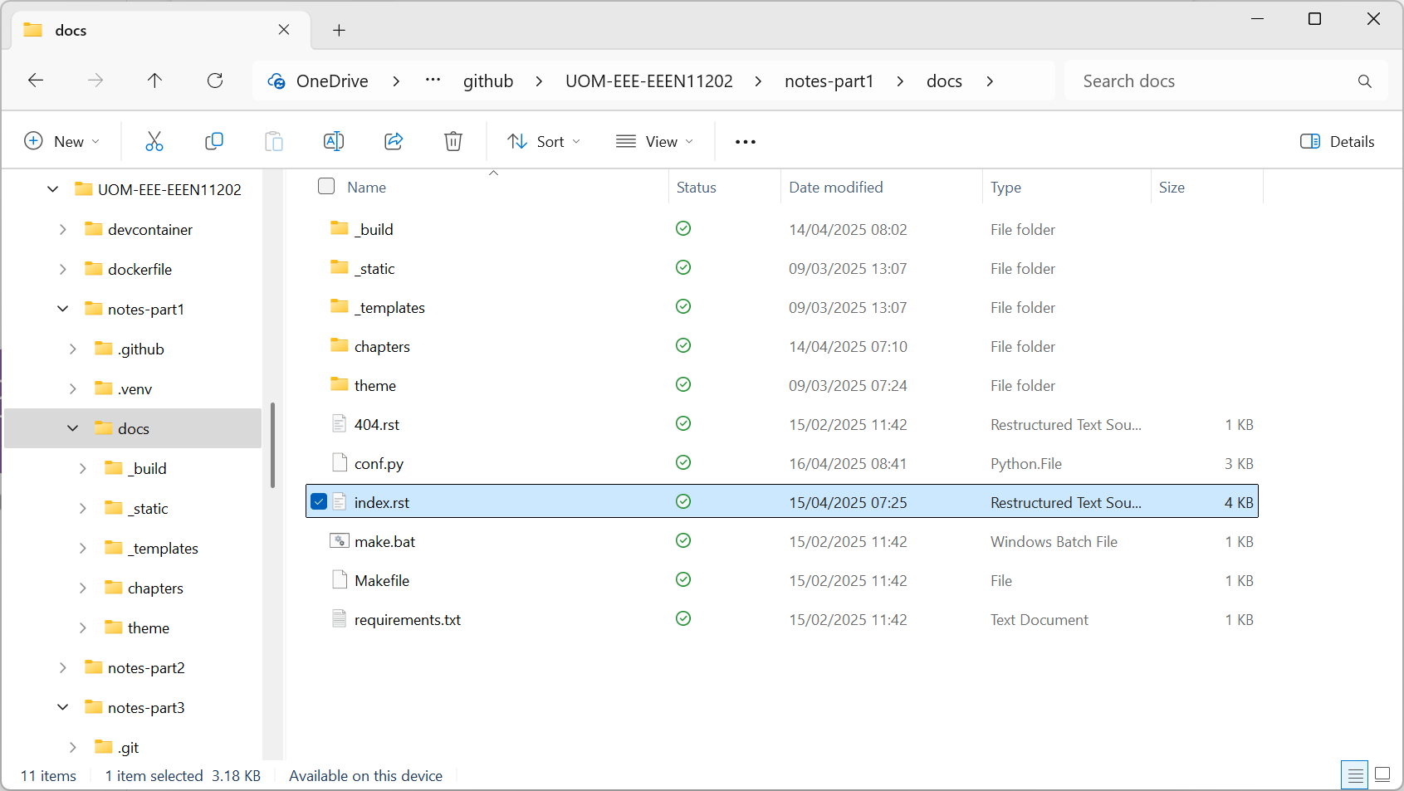
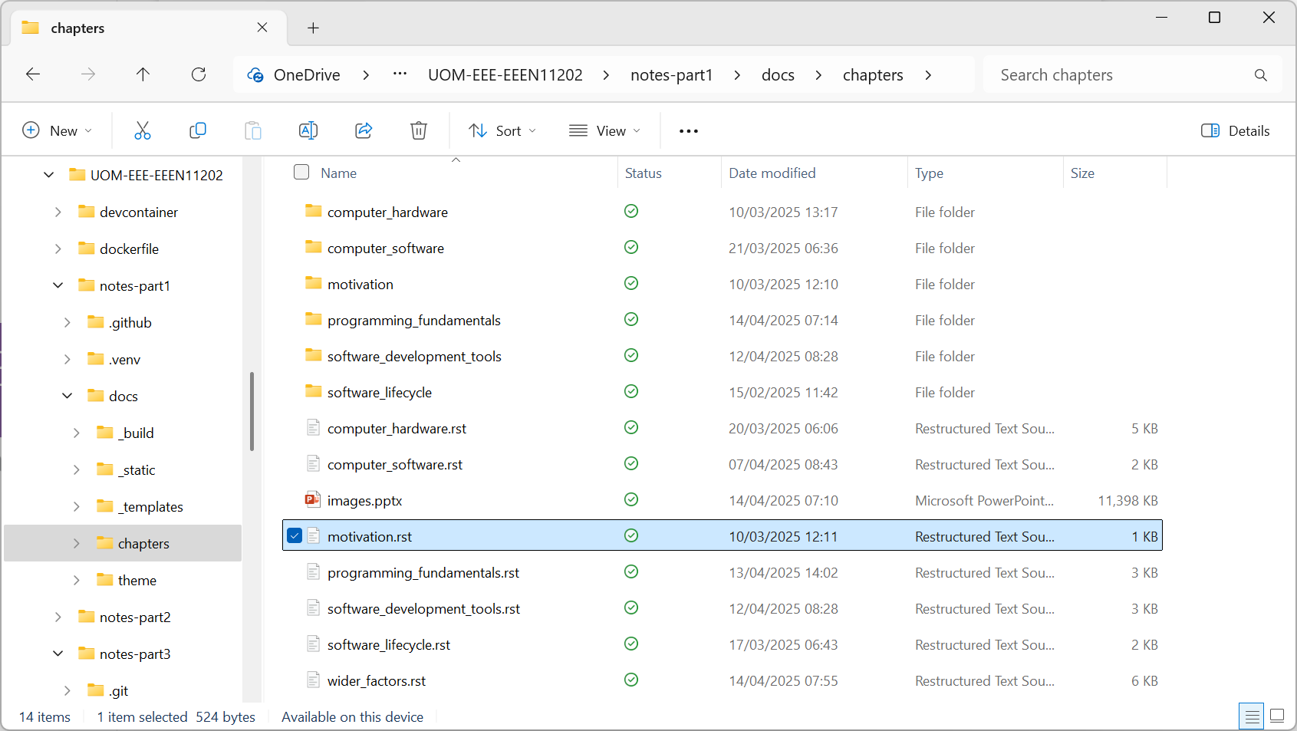

Slide 2
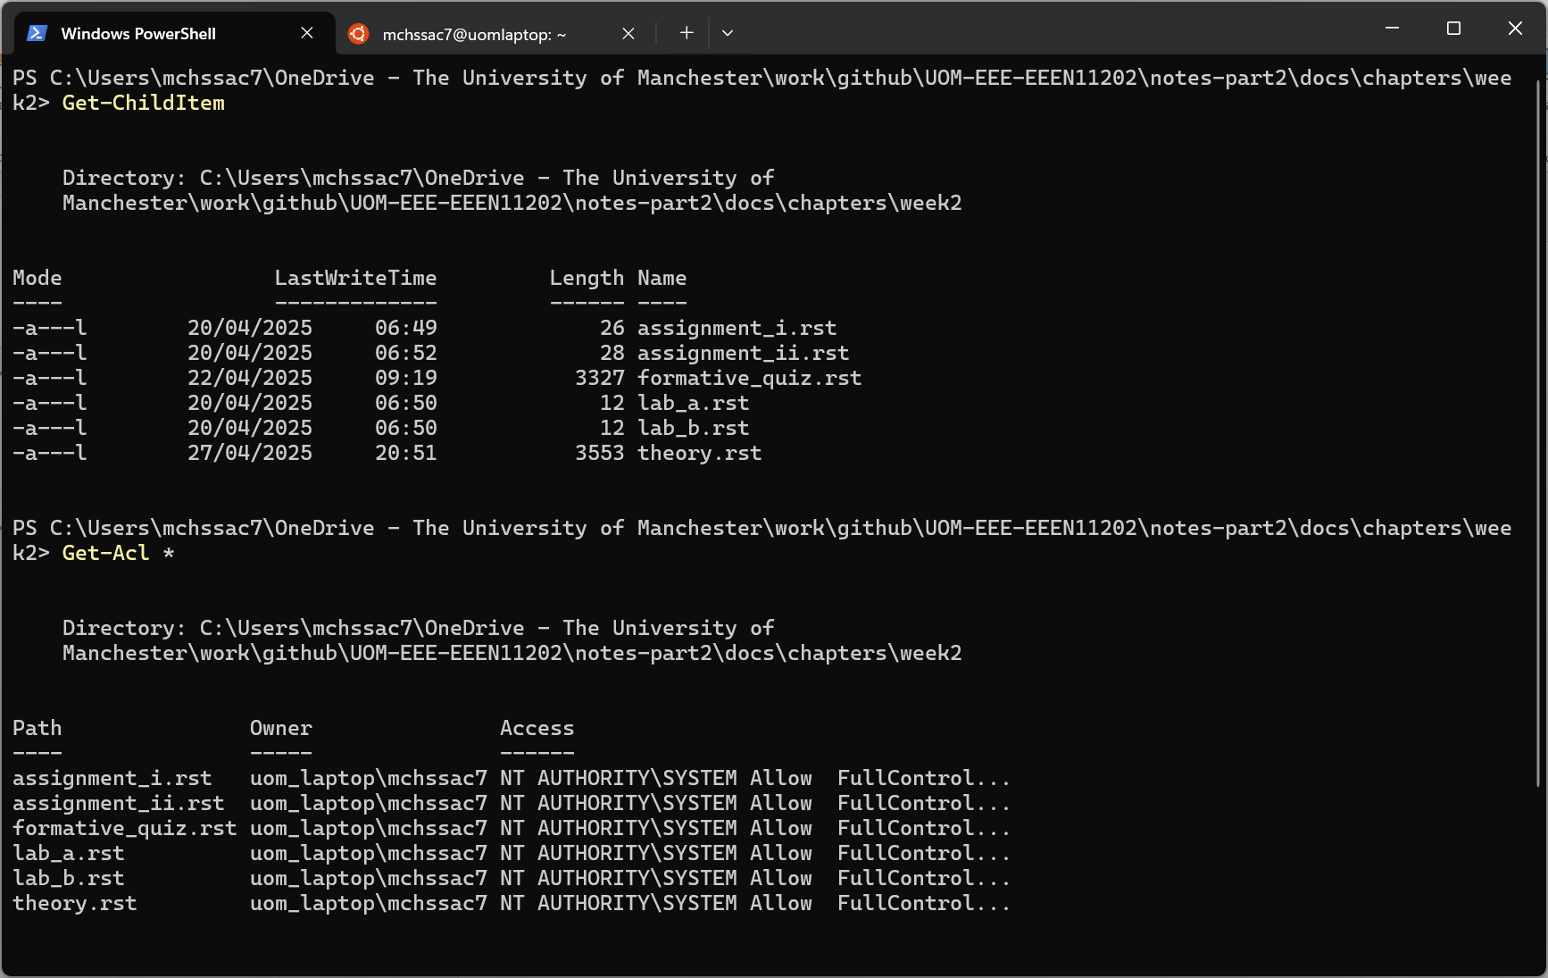
Command to display files in this folder
File names displayed
Command to display files permissions
Security permissions. Syntax is not important here

Slide 3
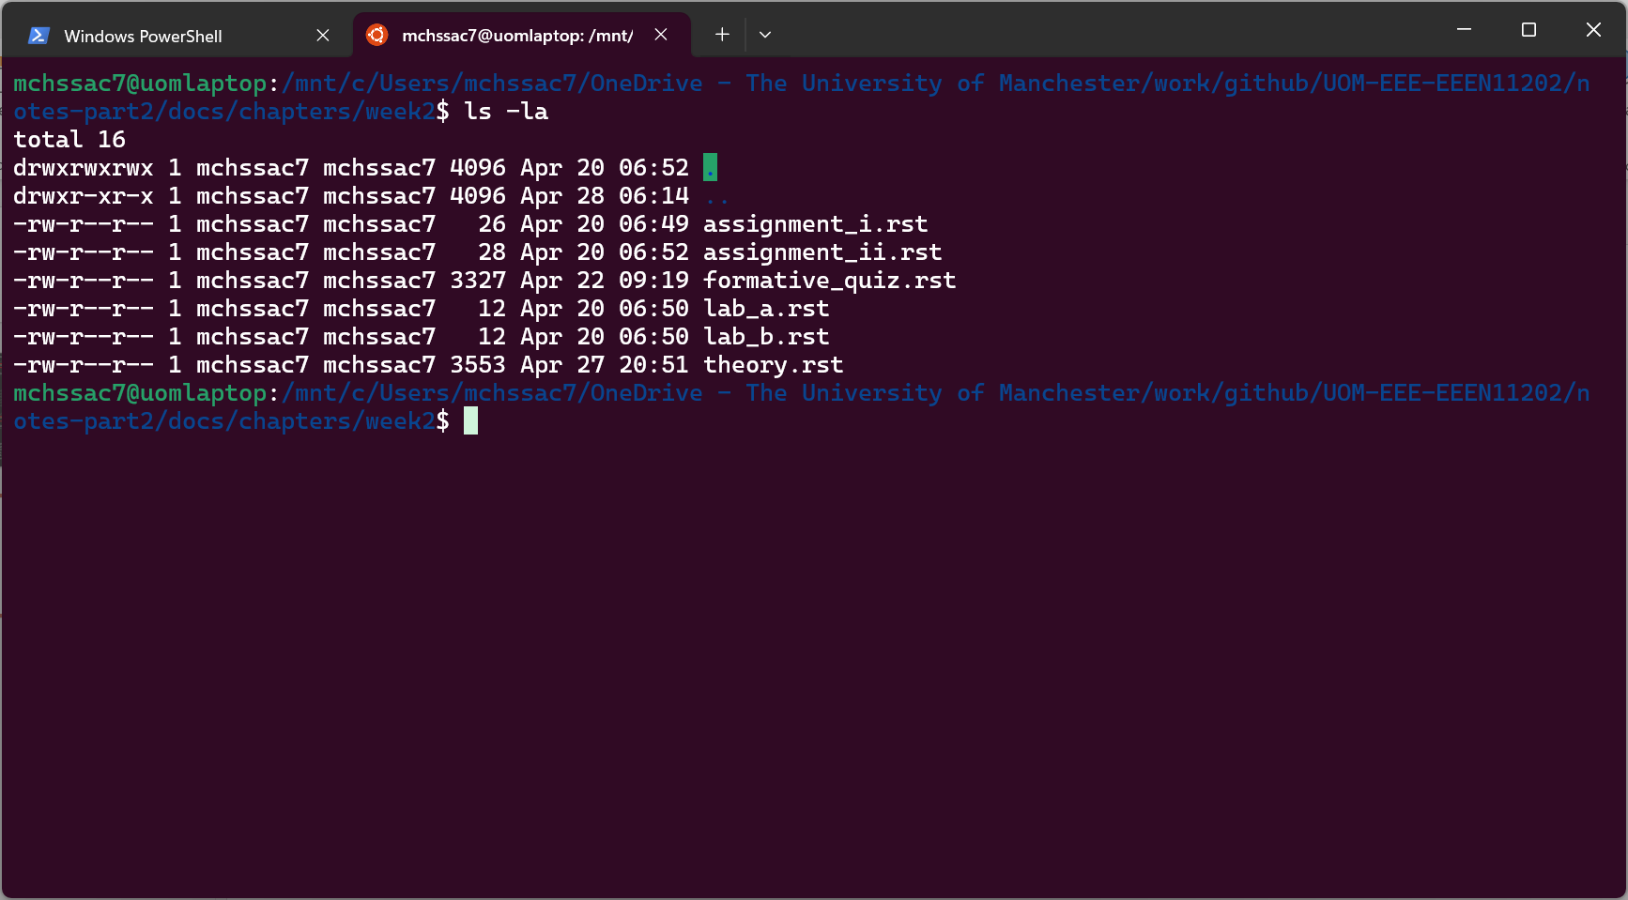
Command to display files in this folder
Security permissions. Syntax is not important here

Slide 4
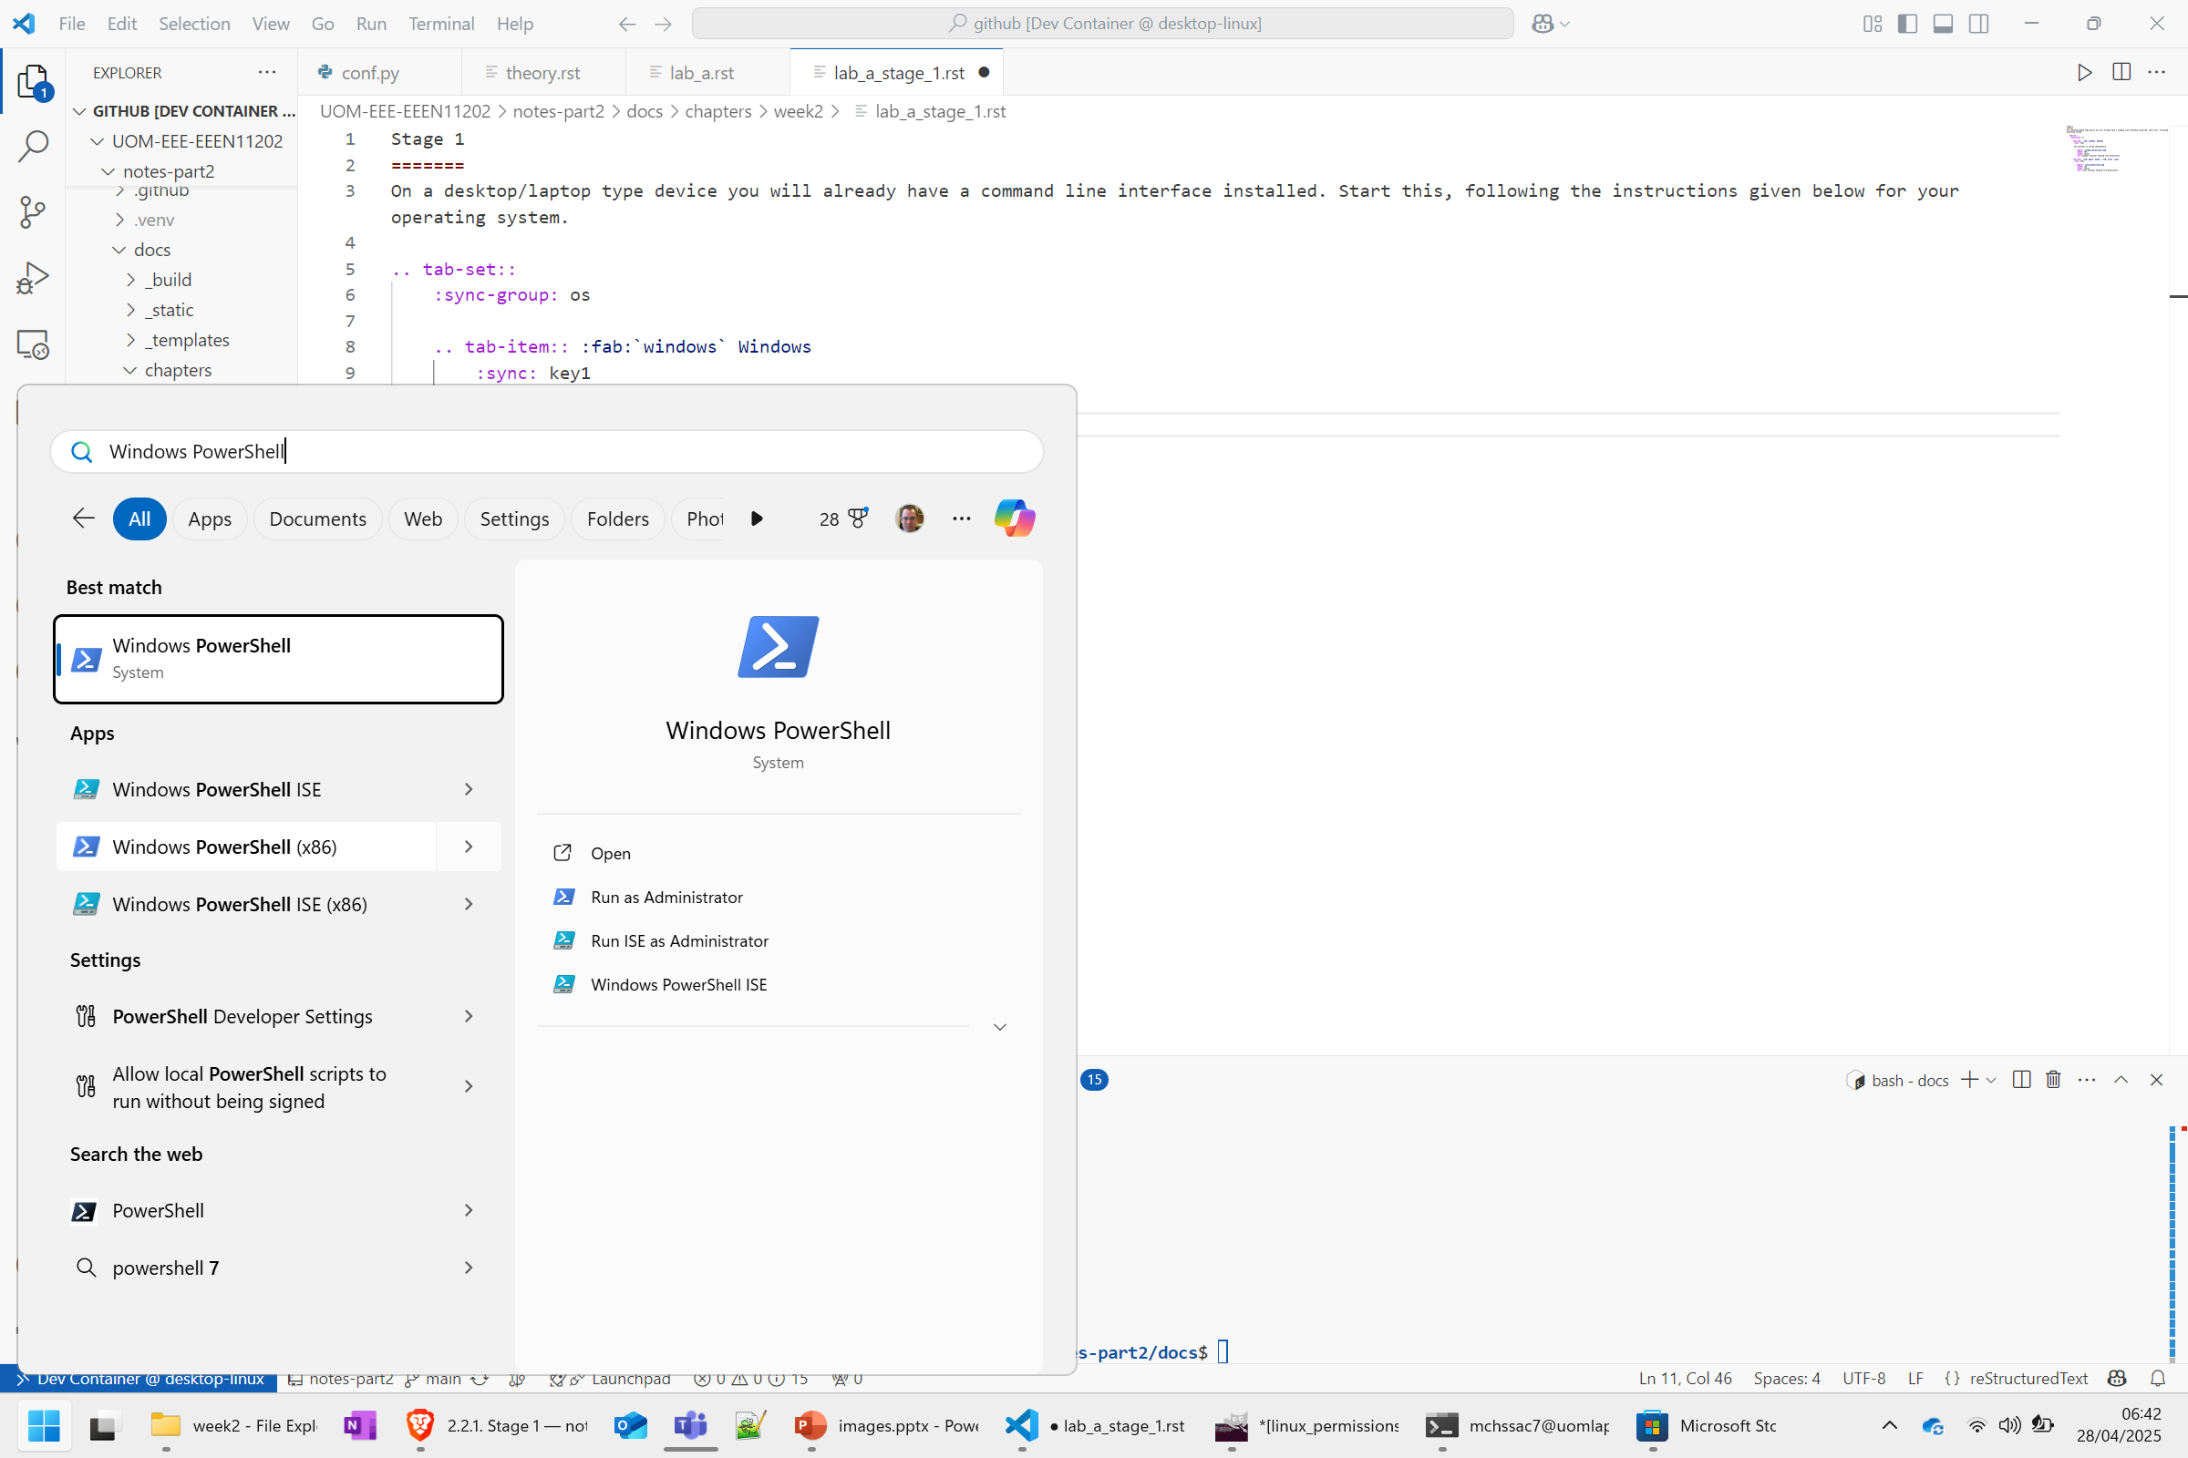

Slide 5
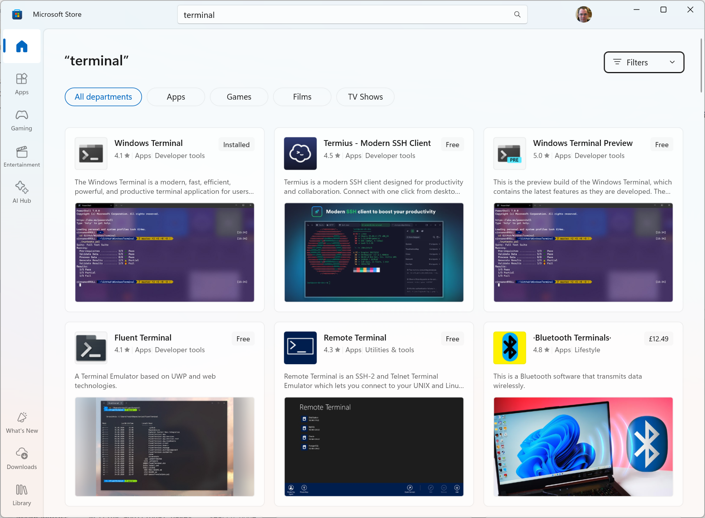

Slide 6
