Slide 1

Advanced Workshop 3: PyTorch, GPUs and Tensors

Slide 2
OVERVIEW
PyTorch Explained
Why deep learning uses GPUs
Tensors explained

Slide 3


Slide 4
Brief history
Torch – machine learning framework, based Lua language
Modularity
Torch was becoming outdated, Torch founders created a new tool based on torch called PyTorch

Slide 5
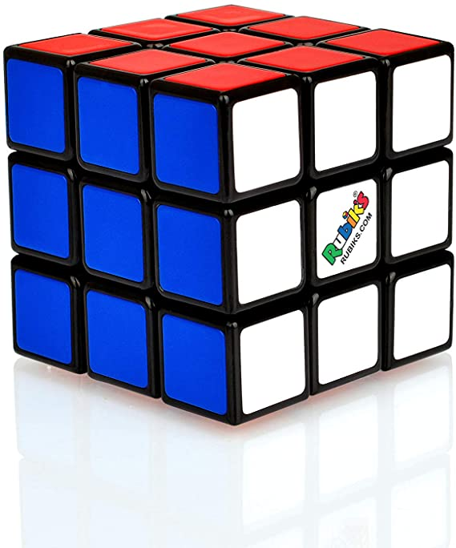
Pytorch
PyTorch: deep learning framework and a scientific computing package
Scientific computing mostly derived from PyTorch’s tensor library and operations.
A tensor is an n dimensional array
Tensors are important for DL and NNs as they are the data structures used for building and training NNs
GPU support built in
Critical functions in C/C++

Slide 6
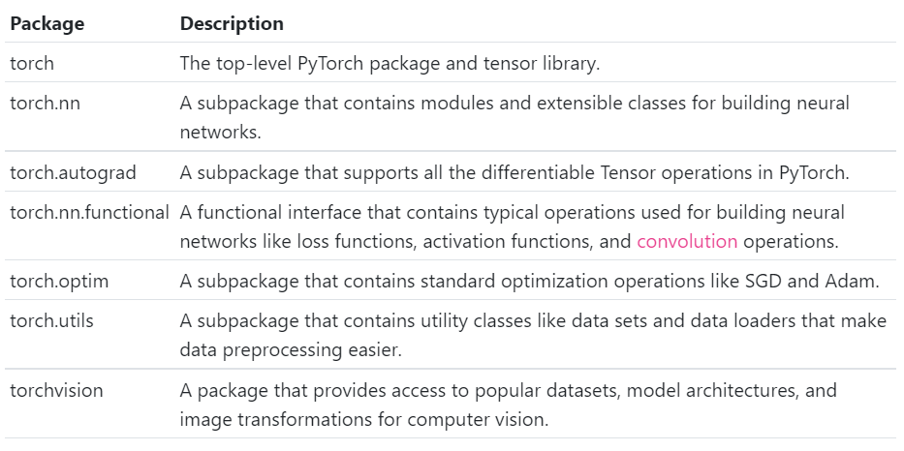
Pytorch packages
conda install pytorch torchvision torchaudio cudatoolkit=10.2 -c pytorch
Notes:
Pytorch packages
Top level contains all other pacvkages and the tensor library
Nn layers weights and forward functions
Autograd handles derivatives
Gives loss and activation functions
Optimisation alogrithims e.g. SGD
Utils data sets and loaders
Vision popular datasetrs image transofrmation

Slide 7
Why pytorch
Thin package
Building NN from scratch
Deeper understanding of NNs
Designed to be an extension of python, so is easy to debug

Slide 8
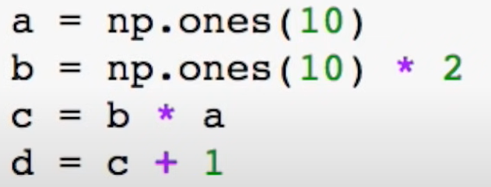
Programming
Imperative programming: performs computation as you perform it
Symbolic programming: creates adds to a computation graph at each operation. Computation happens at the last step of the code
Notes:
Symbolic more efficient as memory can be reused
Imperative more flexilbe print in the middle of computation and loops inn computation

Slide 9
Computational graphs
Tensor flow: first assembles a graph the uses session to execute operations in the graph
Can optimise the graph at the start, so can be more efficiently ran in parallel
Work well for feedforward NNs or convolution networks
Pytorch: adds to graph at each operation, the graph is dynamic and can change while being ran

Slide 10
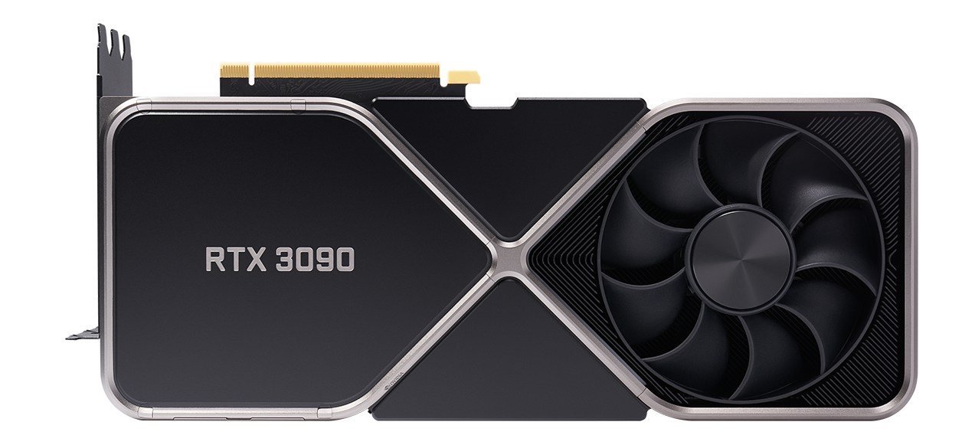

Slide 11
GPUs
Graphics processing unit
Parallel computing – broken down, smaller computations, can be carried out in parallel, then synchronised to give final result
The more cores the more parallel operations
CPUs 4-16 cores
GPUs thousands of cores (10496)
NNs are very parallel

Slide 12
convolution

Slide 13

CUDA
Software platform (API)
Pairs with their hardware
Can accelerate computation
Can download for free
PyTorch has CUDA built in
Supports multiple GPUs

Slide 14
GPU vs CPU
Only faster for specialised tasks
Moving data from CPU to GPU is costly therefore computation may be slower for a simple task
Not good for breaking down small tasks to even smaller tasks

Slide 16
Tensor
A tensor is an n dimensional array
Primary data structure
Represents inputs, outputs and transformations
Computer science | Mathematics | Indexes required
Number | Scalar | 0
Array | Vector | 1
2d-array | matric | 2
nd-array | nd-tensor | n

Slide 17


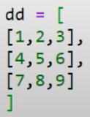

Tensor examples

Slide 18
Rank, axes and shape
Rank: refers to number of dimension (number of axes)
Axis: specific dimension of a tensor
Axis length: how many indexes are available along each axis
Shape: length of each axis of a tensor
dd = [
[1,2,3],
[4,5,6],
[7,8,9]
]

Slide 19
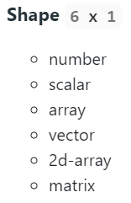
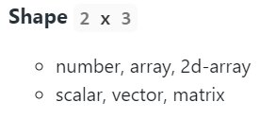
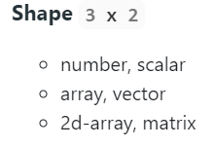

Slide 20
import torch
from torch.autograd import Variable
dtype = torch.FloatTensor
N, D_in, H, D_out = 64, 1000, 100, 10
x = Variable(torch.randn(N, D_in).type(dtype), requires_grad=False)
y = Variable(torch.randn(N, D_out).type(dtype), requires_grad=False)
w1 = Variable(torch.randn(D_in, H).type(dtype), requires_grad=True)
w2 = Variable(torch.randn(H, D_out).type(dtype), requires_grad=True)
learning_rate = 1e-6
for t in range(500):
y_pred = x.mm(w1).clamp(min=0).mm(w2)
loss = (y_pred - y).pow(2).sum()
print(t, loss.data[0])
loss.backward()
w1.data -= learning_rate * w1.grad.data
w2.data -= learning_rate * w2.grad.data
w1.grad.data.zero_()
w2.grad.data.zero_()

