Slide 1

Announcements Wednesday 27th October 2021

Slide 2
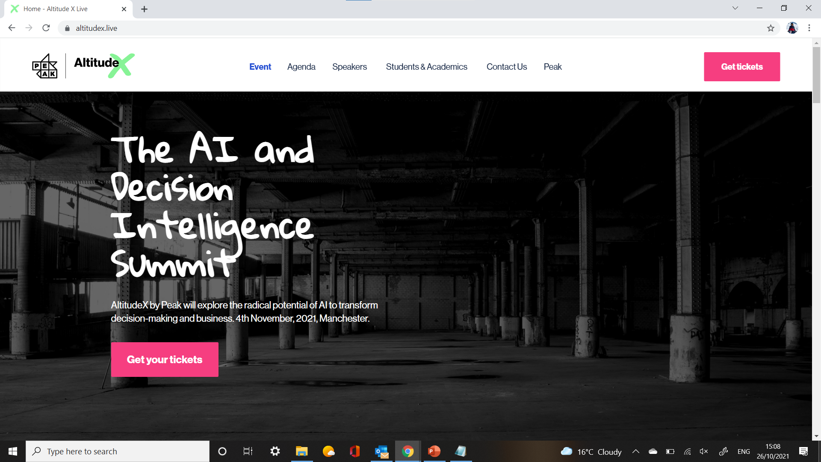
1. altitude x: all-day data science conference

Slide 3

1. altitude x: all-day data science conference

Slide 4

2. how can we improve our workshops?
Your feedback here →

Slide 5

3. invitation to bright network

Slide 6
Data Science in Business: SQL

Slide 7
OVERVIEW
SQL: A Brief History
Tables and Relational Databases
Code Review:
Creating, editing and deleting tables in SQL
Ways to join multiple tables
Other cool statements
Connections to Python

Slide 8
definition
SQL (Structured Query Language) is a programming language used to interact with relational databases.

Slide 9
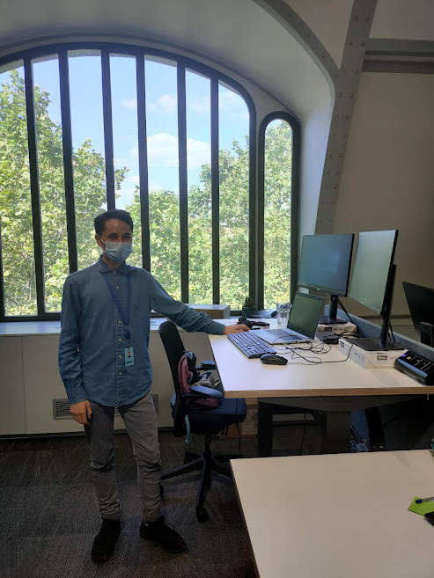

Slide 10
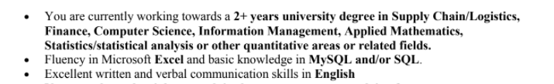

Slide 11
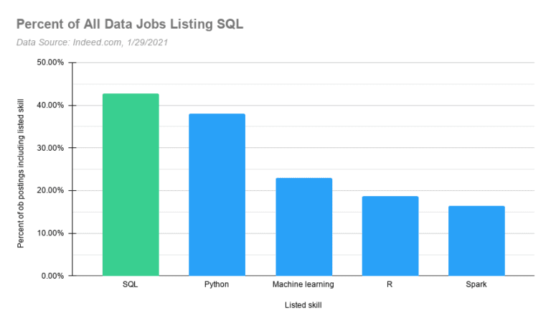

Slide 12
TABLE
students_details
student_id | first_name | date_of_birth | favourite_cheese
11111111 | Jordan | 2000-01-01 | Cheddar
22222222 | Julia | 2000-01-02 | Mozzarella
33333333 | Paul | 2000-01-03 | Cheddar
44444444 | Lake | 2000-01-04 | Wensleydale

Slide 13
Another table
cheese_and_descriptions
type_of_cheese | description
Cheddar | Rich English cheese
Goat Cheese | Soft and creamy
Mozzarella | Perfect for Pizza
Wensleydale | Nice with cranberries!
Feta | Crumbly

Slide 14
And ANOTHER!
students_cheese_purchases
student_id | date_of_purchase | type_of_cheese | price
11111111 | 2021-09-30 | Cheddar | 2.50
22222222 | 2021-10-01 | Cheddar | 5.00
33333333 | 2021-10-01 | Goat Cheese | 245.10
44444444 | 2021-10-02 | Goat Cheese | 6.99
11111111 | 2021-10-03 | Goat Cheese | 13.98

Slide 15
RELATIONS BETWEEN columns
1:1 For every entry in column A, there are 0 or 1 matches in column B.
1:N For every entry in column A, there are 0, 1 or many matches in column B.
M:N For every entry in column A, there are 0, 1 or many matches in column B. For every entry in column B, there are 0, 1 or many matches in column A.

Slide 16
RELATIONAL DATABASE
students_details
student_id | first_name | date_of_birth | favourite_cheese
1:N
1:N
cheese_and_descriptions
type_of_cheese | description
1:N
M:N
students_cheese_purchases
student_id | date_of_purchase | type_of_cheese | price

Slide 17
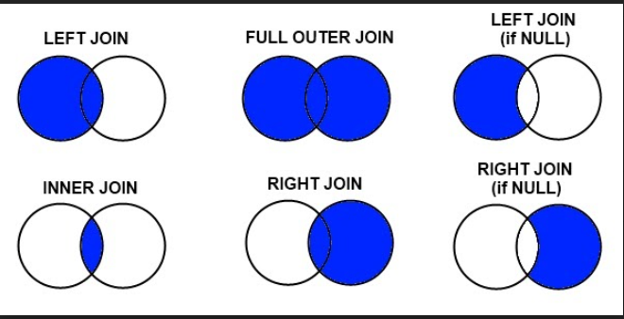
JOIN TYPES

Slide 18
enhancements
SELECT DISTINCT
ORDER BY
TEMPORARY TABLES
WHERE EXISTS
INDEX
LIKE
WILDCARD CHARACTERS
HAVING
STORED PROCEDURES

Slide 19




APPLICATIONS

Slide 20
QUESTIONS?

