Slide 1

Core Workshop:
Support Vector Machines (SVMs)

Slide 2
Overview
Motivation
Geometric view of SVMs
Standard representation
Optimization problem
Hard-margin SVM
Soft-margin SVM
Lagrange Duality
Kernels
Demonstration

Slide 3
Motivation
SVMs:
are binary classifiers
avoids local minimum issues of ANNs +
deal with non-linear data +
require good kernel & hyper-parameter selection –
require long training time for large-scale data –
Notes:
Quadratic optimization problem to avoid ‘local minimum’ issues with neural nets

Slide 4
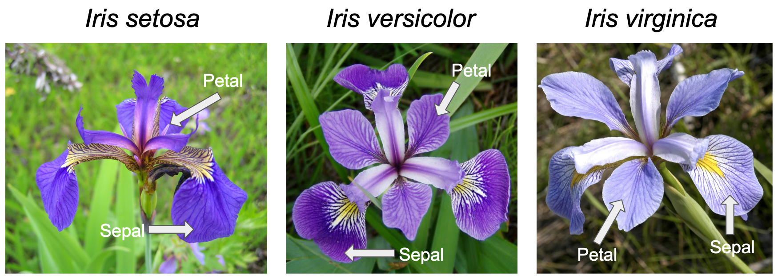
Iris Samples in Nature

Slide 5
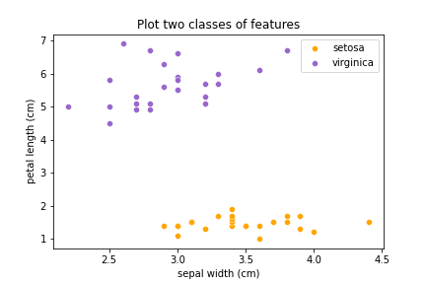
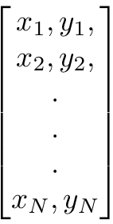
Geometric Problem
Feature matrix
Notes:
Iris dataset with two features
Linearly separable
A hard-margin SVM would suffice

Slide 6
Standard representation: Geometric View
Hyperplane – the separating line diving two classes (the red dashed line)
Margin
Margin – the distance from the closest point to the hyperplane (hard-margin)
Notes:
Support vectors define the hyperplane
The margin is the orthogonal projection of the closest point to the hyperplane (Hard-margin).
The margin follows the ‘Widest-street’ approach.
We are looking for a decision rule to find the decision boundary

Slide 7
Standard representation: Projection
the dot product (produces a scalar):
a . b = a₁b₁+a₂b₂+a₃b₃
provided:
a = [a₁,a₂, a₃]
b = [b₁,b₂, b₃]
Vector W
Vector U
Notes:
Assumption on vector W with unknown magnitude, but perpendicular to the hyperplane
Violator point in the margin region
Dot product of two vectors to aid assessment of position in the margin

Slide 8
Standard representation: Constraints Derivation
Classification decision (hyperplane):
W . U + b ≥ 0 – belongs to ’setosa’
otherwise – belongs to ‘virginica’
Vector W
Classification decision (margin):
W . U + b ≥ 1 – belongs to ’setosa’
W . U + b ≤ –1 – belongs to ‘virginica’
Vector U

Slide 9
Standard representation: Generalized classifier
Decisions:
W . U + b ≥ 1
W . U + b ≤ –1
Classifier is transformed into:
y( W . U + b) ≥ 1
where:
y = +1 for class ‘virginica’
y = –1 for class ‘setosa’
Or without loss of generality:
y_{i}( W . x_{i} + b) ≥ 1
Vector W
Vector U

Slide 10

Standard representation: Margin width derivation
vector X₊ – to a ’virginica’ sample
vector X– – to a ‘setosa’ sample
X₊ – X– = difference vector on the inside of the margin
X₊–X–
W – normal unit vector (perpendicular to the hyperplane)
W
X–
X₊
margin width = (X₊ – X– ) . $\frac{W}{|\left|W\right||}$
Notes:
The margin width is the dot product of the sample-difference vector & the unit normal vector.

Slide 11
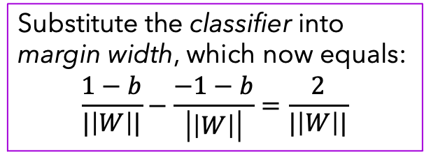

Standard representation: Elaboration on the Hard-Margin
margin width = (X₊ – X– ) . $\frac{W}{|\left|W\right||}$
Classifier for all samples:
y_{i}( W . x_{i} + b) ≥ 1
Classifier for samples on the margin boundary:
y_{i}( W . x_{i} + b) = 1
X₊–X–
W
Substitute the classifier into margin width, which now equals:
$$\frac{1−b}{|\left|W\right||}−\frac{−1−b}{\left|\left|W\right|\right|}=\frac{2}{|\left|W\right||}$$
X–
X₊

Slide 12
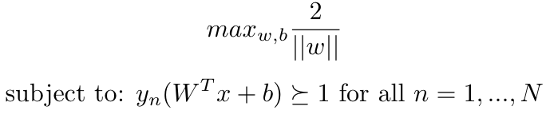
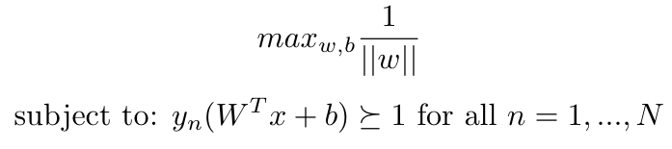
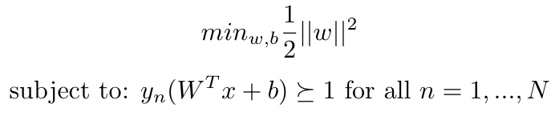
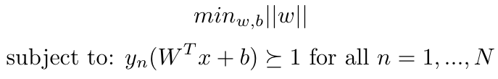
Optimization Problem: Hard-Margin SVM

Slide 13

Soft-margin svm: Geometric View
*ξ_{i}– slack variable for each sample pair
Samples will be classified correctly if they are:
within the ‘slack’ margin
on the correct side of the hyperplane
ξ_{i}
❌
Hinge loss – only punishes misclassifications
ξ_{i}
ξ_{i}
$$l\left(t\right)=max(0, 1−t)$$
Notes:
In practice, no datasets are ideally linearly separable.
Soft-margin relaxes the strong constraint on the margin by introducing a slack variable. Thus, it allows for certain ❌violations of the margin rules.

Slide 14
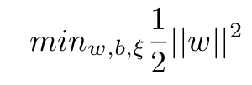
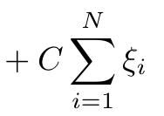
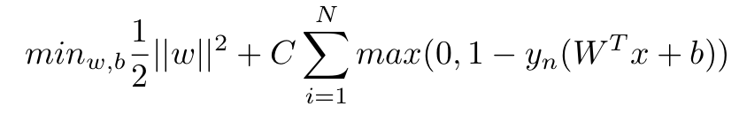
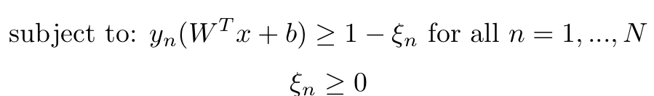

soft-Margin SVM: Formulations
Optimization Problem: Formulation 1
Optimization Problem: Formulation 2
Hinge loss:
$$l\left(t\right)=max(0, 1−t)$$
Notes:
The C hyperparameter is used as a trade-off between maximizing the margin & minimizing the number of errors.
when C is small => more important is margin maximization
otherwise, more weight on minimization of errors

Slide 15
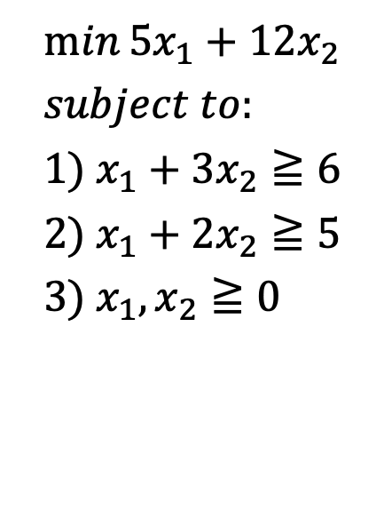


Principle of Duality: Simple Approach to Primal problems
Primal Linear Problem
Strategy 1: multiply 1) by 4
$$5x_{1}+12x_{2}≧4x_{1}+{12x}_{2}≧24$$
$$\min{5x_{1}+12x_{2}}$$
$$subject to: \\ 1) x_{1}+{3x}_{2}≧6 \\ 2) x_{1}+{2x}_{2}≧5 \\ 3) x_{1},x_{2}≧0$$
Strategy 2: multiply 2) by 5
$$5x_{1}+12x_{2}≧5x_{1}+{10x}_{2}≧25$$
Notes:
“In optimization theory the duality principle says that optimization problems can be viewed from either of 2 perspectives: primal & dual

Slide 16

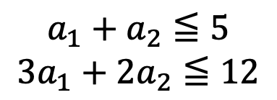

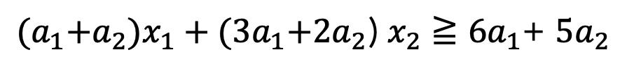

Principle of Duality: Generalizing the Approaches
Primal Linear Problem
$$\min{5x_{1}+12x_{2}}$$
$$subject to: \\ 1) x_{1}+{3x}_{2}≧6 \\ 2) x_{1}+{2x}_{2}≧5 \\ 3) x_{1},x_{2}≧0$$
Generalization of strategies
$$1) {a_{1}x}_{1}+{{3a}_{1}x}_{2}≧6a_{1}$$
$$2) {a_{2}x}_{1}+{2a_{2}x}_{2}≧5a_{2}$$
$$3) a_{1},a_{2}≧0$$
${(a}_{1}+a_{2})x_{1}+{(3a}_{1}+2a_{2}$) $x_{2}≧6a_{1}$+ $5a_{2}$
$$a_{1}+a_{2}≦5$$
$${3a}_{1}+2a_{2}≦12$$
Notes:
Introduction of additional coefficients (Lagrangian multipliers) as a generalization of the previous strategies
The number of constraints in the primal will be equal to the number of variables in the dual problem.
The minimization problem becomes lower-bounded & we will maximize this lower bound.

Slide 17
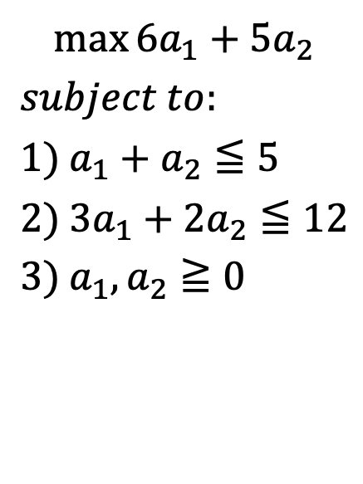
Principle of Duality: Primal vs Dual
Primal Linear Problem
Dual Linear Problem
$$\min{5x_{1}+12x_{2}}$$
$$subject to: \\ 1) x_{1}+{3x}_{2}≧6 \\ 2) x_{1}+{2x}_{2}≧5 \\ 3) x_{1},x_{2}≧0$$
$$\max{6a_{1}+5a_{2}}$$
$$subject to: \\ 1) a_{1}+a_{2}≦5 \\ 2) 3a_{1}+{2a}_{2}≦12 \\ 3) a_{1},a_{2}≧0$$

Slide 18
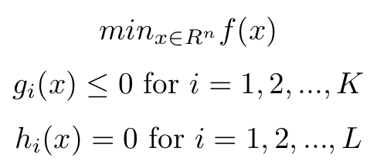
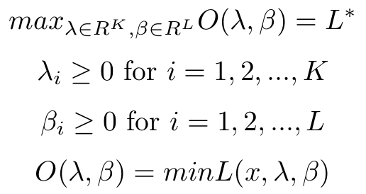
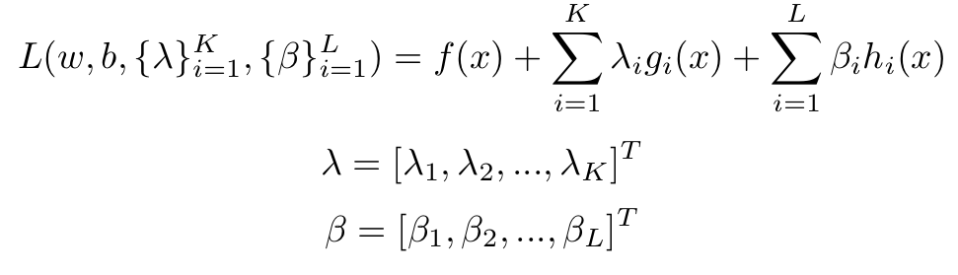
Lagrange Duality: Constrained Optimization Problems
Primal Problem
Dual Problem
subject to:
subject to:
LaGrangian function

Slide 19
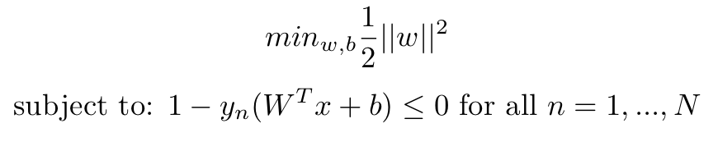
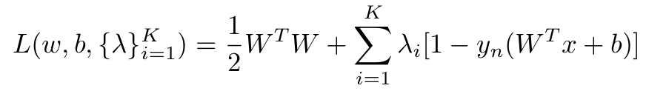
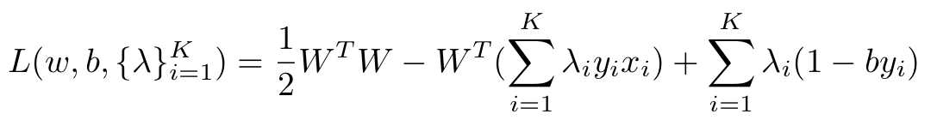
Lagrangian in Hard-Margin SVM
Primal Problem:
Lagrangian:
Quadratic
Linear
Constant
Notes:
The Lagrangian results in a quadratic equation to which we are going to find the minima using the gradient = 0.

Slide 20
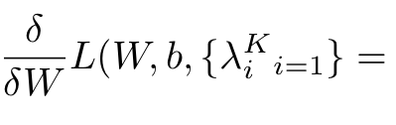
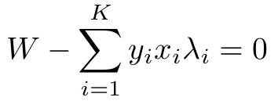

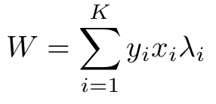
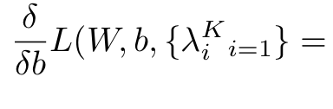
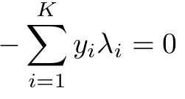
KKT Conditions
Lagrangian:
KKT conditions:
Notes:
KKT (Karush–Kunh–Tucker)

Slide 21
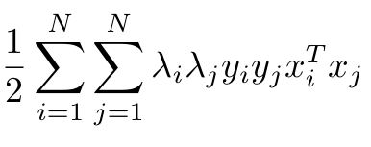
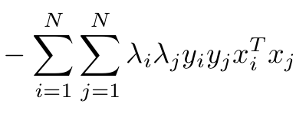
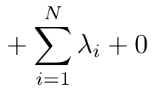
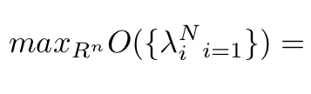
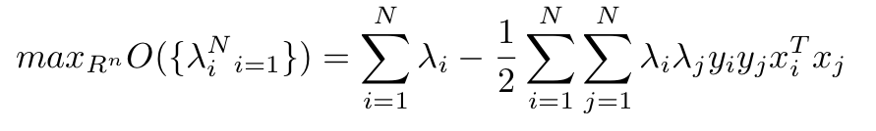
Dual problem in Hard-Margin SVM
Lagrangian:
KKT conditions:
Dual Problem:
Insert into a QP solver (like SMO)
Notes:
To solve the dual problem, we could use the QP solver Sequential Minimal Optimisation (SMO).

Slide 22
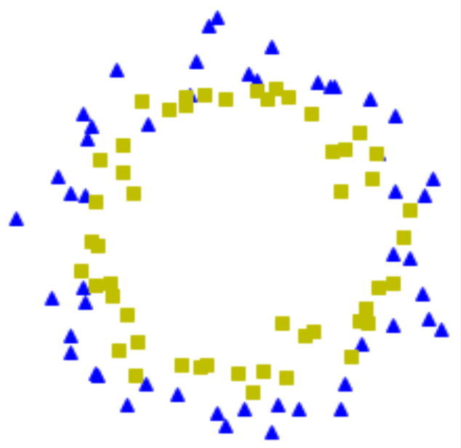
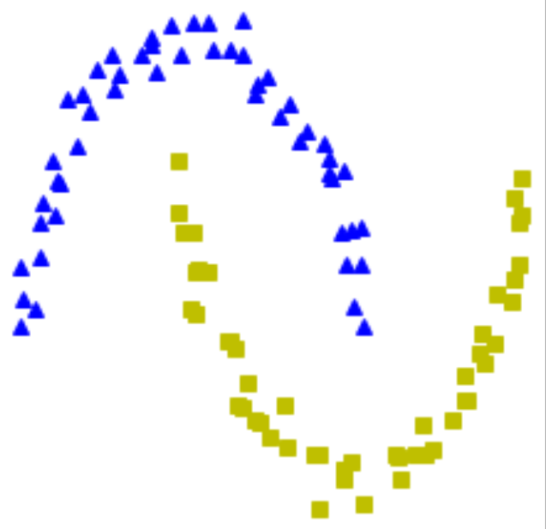
Non-linearly separable data

Slide 23
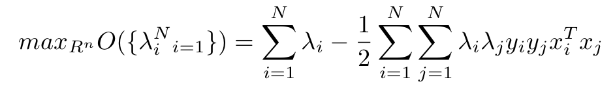
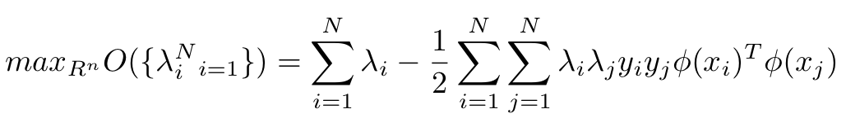
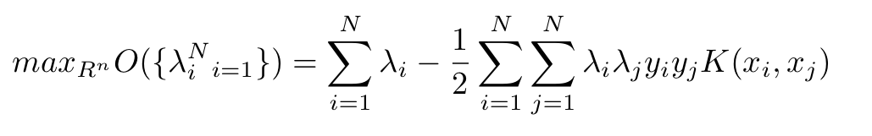
Kernels
Dual Problem:
Feature Transform:
Kernel:

