Slide 1





Week 2: Python For Data Science
and Machine Learning

Slide 2
OVERVIEW
The Big Picture: Machine Learning and 4 Key Libraries
Machine Learning
4 libraries [thano picture]
Introduction each library briefly
Libraries
note on OOP - don’t need to know OOP to use them but it helps and will be useful when we get to PyTorch
a note on matplotlib and anatomy of a figure
jupyter notebook [ with basics plotttg]
Pandas
What is it
Some key commands
flight data
NumPy
What is it , nd arrays and how they’re used in ML [matrices vectors, the objects our models use - not just data but also parameters vectors e.t.c.]
why it’s important vectorizeed operations [visuals from intermediate data science notes] vs lists of lists
some key commands [visualized if possible], slicing
Jupyter notebook
ScikitLearn
what is it
some key commands
Jupyter notebook

Slide 3
Why the basics?
these libraries form the foundation of nearly everything you’re likely to in ML/DS and
provide you with a python “starter pack” for subsequent workshops, hackathons
if you haven’t already, you can go and build on this set of ideas/commands
good preparation/refresher of the basics of Python for PyTorch skills section we have planned where we’ll be building and training a bespoke neural network (as is done in industry and academia) that we can train on a GPU for faster learning!

Slide 4
What is Machine Learning?
Data + Model
Learning Algorithm
Predictions
Decisions
data are our observations
model contains our assumptions (often based on previous experience)
learning algorithm combines data and model to yield predictor function

Slide 5
Machine Learning with Python
Scikit-learn
Data + Model
Learning Algorithm
Predictions
Decisions
Pandas
NumPy
Matplotlib 👁

Slide 6
Matplotlib
working with very large and very abstract objects when doing machine learning in python
Matplotlib gives us a way to visualize what’s going on at each stage of the workflow
EDA
Model choice/assumptions
Training -e.g. behaviour of loss functions
Final Model
creates figures
plot lines/curves in plotting areas
decorates our figures with labels, legends
keeps track of states like the current plotting figure and plotting area

Slide 7
Matplotlib: great but terminology can be a bit confusing
exhibit A:
“axes” in matplotlib does refer to mathematical term for more than one axes.
axes is just the area in which the plot we’re instantiating appears
current documentation isn’t too clear:

Slide 8
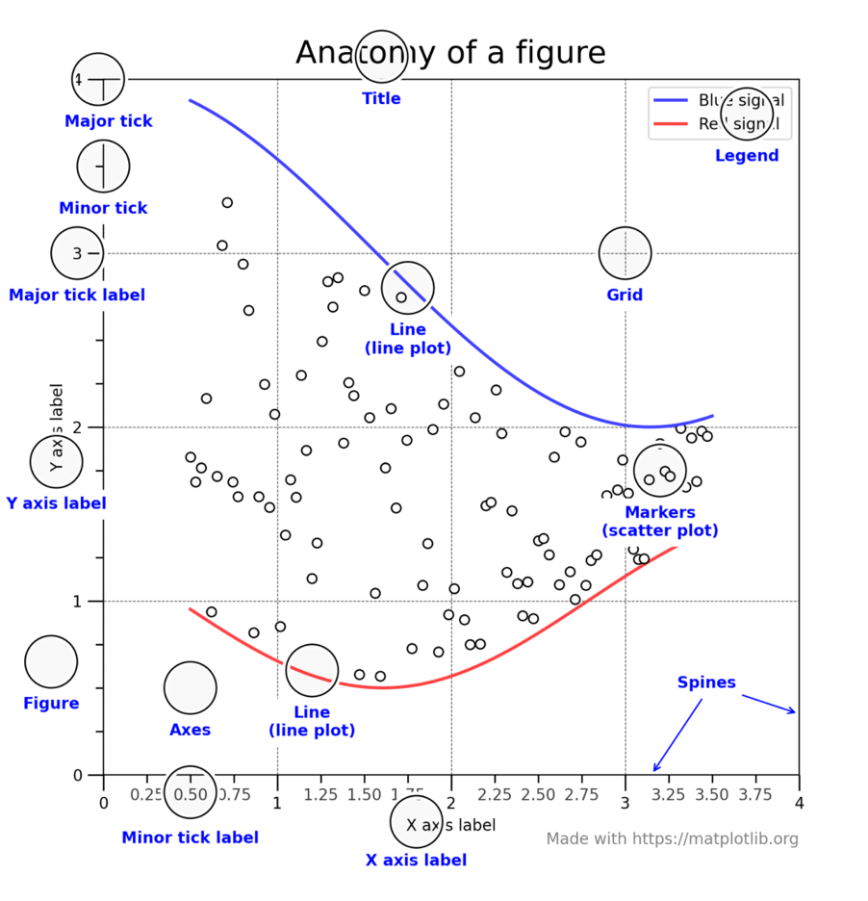

Slide 9
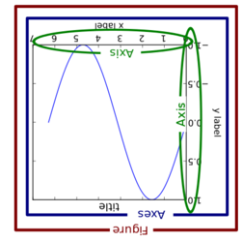
But old documentation is clearer:

Slide 10
Hands-on Session: matplotlib demo

Slide 11
NumPy
a library for manipulating arrays
core data structure is the ndarray
Def.: An array is an indexed collection of variables of the same type
dtypes: floats, integers, Booleans etc.
type is inferred not specified
Optimized for speed and ease of use (SIMD, vectorized operations)
Building block for other packages such as Pandas, Scikit-learn

Slide 12
Basic NumPy Attributes and Methods
Creation
a1= np.array([1,2,3], [4,5,6]
np.arange(10)
np.ones(100) * 10
np.linspace(0, 1, 100)
Maths
np.sqrt(a1)
np.exp(a2)
np.sin(np.linspace(0, 1, 100) *2 * np.pi))

Slide 13
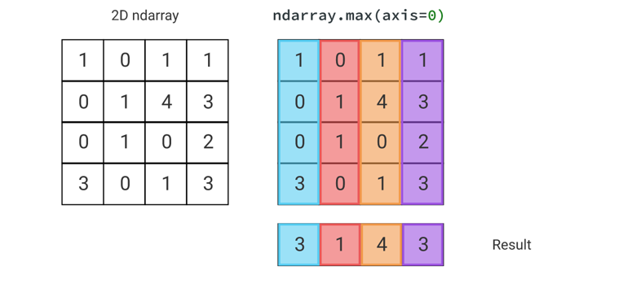
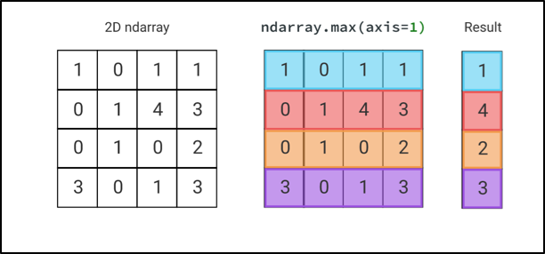
Axis Parameter in NumPy and Pandas Functions
axis=1 means row-wise
axis =0 means column-wise
terminology like “along the rows” is ambiguous. Think about ndarray.sum()
example: when we use the ndarray.max method
axis=0 For each column find and return the largest entry.

Slide 14
Selecting Elements from a NumPy Array: Indexing (and Slicing)
array[ row_selection, column_selection ]
don’t forget zero-indexing!
subtract the matrix index you want by 1 to get the Python index (i.e. 1st element of list is list[0] etc
individual elements
i, jth entry of array: array[ i-1, j-1]
the ith row:
array[i-1, : ]
the jth column:
arra [: , j-1]
submatrices: array[slice_1, slice_2] #
array[ i-1 : k+1, j-1 : m+1 ] #the ith row to the kth row, and the jth column to the mth column (assuming k>i, m>j)
two important things to remember
0-indexing
NB: Python slicing inclusive of the first index and exclusive of the 2nd index (we’ll see an e.g. in a moment)
‘ : ‘ - give me everything from this dimension

Slide 15
Selecting Elements from a NumPy Array: Masks
Masks allow us to access values in an array that meet certain criteria
useful when we want to extract/modify/manipulate values in an array based on some criterion
e.g. count all values in an array greater than 5 in the array a1
we’ll see some more examples of masking when we explore pandas
#create a mask
mask = a1 > 5
#returns a Boolean array whose entries are True wherever a1’s were gt 5 , False wherever a2’s entries were False
a1[a1 > 5]

Slide 16
Hands-on Session: numpy demo

Slide 17

PANDAS

Slide 18
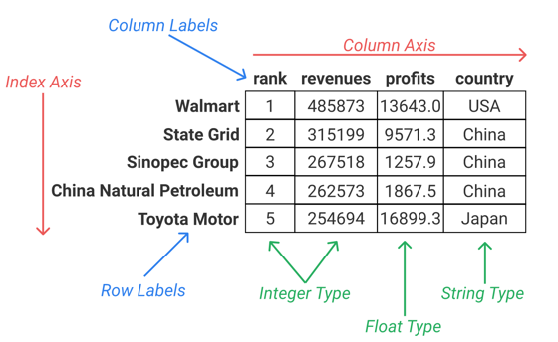
PANDAS VS NUMPY
Pandas is an extension of NumPy:
core object is a dataframe object - the pandas equivalent of a NumPy 2D array
Axis values can have labels, not just numeric ones
dataframes can contain rows/columns with multiple data types, including floats and strings

Slide 19
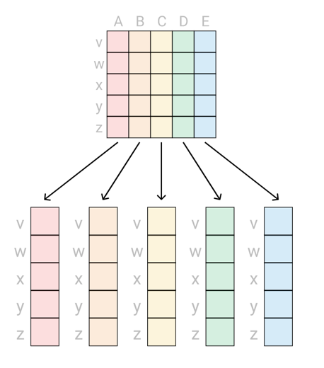
Introduction to Series
A 1D pandas object is always a series
a 2D pandas object is always a dataframe
distinction is important because they have their own unique methods

Slide 20
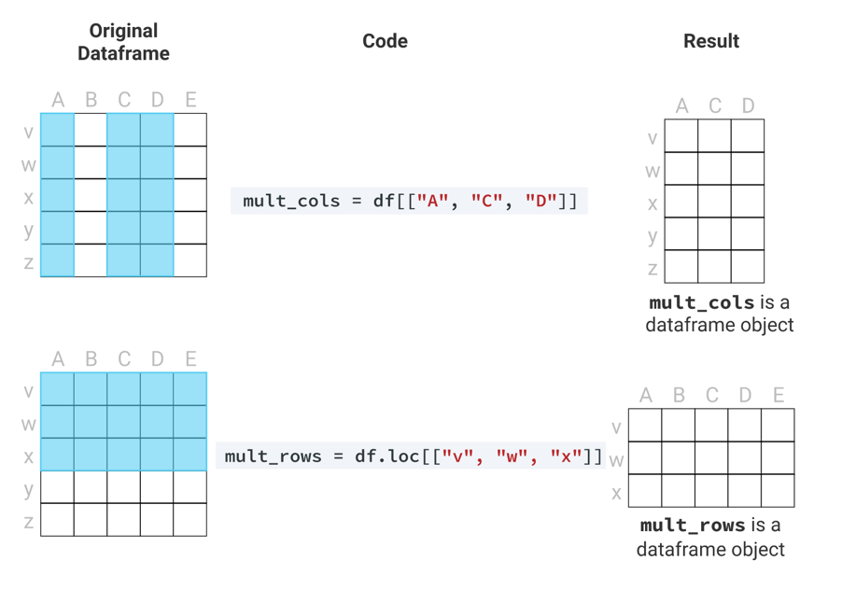
Series vs DataFrames

Slide 21
Hands-on Session: pandas demo

Slide 22
Scikit-Learn: Ready-to-go models and learning algorithms
models defined as estimator objects
learning step is completed using .fit() method for the model
all we’ve got to do is plug-in the data
prediction achieved via the .predict() method
all we’ve got to do plug in a test input

