Slide 1


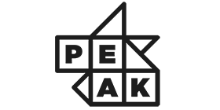


Week 6: Decision tree

Slide 2
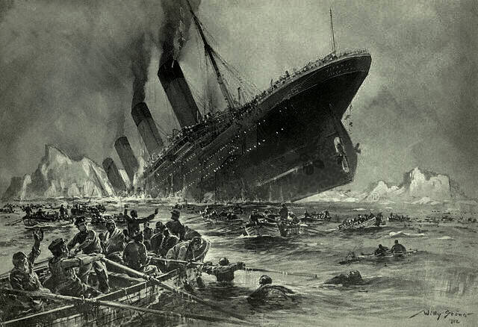
How probable would you Have survived in titanic
https://en.wikipedia.org/wiki/File:St%C3%B6wer_Titanic.jpg Titanic sinking by Willy Stöwer
Notes:
In the very beginning of the workshop, let me ask you, how probable would you survive in titanic? Let's find it out in todays live coding.

Slide 3
overview
Decision tree
Basic mechanism
Pros and cons
Types of implementing algorithm
Live example
Random forest
Bagging
Pros and cons
Live example
Notes:
Here we will have a quick overview over this workshop about decision tree.
First of all, what is this decision tree about? How does this work? How does this help us?
Once we get to know about it, what advantages and disadvantages does this algorithm have?
Soon after, a live example is the best way to illustrate a decisión tree, where we want predict how probable would you guys survive in the disaster of Titanic?
On the other hand, we have a variation of decisión tree called random forest, which is very useful to solve some of the problems we encounter with decisión tree.
In this section, we will learn what is bagging.
Afterwards, pros and cons of using this algorithm.
Finally, another live example with Titanic using random forest.

Slide 4
Basic mechanism
Notes:
What is this thing called decision tree? Is it evergreen? Let’s have a look down into its root mechanism.

Slide 5
Decision Tree?
Entity to be predicted → test
Supervised classification + regression
Straightforward, human intuitive
Flowchart with tree structure
Leaf nodes
Internal nodes
Branches
No
Yes
Another test
Category 1
< 5
≥5
Category 2
Test again
Yes
No
Category 1
Category 3
Notes:
Decision tree is a type of supervised learning that is mainly used in classification problems, though it can do regression tasks. Supervised learning means it needs some correct data at the beginning of training of the model, to let it learn under supervise. Classification problems are those tasks that we must place the entity into some category, whereas regression consists of predicting continuous values.
As you will see in a moment, the decision tree is very straightforward and human intuitive. What’s more, it is basically how we human think in a very basic way.
A decision tree is just a flowchart with tree structure, we can understand it as a bunch of if then else statements that leads to our result. For example, should I wear an extra jacket tomorrow? Then I will first think is tomorrow windy? If not, then I wont, if yes then I will ask is tomorrow going to be hot? No, then I will wear an extra jacket. So, we can distinguish 3 elements here.
Leaf nodes, are those nodes that symbolises the result of the classification, they don’t have any more children, which means that we have a decision there.
Internal nodes, they are any node that is not a leaf node, this is any test or attribute to be tested by the algorithm. Condition of if and else
Branches, they are the result of the test, the result of the if and else condition

Slide 6
Decision tree for playing tennis
Outlook
Today’s weather:
Outlook: rain
Humidity: normal
Wind: weak
Outlook: overcast
Humidity: high
Wind: strong
Outlook: sunny
Humidity: high
Wind: weak
Sunny
Rain
Overcast
Humidity
Yes
Wind
High
Normal
Strong
Weak
No
Yes
No
Yes
Notes:
Now we are going to do a simulation with a decision tree for whether we should play tennis today depending on the weather. Today is overcast, which is a good day for playing tennis, the humidity is high and wind strong, should we go out?
Click. Judging by the decision tree, yes, it is good day to go out.
Click. What about if it is a sunny day?
Click. Then the decision tree asks for the humidity, and depending on if it is high or normal, it will decide if it is ok.
Click. As our humidity is high, then the tree predicts it is not a very recommended playing tennis outside.
Click. Now I propose this situation to you guys and here is the complete decision tree, anyone dare to give the answer?
Click. Wonderful, the answer is yes

Slide 7
Pros and cons
Pros
Cons
Easy to understand and visualise
Does not require a lot of computation
Able to handle categorical and continuous data
Can deal with non-linear data
Reveals the important characteristics to predict
No need for technical knowledge in the data
Robustly estimate a continuous value
Very prone to overfitting
Ignore relationship between variables
Can be computationally expensive to train
Notes:
After this quick example, we may have noticed some of the pros and cons of decision tree.
In advantages, it goes without saying the easiness of decision trees to visualise. Moreover, it does not require a lot of computational power as it only needs to travel through the tree all way down. Also, it is able to handle categorical data as continuous data, though in a limited way. It mainly deals with non-linear data, in fact, our decision tree separated the playing tennis example non-linearly. What's more, by looking at the earliest tests in the tree, we got to know the decisive attributes of the classification, as earlier branching have more impacts than late branching. In addition, when training a tree like this, we are not required to have lots of technical knowledge in the target data, as the decision tree does not need to understand the meaning of the attributes but how it affects the conclusion.
On the other hand, we have some disadvantages in this algorithm. The limited handling of the continuous data is because in the end, the decision trees result is still categorical, therefore it is hard to get an accurate estimate of the continuous value. Moreover, it is very prone to overfitting, this means that it would work incredibly well in the train data, but not as well in the test data. This is due to on the very ground, decision tree is still a bunch of if and else statements, what brings nearly perfect results when testing with the data that it was constructed on, but not in the case when testing new data. Another point that you might noticed, it is does not reveal any relationship between variables. And finally, it can be computationally expensive to train, as it involves calculations and sorting to look for optimal classificatory system, meaning that it must go through quite of trainings.

Slide 8
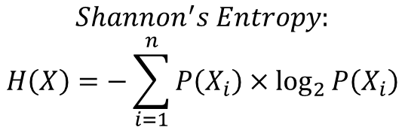

Types of decision tree algorithm
Iterative Dichotomiser 3 (ID3): Information Gain by change in entropy
C4.5: Following ID3 but use of Gain Ratio to improve
Classification and Regression Tree (CART): binary tree using GINI index
$$−H=0.5×\log_{2}{0.5}+0.5×\log_{2}{0.5}$$
$$H=1$$
$$Shannon^{′}s Entropy:$$
$$H\left(X\right)=−\sum_{i=1}^{n}{P\left(X_{i}\right)×\log_{2}{P\left(X_{i}\right)}}$$
Notes:
There are mainly 3 types of implementing algorithm for decision tree.
The first one is called ID3, stands for iterative dichotomiser 3, which essentially uses the information gain by change in entropy. Entropy is this word that we always hear about but unsure what it is. Shannon, the father of Information Theory, defined the entropy with this probabilistic formula. Basically, it says that in a system, whenever you try to predict a certain state correctly by random, the more probable you are correct, the lower is the entropy. Lower entropy means more certainty and purity.
Click. For example, if we split a level of tree by an attribute A, and the result of split looks like this. Note that the color of the balls means the correct category that they must be. We know by our eyes that this classification is not very accurate, and how do we compute this accuracy? Here is where the entropy enters in the game. We obtain by a quick calculation that the entropy in this first box is 1. Let’s see if another attribute B makes better classification.

Slide 9
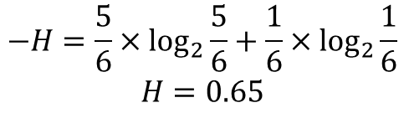
Types of decision tree algorithm
Iterative Dichotomiser 3 (ID3): Information Gain by change in entropy
C4.5: Following ID3 but use of Gain Ratio to improve
Classification and Regression Tree (CART): binary tree using GINI index
$$−H=\frac{5}{6}×\log_{2}{\frac{5}{6}}+\frac{1}{6}×\log_{2}{\frac{1}{6}}$$
$$H=0.65$$
$$Shannon^{′}s Entropy:$$
$$H\left(X\right)=−\sum_{i=1}^{n}{P\left(X_{i}\right)×\log_{2}{P\left(X_{i}\right)}}$$
Notes:
So here it is obvious the balls are more correctly categorised, and effectively, the entropy is lower in this case.
Knowing this property, the decision tree tries different attributes and test their Information Gain, this is the change in entropy. The attribute that can lower the most our uncertainty data will be our best choice. In this case, attribute B will be choosen.
C4.5 really does the same thing, only that it optimises some biases that ID3 can have.

Slide 10


Types of decision tree algorithm
Iterative Dichotomiser 3 (ID3): Information Gain by change in entropy
C4.5: Following ID3 but use of Gain Ratio to improve
Classification and Regression Tree (CART): binary tree using GINI index
$$G=1−{\left(\frac{1}{2}\right)}^{2}−{\left(\frac{1}{2}\right)}^{2}$$
$$G=0.5$$
$$GINI index:$$
$$G=1−\sum_{i=1}^{n}{{P\left(X_{i}\right)}^{2}}$$
Notes:
Another very common algorithm is the classification and regression tree. As its name says, it is able of classification and regression. A key characteristic of it is that it splits into binary (two) branches at most, like a binary tree. And the index used by it differs from ID3, it uses GINI index. GINI index is quite a very similar thing as the entropy, it measures the impurity of our system. Therefore, the higher GINI index means that we are in more chaotic system. We take the same example as before.
Click. In this mixy box, our GINI has an index of 0,5. Let’s see how it is in a more pure system.

Slide 11

Types of decision tree algorithm
Iterative Dichotomiser 3 (ID3): Information Gain by change in entropy
C4.5: Following ID3 but use of Gain Ratio to improve
Classification and Regression Tree (CART): binary tree using GINI index
$$G=1−{\left(\frac{5}{6}\right)}^{2}−{\left(\frac{1}{6}\right)}^{2}$$
$$G=0.28$$
$$GINI index:$$
$$G=1−\sum_{i=1}^{n}{{P\left(X_{i}\right)}^{2}}$$
Notes:
We can see here that after testing attribute B, the GINI index is lower, to 0,28. As the ID3 and CART both have similar computing method, and GINI is slight faster because logarithm is not required, we will use this algorithm in the following example.

Slide 12
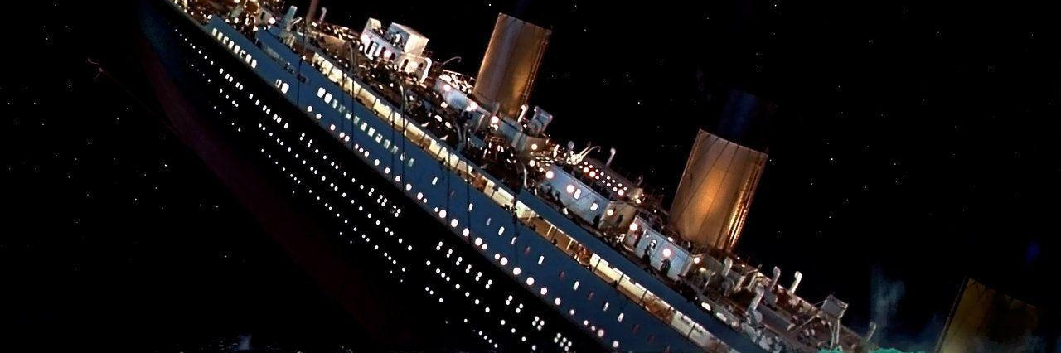
Live coding: titanic survival - Decision tree
Notes:
c

Slide 13
Random forest
Notes:
Thus, is there any way to combat the overfitting of a decision tree? Here is where random forest enters.

Slide 14
bagging
Ensemble methods
Bagging = Bootstrap + Aggregation
Subset of data and features randomly with replacement
Notes:
This is achieved by ensemble methods. Ensemble methods is just a solution that data scientist found to reduce overfitting and models with high variance, by creating various instances of a model and decide on the final model by majority voting of the instances. This is the way we are doing it in random forest, our solution will be to create various decision trees so that they vote on the final model of decision tree. Hence, forest, because of various tree. In specific, the method applied in random forest is called bagging. Bagging is bootstrap aggregation. The idea here is to create subsets of features and data picking randomly with replacement. Then, each collection of data is used to create its own decision tree.

Slide 15
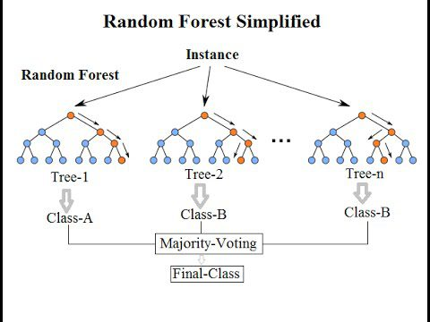
Decision forest
Bagging
Vote by majority the optimized split
More robust
Source: https://www.kdnuggets.com/2017/10/random-forests-explained.html
Notes:
Decision forest relies heavily in this method, bagging to create mini decision trees individually. Apart of bagging, decision forest’s final step is to call for votes by majority, to decide the optimized node. As they say, two is more than the sum of one, we get a better tree after multiple trees. The resulting one is more robust to variations in data, hence better performance. Here we have a visualization of random forest simplified.

Slide 16
Pros and cons
Pros
Cons
Decrease overfitting and high variance
Handles higher dimensionality data well
Robust to missing values and maintains accuracy
Inaccurate with regression predictions
Notes:
The pros and cons of random forest based on decision tree are the following. First, of course, is that it decreases overfitting and high variance, that is the main purpose. Second is that it can handle high dimension data with good performance. Third is that it is not sensible to missing values. In contrast, it trades the accuracy with regression model, even worse than decision tree as it is a gathering and mean of multiple trees, it lacks accuracy.

Slide 17
Live coding: titanic survival – decision forest
Notes:
c

Slide 18

Thanks for your attention
Questions?
Notes:
And that brings to the end of today’s workshop. Please don’t be afraid to ask questions if any, I will try to answer them as I can haha.

Slide 19
Bibliography and sources
https://www.geeksforgeeks.org/decision-tree/?ref=rp
https://www.ryanxin.cn/archives/283
https://www.geeksforgeeks.org/decision-tree-introduction-example/
https://www.geeksforgeeks.org/decision-tree-implementation-python/
https://zhuanlan.zhihu.com/p/30059442
https://www.jianshu.com/p/655d8e555494
https://blog.csdn.net/jiaoyangwm/article/details/79525237
https://towardsdatascience.com/machine-learning-algorithms-in-laymans-terms-part-2-a0a74df9a9ac
https://towardsdatascience.com/decision-tree-ensembles-bagging-and-boosting-266a8ba60fd9
https://www.kaggle.com/c/titanic/overview
https://www.kaggle.com/datavoyager/titanic-random-forest
https://www.kaggle.com/zlatankr/titanic-random-forest-82-78/notebook
https://www.kaggle.com/rprkh15/titanic-survival-prediction/notebook
https://www.jianshu.com/p/655d8e555494
https://www.jianshu.com/p/28d5de57bbce
https://scikit-learn.org/stable/modules/generated/sklearn.tree.DecisionTreeClassifier.html
https://scikit-learn.org/stable/modules/generated/sklearn.ensemble.RandomForestClassifier.html

