Slide 1





Week 9: Structured Query Language (SQL)

Slide 2
OVERVIEW
Brief recap of SQL (cf. Semester 1, Week 5)
SELECT statements
Interactive Challenge

Slide 3
SQL
A programming language for interacting with relational databases.
Cheese_and_descriptions
type_of_cheese | description
student_cheese_purchases
student_id | date_of_purchase | cheese_type_purchased | price
student_details
student_id | first_name | date_of_birth | favourite_cheese

Slide 4
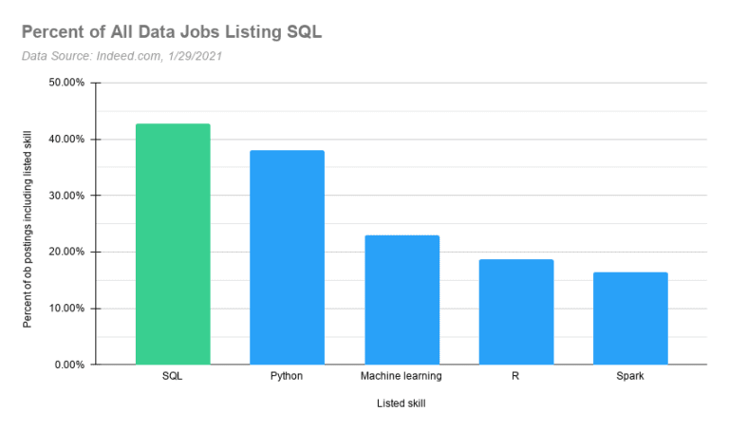
WHO USES SQL?

Slide 5
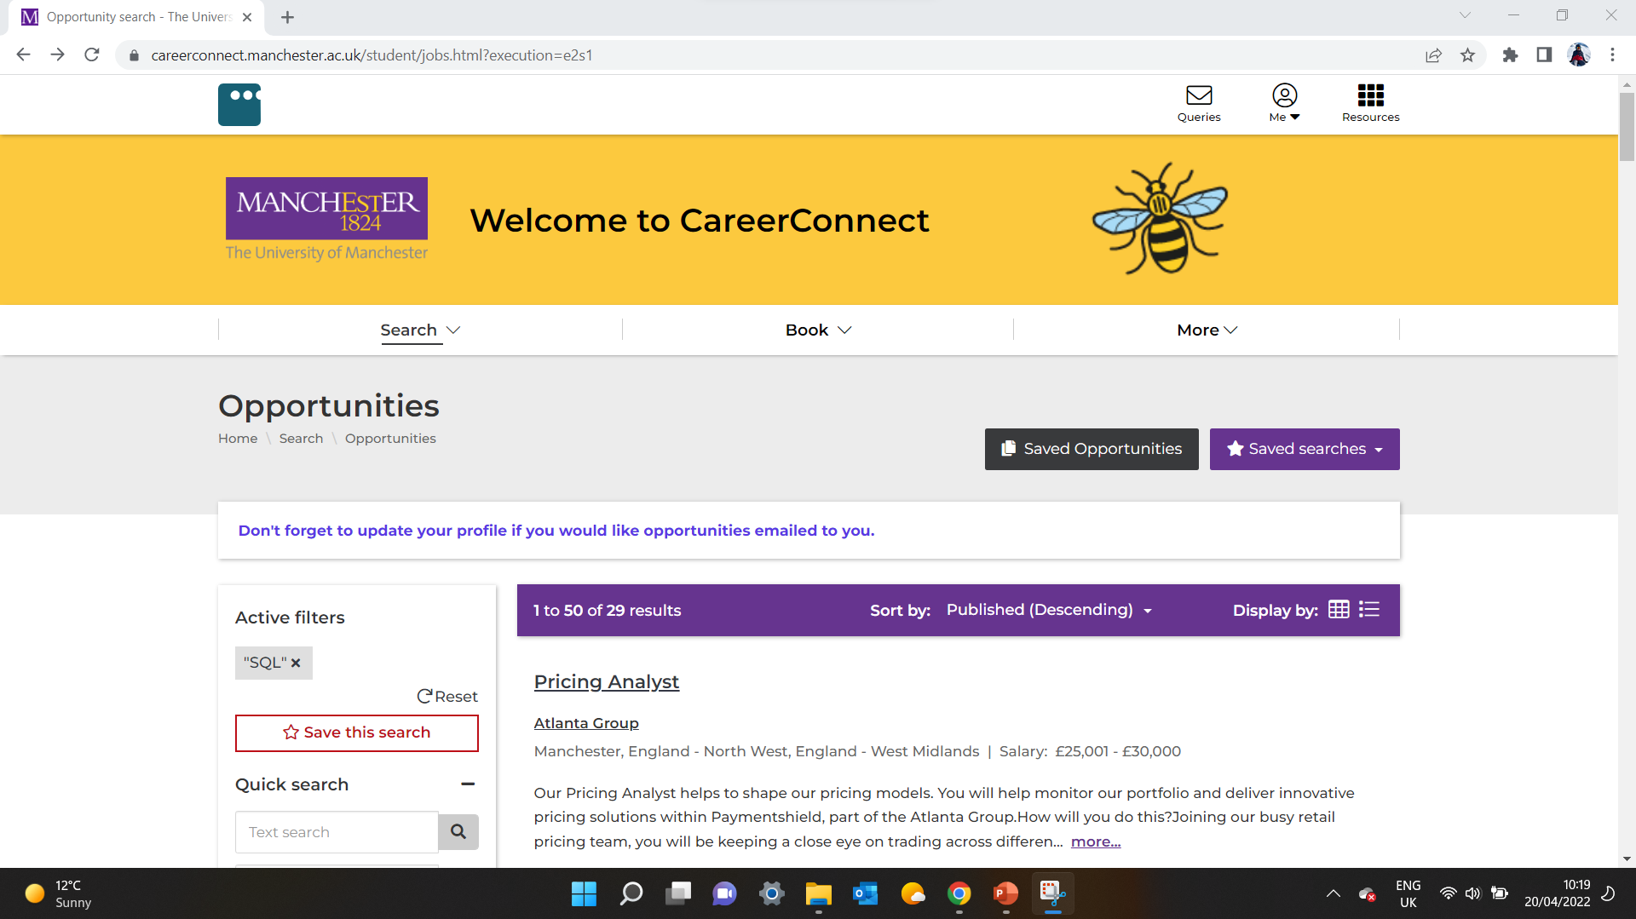



Slide 6
BRIEF
MUDSS have tasked you with recruiting 10 students for the 2022/23 committee.
We have data about 100 applicants.
Your task is to pick the top 10 based on two conditions:
1. Choose the 5 applicants with the highest ‘love of data science score’ that go to a University in Manchester and are aged 30 or less.
2. Choose the 5 applicants not selected in 1. with the highest number of extracurriculars.

Slide 7
THE DATABASE
applicants
student_id | name | age | city | university | degree
cities
country | city
extracurriculars
student_id | extra_curriculars
survey_scores
student_id | timestamp | score

Slide 8
THE DATABASE
applicants
student_id | name | age | city | university | degree
Provides details about every applicant. Applicants are uniquely identified by their ‘student_id’ number, an integer between 100 and 999.
cities
country | city
Gives the country of every city that an applicant comes from.
extracurriculars
student_id | extra_curriculars
‘Extra_curriculars’ is the number of university societies that the applicant is a member of.
survey_scores
student_id | timestamp | score
Every applicant completed a survey at time ‘timestamp’, from which they received a ‘score’ from 1-10 for how much they like data science.

Slide 9
TASKS
1) Write a query that returns data for all applicants. Use only the 'applicants' table for now.
2) Write a query that returns the number of applicants.
3) Write a query that returns the number of applicants at a University in Manchester aged 30 or less.
4) Write a query that returns data for all applicants alongside their score in the data science survey.
5) Using your answer in (4), write a query to identify the 5 candidates with the highest score that are at a University in Manchester and aged 30 or less.
6) Write a query to identify the 5 candidates with the highest number of extracurriculars that are NOT in the top 5 candidates you identified for (5).
7) Write a query to return the 10 candidates you have identified in (5) and (6). This is your final submission for the brief!

Slide 10
SELECT STATEMENTS
1) Select data from one or more tables
SELECT column1
, column2
, …
, columnx
FROM table;

Slide 11
SELECT STATEMENTS
2) Aggregating data upon selection
SELECT AGGREGATE(column1)
FROM table;

Slide 12
SELECT STATEMENTS
3) Applying filters
SELECT AGGREGATE(column1)
FROM table
WHERE column1 = “value”
AND column2 > some_integer;

Slide 13
SELECT STATEMENTS
4) Retrieving data from multiple tables using JOIN
SELECT column1
FROM table_a
[INNER/ LEFT/ RIGHT/ OUTER] JOIN
table_b
ON table_a.column = table_b.column
;

Slide 14
SELECT STATEMENTS
5) Order and limit results
SELECT column1
FROM table_a
[INNER/ LEFT/ RIGHT/ OUTER] JOIN
table_b
ON table_a.column1 = table_b.column1
WHERE column = “value”
ORDER BY order_column [ASC/DESC]
LIMIT x
;

Slide 15
SELECT STATEMENTS
6) A statement within a statement
SELECT column1
FROM (SELECT …)
WHERE column = “value”
AND int_column NOT IN (SELECT …)
;

Slide 16
SELECT STATEMENTS
7) Vertical joins (aka unions)
(SELECT column1
, …
, columnN
…)
UNION
(SELECT column1 , …
, columnN
…)
;

Slide 17

https://www.w3schools.com/sql/

Slide 18
SUMMARY
SQL is a programming language for interacting with relational databases.
Requisite for many data jobs.
SELECT statements get data.
Specify columns and tables.
Filter with WHERE.
Combine tables with JOIN or UNION.
SELECT within SELECT.
ORDER / LIMIT your results.

