Slide 1





R

Slide 2



Ross Ihaka
Robert Gentleman

Slide 3



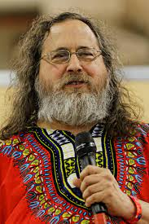



S

Slide 4



What is R?
R is a language and environment for statistical computing and graphics.
Developed in 1993 and used by data analyst, miners and statistician.
Used by companies like

Slide 5


If you have no coding experience, then R may be easier to learn.
Statistical models can be written with only a few lines.
The same piece of functionality can be written in several ways with R.
People with a software engineering background may find Python comes more naturally to them than R.
Coding and debugging is easy because of the simple syntax.
Any piece of functionality is always written the same way with Python.

Slide 6
Widely considered the best tool for making beautiful graphs and visualizations.
R is easier to learn when you start out, but the intricacies of advanced functionalities makes it more difficult to develop expertise.
Built around a command line, but the majority of R users work inside of RStudio, an environment that includes a data editor, debugging support, and a window to hold graphics as well.
General-purpose programming languages are useful beyond just data analysis.
Has gained popularity for its code readability, speed, and many functionalities.
Python’s focus on readability and simplicity means its learning curve is relatively linear and smooth.
Has high ease of deployment and reproducibility.

Slide 7
Finding the right packages to use in R may be time consuming.
There are many dependencies between R libraries.
R can be considered slow if code is written poorly.
Not as popular as Python for deep learning and NLP.
Python doesn’t have as many libraries for data science as R.
Python requires rigorous testing as errors show up in runtime.
Visualizations are more convoluted in Python than in R, and results are not as eye-pleasing or informative.

Slide 8
The R environment
an effective data handling and storage facility,
a suite of operators for calculations on arrays, in particular matrices,
a large, coherent, integrated collection of intermediate tools for data analysis,
graphical facilities for data analysis and display either on-screen or on hardcopy, and
a well-developed, simple and effective programming language which includes conditionals, loops, user-defined recursive functions and input and output facilities.
R has its own LaTeX-like documentation format, which is used to supply comprehensive documentation, both on-line in a number of formats and in hardcopy.

Slide 9
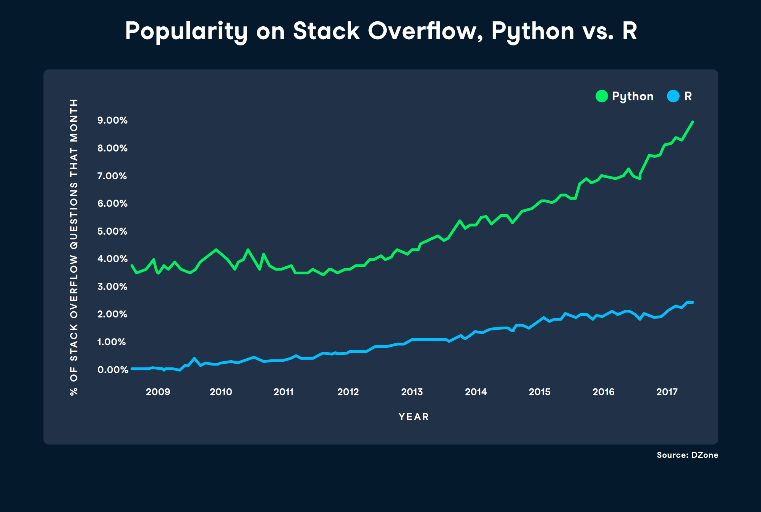

Slide 10
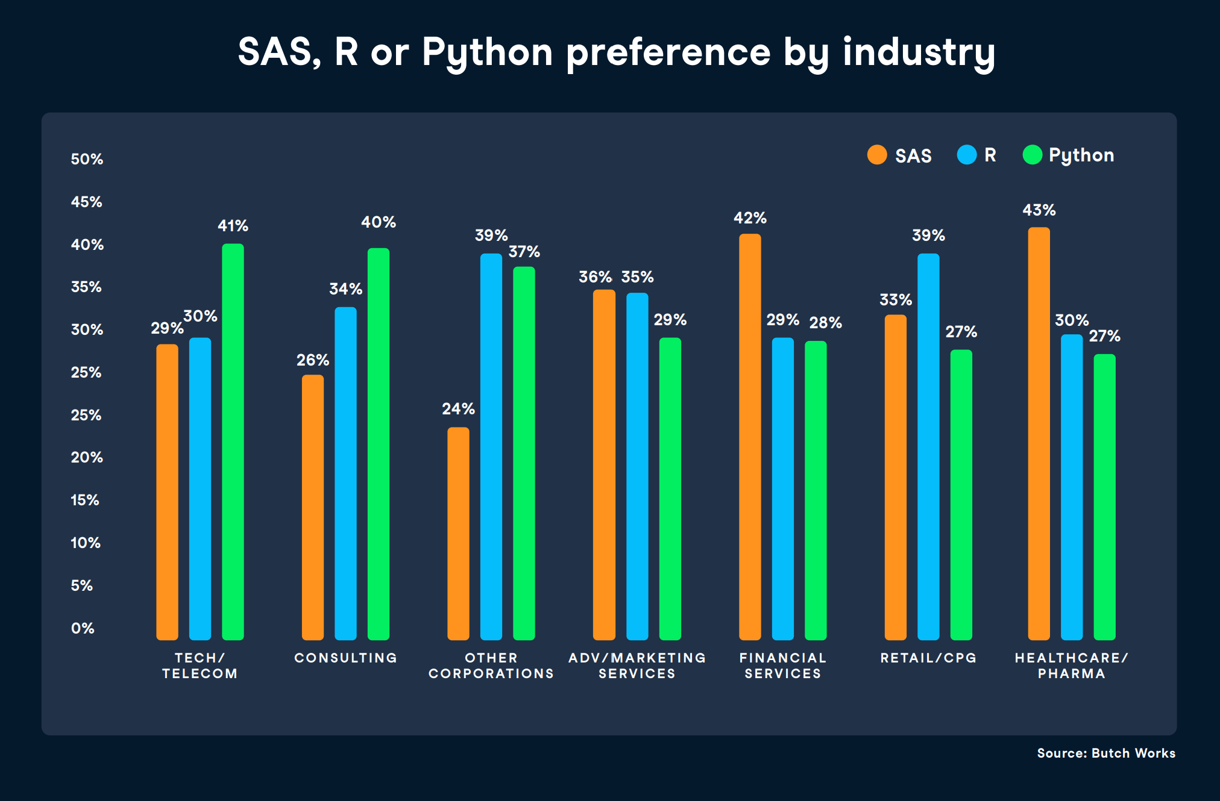

Slide 11
