Slide 1
Logistic Regression
EEG Feeling Emotions
Lifeng Qiu Lin

Slide 2
How does it work?
How does it learn?
Table of Content
EEG Feeling Emotions
What for?
How to implement it?

Slide 3
1
What is Logistic Regression (LR) for?
Notes:
Believe me or not, I only need two minutes to teach you what is a logistic regression model.

Slide 4
LR’s Purpose – machine learning model
Large dataset
Into a class
New data
Train
Recognise
Predict
Notes:
Characteristic of a regular ml model

Slide 5
LR’s Purpose - characteristics
Supervised
Binary Classification

Slide 6
LR’s Purpose - visualisation
Happy
LR model
Sad
Notes:
For example, real emotions disguised beyond the face, but a model can distinguish them

Slide 7
2
How does LR work?
Notes:
That is LR in two minutes. About how to use LR, not how to implement one

Slide 8
LR’s Approach – convert into a value in regression line
LR’s content
Hours of sleep | Hugs had
7 | 5
7.5 | 3
5 | 2
5.5 | 0
8 | 3
Values
14
5
-5
-14
6
$$hours of sleep×2+hugs had×5 −25$$
Notes:
The purple variables is obtained from a LR model. We assume have one trained for this purpose.

Slide 9

LR’s Approach – convert to sigmoid values
LR’s content
Values
14
5
-5
-14
6
Sigmoid values
0.9999
0.9933
0.0064
8*10^-7
0.9975
$$\frac{1}{1+e^{−value}}$$
Notes:
The purple variables is obtained from a LR model. We assume have one trained for this purpose.

Slide 10
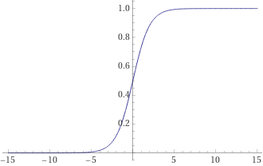
LR’s Approach – visualise sigmoid values
Plot sigmoid
Sigmoid values in plot
Sigmoid values
0.9999
0.9933
0.0064
8*10^-7
0.9975

Slide 11
LR’s Approach – classify to a function
Sigmoid values in plot
Happy-Sad threshold
Sigmoid values | Emotion
0.9999 | Happy
0.9933 | Happy
0.0064 | Sad
8*10^-7 | Sad
0.9975 | Happy

Slide 12
3
How to implement a LR?

Slide 13

LR’s Implementation – revision to LR’s components
Hours of sleep | Hugs had
7 | 5
7.5 | 3
5 | 2
5.5 | 0
8 | 3
LR’s component
Values
14
5
-5
-14
6
LR’s component
Probabilities | Emotion
0.9999 | Happy
0.9933 | Happy
0.0064 | Sad
8*10^-7 | Sad
0.9975 | Happy
$$hours of sleep×2+hugs had×5 −25$$
$$\frac{1}{1+e^{−value}}$$
Linear Predictor
Sigmoid function
Thresholding
Notes:
Three main components, thresholding is a final step

Slide 14
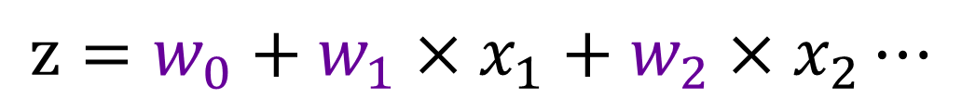
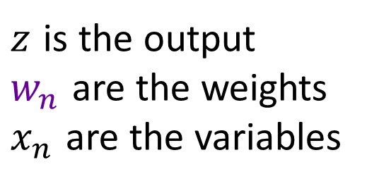
LR’s Implementation – linear predictor
Linear Predictor
$$z=w_{0}+w_{1}×x_{1}+w_{2}×x_{2}⋯$$
$z$ is the output
$w_{n}$ are the weights
$x_{n}$ are the variables
Notes:
Components of a linear predictor

Slide 15
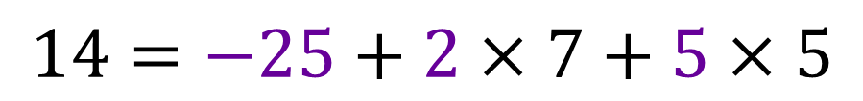
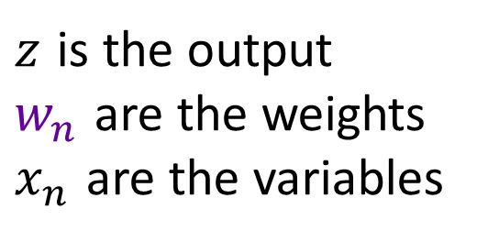
LR’s Implementation – linear predictor
Linear Predictor
$$14=−25+2×7+5×5$$
$z$ is the output
$w_{n}$ are the weights
$x_{n}$ are the variables
Notes:
The first row in the previous example, can anyone tell me which of these corresponds to z, w and x?

Slide 16
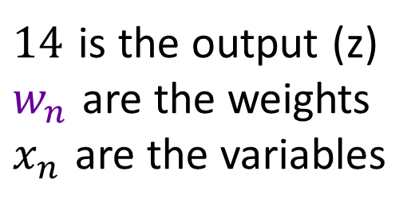
LR’s Implementation – linear predictor
Linear Predictor
$$14=−25+2×7+5×5$$
$14$ is the output (z)
$w_{n}$ are the weights
$x_{n}$ are the variables
Notes:
The first row in the previous example, can anyone tell me which of these corresponds to z, w and x?

Slide 17
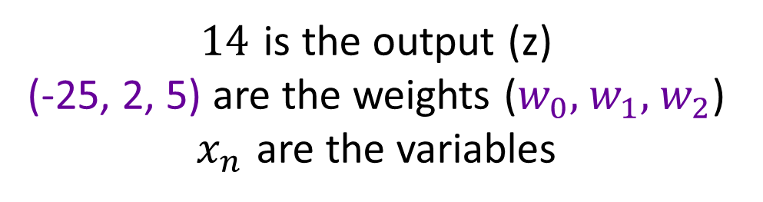
LR’s Implementation – linear predictor
Linear Predictor
$$14=−25+2×7+5×5$$
$14$ is the output (z)
(-25, 2, 5) are the weights ($w_{0},$ $w_{1},$ $w_{2}$)
$x_{n}$ are the variables
Notes:
The first row in the previous example, can anyone tell me which of these corresponds to z, w and x?

Slide 18
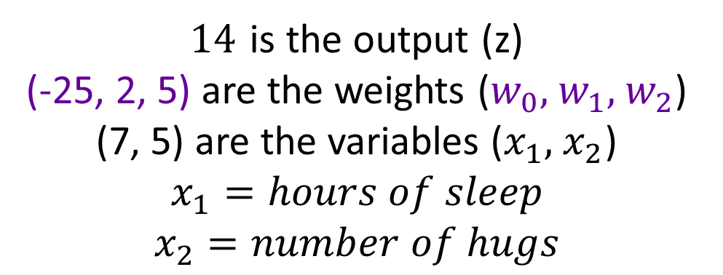
LR’s Implementation – linear predictor
Linear Predictor
$$14=−25+2×7+5×5$$
$14$ is the output (z)
(-25, 2, 5) are the weights ($w_{0},$ $w_{1},$ $w_{2}$)
(7, 5) are the variables ($x_{1},$ $x_{2}$)
$$x_{1}=hours of sleep$$
$$x_{2}=number of hugs$$
Notes:
The first row in the previous example, can anyone tell me which of these corresponds to z, w and x?

Slide 19
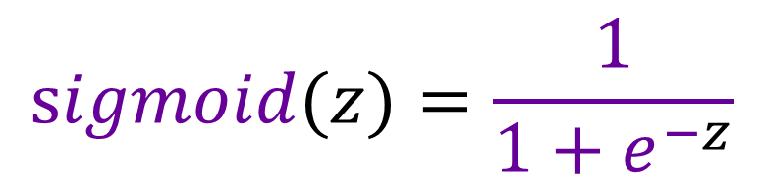
LR’s Implementation – sigmoid function
Sigmoid function
$$sigmoid(z)=\frac{1}{1+e^{−z}}$$
$$e=Euler^{′}s number=2.71828…$$

Slide 20
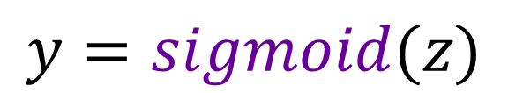

LR’s Implementation – sigmoid function
Sigmoid function
$$y=sigmoid(z)$$
$sigmoid$ is a kind of function

Slide 21
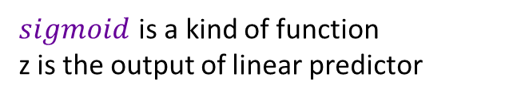
LR’s Implementation – sigmoid function
Sigmoid function
$$y=sigmoid(z)$$
$sigmoid$ is a kind of function
z is the output of linear predictor

Slide 22
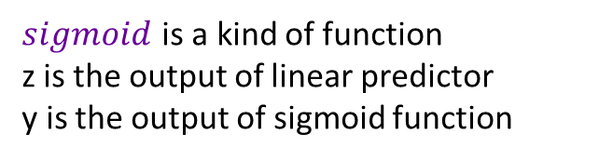
LR’s Implementation – sigmoid function
Sigmoid function
$$y=sigmoid(z)$$
$sigmoid$ is a kind of function
z is the output of linear predictor
y is the output of sigmoid function

Slide 23
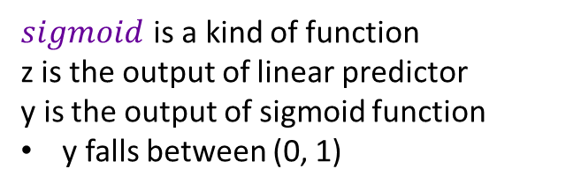
LR’s Implementation – sigmoid function
Sigmoid function
$$y=sigmoid(z)$$
$sigmoid$ is a kind of function
z is the output of linear predictor
y is the output of sigmoid function
y falls between (0, 1)

Slide 24
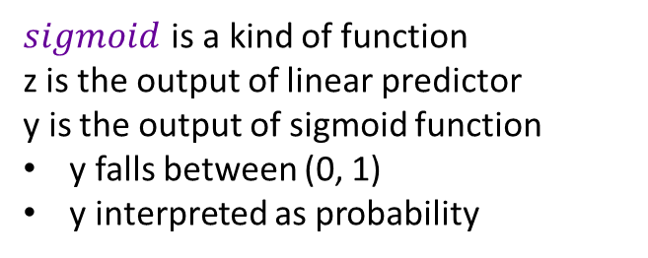
LR’s Implementation – sigmoid function
Sigmoid function
$$y=sigmoid(z)$$
$sigmoid$ is a kind of function
z is the output of linear predictor
y is the output of sigmoid function
y falls between (0, 1)
y interpreted as probability

Slide 25
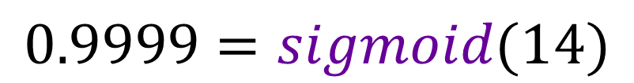
LR’s Implementation – sigmoid function
Sigmoid function
$$0.9999=sigmoid(14)$$
$sigmoid$ is a kind of function
z is the output of linear predictor
y is the output of sigmoid function
y falls between (0, 1)
y interpreted as probability

Slide 26
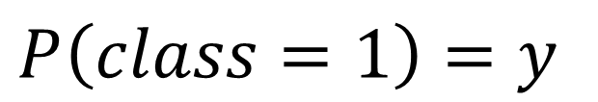
LR’s Implementation – thresholding
$$P\left(class=1\right)=y$$
Thresholding

Slide 27
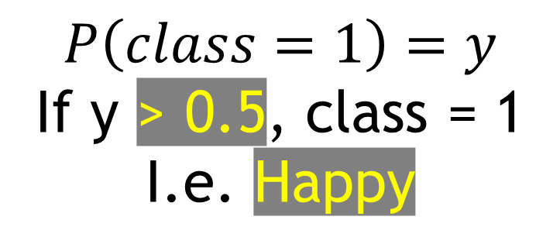
LR’s Implementation – thresholding
$$P\left(class=1\right)=y$$
If y > 0.5, class = 1
I.e. Happy
Thresholding

Slide 28
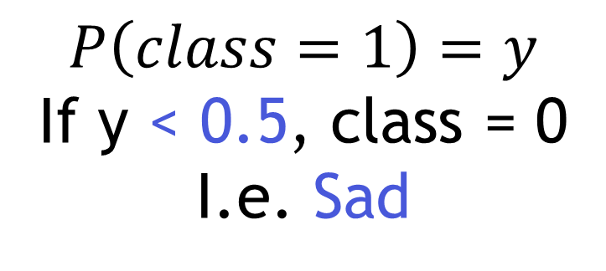
LR’s Implementation – thresholding
$$P\left(class=1\right)=y$$
If y < 0.5, class = 0
I.e. Sad
Thresholding

Slide 29
4
How does it learn?

Slide 30
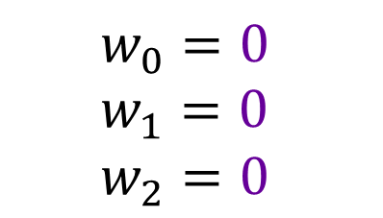
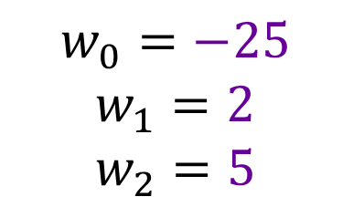
LR’s Learning
?
$$w_{0}=0$$
$w_{1}=0$
$$w_{2}=0$$
$$w_{0}=−25$$
$w_{1}=2$
$$w_{2}=5$$
Notes:
What do we do to find these numbers? This process is what is called learning

Slide 31


LR’s Learning – types of learning
MLE/GD
$$w_{0}=0$$
$w_{1}=0$
$$w_{2}=0$$
$$w_{0}=−25$$
$w_{1}=2$
$$w_{2}=5$$
MLE = Maximum Likelihood Estimation
GD = Gradient Descent
Notes:
The two main kinds of learning

Slide 32
LR’s Learning – difference between MLE and GD
Place the stick to separate as clearly as possible one ball from another
Notes:
Differences, how would you place this stick to separate them as clearly as possible

Slide 33
LR’s Learning – difference between MLE and GD
MLE
Place the stick to separate as clearly as possible one ball from another
Notes:
MLE would find the sum, and half it into two. A one step maximum division

Slide 34
LR’s Learning – difference between MLE and GD
GD
Place the stick to separate as clearly as possible one ball from another
Notes:
GD gradually approaches to the best division, step by step

Slide 35
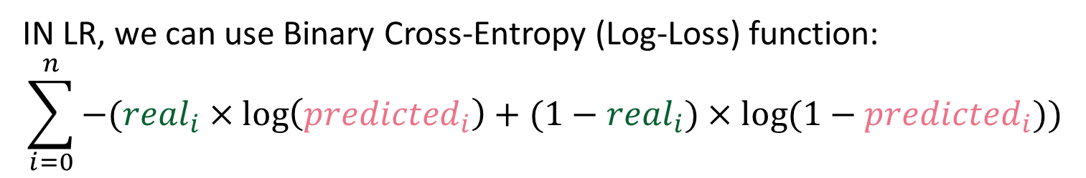
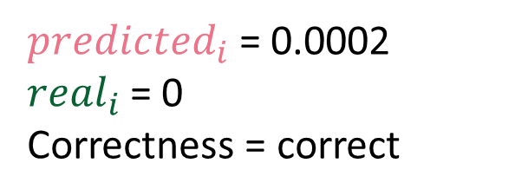
LR’s Learning – loss function
How we measure the “badness” of a separation
IN LR, we can use Binary Cross-Entropy (Log-Loss) function:
$$\sum_{i=0}^{n}{−({real}_{i}×\log\left({predicted}_{i}\right)+(1−{real}_{i})×log⁡(1−{predicted}_{i}))}$$
${predicted}_{i}$ = 0.0002
${real}_{i}$ = 0
Correctness = correct
Log-Loss = ?
Notes:
Lets see what is the result of this

Slide 36
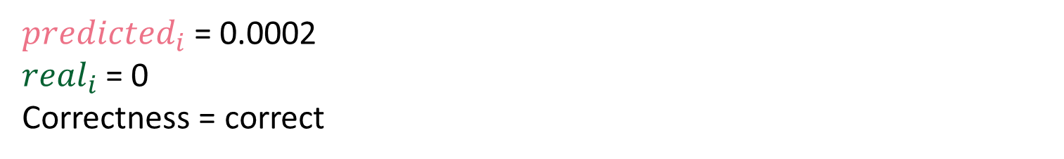
LR’s Learning – loss function
How we measure the “badness” of a separation
IN LR, we can use Binary Cross-Entropy (Log-Loss) function:
$$\sum_{i=0}^{n}{−({real}_{i}×\log\left({predicted}_{i}\right)+(1−{real}_{i})×log⁡(1−{predicted}_{i}))}$$
${predicted}_{i}$ = 0.0002
${real}_{i}$ = 0
Correctness = correct
Log-Loss ≈ 0
Notes:
Okay, log loss is effectively low

Slide 37
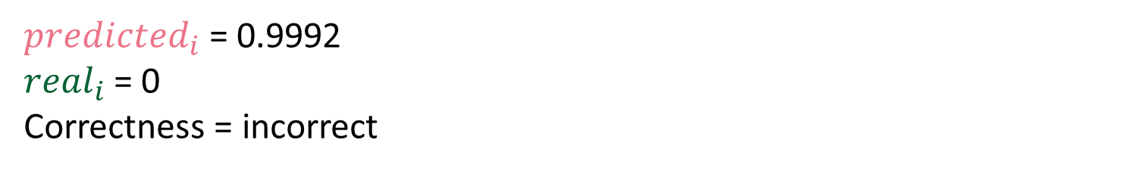
LR’s Learning – loss function
How we measure the “badness” of a separation
IN LR, we can use Binary Cross-Entropy (Log-Loss) function:
$$\sum_{i=0}^{n}{−({real}_{i}×\log\left({predicted}_{i}\right)+(1−{real}_{i})×log⁡(1−{predicted}_{i}))}$$
${predicted}_{i}$ = 0.9992
${real}_{i}$ = 0
Correctness = incorrect
Log-Loss = ?
Notes:
What about this one

Slide 38
LR’s Learning – loss function
How we measure the “badness” of a separation
IN LR, we can use Binary Cross-Entropy (Log-Loss) function:
$$\sum_{i=0}^{n}{−({real}_{i}×\log\left({predicted}_{i}\right)+(1−{real}_{i})×log⁡(1−{predicted}_{i}))}$$
${predicted}_{i}$ = 0.9992
${real}_{i}$ = 0
Correctness = incorrect
Log-Loss ≈ 7.1309
Notes:
The log loss is higher here

Slide 39
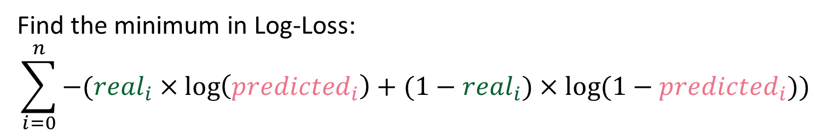
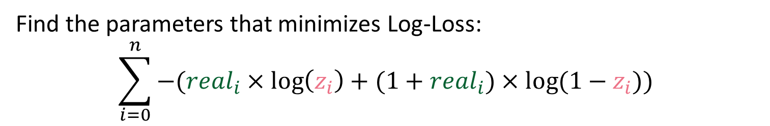
LR’s Learning– Maximum Likelihood Estimation
Find the minimum in Log-Loss:
$$\sum_{i=0}^{n}{−({real}_{i}×\log\left({predicted}_{i}\right)+(1−{real}_{i})×log⁡(1−{predicted}_{i}))}$$
Find the parameters that minimizes Log-Loss:
$$\sum_{i=0}^{n}{−({real}_{i}×\log\left(z_{i}\right)+(1+{real}_{i})×log⁡(1−z_{i}))}$$
Notes:
Here is how MLE would use loss, there is a mathematical, easy way to find the parameters to do so

Slide 40

LR’s Learning– Gradient Descent
Gradually subtract the loss to each of the parameters:
$$\sum_{i=0}^{n}{−({real}_{i}×\log\left({predicted}_{i}\right)+(1−{real}_{i})×log⁡(1−{predicted}_{i}))}$$
This is done via a specific set of steps.
Notes:
Here is how GD would use loss

Slide 41
LR’s Learning – final parameters
MLE/GD
$$w_{0}=0$$
$w_{1}=0$
$$w_{2}=0$$
$$w_{0}=−25$$
$w_{1}=2$
$$w_{2}=5$$
Notes:
The two main kinds of learning

Slide 42

LR’s Learning – ready
Hours of sleep | Hugs had
7 | 5
7.5 | 3
5 | 2
5.5 | 0
8 | 3
LR’s component
Values
14
5
-5
-14
6
LR’s component
Probabilities | Emotion
0.9999 | Happy
0.9933 | Happy
0.0064 | Sad
8*10^-7 | Sad
0.9975 | Happy
$$hours of sleep×2+hugs had×5 −25$$
$$\frac{1}{1+e^{−value}}$$
Linear Predictor
Sigmoid function
Thresholding
Notes:
Three main components, thresholding is a final step

Slide 43
5
EEG Feeling Emotions

Slide 44

https://bit.ly/3TjH5yK

Slide 45
Thank you everyone!

