Slide 1



CIS 631
Parallel Processing
Lecture 11: Parallel Algorithms
Allen D. Malony
malony@cs.uoregon.edu
Department of Computer and Information Science
University of Oregon

Slide 2
Acknowledgements
Portions of the lectures slides were adopted from:
  A. Grama, A. Gupta, G. Karypis, and V. Kumar, “Introduction to Parallel Computing,” 2003.
  Chapters 8, 9, and 10

Slide 3
Outline
Dense matrix algorithms
Sorting algorithms
Graph algorithms

Slide 4
Dense Matrix Algorithms
Great deal of activity in algorithms and software for solving linear algebra problems
  Solution of linear systems ( Ax = b )
  Least-squares solution of over- or under-determined systems ( min ||Ax-b|| )
  Computation of eigenvalues and eigenvectors ( Ax=λx )
  Driven by numerical problem solving in scientific computation
Solutions involves various forms of matrix computations
Focus on high-performance matrix algorithms
  Key insight is to maximize computation to communication

Slide 5
Solving a System of Linear Equations
Ax=b
  a_{0,0}x₀ + a_{0,1}x₁ + … + a_{0,n-1}x_{n-1} = b₀
  a_{1,0}x₀ + a_{1,1}x₁ + … + a_{1,n-1}x_{n-1} = b₁
  …
  A_{n-1,0}x₀ + a_{n-1,1}x₁ + … + a_{n-1,n-1}x_{n-1} = b_{n-1}
Gaussian elimination (classic algorithm)
  Forward elimination to Ux=y (U is upper triangular)
    Without or with partial pivoting
  Back substitution to solve for x
  Parallel algorithms based on partitioning of A

Slide 6
Sequential Gaussian Elimination
1. procedure GAUSSIAN ELIMINATION (A, b, y)
2. Begin
3. for k := 0 to n - 1 do /* Outer loop */
4. begin
5. for j := k + 1 to n - 1 do
6. A[k, j] := A[k, j ]/A[k, k]; /* Division step */
7. y[k] := b[k]/A[k, k];
8. A[k, k] := 1;
9. for i := k + 1 to n - 1 do
10. begin
11. for j := k + 1 to n - 1 do
12. A[i, j] := A[i, j] - A[i, k] x A[k, j ]; /* Elimination step */
13. b[i] := b[i] - A[i, k] x y[k];
14. A[i, k] := 0;
15. endfor; /*Line9*/
16. endfor; /*Line3*/
17. end GAUSSIAN ELIMINATION

Slide 7
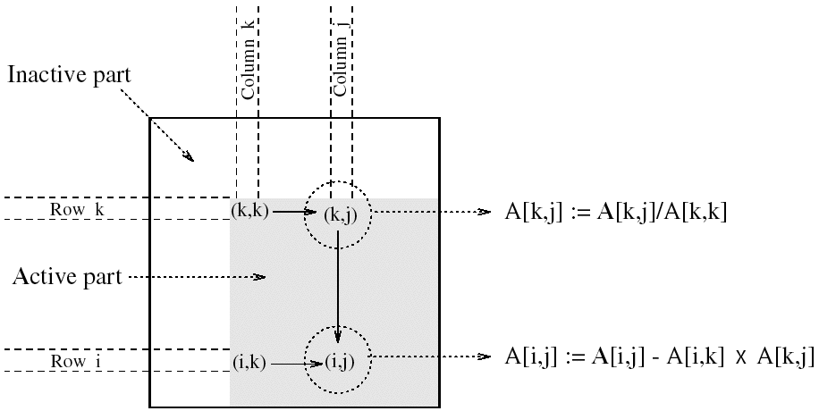
Computation Step in Gaussian Elimination
5x + 3y = 22
8x + 2y = 13
x = (22 - 3y) / 5
8(22 - 3y)/5 + 2y = 13
x = (22 - 3y) / 5
y = (13 - 176/5) / (24/5 + 2)

Slide 8
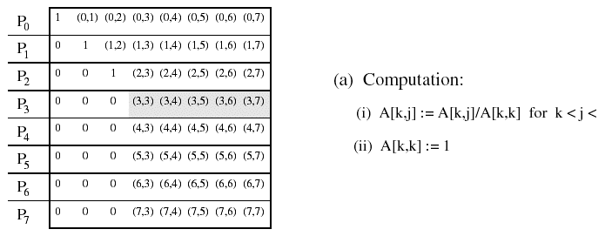
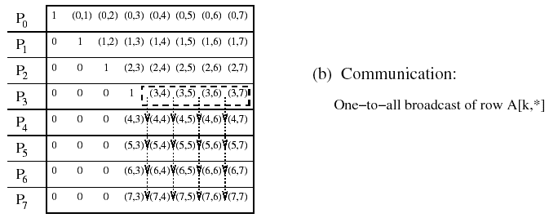
Rowwise Partitioning on Eight Processes
n

Slide 9
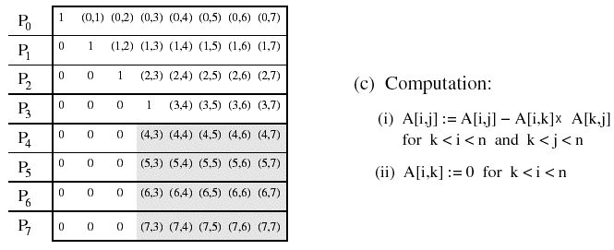
Rowwise Partitioning on Eight Processes

Slide 10
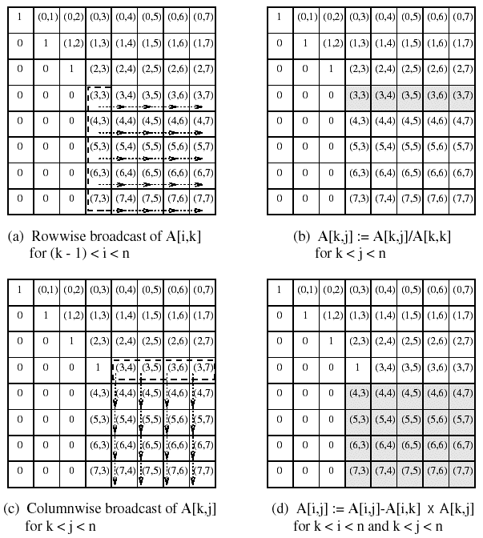
2D Mesh Partitioning on 64 Processes

Slide 11
Back Substitution to Find Solution
1. procedure BACK SUBSTITUTION (U, x, y)
2. begin
3. for k := n - 1 downto 0 do /* Main loop */
4. begin
5. x[k] := y[k];
6. for i := k - 1 downto 0 do
7. y[i] := y[i] - x[k] xU[i, k];
8. endfor;
9. end BACK SUBSTITUTION

Slide 12
Dense Linear Algebra (www.netlib.gov)
Basic Linear Algebra Subroutines (BLAS)
  Level 1 (vector-vector): vectorization
  Level 2 (matrix-vector): vectorization, parallelization
  Level 3 (matrix-matrix): parallelization
LINPACK (Fortran)
  Linear equations and linear least-squares
EISPACK (Fortran)
  Eigenvalues and eigenvectors for matrix classes
LAPACK (Fortran, C) (LINPACK + EISPACK)
  Use BLAS internally
ScaLAPACK (Fortran, C, MPI) (scalable LAPACK)

Slide 13

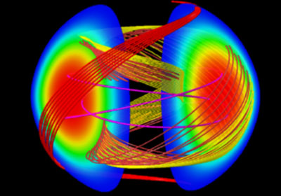
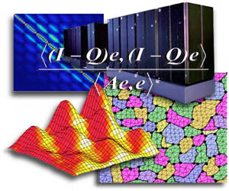
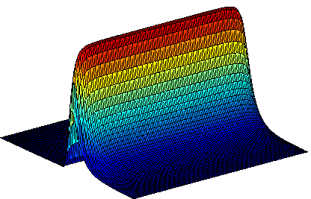

Numerical Libraries
PETSc (http://www.mcs.anl.gov/petsc/petsc-as)
  data structures / routines for partial differential equations
  MPI based
SuperLU (http://crd.lbl.gov/~xiaoye/SuperLU/)
  Large sparse nonsymmetric linear systems
Hypre (http://www.llnl.gov/CASC/hypre)
  Large sparse linear systems
TAO (http://www.mcs.anl.gov/research/projects/tao/)
  Toolkit for Advanced Optimization
DOE ACTS (http://acts.nersc.gov/)
  Advanced CompuTational Software

Slide 14
Sorting Algorithms
Task of arranging unordered collection into order
Permutation of a sequence of elements
Internal versus external sorting
  External sorting uses auxiliary storage
Comparison-based
  Compare pairs of elements and exchange
  O(n log n)
Noncomparison-based
  Use known properties of elements
  O(n)

Slide 15
Sorting on Parallel Computers
Where are the elements stored?
  Need to be distributed across processes
  Sorted order will be with respect to process order
How are comparisons performed?
  One element per process
    compare-exchange
    interprocess communication will dominate execution time
  More than one element per process
    compare-split
Sorting networks
  Based on comparison network model
Contrast with shared memory sorting algorithms

Slide 16
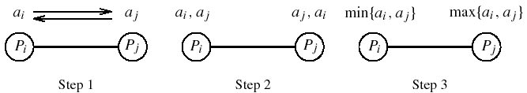
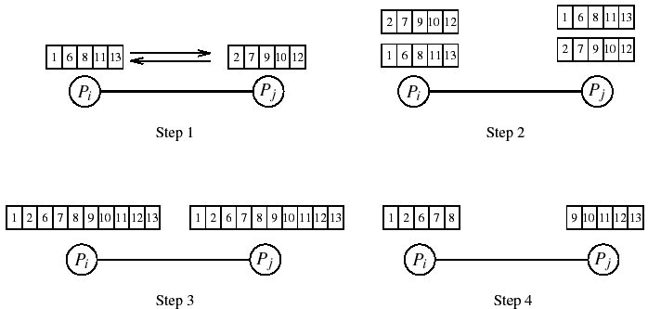
Single vs. Multi Element Comparision
One element per processor
Multiple elements per processor

Slide 17
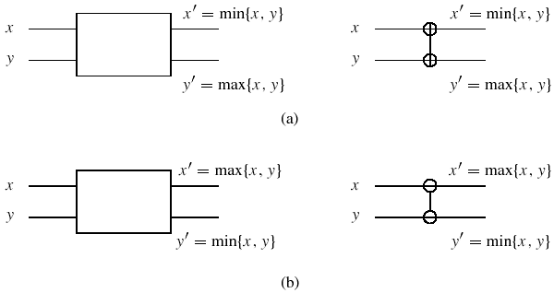
Sorting Networks
Networks to sort n elements in less than O(n log n)
Key component in network is a comparator
  Increasing or decreasing comparator
Comparators connected in parallel and permute elements

Slide 18
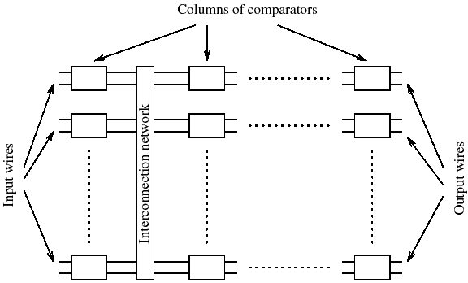
Sorting Network Design
Multiple comparator stages (# stages, # comparators)
Connected together by interconnection network
Output of last stage is the sorted list
O(log²n) sorting time
Convert any
sorting network
to sequential
algorithm

Slide 19
Bitonic Sort
Create a bitonic sequence then sort the sequence
Bitonic sequence
  sequence of elements <a₀, a₁, …, a_{n-1}>
  <a₀, a₁, …, a_{i}> is monotonically increasing
  <a_{i}, a_{i+1}, …, a_{n-1}> is monotonically decreasing
Sorting using bitonic splits is called bitonic merge
Bitonic merge network is a network of comparators
  Implement bitonic merge
Bitonic sequence is formed from unordered sequence
  Bitonic sort creates a bitonic sequence
  Start with sequence of size two (default bitonic)

Slide 20
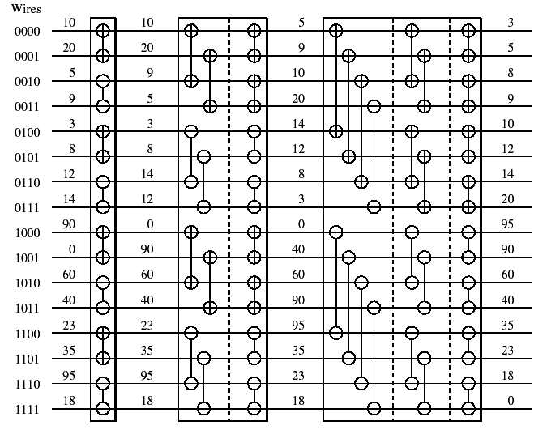
Bitonic Sort Network
Unordered sequence
Bitonic sequence
decrease
increase

Slide 21
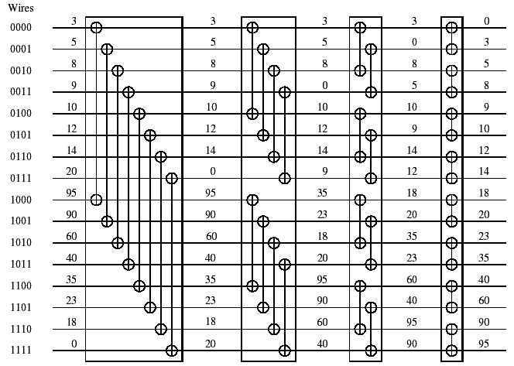
Bitonic Merge Network
Bitonic sequence
Sorted sequence

Slide 22
Parallel Bitonic Sort on a Hypercube
1. procedure BITONIC SORT(label, d)
2. begin
3. for i := 0 to d - 1 do
4. for j := i downto 0 do
5. if (i + 1)st bit of label = j th bit of label then
6. comp exchange max(j);
7. else
8. comp exchange min(j);
9. end BITONIC SORT

Slide 23
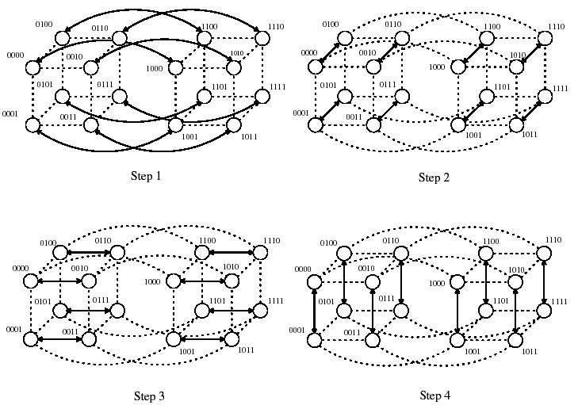
Parallel Bitonic Sort on a Hypercube (Last stage)

Slide 24
Bubble Sort and Variants
Can easily parallelize sorting algorithms of O(n²)
Bubble sort compares and exchanges adjacent elements
  O(n) each pass
  O(n) passes
  Available parallelism?
Odd-even transposition sort
  Compares and exchanges odd and even pairs
  After n phases, elements are sorted
  Available parallelism?

Slide 25
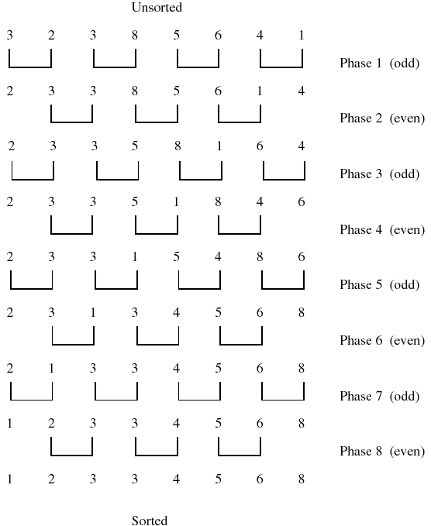
Odd-Even Transposition Sort

Slide 26
Parallel Odd-Even Transposition Sort on Ring
1. procedure ODD-EVEN PAR(n)
2. begin
3. id := process’s label
4. for i := 1 to n do
5. begin
6. if i is odd then
7. if id is odd then
8. compare-exchange min(id + 1);
9. else
10. compare-exchange max(id - 1);
11. if i is even then
12. if id is even then
13. compare-exchange min(id + 1);
14. else
15. compare-exchange max(id - 1);
16. end for
17. end ODD-EVEN PAR

Slide 27
Quicksort
Quicksort has average complexity of O(n log n)
Divide-and-conquer algorithm
  Divide into subsequences where every element in first is less than or equal to every element in the second
  Pivot is used to split the sequence
  Conquer step recursively applies quicksort algorithm
Available parallelism?

Slide 28
Sequential Quicksort
1. procedure QUICKSORT (A, q, r )
2. begin
3. if q < r then
4. begin
5. x := A[q];
6. s := q;
7. for i := q + 1 to r do
8. if A[i] ≤ x then
9. begin
10. s := s + 1;
11. swap(A[s], A[i ]);
12. end if
13. swap(A[q], A[s]);
14. QUICKSORT (A, q, s);
15. QUICKSORT (A, s + 1, r );
16. end if
17. end QUICKSORT

Slide 29
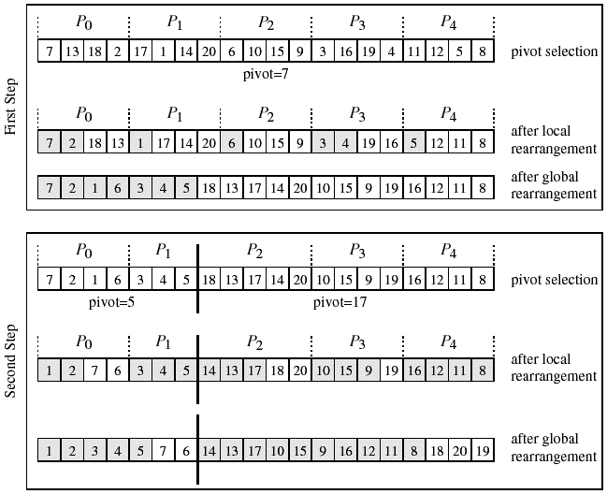
Parallel Shared Address Space Quicksort

Slide 30
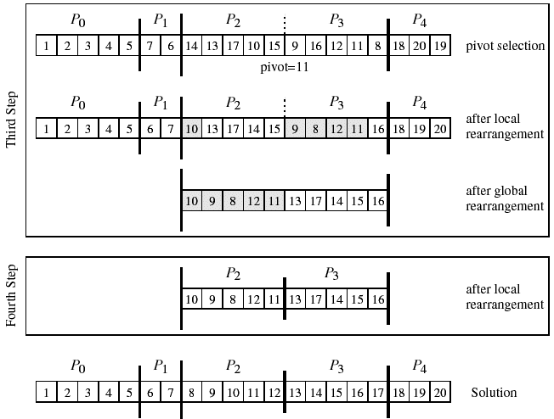
Parallel Shared Address Space Quicksort

Slide 31
Bucket Sort and Sample Sort
Bucket sort is popular when elements (values) are uniformly distributed over an interval
  Create m buckets and place elements in appropriate bucket
  O(n log(n/m))
  If m=n, can use value as index to achieve O(n) time
Sample sort is used when uniformly distributed assumption is not true
  Distributed to m buckets and sort each with quicksort
  Draw sample of size s
  Sort samples and choose m-1 elements to be splitters
  Split into m buckets and proceed with bucket sort

Slide 32
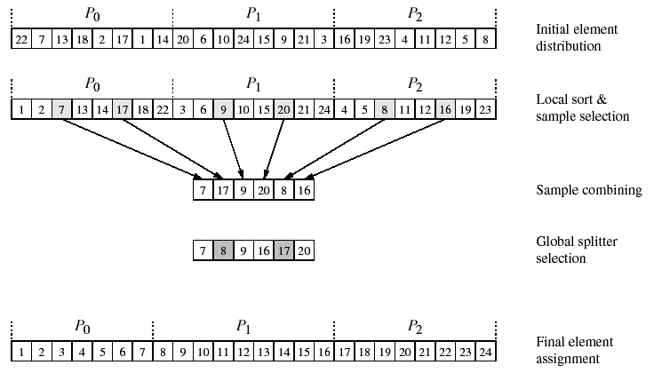
Parallel Sample Sort

Slide 33
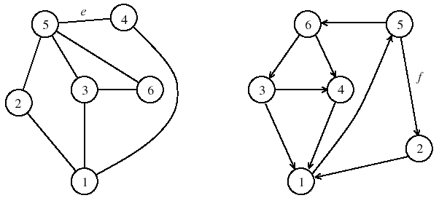
Graph Algorithms
Graph theory important in computer science
Many complex problems are graph problems
G = (V, E)
  V finite set of points called vertices
  E finite set of edges
  e ∈ E is an pair (u,v), where u,v ∈ V
  Unordered and ordered graphs

Slide 34
Graph Terminology
Vertex adjacency if (u,v) is an edge
Path from u to v if there is an edge sequence starting at u and ending at v
If there exists a path, v is reachable from u
A graph is connected if all pairs of vertices are connected by a path
A weighted graph associates weights with each edge
Adjacency matrix is an n x n array A such that
  A_{i,j} = 1 if (v_{i},v_{j}) ∈ E; 0 otherwise
  Can be modified for weighted graphs (∞ is no edge)
  Can represent as adjacency lists

Slide 35
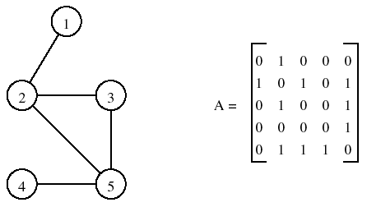
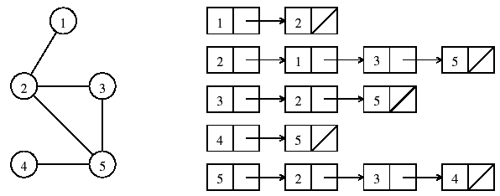
Graph Representations
Adjacency matrix
Adjacency list

Slide 36
Minimum Spanning Tree
A spanning tree of an undirected graph G is a subgraph of G that is a tree containing all the vertices of G
The minimum spanning tree (MST) for a weighted undirected graph is a spanning tree with minimum weight
Prim’s algorithm can be used
  Greedy algorithm
  Selects an arbitrary starting vertex
  Chooses new vertex guaranteed to be in MST
  O(n²)
  Prim’s algorithm is iterative

Slide 37
Prim’s Minimum Spanning Tree Algorithm
1. procedure PRIM MST(V, E,w, r )
2. begin
3. VT := {r };
4. d[r] := 0;
5. for all v ∈ (V - VT ) do
6. if edge (r, v) exists set d[v] := w(r, v);
7. else set d[v] :=∞;
8. while VT ≠ V do
9. begin
10. find a vertex u such that d[u] := min{d[v]|v ∈ (V - VT )};
11. VT := VT ∪ {u};
12. for all v ∈ (V - VT ) do
13. d[v] := min{d[v],w(u, v)};
14. endwhile
15. end PRIM MST
*

Slide 38
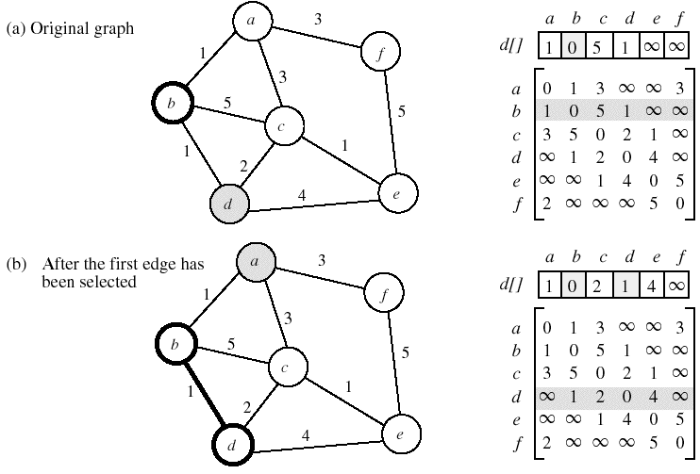
Example: Prim’s MST Algorithm

Slide 39
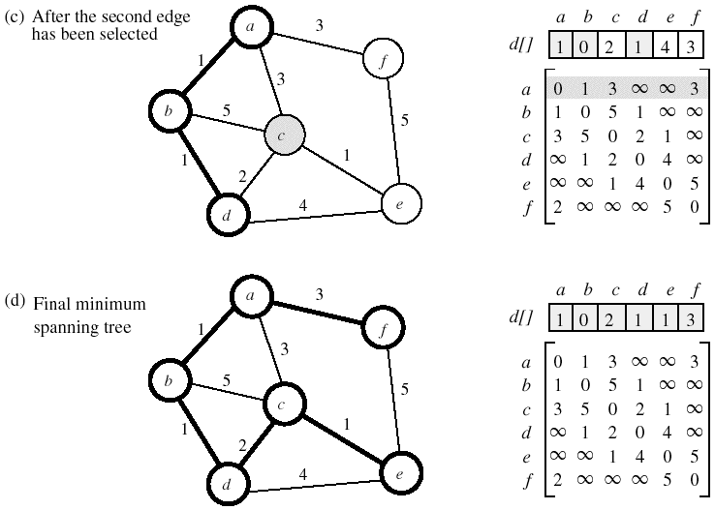
Example: Prim’s MST Algorithm

Slide 40
Parallel Formulation of Prim’s Algorithm
Difficult to perform different iterations of the while loop in parallel because d[v] may change each time
Can parallelize each iteration though
Partition vertices into p subsets V_{i}, i=0,…,p-1
Each process P_{i} computes
  d_{i}[u]=min{d_{i}[v] | v ∈ (V-V_{T}) ∩ V_{i}}
Global minimum is obtained using all-to-one reduction
New vertex is added to V_{T} and broadcast to all processes
New values of d[v] are computed for local vertex
O(n²/p) + O(n log p) (computation + communication)

Slide 41
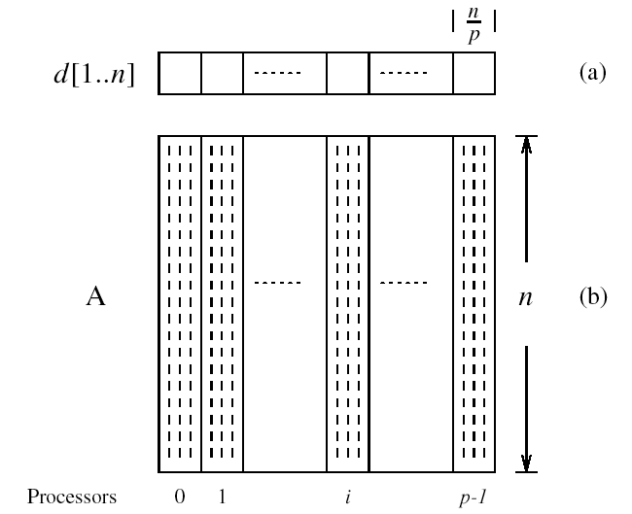
Partitioning in Prim’s Algorithm

Slide 42
Single-Source Shortest Paths
Find shortest path from a vertex v to all other vertices
The shortest path in a weighted graph is the edge with the minimum weight
Weights may represent time, cost, loss, or any other quantity that accumulates additively along a path
Dijkstra’s algorithm finds shortest paths from a vertex s
  Similar to Prim’s MST algorithm
    MST with vertex v as starting vertex
  Incrementally finds shortest paths in greedy manner
  Keep track of minimum cost to reach a vertex from s
  O(n²)

Slide 43
Dijkstra’s Single-Source Shortest Paths Algorithm
1. procedure DIJKSTRA SINGLE SOURCE SP(V, E,w, s)
2. begin
3. V_{T} := {s};
4. for all v ∈ (V - V_{T} ) do
5. if (s, v) exists set l[v] := w(s, v);
6. else set l[v] :=∞;
7. while V_{T} ≠ V do
8. begin
9. find a vertex u such that l[u] := min{l[v]|v ∈ (V - V_{T} )};
10. VT := V_{T} ∪ {u};
11. for all v ∈ (V - V_{T} ) do
12. l[v] := min{l[v], l[u] + w(u, v)};
13. endwhile
14. end DIJKSTRA SINGLE SOURCE SP

Slide 44
Parallel Formulation of Dijkstra’s Algorithm
Very similar to Prim’s MST parallel formulation
Use 1D block mapping as before
All processes perform computation and communication similar to that performed in Prim’s algorithm
Parallel performance is the same
  O(n²/p) + O(n log p)
  Scalability
    O(n²) is the sequential time
    O(n²) / [O(n²/p) + O(n log p)]

Slide 45
All Pairs Shortest Path
Find the shortest path between all pairs of vertices
Outcome is a n x n matrix D={d_{i,j}} such that d_{i,j} is the cost of the shortest path from vertex v_{i} to vertex v_{j}
Dijsktra’s algorithm
  Execute single-source algorithm on each process
  O(n³)
  Source-partitioned formulation (use sequential algorithm)
  Source-parallel formulation (use parallel algorithm)
Floyd’s algorithm
  Builds up distance matrix from the bottom up

Slide 46
Floyd’s All-Pairs Shortest Paths Algorithm
1. procedure FLOYD ALL PAIRS SP(A)
2. begin
3. D⁽⁰⁾ = A;
4. for k := 1 to n do
5. for i := 1 to n do
6. for j := 1 to n do
7. d^{(k)}_{i, j} := min d^{(k-1)}_{i, j} , d^{(k-1)}_{i,k} + d^{(k-1)}_{k, j} ;
8. end FLOYD ALL PAIRS SP

Slide 47
Parallel Floyd’s Algorithm
1. procedure FLOYD ALL PAIRS PARALLEL (A)
2. begin
3. D⁽⁰⁾ = A;
4. for k := 1 to n do
5. forall P_{i,j}, where i, j ≤ n, do in parallel
6. d^{(k)}_{i, j} := min d^{(k-1)}_{i, j} , d^{(k-1)}_{i,k} + d^{(k-1)}_{k, j} ;
7. end FLOYD ALL PAIRS PARALLEL

Slide 48
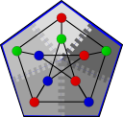
Parallel Graph Algorithm Library – Boost
Parallel Boost Graph Library (Indiana University)
  Generic C++ library for high-performance parallel
  and distributed graph computation
  Builds on the Boost Graph Library (BGL)
    offers similar data structures, algorithms, and syntax
  Research platform for parallel graph algorithms
  Provide solid implementations for solving large-scale graph problems
  Boost Software License (BSD-like)
  D. Gregor and A. Lumsdaine, “The Parallel BGL: A Generic Library for Distributed Graph Computations, Parallel Object-Oriented Scientific Computing (POOSC), July 2005.

Slide 49
Original BGL: Algorithms
Searches (breadth-first, depth-first, A*)
Single-source shortest paths (Dijkstra, Bellman-Ford, DAG)
All-pairs shortest paths (Johnson, Floyd-Warshall)
Minimum spanning tree (Kruskal, Prim)
Components (connected, strongly connected, biconnected)
Maximum cardinality matching
Max-flow (Edmonds-Karp, push-relabel)
Sparse matrix ordering (Cuthill-McKee, King, Sloan, minimum degree)
Layout (Kamada-Kawai, Fruchterman-Reingold, Gursoy-Atun)
Betweenness centrality
PageRank
Isomorphism
Vertex coloring
Transitive closure
Dominator tree

Slide 50
Original BGL Summary
The original BGL is large, stable, efficient
  Lots of algorithms, graph types
  Peer-reviewed code with many users, nightly regression testing, and so on
  Performance comparable to FORTRAN.
Who should use the BGL?
  Programmers comfortable with C++
  Users with graph sizes from tens of vertices to millions of vertices

Slide 51
BGL-Python
Python is ideal for rapid prototyping:
  It’s a scripting language (no compiler)
  Dynamically typed means less typing for you
  Easy to use: you already know Python…
BGL-Python provides access to the BGL from within Python
  Similar interfaces to C++ BGL
  Easier to learn than C++
  Great for scripting, GUI applications
  help(bgl.dijkstra_shortest_paths)

Slide 52
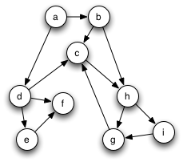
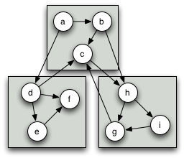
The Parallel BGL
A version of the C++ BGL for computational clusters
  Distributed memory for huge graphs
  Parallel processing for improved performance
An active research project
Closely related to the original BGL
  Parallelizing BGL programs should be “easy”
A simple, directed graph…
distributed across 3 processors

Slide 53
Parallel Graph Algorithms
Breadth-first search
Eager Dijkstra’s single-source shortest paths
Crauser et al. single-source shortest paths
Depth-first search
Minimum spanning tree (Boruvka, Dehne & Götz)
Connected components
Strongly connected components
Biconnected components
PageRank
Graph coloring
Fruchterman-Reingold layout
Max-flow (Dinic’s)

Slide 54
Parallel BGL in Python
Preliminary support for the Parallel BGL in Python
  Just import boost.graph.distributed
  Similar interface to sequential BGL-Python
Several options for usage with MPI:
  Straight MPI: mpirun -np 2 python script.py
  pyMPI: allows interactive use of the interpreter
Initially used to prototype our distributed Fruchterman-Reingold implementation.

Slide 55
Parallel BGL Summary
The Parallel BGL is built for huge graphs
  Millions to hundreds of millions of nodes
  Distributed-memory parallel processing on clusters
  Future work will permit larger graphs…
Parallel programming has a learning curve
  Parallel graph algorithms much harder to write
  Distributed graph manipulation can be tricky
Parallel BGL is an active research library
http://osl.iu.edu/research/pbgl/

Slide 56
Next Class
Algorithms for simulation
Analytical modeling of parallel programs

