Slide 1



CIS 631
Parallel Processing
Lecture 3: Parallel Performance Modeling of Architectures and Algorithms
Allen D. Malony
malony@cs.uoregon.edu
Department of Computer and Information Science
University of Oregon

Slide 2
Acknowledgements
Portions of the lectures slides were adopted from:
  A. Grama, A. Gupta, G. Karypis, and V. Kumar, “Introduction to Parallel Computing,” 2003.
  G. Chen, “Parallel Programming,” Rensselaer Polytechnic Institute, 2002.
  S. William, “The Roofline Model,” Performance Tuning of Scientific Applications, D. Bailey, R. Lucas, and S. Williams (Eds.), CRC Press, 2011.

Slide 3
Logistics
Get ACISS account
Term paper announcement
Exercise 1 announcement

Slide 4
Outline
Performance scalability
Analytical performance measures
Amdahl’s law and Gustafson’s law
Parallel execution models
Isoefficiency
Roofline model

Slide 5
Causes of Performance Loss
If each processor is rated at k MFLOPS and there are p processors, shouldn’t we see k*p MFLOPS performance?
If it takes 100 seconds on 1 processor, shouldn’t it take 10 seconds on 10 processors?
Several causes affect performance
  Each must be understood separately
  But they interact with each other in complex ways
    Solution to one problem may create another
    One problem may mask another
Scaling (system or problem size) can change conditions
Need to understand performance space

Slide 6
Embarrassingly Parallel Computations
An embarrassingly parallel computation is one that can be obviously divided into completely independent parts that can be executed simultaneously
  In a truly embarrassingly parallel computation there is no interaction between separate processes
  In a nearly embarrassingly parallel computation results must be distributed and collected/combined in some way
Embarrassingly parallel computations have potential to achieve maximal speedup on parallel platforms
  If it takes T time sequentially, there is the potential to achieve T/P time running in parallel with P processors
  What would cause this not to be the case always?

Slide 7
Performance Issues
Sequential Performance
Critical Paths
Bottlenecks
Communication Performance
  Overhead and grainsize
  Too many messages
  Global Synchronization
Algorithmic overhead
Load imbalance
Speculative Loss
…

Slide 8
Why Aren’t Parallel Applications Scalable?
Critical Paths
  Dependencies between computations spread across processors
Bottlenecks
  One processor holds things up
Algorithmic overhead
  Some things just take more effort to do in parallel
Communication overhead
  Spending increasing proportion of time on communication
Load Imbalance
  Makes all processor wait for the “slowest” one
  Dynamic behavior
Speculative loss
  Do A and B in parallel, but B is ultimately not needed

Slide 9
Critical Paths
Long chain of dependence
  Main limitation on performance
  Resistance to performance improvement
Diagnostic
  Performance stagnates to a (relatively) fixed value
  Critical path analysis
Solution
  Eliminate long chains if possible
  Shorten chains by removing work from critical path

Slide 10
Bottlenecks
How to detect?
  One processor A is busy while others wait
  Data dependency on the result produced by A
Typical situations:
  N-to-1 reduction / computation / 1-to-N broadcast
  One processor assigning job in response to requests
Solution techniques:
  More efficient communication
  Hierarchical schemes for master slave
Program may not show ill effects for a long time
Shows up when scaling

Slide 11
Algorithmic Overhead
Different sequential algorithms to solve the same problem
All parallel algorithms are sequential when run on 1 processor
All parallel algorithms introduce addition operations (Why?)
  Parallel overhead
Where should be the starting point for a parallel algorithm?
  Best sequential algorithm might not parallelize at all
  Or, it doesn’t parallelize well (e.g., not scalable)
What to do?
  Choose algorithmic variants that minimize overhead
  Use two level algorithms
Performance is the rub
  Are you achieving better parallel performance?
  Must compare with the best sequential algorithm

Slide 12
Embarrassingly Parallel Computations
No or very little communication between processes
Each process can do its tasks without any interaction with other processes
Examples
  Numerical integration
  Mandelbrot set
  Monte Carlo methods
Input Data
. . .
Processes
Results

Slide 13
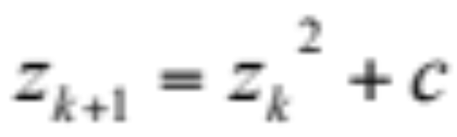
Mandelbrot Set
The Mandelbrot set is a set of points in a complex plane that are "quasi-stable" (will increase and decrease but not exceed some limit) when computed by iterating a function:
  z_{k} is the kth iteration of the complex number z=a+bi
  z_{k+1} is the (k+1)th value of z
  c is a complex number giving the position of the point in the complex plane
  If a point has coordinates (x,y), then c=x+yi

Slide 14
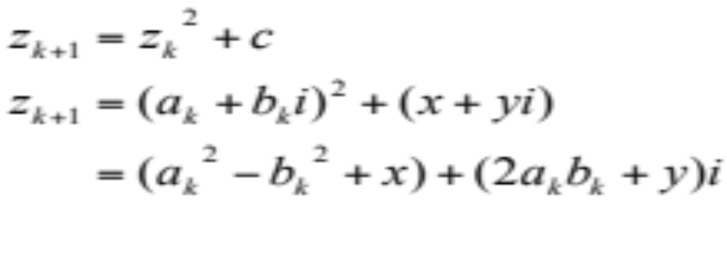
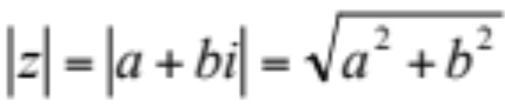
Mandelbrot Set
Computation of a single pixel:
Initial value of z is 0
Iterations are continued until the magnitude of z is greater than 2 (which indicates that eventually z will become infinite) or the number of iterations reaches a threshold
The magnitude of z is given by

Slide 15

Mandelbrot Visualization
Black points do not go to infinity
Colors are added to the points that are not in the set
y
1.5
x
-2.0
1.0
-1.5

Slide 16

Parallelizing Mandelbrot Computation
Mandelbrot set is embarrassingly parallel – computation of any two pixels is completely independent
The numbers of iterations (execution times) for the computation on different pixels are different?
Parallelization strategies:
  Block partitioning
    mapping greatly affects performance
  Dynamic assignment
...

Slide 17
Monte Carlo Methods
Monte Carlo methods
  Based on the use of random selections in calculations leading to the solution of numerical and physical problems
  Similarity of statistical simulation to games of chance
  Also referred to as Monte Carlo simulation
Not all simulations involving the use of random number are Monte Carlo simulation
  Only those in which the passage of time plays no substantial role are
Calculation on different points are independent
It is embarrassingly parallel
Need to generate independent random number sequences

Slide 18
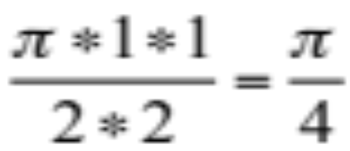
Calculating π with Monte Carlo
Consider a circle of unit radius
Place circle inside a square box with length of side 2
The ratio of the circle area to the area of the square is:
2 in

Slide 19
Monte Carlo Calculation of π
Randomly choose a number of points in the square
For each point p, determine if p is inside the circle
The ratio of points in the circle to points in the square will give an approximation of π/4

Slide 20
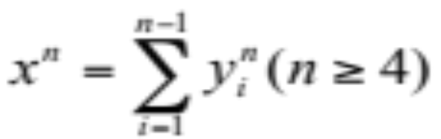
Euler’s Conjecture
It is impossible to exhibit three fourth powers whose sum is a fourth power, four fifth powers whose sum is a fifth power, and similarly for higher powers, Euler, 1769
Is in fact a generalized Fermat’s Last Theorem
  Proved by Wiles in 1994
The first counterexample was found by Lander and Parkin in 1966
  144⁵ = 133⁵+110⁵+84⁵ +27⁵
A counterexample for the fourth power was found by Elkies, 1988
  422481⁴ = 414560⁴+217519⁴+95800⁴
No counterexample known for n>5

Slide 21
EulerNet
http://euler.free.fr/
The main goal is to find a sixth power that is equal to the sum of five sixth powers
Each participant downloads a small program that will run in the background when the CPU is idle
The program acquires a range of numbers that need to be checked from the EulerNet server
Solutions will be reported to the server once the Internet connection is available
Distributed Computing
  The computational problem to be solved must be embarrassingly parallel

Slide 22
Performance Metrics
T₁ is the execution time on a single processor system
T_{p} is the execution time on a p processor system
S(p) (S_{p}) is the speedup
E(p) (E_{p}) is the efficiency
Cost(p) (C_{p}) is the cost
T₁
T_{p}
S( p) =
S_{p}
p
Efficiency =
Cost = p × T_{p}

Slide 23
Performance Metrics
Parallel algorithm is cost-optimal
  parallel cost = sequential time
  C_{p} = T₁
  E_{p} = 100%
Critical when down-scaling
  Parallel algorithm may become slower than sequential

Slide 24
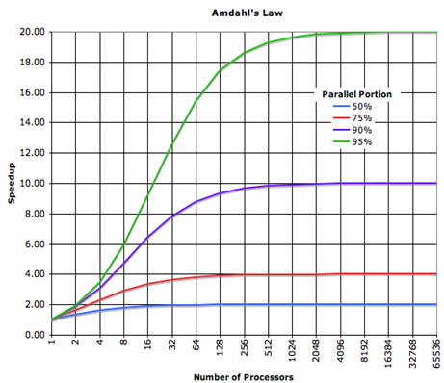
Amdahl’s Law (Fixed Problem Size Speedup)
Let f be the fraction of a program that is sequential
  1-f is the fraction that can be parallelized
Let T₁ be the execution time on 1 processor
Let T_{p} be the execution time on p processors
S_{p} is the speedup
  S_{p} = T₁ / T_{p}
  = T₁ / (f* T₁ +(1-f)* T₁ /p))
  = 1 / (f +(1-f)/p))
As p → ∞
  S_{p} = 1 / f
Uhh, this is not good …

Slide 25
Performance and Scalability
Evaluation
  Sequential runtime is a function of
    problem size and architecture
  Parallel runtime is a function of
    problem size and parallel architecture
    # processors
  Parallel performance affected by
    algorithm + architecture
Scalability
  Ability of parallel algorithm to achieve performance gains proportional with respect to the number of processors
Strong scaling
  problem size is fixed

Slide 26
Gustafson’s Law (Scaled Speedup)
Often interested in running larger problems when scaling
Problem size is determined by constraint on parallel time
Assume parallel time is kept constant
  T_{p} = C = (f +(1-f)) * C
  f_{seq} is the fraction of T_{p} spent in sequential execution
  f_{par} is the fraction of T_{p} spent in parallel execution
What is the execution time on one processor?
  Let C=1, then T_{s} = f_{seq} + p(1 – f_{seq} ) = 1 + (p-1)f_{par}
What is the speedup in this case?
  S_{p} = T_{s} / T_{p} = T_{s} / 1 = f_{seq} + p(1 – f_{seq}) = 1 + (p-1)f_{par}
Scale the problem size as increase number of processors!

Slide 27
Scalability
A program can scale up to use many processors
  What does that mean?
How do you evaluate scalability?
How do you evaluate scalability goodness?
Comparative evaluation
  If double the number of processors, what to expect?
  Is scalability linear?
Use parallel efficiency measure
  Is parallel efficiency retained as problem size increases?
Apply performance metrics
Weak scaling
  problem size can increase

Slide 28
P and NP
P: solved in polynomial time n^{O(1)}
NP: verified in polynomial time n^{O(1)}
Every known NP problem can be solved in exponential time n^{O(n)}
A problem is NP-complete if:
  It is an NP problem, and
  Every problem in NP can be polynomially reduced into this problem

Slide 29
Parallel Feasibility
A problem is feasible if it can be solved by a parallel algorithm with worst case time complexity n^{O(1)} and processor complexity n^{O(1)}
A problem is highly parallel if it can be solved by a parallel algorithm worst case time complexity (log n)^{O(1)} and processor complexity n^{O(1)}
A parallel algorithm is inherently sequential if it is feasible, but has no feasible highly parallel algorithm for its solution
The class of feasible parallel problems is equivalent to the class of P

Slide 30
NC and P-Complete
NC (Nick’s Class) is the class of highly parallel problems
There is a general belief, but not a proof, that P≠NC
A problem L is said to be P-complete if
  L∈P, and
  Every other problem in P can be transformed to L in polylogarithmic (log n)^{O(1)} parallel time using n^{O(1)} processors
Such a transformation is said to be an NC-reduction
A P-complete problem is inherently sequential
If we could find (unlikely) an L∈P-Complete and L∈NC, the it would follow that P=NC

Slide 31
Parallel Computation Thesis
Polynomial sequential space is related to polylogarithmic parallel time
In other words, what can be computed in n^{O(1)} sequential space can be computed in (log n)^{O(1)} parallel time, and vice versa
If a problem p₁ can be transformed to the problem p₂ using polynomial space, then the transformation is also possible using an NC reduction

Slide 32
An NC Problem
Sum
  Given: natural numbers a₁,a₂,…,a_{n}
  Problem: what is a₁+a₂+…+a_{n}?
Sequential time complexity
  O(n)
Parallel time complexity
  n processors: O(log n)
S_{p} = O(n/log n)
E_{p} =O(1/log n)
Cost optimal

Slide 33
Another NC Problem
Matrix multiplication
  Given: two nxn matrices A and B
  Problem: what is AxB?
Sequential time complexity
  O(n³)
Parallel time complexity
  n processors: O(n²)
  n² processors: O(n)
  n³ processors: O(log n)

Slide 34
Question
For a problem with sequential time complexity T(n)=n^{O(1)}
  If the problem can be solved cost-optimally using n processors, is it highly parallel?
  If the problem can be solved cost-optimally using T(n) processors, is it highly parallel?

Slide 35
Review
A problem in P is highly parallel (NC) if it runs in polylogarithmic time (log n)^{O(1)} on polynomial n^{O(1)} processors; otherwise, it is inherently sequential
A P problem is P-complete if every problem in P can be transformed into this problem using an NC-reduction
A P-complete problem is very unlikely to be highly parallel

Slide 36
Major Analytical / Theoretical Techniques
Typically involves simple algebraic formulas, and ratios
  Typical variables are:
    data size (N), number of processors (P), machine constants
  Model performance of individual operations, components, algorithms in terms of the above
    Be careful to characterize variations across processors, and model them with (typically) max operators
  Constants are important in practical parallel computing
    Be wary of asymptotic analysis: use it, but carefully
Scalability analysis:
  Isoefficiency
(See Kumar paper online and chapter slides)

Slide 37
Isoefficiency
Quantify scalability
How much increase in problem size is needed to retain the same efficiency on a larger machine?
Efficiency
  T1 / (p * Tp)
  Tp = computation + communication + idle
Isoefficiency
  Equation for equal-efficiency curves
  If no solution
    problem is not scalable in the
    sense defined by isoefficiency
Equal efficiency curves
problem size
processors

Slide 38
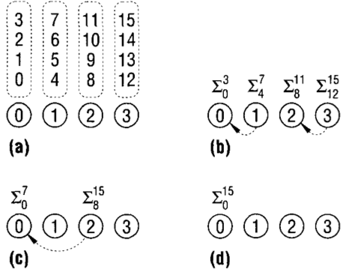
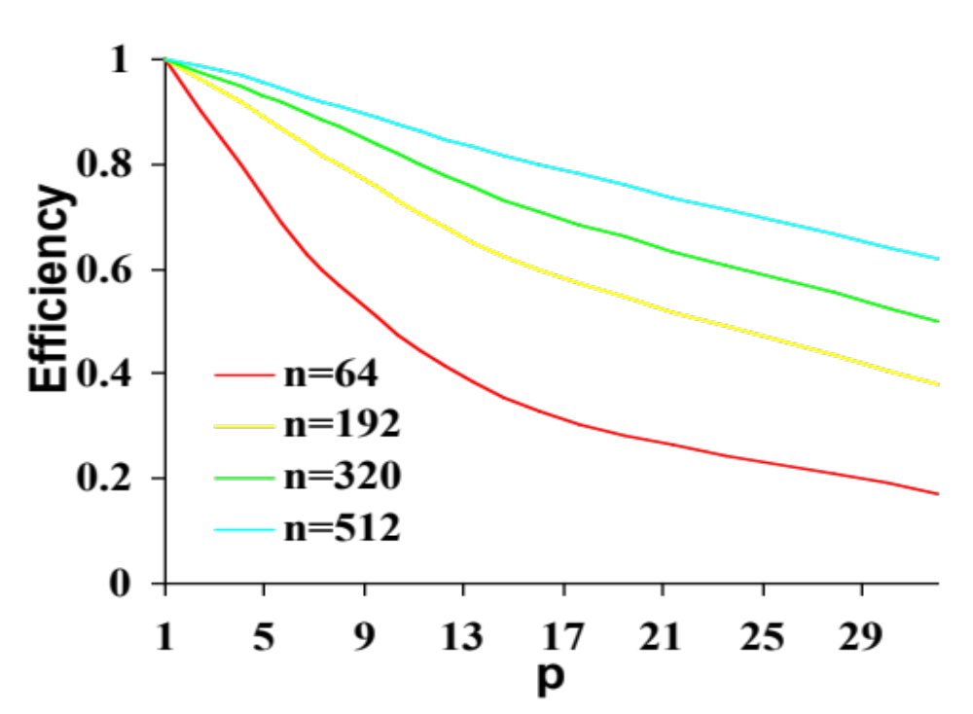
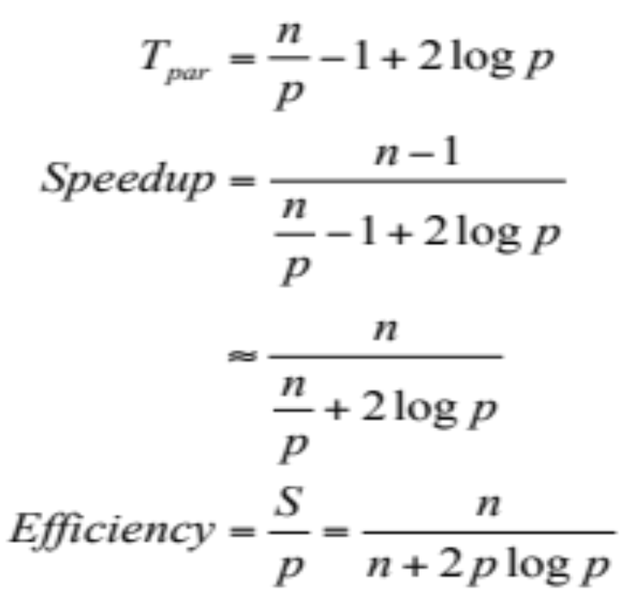
Scalability of Adding n Numbers
Scalability of a parallel system is a
measure of its capacity to increase
speedup with more processors
Adding n numbers on p processors
with strip partition:

Slide 39
Problem Size
Informally, problem size is expressed as a parameter of the input size
  How do we define the problem size for an nxn matrix?
A consistent definition of the size of the problem is the total number of basic operations required to solve the problem, or T_{seq}
Also refer to problem size as “work”, denoted it by W:
W = T_{seq}

Slide 40
Overhead Function
The overhead function of a parallel system is defined as the part of the cost that is not incurred by the best serial algorithm
Denoted by T_{O}, it is a function of W and p
T_{O}(W,p) = pT_{par} - W (pT_{par} includes overhead)
T_{O}(W,p) + W = pT_{par}
Overhead function of adding n numbers on p processor
T_{O}(W,p)=p(n/p - 1 + 2log(p)) - (n-1) ≈ 2plog(p)

Slide 41
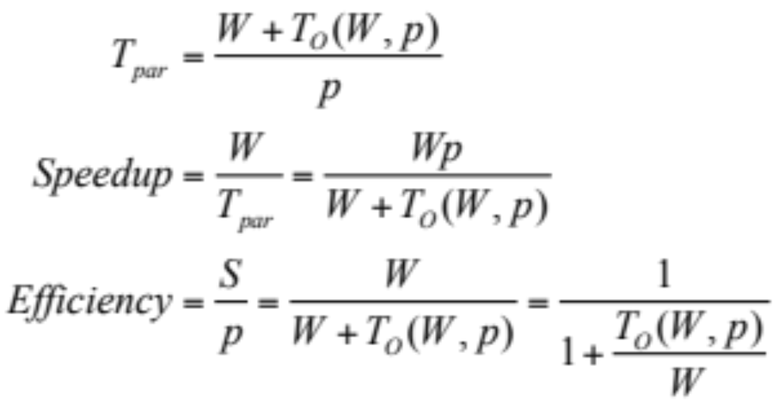
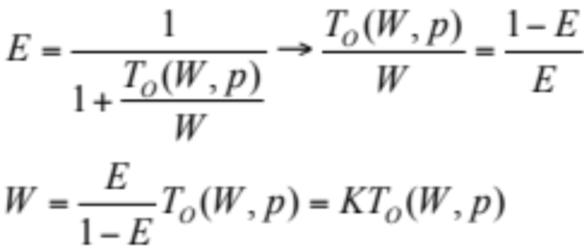
Isoefficiency Function
With a fixed efficiency, W can be expressed as a function of p
W = T_{seq}
Isoefficiency Function

Slide 42
Isoefficiency Function of Adding n Numbers
Overhead function:
  T_{O}(W,p) = pT_{par} – W = 2plog(p)
Isoefficiency function:
  W=K*2plog(p)
If p doubles, W needs also to be doubled to roughly maintain the same efficiency
…
…
.
.
.

Slide 43
More Complex Isoefficiency Functions
A typical overhead function T_{O} can have several distinct terms of different orders of magnitude with respect to both p and W
We can balance W against each term of T_{O} and compute the respective isoefficiency functions for individual terms
  Keep only the term that requires the highest grow rate with respect to p
  This is the asymptotic isoefficiency function

Slide 44


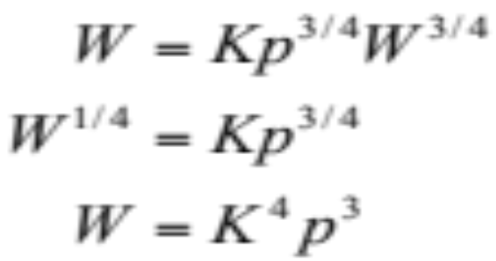
Isoefficiency
Consider a parallel system with an overhead function
Using only the first term
Using only the second term
K⁴p³ gives the overall asymptotic isoefficiency function

Slide 45
Parallel Computation Models
PRAM (parallel RAM)
BSP
LogP
Roofline

Slide 46
PRAM
Parallel Random Access Machine (PRAM)
Shared-memory multiprocessor model
Unlimited number of processors
  Unlimited local memory
  Each processor knows its ID
Unlimited shared memory
Inputs/outputs are placed in shared memory
Memory cells can store an arbitrarily large integer
Each instruction takes unit time
Instructions are sychronized across processors (SIMD)

Slide 47
PRAM Complexity Measures
For each individual processor
  Time: number of instructions executed
  Space: number of memory cells accessed
PRAM machine
  Time: time taken by the longest running processor
  Hardware: maximum number of active processors
Technical issues
  How processors are activated
  How shared memory is accessed

Slide 48
Processor Activation
P₀ places the number of processors (p) in the designated shared-memory cell
  Each active P_{i}, where i < p, starts executing
  O(1) time to activate
  All processors halt when P₀ halts
Active processors explicitly activate additional processors via FORK instructions
  Tree-like activation
  O(log p) time to activate

Slide 49
PRAM is a Theoretical (Unfeasible) Model
Interconnection network between processors and memory would require a very large amount of area
The message-routing on the interconnection network would require time proportional to network size
Algorithm’s designers can forget the communication problems and focus their attention on the parallel computation only
There exist algorithms simulating any PRAM algorithm on bounded degree networks
Design general algorithms for the PRAM model and simulate them on a feasible network

Slide 50
Classification of PRAM Models
EREW (Exclusive Read Exclusive Write)
  No concurrent read/writes to the same memory location
CREW (Concurrent Read Exclusive Write)
  Multiple processors may read from the same global memory location in the same instruction step
ERCW (Exclusive Read Concurrent Write)
  Concurrent writes allowed
CRCW (Concurrent Read Concurrent Write)
  Concurrent reads and writes allowed
CRCW > (ERCW,CREW) > EREW

Slide 51
CRCW PRAM Models
COMMON: all processors concurrently writing into the same address must be writing the same value
ARBITRARY: if multiple processors concurrently write to the address, one of the competing processors is randomly chosen and its value is written into the register
PRIORITY: if multiple processors concurrently write to the address, the processor with the highest priority succeeds in writing its value to the memory location
COMBINING: the value stored is some combination of the values written, e.g., sum, min, or max
COMMON-CRCW model most often used

Slide 52
Complexity of PRAM Algorithms
Problem
 | EREW | CRCW
Search | O(log n) | O(1)
List Ranking | O(log n) | O(log n)
Prefix | O(log n) | O(log n)
Tree Ranking | O(log n) | O(log n)
Finding Minimum | O(log n) | O(1)
Model

Slide 53
BSP Overview
Bulk Synchronous Parallelism
A parallel programming model
Invented by Leslie Valiant at Harvard
Enables performance prediction
SPMD style
Supports both direct memory access and message passing
BSPlib is a BSP library implemented at Oxford

Slide 54
Components of BSP Computer
A set of processor-memory pairs
A communication point-to-point network
A mechanism for efficient barrier synchronization of all processors
Communication Network
Memory
Memory
. . .
Memory
Processor
Processor
. . .
Processor

Slide 55
Supersteps
A BSP computation consists of a sequence of supersteps
In each superstep, processes execute computations using locally available data, and issue communication requests
Processes synchronized at the end of the superstep, at which all communications issued have been completed
p₀
p₁
p₂
p₃
p₄
Superstep
Barrier
Synchronization

Slide 56
BSP Parameters
p = number of processors
l = barrier latency, cost of achieving barrier synchronization
g = communication cost per word
s = processor speed
l, g, and s are measured in FLOPS
Any processor sends and receives at most h messages in a single superstep ( called h-relation communication)
Time for a superstep = max number of local operations performed by any one processor + g*h + l

Slide 57
The LogP Model (Culler, Berkeley)
Processing
  Powerful microprocessor, large DRAM, cache => P
Communication
  Significant latency (100's of cycles) => L
  Limited bandwidth (1 – 5% of memory) => g
  Significant overhead (10's – 100's of cycles) => o
    on both ends
    no consensus on topology
    should not exploit structure
  Limited capacity
No consensus on programming model
  Should not enforce one

Slide 58
LogP
P ( processors )
P
M
P
M
P
M
° ° °
o (overhead)
o
g (gap)
L (latency)
Limited Volume
Interconnection Network
(
L/ g
to or from
a processor)
Latency in sending a (small) mesage between modules
overhead felt by the processor on sending or receiving message
gap between successive sends or receives (1/BW)
Processors

Slide 59
LogP ”Philosophy"
Think about:
  Mapping of N words onto P processors
  Computation within a processor, its cost, and balance
  Communication between processors, its cost, and balance
Characterize the processor and network performance
Do not think about what happens within the network
This should be enough

Slide 60
Typical Values for g and l
 | p | g | l
Multiprocessor Sun | 2-4 | 3 | 50-100
SGI Origin 2000 | 2-8 | 10-15 | 1000-4000
IBM-SP2 | 2-8 | 10 | 2000-5000
NOW (Network of Workstations) | 2-8 | 40 | 5000-20000

Slide 61
Roofline Model (S. Williams)
AMD Barcelona
Sun Victoria Falls
Opteron
Opteron
Opteron
Opteron
Opteron
Opteron
Opteron
Opteron
512KB
victim
512KB
victim
512KB
victim
512KB
victim
4GB/s
(each direction)
512KB
victim
512KB
victim
512KB
victim
512KB
victim
MT SPARC
MT SPARC
MT SPARC
MT SPARC
MT SPARC
MT SPARC
MT SPARC
MT SPARC
MT SPARC
MT SPARC
MT SPARC
MT SPARC
MT SPARC
MT SPARC
MT SPARC
HyperTransport
HyperTransport
MT SPARC
2MB Shared quasi-victim (32 way)
2MB Shared quasi-victim (32 way)
Crossbar
Crossbar
SRI / crossbar
SRI / crossbar
179 GB/s
90 GB/s
8 x 6.4 GB/s
(1 per hub per direction)
179 GB/s
90 GB/s
2x64b memory controllers
2x64b memory controllers
4MB Shared L2 (16 way)
(64b interleaved)
4MB Shared L2 (16 way)
(64b interleaved)
10.66 GB/s
10.66 GB/s
4 Coherency Hubs
4 Coherency Hubs
667MHz DDR2 DIMMs
667MHz DDR2 DIMMs
2x128b controllers
2x128b controllers
21.33 GB/s
10.66 GB/s
21.33 GB/s
10.66 GB/s
667MHz FBDIMMs
667MHz FBDIMMs
IBM Cell Blade
NVIDIA G80
VMT
PPE
SPE
SPE
SPE
SPE
VMT
PPE
Thread
Cluster
Thread
Cluster
SPE
SPE
SPE
SPE
SPE
SPE
SPE
SPE
SPE
SPE
SPE
SPE
256K
256K
256K
256K
256K
256K
256K
256K
256K
512K
L2
256K
256K
256K
256K
256K
256K
256K
512K
L2
Thread
Cluster
Thread
Cluster
BIF
BIF
MFC
MFC
<20GB/s
(each direction)
MFC
MFC
MFC
MFC
MFC
MFC
MFC
MFC
MFC
MFC
MFC
MFC
MFC
MFC
interconnect
EIB (ring network)
EIB (ring network)
Thread
Cluster
Thread
Cluster
XDR memory controllers
XDR memory controllers
Thread
Cluster
Thread
Cluster
25.6 GB/s
25.6 GB/s
512MB XDR DRAM
512MB XDR DRAM
192KB L2 (Textures only)
24 ROPs
6 x 64b memory controllers
86.4 GB/s
768MB 900MHz GDDR3 Device DRAM

Slide 62
Challenges / Goals
We have extremely varied architectures
Moreover, the characteristics of numerical methods can vary dramatically
The result is that performance and the benefit of optimization can vary significantly from one
architecture x kernel combination to the next
We wish to understand whether or not we have attained good performance (high fraction of a theoretical peak)
We wish to identify performance bottlenecks and enumerate potential remediation strategies

Slide 63
Performance Optimization: Contending Forces
Contending forces of device efficiency and usage/traffic
We improve time to solution by improving throughput (efficiency) and reducing traffic
Improve
Throughput
(Gflop/s, GB/s, etc…)
Reduce
Volume of Data
(Flop’s, GB’s, etc…)

Slide 64
Performance Optimization: Contending Forces
Contending forces of device efficiency and usage/traffic
We improve time to solution by improving throughput (efficiency) and reducing traffic
In practice, we are willing to sacrifice one in order to improve the time to solution
Restructure
to satisfy
Little’s Law
Implementation &
Algorithmic
Optimization

Slide 65
Basic Throughput Quantities
At all levels of the system (register files through networks), there are three fundamental (efficiency-oriented) quantities:
  Latency
    every operation requires time to execute
  (i.e. instruction, memory or network latency)
  Bandwidth
    # of (parallel) operations completed per cycle
  (i.e. #FPUs, DRAM, Network, etc…)
  Concurrency
    total # of operations in flight

Slide 66
Little’s Law
Little’s Law:
Concurrency = Latency * Bandwidth
- or –
Effective Throughput = Expressed Concurrency / Latency
This concurrency must be filled with parallel operations
Can not exceed peak throughput with more concurrency
  each channel has a maximum throughput
Consider a CPU with 2 FPU’s each with a 4-cycle latency
  Little’s law states that we must express 8-way ILP to fully utilize the machine

Slide 67
Three Classes of Locality
Temporal Locality
  Reusing data (either registers or cache lines) multiple times
  Amortizes the impact of limited bandwidth
  Transform loops or algorithms to maximize reuse
Spatial Locality
  Data is transferred from cache to registers in words
  However, data is transferred to the cache in 64-128Byte lines
  Using every word in a line maximizes spatial locality
  Transform data structures into structure of arrays (SoA) layout
Sequential Locality
  Many memory address patterns access cache lines sequentially
  CPU’s hardware stream prefetchers exploit this observation to hide speculatively load data to memory latency
  Transform loops to generate (a few) long, unit-stride accesses

Slide 68
Arithmetic Intensity
O( log(N) )
True Arithmetic Intensity (AI)
  AI ~ Total Flops / Total DRAM Bytes
Some HPC kernels have an arithmetic intensity that scales with problem size (increased temporal locality)
Others have constant intensity
Arithmetic intensity is ultimately limited by compulsory traffic
Arithmetic intensity is diminished by conflict or capacity misses
O( 1 )
O( N )
SpMV, BLAS1,2
FFTs
Stencils (PDEs)
Dense Linear Algebra
(BLAS3)
Lattice Methods
Particle Methods

Slide 69
Overlap of Communication
Consider a simple example in which a FP kernel maintains a working set in DRAM
We assume we can perfectly overlap computation with communication
  Either through prefetching/DMA and/or pipelining (decoupling of communication and computation)
Time is the maximum of the time required to transfer the data and the time required to perform the FP operations
Byte’s / STREAM Bandwidth
Flop’s / Flop/s
time

Slide 70
Basic Concept
Synthesize communication, computation, and locality into a single visually-intuitive performance figure using bound and bottleneck analysis
Where i and j are optimizations
Given a kernel’s arithmetic intensity (based on DRAM traffic after being filtered by the cache), programmers can inspect the figure, and bound performance
Moreover, provides insights as to which optimizations will potentially be beneficial
Attainable
Performance_{ij}
= min
FLOP/s with Optimizations_{1-i}
AI * Bandwidth with Optimizations_{1-j}

Slide 71
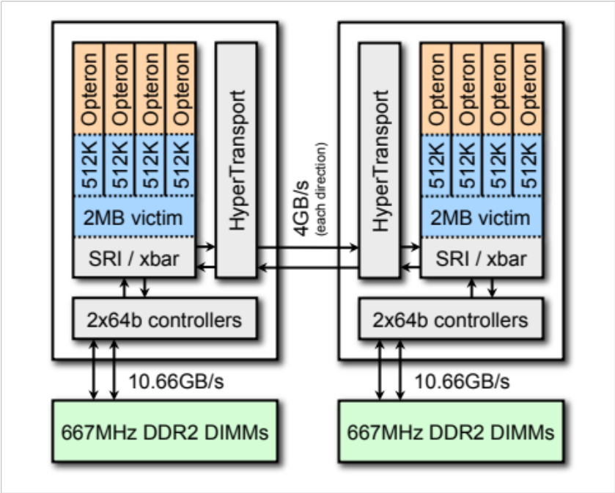
Example
Consider the Opteron 2356:
  Dual Socket (NUMA)
  limited HW stream prefetchers
  quad-core (8 total)
  2.3GHz
  2-way SIMD (DP)
  separate FPMUL and FPADD
  datapaths
  4-cycle FP latency
Assuming expression of parallelism is the challenge, what would the roofline model look like?

Slide 72
Roofline Model for Opteron 2356
Plot on log-log scale
Given AI, we can easily bound performance
But architectures are much more complicated
We will bound performance as we eliminate specific forms of in-core parallelism
256.0
Opteron 2356
(Barcelona)
128.0
64.0
peak DP
32.0
attainable GFLOP/s
16.0
Stream Bandwidth
8.0
4.0
2.0
1.0
0.5
¹/₈
¹/₄
¹/₂
1
2
4
8
16
actual FLOP:Byte ratio

Slide 73
Roofline Model – Computational Ceilings
Opterons have dedicated multipliers and adders.
If the code is dominated by adds, then attainable performance is half of peak.
We call these Ceilings
They act like constraints on performance
256.0
Opteron 2356
(Barcelona)
128.0
64.0
peak DP
32.0
mul / add imbalance
attainable GFLOP/s
16.0
Stream Bandwidth
8.0
4.0
2.0
1.0
0.5
¹/₈
¹/₄
¹/₂
1
2
4
8
16
actual FLOP:Byte ratio

Slide 74
Roofline Model – Computational Ceilings (2)
Opterons have 128-bit datapaths.
If instructions aren’t SIMDized, attainable performance will be halved
256.0
Opteron 2356
(Barcelona)
128.0
64.0
peak DP
32.0
mul / add imbalance
attainable GFLOP/s
16.0
w/out SIMD
Stream Bandwidth
8.0
4.0
2.0
1.0
0.5
¹/₈
¹/₄
¹/₂
1
2
4
8
16
actual FLOP:Byte ratio

Slide 75
Roofline Model – Computational Ceilings (3)
On Opterons, floating-point instructions have a 4 cycle latency.
If we don’t express 4-way ILP, performance will drop by as much as 4x
256.0
Opteron 2356
(Barcelona)
128.0
64.0
peak DP
32.0
mul / add imbalance
attainable GFLOP/s
16.0
w/out SIMD
Stream Bandwidth
8.0
4.0
w/out ILP
2.0
1.0
0.5
¹/₈
¹/₄
¹/₂
1
2
4
8
16
actual FLOP:Byte ratio

Slide 76
Roofline Model – Communication Ceilings
We can perform a similar exercise taking away parallelism from the memory subsystem
256.0
Opteron 2356
(Barcelona)
128.0
64.0
peak DP
32.0
attainable GFLOP/s
16.0
Stream Bandwidth
8.0
4.0
2.0
1.0
0.5
¹/₈
¹/₄
¹/₂
1
2
4
8
16
actual FLOP:Byte ratio

Slide 77
Roofline Model – Communication Ceilings (2)
Explicit software prefetch instructions are required to achieve peak bandwidth
256.0
Opteron 2356
(Barcelona)
128.0
64.0
peak DP
32.0
attainable GFLOP/s
16.0
Stream Bandwidth
8.0
w/out SW prefetch
4.0
2.0
1.0
0.5
¹/₈
¹/₄
¹/₂
1
2
4
8
16
actual FLOP:Byte ratio

Slide 78
Roofline Model – Communication Ceilings (3)
Opterons are NUMA
As such memory traffic must be correctly balanced among the two sockets to achieve good Stream bandwidth.
We could continue this by examining strided or random memory access patterns
256.0
Opteron 2356
(Barcelona)
128.0
64.0
peak DP
32.0
attainable GFLOP/s
16.0
Stream Bandwidth
8.0
w/out SW prefetch
w/out NUMA
4.0
2.0
1.0
0.5
¹/₈
¹/₄
¹/₂
1
2
4
8
16
actual FLOP:Byte ratio

Slide 79
Computation + Communication Ceilings
We may bound performance based on the combination of expressed in-core parallelism and attained bandwidth.
256.0
Opteron 2356
(Barcelona)
128.0
64.0
peak DP
32.0
mul / add imbalance
attainable GFLOP/s
16.0
w/out SIMD
Stream Bandwidth
8.0
w/out SW prefetch
w/out NUMA
4.0
w/out ILP
2.0
1.0
0.5
¹/₈
¹/₄
¹/₂
1
2
4
8
16
actual FLOP:Byte ratio

Slide 80
Roofline Model – Locality Walls
Remember, memory traffic includes more than just compulsory misses.
As such, actual arithmetic intensity may be substantially lower.
Walls are unique to the architecture-kernel combination
256.0
Opteron 2356
(Barcelona)
128.0
64.0
peak DP
32.0
mul / add imbalance
attainable GFLOP/s
16.0
w/out SIMD
Stream Bandwidth
8.0
w/out SW prefetch
w/out NUMA
only compulsory miss traffic
4.0
w/out ILP
2.0
FLOPs
AI =
Compulsory Misses
1.0
0.5
¹/₈
¹/₄
¹/₂
1
2
4
8
16
actual FLOP:Byte ratio

Slide 81
Cache Behavior
Knowledge of the underlying cache operation can be critical
Caches are organized into lines
  Lines are organized into sets & ways (associativity)
  Impacts of conflict, compulsory, and capacity misses are both architecture- and application-dependent
  Ultimately they reduce the actual flop:byte ratio.
Many caches are write allocate
  A write allocate cache read in an entire cache line upon a write miss
  If the application ultimately overwrites that line, the read was superfluous
  Further reduces flop:byte ratio
Because programs access data in words, but hardware transfers it in 64 or 128B cache lines, spatial locality is key
  Array-of-structure data layouts can lead to dramatically lower flop:byte ratios.

Slide 82
Roofline Model – Locality Walls (2)
Remember, memory traffic includes more than just compulsory misses.
As such, actual arithmetic intensity may be substantially lower.
Walls are unique to the architecture-kernel combination
256.0
Opteron 2356
(Barcelona)
128.0
64.0
peak DP
32.0
mul / add imbalance
attainable GFLOP/s
16.0
w/out SIMD
Stream Bandwidth
8.0
w/out SW prefetch
w/out NUMA
+write allocation traffic
only compulsory miss traffic
4.0
w/out ILP
2.0
FLOPs
AI =
Allocations + Compulsory Misses
1.0
0.5
¹/₈
¹/₄
¹/₂
1
2
4
8
16
actual FLOP:Byte ratio

Slide 83
Roofline Model – Locality Walls (3)
Remember, memory traffic includes more than just compulsory misses.
As such, actual arithmetic intensity may be substantially lower.
Walls are unique to the architecture-kernel combination
256.0
Opteron 2356
(Barcelona)
128.0
64.0
peak DP
32.0
mul / add imbalance
attainable GFLOP/s
16.0
w/out SIMD
Stream Bandwidth
8.0
w/out SW prefetch
w/out NUMA
+capacity miss traffic
+write allocation traffic
only compulsory miss traffic
4.0
w/out ILP
2.0
FLOPs
AI =
Capacity + Allocations + Compulsory
1.0
0.5
¹/₈
¹/₄
¹/₂
1
2
4
8
16
actual FLOP:Byte ratio

Slide 84
Roofline Model – Locality Walls (4)
Remember, memory traffic includes more than just compulsory misses.
As such, actual arithmetic intensity may be substantially lower.
Walls are unique to the architecture-kernel combination
256.0
Opteron 2356
(Barcelona)
128.0
64.0
peak DP
32.0
mul / add imbalance
attainable GFLOP/s
16.0
w/out SIMD
Stream Bandwidth
8.0
w/out SW prefetch
w/out NUMA
+conflict miss traffic
+capacity miss traffic
+write allocation traffic
only compulsory miss traffic
4.0
w/out ILP
2.0
FLOPs
AI =
Conflict + Capacity + Allocations + Compulsory
1.0
0.5
¹/₈
¹/₄
¹/₂
1
2
4
8
16
actual FLOP:Byte ratio

Slide 85
Roofline Model – Locality Walls (5)
Optimizations remove these walls and ceilings which act to constrain performance.
256.0
Opteron 2356
(Barcelona)
128.0
64.0
peak DP
32.0
mul / add imbalance
attainable GFLOP/s
16.0
w/out SIMD
Stream Bandwidth
8.0
w/out SW prefetch
w/out NUMA
+conflict miss traffic
+capacity miss traffic
+write allocation traffic
only compulsory miss traffic
4.0
w/out ILP
2.0
1.0
0.5
¹/₈
¹/₄
¹/₂
1
2
4
8
16
actual FLOP:Byte ratio

Slide 86
Optimization Categorization
Maximizing (attained)
In-core Performance
Maximizing (attained)
Memory Bandwidth
Minimizing (total)
Memory Traffic

Slide 87
Optimization Categorization
Maximizing
In-core Performance
Maximizing
Memory Bandwidth
Minimizing
Memory Traffic
Exploit in-core parallelism
(ILP, DLP, etc…)
Good (enough)
floating-point balance

Slide 88


Optimization Categorization
Maximizing
In-core Performance
Maximizing
Memory Bandwidth
Minimizing
Memory Traffic
Exploit in-core parallelism
(ILP, DLP, etc…)
Good (enough)
floating-point balance
reorder
unroll &
jam
eliminate
branches
explicit
SIMD

Slide 89



Optimization Categorization
Maximizing
In-core Performance
Maximizing
Memory Bandwidth
Minimizing
Memory Traffic
Exploit in-core parallelism
(ILP, DLP, etc…)
Good (enough)
floating-point balance
Exploit NUMA
Hide memory latency
Satisfy Little’s Law
unit-stride
streams
reorder
unroll &
jam
memory
affinity
SW
prefetch
eliminate
branches
explicit
SIMD
DMA
lists
TLB
blocking

Slide 90


Optimization Categorization
Maximizing
In-core Performance
Maximizing
Memory Bandwidth
Minimizing
Memory Traffic
Exploit in-core parallelism
(ILP, DLP, etc…)
Good (enough)
floating-point balance
Exploit NUMA
Hide memory latency
Satisfy Little’s Law
Eliminate:
Capacity misses
Conflict misses
Compulsory misses
Write allocate behavior
unit-stride
streams
reorder
cache
blocking
unroll &
jam
memory
affinity
array
padding
SW
prefetch
eliminate
branches
streaming
stores
explicit
SIMD
compress
data
DMA
lists
TLB
blocking

Slide 91
Optimization Categorization
Maximizing
In-core Performance
Maximizing
Memory Bandwidth
Minimizing
Memory Traffic
Exploit in-core parallelism
(ILP, DLP, etc…)
Good (enough)
floating-point balance
Exploit NUMA
Hide memory latency
Satisfy Little’s Law
Eliminate:
Capacity misses
Conflict misses
Compulsory misses
Write allocate behavior
unit-stride
streams
reorder
cache
blocking
unroll &
jam
memory
affinity
array
padding
SW
prefetch
eliminate
branches
streaming
stores
explicit
SIMD
compress
data
DMA
lists
TLB
blocking

Slide 92
















Various Kernels
Williams has examined and heavily optimized a number of kernels and applications for both CPUs and GPUs
He observe that for most, performance is highly correlated with DRAM bandwidth – particularly on the GPU
Note, GTC has a strong scatter/gather component that skews STREAM-based rooflines.
1024
Xeon X5550 (Nehalem)
1024
NVIDIA C2050 (Fermi)
512
512
256
256
128
128
64
64
32
32
16
16
8
8
4
4
2
2
¹/₃₂
¹/₁₆
¹/₈
¹/₄
¹/₂
1
2
4
8
16
32
¹/₃₂
¹/₁₆
¹/₈
¹/₄
¹/₂
1
2
4
8
16
32

Slide 93
Next Class
Parallel performance analysis
Parallel performance tools

