Slide 1



CIS 631
Parallel Processing
Lecture 4: Parallel
Performance Analysis and Engineering
Allen D. Malony
malony@cs.uoregon.edu
Department of Computer and Information Science
University of Oregon

Slide 2
Acknowledgements
Portions of the lectures slides were adopted from:
  Bernd Mohr, “Parallel Programming Models, Tools and Performance Analysis,” Tutorial, Research Centre Juelich, 2002.
  Allen D. Malony, “Computational Science, Scalable Parallel Computing, and Performance Tools,” Alexander von Humboldt lecture, Research Centre Juelich, 2002.
  Lawrence Livermore National Laboratory, “Parallel Performance Tools Tutorial,” 2002.
  Various TAU presentations and tutorials.

Slide 3
Outline
Review
Parallel performance analysis problem
Parallel performance analysis methodology
Measurement and analysis techniques
Performance engineering approach

Slide 4
Parallel Programming
To use a scalable parallel computer, you must be able to write parallel programs
You must understand the programming model and the programming languages, libraries, and systems software used to implement it
Unfortunately, parallel programming is not easy

Slide 5
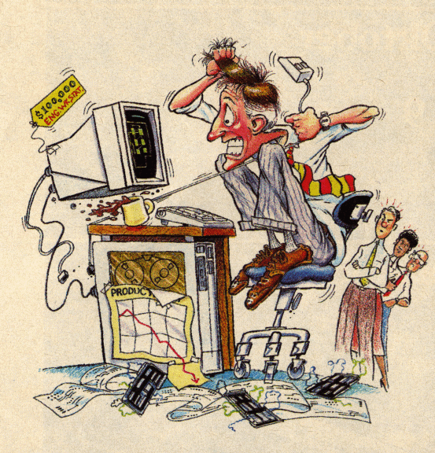
Parallel Programming: Are we having fun yet?
Source: Bernd Mohr

Slide 6
Parallel Programming Models
Two general models of parallel program
  Task parallel
    Problem is broken down into tasks to be performed
    Individual tasks are created and communicate to coordinate operations
  Data parallel
    Problem is viewed as operations of parallel data
    Data distributed across processes and computed locally
Characteristics of scalable parallel programs
  Data domain decomposition to improve data locality
  Communication and latency do not grow significantly

Slide 7
Shared Memory Parallel Programming
Shared memory address space
(Typically) easier to program
  Implicit communication via (shared) data
  Explicit synchronization to access data
Programming methodology
  Manual
    Multi-threading using standard thread libraries
  Automatic
    Parallelizing compilers
    OpenMP parallelism directives
  Explicit threading (e.g. POSIX threads)

Slide 8
Parallel Programming Model: Threads
T₀
T₁
T₀
T₁
T₂
T₃
T₀
T₁
T₂
T₃
T₂
T₃
T₀
T₁
T₂
T₃
Global style
Shared and private data
Work distribution onto threads for global operations
Domain decomposition determines work distribution

Slide 9
Distributed Memory Parallel Programming
Distributed memory address space
(Relatively) harder to program
  Explicit data distribution
  Explicit communication via messages
  Explicit synchronization via messages
Programming methodology
  Message passing
    Plenty of libraries to chose from (MPI dominates)
    Send-receive, one-sided, active messages
  Data parallelism
  Shared virtual memory

Slide 10
Paralle Programming Model: Message Passing
P₀
P₁
P₂
P₃
Local style
Domain decomposition leads to data distribution
Explicit communication and synchronization
Higher programming overhead
Message passing libraries

Slide 11
Basic Parallel Programming Paradigm: SPMD
SPMD: Single Program Multiple Data
One program executes on all processors
Basic paradigm for implementing parallel programs
Process-dependent cases are handled inside the program
Parallelism is “programmed in”
Easier to manage program for scalability
if (processor == 42) then
call do_something()
else
call do_something_else()
endif

Slide 12
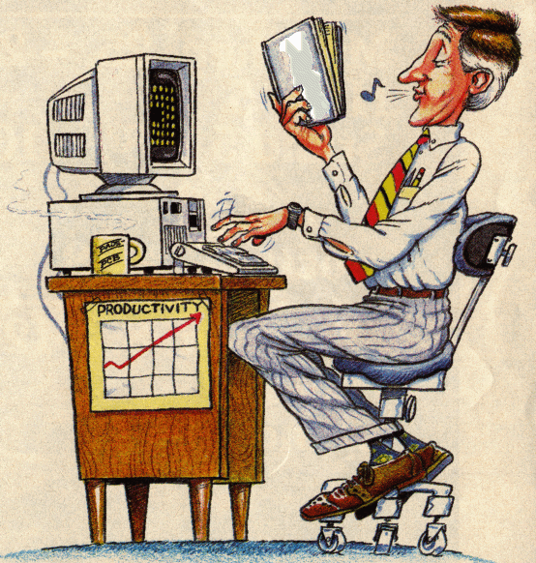
Parallel Programming: Still a Problem?
CIS
631
Source: Bernd Mohr

Slide 13
Parallel Computing and Scalability
Scalability in parallel architecture
  Processor numbers
  Memory architecture
  Interconnection network
  Avoid critical architecture bottlenecks
Scalability in computational problem
  Problem size
  Computational algorithms
    Computation to memory access ratio
    Computation to communication ratio
Parallel programming models and tools
Performance scalability

Slide 14
Amdahl’s Law
T_{seq} : sequential execution time that cannot be parallelized
T_{par} : sequential execution time that can be parallelized
T₁ = T_{seq} + T_{par} ⇒ T_{par} = T₁ - T_{seq}
T_{p} = T_{seq} + T_{par} / p (assume fully parallelized)
As p→∞, T_{p} → T_{seq}
Let f_{seq} be the fraction T_{seq} / T₁ and S_{p} = T₁ / T_{p}
Speedup = S_{p} = T₁ / T_{p} = T₁ / (T_{seq} + T_{par} / p)
= 1 / (f_{seq} + T_{par} / pT₁) = 1 / (f_{seq} + (1- f_{seq})/ p)
  As p→∞, S_{p} = S∞ → 1 / f_{seq}
Speedup bound is determined by the degree of sequential execution time in the computation, not # processors!!!

Slide 15
Amdahl’s Law and Scaled Speedup
Amdahl’s Law makes it hard to obtain good speedup
Change perspective on the problem
Consider scaling of problem size as # processors scale
T_{seq} : sequential execution time (1 and p processors)
T_{par} : execution time in parallel mode on p processors
T_{p} = T_{seq} + T_{par} , T₁ = T_{seq} + pT_{par}
Let f_{par} be the fraction T_{par} / T_{p}
Scaled speedup = S_{p} = 1 + (p-1)T_{par} / T_{p} = 1 + (p-1)f_{par}
f_{seq} * 100% | 10% | 5% | 2% | 1% | .1%
S∞ | 10 | 20 | 50 | 100 | 1000

Slide 16
Parallel Performance
To use a scalable parallel computer well, you must be able to write high-performance parallel programs
To get high-performance parallel programs, you must understand and optimize performance for the combination of programming model, algorithm, language, platform, …
Unfortunately, parallel performance
analysis and optimization is not an easy
process

Slide 17
Parallel Performance Evaluation
Study of performance in parallel systems
  Models and behaviors
  Evaluative techniques
Evaluation methodologies
  Analytical modeling and statistical modeling
  Simulation-based modeling
  Empirical measurement, analysis, and modeling
Purposes
  Planning
  Diagnosis
  Tuning

Slide 18
Performance Observability (My Guiding Thesis)
Performance evaluation problems define the requirements for performance analysis methods
Performance observability is the ability to “accurately” capture, analyze, and present (collectively observe) information about computer system/software performance
Tools for performance observability must balance the need for performance data against the cost of obtaining it (environment complexity, performance intrusion)
  Too little performance data makes analysis difficult
  Too much data perturbs the measured system.
Important to understand performance observability complexity and develop technology to address it

Slide 19
(Parallel) Performance Analysis Process
Implementation
Measurement
Preparation
Performance Analysis
Refinement
Analysis
Program Tuning
Ranking
Production

Slide 20
Parallel Performance Analysis Environment
parallel
system
parallel
program
system/program characteristics
plus performance knowledge
used for initial hypothesis
constraints on observational
capabilities, invocation of
measurement tools
Performance
Hypothesis
Performance
Observation
analysis,
modeling, and
presentation of
empirical data
hypothesis refinement
from empirical results
Stored
Performance
Knowledge
Experimental
Performance
Data
general performance results add
to performance knowledge base

Slide 21
Performance Analysis and Tuning
Successful parallel performance tuning process
  Characterization: finding critical performance problems
  Diagnosis: determining performance problem causes
  Hypothesis testing: selection of performance optimization
  Hypothesis validation: analyzing tuning results
Reasoning and intuition only take you so far
Need to make empirical observations
  Performance instrumentation tools
  Performance measurement tools
  Performance analysis tools

Slide 22
Performance Factors
Factors which determine a program's performance are complex, interrelated, and sometimes hidden
Application related factors
  Algorithms dataset sizes
  Memory usage patterns
  I/O communication patterns
Hardware related factors
  Processor architecture
  Memory hierarchy
Software related factors
  Operating system
  Compiler preprocessor
  Task Granularity
  Load Balancing
  Amdahl's Law
  I/O network
  Communication protocols
  Libraries

Slide 23
Utilization of Computational Resources
Often resources are under-utilized or used inefficiently
Identifying these circumstances can give clues to where performance problems exist
Resources may be “virtual” (i.e., not a physical resource)
  Thread or process
Performance analysis tools are essential to optimizing an application's performance
  Can assist you in understanding what your program is "really doing”
  May provide suggestions how program performance should be improved

Slide 24
Performance Analysis and Tuning: The Basics
Most important goal of performance tuning is to reduce a program's wall clock execution time
  Iterative process to optimize efficiency
  Efficiency is a relationship of execution time
So, where does the time go?
Find your program's hot spots and eliminate the bottlenecks in them
  Hot spot: an area of code within the program that uses a disproportionately high amount of processor time
  Bottleneck : an area of code within the program that uses processor resources inefficiently and therefore causes unnecessary delays
Understand what, where, and how time is being spent

Slide 25
Sequential versus Parallel Performance
Sequential performance is all about how time is distributed and what resources are used where and when
Parallel performance is about sequential performance AND parallel interactions
  Sequential performance is the performance within each thread of execution (i.e., its sequential performance)
  Parallel interactions lead to overheads
    synchronization
    communication
  Parallel interactions also lead to parallelism inefficiency
    load imbalances

Slide 26
Sequential Performance Tuning
Sequential performance tuning is a time-driven process
Find the thing that takes the most time and make it take less time (i.e., make it more efficient)
May lead to program restructuring
  Changes in data storage and structure
  Rearrangement of tasks and operations
May look for opportunities for better resource utilization
  Cache management is a big one
  Locality, locality, locality!
  Virtual memory management may also pay off
May look for opportunities for better processor usage

Slide 27
Parallel Performance Tuning versus Sequential
In contrast to sequential performance tuning, parallel performance tuning might be described as conflict-driven or interaction-driven
Find the points of parallel interactions and determine the overheads associated with them
Overheads can be the cost of performing the interactions
  Transfer of data
  Extra operations to implement coordination
Overheads also include time spent waiting
  Lack of work
  Waiting for dependency to be satisfied

Slide 28
Interesting Performance Phenomena
Superlinear speedup
  Speedup in parallel execution is greater than linear
  S_{p} > p
  How can this happen?
Need to keep in mind the relationship of performance and resource usage
Computation time (i.e., real work) is not simply a linear distribution to parallel threads of execution
Resource utilization thresholds can lead to performance inflections

Slide 29
How Is Time Measured?
How do we determine where the time goes?
“A person with one clock knows what time it is, a person with two clocks is never sure.” Confucious
“Define time.” Bill Clinton (attributed)
Time is only as good (accurate) as the clock we use
Clocks are not the same and, thus, time is not the same
  Wallclock time – measured against “real” time
  CPU (virtual) time – time accumulates (i.e., “ticks”) only when process is executing
  Clocks have different resolutions and overheads for access
    affects accuracy

Slide 30
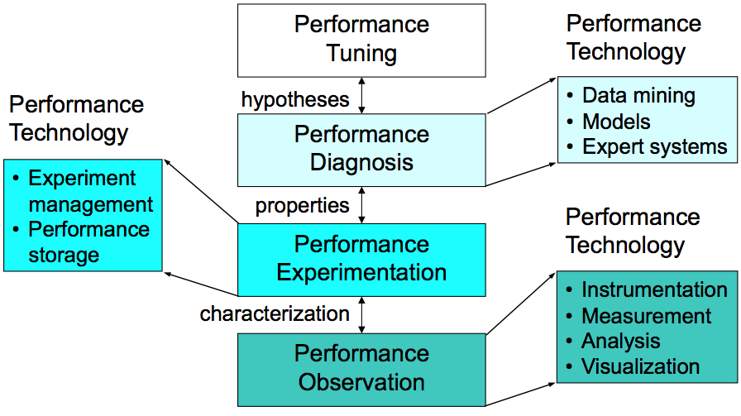
Performance Engineering
Optimization process
Effective use of performance technology

Slide 31
Performance Optimization Cycle
Expose factors
Collect performance data
Calculate metrics
Analyze results
Visualize results
Identify problems
Tune performance
Instrumentation
Measurement
Analysis
Presentation
Optimization

Slide 32
Parallel Performance Properties
Parallel code performance is influenced by both sequential and parallel factors?
Sequential factors
  Computation and memory use
  Input / output
Parallel factors
  Thread / process interactions
  Communication and synchronization

Slide 33
Performance Observation
Understanding performance requires observation of performance properties
Performance tools and methodologies are primarily distinguished by what observations are made and how
  What aspects of performance factors are seen
  What performance data is obtained
Tools and methods cover broad range

Slide 34
Metrics and Measurement
Observability depends on measurement
A metric represents a type of measured data
  Count, time, hardware counters
A measurement records performance data
  Associates with program execution aspects
Derived metrics are computed
  Rates (e.g., flops)
Metrics / measurements decided by need

Slide 35
Execution Time
Wall-clock time
  Based on realtime clock
Virtual process time
  Time when process is executing
    user time and system time
  Does not include time when process is stalled
Parallel execution time
  Runs whenever any parallel part is executing
  Global time basis

Slide 36
Direct Performance Observation
Execution actions exposed as events
  In general, actions reflect some execution state
    presence at a code location or change in data
    occurrence in parallelism context (thread of execution)
  Events encode actions for observation
Observation is direct
  Direct instrumentation of program code (probes)
  Instrumentation invokes performance measurement
  Event measurement = performance data + context
Performance experiment
  Actual events + performance measurements

Slide 37
Indirect Performance Observation
Program code instrumentation is not used
Performance is observed indirectly
  Execution is interrupted
    can be triggered by different events
  Execution state is queried (sampled)
    different performance data measured
  Event-based sampling (EBS)
Performance attribution is inferred
  Determined by execution context (state)
  Observation resolution determined by interrupt period
  Performance data associated with context for period

Slide 38
Direct Observation: Events
Event types
  Interval events (begin/end events)
    measures performance between begin and end
    metrics monotonically increase
  Atomic events
    used to capture performance data state
Code events
  Routines, classes, templates
  Statement-level blocks, loops
User-defined events
  Specified by the user
Abstract mapping events

Slide 39
Direct Observation: Instrumentation
Events defined by instrumentation access
Instrumentation levels
  Source code
  Library code
  Object code
  Executable code
  Runtime system
  Operating system
Different levels provide different information
Different tools needed for each level
Levels can have different granularity

Slide 40
Direct Observation: Techniques
Static instrumentation
  Program instrumented prior to execution
Dynamic instrumentation
  Program instrumented at runtime
Manual and automatic mechanisms
Tool required for automatic support
  Source time: preprocessor, translator, compiler
  Link time: wrapper library, preload
  Execution time: binary rewrite, dynamic
Advantages / disadvantages

Slide 41
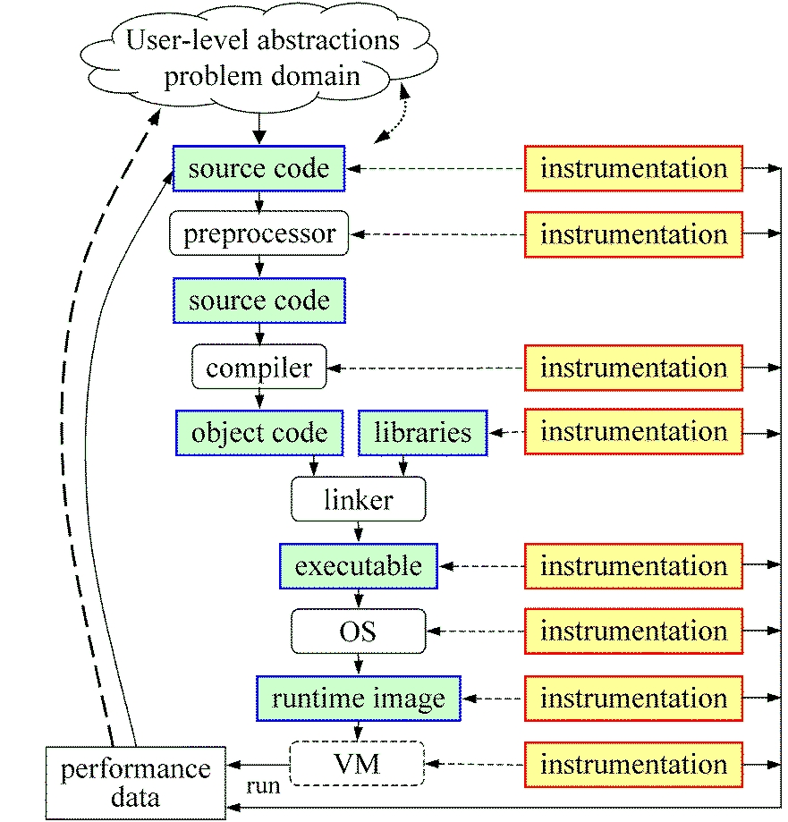
Direct Observation: Mapping
Associate performance
data with high-level
semantic abstractions
Abstract events at
user-level provide
semantic context

Slide 42
Indirect Observation: Events/Triggers
Events are actions external to program code
  Timer countdown, HW counter overflow, …
  Consequence of program execution
  Event frequency determined by:
    Type, setup, number enabled (exposed)
Triggers used to invoke measurement tool
  Traps when events occur (interrupt)
  Associated with events
  May add differentiation to events

Slide 43
Indirect Observation: Context
When events trigger, execution context determined at time of trap (interrupt)
  Access to PC from interrupt frame
  Access to information about process/thread
  Possible access to call stack
    requires call stack unwinder
Assumption is that the context was the same during the preceding period
  Between successive triggers
  Statistical approximation valid for long running programs

Slide 44
Direct / Indirect Comparison
Direct performance observation
  ☺ Measures performance data exactly
  ☺ Links performance data with application events
  😐 Requires instrumentation of code
  ☹ Measurement overhead can cause execution
  intrusion and possibly performance perturbation
Indirect performance observation
  ☺ Argued to have less overhead and intrusion
  ☺ Can observe finer granularity
  ☺ No code modification required (may need
  symbols)
  ☹ Inexact measurement and attribution

Slide 45
Measurement Techniques
When is measurement triggered?
  External agent (indirect, asynchronous)
    interrupts, hardware counter overflow, …
  Internal agent (direct, synchronous)
    through code modification
How are measurements made?
  Profiling
    summarizes performance data during execution
    per process / thread and organized with respect to context
  Tracing
    trace record with performance data and timestamp
    per process / thread

Slide 46
Measured Performance
Counts
Durations
Communication costs
Synchronization costs
Memory use
Hardware counts
System calls

Slide 47
Critical issues
Accuracy
  Timing and counting accuracy depends on resolution
  Any performance measurement generates overhead
    Execution on performance measurement code
  Measurement overhead can lead to intrusion
  Intrusion can cause perturbation
    alters program behavior
Granularity
  How many measurements are made
  How much overhead per measurement
Tradeoff (general wisdom)
  Accuracy is inversely correlated with granularity

Slide 48
Profiling
Recording of aggregated information
  Counts, time, …
… about program and system entities
  Functions, loops, basic blocks, …
  Processes, threads
Methods
  Event-based sampling (indirect, statistical)
  Direct measurement (deterministic)

Slide 49
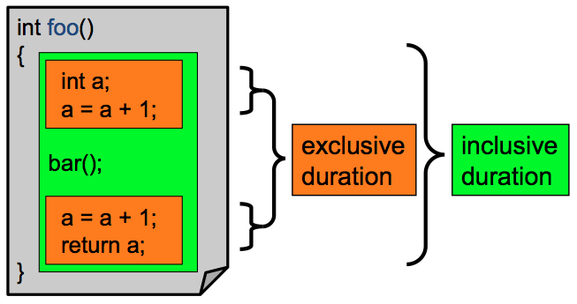
Inclusive and Exclusive Profiles
Performance with respect to code regions
Exclusive measurements for region only
Inclusive measurements includes child regions

Slide 50
Flat and Callpath Profiles
Static call graph
  Shows all parent-child calling relationships in a program
Dynamic call graph
  Reflects actual execution time calling relationships
Flat profile
  Performance metrics for when event is active
  Exclusive and inclusive
Callpath profile
  Performance metrics for calling path (event chain)
  Differentiate performance with respect to program execution state
  Exclusive and inclusive

Slide 51
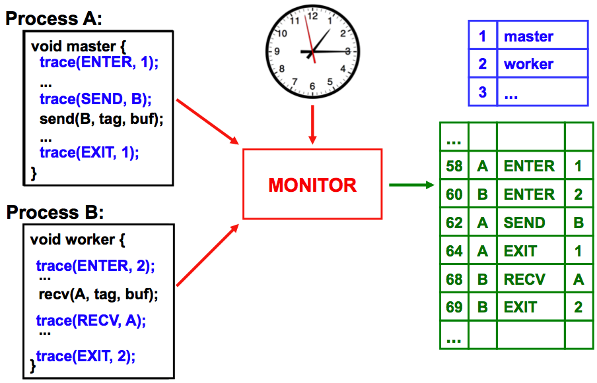
Tracing Measurement

Slide 52
Tracing Analysis and Visualization
1
master
main
2
worker
master
3
...
worker
...
58
A
ENTER
1
60
B
ENTER
2
A
62
A
SEND
B
64
A
EXIT
1
B
68
B
RECV
A
69
B
EXIT
2
58
60
62
64
66
68
70

Slide 53
Trace Formats
Different tools produce different formats
  Differ by event types supported
  Differ by ASCII and binary representations
    Vampir Trace Format (VTF)
    KOJAK (EPILOG)
    Jumpshot (SLOG-2)
    Paraver
Open Trace Format (OTF)
  Supports interoperation between tracing tools

Slide 54
Profiling / Tracing Comparison
Profiling
  ☺ Finite, bounded performance data size
  ☺ Applicable to both direct and indirect methods
  😐 Loses time dimension (not entirely)
  ☹ Lacks ability to fully describe process interaction
Tracing
  ☺ Temporal and spatial dimension to performance data
  ☺ Capture parallel dynamics and process interaction
  😐 Some inconsistencies with indirect methods
  ☹ Unbounded performance data size (large)
  ☹ Complex event buffering and clock synchronization

Slide 55
Performance Problem Solving Goals
Answer questions at multiple levels of interest
  High-level performance data spanning dimensions
    machine, applications, code revisions, data sets
    examine broad performance trends
  Data from low-level measurements
    use to predict application performance
Discover general correlations
  performance and features of external environment
  Identify primary performance factors
Benchmarking analysis for application prediction
Workload analysis for machine assessment

Slide 56
Performance Analysis Questions
How does performance vary with different compilers?
Is poor performance correlated with certain OS features?
Has a recent change caused unanticipated performance?
How does performance vary with MPI variants?
Why is one application version faster than another?
What is the reason for the observed scaling behavior?
Did two runs exhibit similar performance?
How are performance data related to application events?
Which machines will run my code the fastest and why?
Which benchmarks predict my code performance best?

Slide 57
Automatic Performance Analysis
Simple
analysis
feedback
72%
Faster!
Build
application
Execute
application
environment /
performance
data
build
information
Performance
database
Offline
analysis

Slide 58
Performance Data Management
Performance diagnosis and optimization involves multiple performance experiments
Support for common performance data management tasks augments tool use
  Performance experiment data and metadata storage
  Performance database and query
What type of performance data should be stored?
  Parallel profiles or parallel traces
  Storage size will dictate
  Experiment metadata helps in meta analysis tasks
Serves tool integration objectives

Slide 59
Metadata Collection
Integration of metadata with each parallel profile
  Separate information from performance data
Three ways to incorporate metadata
  Measured hardware/system information
    CPU speed, memory in GB, MPI node IDs, …
  Application instrumentation (application-specific)
    Application parameters, input data, domain decomposition
    Capture arbitrary name/value pair and save with experiment
  Data management tools can read additional metadata
    Compiler flags, submission scripts, input files, …
    Before or after execution
Enhances analysis capabilities

Slide 60
Performance Data Mining
Conduct parallel performance analysis in a systematic, collaborative and reusable manner
  Manage performance complexity and automate process
  Discover performance relationship and properties
  Multi-experiment performance analysis
Data mining applied to parallel performance data
  Comparative, clustering, correlation, characterization, …
  Large-scale performance data reduction
Implement extensible analysis framework
  Abstraction / automation of data mining operations
  Interface to existing analysis and data mining tools

Slide 61
How to explain performance?
Should not just redescribe performance results
Should explain performance phenomena
  What are the causes for performance observed?
  What are the factors and how do they interrelate?
  Performance analytics, forensics, and decision support
Add knowledge to do more intelligent things
  Automated analysis needs good informed feedback
  Performance model generation requires interpretation
Performance knowledge discovery framework
  Integrating meta-information
  Knowledge-based performance problem solving
Notes:
Check Dresden talk for common language for these slides

Slide 62
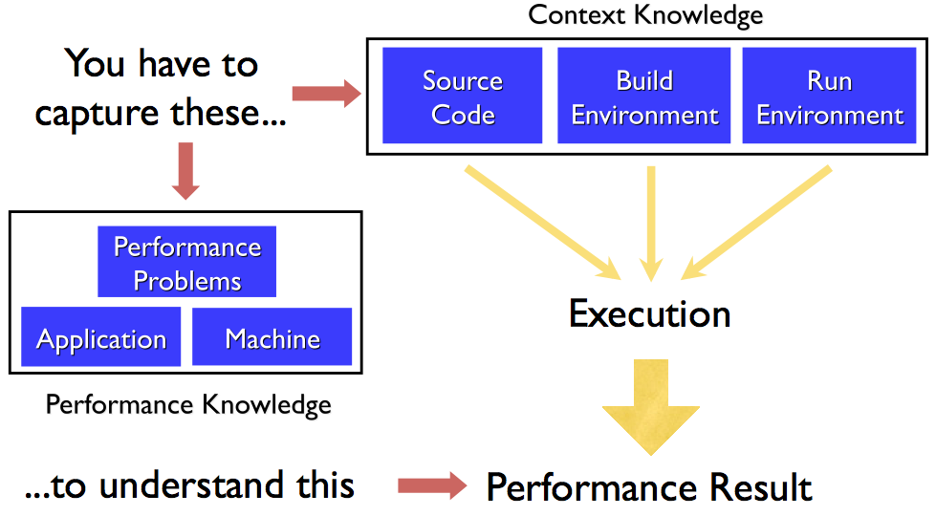
Metadata and Knowledge Role

Slide 63
Performance Optimization Process
Performance characterization
  Identify major performance contributors
  Identify sources of performance inefficiency
  Utilize timing and hardware measures
Performance diagnosis (Performance Debugging)
  Look for conditions of performance problems
  Determine if conditions are met and their severity
  What and where are the performance bottlenecks
Performance tuning
  Focus on dominant performance contributors
  Eliminate main performance bottlenecks

Slide 64
POINT Project
“High-Productivity Performance Engineering (Tools, Methods, Training) for NSF HPC Applications”
  NSF SDCI, Software Improvement and Support
  University of Oregon, University of Tennessee, National Center for Supercomputing Applications, Pittsburgh Supercomputing Center
POINT project
  Petascale Productivity from Open, Integrated Tools
  http://www.nic.uoregon.edu/point

Slide 65
Motivation
Promise of HPC through scalable scientific and engineering applications
Performance optimization through effective performance engineering methods
  Performance analysis / tuning “best practices”
Productive petascale HPC will require
  Robust parallel performance tools
  Training good performance problem solvers

Slide 66
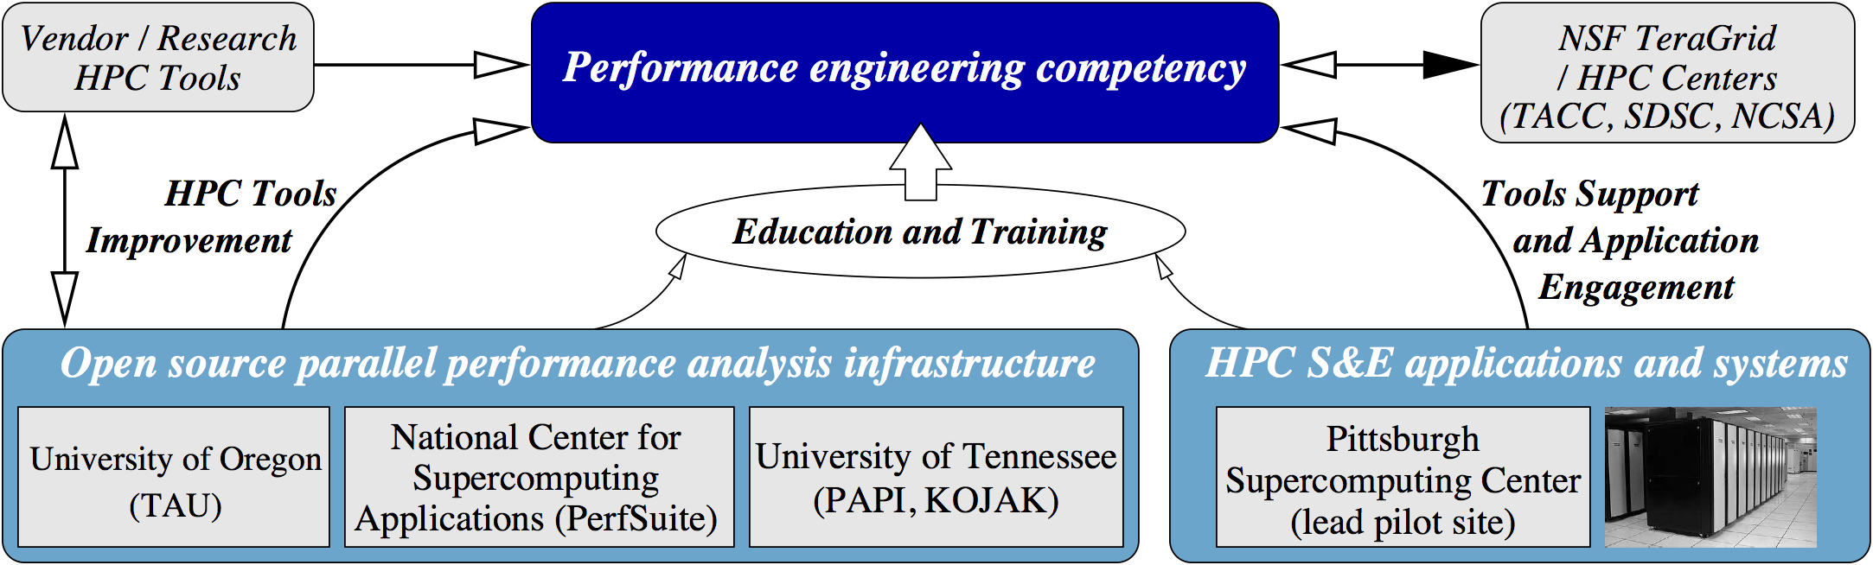
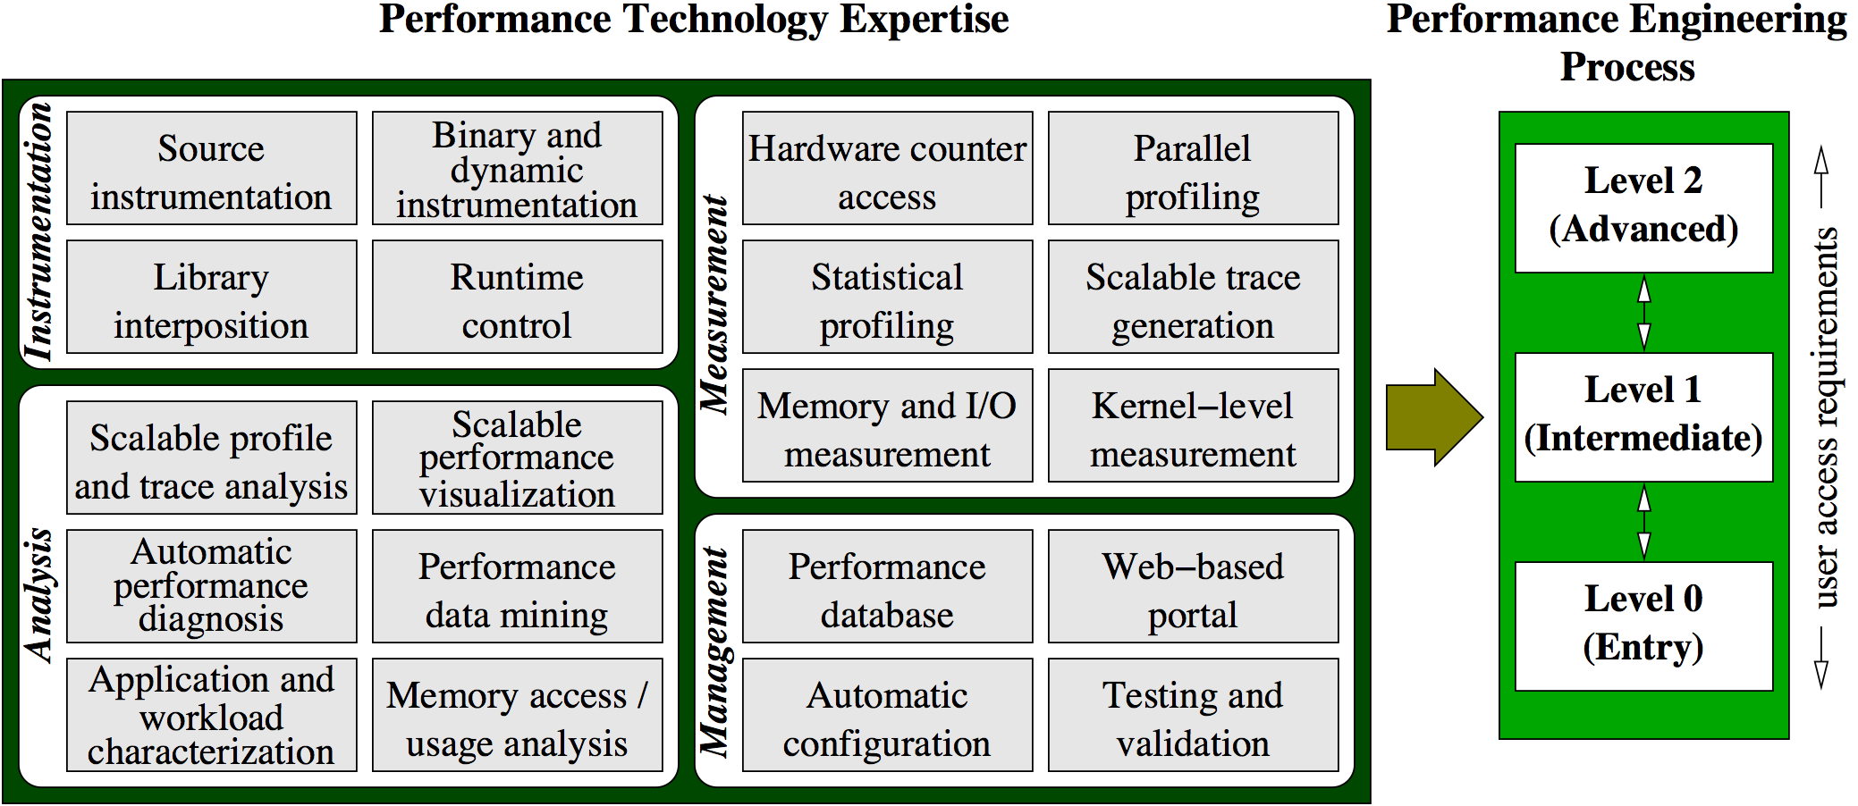
POINT Project Organization
Testbed Apps
ENZO
NAMD
NEMO3D

Slide 67






Parallel Performance Technology
PAPI
  University of Tennessee, Knoxville
PerfSuite
  National Center for Supercomputing Applications
TAU Performance System
  University of Oregon
Kojak / Scalasca
  Research Centre Juelich
Vampir and VampirTrace
  T.U. Dresden

Slide 68
Next Class
Parallel performance tools
TAU Performance System

