Slide 1



CIS 631
Parallel Processing
Lecture 13: Parallel
Performance Tools
Allen D. Malony
malony@cs.uoregon.edu
Department of Computer and Information Science
University of Oregon

Slide 2
Acknowledgements
Portions of the lectures slides were adopted from:
  Bernd Mohr, “Parallel Programming Models, Tools and Performance Analysis,” Tutorial, Research Centre Juelich, 2002.
  Allen D. Malony, “Computational Science, Scalable Parallel Computing, and Performance Tools,” Alexander von Humboldt lecture, Research Centre Juelich, 2002.
  Lawrence Livermore National Laboratory, “Parallel Performance Tools Tutorial,” 2002.
  A. Malony and B. Mohr, “Performance Technology for Complex Parallel Systems,” SC 2001 Tutorial, 2001.

Slide 3
Outline
TAU performance system status
Vampir trace visualization system
Automatic performance analysis and Expert

Slide 4
TAU Performance System Status
Computing platforms
  IBM SP / Power4, SGI Origin 2K/3K, Intel Teraflop, Cray T3E / SV-1 (X-1 planned), Compaq SC, HP, Sun, Hitachi SR8000, NEX SX-5 (SX-6 underway), Intel (x86, IA-64) and Alpha Linux cluster, Apple (OS X), Windows
Programming languages
  C, C++, Fortran 77, F90, HPF, Java, OpenMP, Python
Communication libraries
  MPI, PVM, Nexus, shmem, Tulip, ACLMPL, MPIJava
Thread libraries
  pthreads, Java,Windows, Tulip, SMARTS, OpenMP

Slide 5
TAU Performance System Status (continued)
Compilers
  KAI, PGI, GNU, Fujitsu, Sun, Microsoft, SGI, Cray, IBM, Compaq
Application libraries
  Blitz++, A++/P++, PETSc, SAMRAI, Overture, PAWS
Application frameworks
  POOMA, POOMA-2, MC++, Conejo, Uintah, VTF, UPS
Projects
  Aurora / SCALEA: ACPC, University of Vienna
TAU full distribution (Version 2.1x, web download)
  Measurement library and profile analysis tools
  Automatic software installation and examples
  TAU User’s Guide

Slide 6
PDT Status
Program Database Toolkit (Version 2.x, web download)
  EDG C++ front end (Version 2.45.2)
  Mutek Fortran 90 front end (Version 2.4.1)
  C++ and Fortran 90 IL Analyzer
  DUCTAPE library
  Standard C++ system header files (KCC Version 4.0f)
PDT-constructed tools
  TAU instrumentor (C/C++/F90)
  Program analysis support for SILOON and CHASM
Platforms
  SGI, IBM, Compaq, SUN, HP, Linux (IA32/IA64),
  Apple, Windows, Cray T3E, Hitachi

Slide 7
Work in Progress
Trace visualization
  Event traces with counters (Vampir 3.0 will visualize)
  EPILOG trace conversion
Runtime performance monitoring and analysis
  Online performance data access
  Performance analysis and visualization in SCIRun
Performance Database Framework
  XML parallel profile representation of TAU profiles
  PostgresSQL performance database
Next-generation PDT
Performance analysis for component software (CCA)

Slide 8

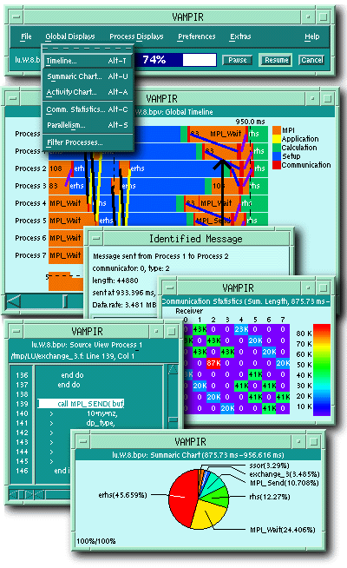

Vampir
Visualization and Analysis of MPI PRograms
Originally developed by Forschungszentrum Jülich
Current development by Technical University Dresden
Distributed by PALLAS, Germany
http://www.pallas.de/pages/vampir.htm

Slide 9
Vampir: General Description
Offline trace analysis for message passing trace files
Convenient user–interface / easy customization
Scalability in time and processor–space
Excellent zooming and filtering
Display and analysis of MPI and application events:
  user subroutines
  point–to–point communication
  collective communication
  MPI–2 I/O operations
Large variety of customizable (via context menus) displays for ANY part of the trace

Slide 10
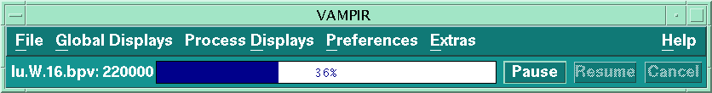
Vampir: Main Window
Trace file loading can be
  interrupted at any time
  resumed
  started at a specified time offset
Provides main menu
  access to global and process local displays
  preferences
  help
Trace file can be re–written (re–grouped symbols)

Slide 11
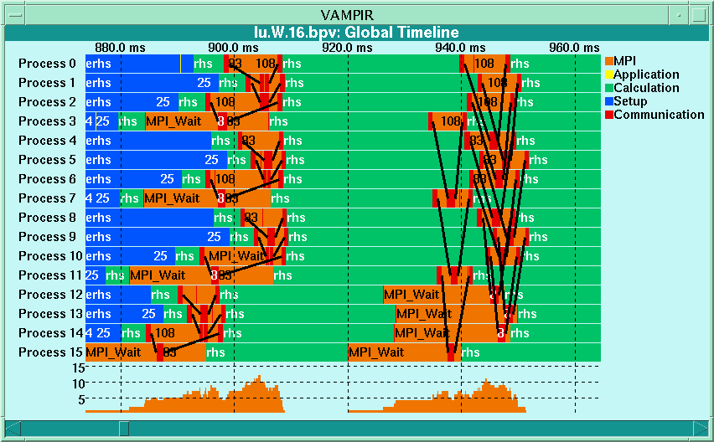
Vampir: Timeline Diagram
Functions organized into groups
Coloring by group
Message lines can be colored by tag or size
Information about states, messages, collective, and I/O operations available by clicking on the representation

Slide 12
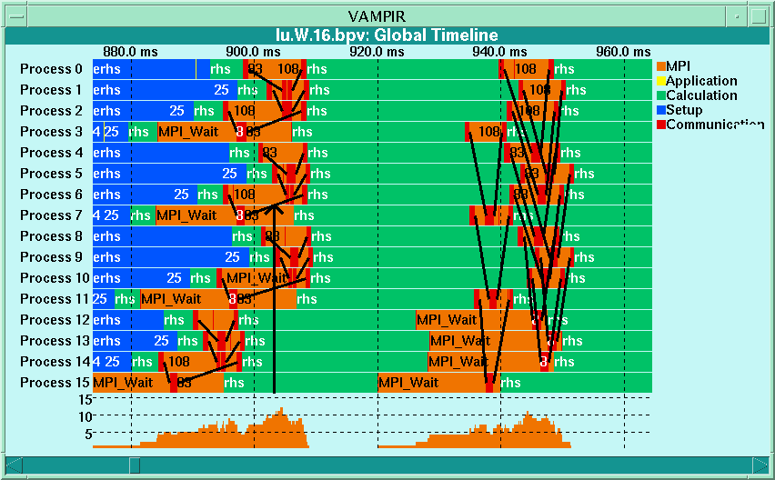
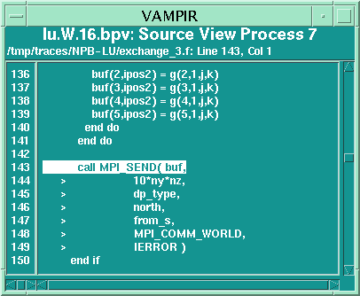
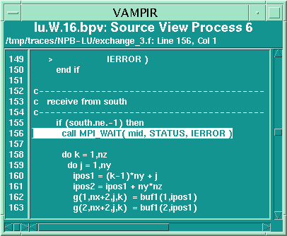
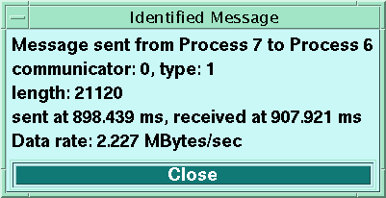
Vampir: Timeline Diagram (Message Info)
Source–code references are displayed if recorded in trace

Slide 13

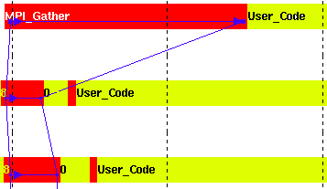
Vampir: Support for Collective Communication
For each process: locally mark operation
Connect start/stop points by lines
 Stop of op
Start of op
 Data being sent
Data being received

Slide 14
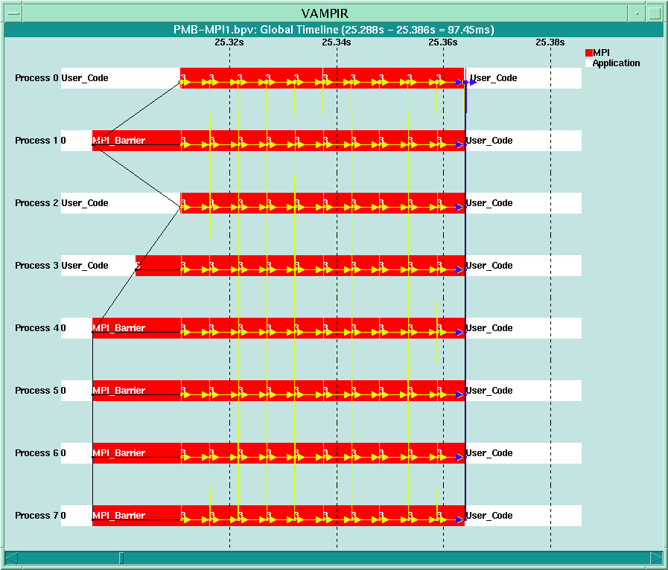
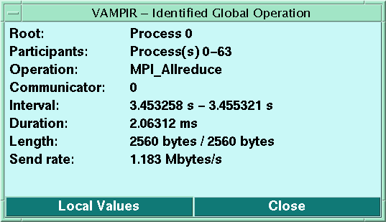
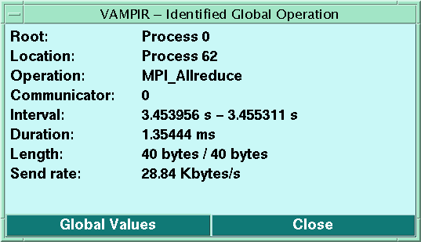
Vampir: Collective Communication Display

Slide 15
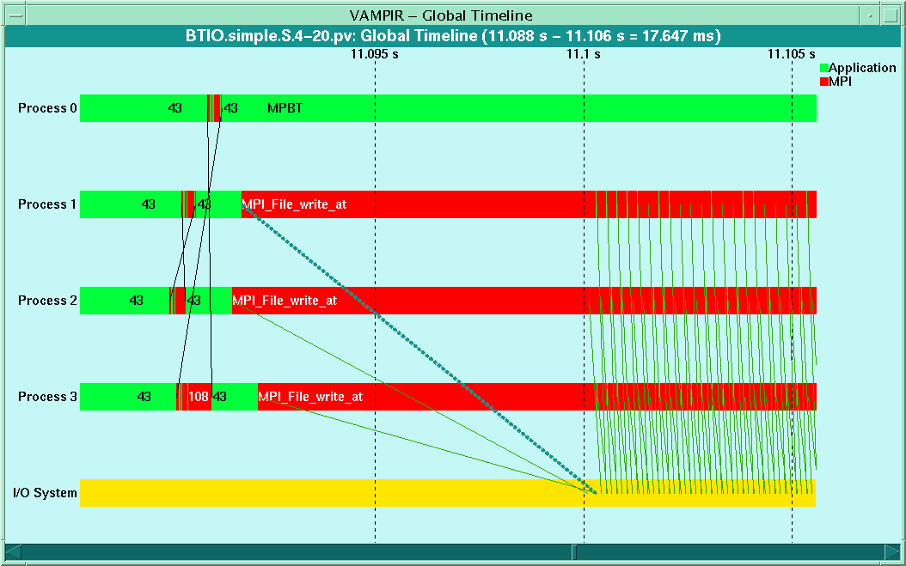
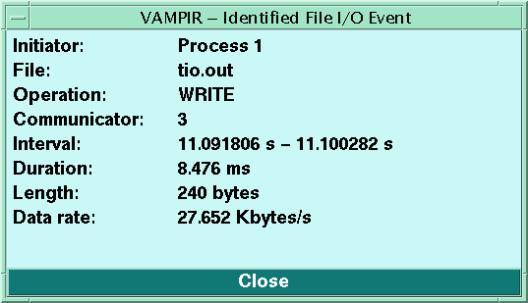
Vampir: MPI-I/O Support
MPI I/O operations shown as message lines
to separate I/O system time line

Slide 16
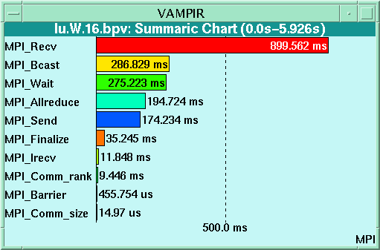
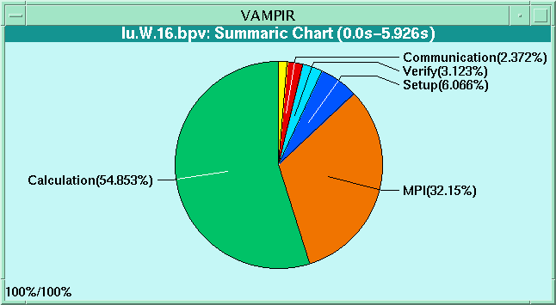
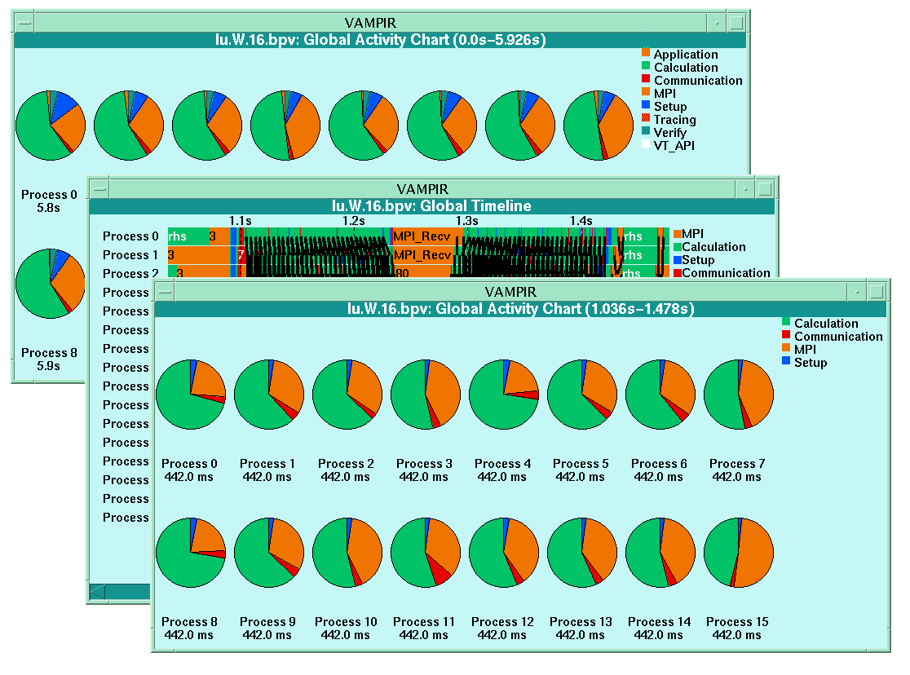
Vampir: Execution Statistics Displays
Aggregated
profiling
information: execution time, # calls, inclusive/exclusive
Available for all/any group (activity)
Available for all routines (symbols)
Available for any trace part (select in timeline diagram)

Slide 17
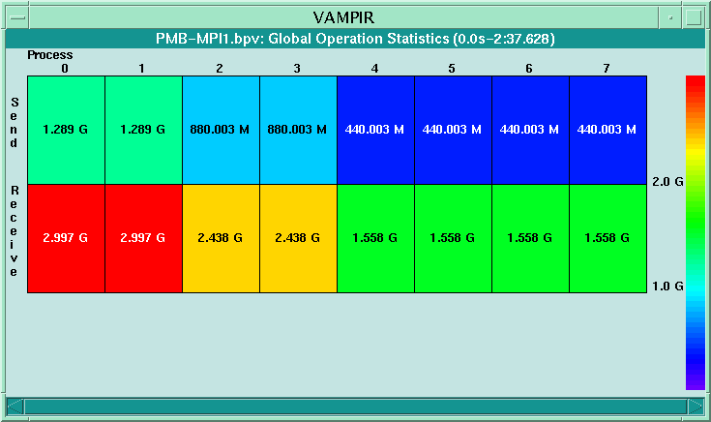
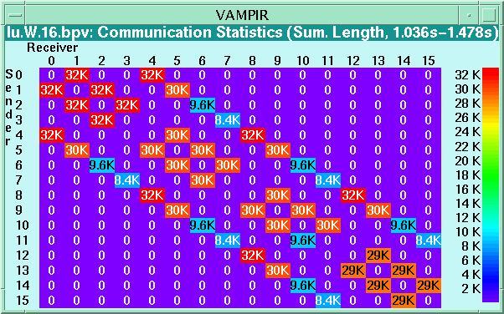
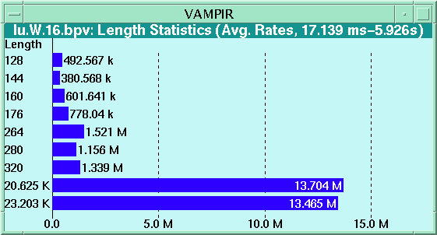
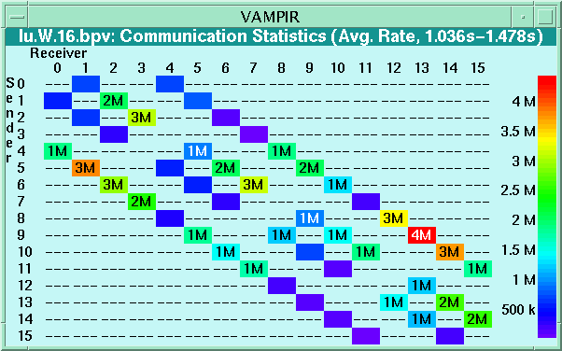
Vampir: Communication Statistics Displays
Bytes sent/received for collective operations
Message length statistics
Available for any trace part
Byte and message count,
min/max/avg message length and min/max/avg bandwidth
for each process pair

Slide 18
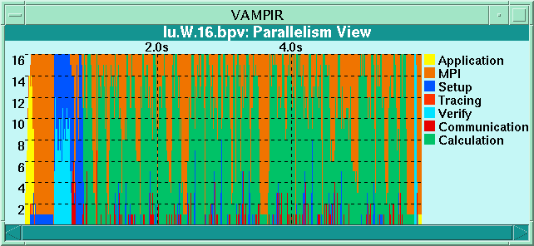
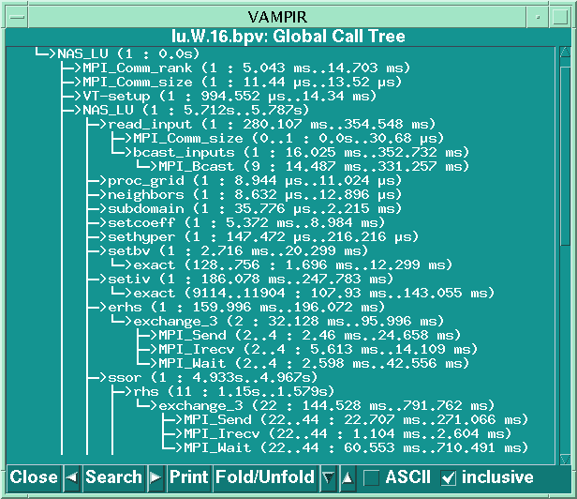
Vampir: Other Features
Dynamic global call graph tree
Parallelism display
Powerful filtering and trace comparison features
All diagrams highly customizable (through context menus)

Slide 19
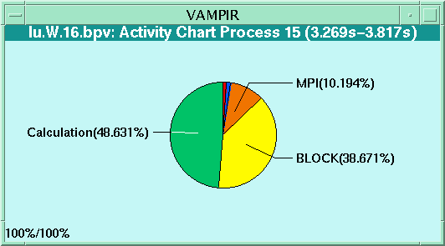
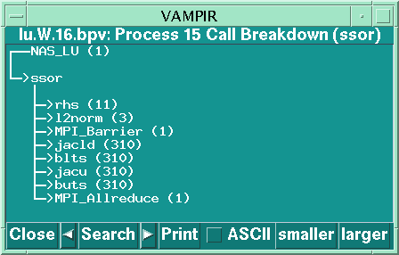
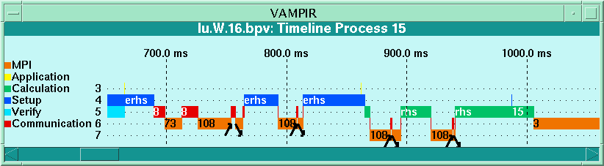
Vampir: Process Displays
Activity chart
Call tree
Timeline
For all selected processes in the global displays

Slide 20
Vampir: New Features
New Vampir versions (3 and 4)
  New core (dramatic timeline speedup,
  significantly reduced memory footprint)
  Load–balance analysis display
  Hardware counter value displays
  Thread analysis
  show hardware and grouping structure
  Improved statistics displays
  Raised scalability limits:
  can now analyse 100s of processes/threads

Slide 21
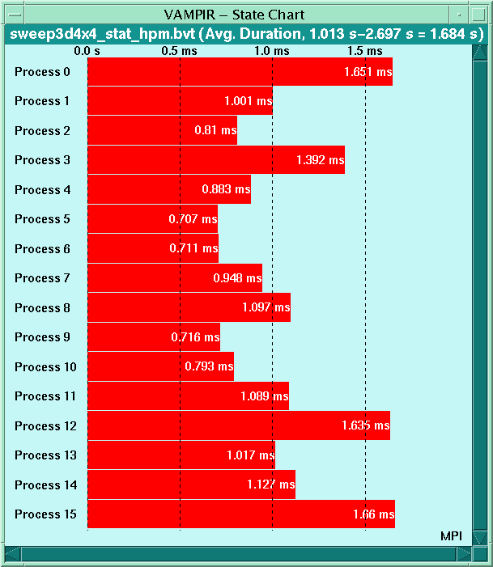
Vampir: Load Balance Analysis
State Chart display
Aggregated profiling
information:
execution time, # calls,
inclusive/exclusive
For all/any group
(activity)
For all routines
(symbols)
For any trace part

Slide 22
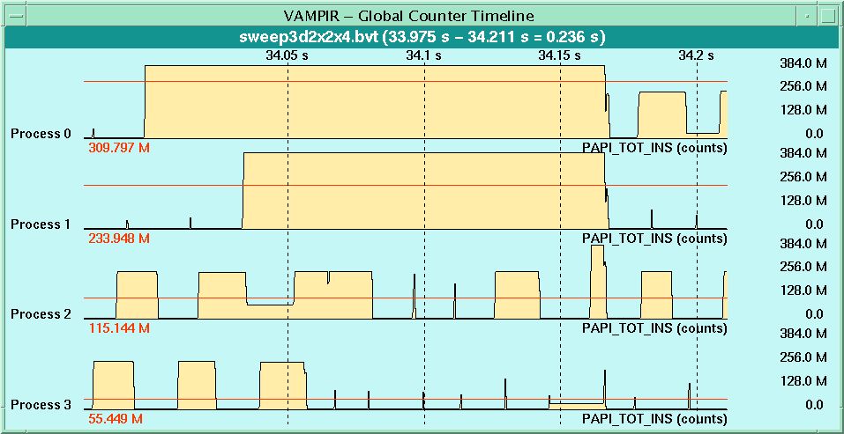
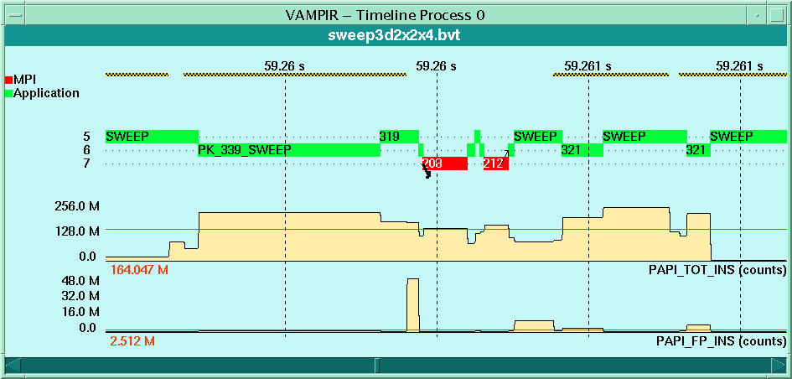
Vampir: HPM Counter
Counter Timeline Display
Process Timeline Display

Slide 23
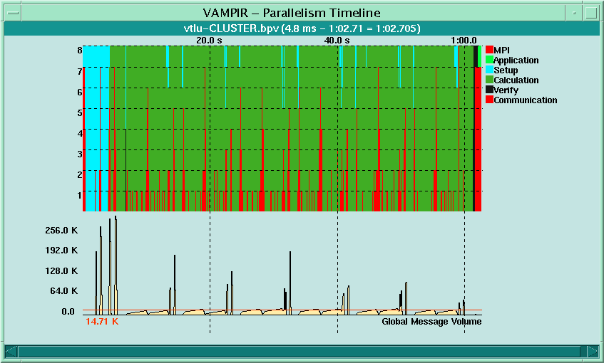
Vampir: Cluster Timeline
Display of whole system
Parallelism Display
Communication Volume Display

Slide 24
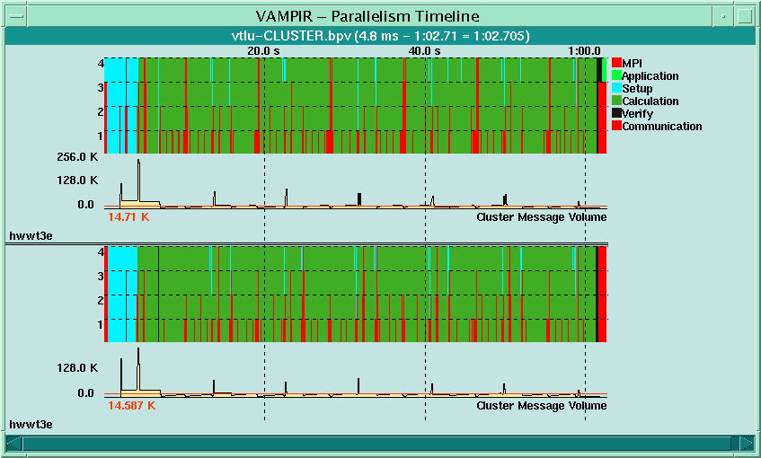
Vampir: Cluster Timeline
SMP or Grid Nodes Display
Parallelism Display
for each Node
Parallelism Display
for each Node
Intra–node Communication
Volume

Slide 25
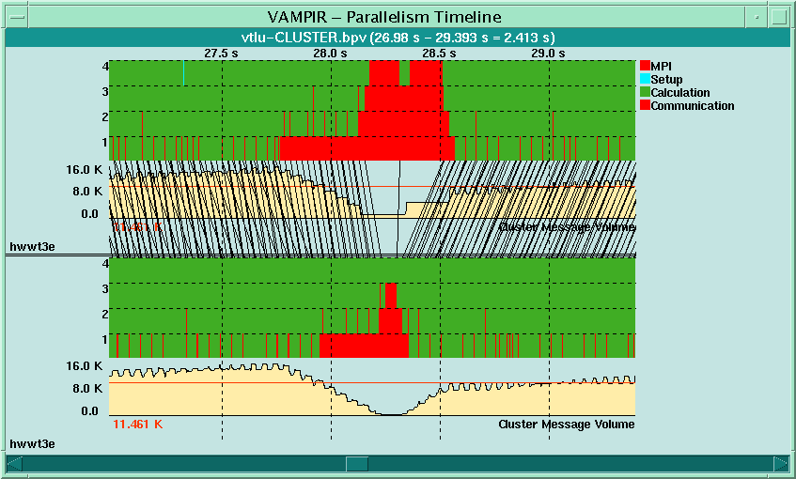
Vampir: Cluster Timeline(2)
Display of messages between nodes enabled

Slide 26
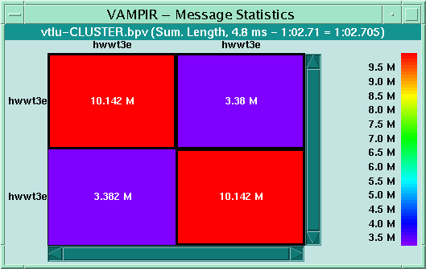
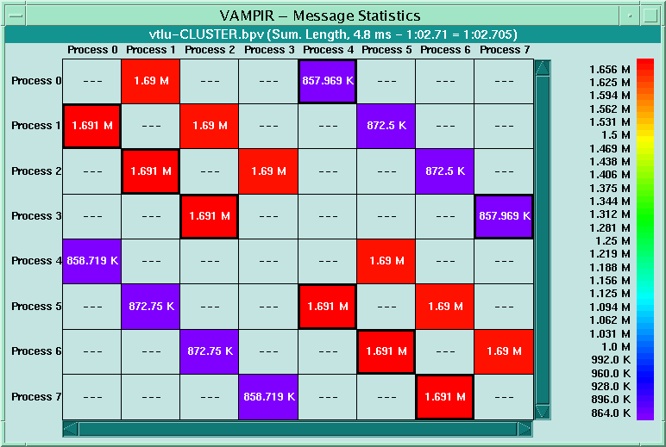
Vampir: Improved Message Statistics Display
Process View
NodeView

Slide 27
Release Schedule
Vampir/SX and Vampirtrace/SX
  version 1 available via NEC Japan
  version 2 is ready for release
Vampir/SC and Vampirtrace/SC
  version 3 is available from Pallas
  version 4 scheduled for Q4/2001
Vampir and Vampirtrace
  version 3 is scheduled for Q4/2001
  version 4 will follow in 2002

Slide 28
Vampir Feature Matrix

Slide 29
Vampirtrace
Commercial product of Pallas, Germany
Library for Tracing of MPI and Application Events
  records MPI point-to-point communication
  records MPI collective communication
  records MPI–2 I/O operations
  records user subroutines (on request)
  records source–code information (some platforms)
  support for shmem (Cray T3E)
Uses the PMPI profiling interface
http://www.pallas.de/pages/vampirt.htm

Slide 30
Vampirtrace: Usage
Record MPI–related information
  Re–link a compiled MPI application (no re-compilation)
    {f90,cc,CC} *.o -o myprog
    -L$(VTHOME)/lib -lVT -lpmpi -lmpi
  Re-link with -vt option to MPICH compiler scripts
    {mpif90,mpicc,mpiCC} -vt *.o -o myprog
  Execute MPI binary as usual
Record user subroutines
  insert calls to Vampirtrace API (portable, but inconvenient)
  use automatic instrumentation
  (NEC SX, Fujitsu VPP, Hitachi SR)
  use instrumentation tool (Cray PAT, dyninst, ...)

Slide 31
Vampirtrace Instrumentation API (C / C++)
Calls for recording user subroutines
VT calls can only be used between
MPI_Init and MPI_Finalize!
Event numbers used must be globally unique
Selective tracing: VT_traceoff(),VT_traceon()
#include "VT.h"
/* Symbols defined with/without source information */
VT_symdefl(123, "foo", "USER", "foo.c:6");
VT_symdef (123, "foo", "USER");
void foo {
VT_begin(123); /* 1st executable line */
...
VT_end(123); /* at EVERY exit point! */
}

Slide 32
VT++.h – C++ Class Wrapper for Vampirtrace
#ifndef __VT_PLUSPLUS_
#define __VT_PLUSPLUS_
#include "VT.h"
class VT_Trace {
public: VT_Trace(int code) {VT_begin(code_ = code);}
~VT_Trace() {VT_end(code_);}
private: int code_;
};
#endif /* __VT_PLUSPLUS_ */
Same tricks can be used to wrap other C++ tracing APIs
Usage:
VT_symdef(123, "foo", "USER"); // symbol definition as before
void foo(void) { // user subroutine to monitor
VT_Trace vt(123); // declare VT_Trace object in 1st line
... // => automatic tracing by ctor/dtor
}

Slide 33
Vampirtrace Instrumentation API (Fortran)
Calls for recording user subroutines
Selective tracing: VTTRACEOFF(),VTTRACEON()
include 'VT.inc'
integer ierr
call VTSYMDEF(123, "foo", "USER", ierr) !or
call VTSYMDEFL(123, "foo", "USER", "foo.f:8", ierr)
C
SUBROUTINE foo(...)
include 'VT.inc'
integer ierr
call VTBEGIN(123, ierr)
C ...
call VTEND(123, ierr);
END

Slide 34
Vampirtrace: Runtime Configuration
Trace file collection and generation can be controlled by using a configuration file
  Trace file name, location, size, flush behavior
  Activation/deactivation of trace recording for specific processes, activities (groups of symbols), and symbols
Activate a configuration file with environment variables
  VT_CONFIG name of configuration file
  (use absolute pathname if possible)
  VT_CONFIG_RANK MPI rank of process which should
  read and process configuration file
Reduce trace file sizes
  restrict event collection in a configuration file
  use selective tracing functions

Slide 35
Vampirtrace: Configuration File Example
# collect traces only for MPI ranks 1 to 5
TRACERANKS 1:5:1
# record at most 20000 records per rank
MAX-RECORDS 20000
# do not collect administrative MPI calls
SYMBOL MPI_comm* off
SYMBOL MPI_cart* off
SYMBOL MPI_group* off
SYMBOL MPI_type* off
# do not collect USER events
ACTIVITY USER off
# except routine foo
SYMBOL foo on
Be careful to record complete message transfers!
See Vampirtrace User's Guide for complete description

Slide 36
New Features – Tracing
New Vampirtrace versions (3 and 4)
  New core (significantly reduce memory
  and runtime overhead)
  Better control of trace buffering and flush files
  New filtering options
  Event recording by thread
  Support of MPI–I/O
  Hardware counter data recording (PAPI)
  Support of process/thread groups

Slide 37
Vampirtrace Feature Matrix

Slide 38
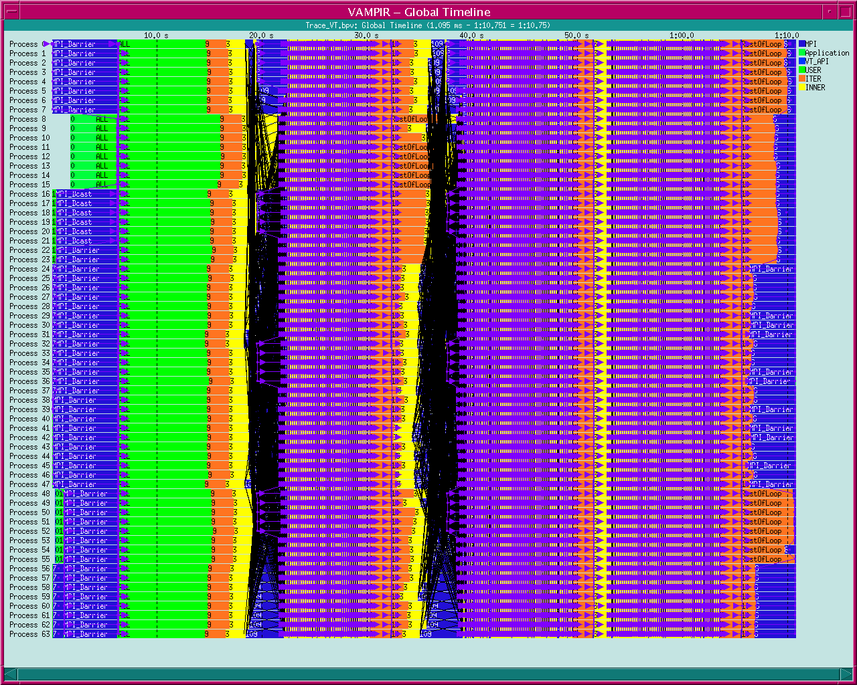
Motivation: Current Tool Support
Graphical presentation of enormous
amounts of low-level data
Manual search for performance problems
  Different aspects over different views
Too simple performance metrics
  Counter, rates
  Low-level view of behavior
Complex to use, Hard to learn
Needed: Automatic Performance Analysis
⇨ Transformation of large volumes of low-level data
into small volumes of high-level data

Slide 39

KOJAK
Kit for Objective Judgement and Automatic
Knowledge-based detection of bottlenecks
Forschungszentrum Jülich, Germany
Goal: Automatic, portable and generic
performance-analysis environment
Current focus
  Event traces
  Parallel computers with SMP nodes
  MPI, OpenMP, hybrid (OpenMP + MPI)
http://www.fz-juelich.de/zam/kojak/

Slide 40

APART
European IST Working Group APART (since 1999)
Automatic Performance Analysis: Real Tools
Forum for scientists and vendors of hardware/software
About 20 partners in Europe and the U.S.
http://www.fz-juelich.de/apart/

Slide 41
Performance Analysis: APART Terminology
Performance property
  Aspect of performance behavior
    Example: communication dominated by waiting time
  Specification
    As condition referring to performance data
  Quantification
    Severity ::= execution time spent on specific behavior
    Allows for normalization
Performance problem
  “Negative” performance property
Performance bottleneck
  Performance problem with highest severity

Slide 42
Performance Property: Message in Wrong Order
Location
B
SEND
C
SEND
waiting time
A
RECV
RECV
Time

Slide 43
More Examples of Performance Properties
Message Passing (MPI)
Shared Memory (OpenMP)
    Blocked sender
    Waiting for new messages although older messages ready to be received
    Waiting for last participant
    in N-to-N operation
  Late Receiver
  Messages in Wrong Order
  Wait at N x N
  …
    Waiting time in explicit or implicit barriers
    Waiting for lock owned by another thread
    Time on unused CPUs while executing in sequential mode
  Barrier Synchronization
  Lock Synchronization
  Idle Threads
  …

Slide 44
Event-Based Specification
Basic event model
  Hierarchy of event types
  Event ::= Set of attributes
  Event trace ::= Sequence of events in chronological order
EVENT
FLOW
P2P
TEAM
SYNC
ENTER
EXIT
SEND
RECV
FORK
JOIN
ALOCK
RLOCK
MPICEXIT
OMPCEXIT

Slide 45
Event-Based Specification
Problem: Event-based specification of properties?
  Complex relationships among constituents
  May depend on execution state of the program
  May depend on programming model
Solution: Definition of a enhanced event model
by encapsulation of complex relationships
  State sequences (state ::= set of the triggering events)
    Inductively defined by transition operators
    e.g., message queue, region stack, …
  Pointer attributes (link between corresponding events)
    Defined as function over attributes and state sequences
    e.g., sender, enclosing region, …

Slide 46
Event-Based Specification
Property represented as a compound event (event pattern)
  Set of primitive events (constituents)
  Distinguished root event
    Starting point of search for constituents
  Relationships between constituents
  and other conditions
    Defined based on state sequences and pointer attributes
Felix Wolf, Ph.D. Dissertation, 2003.

Slide 47
Implementation
Enhanced event model implemented as EARL (Python/C++)
Compound event specified as Python class
  Implements interface (Pattern)
  Overrides call-back method for root event type
    Locates constituents
    Checks conditions
    Calculates severity per call tree node and location
    ⇒ severity matrix
  Registers call-back method with analysis process
  All properties arranged in a specialization hierarchy
Analysis process
  Walks sequentially through event trace
  Invokes registered call-back methods for each event
Property
Path
Location

Slide 48
Example
Location
B
SEND
ENTER
EXIT
SEND
RECV
message
enterptr
sendptr
C
SEND
??
waiting time
A
RECV
RECV
Time
call back

Slide 49
KOJAK Architecture
Semi-automatic
Instrumentation
user
program
OPARI /
TAU instr.
modified
program
POMP+PMPI
libraries
executable
Compiler /
Linker
EPILOG
trace library
execute
Automatic
Analysis
EXPERT
Analyzer
analysis
result
EXPERT
Presenter
EPILOG
event trace
EARL
Manual Analysis
trace
converter
VTF3
event trace
VAMPIR

Slide 50



KOJAK Tool Components
Instrument user application with EPILOG tracing library calls
  User functions and regions:
    Automatically by compiler (PGI, Hitachi)
    Automatically by TAU source instrumentor
  MPI calls:
    Automatically by PMPI Wrapper Library (MPI 1.2 only)
  OpenMP:
    Automatically by OPARI source instrumentor
Analyze measured event trace
  Automatically with EXPERT trace analyzer
  (based on EARL trace analysis language)
  Manually with VAMPIR
  (using EPILOG-VTF3 converter)

Slide 51
EXtensible PERformance Tool
Representation of results (severity matrix)
along three hierarchical axes
  Performance property (general → specific)
  Region tree path
  Location (machine → node → process → thread)
Three coupled tree browsers
Each node displays severity
  As color: for easy identification of bottlenecks
  As value: for precise comparison
Displayed severity depends on state
  Collapsed (inclusive severity)
  Expanded (exclusive severity)
10 main
100 main
30 foo
60 bar
13

Slide 52
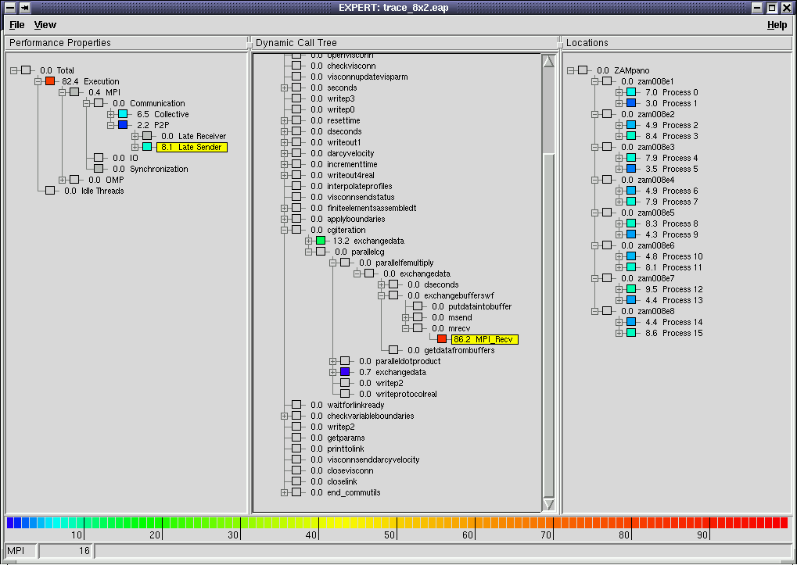
Call Path Tree
Where in the source code?
In which context?
Performance Property
Which type of behavior
caused the problem?
Color Scale
How severe is the problem?
Location
How is the problem distributed across the machine?

Slide 53
Expert Conclusion
Formal characterization of inefficient behavior
  Automatic detection in event traces
  Simple specification through abstraction mechanisms
Specification of common performance problems
  MPI, OpenMP, and hybrid applications
Integrated multi-dimensional representation
of performance behavior
Extensible modular tool architecture

Slide 54
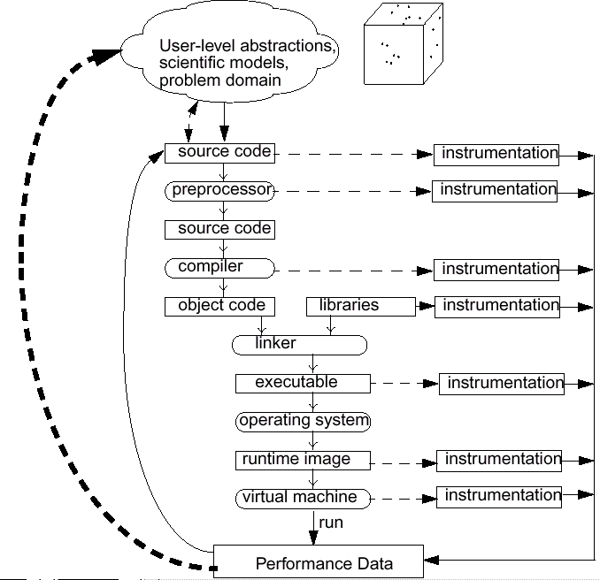
Semantic Performance Mapping
Associate performance measurements with high-level semantic abstractions
Need mapping support in the performance measurement system to assign data correctly

Slide 55
Semantic Entities/Attributes/Associations (SEAA)
New dynamic mapping scheme (S. Shende, Ph.D. thesis)
  Contrast with ParaMap (Miller and Irvin)
  Entities defined at any level of abstraction
  Attribute entity with semantic information
  Entity-to-entity associations
Two association types (implemented in TAU API)
  Embedded – extends associated
  object to store performance
  measurement entity
  External – creates an external look-up
  table using address of object as key to
  locate performance measurement entity
…

Slide 56
Hypothetical Mapping Example
Particles distributed on surfaces of a cube
Particle* P[MAX]; /* Array of particles */
int GenerateParticles() {
/* distribute particles over all faces of the cube */
for (int face=0, last=0; face < 6; face++){
/* particles on this face */
int particles_on_this_face = num(face);
for (int i=last; i < particles_on_this_face; i++) {
/* particle properties are a function of face */ P[i] = ... f(face);
...
}
last+= particles_on_this_face;
}
}

Slide 57
Hypothetical Mapping Example (continued)
int ProcessParticle(Particle *p) {
/* perform some computation on p */
}
int main() {
GenerateParticles();
/* create a list of particles */
for (int i = 0; i < N; i++)
/* iterates over the list */
ProcessParticle(P[i]);
}
work
packets
…
engine
How much time is spent processing face i particles?
What is the distribution of performance among faces?

Slide 58
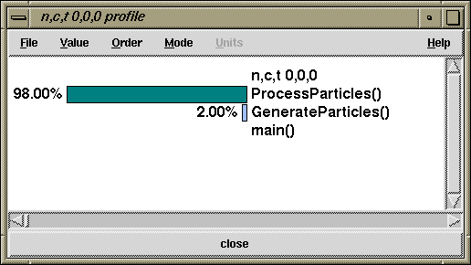
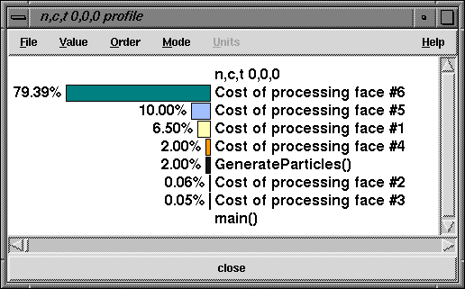
No Performance Mapping versus Mapping
Typical performance tools report performance with respect to routines
Does not provide support for mapping
Performance tools with SEAA mapping can observe performance with respect to scientist’s programming and problem abstractions
TAU (no mapping)
TAU (w/ mapping)

Slide 59
Midterm
Four sections
  Analytical modeling and performance analysis
  Parallel programming
  Parallel algorithms
  Parallel architecture and systems (maybe)
Open notes
Mostly, the test will be self-contained
Suggested preparation
  Read through lecture notes
  Practice thinking in parallel

