Slide 1



CIS 631
Parallel Processing
Lecture 2: Parallel Architectures
Allen D. Malony
malony@cs.uoregon.edu
Department of Computer and Information Science
University of Oregon

Slide 2
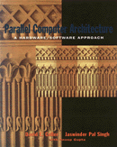
Acknowledgements
Portions of the lectures slides were adopted from:
  David Patterson, CS252, University of California, Berkeley, 2001.
  David E. Culler, CS 258, University of California, Berkeley, 1999.
  http://www.eecs.berkeley.edu/~culler/cs258-s99/.
  Parallel Computer Architecture:
  Hardware/Software Approach,
  D. Culler, J. Singh, A. Gupta,
  Morgan Kaufmann, 1998.

Slide 3
Outline
Parallel architecture types
Instruction-level parallelism
Vector processing
SIMD
Shared memory
  Memory organization: UMA, NUMA
  Coherency: CC-UMA, CC-NUMA
Distributed memory
Clusters
Interconnection networks

Slide 4
Parallel Architecture Types
Uniprocessor
  Scalar processor
  Vector processor
  Single Instruction Multiple Data (SIMD)
Shared Memory
Multiprocessor (SMP)
  Shared memory address space
  Bus-based memory system
  Interconnection network
processor
memory
processor
…
processor
bus
processor
vector
memory
memory
processor
…
processor
network
…
processor
…
memory
memory

Slide 5
Introduction to Parallel Architectures
Distributed Memory
Multiprocessor
  Message passing
  between nodes
  Massively Parallel Processor (MPP)
    Many, many processors
Cluster of SMPs
  Shared memory addressing within SMP node
  Message passing between SMP nodes
  Can also be regarded as MPP if processor number is large
memory
memory
…
M
M
processor
processor
…
P
…
P
P
…
P
interconnection network
network
interface
processor
processor
interconnection network
…
…
…
P
P
P
P
memory
memory
…
M
M

Slide 6
Introduction to Parallel Architectures
Multicore
  Multicore processor
  GPU accelerator
Multicore SMP+GPU Cluster
  Shared memory addressing within SMP node
  Message passing between SMP nodes
  GPU accelerators attached
C
C
C
C
m
m
m
m
memory
M
…
M
processor
P
P
P
P
PCI
…
…
memory
interconnection network
P
…
P
P
…
P
…
M
M

Slide 7
How do you get parallelism in the hardware?
Instruction-Level Parallelism (ILP)
Data parallelism
  Increase amount of data to be operated on at same time
Processor parallelism
  Increase number of processors
Memory system parallelism
  Increase number of memory units
  Increase bandwidth to memory
Communication parallelism
  Increase amount of interconnection between elements
  Increase communication bandwidth

Slide 8
Instruction-Level Parallelism
Opportunities for splitting up instruction processing
Pipelining within instruction
Pipelining between instructions
Overlapped execution
Multiple functional units
Out of order execution
Multi-issue execution
Superscalar processing
Superpipelining
Very Long Instruction Word (VLIW)

Slide 9
Parallelism in Single Processor Computers
History of processor architecture innovation
ILP
Unpipelined
Pipelined
Vector
multiple
E unit
only scalar
instructions
vector
instructions
horizontal
control
issue-when-
ready
register
to register
memory
to memory
CDC
6600
FPS
AP-120B
CDC
7600
CRAY-1
CDC
Cyber-205
scoreboarding
VLIW
IBM
360/91
reservation stations

Slide 10
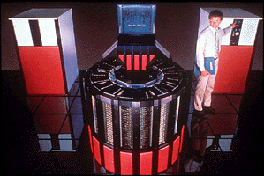
Vector Processing
Scalar processing
  Processor instructions operate on scalar values
  integer registers and floating point registers
Vectors
  Set of scalar data
  Vector registers (integer, floating point (typically))
  Vector instructions operate on vector registers (SIMD)
Vector unit pipelining
Multiple vector units
Vector chaining
Cray 2
Liquid-cooled with inert fluorocarbon. (That’s a waterfall fountain!!! Very cool!)

Slide 11
Data Parallel Architectures
SIMD (Single Instruction Multiple Data)
  Logical single thread (instruction) of control
  Processor associated with data elements
Architecture
  Array of simple processors with memory
  Processors arranged in a regular topology
  Control processor issues instructions
    All processors execute same instruction (maybe disabled)
  Specialized synchronization and communicaton
  Specialized reduction operations
  Array processing
C
o
n
t
r
o
l
p
r
o
c
e
s
s
o
r
P
E
P
E
°
°
°
P
E
P
E
P
E
°
°
°
P
E
°
°
°
°
°
°
°
°
°
P
E
P
E
°
°
°
P
E

Slide 12
AMT DAP 500
Applied Memory Technology (AMT)
Distributed Array Processor (DAP)
USER
INTERFACE
HOST
CONNECTION
UNIT
HOST
ACCUMULATOR
O
ACTIVITY CONTROL
A
MASTER
CONTROL
UNIT
CODE
MEMORY
CARRY
C
PROCESSOR
ELEMENTS
DATA
D
FAST DATA
CHANNEL
ARRAY
MEMORY
32K
BITS
32
32

Slide 13
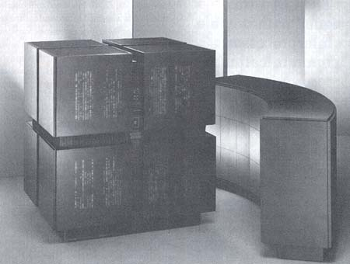
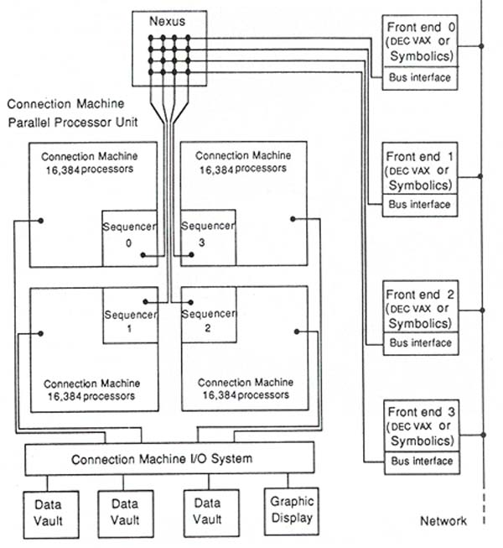
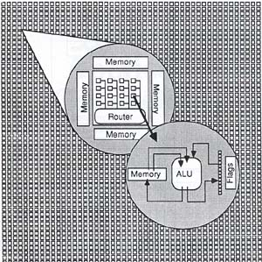
Thinking Machines Connection Machine
16,000 processors!!!
(Tucker, IEEE Computer, Aug. 1988)

Slide 14
Vector and SIMD Processing Timeline
CDC Cyber 205
(Levine, 1982)
ETA 10
(ETA, Inc. 1989)
CDC 7600
(CDC, 1970)
Cray Y-MP
(Cray Research, 1989)
Cray/MPP
(Cray Research, 1993)
Cray 1
(Russell, 1978)
Fujitsu, NEC, Hitachi Models
(a) Multivector track
DAP 610
(AMT, Inc. 1987)
Goodyear MPP
(Batcher, 1980)
CM2
(TMC, 1990)
Illiac IV
(Barnes et al, 1968)
MasPar MP1
(Nickolls, 1990)
MasPar MP2
(1991)
BSP
(Kuck and Stokes, 1982)
IBM GF/11
(Beetem et al, 1985)
(b) SIMD track

Slide 15
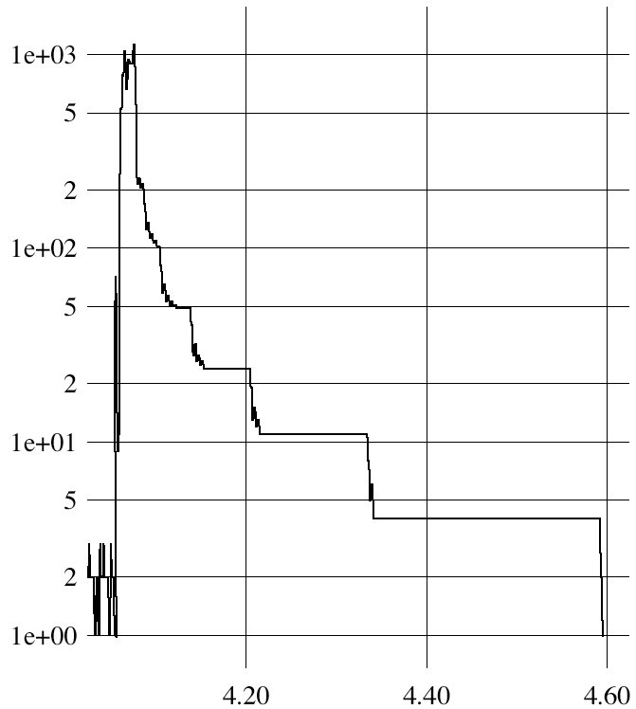
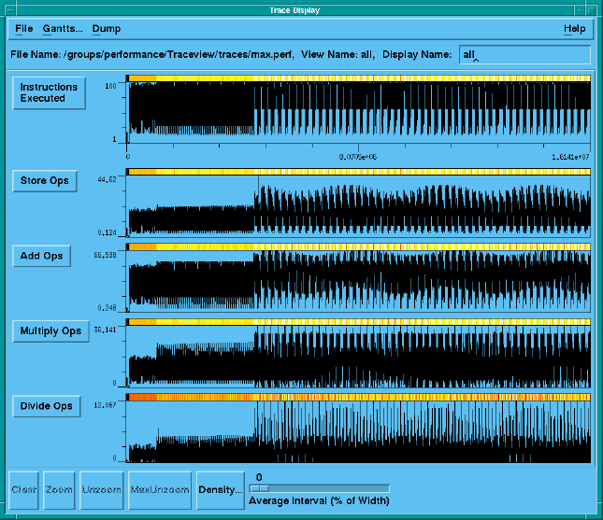
What’s the maximum parallelism in a program?
“MaxPar: An Execution Driven Simulator for Studying Parallel Systems,” Ding-Kai Chen, M.S. Thesis, University of Illinois, Urbana-Champaign, 1989.
Analyze the data dependencies in application execution
512-point FFT
Flo52

Slide 16
Dataflow Architectures
Represent computation as graph of dependencies
Operations stored in memory until operands are ready
Operations can be dispatched to processors
Tokens carry tags of next
instruction to processor
Tag compared in matching
store
A match fires execution
Machine does the hard
parallelization work
Hard to build right

Slide 17
Shared Physical Memory
Add processors to single processor computer system
Processors share computer system resources
  Memory, storage, …
Sharing physical memory
  Any processor can reference any memory location
  Any I/O controller can reference any memory address
  Single physical memory address space
Operating system runs on any processor, or all
  OS see single memory address space
  Uses shared memory to coordinate
Communication occurs as a result of loads and stores

Slide 18
Caching in Shared Memory Systems
Reduce average latency
  automatic replication closer to processor
Reduce average bandwidth
Data is logically transferred from
producer to consumer to memory
  store reg → mem
  load reg ← mem
Processors can share data efficiently
What happens when store and load are executed on different processors?
Cache coherence problems
P
P
P

Slide 19
Shared Memory Multiprocessors (SMP)
Architecture types
Differences lie in memory system interconnection
Single processor
Multiple processors
P
P
P
P
P
P
P
P
P
P
M
M
multi-port
M
shared bus
interconnection
network
M
I
/
O
d
e
v
i
c
e
s
What does
this look like?
M
e
m
M
e
m
M
e
m
M
e
m
I
/
O
c
t
r
l
I
/
O
c
t
r
l
I
n
t
e
r
c
o
n
n
e
c
t
I
n
t
e
r
c
o
n
n
e
c
t
P
r
o
c
e
s
s
o
r
P
r
o
c
e
s
s
o
r

Slide 20

Bus-based SMP
I/O
I/O
Memory bus handles all
memory read/write traffic
Processors share bus
Uniform Memory Access (UMA)
  Memory (not cache) uniformly equidistant
  Take same amount of time (generally) to complete
May have multiple memory modules
  Interleaving of physical address space
Caches introduce memory hierarchy
  Lead to data consistency problems
  Cache coherency hardware necessary (CC-UMA)
C
C
M
M
$
$
P
P

Slide 21
Crossbar SMP
Replicates memory bus for
every processor and I/O controller
  Every processor has direct path
UMA SMP architecture
Can still have cache coherency issues
Multi-bank memory or interleaved memory
Advantages
  Bandwidth scales linearly (no shared links)
Problems
  High incremental cost (cannot afford for many processors)
  Use switched multi-stage interconnection network
P
P
I/O
C
I/O
C
M
M
M
M

Slide 22
“Dance Hall” SMP and Shared Cache
Interconnection network connects
processors to memory
Centralized memory (UMA)
Network determines performance
  Continuum from bus to crossbar
  Scalable memory bandwidth
Memory is physically separated from
processors
Could have cache coherence problems
Shared cache reduces coherence problem
and provides fine grained data sharing
M
M
° ° °
M
Network
$
$
° ° °
$
P
P
P
Main memory
(Interleaved)
First-level $
(Interleaved)
Switch
P
1
P
n

Slide 23
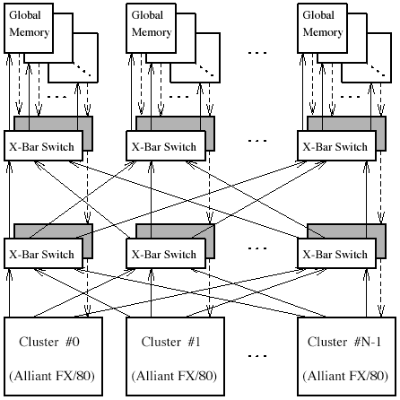
University of Illinios CSRD Cedar Machine
Center for Supercomputing Research and Development
Multi-cluster scalable
parallel computer
Alliant FX/80
  8 processors w/ vectors
  Shared cache
  HW synchronization
Omega switching network
Shared global memory
SW-based global memory
coherency

Slide 24
Natural Extensions of the Memory System
P
1
P
n
Scale
Switch
(Interleaved)
P
First-level $
P
1
n
(Interleaved)
$
$
Main memory
Inter
connection network
Shared Cache
Mem
Mem
P
Centralized Memory
Dance Hall, UMA
P
P
1
P
n
I/O
C
Mem
$
Mem
$
I/O
C
M
M
M
M
Inter
connection network
Crossbar, Interleaved
Distributed Memory (NUMA)

Slide 25
Non-Uniform Memory Access (NUMA) SMPs
Distributed memory
Memory is physically resident
close to each processor
Memory is still shared
Non-Uniform Memory Access (NUMA)
  Local memory and remote memory
  Access to local memory is faster, remote memory slower
  Access is non-uniform
  Performance will depend on data locality
Cache coherency is still an issue (more serious)
Interconnection network architecture is more scalable
Network
M
$
M
$
° ° °
M
$
P
P
P

Slide 26
Cache Coherency and SMPs
Caches play key role in SMP performance
  Reduce average data access time
  Reduce bandwidth demands placed on shared interconnect
Private processor caches create a problem
  Copies of a variable can be present in multiple caches
  A write by one processor may not become visible to others
    They’ll keep accessing stale value in their caches
  ⇒ Cache coherence problem
What do we do about it?
  Organize the memory hierarchy to make it go away
  Detect and take actions to eliminate the problem

Slide 27
Definitions
Memory operation (load, store, read-modify-write, …)
Memory issue is operation presented to memory system
Processor perspective
  Write: subsequent reads return the value
  Read: subsequent writes cannot affect the value
Coherent memory system
  There exists a serial order of memory operations on each location such that
    operations issued by a process appear in order issued
    value returned by each read is that written by previous write
  ⇒ write propagation + write serialization

Slide 28
Motivation for Memory Consistency
Coherence implies that writes to a location become visible to all processors in the same order
But when does a write become visible?
How do we establish orders between a write and a read by different processors?
  Use event synchronization
Implement hardware protocol for cache coherency
Protocol will be based on model of memory consistency
P
1
P
2
/* Assume initial value of A and flag is 0 */
A = 1;
while (flag == 0);
/* spin idly */
flag = 1;
print A;

Slide 29
Memory Consistency
Specifies constraints on the order in which memory operations (from any process) can appear to execute with respect to each other
  What orders are preserved?
  Given a load, constrains the possible values returned by it
Implications for both programmer and system designer
  Programmer uses to reason about correctness
  System designer can use to constrain how much accesses can be reordered by compiler or hardware
Contract between programmer and system

Slide 30
Sequential Consistency
Total order achieved by interleaving accesses from different processes
  Maintains program order
  Memory operations (from all processes) appear to issue, execute, and complete atomically with respect to others
  As if there was a single memory (no cache)
“A multiprocessor is sequentially consistent if the result of any execution is the same as if the operations of all the processors were executed in some sequential order, and the operations of each individual processor appear in this sequence in the order specified by its program.” [Lamport, 1979]

Slide 31
Sequential Consistency (Sufficient Conditions)
There exist a total order consistent with the memory operations becoming visible in program order
Sufficient Conditions
  every process issues memory operations in program order
  after write operation is issued, the issuing process waits for write to complete before issuing next memory operation (atomic writes)
  after a read is issued, the issuing process waits for the read to complete and for the write whose value is being returned to complete (globally) before issuing its next memory operation
Cache-coherent architectures implement consistency

Slide 32
Bus-based Cache-Coherent (CC) Architecture
Bus Transactions
  Single set of wires connect several devices
  Bus protocol: arbitration, command/addr, data
  Every device observes every transaction
Cache block state transition diagram
  FSM specifying how disposition of block changes
    invalid, valid, dirty
  Snoopy protocol
Basic Choices
  Write-through vs Write-back
  Invalidate vs. Update

Slide 33
Snoopy Cache-Coherency Protocols
Bus is a broadcast medium
Caches know what they have
Cache controller “snoops” all transactions on shared bus
  relevant transaction if for a block its cache contains
  take action to ensure coherence
    invalidate, update, or supply value
  depends on state of the block and the protocol
State
Address
Data

Slide 34
Example: Write-thru Invalidate
P
1
P
2
P
3
u
= ?
u
= ?
3
$
4
$
5
$
u
:5
u
:5
u
= 7
1
I/O devices
u
:5
2
Memory

Slide 35
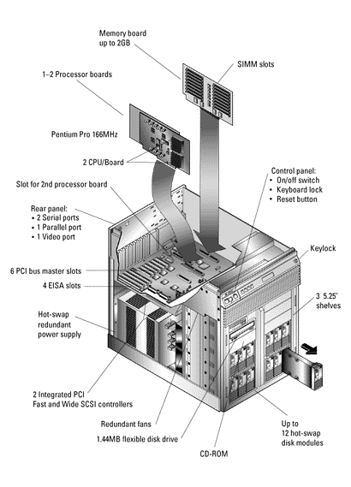
Intel Pentium Pro Quad Processor
C
P
U
P
-
P
r
o
P
-
P
r
o
P
-
P
r
o
I
n
t
e
r
r
u
p
t
2
5
6
-
K
B
m
o
d
u
l
e
m
o
d
u
l
e
m
o
d
u
l
e
c
o
n
t
r
o
l
l
e
r
L
2
$
B
u
s
i
n
t
e
r
f
a
c
e
P
-
P
r
o
b
u
s
(
6
4
-
b
i
t
d
a
t
a
,
3
6
-
b
i
t
a
d
d
r
e
s
s
,
6
6
M
H
z
)
b
P
C
I
P
C
I
M
e
m
o
r
y
r
i
d
g
e
b
r
i
d
g
e
c
o
n
t
r
o
l
l
e
r
P
C
I
I
I
M
I
U
c
I
/
O
C
C
a
r
d
s
P
P
1
-
,
2
-
,
o
r
4
-
w
a
y
i
n
t
e
r
l
e
a
v
e
d
D
R
A
M
  All coherence and multiprocessing glue in processor module
  Highly integrated, targeted at high volume
  Low latency and bandwidth

Slide 36
Next Class
More cache-coherent SMPs
Distributed memory parallel computers
Clusters
Clusters of SMPs

