Slide 1



CIS 631
Parallel Processing
Lecture 6: Parallel Programming
Allen D. Malony
malony@cs.uoregon.edu
Department of Computer and Information Science
University of Oregon

Slide 2
Acknowledgements
Portions of the lectures slides were adopted from:
  I. Foster, “Designing and Building Parallel Programs,” 1995.
  Vijay Pai, COMP 422, “Parallel Programming,” Rice University, 2002.
  A. Grama, A. Gupta, G. Karypis, and V. Kumar, “Introduction to Parallel Computing,” 2003.

Slide 3
Outline
Dependency and Synchronization
Methodological design of parallel programs
Types of parallel programs
  Data parallel vs. task parallel
  Pipelining
  Task graphs
  Master-slave
  Producer-consumer
  Divide-and-conquer
  SPMD
  Loop scheduling

Slide 4
Fork-Join Parallelism
  x = g(a);
  for( i=0; i<100; i++ ) a[i] = f(i);
  y = h(a);
  for( i=0; i<100; i++ ) b[i] = x + h( a[i]);
First loop is a DOALL loop
Middle statement is sequential
Second loop is a DOALL loop
Execution moves between sequential and parallel phases
Call this fork-join parallelism
…
…

Slide 5
Fork-Join and Barrier Synchronization
fork() causes a number of processes to be created and to be run in parallel
join() causes all these processes to wait until all of them have executed a join() (barrier synchronization)
  fork();
  for( i=0; i<100; i++ ) a[i] = f(i);
  join();
  y = h(a);
  fork();
  for( i=0; i<100; i++ ) b[i] = x + h( a[i]);
  join();

Slide 6
Synchronization Issues
Synchronization is necessary to make some programs execute correctly in parallel
Dependences have to be “covered” by appropriate synchronization operations
Different sychronization constructs exist in different parallel programming models
However, synchronization is expensive
To reduce synchronization
  May need to limit parallelization
  Look for opportunities to increase parallelism granularity

Slide 7
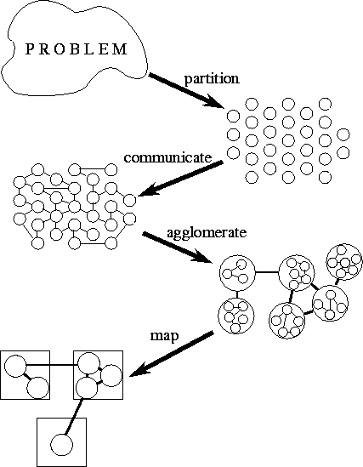
Methodological Design
Partition:
  Task/data
  decomposition
Communication
  Task execution
  coordination
Agglomeration
  Evaluation of the
  structure
Mapping
  Resource assignment

Slide 8
Partitioning
Partitioning stage is intended to expose
opportunities for parallel execution
Focus on defining large number of small
task to yield a fine-grained decomposition
of the problem
A good partition divides into small pieces both the computation associated with a problem and the data on which this computation operates
Domain decomposition focuses on computation data
Functional decomposition focuses on computation tasks
Mixing domain/functional decomposition is possible

Slide 9
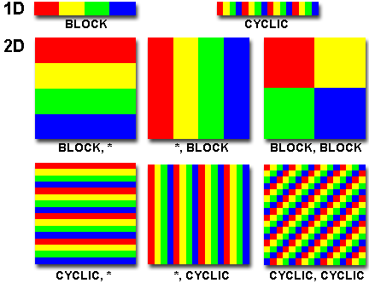
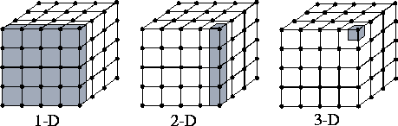
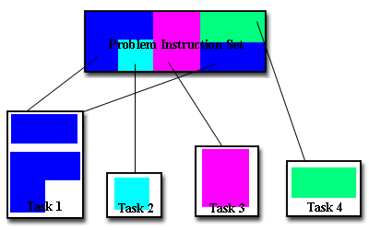
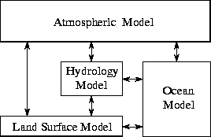
Domain and Functional Decomposition
Domain decomposition of two / three-dimensional grid
Functional decomposition of a climate model

Slide 10
Partitioning Checklist
Does your partition define at least an order of magnitude more tasks than there are processors in your target computer? If not, may loose design flexibility.
Does your partition avoid redundant computation and storage requirements? If not, may not be scalable.
Are tasks of comparable size? If not, it may be hard to allocate each processor equal amounts of work.
Does the number of tasks scale with problem size? If not may not be able to solve larger problems with more processors
Have you identified several alternative partitions?

Slide 11
Communication
Tasks generated by a partition must
interact to allow the computation to proceed
  Information flow: data and control
Types of communication
  Local vs. Global: locality of communication
  Structured vs. Unstructured: communication patterns
  Static vs. Dynamic: determined by runtime conditions
  Synchronous vs. Asynchronous: coordination degree
Granularity and frequency of communication
  Size of data exchange
Communication as control

Slide 12
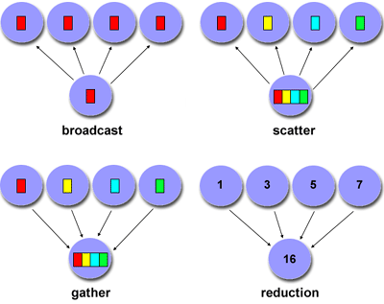
Types of Communication
Point-to-point
Group-based
Hierachical
Collective

Slide 13
Communication Design Checklist
Is the distribution of communications equal?
  Unbalanced communication may limit scalability
What is the communication locality?
  Wider communication locales are more expensive
What is the degree of communication concurrency?
  Communication operations may be parallelized
Is computation associated with different tasks able to proceed concurrently? Can communication be overlapped with computation?
  Try to reorder computation and communication to expose opportunities for parallelism

Slide 14
Agglomeration
Move from parallel abstractions
to real implementation
Revisit partitioning and communication
  View to efficient algorithm execution
Is it useful to agglomerate (combine) tasks?
Is it useful to replicate data and/or computation?
Changes important algorithm and performance ratios
  Surface-to-volume: reduction in communication at the expense of decreasing parallelism
  Communication/computation: which cost dominates
Replication may allow reduction in communication
Maintain flexibility to allow overlap

Slide 15
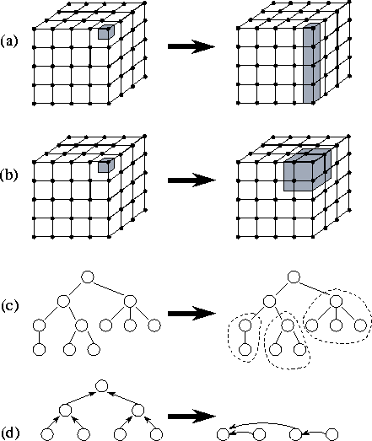
Types of Agglomeration
Element to column
Element to block
  Better surface to volume
Task merging
Task reduction
  Reduces communication

Slide 16
Agglomeration Design Checklist
Has increased locality reduced communication costs?
Is replicated computation worth it?
Does data replication compromise scalability?
Is the computation still balanced?
Is scalability in problem size still possible?
Is there still sufficient concurrency?
Is there room for more agglomeration?
Fine-grained vs. coarse-grained?

Slide 17
Mapping
Specify where each task is to execute
  Less concern on shared-memory computers
Attempt to minimize execution time
  Place concurrent tasks on different
  processors to enhance physical concurrency
  Place communicating tasks on same processor, or on processors close to each other, to increase locality
  Strategies can conflict!
Mapping problem is NP-complete
  Use problem classifications and heuristics
Static and dynamic load balancing

Slide 18
Mapping Algorithms
Load balancing (partitioning) algorithms
Data-based algorithms
  Think of computational load with respect to amount of data being operated on
  Assign data (i.e., work) in some known manner to balance
  Take into account data interactions
Task-based (task scheduling) algorithms
  Used when functional decomposition yields many tasks with weak locality requirements
  Use task assignment to keep processors busy computing
  Consider centralized and decentralize schemes

Slide 19
Mapping Design Checklist
Is static mapping too restrictive and non-responsive?
Is dynamic mapping too costly in overhead?
Does centralized scheduling lead to bottlenecks?
Do dynamic load-balancing schemes require too much coordination to re-balance the load?
What is the tradeoff of dynamic scheduling complexity versus performance improvement?
Are there enough tasks to achieve high levels of concurrency? If not, processors may idle.

Slide 20
Types of Parallel Programs
Flavors of parallelism
  Data parallelism
    All processors do same thing on different data
  Task parallelism
    Processors are assigned tasks that do different things
Parallel execution models
  Data parallel
  Pipelining (Producer-Consumer)
  Task graph
  Work pool
  Master-Worker

Slide 21
Data Parallel
Data is decomposed (mapped) onto processors
Processors performance similar (identical) tasks on data
Tasks are applied concurrently
Load balance is obtained through data partitioning
  Equal amounts of work assigned
Certainly may have interactions between processors
Data parallelism scalability
  Degree of parallelism tends to increase with problem size
  Makes data parallel algorithms more efficient
Single Program Multiple Data (SPMD)
  Convenient way to implement data parallel computation

Slide 22
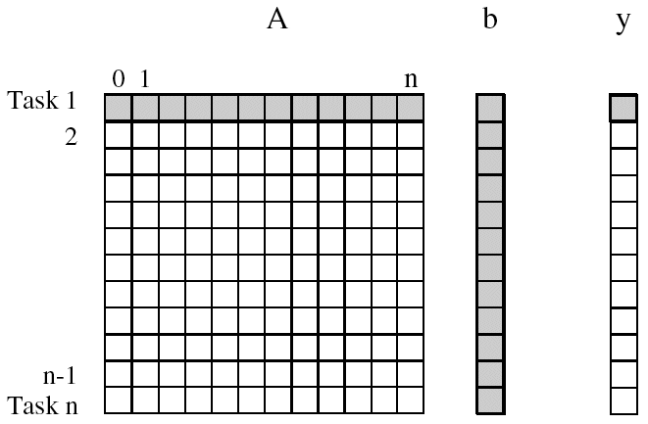
Matrix - Vector Multiplication
A x b = y
Allocate tasks to rows of A
  y[i] = ∑A[i,j]*b[j]
Dependencies?
Speedup?
Computing each
element of y can be
done independently
j

Slide 23
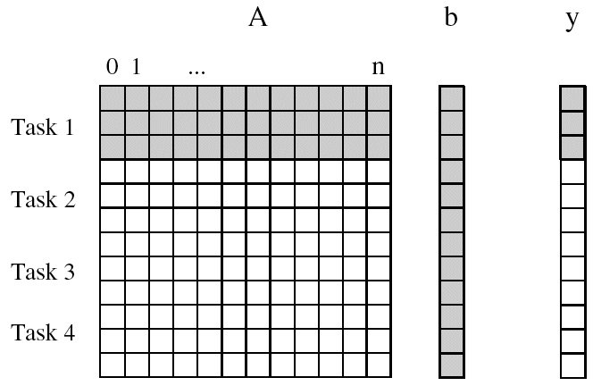
Matrix-Vector Multiplication with Limited Tasks
Suppose we only have 4 tasks
Dependencies?
Speedup?

Slide 24
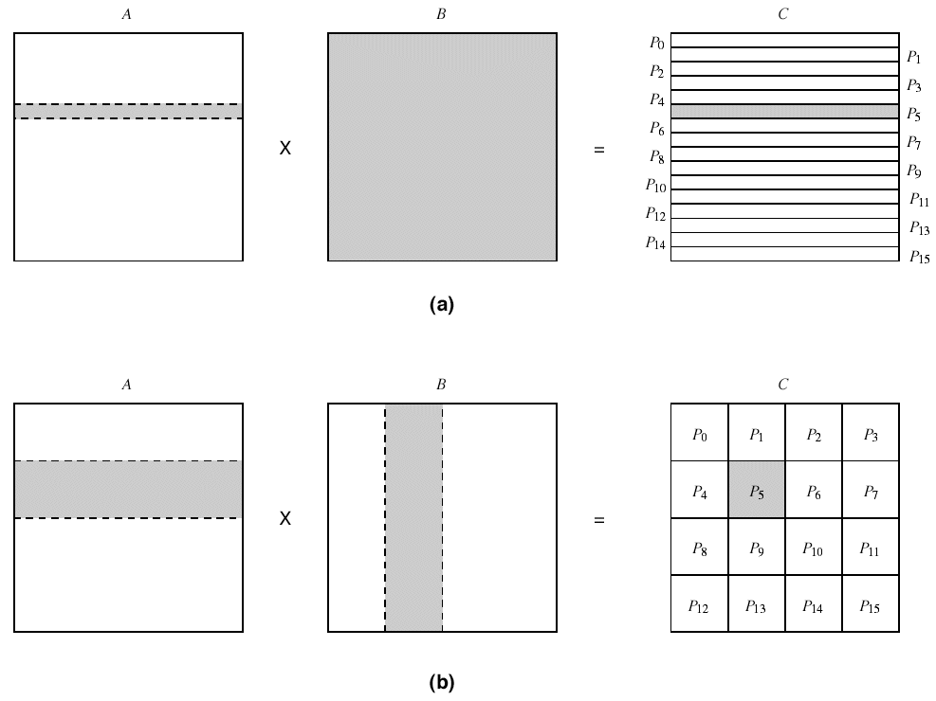
Matrix Multiplication
A
B
C
A x B = C
A[i,:] • B[:,j] = C[i,j]
Row partitioning
  N tasks
Block partitioning
  N*N/B tasks
Shading shows data
sharing in B matrix
x
=

Slide 25
Granularity of Task and Data Decompositions
Granularity can be with respect to tasks and data
Task granularity
  Equivalent to choosing the number of tasks
  Fine-grained decomposition results in large # tasks
  Large-grained decomposition has smaller # tasks
  Translates to data granularity after # tasks chosen
    consider matrix multiplication
Data granularity
  Think of in terms of amount of data needed in operation
  Relative to data as a whole
  Decomposition decisions based on input, output, input-output, or intermediate data

Slide 26


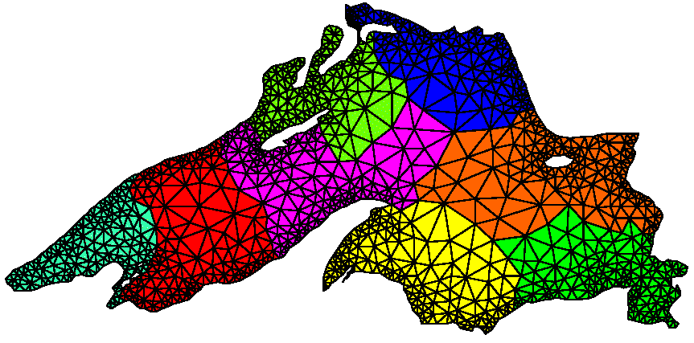
Mesh Allocation to Processors
Mesh model of Lake Superior
How to assign mesh elements
to processors
Distribute onto 8 processors
  randomly graph partitioning for
  minimum edge cut

Slide 27
Pipeline Model
Stream of data operated on by succession of tasks
  Task 1 Task 2 Task 3 Task 4
  Tasks are assigned to processors
Consider N data units
data
input
P1
P2
P3
P4
Task 1
Task 2
Task 3
Task 4
Sequential
Parallel (each task assigned to a processor)
4 data units
8 data units
4-way parallel, but
for longer time
4-way parallel

Slide 28
Pipeline Performance
N data and T tasks
Each task takes unit time t
Sequential time = N*T*t
Parallel pipeline time = start + finish + (N-2T)/T * t
= O(N/T) (for N>>T)
Try to find a lot of data to pipeline
Try to divide computation in a lot of pipeline tasks
  More tasks to do (longer pipelines)
  Shorter tasks to do
Pipeline computation special form of producer-consumer
  Producer tasks output data input by consumer tasks

Slide 29
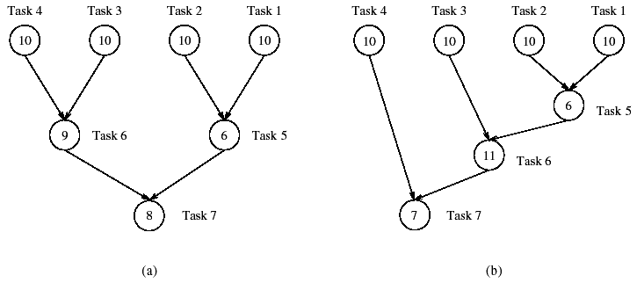
Tasks Graphs
Computations in any parallel algorithms can be viewed as a task dependency graph
Task dependency graphs may be simple or non-trivial
  Pipeline
  Arbitrary (represents the algorithm dependencies)
Task 1
Task 2
Task 3
Task 4
Numbers are
time taken to
perform task

Slide 30
Task Graph Performance
Determined by the critical path
  Sequence of dependent tasks that takes the longest time
  Critical path length bounds parallel execution time
Min time = 27
Min time = 34

Slide 31
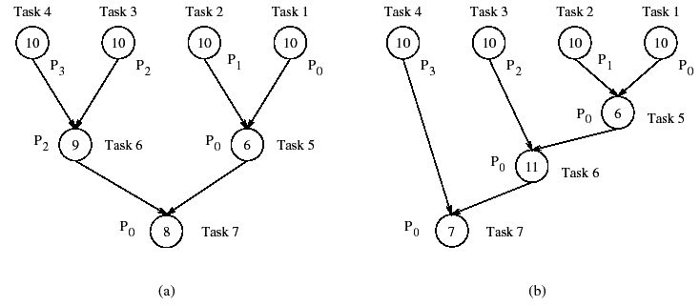
Task Assignment (Mapping) to Processors
Given a set of tasks and number of processors
How to assign tasks to processors?
Should take dependencies into account
Task mapping will determine execution time
Total time = ?
Total time = ?

Slide 32
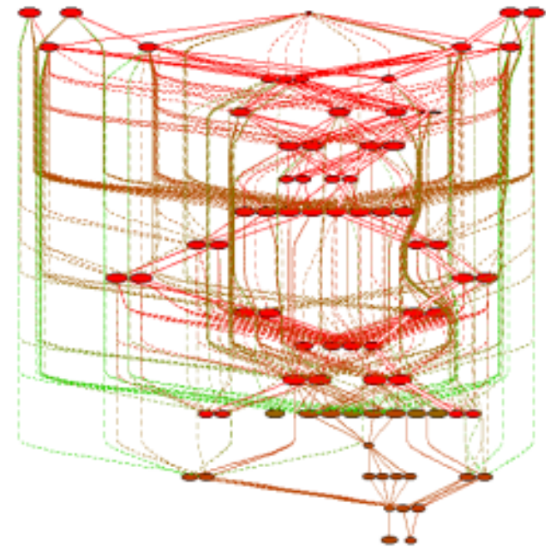
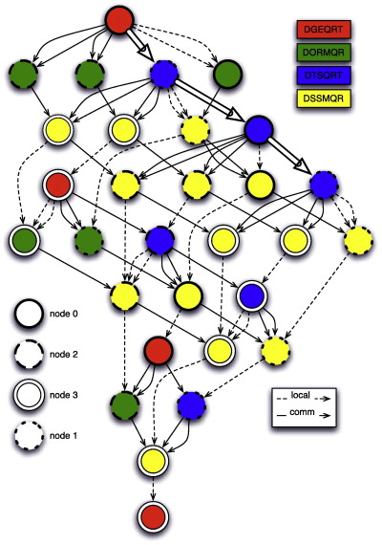
Task Graphs in Action
Uintah task graph scheduler
  C-SAFE: Center for Simulation of
  Accidental Fires and Explosions,
  University of Utah
  Large granularity tasks
PLASMA
  DAG-based parallel
  linear algebra
  DAGuE: A generic
  distributed DAG engine
  for HPC
Task graph for
PDE solver
DAG of QR for a 4 × 4 tiles matrix on a 2 × 2 grid of processors.

Slide 33
Bag o’ Tasks Model and Worker Pool
Set of tasks to be performed
How do we schedule them?
  Find independent tasks
  Assign tasks to available processors
Bag o’ Tasks approach
  Tasks are stored in
  a bag waiting to run
  If all dependencies
  are satisified, it is
  moved to a ready to run queue
  Scheduler assigns a task to a free processor selected from a pool of (worker) processors
Dynamic approach
Useful for achieving load balance
Asynchronous Dynamic Load Balancing (ADLB, ANL)
Processors
Bag o’
tasks
independent tasks
ready to run
…

Slide 34
Master-Worker Parallelism
One or more master processes generate work
Masters allocate work to worker processes
Workers idle if have nothing to do
Workers are mostly stupid and must be told what to do
  Execute independently
  May need to synchronize, but most be told to do so
Master may become the bottleneck if not careful
What are the performance factors and expected performance behavior
  Consider task granularity and asynchrony
  How do they interact?

Slide 35
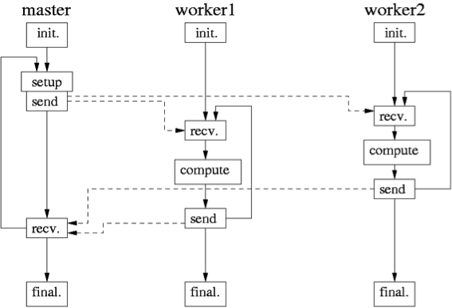
Master-Worker Execution Model (Li Li)
Li Li, “Model-based Automatics Performance Diagnosis of Parallel Computations,” Ph.D. thesis, 2007.

Slide 36
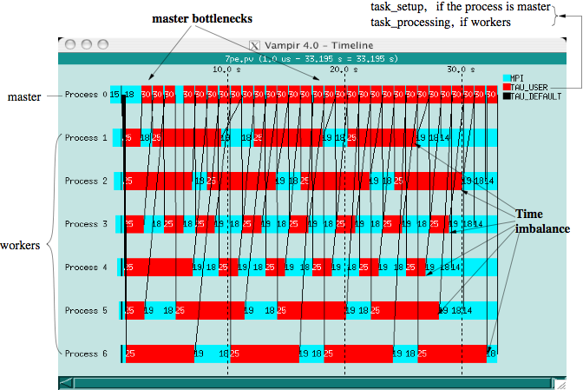
M-W Execution Trace (Li Li)
Notes:
A problematic Master-Worker program run with 7 processes on a SMP cluster with 16 dual processor nodes connected through gigabyte switches.

Slide 37
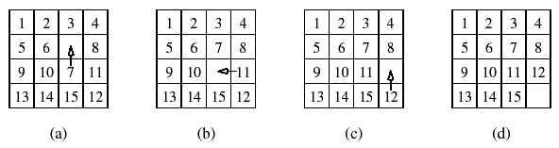
Search-Based (Exploratory) Decomposition
15-puzzle problem
15 tiles numbered 1 through 15 placed in 4x4 grid
  Blank tile located somewhere in grid
  Initial configuration is out of order
  Find shortest sequence of moves to put in order
Sequential search across space of solutions
  May involve some heuristics

Slide 38
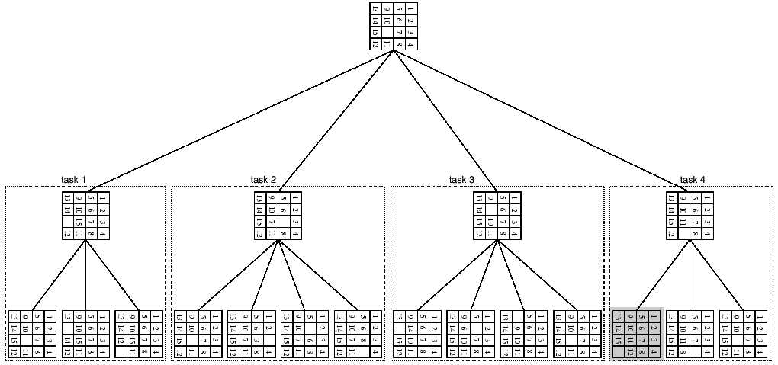
Parallelizing the 15-Puzzle Problem
Enumerate move choices at each stage
Assign to processors
May do pruning
Wasted work

Slide 39
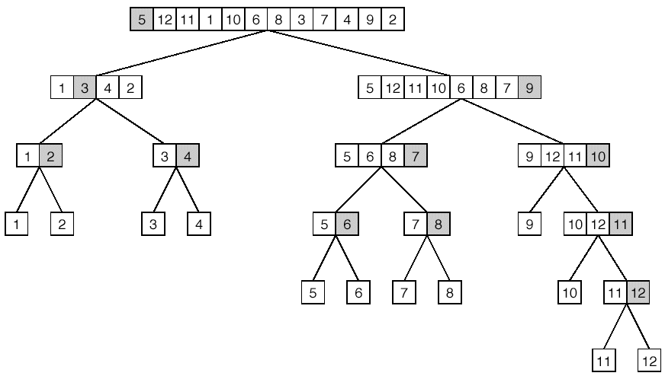
Divide-and-Conquer Parallelism
Break problem up in orderly manner into smaller, more manageable chunks and solve
Quicksort example

Slide 40
Next Class
Programming models
Standard parallel programming techniques
  shared memory (Pthreads)
  message passing (MPI)
  data parallelism (Fortran 90, CUDA)
  shared memory + data parallelism (OpenMP)
  object-oriented parallelism (?)

