Slide 1



CIS 631
Parallel Processing
Lecture 8: MPI Programming and Applications
Allen D. Malony
malony@cs.uoregon.edu
Department of Computer and Information Science
University of Oregon

Slide 2
Acknowledgements
Portions of the lectures slides were adopted from:
  Argonne National Laboratory, MPI tutorials,
  http://www-unix.mcs.anl.gov/mpi/learning.html
  Lawrence Livermore National Laboratory, MPI tutorials

Slide 3
Outline
Matrix multiplication example
Global operations
Non-blocking communication
Groups, communicators, and contexts
Matrix multiplication: Cannon’s algorithm

Slide 4
MPI Matrix Multiplication (no index translation)
A
B
C
A x B = C
A[i,:] • B[:,j] = C[i,j]
main(int argc, char *argv[])
{
MPI_Init (&argc, &argv);
MPI_Comm_rank(MPI_COMM_WORLD, &myrank);
MPI_Comm_size(MPI_COMM_WORLD, &p);
from = (myrank * n)/p;
to = ((myrank+1) * n)/p;
/* Data distribution */ ...
/* Computation */ ...
/* Result gathering */ ...
MPI_Finalize();
}
x
=
Try to write a scalable code
Assume p perfectly divides n

Slide 5
MPI Matrix Multiplication: Data Distribution
/* Data distribution - Block by rows */
  if( myrank != 0 ) {
  MPI_Recv( &a[from], n*n/p, MPI_INT, 0, tag,
  MPI_COMM_WORLD, &status );
  MPI_Recv( &b, n*n, MPI_INT, 0, tag,
  MPI_COMM_WORLD,&status );
  } else {
  for( i=1; i<p; i++ ) {
  MPI_Send( &a[from], n*n/p, MPI_INT, i, tag, MPI_COMM_WORLD );
  MPI_Send( &b, n*n, MPI_INT, i, tag,
  MPI_COMM_WORLD );
  }
  }
x

Slide 6
MPI Matrix Multiplication: Computation
/* Computation */
for ( i=from; i<to; i++)
for (j=0; j<n; j++) {
c[i][j]=0;
for (k=0; k<n; k++)
c[i][j] += a[i][k]*b[k][j];
}
x
=

Slide 7
MPI Matrix Multiplication: Results Gathering
/* Result gathering */
if (myrank!=0)
MPI_Send( &c[from], n*n/p, MPI_INT, 0,
tag, MPI_COMM_WORLD);
else
for (i=1; i<p; i++)
MPI_Recv( &c[from], n*n/p, MPI_INT,
i, tag, MPI_COMM_WORLD,
&status);

Slide 8
MPI Matrix Multiplication (index translation)
Why do you need “rank” indexing on local arrays?
Suppose want to use “standard” indexing
main(int argc, char *argv[])
{
MPI_Init (&argc, &argv);
MPI_Comm_rank(MPI_COMM_WORLD, &myrank);
MPI_Comm_size(MPI_COMM_WORLD, &p);
from = (myrank * n)/p;
to = ((myrank+1) * n)/p;
/* Data distribution */ ...
/* Computation */ ...
/* Result gathering */ ...
MPI_Finalize();
}

Slide 9
MPI Matrix Multiplication: Data Distribution
/* Data distribution - Block by rows */
  if( myrank != 0 ) {
  MPI_Recv( &a, n*n/p, MPI_INT, 0, tag,
  MPI_COMM_WORLD,&status );
  MPI_Recv( &b, n*n, MPI_INT, 0, tag,
  MPI_COMM_WORLD,&status );
  } else {
  for( i=1; i<p; i++ ) {
  MPI_Send( &a[from], n*n/p, MPI_INT, i, tag, MPI_COMM_WORLD );
  MPI_Send( &b, n*n, MPI_INT, I, tag,
  MPI_COMM_WORLD );
  }
  }

Slide 10
MPI Matrix Multiplication: Computation
/* Computation */
for ( i=0; i<n/p; i++)
for (j=0; j<n; j++) {
c[i][j]=0;
for (k=0; k<n; k++)
c[i][j] += a[i][k]*b[k][j];
}

Slide 11
MPI Matrix Multiplication: Results Gathering
/* Result gathering */
if (myrank!=0)
MPI_Send( &c, n*n/p, MPI_INT, 0,
tag,MPI_COMM_WORLD);
else
for( i=1; i<p; i++ )
MPI_Recv( &c[from], n*n/p, MPI_INT, i, tag, MPI_COMM_WORLD,
&status);
Does this work?

Slide 12
Owner Computes Rule
The process that owns the data is the process that will compute new data values
Ownership is determined by data distribution
  Domain decomposition
Ownership may be implicitly determined
  Could depend on other aspects of the program
Why is the owner computes rule useful in distributed memory parallel programming?

Slide 13
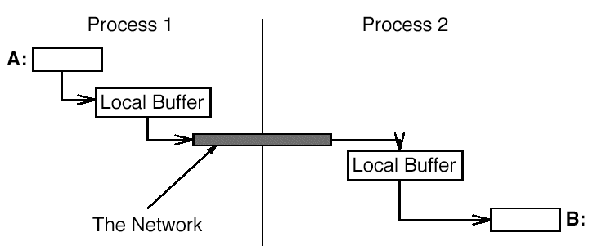
Buffering Issues
Where does data go when you send it?
One possibility is:
This is not very efficient
  Three copies in addition to the exchange of data
  Copies are “bad”

Slide 14
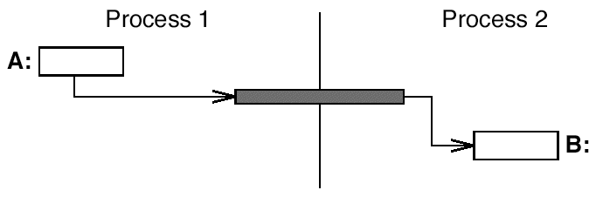
Better Buffering
Prefer:
Requires either
  MPI_SEND does not return until data delivered
  Or allow a send to return before completing transfer
In the latter case, we need to test for completion later

Slide 15
Blocking vs. Non-Blocking Send and Receive
The semantics of blocking/non-blocking has nothing to do with when messages are sent or received
The difference is when the buffer is free to be re-used
Is this a good way to think about it? Why?
Blocking
  A blocking send routine will only “return” if it is safe to modify the application buffer (your send data)
  A blocking send is synchronous when the receiver confirms a safe send (again, we are talking semantics)
  A blocking send is asynchronous if a system buffer is used to hold the data for eventual delivery to the receiver
  A blocking receive only “returns” after the data has arrived and is ready for use by the program

Slide 16
Non-Blocking
Non-blocking
  Send and receive routines do not wait for any communication events to complete, either
    message copying from user memory to system buffer space
    actual arrival of message
  Simply “request” the MPI library to perform the operation when it is able, but cannot predict when
  It is unsafe to modify the application buffer until you know the non-blocking operation was actually performed
    use “wait” routines to do this
  Non-blocking communications are primarily used to overlap computation with communication and exploit possible performance gain (How?)

Slide 17
Send-Receive
Send-receive operation combine in one function call the sending of a message to one process and receiving of a message from another:
  MPI_Sendrecv(sendbuf, sendcount, sendtype, dest, sendtag, recvbuf, recvcount, recvtype, source, recvtag, comm, status)
Use same buffer for sending and receiving:
  MPI_Sendrecv_replace(buf, count, datatype, dest, sendtag, source, recvtag, comm, status)
Exchange data with neighbors
  MPI_Sendrecv(&a,n,MPI_DOUBLE,right,TAG,&b,n,
  MPI_DOUBLE,left,TAG,MPI_COMM_WORLD,&Status);

Slide 18
Non-Blocking MPI Send and Receive Operations
Saw how non-blocking operations help to avoid deadlock
Important for overlapping communication / computation
Non-blocking send and receive routines
  MPI_Isend(buf, count, datatype, dest,
    tag, comm, request)
  MPI_Irecv(buf, count, datatype, source,
    tag, comm, request)
Request represents the particular Isend or Irecv
  Used as an argument in test and wait routines

Slide 19
MPI Test and Wait
Routines to test status of non-blocking send and receive
  MPI_Test(request, flag, status)
  MPI_Wait(request, status)
MPI_Test tests whether or not the non-blocking operation identified by request has finished
  Returns true or false in flag
  If true, request object deallocated
MPI_Wait blocks until the non-blocking operation identified by request completes
  request object deallocated on return

Slide 20
Waiting on Several Completions
It is often desirable to wait on multiple requests
  MPI_Waitall(count, request_array,
  status_array)
  MPI_Waitany(count, requests_array,
  index, status)
  MPI_Waitsome(incount, requests_array,
  outcount, indices_array,
  status_array)
There are corresponding versions of test for each of these
Why is this useful?

Slide 21
Exchanging Data with Neighbors
 | Blocking Recv | Non-blocking Recv
Blocking Send | MPI_Send(A,…,left,…); MPI_Recv(B,…,right,…); | MPI_Send(A,…,left,…); MPI_Irecv(B,…,right,…, &req); MPI_Wait(&req,&status);
Non-blocking Send | MPI_Isend(A,…,left,…, &req); MPI_Recv(B,…,right…); MPI_Wait(&req,&status); | MPI_Isend(A,…,left,…, &req1); MPI_Irecv(B,…,right…, &reg2); MPI_Wait(&req1,&status); MPI_Wait(&req2,&status);

Slide 22
Probe and Cancel
MPI_Probe() and MPI_Iprobe() allow incoming messages to be checked for, without receiving them
  MPI_Probe(source, tag, comm, status)
  MPI_Iprobe(source, tag, comm,
  flag, status)
MPI_Cancel() cancels pending communication
  MPI_Cancel(request)

Slide 23
Persistent Communication Requests
MPI communication functions called repeatedly inside a loop
  for(i=0;i<nsteps;i++){
  MPI_Send(&a,n,MPI_DOUBLE,right,TAG,MPI_COMM_WORLD);
  MPI_Recv(&b,n,MPI_DOUBLE,left,TAG,MPI_COMM_WORLD,&status);
  …
  }
Persistent requests reduce overhead of creating messages
  MPI_Send_init(&a,n,MPI_DOUBLE,right,TAG,
  MPI_COMM_WORLD,&req1);
  MPI_Recv_init(&b,n,MPI_DOUBLE,left,TAG,
  MPI_COMM_WORLD,&req2);
  for(i=0;i<nsteps;i++){
  MPI_Start(&req1); MPI_Start(&req2);
  MPI_Wait(&req1,&status);
  MPI_Wait(&req2,&status);
  …
  }

Slide 24
Communication Modes
Safety − A program is safe if it will produce correct result even if the system provides no buffering
MPI offers the choice of four communication modes
  Standard:
    MPI_Send, MPI_Isend, MPI_Send_init
  Buffered:
    MPI_Bsend, MPI_Ibsend, MPI_Bsend_init
  Synchronous:
    MPI_Ssend, MPI_Issend, MPI_Ssend_init
  Ready:
    MPI_Rsend, MPI_Irsend, MPI_Rsend_init
There is only one receive mode

Slide 25
Buffered Mode
A send can complete without matching receive
The system must provide buffering
  MPI_Bsend(buf, count, datatype, dest,
  tag, comm)
  MPI_Ibsend(buf, count, datatype, dest,
  tag, comm, request)
  MPI_Bsend_init(buf, count, datatype,
  dest, tag, comm, request)

Slide 26
Synchronous Mode
Send can start before a matching receive has been posted
Won’t complete until matching receive has been posted and the matching receive has begun reception of the data
  MPI_Ssend(buf, count, datatype, dest,
  tag, comm)
  MPI_Issend(buf, count, datatype, dest,
  tag, comm, request)
  MPI_Ssend_init(buf, count, datatype,
  dest, tag, comm,
  request)

Slide 27
Ready Mode
A send may start only if the matching receive is posted
Otherwise, the operation is erroneous and outcome is undefined
  MPI_Rsend(buf, count, datatype, dest,
  tag, comm)
  MPI_Irsend(buf, count, datatype, dest,
  tag, comm, request)
  MPI_Rsend_init(buf, count, datatype,
  dest, tag, comm,
  request)

Slide 28
MPI Global Operations
Often, it is useful to have one-to-many or many-to-one message communication.
This is what MPI’s global operations do
  MPI_Barrier
  MPI_Bcast
  MPI_Gather
  MPI_Scatter
  MPI_Reduce
  MPI_Allreduce
MPI does not specify how any of these are implemented
Global operations should be as efficient as possible

Slide 29
Barrier
MPI_Barrier(comm)
  Global barrier synchronization
  All processes in communicator wait at barrier
  Released when all have arrived

Slide 30
Broadcast
MPI_Bcast(inbuf, incnt, intype, root,
comm)
  inbuf:address of input buffer on root
  inbuf:address of output buffer elsewhere
  incnt: number of elements
  intype: type of elements
  root: process id of root process

Slide 31
Before Broadcast
inbuf
proc0
proc1
proc2
proc3
root

Slide 32
After Broadcast
inbuf
proc0
proc1
proc2
proc3
root

Slide 33
MPI Scatter
MPI_Scatter(inbuf, incnt, intype,
outbuf, outcnt, outtype, root, comm)
  inbuf: address of input buffer
  incnt: number of input elements
  intype: type of input elements
  outbuf: address of output buffer
  outcnt: number of output elements
  outtype: type of output elements
  root: process id of root process

Slide 34
Before Scatter
inbuf
outbuf
proc0
proc1
proc2
proc3
root

Slide 35
After Scatter
inbuf
outbuf
proc0
proc1
proc2
proc3
root

Slide 36
MPI Gather
MPI_Gather(inbuf, incnt, intype,
outbuf, outcnt, outtype, root, comm)
  inbuf: address of input buffer
  incnt: number of input elements
  intype: type of input elements
  outbuf: address of output buffer
  outcnt: number of output elements
  outtype: type of output elements
  root: process id of root process

Slide 37
Before Gather
inbuf
outbuf
proc0
proc1
proc2
proc3
root

Slide 38
After Gather
inbuf
outbuf
proc0
proc1
proc2
proc3
root

Slide 39
Broadcast / Gather / Scatter
These three primitives combine sends and receives
  May be confusing
  Collective operations
Perhaps un-intended consequence
  Requires global agreement on layout of array

Slide 40
Groups, Communicators, and Contexts
A group is an ordered set of processes
  Each process in a group has a unique integer rank
  Rank values are from 0 to N-1, where N is the group size
  A group is accessible to the programmer by a “handle”
A communicator is a group of processes that are allowed to communicate between themselves
  All MPI messages must specify a communicator
  Communicators accessible to programmer by “handles”
A context is a system-defined object that uniquely identifies a communicator

Slide 41
More Groups and Communicators
Groups/communicators are dynamic
Processes may be in more than one group/communicator
  They will have a unique rank within group/communicator
Typical usage:
  1. Extract handle using MPI_Comm_group
  2. Form new group using MPI_Group_incl
  3. Create new communicator using MPI_Comm_create
  4. Determine new rank in communicator using MPI_Comm_rank
  5. Conduct communications using any MPI routine
  6. Free up communicator and group

Slide 42
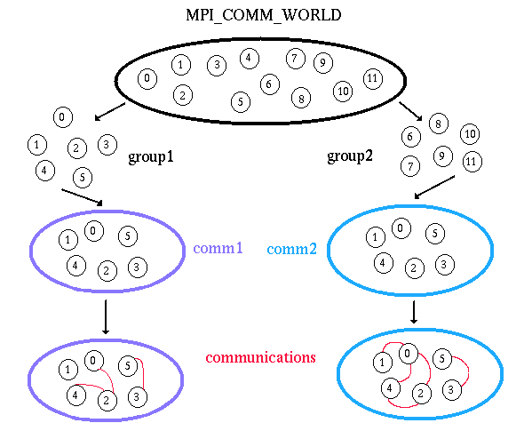
Logical View
Groups are derived
from communicators
Communicators
are created from
groups

Slide 43
Group Constructors
MPI_Comm_group(comm,group)
  Returns in group a handle to the group of comm
MPI_Group_union(group1,group2,new)
  Returns a new group including all elements of the first group ( group1), followed by all elements of second group ( group2) not in first.
MPI_Group_intersection(group1,group2,new)
  Returns a new group including elements of the first group that are also in the second group, ordered as in first group.
MPI_Group_difference(group1,group2,new)
  Returns a new group including all elements of the first group that are not in the second group, ordered as in the first group.

Slide 44
Group Constructors
MPI_Group_incl(oldgroup, n, ranks, new)
  Creates a new group that consists of the n processes in oldgroup with ranks rank[0],..., rank[n-1]; the process with rank[i] in newgroup is the process with rank ranks[i] in the oldgroup.
MPI_Group_excl(oldgroup, n, ranks, new)
  Creates a new group that is obtained by deleting from oldgroup those processes with ranks ranks[0] ,... ranks[n-1]. The ordering of processes in newgroup is identical to the ordering in oldgroup.

Slide 45
Communicator Constructors
MPI_Comm_create(oldcomm, group, newcomm)
  Creates a new communicator newcomm from a group group in communicator defined by oldcomm.
  Not clear to me why oldcomm is required here …
MPI_Comm_split(oldcomm, color, key, newcomm)
  Partitions the group associated with oldcomm into disjoint subgroups, one for each value of color
  Each subgroup contains all processes of the same color
  Within each subgroup, the processes are ranked in the order defined by the value of the argument key, with ties broken according to their rank in the old group
  A new communicator is created for each subgroup and returned in newcomm

Slide 46
Predefined Communicator
MPI_COMM_WORLD
  Contains all processes available at start of the program
MPI_COMM_NULL
  An invalid communicator
MPI_COMM_SELF
  Contains only the local process
MPI_COMM_EMPTY
  There is no such thing as MPI_COMM_EMPTY
  Why not?

Slide 47
Split Example
MPI_Comm my_row_comm;
int my_row;
my_row = my_rank / 3;
MPI_Comm_split(MPI_COMM_WORLD,my_row,my_rank,&my_row_comm);
MPI_COMM_WORLD
0
1
2
my_row_comm #0
3
4
5
my_row_comm #1
6
7
8
my_row_comm #2

Slide 48
Virtual Topologies
What Are They?
  A mapping/ordering of MPI processes into a geometric “shape”
  Two main MPI supported topologies are Cartesian (grid) and Graph
MPI topologies are virtual
  There may be no relation between the physical structure of the parallel machine and the process topology.
Virtual topologies are built upon MPI communicators and groups
  Must be “programmed” by the application developer

Slide 49
Why use Virtual Topologies?
Useful for specific communication patterns
Simplified programming
Communication efficiency
Particular implementation may optimize process mapping based upon physical characteristics of parallel machine
Mapping of processes into an MPI virtual topology is dependent upon the MPI implementation, and may be totally ignored

Slide 50
Cartesian Virtual Topology
MPI_Cart_create(comm_old, ndims, dims, wrap, reorder, comm_cart)
  Returns a handle to a new communicator to which the Cartesian topology information is attached
  If reorder=false, then the rank of each process in the new group is identical to its rank in the old group
  Otherwise, the function may reorder the processes
  ndims: number of dimension
  dims: dimension sizes
  wrap_around: whether each dimension is circular

Slide 51
Graph Topology
MPI_Graph_create(comm_old, nnodes, index, edges, reorder, comm_graph)
  Returns a new communicator to which the graph topology information is attached
  If reorder=false, then the rank of each process in the new group is identical to its rank in the old group
  Otherwise, the function may reorder the processes
  nnodes: number of nodes
  index: the ith entry indicates the position of the node list in edges containing all nodes that are connected to the ith node
  edges: a flatten list of edges represented by the connected nodes

Slide 52
Example of Creating a Graph
Process neighbors
  0: 1, 2, 3
  1: 0
  2: 1, 3
  3: 0, 2
Input arguments:
  nnodes: 4
  index: 3, 4, 6, 8
  edges: 1, 2, 3, 0, 1, 3, 0, 2
0
1
3
2

Slide 53
Matrix Multiplication: Cannon’s Algorithm
Step 1: Initially processor P(i,j) has submatrices A(i,j) and B(i,j)
Step 2: Submatrices are moved from their initial position to an “aligned” position. The complete ith row of A is shifted i places left, and the complete ith column of B is shifted i places upwards. All shifts are wraparound
1
2
3
A(0,0)
B(0,0)
A(0,1)
B(0,1)
A(0,2)
B(0,2)
A(0,3)
B(0,3)
A(0,0)
B(0,0)
A(0,1)
B(1,1)
A(0,2)
B(2,2)
A(0,3)
B(3,3)
1
A(1,0)
B(1,0)
A(1,1)
B(1,1)
A(1,2)
B(1,2)
A(1,3)
B(1,3)
A(1,1)
B(1,0)
A(1,2)
B(2,1)
A(1,3)
B(3,2)
A(1,0)
B(0,3)
2
A(2,0)
B(2,0)
A(2,1)
B(2,1)
A(2,2)
B(2,2)
A(2,3)
B(2,3)
A(2,2)
B(2,0)
A(2,3)
B(3,1)
A(2,0)
B(0,2)
A(2,1)
B(1,3)
3
A(3,0)
B(3,0)
A(3,1)
B(3,1)
A(3,2)
B(3,2)
A(3,3)
B(3,3)
A(3,3)
B(3,0)
A(3,0)
B(0,1)
A(3,1)
B(1,2)
A(3,2)
B(2,3)

Slide 54
Matrix Multiplication: Cannon’s Algorithm
Step 3: Each P(i,j) processor multiplies its elements and adds sum to C(i,j)
Step 4: Every row of A is shifted one place left, and every column of B is shifted one place upwards
Repeat step 3 and 4 until the final result is obtained
A(0,1)
B(1,0)
A(0,2)
B(2,1)
A(0,3)
B(3,2)
A(0,0)
B(0,3)
A(1,2)
B(2,0)
A(1,3)
B(3,1)
A(1,0)
B(0,2)
A(1,1)
B(1,3)
A(2,3)
B(3,0)
A(2,0)
B(0,1)
A(2,1)
B(1,2)
A(2,2)
B(2,3)
A(3,0)
B(0,0)
A(3,1)
B(1,1)
A(3,2)
B(2,2)
A(3,3)
B(3,3)

Slide 55
Implementing Cannon’s Algorithm
#include<stdio.h>
#include<mpi.h>
int main(int argc, char* argv[]){
int n,size,my_rank,remote_rank;
int i,j;
int a,b,c;
int left,right,up,down;
int dimensions[2],wrap_around[2],coordinates[2];
MPI_Status status;
MPI_Comm cart_comm;
MPI_Init(&argc,&argv);
MPI_Comm_size(MPI_COMM_WORLD,&size);
MPI_Comm_rank(MPI_COMM_WORLD,&my_rank);
for(n=1;n*n<size;n++);
if(n*n!=size) {
printf("size %d is not a square.\n",size);
MPI_Finalize();
return 1;
}

Slide 56
Implementing Cannon’s Algorithm (continued)
dimensions[0]=dimensions[1]=n;
wrap_around[0]=wrap_around[1]=1;
MPI_Cart_create(MPI_COMM_WORLD,2,dimensions,wrap_around,1,&cart_comm);
MPI_Comm_rank(cart_comm,&my_rank);
MPI_Cart_coords(cart_comm,my_rank,2,coordinates);
MPI_Cart_shift(cart_comm,1,1,&left,&right);
MPI_Cart_shift(cart_comm,0,1,&up,&down);
a=b=coordinates[0]+coordinates[1];
for(i=0;i<coordinates[0];i++)
MPI_Sendrecv_replace(&a,1,MPI_INT,left,0,right,0,cart_comm,&status);
for(i=0;i<coordinates[1];i++)
MPI_Sendrecv_replace(&b,1,MPI_INT,up,0,down,0,cart_comm,&status);
for(c=0,i=0;i<n;i++){
c+=a*b;
MPI_Sendrecv_replace(&a,1,MPI_INT,left,0,right,0,cart_comm,&status);
MPI_Sendrecv_replace(&b,1,MPI_INT,up,0,down,0,cart_comm,&status);
}

Slide 57
Implementing Cannon’s Algorithm (continued)
if(my_rank==0)
{
for(remote_rank=0,i=0;i<n;i++)
{
for(j=0;j<n;j++,remote_rank++)
{
if(remote_rank!=0)
MPI_Recv(&c,1,MPI_INT,remote_rank,0,cart_comm,&status);
printf("%d ",c);
}
printf("\n");
}
}
else
MPI_Send(&c,1,MPI_INT,0,0,cart_comm);
MPI_Finalize();
return 0;
}

Slide 58
MPI Parallelization Process
Divide program in parallel parts
Create and destroy processes to do above
Partition and distribute the data
Communicate data at the right time
(Sometimes) perform index translation
Still need to do synchronization?
  Sometimes, but many times goes hand in hand with data communication

Slide 59
Parallel Libraries and MPI
Many libraries developed using MPI
  Powerful parallelization and programming model
  Gain portability advantages
Scientific linear algebra, numerical, … libraries
  ScaLAPACK, SuperLU, PETSc, Trilinos, PMTL(Parallel Matrix Template Library), …
Graph, mesh, data, … libraries
  PBGL (Parallel Boost Graph Library), ParMetis, PPM (Parallel Particle Mesh), HDF5, …
Data, communication, computational, … libraries
  GA (Global Arrays), ADLB (Asynchronous Dynamic Load Balancing), ARMCI (Aggregate Remote Memory Copy Interface), AP (Active Pebbles), LibNBC(Non-Blocking Collectives), AM++ (Active Message), …
“Writing Parallel Libraries with MPI -- The Good, the Bad, and the Ugly,” Torsten Hoefler, Keynote at EuroMPI 2011, Sept. 21, 2011.

Slide 60
The GAS / PGAS Model
A parallel program consists of a set of threads and at least one address space
A program is said to have a global view if all threads share a single address space
  GAS – Global Address Space
A program is said to have a local view if the threads have distinct address spaces
  PGAS – Partitioned Global Address Space
How are global and local views supported in reality
  Shared memory provides by default
  Distributed memory requires something more
Notes:
Popular parallel programming models that lead to PGAS
I’ll ignore the process/thread distinction for now and use a thread to mean “a program counter” or “an activity in the program”
OpenMP is good because it’s easy – matches memory model of sequential programming
MPI is good because it’s fast – the programmer is forced to manage data across the address spaces

Slide 61
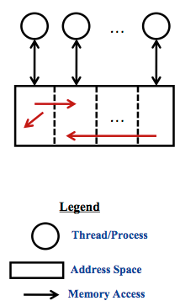
GAS / PGAS Motivation and Implementation
Need to support GAS and PGAS model in distributed memory systems
  Threads with partitioned shared space
  Datum may reference data in other partitions
  Global array fragments in multiple partitions
Advantages
  Shared memory programming … why?
  Performance … why?
Disadvantages
  Shared memory programming … why?
  Performance … why?
Library approach: GA, …
Language approach: UPC, CAF, X10, Chapel

Slide 62
Realizing Dynamic Parallelism in PGAS
Dynamic PGAS library ...
  C, Fortran, Java, …
  Co-habiting with MPI
… implementing …
  Remote references
  Global data structures
  Inter-place messaging
  Global and/or collective operations
  Intra-place concurrency
  Atomic operations
… through languages …
  Asynchronous CAF
  Asynchronous UPC
  X10
  Chapel
… leveraging runtimes
  GASNet, ARMCI, LAPI
  UPC runtime
  Chapel runtime
Libraries reduce cost of adoption, languages offer enhanced productivity

Slide 63
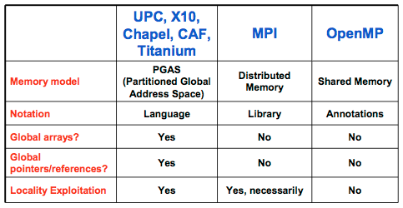
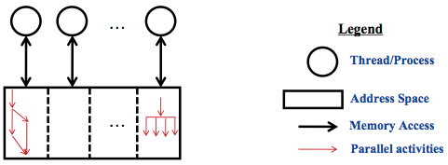
PGAS vs. Others
Dynamic
parallelism

Slide 64
Next Class
Shared memory parallel programming
Threads

