Slide 1

Lecture 1: Introduction and Fundamentals
Allen D. Malony
Department of Computer and Information Science

Slide 2
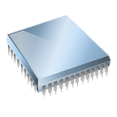



What is Performance?
In computing, performance is defined by 2 factors
Computational requirements (what needs to be done)
Computing resources (what it costs to do it)
Computational problems translate to requirements
Computing resources interplay and tradeoff
1
Performance ~
Resources for solution
… and ultimately
Hardware
Time
Energy
Money

Slide 3
Why do we care about Performance?
Performance itself is a measure of how well the computational requirements can be satisfied
We evaluate performance to understand the relationships between requirements and resources
Decide how to change “solutions” to target objectives
Performance measures reflect decisions about how and how well “solutions” are able to satisfy the computational requirements
“The most constant difficulty in contriving the engine has arisen from the desire to reduce the time in which the calculations were executed to the shortest which is possible.” Charles Babbage, 1791 – 1871

Slide 4
What is Parallel Performance?
Here we are concerned with performance issues when using a parallel computing environment
Performance with respect to parallel computation
Performance is the raison d’être for parallelism
Parallel performance versus sequential performance
If the “performance” is not better, parallelism is not necessary
Parallel processing includes techniques and technologies necessary to compute in parallel
Hardware, networks, operating systems, parallel libraries, languages, compilers, algorithms, tools, …
Parallelism must deliver performance
How? How well?

Slide 5
Concurrency and Parallelism
Concurrent execution
Multiple tasks can execute at the same time
There are no dependencies between the tasks
Parallel execution
Concurrent tasks actually execute at the same time
Multiple processing resources are available
Find concurrent execution opportunities
Develop support for enabling parallel execution
Parallelism granularity
Processes, threads, routines, statements, instructions, …

Slide 6
Why use parallel processing?
Two primary reasons (both performance related)
Faster time to solution (response time)
Solve bigger computing problems in same time
Other factors motivate parallel processing
Effective use of machine resources
Cost efficiencies
Overcoming memory constraints
Serial machines have inherent limitations
Processor speed
Memory bottlenecks
Parallelism has become the future of computing
Performance is still the driving concern

Slide 7
Performance Expectations
If each processor is rated at k MFLOPS and there are p processors, we should expect to see k*p MFLOPS performance? Correct?
If it takes 100 seconds on 1 processor, it should take 10 seconds on 10 processors? Correct?
Several causes affect performance
Each must be understood separately
But they interact with each other in complex ways
solution to one problem may create another
one problem may mask another
Scaling (system, problem size) can change conditions
Need to understand performance space

Slide 8
Scalability
A program can scale up to use many processors
What does that mean?
How do you evaluate scalability?
How do you evaluate scalability goodness?
Comparative evaluation
If double the number of processors, what to expect?
Is scalability linear?
Use parallel efficiency measure
Is efficiency retained as problem size increases?
Apply performance metrics

Slide 9
Performance Metrics and Formulas
T₁ is the execution time on a single processor
T_{p} is the execution time on a p processor system
S(p) (S_{p}) is the speedup
E(p) (E_{p}) is the efficiency
Cost(p) (C_{p}) is the cost
Parallel algorithm is cost-optimal
Parallel time = sequential time (C_{p} = T₁ , E_{p} = 100%)
T₁
T_{p}
S( p) =
S_{p}
p
Efficiency =
Cost = p × T_{p}

Slide 10
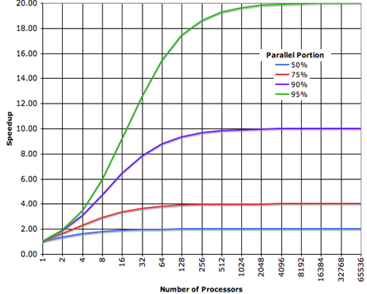
Amdahl’s Law (Fixed Size Speedup)
Let f be the fraction of a program that is sequential
1-f is the fraction that can be parallelized
Let T₁ be the execution time on 1 processor
Let T_{p} be the execution time on p processors
S_{p} is the speedup
S_{p} = T₁ / T_{p}
= T₁ / (fT₁ +(1-f)T₁ /p))
= 1 / (f +(1-f)/p))
As p → ∞
S_{p} = 1 / f

Slide 11
Performance and Scalability
Evaluation
Sequential runtime (T_{seq}) is a function of
problem size and architecture
Parallel runtime (T_{par}) is a function of
problem size and parallel architecture
# processors
Parallel performance affected by
algorithm + architecture
Scalability
Ability of parallel algorithm to achieve performance gains proportional with respect to the number of processors
Amdahl’s Law applies when the problem size is fixed
Strong scaling (p→∞, S_{p} = S∞ → 1 / f )
Speedup bound is determined by the degree of sequential execution time in the computation, not # processors!!!

Slide 12
Gustafson’s Law (Scaled Speedup)
Often interested in running larger problems when scaling
Problem size is determined by constraint on parallel time
Assume parallel time is kept constant
T_{p} = C = (f +(1-f)) * C
f_{seq} is the fraction of T_{p} spent in sequential execution
f_{par} is the fraction of T_{p} spent in parallel execution
What is the execution time on one processor?
Let C=1, then T_{s} = f_{seq} + p(1 – f_{seq} ) = 1 + (p-1)f_{par}
What is the speedup in this case?
S_{p} = T_{s} / T_{p} = T_{s} / 1 = f_{seq} + p(1 – f_{seq}) = 1 + (p-1)f_{par}
Gustafson’s Law applies when the problem size can increase as the number of processors increase
Weak scaling (S_{p} = 1 + (p-1)f_{par} )

Slide 13
Scalable Parallel Computing
Scalability in parallel architecture
Processor numbers
Memory architecture
Interconnection network
Avoid critical architecture bottlenecks
Scalability in computational problem
Problem size
Computational algorithms
Computation to memory access ratio
Computation to communication ratio
Parallel programming models and tools
Performance scalability

Slide 14
Parallel Architecture Types – 1
Uniprocessor
Scalar processor
Vector processor
Single Instruction Multiple Data (SIMD)
Shared Memory Multiprocessor (SMP)
Shared address space
Bus-based memory system
Interconnection network
processor
memory
processor
…
processor
processor
vector
bus
memory
memory
processor
…
processor
processor
…
network
…
memory
memory

Slide 15
Parallel Architecture Types – 2
Distributed Memory Multiprocessor (DMP)
Message passing between nodes
Massively Parallel Processor (MPP)
Clusters of SMPs
Shared address space on SMP node
Message passing between nodes
Can also be a MPP
memory
memory
M
M
…
…
…
processor
processor
P
P
P
P
network
interface
…
interconnection network
interconnection network
processor
processor
…
P
…
P
P
…
P
memory
memory
…
M
M

Slide 16
Parallel Architecture Types – 3
Multicore (Manycore)
Multicore processor
Accelerator / coprocessor
“Fused” processor
Multicore Heterogeneous Cluster
Shared address space on SMP node and message passing between nodes
CPUs + accelerator nodes
C
C
C
C
cores can be hardware multithreaded (hyperthread)
m
m
m
m
memory
M
…
M
…
processor
PCI
P
P
P
P
…
memory
interconnection network
P
…
P
P
…
P
processor
…
M
M
memory

Slide 17
How do you get parallelism in hardware?
Instruction-Level Parallelism (ILP)
Data parallelism
Increase amount of data to be operated on at same time
Processor parallelism
Increase number of processors
Memory system parallelism
Increase number of memory units
Increase bandwidth to memory
Communication parallelism
Increase amount of interconnection between elements
Increase communication bandwidth

Slide 18
Embarrassingly Parallel Computations
An embarrassingly parallel computation is one that can be obviously divided into completely independent parts that can be executed simultaneously
In a truly embarrassingly parallel computation there is no interaction between separate processes
In a nearly embarrassingly parallel computation results must be distributed and collected/combined in some way
Embarrassingly parallel computations have potential to achieve maximal speedup on parallel platforms
If it takes T time sequentially, there is the potential to achieve T/P time running in parallel with P processors
What would cause this not to be the case always?

Slide 19
Why Are Parallel Applications not Scalable?
Critical Paths
Dependencies between computations spread across processors
Bottlenecks
One processor holds things up
Algorithmic overhead
Some things just take more effort to do in parallel
Communication overhead
Spending increasing proportion of time on communication
Load Imbalance
Makes all processor wait for the “slowest” one
Dynamic behavior
Speculative loss
Do A and B in parallel, but B is ultimately not needed

Slide 20
Critical Paths
Long chain of dependence
Main limitation on performance
Resistance to performance improvement
Diagnostic
Performance stagnates to a (relatively) fixed value
Critical path analysis
Solution
Eliminate long chains if possible
Shorten chains by removing work from critical path

Slide 21
Bottlenecks
How to detect?
One processor A is busy while others wait
Data dependency on the result produced by A
Typical situations:
N-to-1 reduction / computation / 1-to-N broadcast
One processor assigning job in response to requests
Solution techniques:
More efficient communication
Hierarchical schemes for master slave
Program may not show ill effects for a long time
Shows up when scaling

Slide 22
Algorithmic Overhead
Different sequential algorithms to solve the same problem
All parallel algorithms are sequential when run on 1 processor
All parallel algorithms introduce addition operations (Why?)
Parallel overhead
Where should be the starting point for a parallel algorithm?
Best sequential algorithm might not parallelize at all
Or, it doesn’t parallelize well (e.g., not scalable)
What to do?
Choose algorithmic variants that minimize overhead
Use two level algorithms
Performance is the rub
Are you achieving better parallel performance?
Must compare with the best sequential algorithm

Slide 23
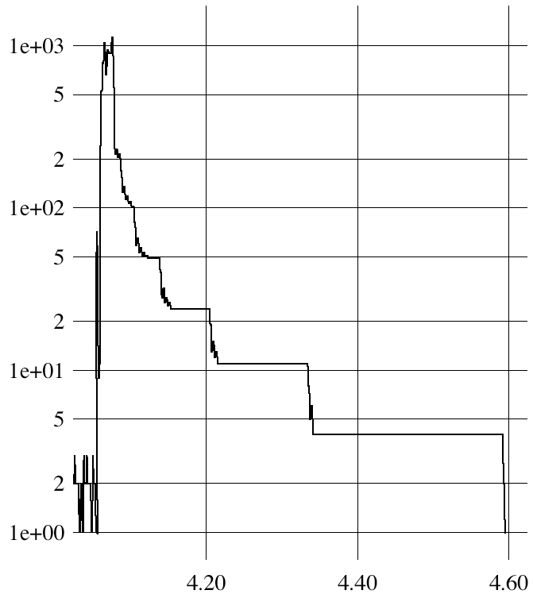
What is the maximum parallelism possible?
Depends on application, algorithm, program
Data dependencies in execution
MaxPar analyzes the earliest possible “time” any data can be computed
Assumes a time model
Result is the maximum parallelism available
Parallelism varies!
512-point FFT
parallel
signature
Ding-Kai Chen, “MaxPar: An Execution-driven Simulator for Studying,” Master’s thesis dissertation, University of Illinois, Urbana-Champaign, 1989.

Slide 24
Analytical / Theoretical Techniques
Involves simple algebraic formulas and ratios
Typical variables are:
data size (N), number of processors (P), machine constants
Model performance of individual operations, components, algorithms in terms of the above
be careful to characterize variations across processors
model them with max operators
Constants are important in practice
Use asymptotic analysis carefully
Scalability analysis
Isoefficiency (Kumar)

Slide 25
Isoefficiency
How to quantify scalability
How much increase in problem size is needed to retain the same efficiency on a larger machine?
Efficiency
T₁ / (p * T_{p})
T_{p} = computation + communication + idle
Isoefficiency
Equation for equal-efficiency curves
If no solution
problem is not scalable in the sense defined by isoefficiency
Equal efficiency curves
problem size
processors

Slide 26
Problem Size and Overhead
Informally, problem size is expressed as a parameter of the input size
A consistent definition of the size of the problem is the total number of basic operations (T_{seq} )
Also refer to problem size as “work (W = T_{seq} )
Overhead of a parallel system is defined as the part of the cost not in the best serial algorithm
Denoted by T_{O}, it is a function of W and p
T_{O}(W,p) = pT_{par} - W (pT_{par} includes overhead)
T_{O}(W,p) + W = pT_{par}

Slide 27
Isoefficiency Function
With a fixed efficiency, W is as a function of p
W = T_{seq}
Isoefficiency Function

Slide 28
Isoefficiency Function of Adding n Numbers
Overhead function:
T_{O}(W,p) = pT_{par} – W = 2plog(p)
Isoefficiency function:
W=K*2plog(p)
If p doubles, W needs also to be doubled to roughly maintain the same efficiency
Isoefficiency functions can be more difficult to express for more complex algorithms
…
…
.
.
.

Slide 29
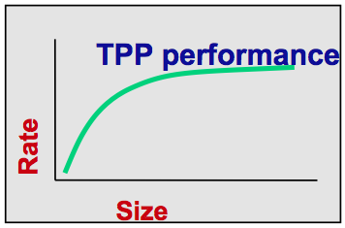
Top 500 Benchmarking Methodology
Listing of the world’s 500 most powerful computers
Yardstick for high-performance computing (HPC)
R_{max} : maximal performance Linpack benchmark
dense linear system of equations (Ax = b)
Data listed
R_{peak} : theoretical peak performance
N_{max} : problem size needed to achieve R_{max}
N_{1/2} : problem size needed to achieve 1/2 of R_{max}
Manufacturer and computer type
Installation site, location, and year
Updated twice a year at SC and ISC conferences

Slide 30
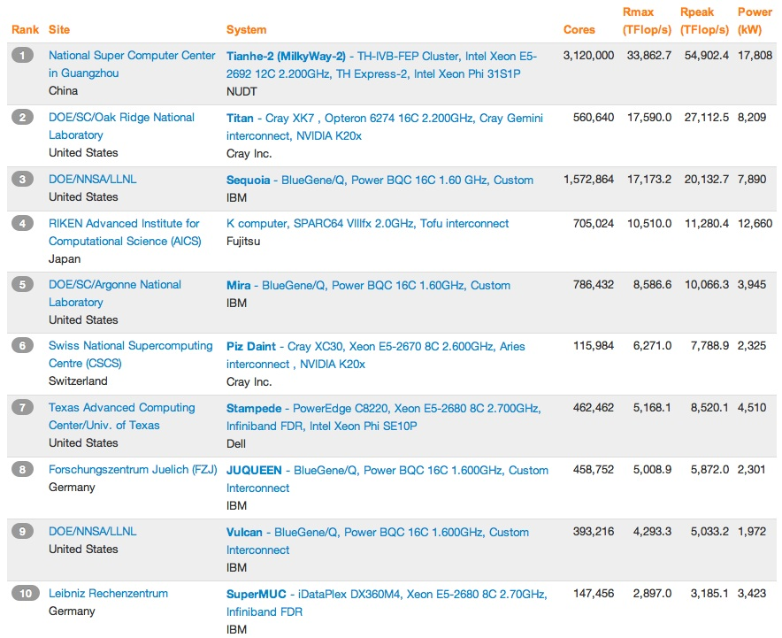
Top 10 (November 2013)
Different architectures

Slide 31
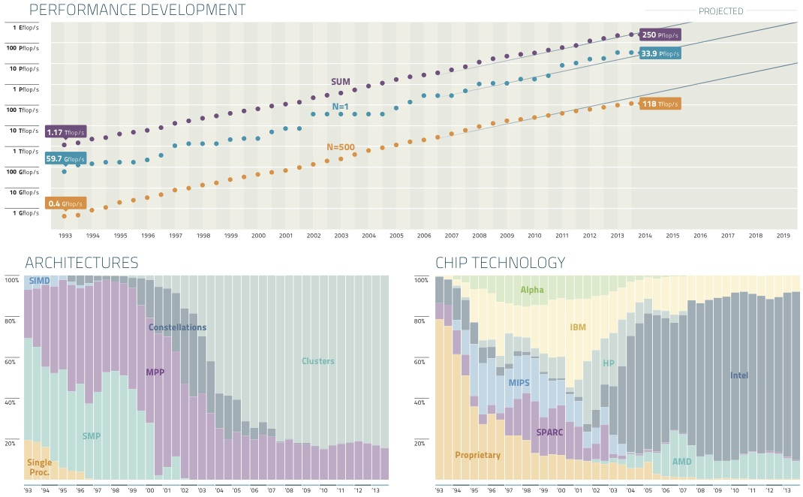
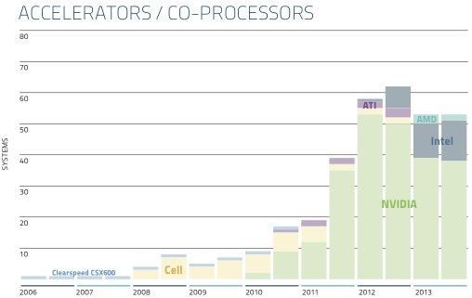
Top 500 – Performance (November 2013)

Slide 32
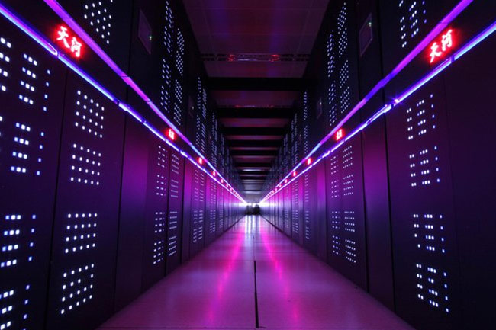
#1: NUDT Tiahne-2 (Milkyway-2)
Compute Nodes have 3.432 Tflop/s per node
16,000 nodes
32000 Intel Xeon CPU
48000 Intel Xeon Phi
Operations Nodes
4096 FT CPUs
Proprietary interconnect
TH2 express
1PB memory
Host memory only
Global shared parallel storage is 12.4 PB
Cabinets: 125+13+24 =162
Compute, communication, storage
~750 m2

Slide 33
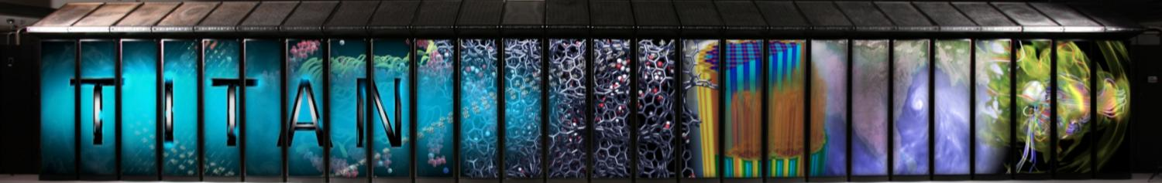
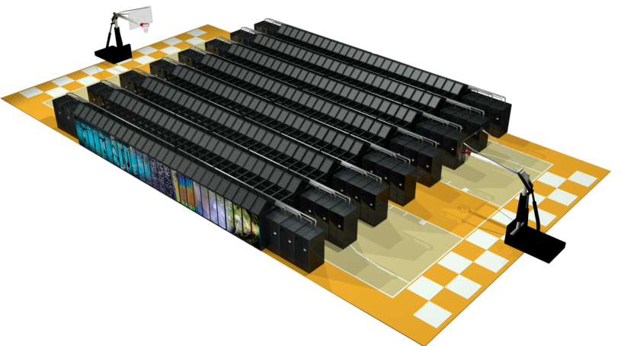
#2: ORNL Titan Hybrid System (Cray XK7)
Peak performance of 27.1 PF
24.5 GPU + 2.6 CPU
18,688 Compute Nodes each with:
16-Core AMD Opteron CPU
NVIDIA Tesla “K20x” GPU
32 + 6 GB memory
512 Service and I/O nodes
200 Cabinets
710 TB total system memory
Cray Gemini 3D Torus Interconnect
8.9 MW peak power
4,352 ft²

Slide 34
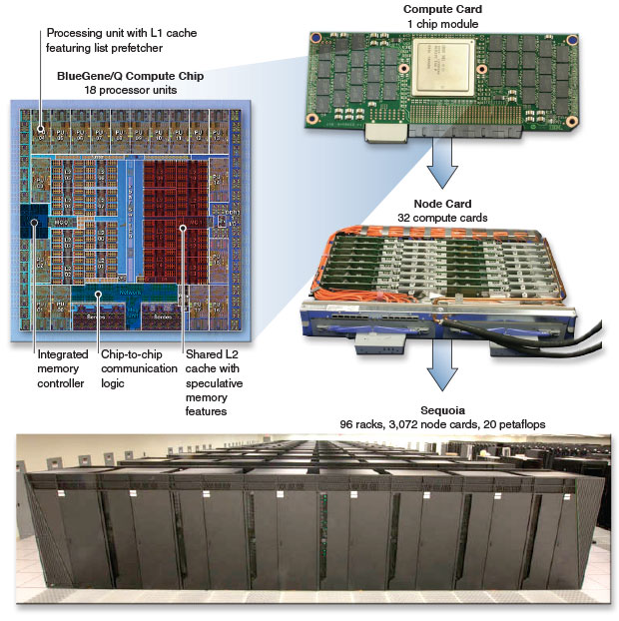
#3: LLNL Sequoia (IBM BG/Q)
Compute card
16-core PowerPC A2 processor
16 GB DDR3
Compute node has 98,304 cards
Total system size:
1,572,864 processing cores
1.5 PB memory
5-dimensional torus interconnection network
Area of 3,000 ft²

Slide 35
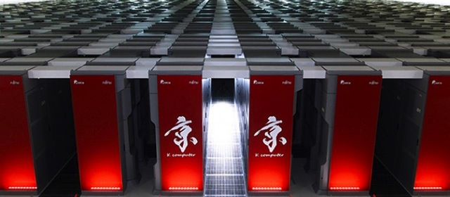
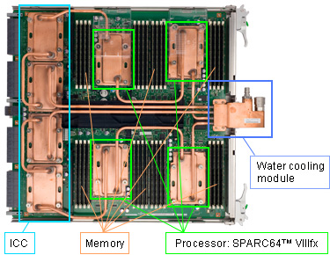
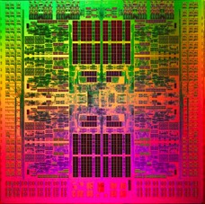
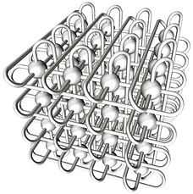
#4: RIKEN K Computer
80,000 CPUs
SPARC64 VIIIfx
640,000 cores
800 water-cooled racks
5D mesh/torus interconnect (Tofu)
12 links between node
12x higher scalability than 3D torus

Slide 36
Contemporary HPC Architectures
Date | System | Location | Comp | Comm | Peak (PF) | Power (MW)
2009 | Jaguar; Cray XT5 | ORNL | AMD 6c | Seastar2 | 2.3 | 7.0
2010 | Tianhe-1A | NSC Tianjin | Intel + NVIDIA | Proprietary | 4.7 | 4.0
2010 | Nebulae | NSCS Shenzhen | Intel + NVIDIA | IB | 2.9 | 2.6
2010 | Tsubame 2 | TiTech | Intel + NVIDIA | IB | 2.4 | 1.4
2011 | K Computer | RIKEN/Kobe | SPARC64 VIIIfx | Tofu | 10.5 | 12.7
2012 | Titan; Cray XK6 | ORNL | AMD + NVIDIA | Gemini | 27 | 9
2012 | Mira; BlueGeneQ | ANL | SoC | Proprietary | 10 | 3.9
2012 | Sequoia; BlueGeneQ | LLNL | SoC | Proprietary | 20 | 7.9
2012 | Blue Waters; Cray | NCSA/UIUC | AMD + (partial) NVIDIA | Gemini | 11.6
2013 | Stampede | TACC | Intel + MIC | IB | 9.5 | 5
2013 | Tianhe-2 | NSCC-GZ (Guangzhou) | Intel + MIC | Proprietary | 54 | ~20

Slide 37
Parallel Programming Landscape
Evolution of parallel machines has driven the advances of how parallel machines are programmed
Parallel programming model
Shared memory multithreading (pthread, OpenMP, TBB)
Distributed memory message passing
Accelerator / coprocessor data parallel (CUDA, OpenACC)
Heterogeneous systems require a combination of methods
Parallel software “stack”
Languages (must be supported by a compiler)
Libraries (numerical, threading, messaging, I/O, …)
Runtime systems (scheduling, memory management, …)
OS
Parallel programming tools

Slide 38
Types of Parallel Computing Models
Data parallel
Simultaneous execution on multiple data (SIMD)
Multi(many)-threaded execution on multiple data
Task parallel
Different instructions on different data (MIMD)
Different programs on different data (MPMD)
SPMD (Single Program, Multiple Data)
Combination of data parallel and task parallel
Not synchronized at individual operation level
Hybrid parallel computing combines methods

Slide 39
SPMD (Single Program, Multiple Data)
Data distributed across processes
Not logically shared
~~~~~
~~~
~~~~
~~
“Owner compute” rule:
Process that “owns” the data (local data) performs computations
on that data
Multiple
data
Shared
program
~~~~~
~~~
~~~~
~~
~~~~~
~~~
~~~~
~~
~~~~~
~~~
~~~~
~~

Slide 40
Parallel Performance Engineering
Scalable, optimized applications deliver HPC promise
Optimization through performance engineering
Understand performance complexity and inefficiencies
Tune application to run optimally on high-end machines
How to make the process effective and productive?
What performance technology (tools) should be used?
Performance technology part of larger environment
Programmability, reusability, portability, robustness
Application development and optimization productivity
Parallel performance tools have been driven by parallel system advances and increased complexity of parallel computation and execution

Slide 41
Parallel Performance Engineering Process
Traditionally an empirically-based approach
observation experimentation diagnosis tuning
Performance technology developed for each level
Performance Tuning
Performance Technology
Performance Technology
hypotheses
Data mining
Models
Expert systems
Performance
Diagnosis
Experiment management
Performance storage
properties
Performance Technology
Performance
Experimentation
Instrumentation
Measurement
Analysis
Visualization
characterization
Performance
Observation

Slide 42

Parallel Performance Diagnosis
parallel
system
parallel
program
system/program characteristics plus performance knowledge used for initial hypothesis
constraints on observational
capabilities, invocation of measurement tools
Performance
Hypothesis
Performance
Observation
analysis, modeling, and presentation of empirical data
hypothesis refinement from empirical results
Stored Performance Knowledge
Experimental
Performance
Data
general performance results add to performance knowledge base

Slide 43
Performance Expectations
Context for understanding the performance behavior of the application and system
Traditional performance expectations are implicit
Users must compare to absolute (peak) performance
Peak measures provide an absolute upper bound
rarely is peak performance reached (5-10% is typical)
How do we know if a parallel program is performing well or performing poorly?
Performance tools should incorporate better performance expectation to be effective
These can come from more knowledge about parallel algorithms, programming environments, HW, systems

Slide 44
Performance Problem Solving Goals
Answer questions at multiple levels of interest
High-level performance data spanning dimensions
machine, applications, code revisions, data sets
examine broad performance trends
Data from low-level measurements
use to predict application performance
Discover general correlations
Performance and features of external environment
Identify primary performance factors
Benchmarking analysis for application prediction
Workload analysis for machine assessment

