Slide 1

Lecture 2: Principles and Methods
Allen D. Malony
Department of Computer and Information Science

Slide 2
Parallel Programming
To use a scalable parallel computer, you must be able to write parallel programs
You must understand the programming model and the programming languages, libraries, and systems software used to implement it
Unfortunately, parallel programming is not easy

Slide 3
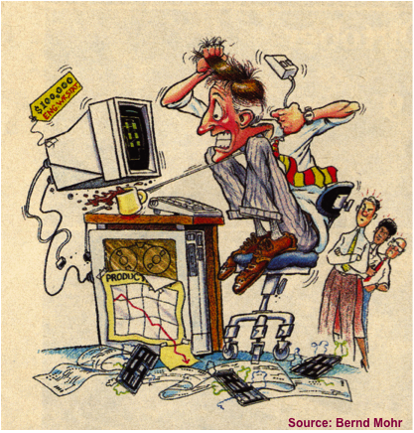
Parallel Programming: Are we having fun yet?

Slide 4
Parallel Programming Models
Two general models of parallel program
Task parallel
problem is broken down into tasks to be performed
individual tasks are created and communicate to coordinate operations
Data parallel
problem is viewed as operations of parallel data
data distributed across processes and computed locally
Characteristics of scalable parallel programs
Data domain decomposition to improve data locality
Communication and latency do not grow significantly

Slide 5
Shared Memory Parallel Programming
Shared memory address space
(Typically) easier to program
Implicit communication via (shared) data
Explicit synchronization to access data
Programming methodology
Manual
multi-threading using standard thread libraries
Automatic
parallelizing compilers
OpenMP parallelism directives
Explicit threading (e.g. POSIX threads)

Slide 6
Distributed Memory Parallel Programming
Distributed memory address space
(Relatively) harder to program
Explicit data distribution
Explicit communication via messages
Explicit synchronization via messages
Programming methodology
Message passing
plenty of libraries to chose from (MPI dominates)
send-receive, one-sided, active messages
Data parallelism

Slide 7
Basic Parallel Programming Paradigm: SPMD
SPMD: Single Program Multiple Data
One program executes on all processors
Basic paradigm for implementing parallel programs
Process-dependent cases are handled in the program
Parallelism is “programmed in”
Easier to manage program for scalability
MPMD: Multiple Program Multiple Data
Support compositing of multiple program together

Slide 8
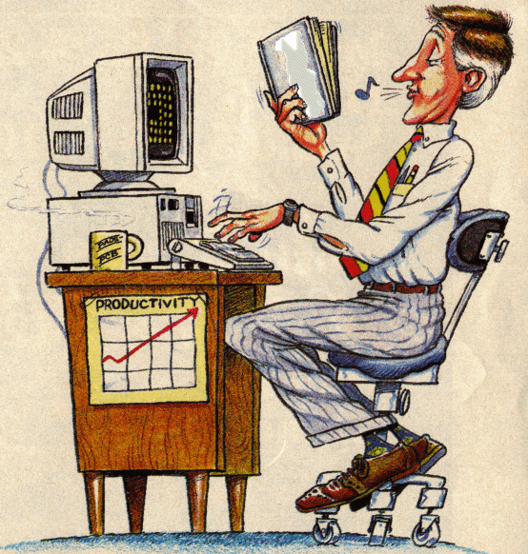
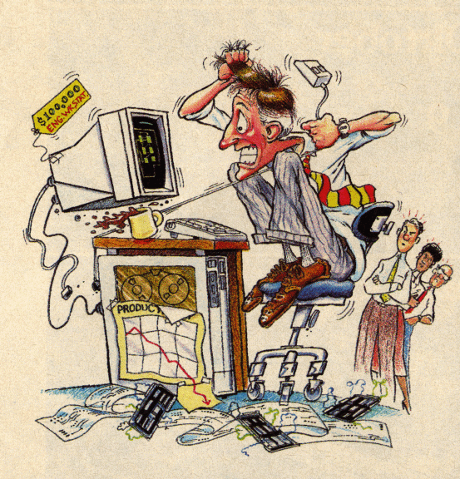
Parallel Programming: Still a Problem?
CIS
631
Source: Bernd Mohr

Slide 9
Parallel Computing and Scalability
Scalability in parallel architecture
Processor numbers
Memory architecture
Interconnection network
Avoid critical architecture bottlenecks
Scalability in computational problem
Problem size
Computational algorithms
computation to memory access ratio
computation to communication ratio
Parallel programming models and tools
Performance scalability

Slide 10
Amdahl’s Law
T_{seq} : sequential execution time that cannot be parallelized
T_{par} : sequential execution time that can be parallelized
T₁ = T_{seq} + T_{par} ⇒ T_{par} = T₁ - T_{seq}
T_{p} = T_{seq} + T_{par} / p (assume fully parallelized)
As p→∞, T_{p} → T_{seq}
Let f_{seq} be the fraction T_{seq} / T₁ and S_{p} = T₁ / T_{p}
Speedup = S_{p} = T₁ / T_{p} = T₁ / (T_{seq} + T_{par} / p) = 1 / (f_{seq} + T_{par} / pT₁) = 1 / (f_{seq} + (1- f_{seq})/ p)
As p→∞, S_{p} = S∞ → 1 / f_{seq}
Speedup bound is determined by the degree of sequential execution time in the computation, not # processors!!!

Slide 11
Amdahl’s Law and Scaled Speedup
Amdahl’s Law makes it hard to obtain good speedup
Change perspective on the problem
Consider scaling of problem size as # processors scale
T_{seq} : sequential execution time (1 and p processors)
T_{par} : execution time in parallel mode on p processors
T_{p} = T_{seq} + T_{par} , T₁ = T_{seq} + pT_{par}
Let f_{par} be the fraction T_{par} / T_{p}
Scaled speedup = S_{p} = 1 + (p-1)T_{par} / T_{p} = 1 + (p-1)f_{par}
f_{seq} * 100% | 10% | 5% | 2% | 1% | .1%
S∞ | 10 | 20 | 50 | 100 | 1000

Slide 12
Parallel Performance and Complexity
To use a scalable parallel computer well, you must write high-performance parallel programs
To get high-performance parallel programs, you must understand and optimize performance for the combination of programming model, algorithm, language, platform, …
Unfortunately, parallel performance measurement, analysis and optimization can be an easy process
Parallel performance is complex

Slide 13
Parallel Performance Evaluation
Study of performance in parallel systems
Models and behaviors
Evaluative techniques
Evaluation methodologies
Analytical modeling and statistical modeling
Simulation-based modeling
Empirical measurement, analysis, and modeling
Purposes
Planning
Diagnosis
Tuning

Slide 14
Parallel Performance Engineering and Productivity
Scalable, optimized applications deliver HPC promise
Optimization through performance engineering process
Understand performance complexity and inefficiencies
Tune application to run optimally on high-end machines
How to make the process more effective and productive?
What performance technology should be used?
Performance technology part of larger environment
Programmability, reusability, portability, robustness
Application development and optimization productivity
Process, performance technology, and its use will change as parallel systems evolve
Goal is to deliver effective performance with high productivity value now and in the future

Slide 15
Motivation
Parallel / distributed systems are complex
Four layers
application
algorithm, data structures
parallel programming interface / middleware
compiler, parallel libraries, communication, synchronization
operating system
process and memory management, IO
hardware
CPU, memory, network
Mapping/interaction between different layers

Slide 16
Performance Factors
Factors which determine a program's performance are complex, interrelated, and sometimes hidden
Application related factors
Algorithms dataset sizes, task granularity, memory usage patterns, load balancing. I/O communication patterns
Hardware related factors
Processor architecture, memory hierarchy, I/O network
Software related factors
Operating system, compiler/preprocessor, communication protocols, libraries

Slide 17
Utilization of Computational Resources
Resources can be under-utilized or used inefficiently
Identifying these circumstances can give clues to where performance problems exist
Resources may be “virtual”
Not actually a physical resource (e.g., thread, process)
Performance analysis tools are essential to optimizing an application's performance
Can assist you in understanding what your program is "really doing”
May provide suggestions how program performance should be improved

Slide 18
Performance Analysis and Tuning: The Basics
Most important goal of performance tuning is to reduce a program's wall clock execution time
Iterative process to optimize efficiency
Efficiency is a relationship of execution time
So, where does the time go?
Find your program's hot spots and eliminate the bottlenecks in them
Hot spot: an area of code within the program that uses a disproportionately high amount of processor time
Bottleneck : an area of code within the program that uses processor resources inefficiently and therefore causes unnecessary delays
Understand what, where, and how time is being spent

Slide 19
Sequential Performance
Sequential performance is all about:
How time is distributed
What resources are used where and when
“Sequential” factors
Computation
choosing the right algorithm is important
compilers can help
Memory systems and cache and memory
more difficult to assess and determine effects
modeling can help
Input / output

Slide 20
Parallel Performance
Parallel performance is about sequential performance AND parallel interactions
Sequential performance is the performance within each thread of execution
“Parallel” factors lead to overheads
concurrency (threading, processes)
interprocess communication (message passing)
synchronization (both explicit and implicit)
Parallel interactions also lead to parallelism inefficiency
load imbalances

Slide 21
Sequential Performance Tuning
Sequential performance tuning is a time-driven process
Find the thing that takes the most time and make it take less time (i.e., make it more efficient)
May lead to program restructuring
Changes in data storage and structure
Rearrangement of tasks and operations
May look for opportunities for better resource utilization
Cache management is a big one
Locality, locality, locality!
Virtual memory management may also pay off
May look for opportunities for better processor usage

Slide 22
Parallel Performance Tuning
In contrast to sequential performance tuning, parallel performance tuning might be described as conflict-driven or interaction-driven
Find the points of parallel interactions and determine the overheads associated with them
Overheads can be the cost of performing the interactions
Transfer of data
Extra operations to implement coordination
Overheads also include time spent waiting
Lack of work
Waiting for dependency to be satisfied

Slide 23
Interesting Performance Phenomena
Superlinear speedup
Speedup in parallel execution is greater than linear
S_{p} > p
How can this happen?
Need to keep in mind the relationship of performance and resource usage
Computation time (i.e., real work) is not simply a linear distribution to parallel threads of execution
Resource utilization thresholds can lead to performance inflections

Slide 24
Parallel Performance Engineering Process
Implementation
Measurement
Preparation
Performance Analysis
Refinement
Analysis
Program Tuning
Ranking
Production

Slide 25
Performance Observability (Guiding Thesis)
Performance evaluation problems define the requirements for performance analysis methods
Performance observability is the ability to “accurately” capture, analyze, and present (collectively observe) information about computer system/software performance
Tools for performance observability must balance the need for performance data against the cost of obtaining it (environment complexity, performance intrusion)
Too little performance data makes analysis difficult
Too much data perturbs the measured system.
Important to understand performance observability complexity and develop technology to address it

Slide 26
Parallel Performance Engineering Process
Traditionally an empirically-based approach
observation experimentation diagnosis tuning
Performance technology developed for each level
Performance Tuning
Performance Technology
Performance Technology
hypotheses
Data mining
Models
Expert systems
Performance
Diagnosis
Experiment management
Performance storage
properties
Performance Technology
Performance
Experimentation
Instrumentation
Measurement
Analysis
Visualization
characterization
Performance
Observation

Slide 27
Performance Analysis and Optimization Cycle
Instrumentation
Insertion of extra code (probes, hooks) into application
Transformation of the results into a representation that can be easily understood by a human user
Collection of data relevant to performance analysis
Elimination of performance problems
Calculation of metrics, identification of performance problems
Measurement
Analysis
Presentation
Optimization

Slide 28
Performance Metrics and Measurement
Observability depends on measurement
What is able to be observed and measured?
A metric represents a type of measured data
Count: how often some thing occurred
calls to a routine, cache misses, messages sent, …
Duration: how long some thing took place
execution time of a routine, message communication time, …
Size: how big some thing is
message size, memory allocated, …
A measurement records performance data
Certain quantities can not be measured directly
Derived metric: calculated from metrics
rates of some thing (e.g., flops per second) are one example

Slide 29
Performance Benchmarking
Benchmarking typically involves the measurement of metrics for a particular type of evaluation
Standardize on an experimentation methodology
Standardize on a collection of benchmark programs
Standardize on set of metrics
High-Performance Linpack (HPL) for Top 500
NAS Parallel Benchmarks
SPEC
Typically look at MIPS and FLOPS

Slide 30
How Is Time Measured?
How do we determine where the time goes?
“A person with one clock knows what time it is, a person with two clocks is never sure.” Confucious (attributed)
Clocks are not the same
Have different resolutions and overheads for access
Time is an abstraction based on clock
Only as good (accurate) as the clock we use
Only as good as what we use it for

Slide 31
Execution Time
There are different types of time
Wall-clock time
Based on realtime clock (continuously running)
Includes time spent in all activities
Virtual process time (aka CPU time)
Time when process is executing (CPU is active)
user time and system time (can mean different things)
Does not include time when process is inherently waiting
Parallel execution time
Runs whenever any parallel part is executing
Need to define a global time basis

Slide 32
Observation Types
There are two types of performance observation that determine different measurement methods
Direct performance observation
Indirect performance observation
Direct performance observation is based on a scientific theory of measurement that considers the cost (overhead) with respect to accuracy
Indirect performance observation is based on a sampling theory of measurement that assumes some degree of statistical stationarity

Slide 33
Direct Performance Observation
Execution actions exposed as events
In general, actions reflect some execution state
presence at a code location or change in data
occurrence in parallelism context (thread of execution)
Events encode actions for observation
Observation is direct
Direct instrumentation of program code (probes)
Instrumentation invokes performance measurement
Event measurement = performance data + context
Performance experiment
Actual events + performance measurements

Slide 34
Indirect Performance Observation
Program code instrumentation is not used
Performance is observed indirectly
Execution is interrupted
can be triggered by different events
Execution state is queried (sampled)
different performance data measured
Event-based sampling (EBS)
Performance attribution is inferred
Determined by execution context (state)
Observation resolution determined by interrupt period
Performance data associated with context for period

Slide 35
Direct Observation: Events
Event types
Interval events (begin/end events)
measures performance between begin and end
metrics monotonically increase
Atomic events
used to capture performance data state
Code events
Routines, classes, templates
Statement-level blocks, loops
User-defined events
Specified by the user
Abstract mapping events

Slide 36
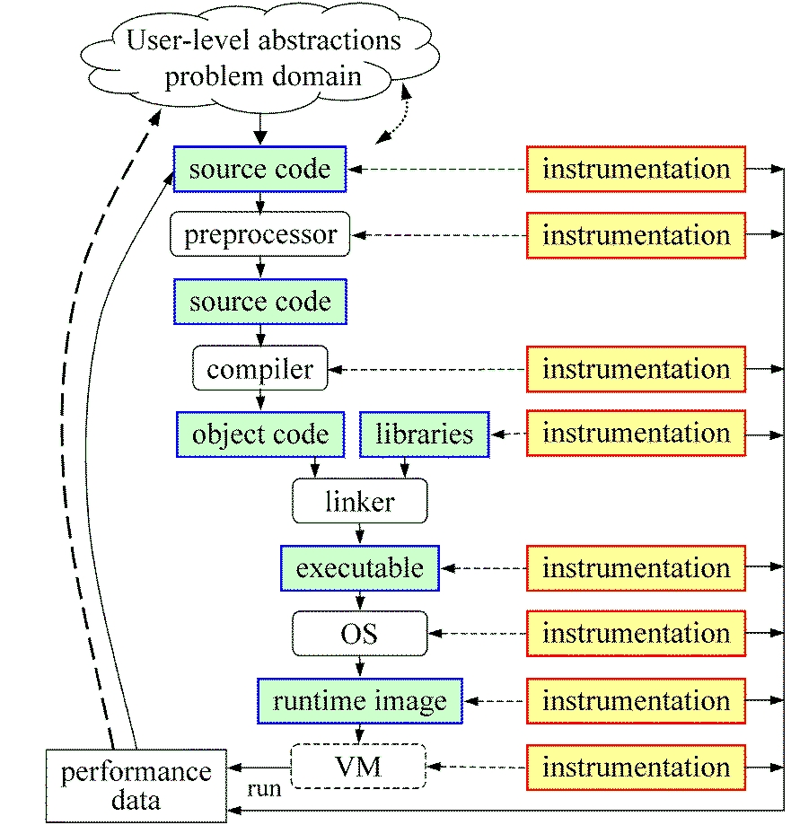
Direct Observation: Instrumentation
Events defined by instrumentation access
Instrumentation levels
Source code
Library code
Object code
Executable code
Runtime system
Operating system
Levels provide different information / semantics
Different tools needed for each level
Often instrumentation on multiple levels required

Slide 37
Direct Observation: Techniques
Static instrumentation
Program instrumented prior to execution
Dynamic instrumentation
Program instrumented at runtime
Manual and automatic mechanisms
Tool required for automatic support
Source time: preprocessor, translator, compiler
Link time: wrapper library, preload
Execution time: binary rewrite, dynamic
Advantages / disadvantages

Slide 38
Indirect Observation: Events/Triggers
Events are actions external to program code
Timer countdown, HW counter overflow, …
Consequence of program execution
Event frequency determined by:
type, setup, number enabled (exposed)
Triggers used to invoke measurement tool
Traps when events occur (interrupt)
Associated with events
May add differentiation to events

Slide 39
Indirect Observation: Context
When events trigger, execution context determined at time of trap (interrupt)
Access to PC from interrupt frame
Access to information about process/thread
Possible access to call stack
requires call stack unwinder
Assumption is that the context was the same during the preceding period
Between successive triggers
Statistical approximation valid for long running programs assuming repeated behavior

Slide 40
Direct / Indirect Comparison
Direct performance observation
☺ Measures performance data exactly
☺ Links performance data with application events
😐 Requires instrumentation of code
☹ Measurement overhead can cause execution intrusion and possibly performance perturbation
Indirect performance observation
☺ Argued to have less overhead and intrusion
☺ Can observe finer granularity
☺ No code modification required (may need symbols)
☹ Inexact measurement and attribution

Slide 41
Measurement Techniques
When is measurement triggered?
External agent (indirect, asynchronous)
sampling via interrupts, hardware counter overflow, …
Internal agent (direct, synchronous)
through code modification (instrumentation)
How are measurements made (data recorded)?
Profiling
summarizes performance data during execution
per process / thread and organized with respect to context
Tracing
trace record with performance data and timestamp
per process / thread

Slide 42
Critical Issues
Accuracy
Timing and counting accuracy depends on resolution
Any performance measurement generates overhead
execution on performance measurement code
Measurement overhead can lead to intrusion
Intrusion can cause perturbation
alters program behavior
Granularity
How many measurements are made
How much overhead per measurement
Tradeoff (general wisdom)
Accuracy is inversely correlated with granularity

Slide 43
Measured Performance
Counts
Durations
Communication costs
Synchronization costs
Memory use
Hardware counts
System calls

Slide 44
Profiling
Recording of aggregated information
Counts, time, …
… about program and system entities
Functions, loops, basic blocks, …
Processes, threads
Methods
Event-based sampling (indirect, statistical)
Direct measurement (deterministic)

Slide 45
Inclusive and Exclusive Profiles
Performance with respect to code regions
Exclusive measurements for region only
Inclusive measurements includes child regions
int f1()
{
int a;
a = a + 1;
f2();
a = a + 1;
return a;
}
inclusive
duration
exclusive
duration
child
duration

Slide 46
Flat and Callpath Profiles
Static call graph
Shows all parent-child calling relationships in a program
Dynamic call graph
Reflects actual execution time calling relationships
Flat profile
Performance metrics for when event is active
Exclusive and inclusive
Callpath profile
Performance metrics for calling path (event chain)
Differentiate performance with respect to program execution state
Exclusive and inclusive

Slide 47
Measurement Methods: Tracing
Recording information about significant points (events) during execution of the program
Enter/leave a code region (function, loop, …)
Send/receive a message ...
Save information in event record
Timestamp, location ID, event type
Any event specific information
An event trace
Stream of event records sorted by time
Main advantage is that it can be used to reconstruct the dynamic behavior of the parallel execution
Abstract execution model on level of defined events

Slide 48
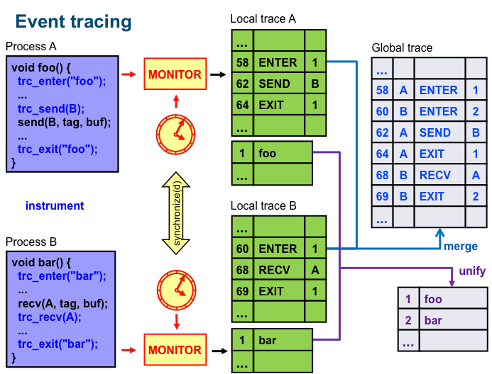
Event Tracing

Slide 49
Tracing: Time-line Visualization
1
master
main
2
slave
master
3
...
slave
...
58
A
ENTER
1
60
B
ENTER
2
62
A
SEND
B
A
64
A
EXIT
1
68
B
RECV
A
B
69
B
EXIT
2
...
58
60
62
64
66
68
70

Slide 50
Trace File Formats
There have been a variety of tracing formats developed over the years and supported in different tools
Vampir
VTF: family of historical ASCII and binary formats
MPICH / JumpShot
ALOG, CLOG, SLOG, SLOG-2
Scalasca
EPILOG (Jülich open-source trace format)
Paraver (BSC, CEPBA)‏
TAU Performance System
Convergence on Open Trace Format (OTF)

Slide 51
Profiling / Tracing Comparison
Profiling
☺ Finite, bounded performance data size
☺ Applicable to both direct and indirect methods
😐 Loses time dimension (not entirely)
☹ Lacks ability to fully describe process interaction
Tracing
☺ Temporal and spatial dimension to performance data
☺ Capture parallel dynamics and process interaction
☺ Can derive parallel profiles for any time region
😐 Some inconsistencies with indirect methods
☹ Unbounded performance data size (large)
☹ Complex event buffering and clock synchronization

Slide 52
Performance Analysis and Visualization
Gathering performance data is not enough
Need to analyze the data to derive performance understanding
Need to present the performance information in meaningful ways for investigation and insight
Single-experiment performance analysis
Identifies performance behavior within an execution
Multi-experiment performance analysis
Compares and correlates across different runs to expose key factors and relationships

