Slide 1

Lecture 3: Technologies
Allen D. Malony
Department of Computer and Information Science

Slide 2
Performance Tools and Technologies
It is never the case that performance tools are developed from scratch
They depend on a range of technologies that can themselves be significant engineering efforts
Even simple conceptual things can be hard
Most technologies deal with how to observe performance metrics or state
"If I have seen further it is by standing on the shoulders of giants.”
- Sir Isaac Newton

Slide 3
Technologies
Timers
Counters
Instrumentation
Source (PDT)
PMPI
Compiler instrumentation
Binary
Dyninst
PEBIL
MAQAO
Runtime Interfaces
Program Address Resolution: Binutils
Stack Walking
StackwalkerAPI
Libunwind
Backtrace
Heterogeneous (accelerator) timers and counters

Slide 4
Time
How is time measured in a computer system?
How do we derive time from a clock?
What clock/time technologies are available to a measurement system?
How are clocks synchronized in a parallel computer in order to provide a “global time” common between nodes?
Different technologies are available
Issues of resolution and accuracy

Slide 5
Timer: gettimeofday()
UNIX function
Returns wall-clock time in seconds and microseconds
Actual resolution is hardware-dependent
Base value is 00:00 UTC, January 1, 1970
Some implementations also return the timezone
#include <sys/time.h>
struct timeval tv;
double walltime; /* seconds */
gettimeofday(&tv, NULL);
walltime = tv.tv_sec + tv.tv_usec * 1.0e-6;

Slide 6
Timer: clock_gettime()
POSIX function
For clock_id CLOCK_REALTIME it returns wall-clock time in seconds and nanoseconds
More clocks may be implemented but are not standardized
Actual resolution is hardware-dependent
#include <time.h>
struct timespec tv;
double walltime; /* seconds */
Clock_gettime(CLOCK_REALTIME, &tv);
walltime = tv.tv_sec + tv.tv_nsec * 1.0e-9;

Slide 7
Timer: getrusage()
UNIX function
Provides a variety of different information
Including user time, system time, memory usage, page faults, and other resource use information
Information provided system-dependent!
#include <sys/resource.h>
struct rusage ru;
double usrtime; /* seconds */
int memused;
getrusage(RUSAGE_SELF, &ru);
usrtime = ru.ru_utime.tv_sec + ru.ru_utime.tv_usec * 1.0e-6; memused = ru.ru_maxrss;

Slide 8
Timer: Others
MPI provides portable MPI wall-clock timer
Not required to be consistent/synchronized across ranks!
OpenMP 2.0 also provides a library function
Hybrid MPI/OpenMP programming?
Interactions between both standards (yet) undefined
#include <mpi.h>
double walltime; /* seconds */
walltime = MPI_Wtime();
#include <omp.h>
double walltime; /* seconds */
walltime = omp_get_wtime();

Slide 9
Timer: Others
Fortran 90 intrinsic subroutines
cpu_time()
system_clock()
Hardware counter libraries typically provide “timers” because underlying them are cycle counters
Vendor APIs
PMAPI, HWPC, libhpm, libpfm, libperf, …
PAPI (Performance API)

Slide 10
What Are Performance Counters
Extra processor logic inserted to count specific events
Updated at every cycle (or when some event occurs)
Strengths
Non-intrusive
Very accurate
Low overhead
Weaknesses
Provides only hard counts
Specific for each processor
Access is not appropriate for the end user
nor is it well documented
Lack of standard on what is counted

Slide 11
Hardware Counter Issues
Kernel level
Handling of overflows
Thread accumulation
Thread migration
State inheritance
Multiplexing
Overhead
Atomicity
Multi-platform interfaces
Performance API (PAPI)
University of Tennessee, USA
Lightweight Performance Tools (LIKWID)
University of Erlangen, Germany
Multi
platform
interface
Kernel
Hardware
counters

Slide 12
Hardware Measurement
Typical measured events account for:
Functional units status
float point operations
fixed point operations
load/stores
Access to memory hierarchy
Cache coherence protocol events
Cycles and instructions counts
Speculative execution information
instructions dispatched
branches mispredicted

Slide 13
Hardware Metrics
Typical hardware counter Useful derived metrics
Cycles / Instructions IPC
Floating point instructions FLOPS
Integer instructions computation intensity
Load/stores instructions per load/store
Cache misses load/stores per cache miss
Cache misses cache hit rate
Cache misses loads per load miss
TLB misses loads per TLB miss
Derived metrics allow users to correlate the behavior of the application to hardware components
Define threshold values acceptable for metrics and take actions regarding optimization when below/above thresholds

Slide 14
Accuracy Issues
Granularity of the measured code
If not sufficiently large enough, overhead of the counter interfaces may dominate
Mainly applies to time
Pay attention to what is not measured:
Out-of-order processors
Sometimes speculation is included
Lack of standard on what is counted
microbenchmarks can help determine accuracy of the hardware counters
Impact of measurement on counters themselves
Typically less of an issue

Slide 15
Hardware Counters Access on Linux
Linux had not defined an out-of-the-box interface to access the hardware counters!
Linux Performance Monitoring Counters Driver (PerfCtr) by Mikael Pettersson from Uppsala X86 + X86-64
needs kernel patching!
http://user.it.uu.se/~mikpe/linux/perfctr/
Perfmon by Stephane Eranian from HP – IA64
it was being evaluated to be added to Linux
http://www.hpl.hp.com/research/linux/perfmon/
Linux 2.6.31
Performance Counter subsystem provides an abstraction of special performance counter hardware registers

Slide 16
Utilities to Count Hardware Events
There are utilities that start a program and at the end of the execution provide overall event counts
hpmcount (IBM)
CrayPat (Cray)
pfmon from HP (part of Perfmon for AI64)
psrun (NCSA)
cputrack, har (Sun)
perfex, ssrun (SGI)
perf (Linux 2.6.31)

Slide 17

PAPI – Performance API
Middleware to provide a consistent and portable API for the performance counter hardware in microprocessors
Countable events are defined in two ways:
Platform-neutral preset events
Platform-dependent native events
Presets can be derived from multiple native events
Two interfaces to the underlying counter hardware:
High-level interface simply provides the ability to start, stop and read the counters for a specified list of events
Low-level interface manages hardware events in user defined groups called EventSets
Events can be multiplexed if counters are limited http://icl.cs.utk.edu/papi/

Slide 18
PAPI Architecture
Tools
PAPI Low Level
PAPI High Level
Portable
Layer
PAPI Machine Dependent Substrate
Machine
Specific
Layer
Kernel Extensions
Operating System
Hardware Performance Counters

Slide 19
PAPI Predefined Events
Common set of events deemed relevant and useful for application performance tuning (wish list)
papiStdEventDefs.h
Accesses to the memory hierarchy, cache coherence protocol events, cycle and instruction counts, functional unit and pipeline status
Run PAPI papi_avail utility to determine which predefined events are available on a given platform
Semantics may differ on different platforms!
PAPI also provides access to native events on all supported platforms through the low-level interface
Run PAPI papi_native_avail utility to determine which predefined events are available on a given platform

Slide 20
papi_avail Utility
Provides information on what events are available on a particular hardware platform
% papi_avail -h
This is the PAPI avail program.
It provides availability and detail information
for PAPI preset and native events. Usage:
papi_avail [options] [event name]
papi_avail TESTS_QUIET
Options:
-a display only available PAPI preset events
-d display PAPI preset event info in detailed format
-e EVENTNAME display full detail for named preset or native event
-h print this help message
-t display PAPI preset event info in tabular format (default)

Slide 21
High Level API
Meant for application programmers wanting simple but accurate measurements
Calls the lower level API
Allows only PAPI preset events
Eight functions:
PAPI_num_counters
PAPI_start_counters, PAPI_stop_counters
PAPI_read_counters
PAPI_accum_counters
PAPI_flops
PAPI_flips, PAPI_ipc (New in Version 3.x)
Not thread-safe (Version 2.x)

Slide 22
Low Level API
Increased efficiency and functionality over the high level PAPI interface
54 functions
Access to native events
Obtain information about the executable, the hardware, and memory
Set options for multiplexing and overflow handling
System V style sampling (profil())
Thread safe

Slide 23






Component PAPI
Developed for the purpose of extending counter sets while providing a common interface
Low Level
User API
High Level
User API
PAPI FRAMEWORK
Developer API
Developer API
Developer API
PAPI COMPONENT
(Network)
PAPI COMPONENT
(CPU)
PAPI COMPONENT
(System Health)
Operating System
Operating System
Operating System
Counter Hardware
Counter Hardware
Counter Hardware

Slide 24
Source Instrumentation with Timers
Measuring performance using timers requires instrumentation
Have to uniquely identify code region (name)
Have to add code for timer start and stop
Have to compute delta and accumulate statistics
Hand-instrumenting becomes tedious very quickly, even for small software projects
Also a requirement for enabling instrumentation only when wanted
Avoids unnecessary overheads when not needed

Slide 25
Program Database Toolkit (PDT)
University of Oregon, Research Center Juelich (FZJ Germany), Edison Design Group, Inc. (USA), LLNL (USA)
Automated instrumentation of C/C++, Fortran source code
Source code parser(s) identify blocks such as function boundaries, loop boundaries, generates a .PDB file for each source file
Instrumentor uses .PDB file to insert API calls into source code files at block enter/exit, outputs an instrumented code file
Instrumented source passed to compiler for compilation to object file
Linker links application with measurement library providing definitions for API calls
Free download: http://tau.uoregon.edu

Slide 26
PDT Architecture
Application/Library
Source
code
Commercial grade frontend parsers
Program database (PDB)
Fortran
C / C++
EDG, Mutek, GNU
DUCTAPE
…
TAU
Instrumentor
Tools

Slide 27
PMPI – MPI Standard Profiling Interface
The MPI (Message Passing Interface) standard defines a mechanism for instrumenting all API calls in an MPI implementation
Each MPI_* function call is actually a weakly defined interface that can be re-defined by performance tools
Each MPI_* function call eventually calls a corresponding PMPI_* function call which provides the expected MPI functionality
Performance tools can redefine MPI_* calls

Slide 28
PMPI Example
Original MPI_Send() definition:
Possible Performance tool definition:
int __attribute__((weak))
MPI_Send(void *buf, int count, MPI_Datatype datatype, int dest, int tag, MPI_Comm comm) {
PMPI_Send(buf, count, datatype, dest, tag, comm);
}
int MPI_Send(void *buf, int count, MPI_Datatype datatype, int dest, int tag, MPI_Comm comm) {
MYTOOL_Timer_Start(“MPI_Send”);
PMPI_Send(buf, count, datatype, dest, tag, comm);
MYTOOL_Timer_Stop(“MPI_Send”);
MYTOOL_Message_Size(“MPI_Send”, count * sizeof(datatype));
}

Slide 29
Compiler Instrumentation
Modern compilers provide the ability to instrument functions at compile time
Can exclude files, functions
GCC example:
-finstrument-functions parameter
Instruments function entry and exit(s)
void __cyg_profile_func_enter (void *this_fn, void *call_site);
void __cyg_profile_func_exit (void *this_fn, void *call_site);

Slide 30
Compiler Instrumentation – Tool Interface
Measurement libraries have to implement those two functions:
void __cyg_profile_func_enter (void *this_fn, void *call_site);
void __cyg_profile_func_exit (void *this_fn, void *call_site);
The function and call site pointers are instruction addresses
How to resolve those addresses to source code locations?
Binutils: libbfd, libiberty (discussed later)

Slide 31
Binary Instrumentation
Source Instrumentation not possible in all cases
Exotic / Domain Specific Languages (no parser support)
Pre-compiled system libraries
Utility libraries without source available
Binary instrumentation modifies the existing executable and all libraries, adding user-specified function entry/exit API calls
Can be done once, or as first step of execution

Slide 32
Binary Instrumentation: Dyninst API
University of Wisconsin, University of Maryland
Provides binary instrumentation for runtime code patching:
Performance Measurement Tools
Correctness Debuggers (efficient data breakpoints)
Execution drive simulations
Computational Steering
http://www.dyninst.org

Slide 33

Binary Instrumentation: PEBIL
San Diego Supercomputing Center / PMaC group
Static binary instrumentation for x86_64 Linux
PEBIL = PMaC’s Efficient Binary Instrumentation for Linux/x86
Lightweight binary instrumentation tool that can be used to capture information about the behavior of a running executable
http://www.sdsc.edu/PMaC/projects/pebil.html

Slide 34
PEBIL Design
Efficiency is priority #1
Designed around a few use cases
Execution counting
Memory tracing
Static binary rewriter
Write instrumented + runnable executable to disk
keep original behavior intact
gather information as a side-effect
Instrument once, run many times
No instrumentation cost at runtime
Code patching (not just-in-time compiled!)

Slide 35
How Binary Instrumentation Works
Original
Instrumented
0000c000 <foo>:
c000: 48 89 7d f8 mov %rdi,-0x8(%rbp)
c004: 5e pop %rsi
c005: 75 f8 jne 0xc004
c007: c9 leaveq
c008: c3 retq
Basic Block 1
Basic Block 2
Basic Block 3
0000d000 <foo>:
d000: e9 de ad be ef jmp 0x1000 # to instrumentation
d005: 48 89 7d f8 mov %rdi,-0x8(%rbp)
d000: e9 de ad be ef jmp 0x1010 # to instrumentation
d00a: 5e pop %rsi
d00b: 75 00 00 00 f8 jne 0xd009
d000: e9 de ad be ef jmp 0x1020 # to instrumentation
d00a: c9 leaveq
d00b: c3 retq
// do stuff
// jump back

Slide 36
Use case: Memory Address Collection
Collect the address of every load/store issued by the application
Put addresses in a buffer, process addresses in batch
Fewer function calls
Less cache pollution
for (i = 0; i < n; i++){
A[i] = B[i];
}
if (cur + 2 > BUF_SIZE) clear_buf();
buffer[cur + 0] = &(A[i]);
buffer[cur + 1] = &(B[i]);

Slide 37





Binary Instrumentation: MAQAO
Modular Assembly Quality Analyzer and Optimizer
Tool for analyzing and optimizing binary code
Intel64 and Xeon Phi architectures supported
Binary release only (for now)
http://maqao.org

Slide 38
MAQAO: Introduction
Easy install
Packaging : ONE (static) standalone binary
Easy to embed
Audience
User/Tool developer: analysis and optimization tool
Performance tool developer: framework services
TAU: tau_rewrite (MIL)
ScoreP: on-going effort (MIL)

Slide 39
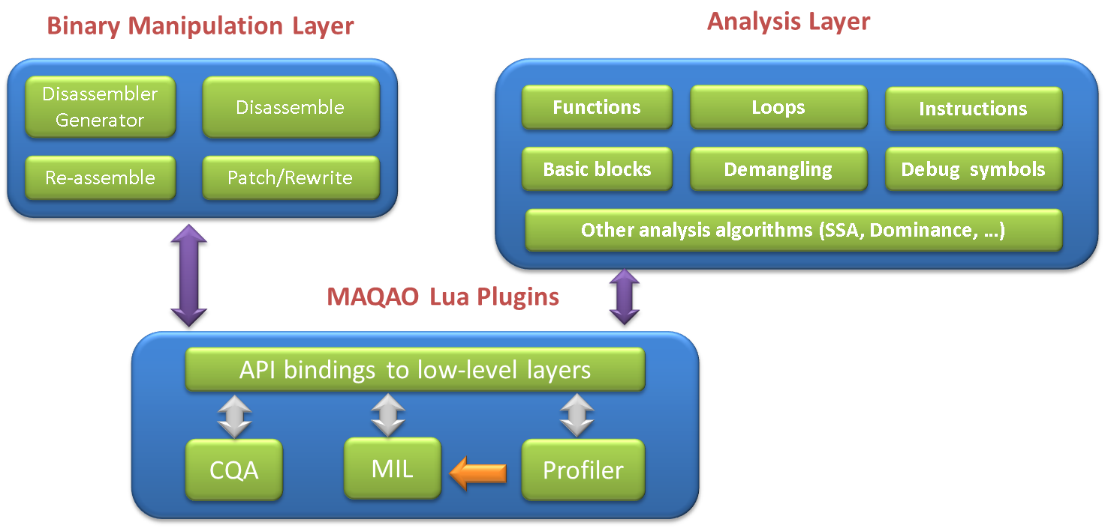
MAQAO: Architecture
Image source: http://maqao.org

Slide 40
MAQAO: Measurement and Analysis Tool
Scripting language
Lua language : simplicity and productivity
Fast prototyping
MAQAO Lua API : Access to services
Built on top of the Framework
Loop-centric approach
Output: reports
System deals with low level details
User gets high level reports

Slide 41
Runtime Measurement Support
Some runtime systems provide callback mechanisms for function entry / exit or state transitions
Java JVM
Python
Some OpenMP runtimes (Collector API, OMPT)
Sun/Oracle, OpenUH, Intel (in development)
Measurement tools / libraries:
implement event handlers for callback functions
register with the runtime, are notified when events happen

Slide 42
Periodic Sampling – what is it?
The application is interrupted after a specified period of time
Interruption handler queries the program state
The timer is reset and the process repeats until program termination
Either at termination or during handler, a statistical profile is constructed
Sampling theory states that the state (function) sampled the most frequently is the most time consuming state (function)

Slide 43
Periodic Sampling – how to do it?
ANSI C / POSIX signaling and signal handling
sigaction()
Specify a handler for when a signal is raised
Handler has to be signal-safe*
Handler gets program state context pointer, including current instruction pointer address and full program stack
setitimer()
Portable (POSIX) interval timer
A signal is raised when the timer expires
Timers: real time (process-level only), user CPU time, or user CPU + system CPU time counters
Undefined behavior for threaded applications
timer_create() / timer_settime()
POSIX function like setitimer(), but with a Linux-specific interval timer with threaded support for real time counter
*POSIX.1-2004 lists the functions that are signal-safe

Slide 44
Address Resolution: GNU Binutils
Compiler instrumentation and signal handling deal with instruction pointer addresses
Binutils provides utilities and libraries for looking up addresses and getting function name, source code file and line number
Source info available if code compiled with –g
Iterates over executable and any shared object libraries (if applicable) to find address
Command line version:
addr2line –f –e <executable> <address_1> … <address_n>
http://www.gnu.org/software/binutils/

Slide 45
Stack Walking – how did I get here?
Periodic sampling freezes the program state
“Walking the stack” answers the question: how did I get here?
int func_c(int c) {
return (c+3);
}
int func_b(int b) {
return func_c(b+2);
}
int func_a(int a) {
return func_b(a+1);
}
int main(int argc, char* argv[]) {
int in = atoi(argv[1]);
printf(“%d: %d\n”, in, func_a(in));
}
Current program stack:
Signal interrupt here
func_c(8)
func_b(6)
func_a(5)
main(2, [“main”,”5”])

Slide 46
Stack Walking: libunwind
Libunwind defines a portable and efficient C programming interface (API) to determine the call-chain of a program
Provides the means to manipulate the preserved (callee-saved) state of each call-frame and to resume execution at any point in the call-chain (non-local goto)
Supports both local (same-process) and remote (across-process) operation.
Developed and supported by the Free Software Foundation (FSF)
https://savannah.nongnu.org/projects/libunwind/

Slide 47
Stack Walking: StackWalkerAPI
University of Wisconsin, University of Maryland
An API that allows users to collect a call stack and access information about its stack frames
Support for Linux (x86_64, AMD-64, Power, Power-64), BlueGene/L and BlueGene/P
http://www.dyninst.org/stackwalker

Slide 48
Stack Walking: Linux Backtrace (libc)
A backtrace is a list of the function calls that are currently active in a thread
2 steps: get array of n addresses, resolve them to symbols
Warning! By default, address resolution is not signal-safe
Signal-safe option writes to file descriptor (no malloc)
http://www.gnu.org/software/libc/manual/html_node/Backtraces.html
http://man7.org/linux/man-pages/man3/backtrace.3.html
#include <execinfo.h>
int backtrace(void **buffer, int size);
char **backtrace_symbols(void *const *buffer, int size);
void backtrace_symbols_fd(void *const *buffer, int size, int fd);

Slide 49
Backtrace example
#include <execinfo.h>
#include <stdio.h>
#include <stdlib.h>
/* Obtain a backtrace and print it to stdout. */
void print_trace (void) {
void *array[10];
size_t size;
char **strings;
size_t i;
size = backtrace (array, 10);
// not signal safe! bactrace_symbols calls “malloc”
strings = backtrace_symbols (array, size);
printf ("Obtained %zd stack frames.\n", size);
for (i = 0; i < size; i++)
printf ("%s\n", strings[i]);
free (strings);
}

Slide 50
NVIDIA CUDA Performance Tool Interface
Use of accelerator and coprocessor hardware also requires access to timer and counting information
NVIDIA is developing CUDA Performance Tool Interface (CUPTI) to enable the creation of profiling and tracing tools
CUPTI support was released with CUDA 4.0
Capabilities have steadily improved
Current version is released with CUDA 5.x and the just announced CUDA 6
CUPTI is delivered as a dynamic library

Slide 51
NVIDIA CUPTI APIs
Callback API
Interject tool callback code at the entry and exist to each CUDA runtime and driver API call
Registered tools are invoked for selected events
Counter API
Query, configure, start, stop, read counters on CUDA devices
Device-level counter access
Activity API
GPU kernel and memory copy timing information is stored in a buffer until a synchronization point is encounter and these timings are recorded by the CPU
Synchronization can be either be within a device, stream or occur during some synchronous memory copies and event synchronizations
Can also get information on kernel registers and instructions

Slide 52
PAPI CUDA Component
HW performance counter measurement technology for NVIDIA CUDA platform
Access to HW counters inside the GPUs
Based on CUPTI (CUDA Performance Tool Interface)
PAPI CUDA component can provide detailed performance counter info regarding execution of GPU kernel
Initialization, device management and context management are enabled by CUDA driver API
Domain and event management are enabled by CUPTI
Names of events are established by the following hierarchy: Component.Device.Domain.Event

Slide 53
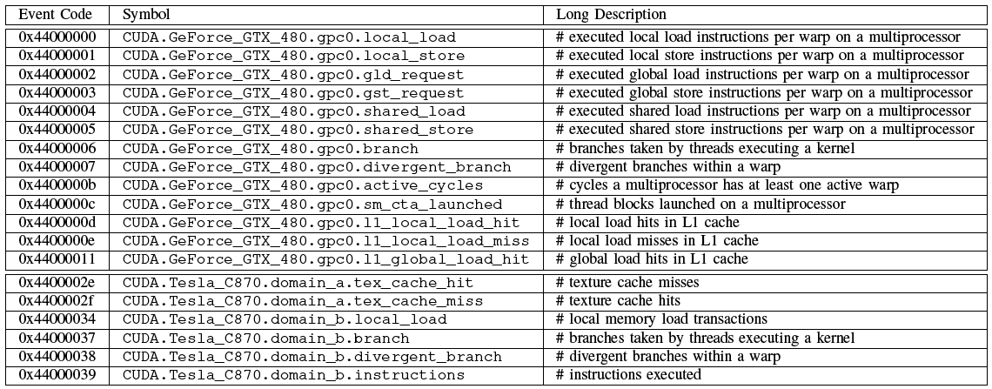
Portion of CUDA Events on Tesla C870

Slide 54
Short Course Outline
Lecture 1: Introduction and Fundamentals
Lecture 2: Methodology
Lecture 3: Tools Technology
Lecture 4: Tools Landscape – Part 1
Lecture 5: Tools Landscape – Part 2
Lecture 6: TAU Performance System
Lecture 7: TAU Applications
Lecture 8: Advances in TAU
Lecture 9: Future Directions
Tuesday
Wednesday
Thursday

