Slide 1

Fork-Join Pattern
Parallel Computing
CIS 410/510
Department of Computer and Information Science

Slide 2
Fibonacci
Recursive Fibonacci is simple and inefficient
long fib ( int n ) {
if (n < 2) return 1;
else {
long x = fib (n-1);
long y = fib(n-2);
return x + y;
}
}

Slide 3
Fibonacci…
Recursive Fibonacci is simple and inefficient
But it does have the property that the sub-calls are independent
Can we parallelize it?

Slide 4
Fibonacci…in Parallel?
long fib ( int n ) {
if (n < 2) return 1;
else {
long x = fork fib (n-1);
long y = fib(n-2);
join;
return x + y;
}
}

Slide 5
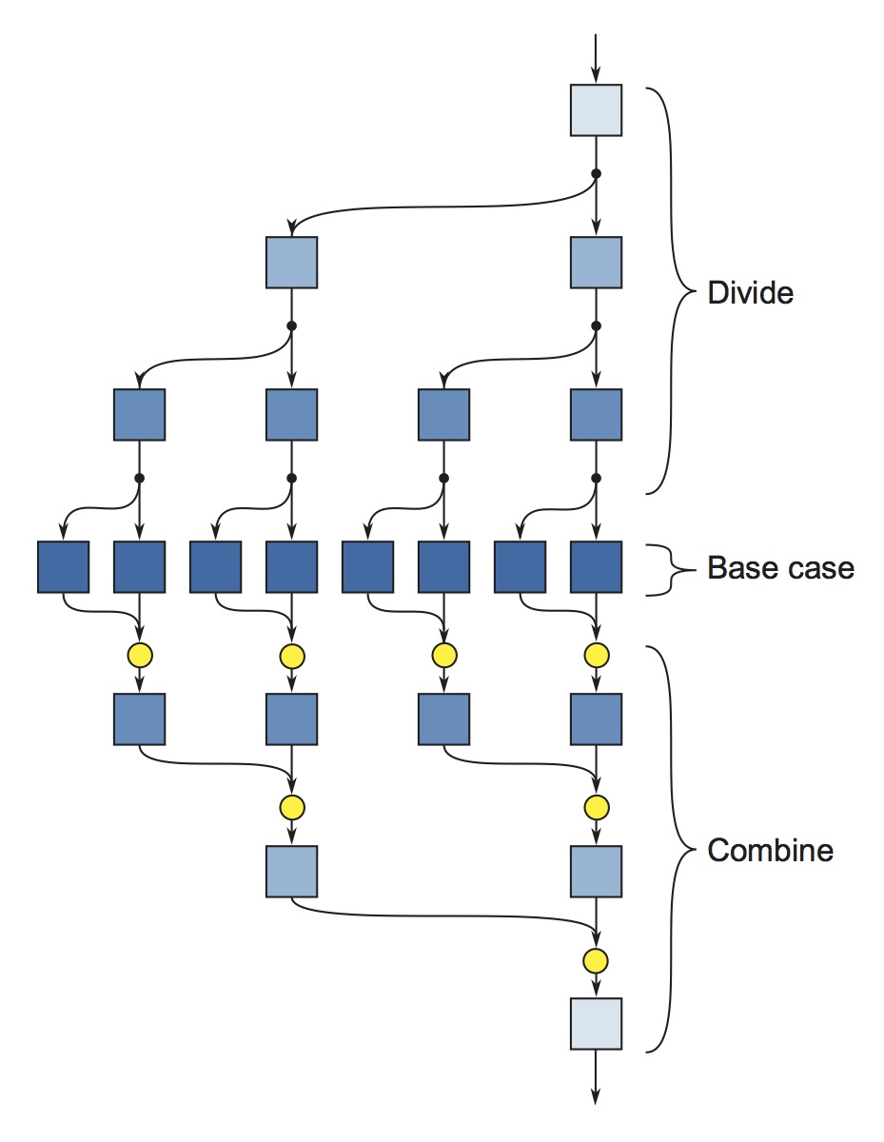
Recursive Fork Join

Slide 6
Fork Join
Simple Idea for Concurrency
“fork” new tasks
“join to delay execution until forked tasks have finished

Slide 7
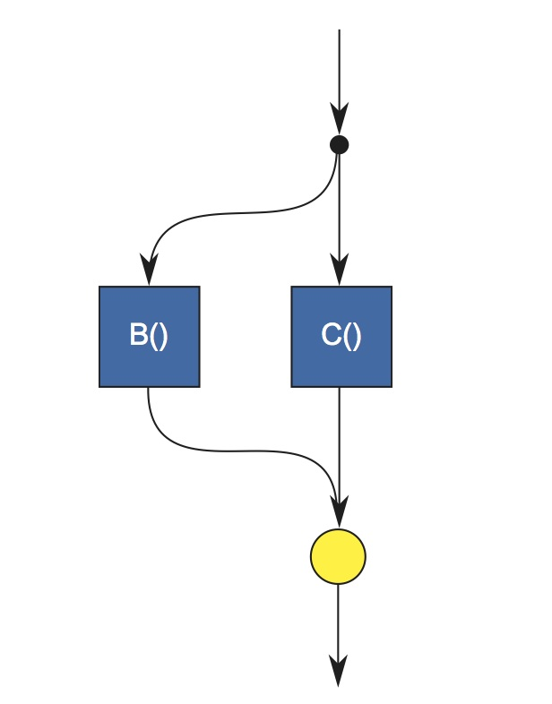
Fork Join Control Flow
fork B();
C();
join

Slide 8
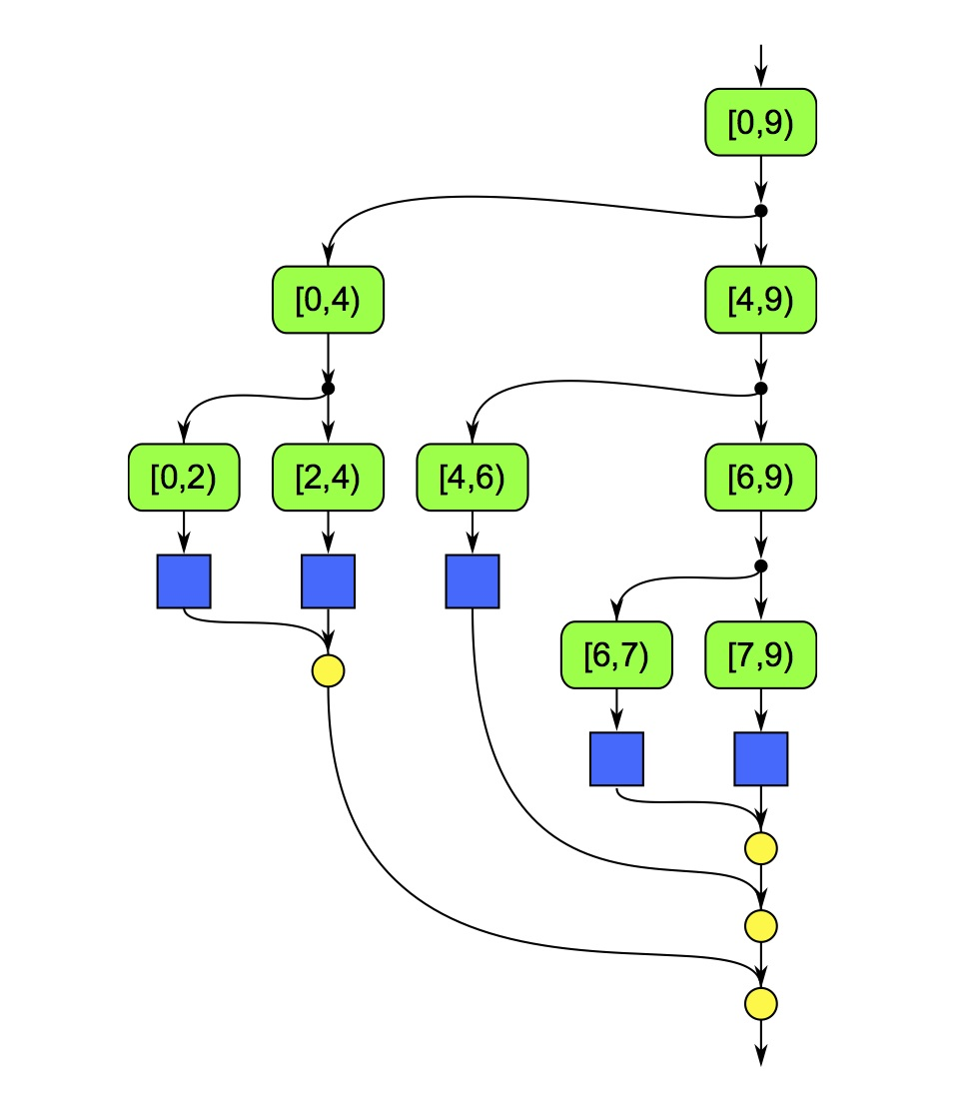
Executing Map as Fork/Join

Slide 9
Work Stealing
The runtimes for TBB/CilkPlus do something known as work stealing
Each worker thread has a queue of tasks
When a call to fork is executed, the thread puts the task on its queue
This provides good locality…but can cause starvation
So, if a thread runs out of work, it “steals” some tasks from a different queue

Slide 10
Steal Continuation vs. Steal Child
TBB and CilkPlus handle fork in different ways
Given code of the form:
fork f();
g();
join;
A TBB thread would put f() on its queue and then execute g(). It would only start working on the queue when it got to the join.
A Cilk thread would put both f() and the remainder of the program (g(); join; etc) on its queue. It is probable that it will execute f() before g().

Slide 11
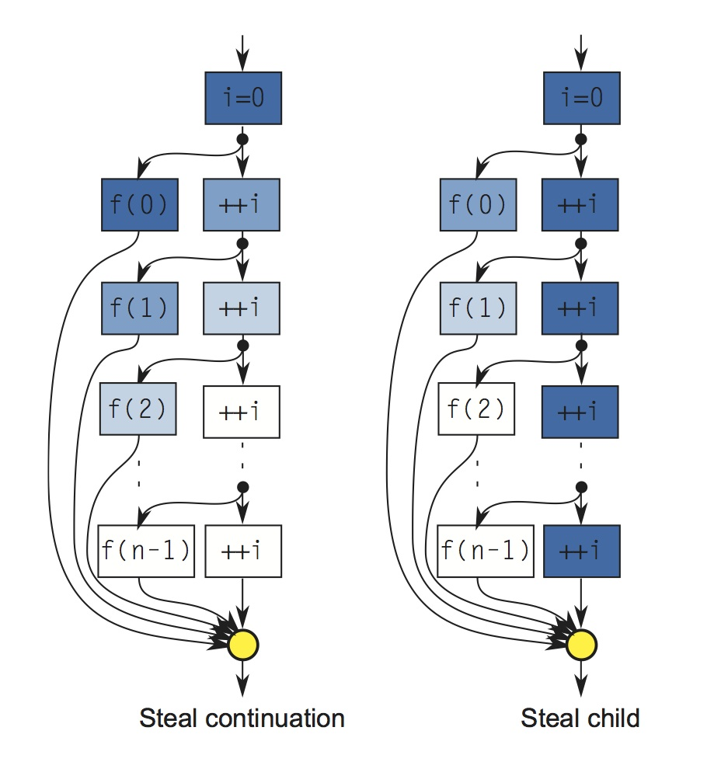
Steal Continuation vs. Steal Child
Steal Continuation
Steal Child

Slide 12
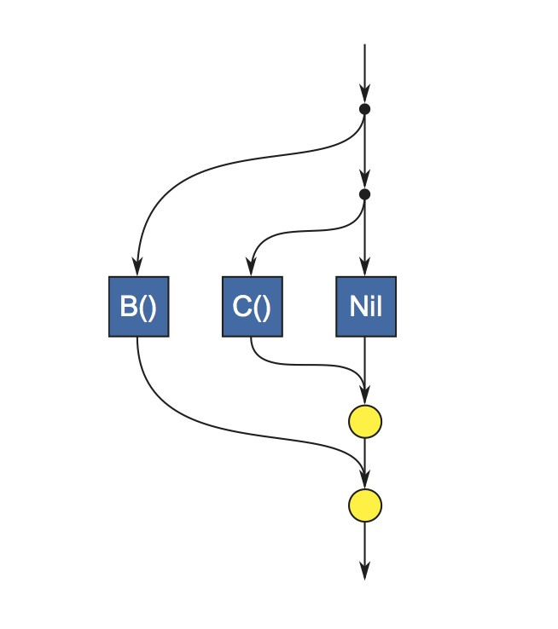
Extra Forking
Simple Idea for Concurrency
“fork” new tasks
“join” to delay execution until forked tasks have finished
Don’t do this!

Slide 13
Performance of Fork/Join
Let A||B be interpreted as “fork A, do B, and join”
Work: T(A||B)₁ = T(A)₁ + T(B)₁
Span: T(A||B)∞ = max(T(A)∞, T(B)∞)
From these you can figure out the Work/Span of algorithms using the asymptotic analysis technique you learned in CIS 315/621

