Slide 1

Fork-Join Pattern
Parallel Computing
CIS 410/510
Department of Computer and Information Science

Slide 2
Fibonacci
Recursive Fibonacci is simple and inefficient
long fib(int n){
if(n < 2) return 1;
else {
long x = fib(n–1);
long y = fib(n-2);
return x+y
}
}
CIS 410/510: Parallel Computing, University of Oregon, Spring 2014
<number>

Slide 3
Fibonacci...
Recursive Fibonacci is simple and inefficient
But it does have the property that the sub-calls are independent
Can we parallelize it?
CIS 410/510: Parallel Computing, University of Oregon, Spring 2014
<number>

Slide 4
Fibonacci...in Parallel?
long fib(int n){
if(n < 2) return 1;
else {
long x = fork fib(n–1);
long y = fib(n-2);
join;
return x+y
}
}
CIS 410/510: Parallel Computing, University of Oregon, Spring 2014
<number>

Slide 5
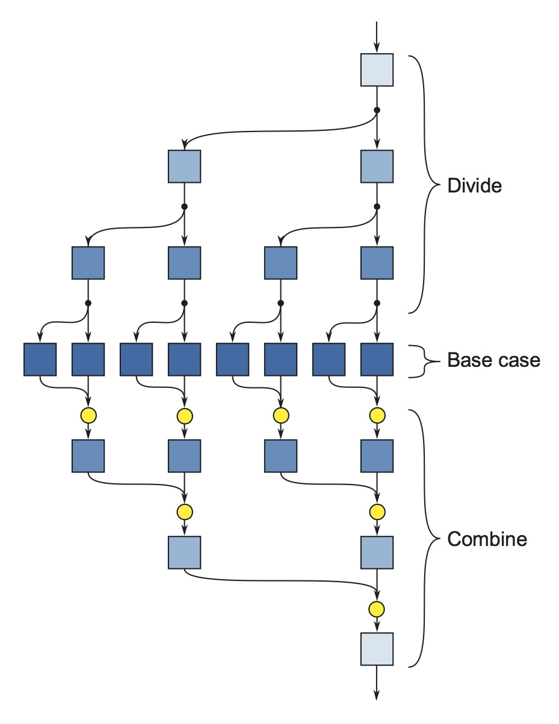
Recursive Fork Join
CIS 410/510: Parallel Computing, University of Oregon, Spring 2014
<number>

Slide 6
Fork Join
Simple Idea for Concurrency
“fork” new tasks
“join” to delay execution until forked tasks have finished
CIS 410/510: Parallel Computing, University of Oregon, Spring 2014
<number>

Slide 7
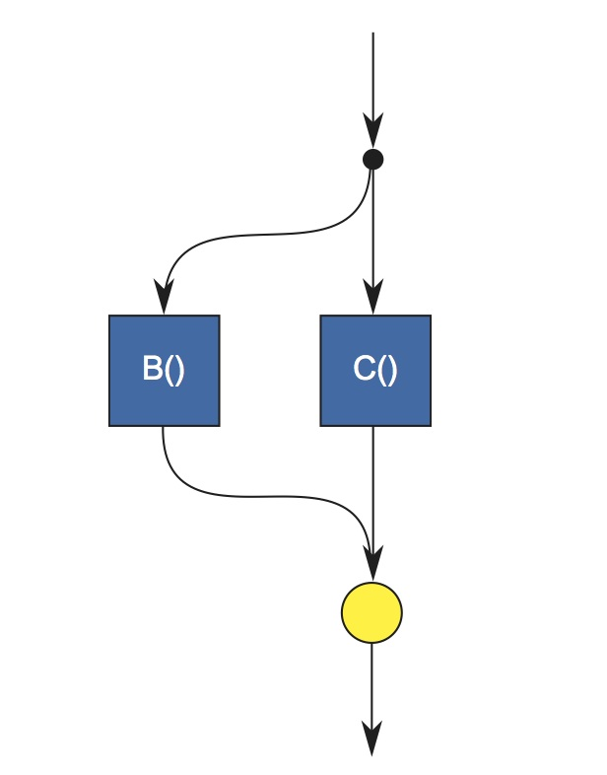
Fork Join Control Flow
fork B();
C();
join;
CIS 410/510: Parallel Computing, University of Oregon, Spring 2014
<number>

Slide 8
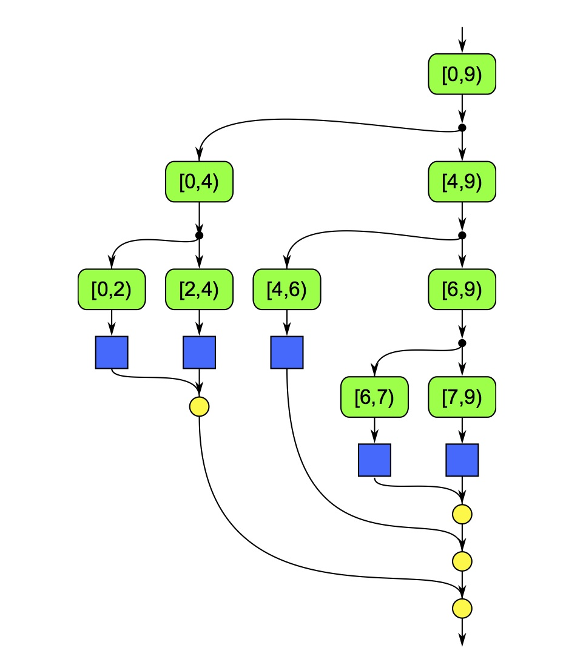
Executing map as fork/join
CIS 410/510: Parallel Computing, University of Oregon, Spring 2014
<number>

Slide 9
Working Stealing
The runtimes for TBB/Cilkplus do something known as work stealing
Each worker thread has a queue of tasks
When a call to fork is executed the thread puts that task on its queue
This provides good locality...but can cause starvation
So, if a thread runs out of work, it “steals” some tasks from a different queue
CIS 410/510: Parallel Computing, University of Oregon, Spring 2014
<number>

Slide 10
Working Stealing
The runtimes for TBB/Cilkplus do something known as work stealing
Each worker thread has a queue of tasks
When a call to fork is executed the thread puts that task on its queue
This provides good locality...but can cause starvation
So, if a thread runs out of work, it “steals” some tasks from a different queue
CIS 410/510: Parallel Computing, University of Oregon, Spring 2014
<number>

Slide 11
Steal Continuation vs Steal Child
TBB and Cilkplus handle fork in different ways
Given code of the form
fork f();
g();
join;
A TBB thread would put f() on its queue and then execute g(); It would only starting working on the queue when it got to the join;
A Cilk thread would put both f() and the remainder of the program (g(); join; etc) on its queue. It is probable that it will execute f() before g()
CIS 410/510: Parallel Computing, University of Oregon, Spring 2014
<number>

Slide 12
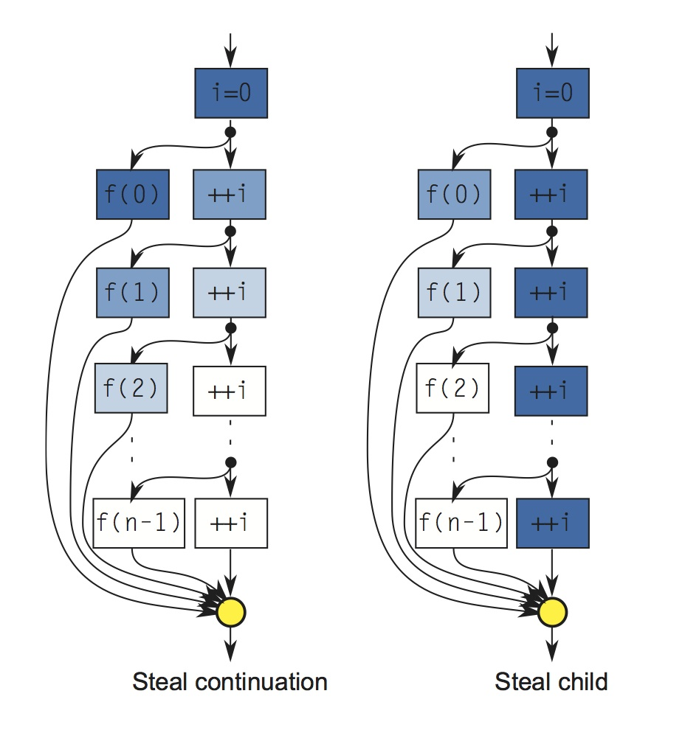
Steal Continuation vs Steal Child
CIS 410/510: Parallel Computing, University of Oregon, Spring 2014
<number>

Slide 13
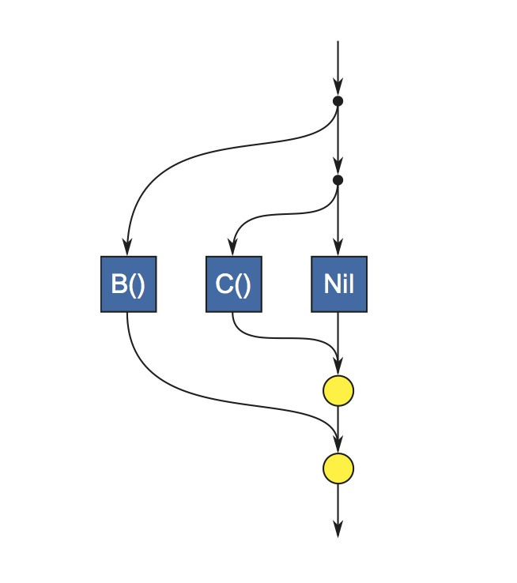
Extra Forking
Simple Idea for Concurrency
“fork” new tasks
“join” to delay execution until forked tasks have finished
Don't do this!
CIS 410/510: Parallel Computing, University of Oregon, Spring 2014
<number>

Slide 14
Performance of Fork/Join
Let A||B be interpreted as ``fork A, do B, and join”
Work: T(A||B)_1 = T(A)_1 + T(B)_1
Span: T(A||B)_infintiy = max(T(A)_infinity,T(B)_infinity)
From these you can figure out the Work/Span of algorithms using the asymptotic analysis technique you learned in 315/621
CIS 410/510: Parallel Computing, University of Oregon, Spring 2014
<number>

