Slide 1

Collectives Pattern
Parallel Computing
CIS 410/510
Department of Computer and Information Science

Slide 2
Reduce

Slide 3
Summing an Array
long sum = 0;
for (int n = 0, n < size, ++m){
sum += arr[n]
}
Fully Sequential
CIS 410/510: Parallel Computing, University of Oregon, Spring 2014

Slide 4
How do we do it in parallel?
Divide and conquer!
Basic algorithm:
Split array into two parts
Sum each part (in parallel)
Return the sum of the two parts
Why does this work?
How can we generalize?
CIS 410/510: Parallel Computing, University of Oregon, Spring 2014

Slide 5
Summing an Array Recursively
long sum(int *arr,size_t size){
if (size == 0) return 0;
else return arr[0] + sum(&arr[1],size – 1);
}
Back to being sequential...
CIS 410/510: Parallel Computing, University of Oregon, Spring 2014

Slide 6
Right to Left Reduction
We can generalize the sum example!
Work over a triple (T,R,h,z)
T is the type of elements in the array
R is the type we want to return
h is a function T*R → R ..that is it takes a T and a R and return an R
z is an element of type R
We apply h to the first element of array, together with the reduction of the rest of the array
Right to left—computes the sum over the rest of the array first
CIS 410/510: Parallel Computing, University of Oregon, Spring 2014

Slide 7
C++ Right Reduction
template<class T, class R, class H> R reduce(H h,R z,T* arr,size_t size){
if (size == 0) return z;
else return h(arr[0],reduce(h,z&arr[1],size – 1));
}
Generalization!
sum(arr,size) = reduce([](int n,long m){return n+m},0,arr,size)
Note that we need the z: it is how we handle empty arrays
CIS 410/510: Parallel Computing, University of Oregon, Spring 2014

Slide 8
What about the parallel sum?
We could make sum happen in parrallel, can we do this in general?
reduce(h,z,[1,2,3,4,5],4) = h(1,h(2,h(3,h(4,h(5,z)))))
The parallel sum would be more like
h(h(h(1,2),h(3,4)),h(5,z))
This might compute something totally different
It is might not even have the same types (requires T = R)
CIS 410/510: Parallel Computing, University of Oregon, Spring 2014

Slide 9
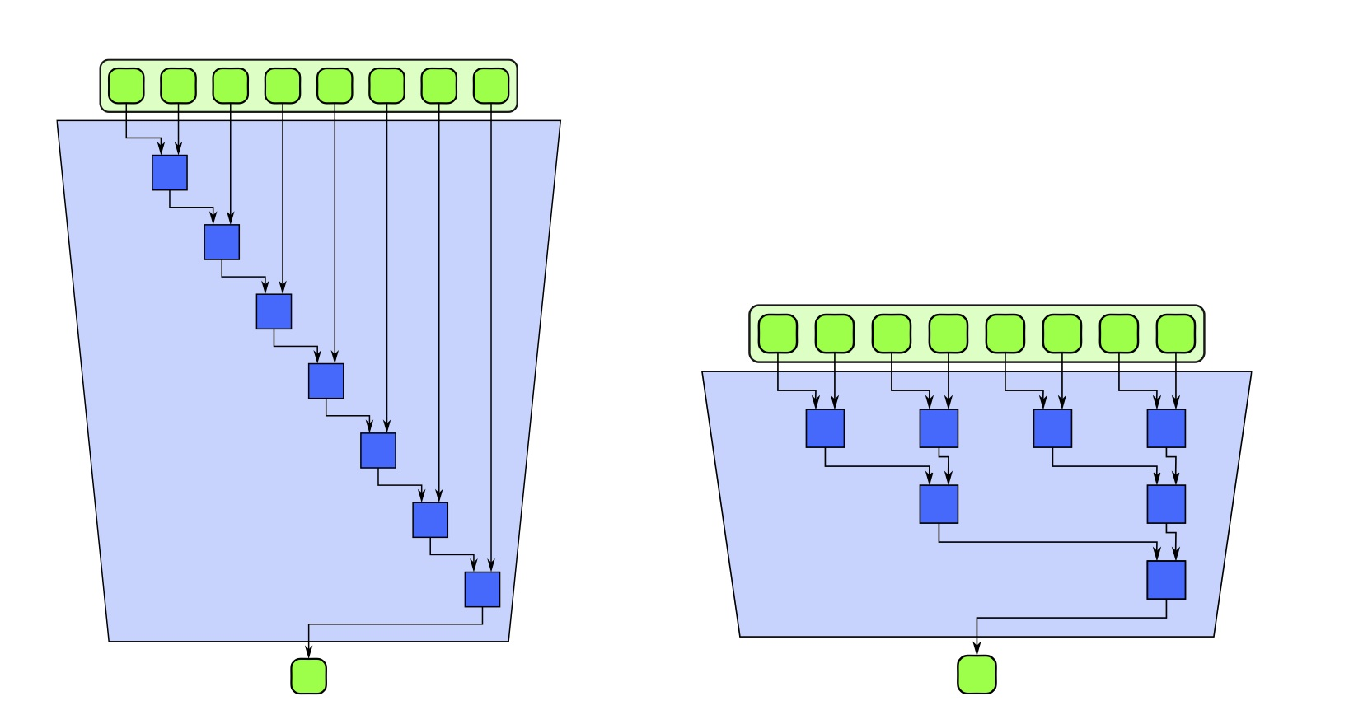
What is going on?
Right reduce is list structured
A “parallel reduce” has to be tree structured
CIS 410/510: Parallel Computing, University of Oregon, Spring 2014

Slide 10
Sum Simple Algebra
Associativity property
(x + y) + z = x + (y + z)
Examples: Addition, Multiplication
Commutativity Property
x + y = y + z
Examples: Addition, Multiplication of Integers
Counter Examples: Multiplication of Matrices
CIS 410/510: Parallel Computing, University of Oregon, Spring 2014

Slide 11
Monoids
A monoid is a triple (S,+,0) S is a set
S is a set
+ is an operation on S (not necessarily addition)
0 is an elements of S (not necessarily 1)
Such that
Associativity: forall x,y,z in S, (x + y) + z = x + (y + z)
Identity: forall x in S, 0 + x = x + 0 = x
Not necessarily commutative
CIS 410/510: Parallel Computing, University of Oregon, Spring 2014

Slide 12
Many Many Monoids
(Z,+,0) where Z is the integers and +,0 are the usual meaning of those
(R,+,0) where R is the reals
(Z,*,1) that is, multiplication of integers
(Real Valued 2-2 matrices,matrix multiplication,the identity matrix)
For any set S: ({f | f : S → S},function composition, the identity function)
(Strings over an alphabet, string concatenation, empty string)
...
CIS 410/510: Parallel Computing, University of Oregon, Spring 2014

Slide 13
Many Many Monoids
(Z,+,0) where Z is the integers and +,0 are the usual meaning of those
(R,+,0) where R is the reals
(Z,*,1) that is, multiplication of integers
(Real Valued 2-2 matrices,matrix multiplication,the identity matrix)
For any set S: ({f | f : S → S},function composition, the identity function)
(Strings over an alphabet, string concatenation, empty string)
…
(If you have taken abstract algebra: every group is a monoid)
CIS 410/510: Parallel Computing, University of Oregon, Spring 2014

Slide 14
Arbitrary Order Reduction
CIS 410/510: Parallel Computing, University of Oregon, Spring 2014

Slide 15
Performance of Parallel Reduction
Looks Like:
Work : O(n)
Span : O(n*log(n)
But slight nuance...
These numbers are not the number of calls to worker function (+) not the total time
We will come back to this!
CIS 410/510: Parallel Computing, University of Oregon, Spring 2014

Slide 16
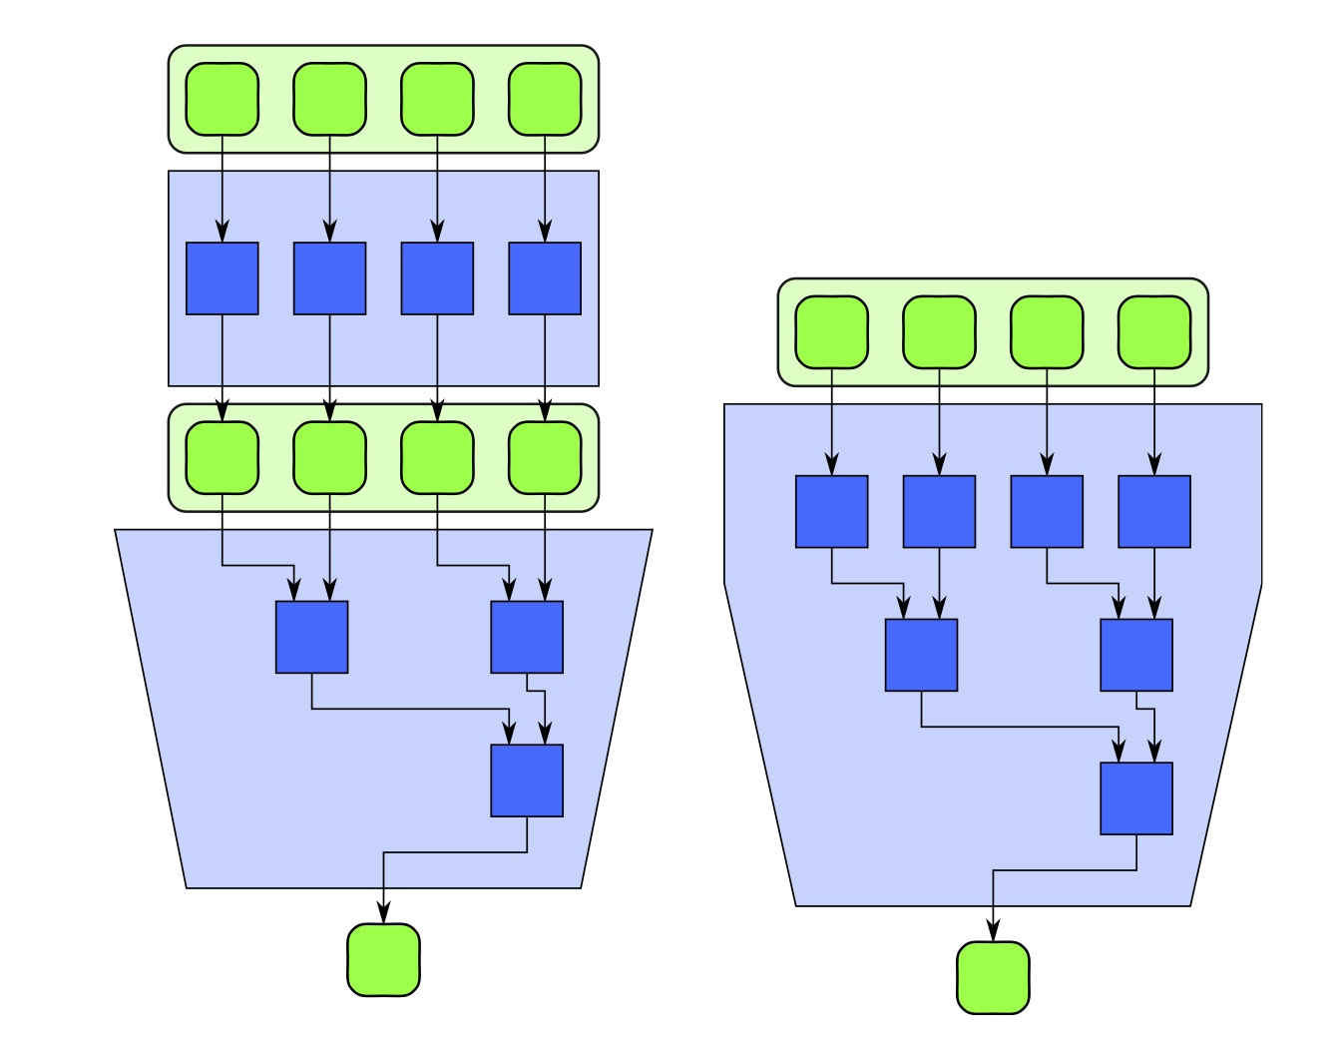
Map/Reduce Fusion
Map then Fuse pattern very common
Fuse them!
CIS 410/510: Parallel Computing, University of Oregon, Spring 2014

Slide 17
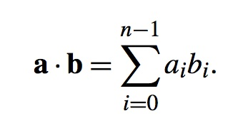
Example: Dot Product
2 vectors of same length
Map (*) to multiply the components
Then reduce with (+) to get the final answer
CIS 410/510: Parallel Computing, University of Oregon, Spring 2014

Slide 18
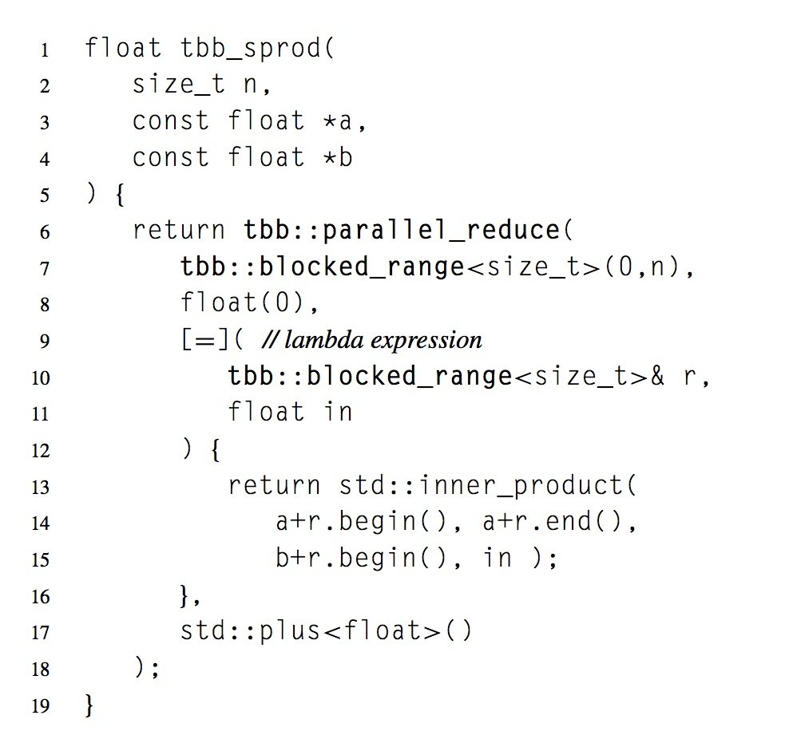
Dot Product in TBB
CIS 410/510: Parallel Computing, University of Oregon, Spring 2014

Slide 19
Merge Sort as a reduction
Define the monoid (S,<>,[]) where
S is the set of in order vectors over some type
<> is the merge operation: [1,3,5,7] <> [2,6,15] = [1,2 ,3,5,6,7,15]
[] is the empty list
We can sort an array via a pair of a map and a reduce
Map each element into a vector containing just that element
Reduce using the monoid above
How fast is this?
CIS 410/510: Parallel Computing, University of Oregon, Spring 2014

Slide 20
Right Biased Sort
Start with [14,3,4,8,7,52,1]
Map to [[14],[3],[4],[8],[7],[52],[1]]
Reduce:
[14] <> ([3] <> ([4] <> ([8] <> ([7] <> ([52] <> [1])))))
= [14] <> ([3] <> ([4] <> ([8] <> ([7] <> [1,52]))))
= [14] <> ([3] <> ([4] <> ([8] <> [1,7,52])))
= [14] <> ([3] <> ([4] <> [1,7,8,52]))
= [14] <> ([3] <> [1,4,7,8,52])
= [14] <> [1,3,4,7,8,52]
= [1,3,4,7,8,14,52]
CIS 410/510: Parallel Computing, University of Oregon, Spring 2014

Slide 21
Right Biased Sort Cont
How long did that take?
Well we did O(n) merges...but each one took O(n) time
O(n^2)
We wanted merge sort, but instead we got insertion sort!
CIS 410/510: Parallel Computing, University of Oregon, Spring 2014

Slide 22
Tree Shape Sort
Start with [14,3,4,8,7,52,1]
Map to [[14],[3],[4],[8],[7],[52],[1]]
Reduce:
(([14] <> [3]) <> ([4] <> [8])) <> (([7] <> [52]) <> [1])
= ([3,14] <> [4,8]) <> ([7,52] <> [1])
= [3,4,8,14] <> [1,7,52]
= [1,3,4,7,8,14,52]
CIS 410/510: Parallel Computing, University of Oregon, Spring 2014

Slide 23
Tree Shaped Sort Performance
Even if we only had a single processor this is better
We do O(log n) merges
Each one is O(n)
So O(n*log(n))
But opportunity for parallelism is not so great
O(n) assuming sequential merge
We will explore parallel merging later in the class
Takeaway: The shape of the Reduction matters!
CIS 410/510: Parallel Computing, University of Oregon, Spring 2014

Slide 24
Shape Matters
Often tree based reductions are slower.
In fact, any reduction can be rewritten using monoids...but the cost of the operation won't be a constant
Parallel reduction is suitable for problems where you have
Cost free associativity (like adding number)
Or tree based reduction is better (like merging)
CIS 410/510: Parallel Computing, University of Oregon, Spring 2014

Slide 25
Scan

Slide 26
Prefix Sums
What if instead of summing a list we wanted to compute all the prefix sums?
int * results = malloc(sizeof(int)*size);
int temp = 0;
for (int n = 0, n < size, ++n){
temp += arr[n];
results[n] = temp;
}
[1,2,3,4,5] → [1,3,6,10,15]
CIS 410/510: Parallel Computing, University of Oregon, Spring 2014

Slide 27
Semi-Groups
A pair (S,+) where
S is a set
+ is a binary operation on S
Is a semi-group if + is associative
Unlike Monoids we don't require identity
Every Monoid is a semi-group, but not vice versa!
CIS 410/510: Parallel Computing, University of Oregon, Spring 2014

Slide 28
Scans
Scan operation generalizes prefix sum
Parameterized by a semi-group.
Scan is often the trick to turn algorithm that seems to have sequential data dependencies into a parallel algorithm
CIS 410/510: Parallel Computing, University of Oregon, Spring 2014

Slide 29
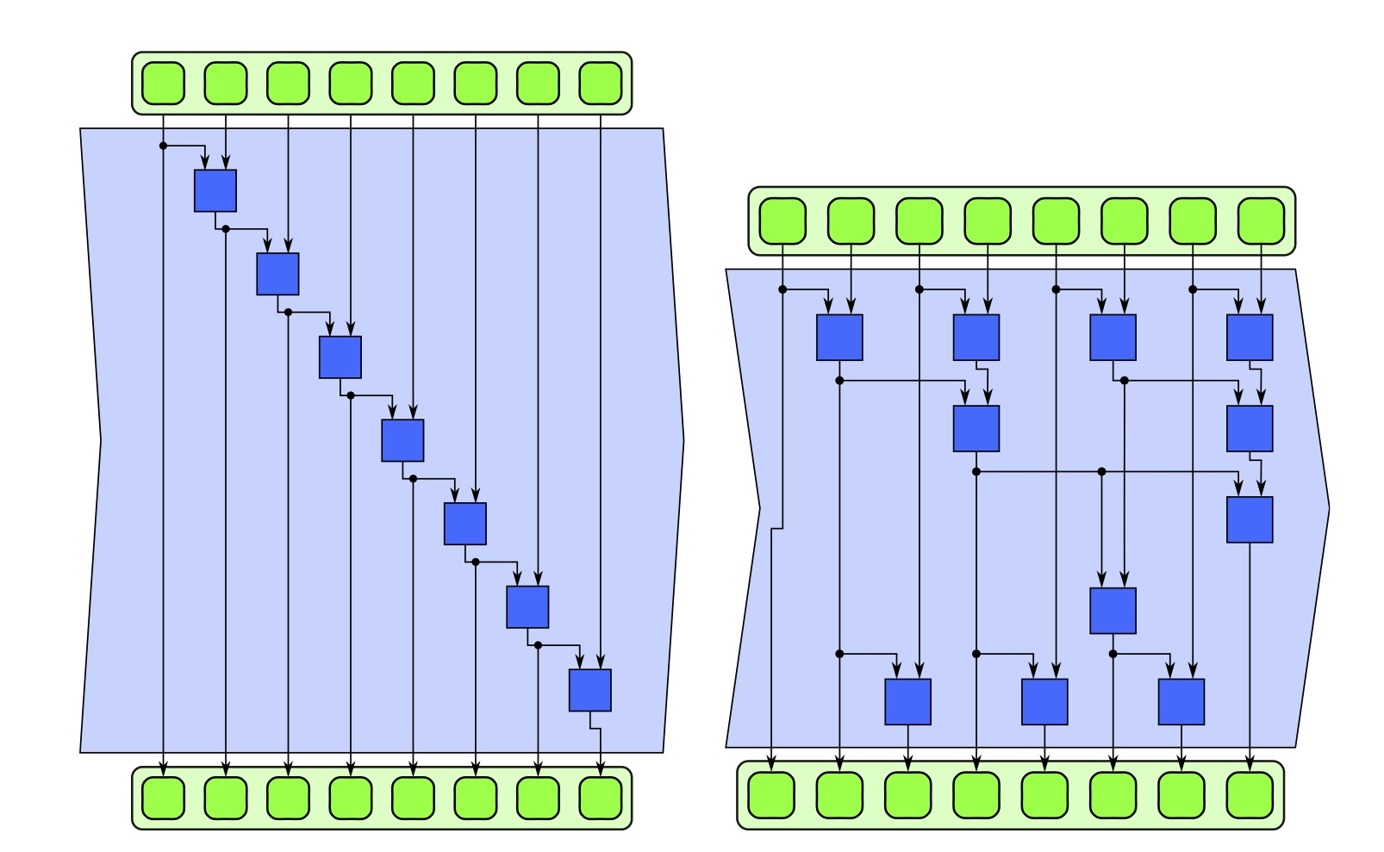
Scans
CIS 410/510: Parallel Computing, University of Oregon, Spring 2014

Slide 30
Binary Addition
Given two bit vectors of length n compute there sum
1010 + 0111 = 10001
Standard Algorithm you learned in elementary school
Add from least significant digit to most significant digit
Keep track of carrying
Very sequential: O(n)
Can we do better?
CIS 410/510: Parallel Computing, University of Oregon, Spring 2014

Slide 31
Binary Addition of Single Bits
Single Bit addition
0 + 0 → 00
0 + 1 → 01
1 + 0 → 01
1 + 1 → 10
Note that we produce carries.
CIS 410/510: Parallel Computing, University of Oregon, Spring 2014

Slide 32
Clever Carrying
Single Bit addition assumes we don't have a carry
What if we do?
Single Bit addition assuming a carry
0 + 0 → 01
0 + 1 → 10
1 + 0 → 10
1 + 1 → 11
Note that we produce carries.
CIS 410/510: Parallel Computing, University of Oregon, Spring 2014

Slide 33
Clever Carrying
Single Bit addition assumes we don't have a carry
What if we do?
Single Bit addition assuming a carry
0 + 0 → 01
0 + 1 → 10
1 + 0 → 10
1 + 1 → 11
CIS 410/510: Parallel Computing, University of Oregon, Spring 2014

Slide 34
Clever Carrying part 2
Single Bit addition behavior depends on if we had a carry!
Single Bit with and without carries
0 + 0 → 00,01
0 + 1 → 01,10
1 + 0 → 01,10
1 + 1 → 10,11
CIS 410/510: Parallel Computing, University of Oregon, Spring 2014

Slide 35
Clever Carrying part 3
We can classify these pairs in terms of
“generates a carry” (G)
“preserves the carry given to it, but does not produce one” (P)
“does not produce a carry” N
Single Bit carrying behavior
0 + 0 → N
0 + 1 → P
1 + 0 → P
1 + 1 → G
CIS 410/510: Parallel Computing, University of Oregon, Spring 2014

Slide 36
The Carrying Semi-Group
The set { P,N,G} forms a semi group under the operation <>
P <> x → x
G <> _ → G
N <> _ → N
Here _ means “any element”
CIS 410/510: Parallel Computing, University of Oregon, Spring 2014

Slide 37
Multi Bit Carrying
We can expand this to multiple bits
11 + 01 always generates a carry (G)
01 + 01 never generates a carry (N)
01 + 10 preserves a carry (P)
AB + CD works in the following way:
A+B → G means AB + CD → G
A+B → N means AB + CN → N
A+B → P means that AB + CD does the same thing as ever B+D
AB + CD
CIS 410/510: Parallel Computing, University of Oregon, Spring 2014

Slide 38
Computing the carry
If we want to compute the carry behavior of the sum of binary numbers
1010100101 + 0101011100
We can do it by first computing the carries pairwise
PPPPPPPGNP
And then using the semi-group structure
((P <> P) <> (P <> P)) <> (((P <> P) <> (P <> G)) <> (N <> P))
= (P <> P) <> (( P <> G) <> N) = P <> (G <> N) = P <> G
= G
Thus we know this example produces a carry
CIS 410/510: Parallel Computing, University of Oregon, Spring 2014

Slide 39
Look Ahead Carry Addition
We can take this idea to produce an algorithm for binary addition
We write all numbers “backwards” (least significant digit to most significant)
Use map to compute a {P,N,G} array
Scan over this array with <> producing an array C
Use map to compute the result
parallel_for(int n = 1, n < len, ++n){
if (R[n – 1] == G) R[n] = A[n] ^ B[n];
else R[n] = !(A[n]^B[n])
}
CIS 410/510: Parallel Computing, University of Oregon, Spring 2014

Slide 40
Scan Performance
Sequential scan calls the function O(n) times
Parallel scan is calls the function
Span: O(log n)
Work: O(n*log n)
Unlike other patterns we have to do extra work to be parallel
But, scan is broadly applicable. If you can't make an algorithm parallel, scan is often a good place to look
CIS 410/510: Parallel Computing, University of Oregon, Spring 2014

