Slide 1

Stencil Pattern
Parallel Computing
CIS 410/510
Department of Computer and Information Science

Slide 2
Table of Contents
What is the stencil pattern?
Implementing stencil with shift
Stencil and cache optimizations
Stencil and communication optimizations
Recurrence

Slide 3
Table of Contents
What is the stencil pattern?
Implementing stencil with shift
Stencil and cache optimizations
Stencil and communication optimizations
Recurrence

Slide 4
What is the stencil pattern?
Stencil: A map where each output depends on a “neighborhood” of inputs. These inputs are a set of fixed offsets relative to the output position.
A stencil output is a function of a “neighborhood” of elements in an input collection

Slide 5
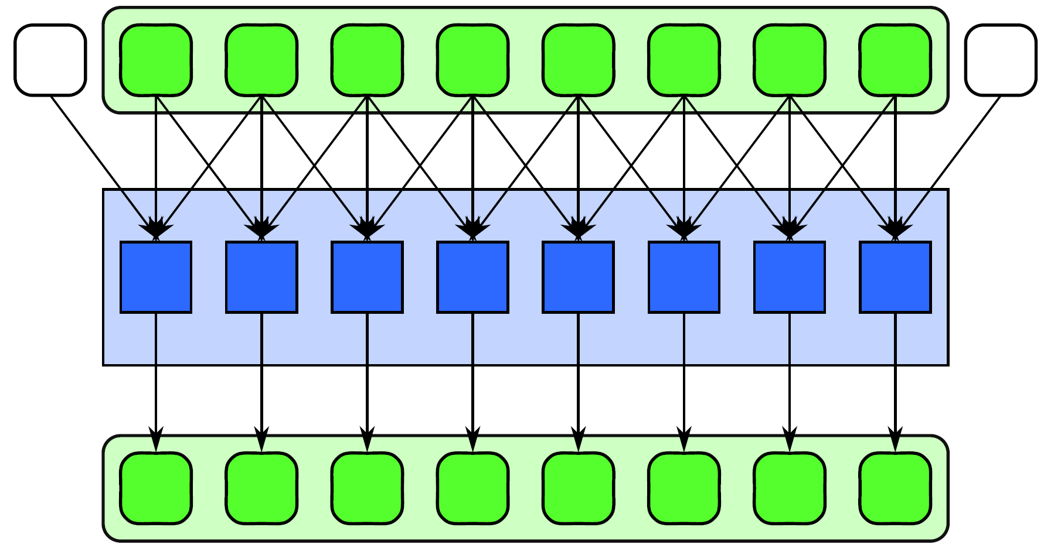
What is the stencil pattern?

Slide 6
What is the stencil pattern?
Input array

Slide 7
What is the stencil pattern?
Function

Slide 8
What is the stencil pattern?
Output Array

Slide 9
What is the stencil pattern?
i-1
i
i+1
This stencil takes the i-1, i, i+1 elements…

Slide 10
What is the stencil pattern?
Applies some function to them…

Slide 11
What is the stencil pattern?
And outputs to the i^{th} position of the output array

Slide 12
What is the stencil pattern?
Stencils can operate on one dimensional and multidimensional data
Stencil neighborhoods can range from compact to sparse, square to cube, and anything else!

Slide 13
What is the stencil pattern?
Practice!

Slide 14
What is the stencil pattern?
Here is our array, A
0
0
0
0
0
9
7
0
0
6
4
0
0
0
0
0

Slide 15
What is the stencil pattern?
Here is our array, A
Apply a stencil operation to the inner square of the form:
(i,j) = avg((i,j), (i-1,j), (i+1,j), (i,j-1), (i,j+1))
0
0
0
0
0
9
7
0
0
6
4
0
0
0
0
0

Slide 16
What is the stencil pattern?
Average all blue squares
0
0
0
0
0
9
7
0
0
6
4
0
0
0
0
0

Slide 17
What is the stencil pattern?
Average all blue squares
Store result in red square
0
0
0
0
0
9
7
0
0
6
4
0
0
0
0
0

Slide 18
What is the stencil pattern?
Average all blue squares
Store result in red square
Repeat 1 and 2 for all green squares
0
0
0
0
0
9
7
0
0
6
4
0
0
0
0
0

Slide 19
What is the stencil pattern?
Average all blue squares
Store result in red square
Repeat 1 and 2 for all green squares
0
0
0
0
0
9
7
0
0
6
4
0
0
0
0
0

Slide 20
What is the stencil pattern?
Output!
How would we parallelize this?
4.4
4
3.8
3.4

Slide 21
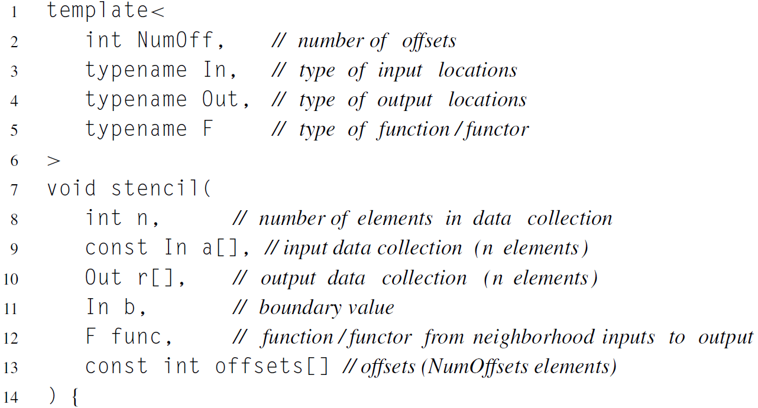
Serial Stencil Example (part 1)

Slide 22
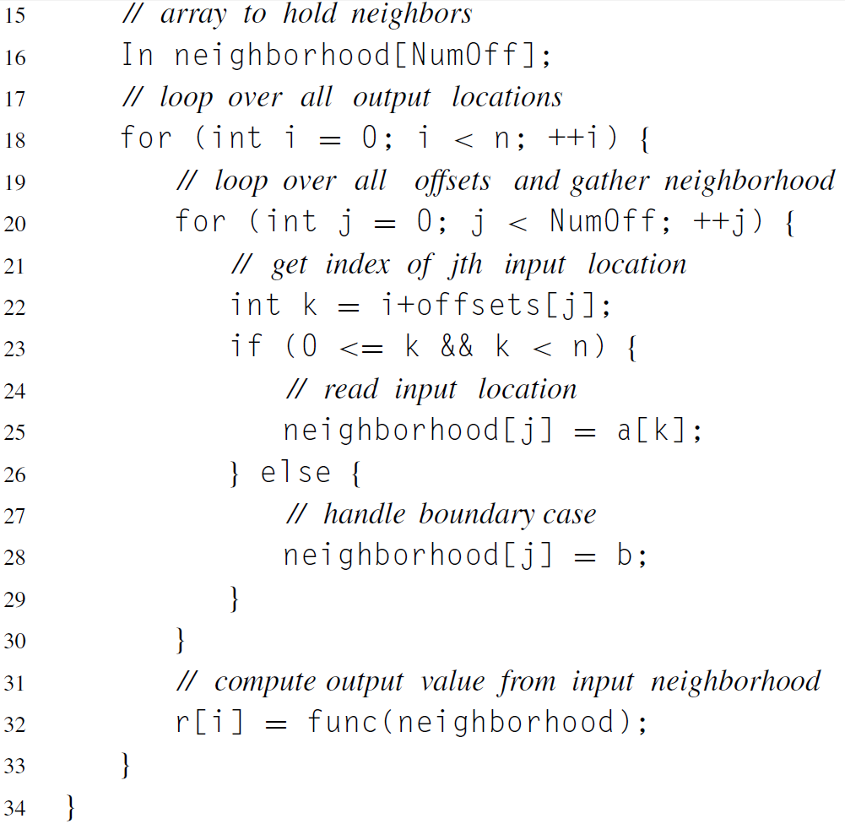
Serial Stencil Example (part 2)

Slide 23
Parallel Stencil Example

Slide 24
Table of Contents
What is the stencil pattern?
Implementing stencil with shift
Stencil and cache optimizations
Stencil and communication optimizations
Recurrence

Slide 25
Implementing Stencil with Shift
One possible implementation of the stencil pattern includes shifting the input data
For each offset in the stencil, we gather a new input vector by shifting the original input by the offset amount

Slide 26
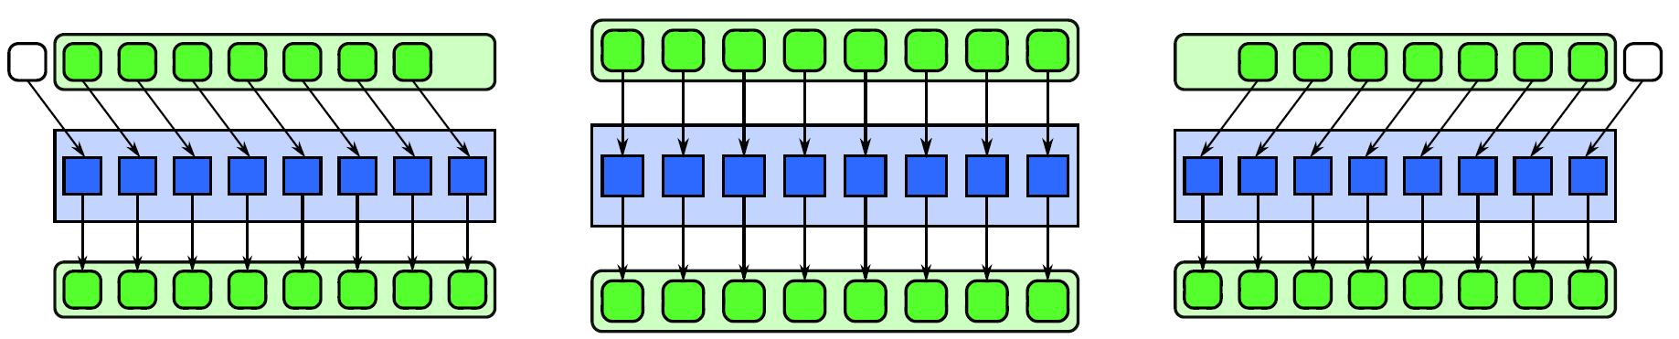
Implementing Stencil with Shift
All input arrays are derived from the same original input array
0
1
2
3
4
5
6
7
1
2
3
4
5
6
7
8
2
3
4
5
6
7
8
9
1
2
3
4
5
6
7
8
1
2
3
4
5
6
7
8
1
2
3
4
5
6
7
8

Slide 27
Implementing Stencil with Shift
This implementation is only beneficial for one dimensional stencils or the memory-contiguous dimension of a multidimensional stencil
Memory traffic to external memory is not reduced with shifts
But, shifts allow vectorization of the data reads, which may reduce the total number of instructions

Slide 28
Table of Contents
What is the stencil pattern?
Implementing stencil with shift
Stencil and cache optimizations
Stencil and communication optimizations
Recurrence

Slide 29
Stencil and Cache Optimizations
Assuming 2D array where rows are contiguous in memory…
Horizontally related data will tend to belong to the same cache line
Vertical offset accesses will most likely result in cache misses

Slide 30
Stencil and Cache Optimizations
Assigning rows to cores:
Maximizes horizontal data locality
Assuming vertical offsets in stencil, this will create redundant reads of adjacent rows from each core
Assigning columns to cores:
Redundantly read data from same cache line
Create false sharing as cores write to same cache line

Slide 31
Stencil and Cache Optimizations
Assigning “strips” to each core can be a better solution
Strip-mining: an optimization in a stencil computation that groups elements in a way that avoids redundant memory accesses and aligns memory accesses with cache lines

Slide 32
Stencil and Cache Optimizations
A strip’s size is a multiple of a cache line in width, and the height of the 2D array
Strip widths are in increments of the cache line size so as to avoid false sharing and redundant reads
Each strip is processed serially from top to bottom within each core

Slide 33
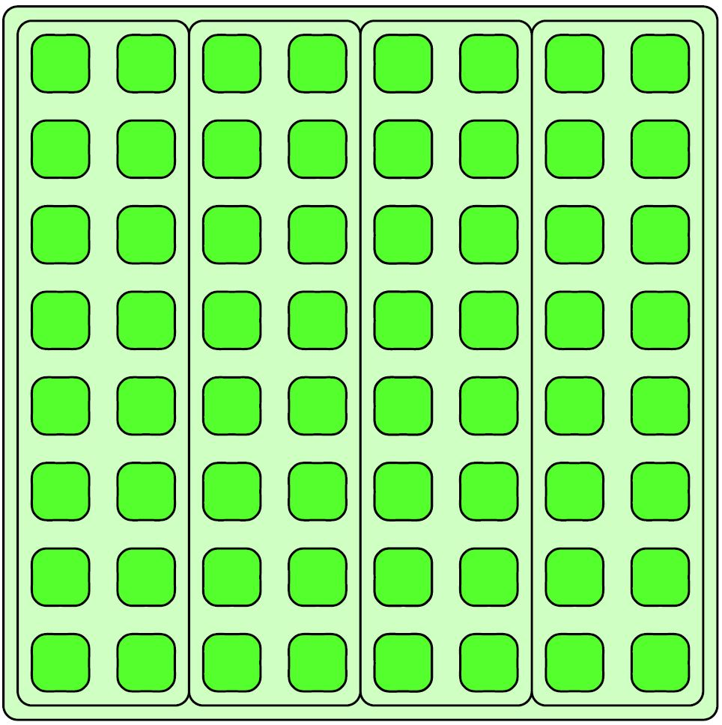
Stencil and Cache Optimizations
m*sizeof(cacheLine)
Height of array

Slide 34
Table of Contents
What is the stencil pattern?
Implementing stencil with shift
Stencil and cache optimizations
Stencil and communication optimizations
Recurrence

Slide 35
Stencil and Communication Optimizations
When data is distributed, overlapping regions (or “ghost cells”) must be explicitly communicated between nodes between loop iterations
Darker cells are PE 0’s ghost cells
After first iteration of stencil computation
PE 1 & PE 2 must send their stencil results to PE 0
PE 0 can perform another iteration of stencil
0
0
0
0
0
PE 0
PE 1
0
9
7
0
PE 2
PE 3
0
6
4
0
0
0
0

Slide 36
Stencil and Communication Optimizations
Generally better to replicate ghost cells in each local memory and swap after each iteration than to share memory
Fine-grained sharing can lead to increased communication cost

Slide 37
Stencil and Communication Optimizations
Halo: set of all ghost cells
Halo must contain all neighbors needed for one iteration
Larger halo (deep halo)
Less communications
More redundant local computation
Latency Hiding: Compute interior of stencil while waiting for ghost cell updates

Slide 38
Table of Contents
What is the stencil pattern?
Implementing stencil with shift
Stencil and cache optimizations
Stencil and communication optimizations
Recurrence

Slide 39
Recurrence
What if we have several nested loops with data dependencies between them when doing a stencil computation?

Slide 40
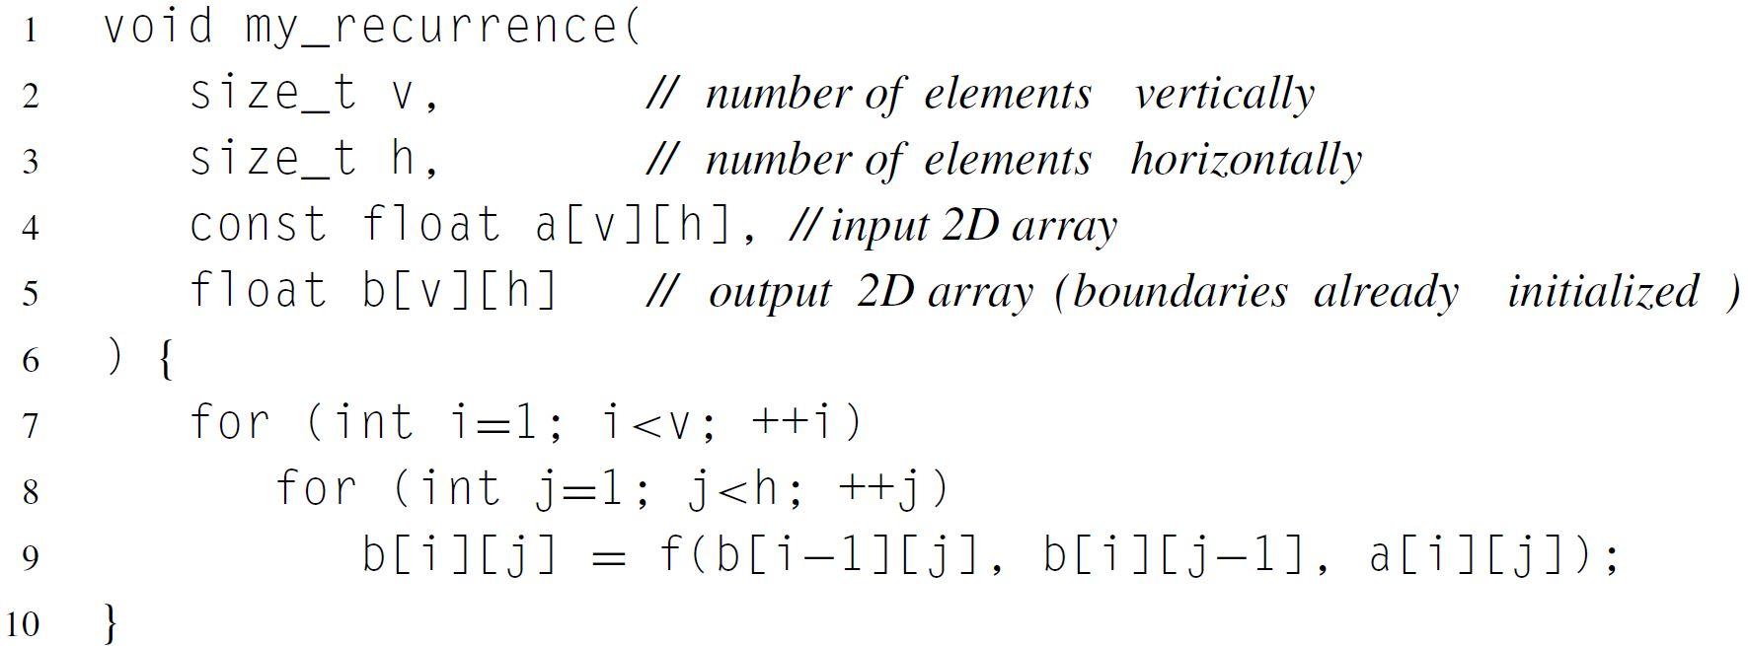
Recurrence

Slide 41
Recurrence
Data dependencies between loops

Slide 42
Recurrence
This can still be parallelized!
Trick: find a plane that cuts through grid of intermediate results
Previously computed values on one side of plane
Values to still be computed on other side of plane
Computation proceeds perpendicular to plane through time (this is known as a sweep)
This plane is called a separating hyperplane

Slide 43
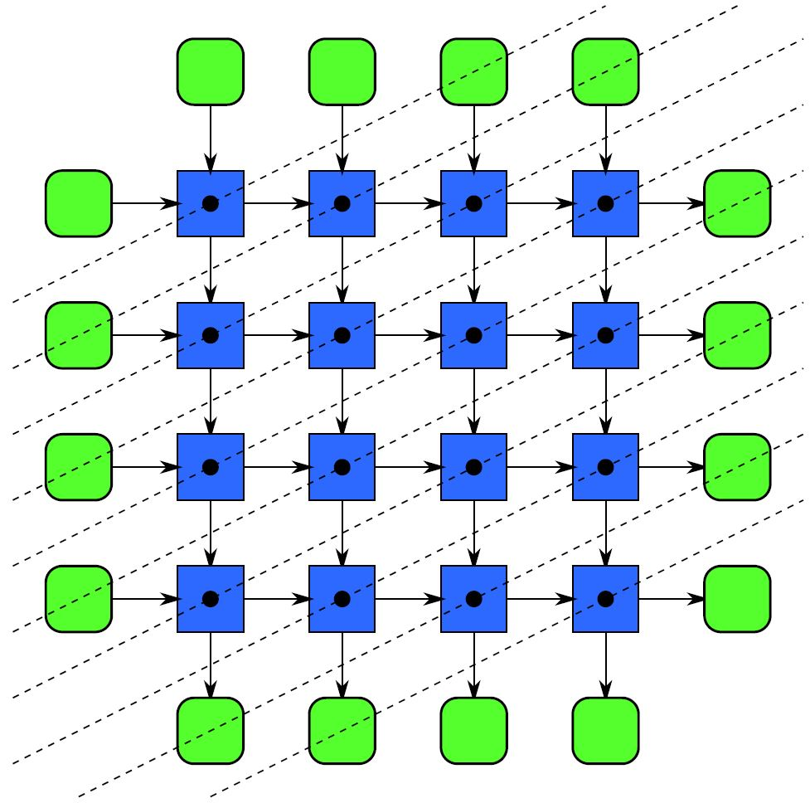
Recurrence
Hyperplanes
Iteration 1
Iteration 2
Iteration 3

Slide 44
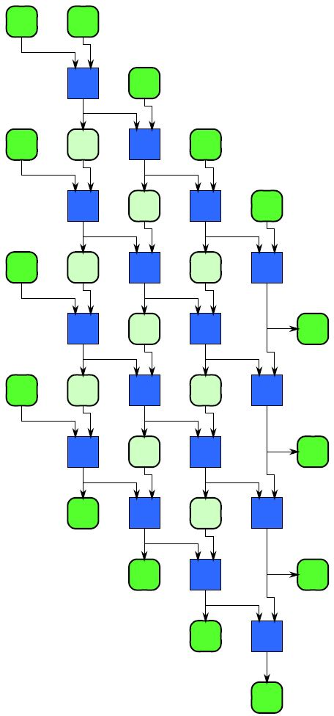
Recurrence
Same grid of intermediate results
Each level corresponds to a loop iteration
Computation proceeds downward

Slide 45
Example Implementation

Slide 46
Conclusion
Examined the stencil and recurrence pattern
Both have a regular pattern of communication and data access
In both patterns we can convert a set of offset memory accesses to shifts
Stencils can use strip-mining to optimize cache use
Ghost cells should be considered when stencil data is distributed across different memory spaces

