Slide 1
Scrubflix - Development
Integrated Development Environments
Microsoft Visual Studio 2015
MySQL Workbench 6.3 CE
Programming Languages
MySQL
ASP.NET
HTML 5
CSS 3
C#.NET
Bootstrap
Frameworks
IIS Express
.NET 4.5.2
MySQL 5.7

Slide 2
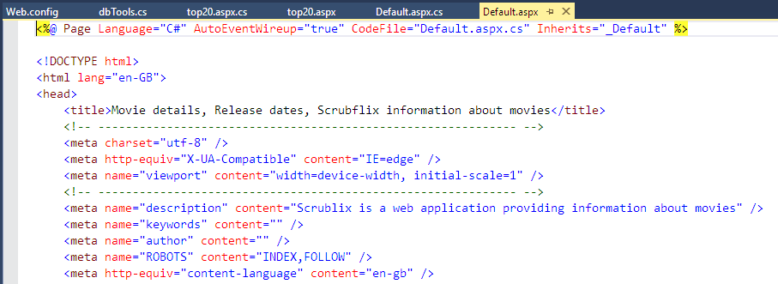
Default.aspx
Each ASP.NET web page has to have a reference to its CodeFile, as this is the code that is executed before a ASP.NET web page is rendered to the screen. This allows in this instance, for the C# .cs code file to interact with a database.

Slide 3
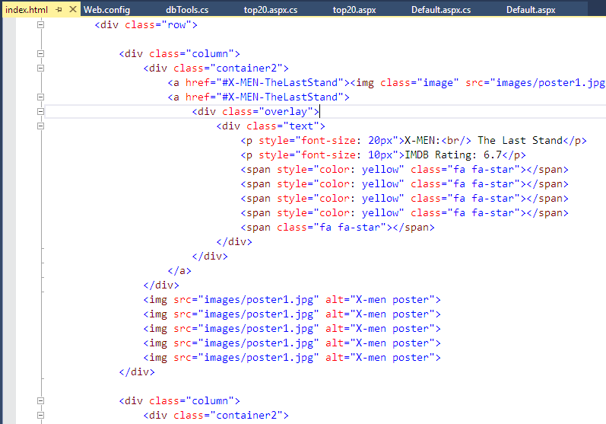
Default.aspx – Original HTML
The approach that I took to render the information contained in the database, was to in part use the HTML code ( shown on above) that was produced by my team member (Lukas)and then adjust to suite.
As can be seen from this HTML code extract, every reference to the film description and image, has to be manually entered into the HTML web page.

Slide 4
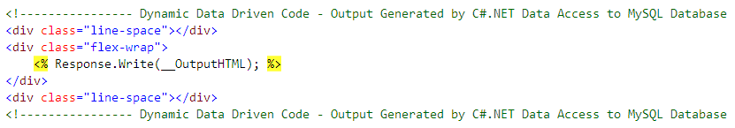
Default.aspx – Inline C# Code
Using a ASP.NET C# inline expression contained within embedded code blocks, we can reference a Code File global variable and display it using
<% c-sharp_funtion(global_variable_name); %>, as can be seen above.
The ASP.NET web page is now dynamic by design and the need to manually update the pages HTML code with hard data is removed.
To format the outputted data, I also created a <div> with a flex-wrap to allow for output data screen wrapping, which is shown in a later slide.

Slide 5
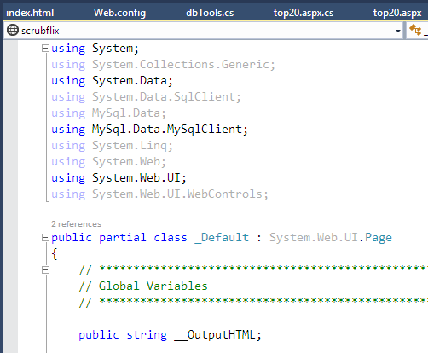
Default.aspx.cs - Declarations
This is the code file for Default.aspx. At the top of the file you will find all of the .NET libraries that are used within the code file. The red highlighted arrow point out that we have used a .NET library specific to My SQL data access.
There is only one global variable defined in the code file but as you can see from the previous slide, it is identical in name. To make this variable accessible to all, it is declared as public and outside of any sub functions defined. It is of type string to allow dynamic HTML with embedded data extracts to be appended, which is described in a further slide.

Slide 6
Data Connection Overview
This is a brief overview of how the web site is actually able to communicate with the database.
An ASP.NET web site has a file called Web.config, which describes the framework or parameters that the web site is required to operate within. It also allows for custom configuration of web site wide variables, that every single web page has access to.
In this instance I have created a connection string which holds all of the access information required to connect to the database.
<connectionStrings>
<add name="films" connectionString="server=localhost;database=scrubflix;uid=scrubfix;pwd=1qaz2wsx;" providerName="MySql.Data.MySqlClient"/>
</connectionStrings>
I have used ‘films’ as my accessor name, which then holds the location and name of the database, along with an authorised user ID and the associated password. It also contains the provider name of the .NET connection framework.
Access to the connection string is via the class dbTools() using the following two lines of code.
dbTools __dbTools = new dbTools();
__dbTools.ParseConnectionString((__dbTools.ConnectionName = dbTools.ConnectionNodes.dBase));

Slide 7
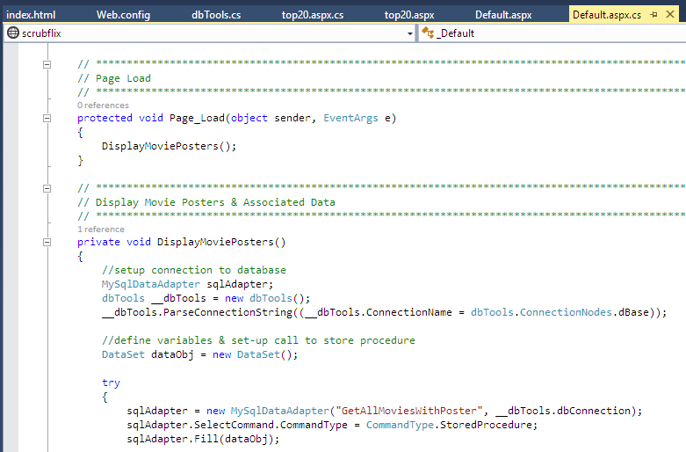
Default.aspx.cs – Data Connectors
The C# function DisplayMoviePosters() creates a database connection to our MySQL database called ‘scrubflix’ (described later). It then calls the MySQL stored procedure ‘GetAllMoviesWithPoster’ and fills the data adapter with the results. This function is called every time the page is loaded or refreshed.

Slide 8
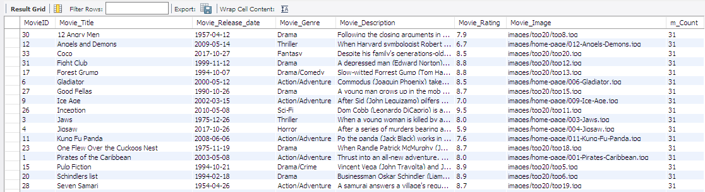
Default.aspx.cs – Data Access
As mentioned I create a Stored Procedure to retrieve the data set required for a given set of requirements. In this instance, I wanted all database entries that had an associated poster image, set in data column Movie_Image.
call scrubflix.GetAllMoviesWithPoster();
This is the actual code in Stored Procedure that is executed and the results are shown below. A counter m_Count is also returned so that the C# functions know how many data rows need to be worked on, which in this case is 31.
BEGIN
select *, (select count(*) from movies where Movie_Image != "") as m_Count from movies where Movie_Image != "" order by movie_title;
END

Slide 9
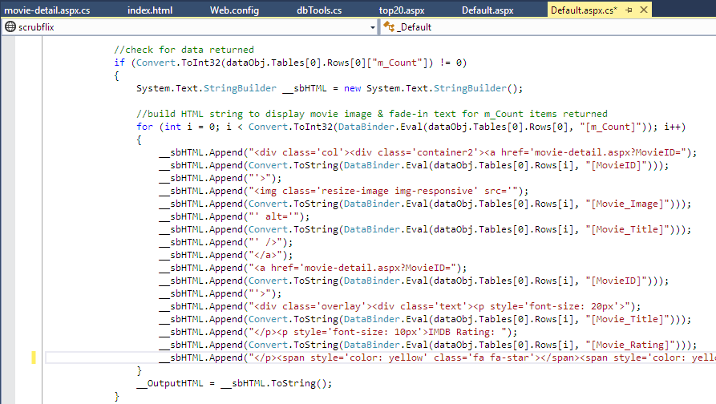
Default.aspx.cs – Data Access cont’d
We now take the information returned into the data set by the Stored Procedure and begin the process of constructing the formatted HTML string to be out put on the web page using the data from the database.
<a> tag to ASPX page passing MovieID
which will be shown in more detail later
HTML dynamic data creation
These lines of code build up the HTML tags with the row data embed in them. As you can see the columns referenced match exactly to the columns show in the last slide. When the code has looped through all of the results returned, the appended __sbHTML string is assigned to the string inline code place holder __OutputHTML.

Slide 10
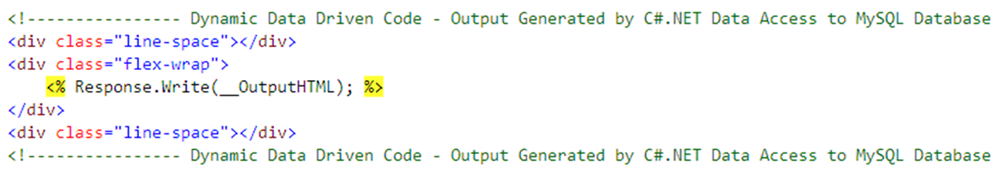
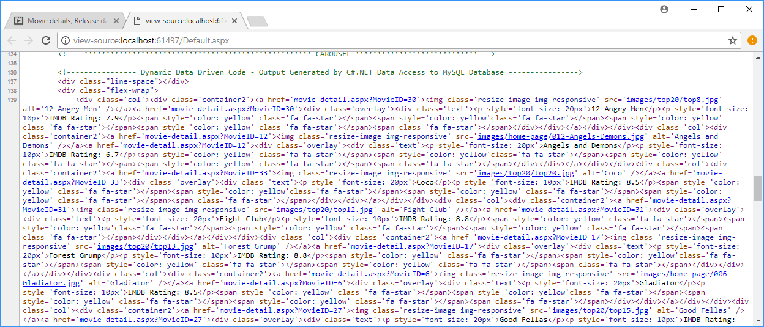
Default.aspx – HTML Comparison
Above the inline C# code and below the resulting runtime dynamic HTML web page code created from the C# code file and Stored Procedure call to get the information from the database.

Slide 11

Default.aspx – Output Result
Dynamically created web page output from database using C# code file and Stored Procedure.

Slide 12
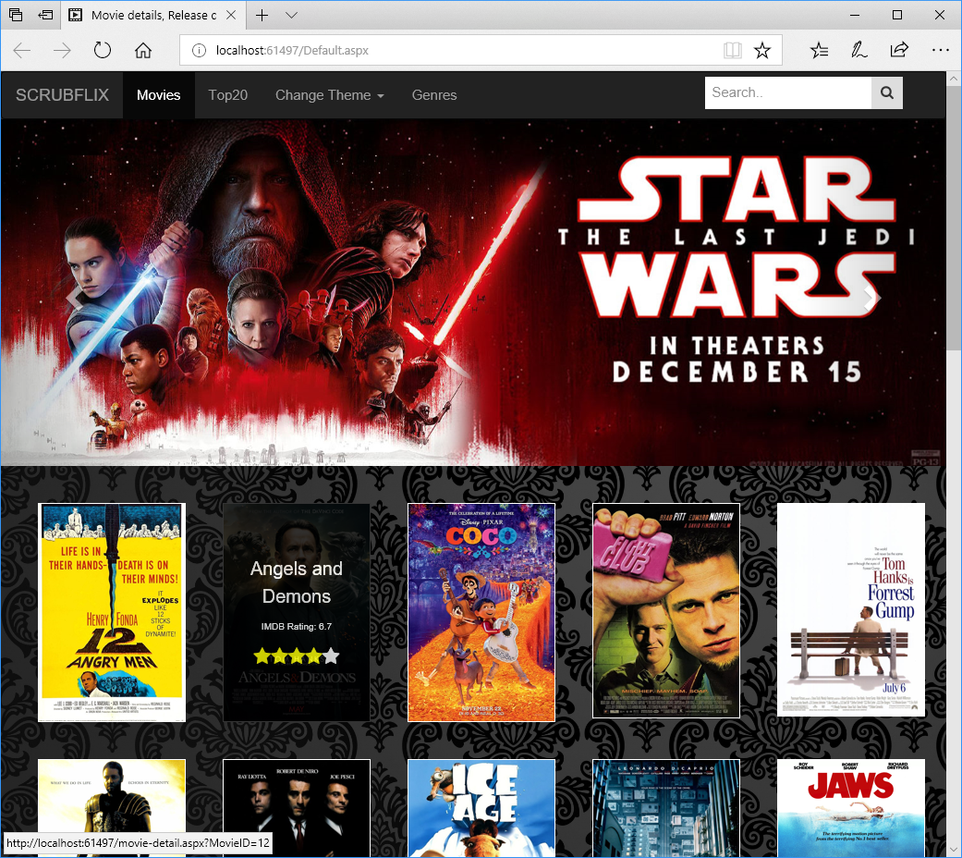
Default.aspx – User Interaction
Notice how the original HTML code that has been embedded in the C# code file still applies its hover effects on an image and that the link is now pointing to the details page with the MovieID being selected – movie-details.aspx?MovieID=12

Slide 13

Default.aspx – User Interaction cont’d
Clicking on the poster image then takes the user to the details page, which is one again dynamically created depending on which MovieID is passed to the page.

Slide 14
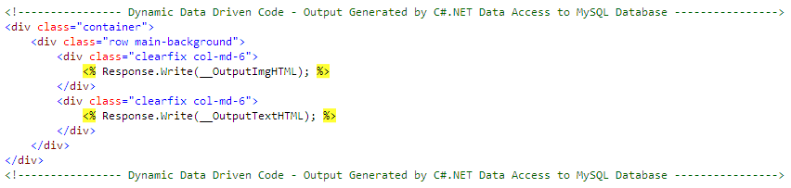
movie-details.aspx – Inline C# Code
This page uses exactly the same coding technique as described previously for default.aspx and default.aspx.cs, except this time we are using two ASP.NET C# inline expression contained within embedded code blocks.
The first embedded code block is used for display an enlarged movie poster images and the second, the full details about the movie.
Both blocks of code are wrapped in a Bootstrap CSS <div> container, with responsive image sizing to make the contents fit on differing devices.

Slide 15
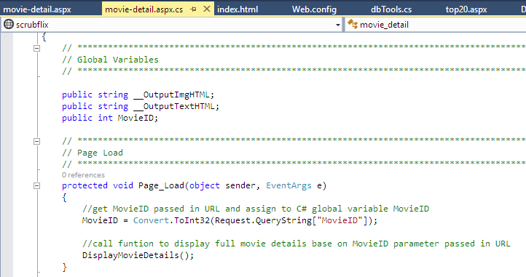
movie-details.aspx.cs – Declarations
Declaration of public stings for inline code output
Public integer for MovieID passed in query string
Within the Page_Load() function we are looking for a value passed in the URL that equals a string defined as Movie-ID. In this example movie-details.aspx?MovieID=12 we are assigning the value 12 to the int MovieID, which will be used as one of the parameters passed to the Stored Procedure GetDetailsByMovieID(in Movie_Selected int(2)) to return the details of the movie selected when the use was on the web page Default.aspx.

Slide 16
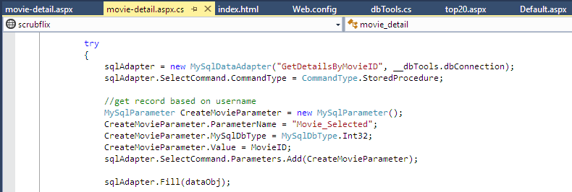
Default.aspx.cs – Data Connectors
Here we are defining the Stored Procedure to call and also adding parameters to pass to the Stored Procedure. Failing to do so, will cause and error as the Stored Procedure must be passed an integer value.

Slide 17
movie-details.aspx.cs – Data Access
This Stored Procedure will only retrieve the data set required for a unique MovieID passed to it – e.g. 12.
call scrubflix.GetDetailsByMovieID(12);
This is the actual code in Stored Procedure that is executed and the results are shown below. A counter m_Count is also returned so that the C# functions know how many data rows need to be worked on. As it is unique, it should only ever be 1. The value 0 would indicate an error or no data returned.
BEGIN
select *, (select count(*) from movies where movieID = Movie_Selected) as m_Count from movies where movieID = Movie_Selected;
END

Slide 18
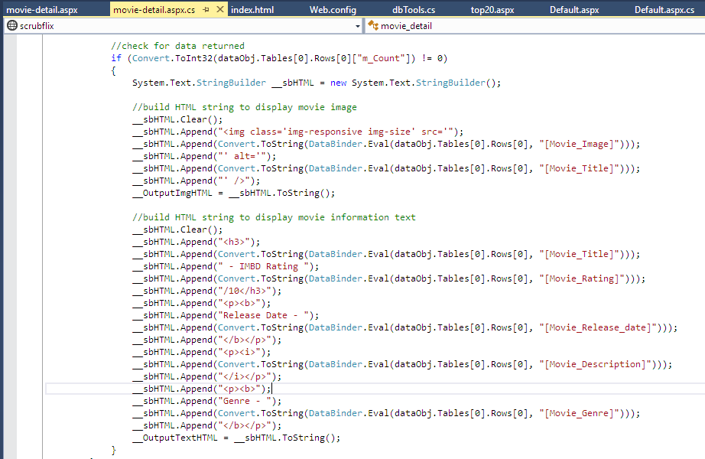
movie-details.aspx.cs – Data Access cont’d
HTML dynamic data creation
As previously described, the techniques used here the same as in default.aspx.cs to build the dynamic HTML code and inject the row data from the database and then outputting the completed data strings to the web page.

Slide 19
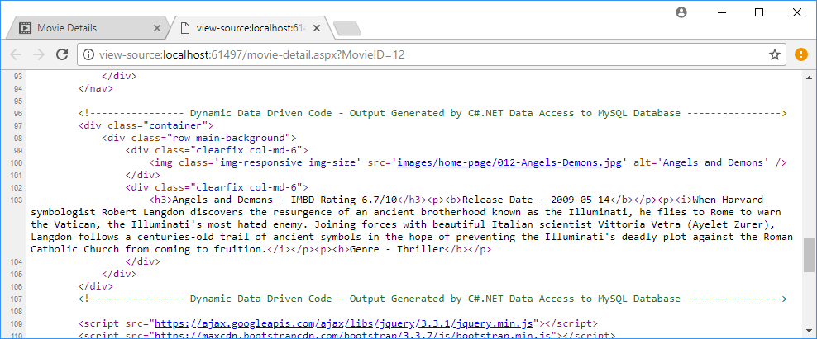
movie-details.aspx – HTML Comparison
Above the inline C# code and below the resulting runtime dynamic HTML web page code created from the C# code file and Stored Procedure call to get the information from the database.

