Slide 1

Android
System, platform and application types

Slide 2
Administrative
Tests 10p
Project 40p
Exam 50p

Slide 3
Course link
upb-fils-mdad.github.io

Slide 4
Bibliography
Wallace Jackson, Android Apps for Absolute Beginners, Apress, 2017
Peter Späth, Learn Kotlin for Android Development, Apress 2019
Android Application Fundamentals, http://developer.android.com/guide/topics/fundamentals.html

Slide 5
Google Android
Platform Developed by Google
Based upon Linux
Virtual Machine (Dalvik) & ART
Open Source
Notes:
- Dalvik & ART

Slide 6

Android Platform
Android
OS
Platform
Application types
Activities
Services
Content providers
Broadcast Receivers

Slide 7

NOT only a OS
Radio Firmware
Phone system
GSM/CDMA /UMTS
Linux
Kernel 4.x and 5.x
Android 11 and newer
Optimised for ARM
User Space Libraries
Bionic
SQLite
WebKit
Application platform
Notes:
Bionic este de fapt un libc mai restrans

Slide 8
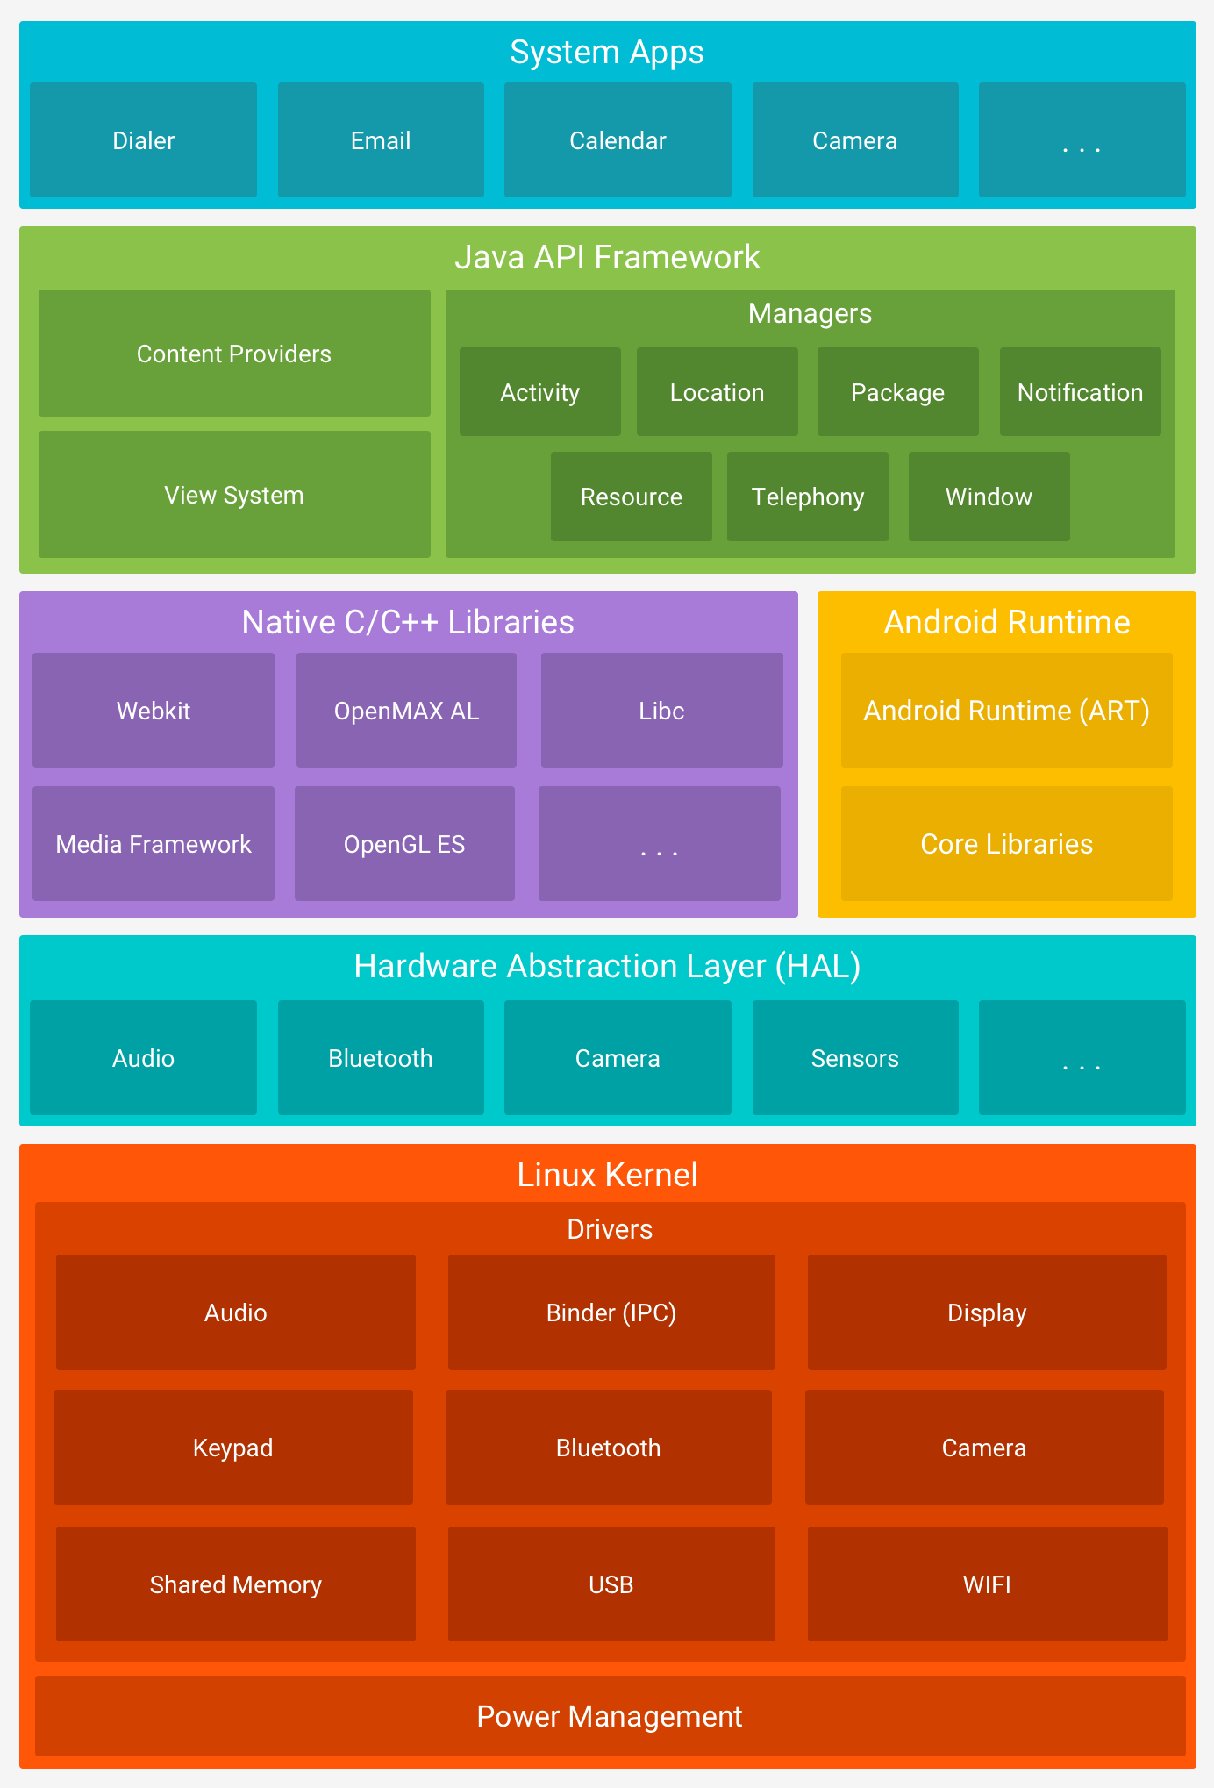
Android Schematics

Slide 9
Kernel
OS
Not visible
Extended Machine
Hardware abstraction
Contains drivers
Manages
Processor
Peripherals
Audio
Video
GPS
WiFi
Input/Output
Network stack
Notes:
Reprezinta o abstractizare a hardwareului (info general valabil) + managing de periferice blabla

Slide 10
Kernel - Optimizations
Memory Management
No swap
On demand application closing system
Power management
WAIT_LOCK
Specific IPC
Binder
AIDL
Synchronous call between processes
Notes:
- La laptop nu se deschide laptopu de la sine, in schimb la tlf trebuie ca tlf sa se poata deschide la nevoie

Slide 11
User Space Libraries
Programming libraries
Link between the kernel and programs
Screen display
printf (…)
scanf (…)
Network access
socket (…)
Bionic
Libc for Android

Slide 12
User Space Libraries
SQlite
WebKit
Surfaces
FreeType
Media Framework
OpenGL|ES
SSL
…
Notes:
Webkit – browser
Surfaces – compositorul de interfata grafica (rendering) (in linux se numeste xorg)
FreeType - fonturi
Media Framework – decodare video/audio OpenGL – randare grafica (jocuri de ex)
SSL -

Slide 13
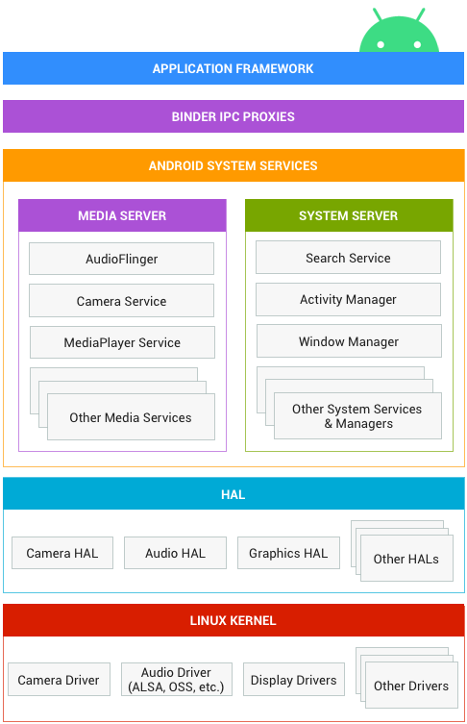
Hardware Abstraction Layer
Drivers
hardware dependent
vendor dependent
have to be licensed as GPL
Drivers are abstracted by a service
the service is changed when hardware is changed
Notes:
- Implementarea driverelor s-a mutat mai sus, sub forma de servicii de android (pentru ca licenta kernelului este de tip GPL, ceea ce impune ca orice contributie trebie sa fie open source)

Slide 14

Dalvik - Android VM
Virtual Machine(Java)
Java 1.5 SE
Most of it
Missing
AWT / Swing
Printing
Other special components
Optimised for mobile
Small memory
Fast garbage collection
Different file format
.class -> .dex
JIT Compiler

Slide 15
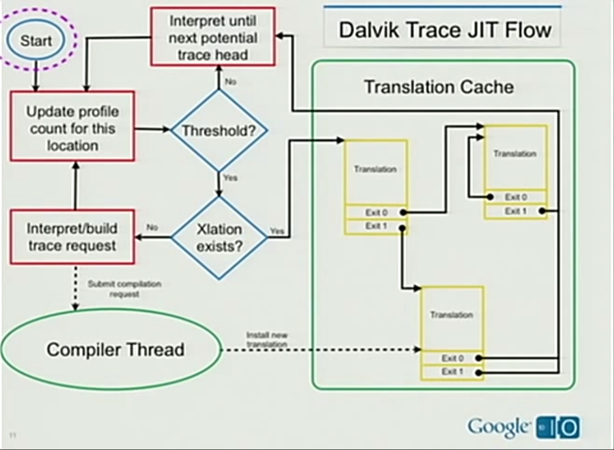
Dalvik JIT

Slide 16
ART - Android Runtime
Environment for compiler and executer
Dalvik
Different file format
.dex -> .elf and odex
Ahead of Time compiling (AOT)
Includes a memory allocator
https://source.android.com/devices/tech/dalvik
Notes:
AOT – la instalare se face compilarea

Slide 17
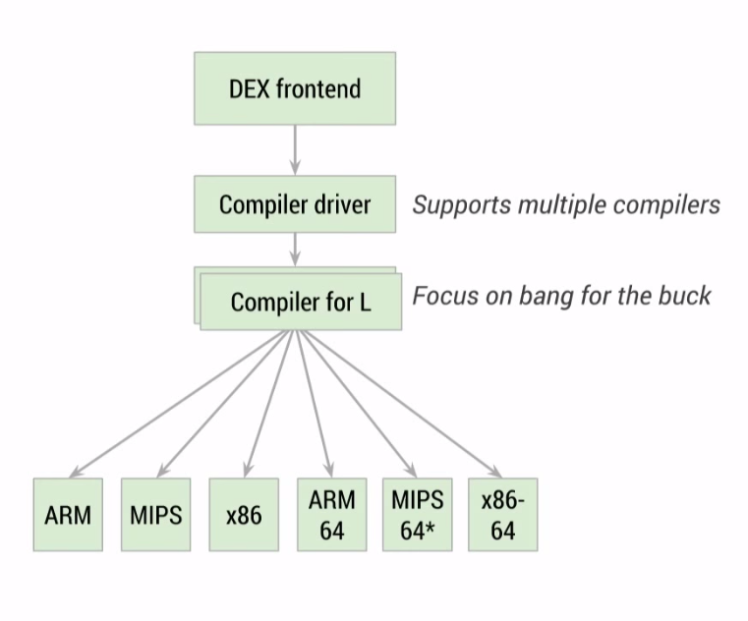
Android ART

Slide 18
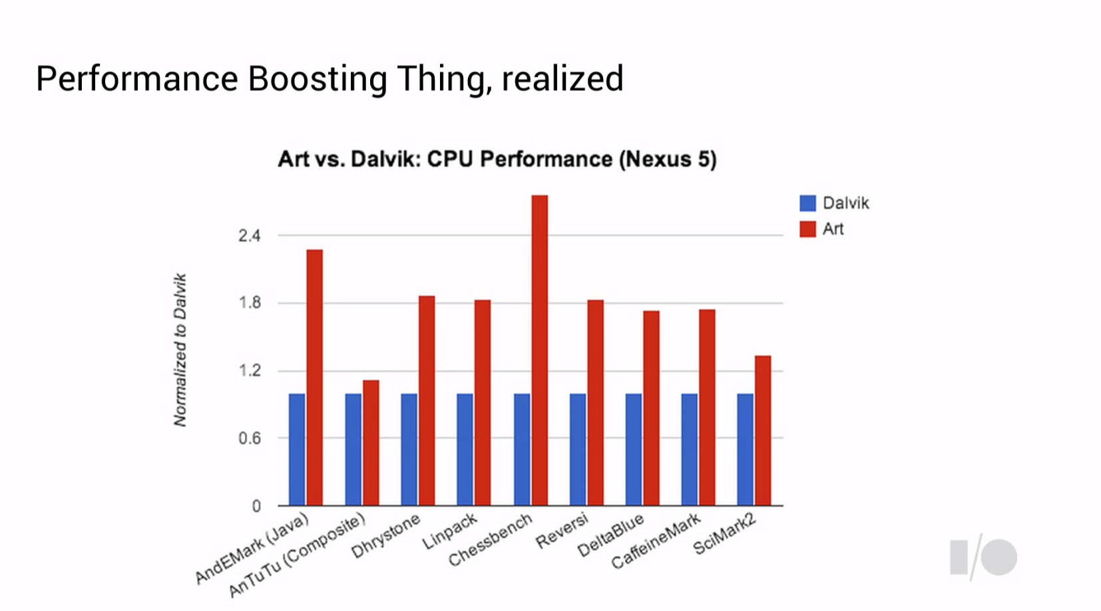
ART Performance
Notes:
- Lajocuri (composable) tu oricum randezi folosing openGL, pe cand la sah, tu faci toate calculele in JAVA (se calculeaza toate mutarile posibile, si se alege cea mai buna, dar de fapt calculeaza un singur minut si apoi alege; cum performanta e mai buna la ART, poate calcula mult mai multe mutari)

Slide 19

Android Libraries
For Dalvik/ART
Not user space libraries!
Written in Java/Kotlin
Access to the device’s functions
Phone
Messages
Sensors
Services
Window Manager
Audio Manager

Slide 20
Android Schematics

Slide 21




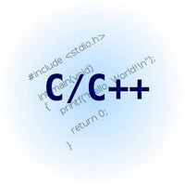

Programming
Dalvik/ART (Application)
in Java/Kotlin
High speed
Access to many libraries
PWA (Progressive WebApp)
In the browser (WebKit)
Slow
JavaScript
Native Development Kit (NDK)
C/C++
Limited number of libraries
High speed
JNI Support
Not recommended for standard applications
C/C++/Rust (services, used by vendors)

Slide 22

Application Security
Implemented in the kernel
Linux policy
Ext3 file system
SELinux
Users can write only in their folder
Every application runs with its own user
Determined by the digital signature!
Group permissions
May write in
/data/name.package.application /
/SDCard/
Works for any application type
Dalvik / PWA / NDK / C/C++ / Rust

Slide 23

Application Security
Implemented in the Android Libraries and Services
Permissions
Declared in the Manifest
Access device’s functions
Network
Phone / messages
Photo
GPS
Access to another application’s components
Permissions imposed by that application
User will be asked
at install (Android < 6)
at usage (Android >= 6)
Works only for Dalvik / ART applications
Native services have to check permissions themselves

Slide 24
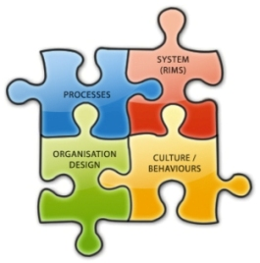
Application & Services (Dalvik/ART)
There is no main()
Formed of components
Activities
Services
Content Providers
Broadcast Receivers
Components can run separately

Slide 25
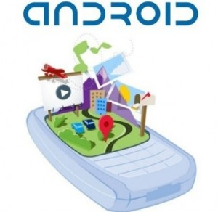
Application Bundle (Dalvik/ART)
APK File
JAR uncompressed
Components
.dex File
Resources
Images
XML Files
Manifest
File with information
Digital signature
Determines the user
For development
For production
Authentic
Self signed
Notes:
2 aplicatii semnate cu aceeasi cheie vor rula pe acelasi user

Slide 26
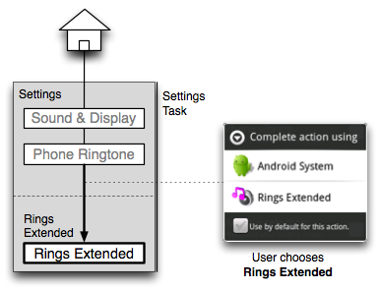
Task (UI Application)
Runs in one process
usually!
There are exceptions
Stack of activities
Root activity
Add
Display
push
Remove
Hide
pop
Activities from other applications

Slide 27
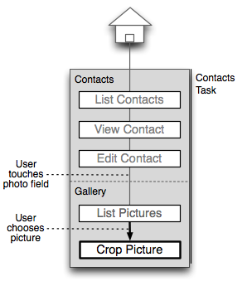
Task (UI Application)
Runs in one process
usually!
There are exceptions
Stack of activities
Root activity
Add
Display
push
Remove
Hide
pop
Activities from other applications

Slide 28
Conclusions
Android Platform
Linux OS
Set of libraries for Android
Programming ways
Dalvik/ART – Java/Kotlin
AJAX – Web
NDK – C/C++
Android Applications are a set of components
Activities
Services
Content Providers
Broadcast Receivers
There is no main()
Task – UI Applications
Set of Activities
Survive the process

Slide 29
Keywords
Operating System
Kernel
User Space Library
Linux
Process
Dalvik
Activity
Service
Content Provider
Broadcast Receiver
ART
Security
Kernel (file system)
User Mode (Dalvik/ART)
Task
Activities Stack

Slide 30

Questions

