Slide 1
CS 1910
Computer Science I
Computational Thinking

Slide 2
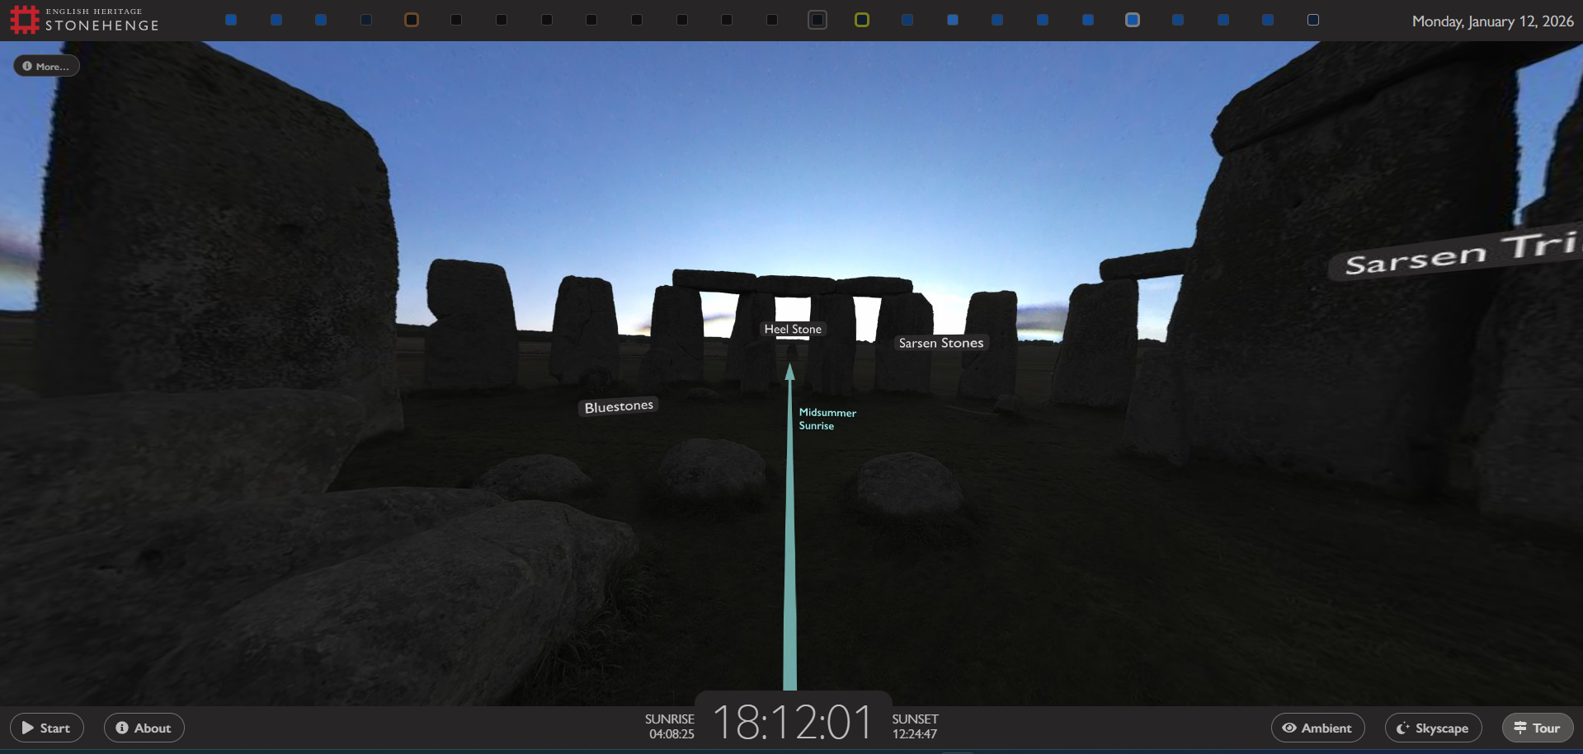
Another “Is this CS”?
Is this CS?
Physical environment mapping
Stitching of images together to create
a single virtual environment
Rendering of the stars based on the current
night sky.
https://www.stonehengeskyscape.co.uk/

Slide 3
Pair Task
Find a partner
One partner will communicate, one will illustrate
The communicator receives a picture
Do NOT show your partner the picture
The illustrator gets out a pencil and blank paper
Do NOT show your partner your paper or work
Using only verbal instructions the communicator should tell the illustrator what to draw
No partner should peek at the others work and only the communicator can talk, the illustrator cannot
5 minutes

Slide 4
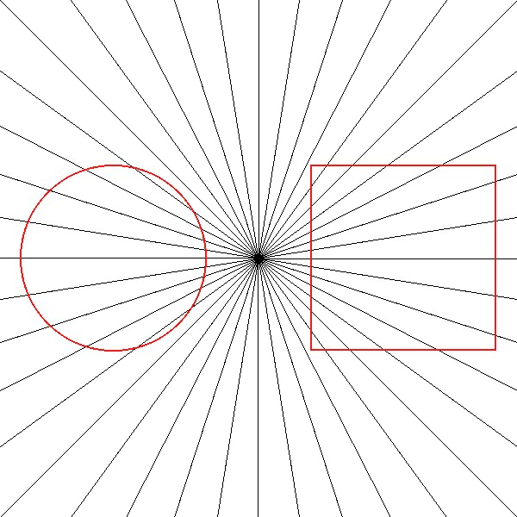

Slide 5
Computational Thinking
Formulating problems and solutions in a way that computers can use
Breaking down complex problems into smaller manageable parts
Recognizing patterns
Hiding away details that are not relevant to the task at hand
Developing step by step solutions
Establishing and checking facts
Translating specifications into machine instructions
Using the facts and patterns to evaluate outcomes

Slide 6
Computational Thinking
Formulating problems and solutions in a way that computers can use
Breaking down complex problems into smaller manageable parts
Recognizing patterns
Hiding away details that are not relevant to the task at hand
Developing step by step solutions
Establishing and checking facts
Translating specifications into machine instructions
Using the facts and patterns to evaluate outcomes
Decomposition
Algorithmic thinking
Logic
Programming
Validation

Slide 7
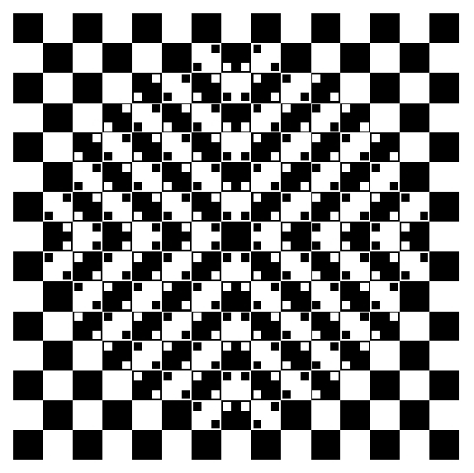
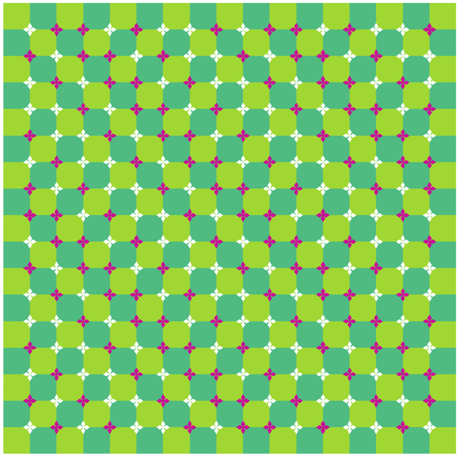
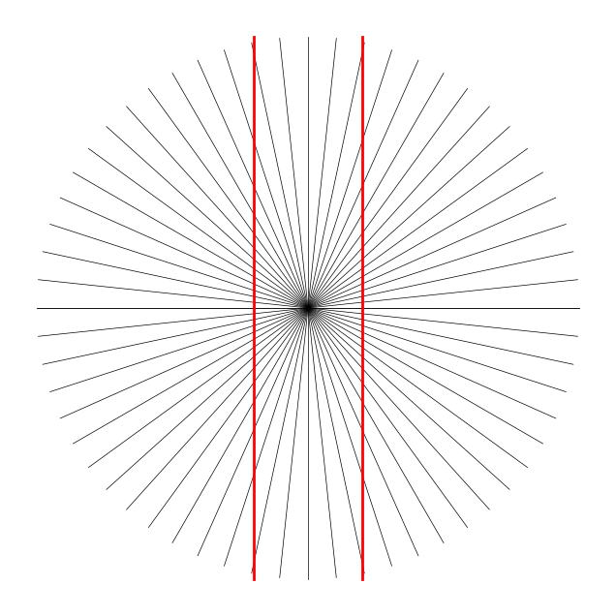
Optical Illusions
Grid pattern appears to bulge out of the page
Grid pattern appears to have waves
Parallel lines appear to curve
Suppose we want to recreate these illusions
Can we use computational thinking to help?
credit: https://www.ritsumei.ac.jp/~akitaoka/index-e.html

Slide 8
Optical Illusion
The red lines are parallel but they have the illusion of being curved

Slide 9
Initial Concerns
Where do I start drawing?
Should I begin at the center or the outer edge?
How do I make the lines straight?
Do I need a ruler or a grid?
How do I space the lines evenly?
Should I measure angles or distances?
What about the circle?
How do I make it perfectly round?
How do I draw the red vertical lines? How far apart should they be?
How do I keep everything aligned?
Do I need to check symmetry after every line?

Slide 10
Optical Illusion
Based on what you explained to your partner – what are the key features of this particular illusion?

Slide 11
Abstraction: Simplify the Problem
Center Point
Circle Boundary
Two Parallel Lines
Radial Lines

Slide 12
DECOMPOSITION
Center Point: Define a centre point.
Circle Boundary: Defined by the length of the line (get it for free!)
Two Parallel Lines: Fixed distance apart, vertical orientation
Radial Lines: Draw a number of line segments out from the centre
Breaking the problem into manageable bits

Slide 13
Decomposition
Step 1:
Setting a centre point
Step 2:
Drawing line segments
Step 3:
Computing angles
Breaking the problem into manageable bits
Break it down only as far as you need to define a sketch of a solution
Notes:
Previous slide from 2025F replaced by breakdown above.

Slide 14
Patterns
Each line segment
same length and width
equally spaced around the circle
Radiate out from the same starting point
(or are centered at that same point)
The two vertical lines are parallel and same length / width, equal distance from the center point
Insight – there is symmetry - the pattern is rotationally symmetric around the centre.
Insight – Length of lines creates the circle!
If we can draw one line segment at a specific angle from a specific point we can complete the whole illusion

Slide 15
Logic
How many “spokes”?
Each spoke has an exact mirror
This could reduce computation and complexity
Angles between each spoke should be equal
Use our insight of symmetry:
Angles should divide evenly into 360 degrees – why?
Parallel lines are spaced equally on either side of the center

Slide 16
DECOMPOSITION
Center Point: Define a centre point.
Radial Lines: Draw a line, rotate 360/(number of lines) and repeat
Circle Boundary: Defined by the x and y distance from the centre point for the end of the line
Two Parallel Lines: Fixed distance apart, vertical orientation
Breaking the problem down into
even smaller steps

Slide 17
Algorithm
A set of step-by-step instructions
Uses Pseudo – code
Systematic approach
Leads to predictable outcome
Algorithms are different than programming – a computer program will often implement an algorithm

Slide 18
PSEUDO Code
Human readable / informal
Not a programming language (meaning that it cannot be interpreted by a machine directly)
Outline the logic and structure using plain language and programming constructs
Steps combined into Blocks
Blocks may repeat
Blacks may only occur when particular facts are true (decision points)
Helps with planning before we move to trying to translate it into a programming language

Slide 19
Known and Unknown
Center Point: Define a centre point. ✔
Radial Lines: Draw a line, rotate 360/(number of lines) and repeat ?
Circle Boundary: Defined by the x and y distance from the centre point for the end of the line ?
Two Parallel Lines: Fixed distance apart, vertical orientation ✔
What facts do we know?

Slide 20
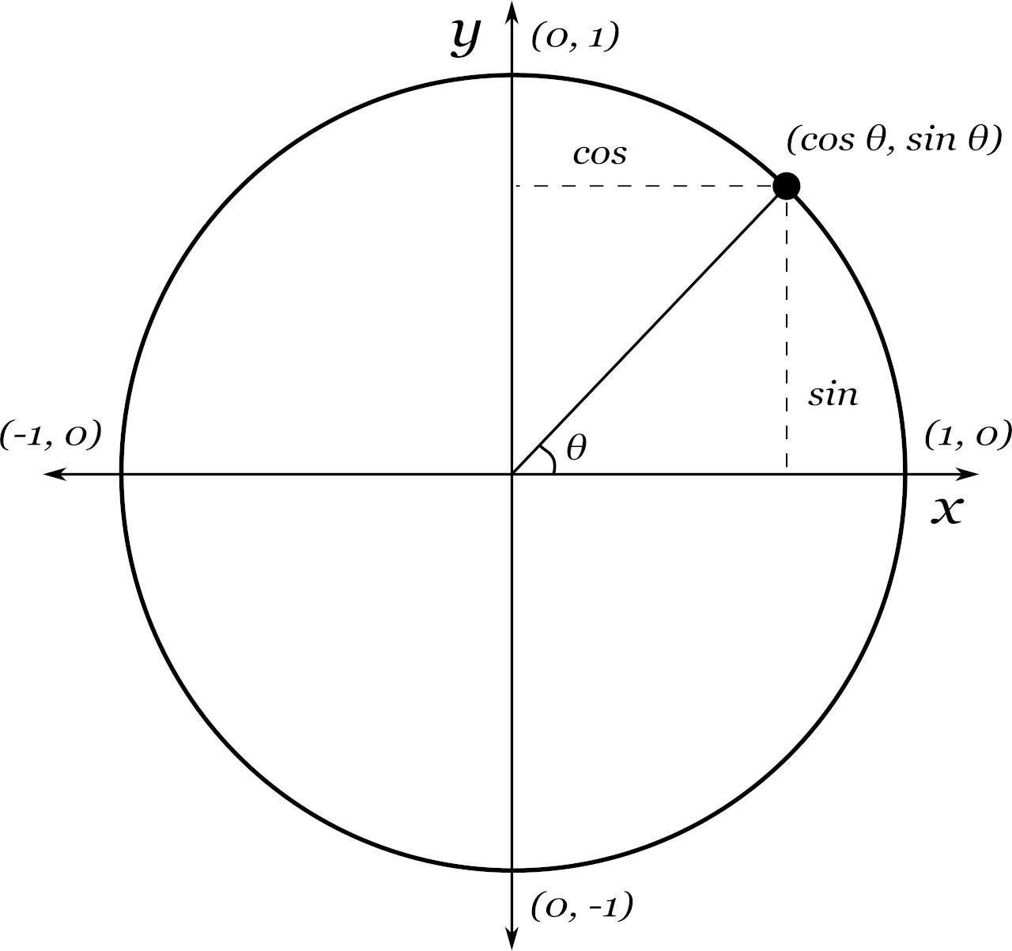
Unit Circle
Notes:
Let’s start with what this figure is telling us. It’s the unit circle, and it reminds us of a simple but powerful fact: for any angle theta measured from the center, the point on the circle is at coordinates cos(theta), sin(theta) – this is trigonometry!
Turns out that most of our mathematics is abstraction – we hid all of that detail about the math behind that picture.
That’s all this diagram is: a visual way to convert an angle into an (x, y) position.
Now, translate that into drawing for our optical illusion. Suppose I want to draw a spoke—a straight line from the center outward.
If I pick an angle theta, and a desired length of line, then the end of the spoke is (length x cos(theta), length x sin(theta)).

Slide 21
Unit Circle
Notes:
Other ways to think about this figure for students:
What the figure shows: A unit circle with an angle $θ$, and the coordinates of a point on the circle given by $\left(\cos{θ} , \sin{θ}\right)$. How it relates to the algorithm: The algorithm uses these trigonometric relationships to compute the endpoints of each spoke.
For each spoke, the angle changes by 360/spokes.
The endpoint of the spoke is calculated as: (x,y) = (length x cos(theta), length x sin(theta))
This is exactly what the figure demonstrates: converting an angle into Cartesian coordinates.
Why Trigonometry is Needed
The figure shows that any point on a circle can be represented using cosine and sine of an angle.
The algorithm on the next slide can leverage this to draw evenly spaced lines radiating from the center.
Without this concept, you’d have to manually calculate positions, which is inefficient.
Abstraction and Pattern
The figure is an abstraction: it shows the relationship between angle and position.
The algorithm applies this abstraction repeatedly in a loop to create a radial pattern.
This demonstrates computational thinking: break the problem into steps, use math to generalize.
All of mathematics is abstraction – and you took a lot of math to get here – so you actually have these skills already, you are just applying them to a different place.

Slide 22
Pseudo Code
Class Discussion
Solution on board
Notes:
Start
Set a length and a spacing and a number of spokes such that 360/spokes is an even number (First we need the angle, and choose a length)
For each spoke: (Repeat until we have all spokes)
Calculate the angle as prior angle + 360/spokes degrees (note the first one starts at 0, then we have 0+360/spokes, and then 0+360/spokes+360/spokes and so on – so there is a pattern)
Draw the line segment from 0,0 to length cos(angle in radians), length sin(angle in radians)
Draw two parallel lines each spacing distance from (0,0) the parallel lines should be 2 length and centered at 0,0
END

Slide 23
Pseudo Code
START
Set a length and a spacing and a number of spokes such that 360/spokes is an even number (why? – we need a length and angle)
For each spoke:
Calculate the angle as prior angle + 360/spokes degrees
Draw the line segment from 0,0 to length cos(angle in radians), length sin(angle in radians)
Draw two parallel lines each spacing distance from (0,0) the parallel lines should be 2 length and centered at 0,0
END
Notes:
Start
Set a length and a spacing and a number of spokes such that 360/spokes is an even number
For each spoke:
Calculate the angle as prior angle + 360/spokes degrees
Draw the line segment from 0,0 to length cos(angle in radians), length sin(angle in radians)
Draw two parallel lines each spacing distance from (0,0) the parallel lines should be 2 length and centered at 0,0
END

Slide 24
Alternative Pseudo Code
Class Discussion
Solution on board
START
Set a length and a spacing and a number of spokes such that 360/spokes is an even number (why? – we need a length and angle)
For each spoke:
Calculate the angle as prior angle + 360/spokes degrees
Draw a line segment from the left side of the circle to the right side of the circle so that I have half as many lines to draw.
Draw two parallel lines each spacing distance from (0,0) the parallel lines should be 2 length and centered at 0,0
END
Notes:
Start
Set a length and a spacing and a number of spokes such that 360/spokes is an even number
For each spoke:
Calculate the angle as prior angle + 360/spokes degrees
Draw the line segment from 0,0 to length cos(angle in radians), length sin(angle in radians)
Draw two parallel lines each spacing distance from (0,0) the parallel lines should be 2 length and centered at 0,0
END

Slide 25
Programming
Follow along today’s code:
https://colab.research.google.com/github/andrewgodbout/F2025CS1910/blob/main/lectures/L02/L02_examples.ipynb

Slide 26
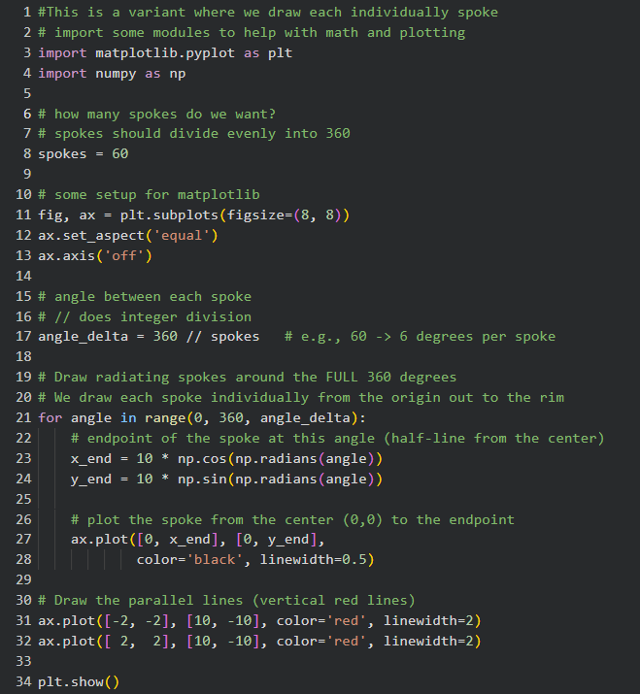
Programming
Obviously. this is a little ahead of our Python learning
Do not be alarmed you are not expected to be able to go from the pseudo code to this today

Slide 27
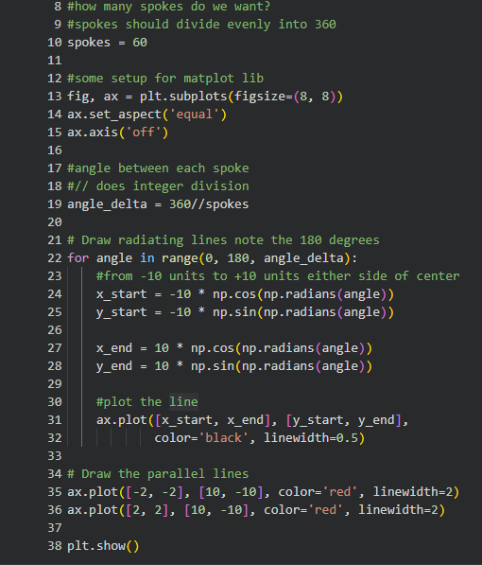
Programming
List of angles but only covering half a circle

Slide 28
Validation
Does the illusion visually appear when plotted?
Are the spokes equally spaced?
Are we missing any spokes (the last one)?
Is the plot centered?

Slide 29
Turtle Draw
A simple drawing library in python that allows us to control a “Turtle” that can leave a trail as we move it around the screen
Great for learning programming concepts
It will show up frequently in the course
Allows a visual understanding of our instructions (code)
Pseudo code and actual code look really similar

Slide 30
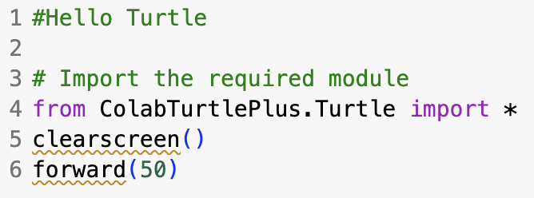
Hello World Hello Turtle Line
A program that prints hello world to the screen is a traditional first CS program
A hash mark (#) indicates that the rest of the writing on this line is not code to be executed but rather a comment, often to help explain something or aid readability
function calls (a function is a group of code
to accomplish something)

Slide 31
What Can Turtle Do (API)
forward (units) – move turtle forward by units
backward(units) – move turtle backward by units
right(degrees) – rotate to the right by degrees
left(degrees) – rotate to the left by degrees
up() – pick the pen up (future movement will produce no trail)
down() – put the pen down
setx(x), sety(y), set the turtle’s position
A selection of things available in the turtle library
Colab Turtle API: https://github.com/mathriddle/ColabTurtlePlus/blob/main/Documentation.md

Slide 32
Draw a Square
Side length 50 units

Slide 33
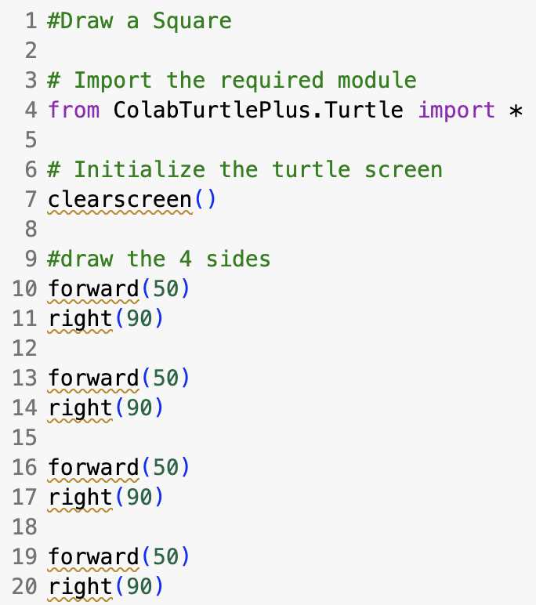
Draw a Square

Slide 34
Turtle Code Hering Illustration
Old Pseudo Code with plotting:
Given 360 / num of spokes angles
For each angle
draw a line segment from 0,0 to length cos(angle), length sin(angle)
Turtle Pseudo Code:
Develop as class on board
We already did the decomposition and pattern matching steps, DO NOT forget that
Notes:
Class discussion hopefully leading to an ”out” and ”back” solution

Slide 35
Turtle Code Program
Develop as class in colab
Can we create a program with 4 spokes (N, S, E, W) and two parallel lines

Slide 36

In class Participation
2026W CS1910 In-Class Participation 02 – Fill out form

Slide 37
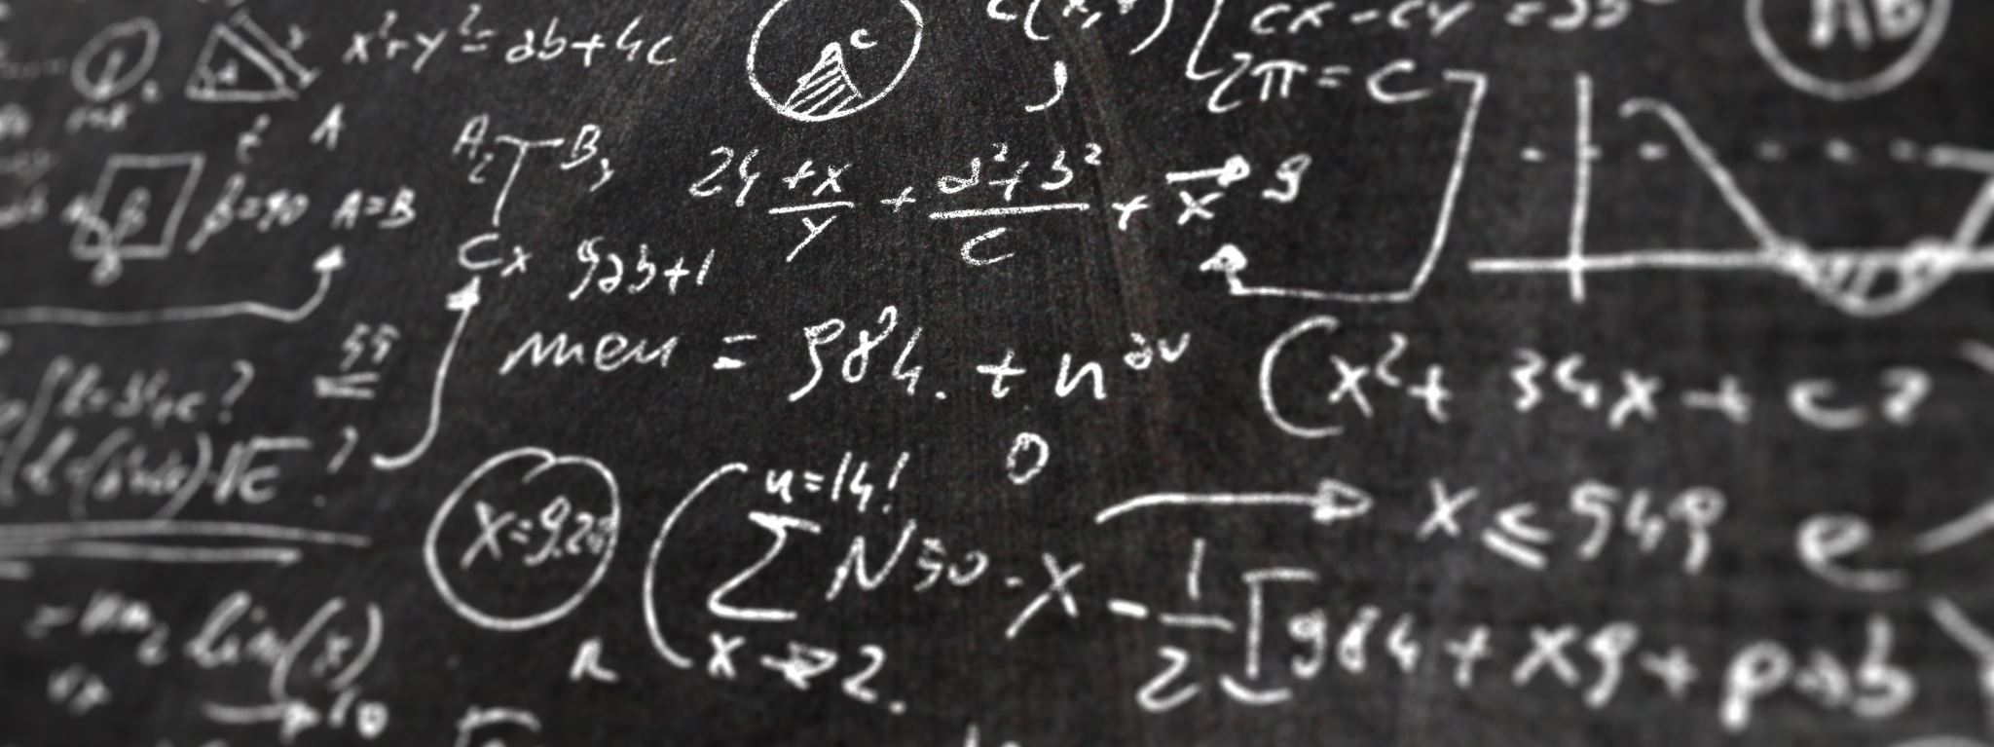
How does AI do at this Drawing Task?

Slide 38
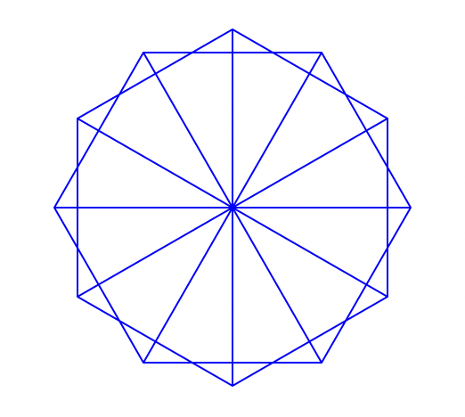
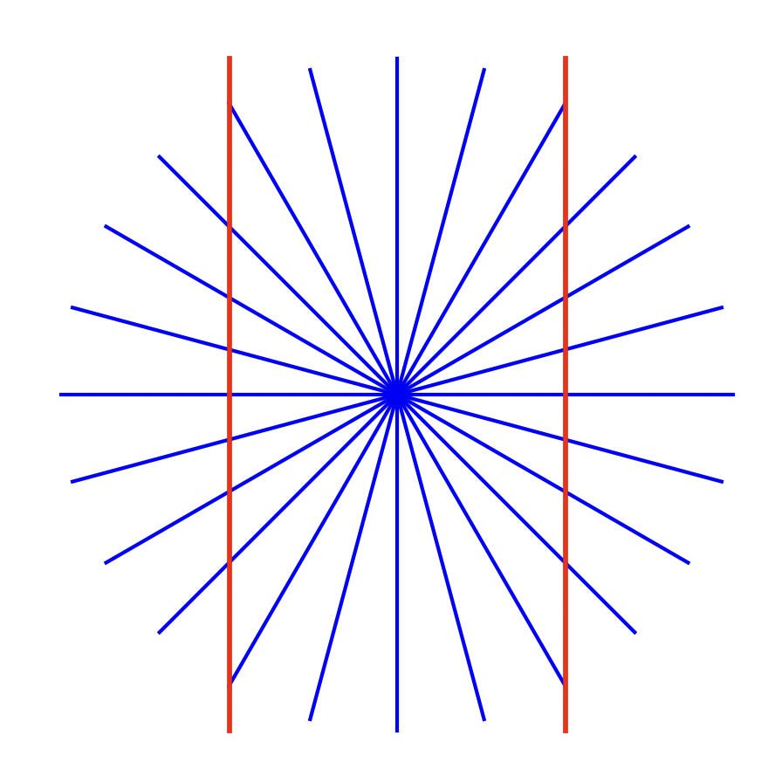
AI Drawing Task
What if we ask for code instructions?
A python plotting library
“give me matplotlib code to draw a circle out of line segments as spokes and then add two parallel vertical lines on either side of the center of the circle”
“Turtle draw pinwheel shape with two parallel lines on either side of the center”
Pretty good
Needs some refinement
Could we have predicted this?

Slide 39
Try at Home
Use GenAI to recreate the green grid wavey illusion
Class Participation survey – how many text prompts do you think it will take you?

Slide 40
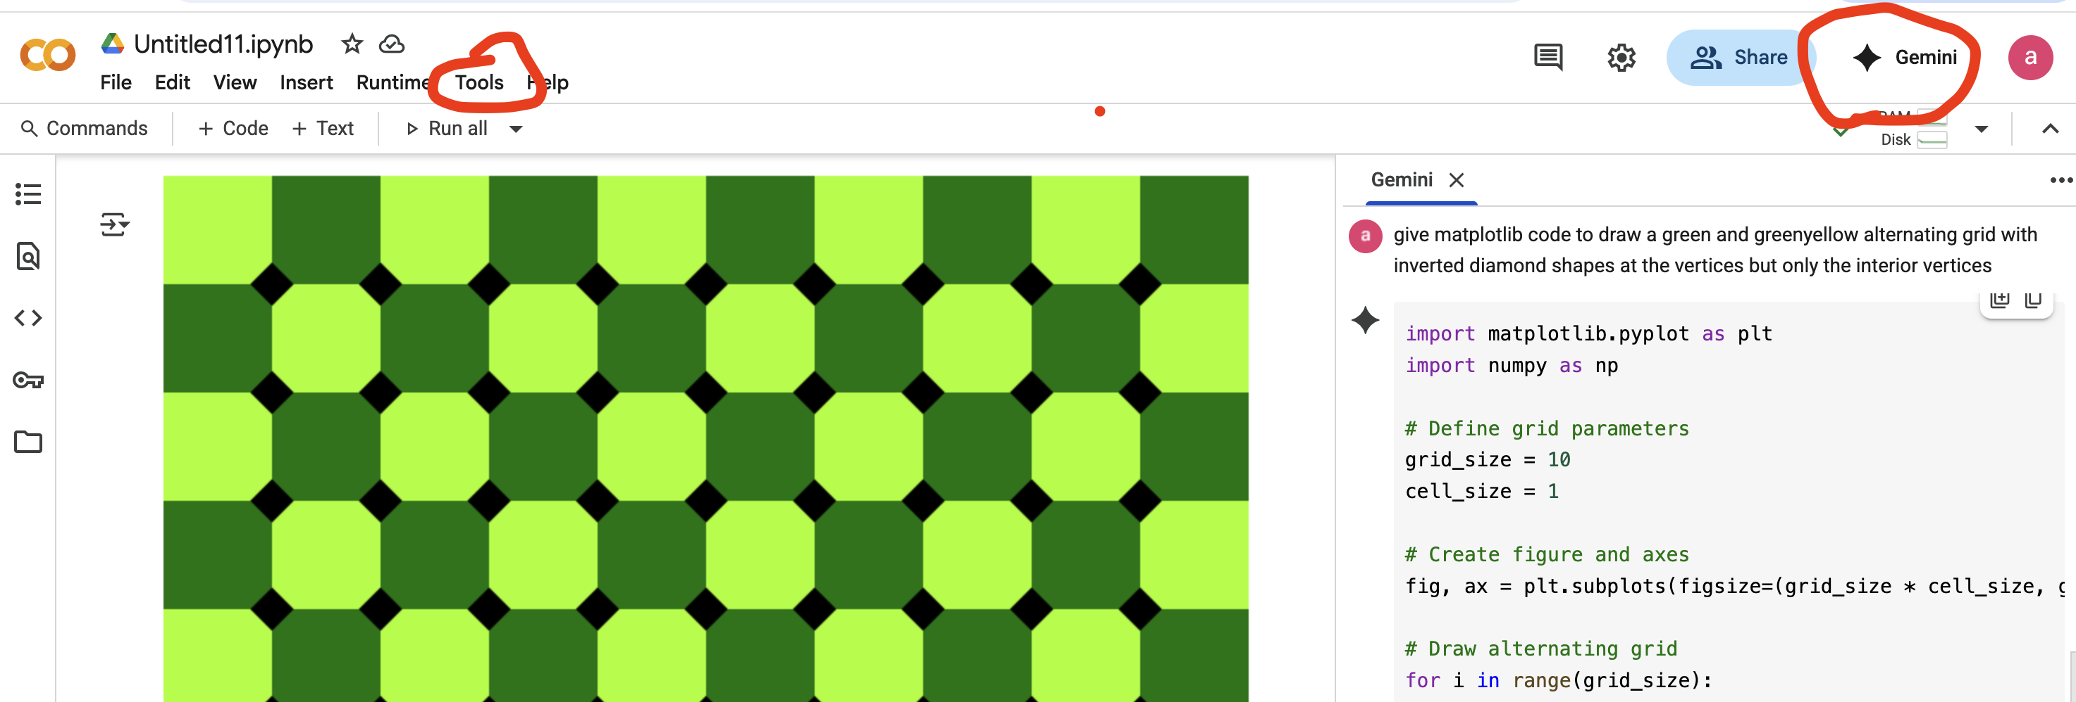
Using GENAI
Under Tools -> Settings->AI Assistance
Uncheck hide Gen AI features
This will produce the Gemini button at top right. Click that and proceed to enter prompts then cut and paste the code into a code block and run the code
Give instructions here and paste the results back into the notebook
Turn off GenAI once you are done
Note: it is challenging to unsee an answer

Slide 41
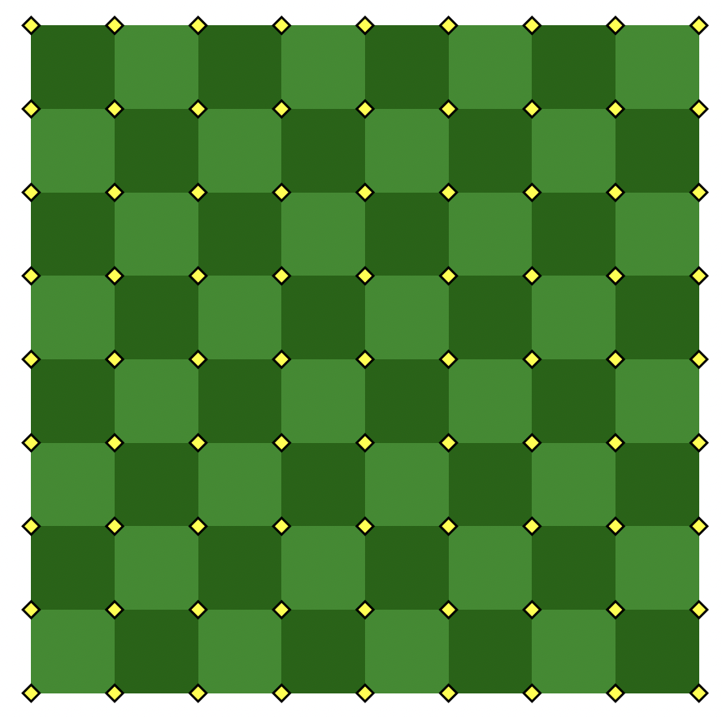
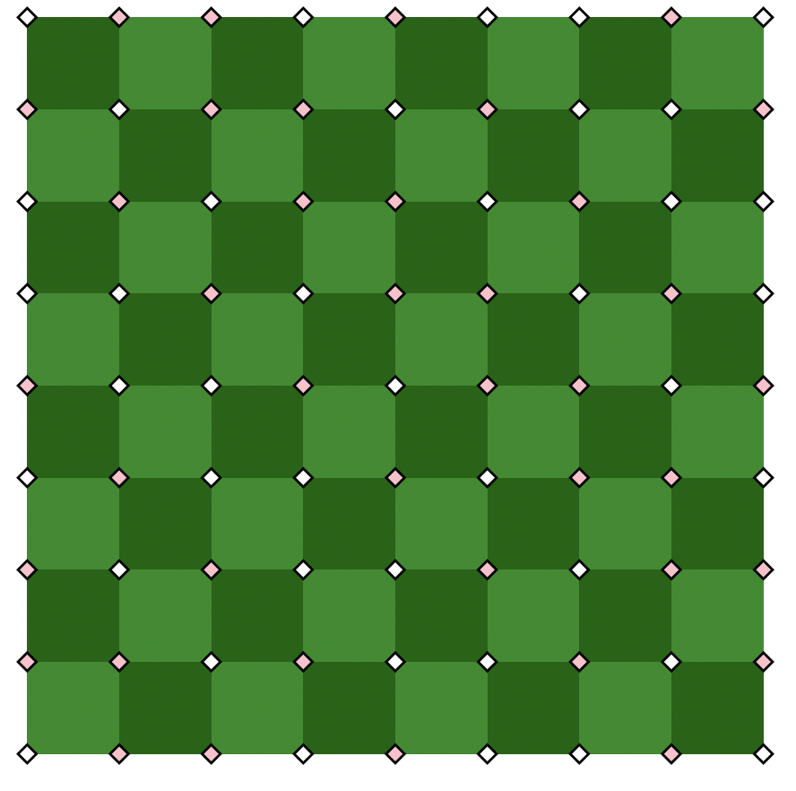
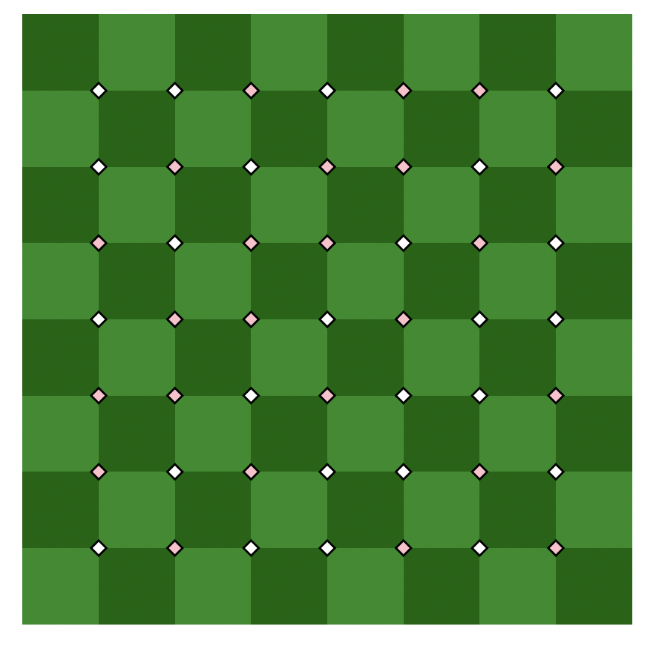
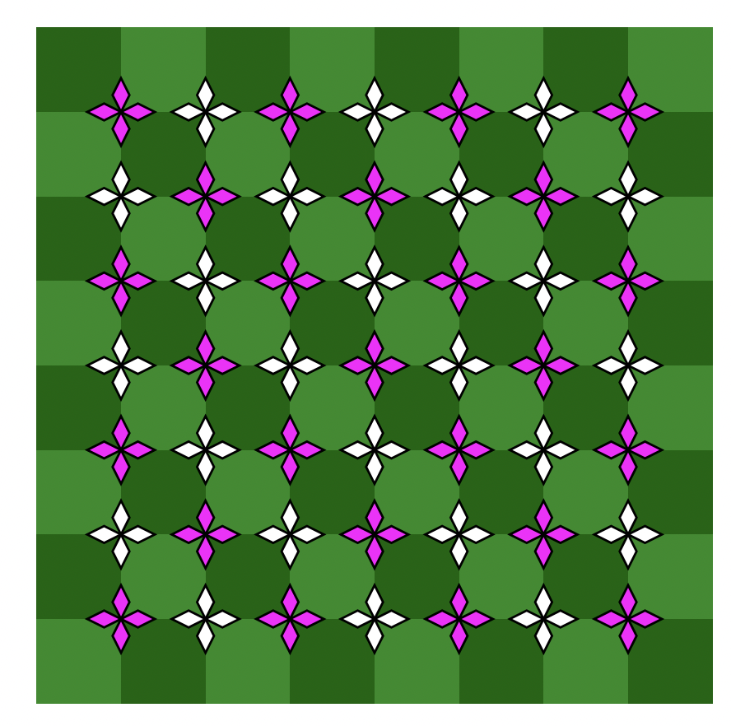
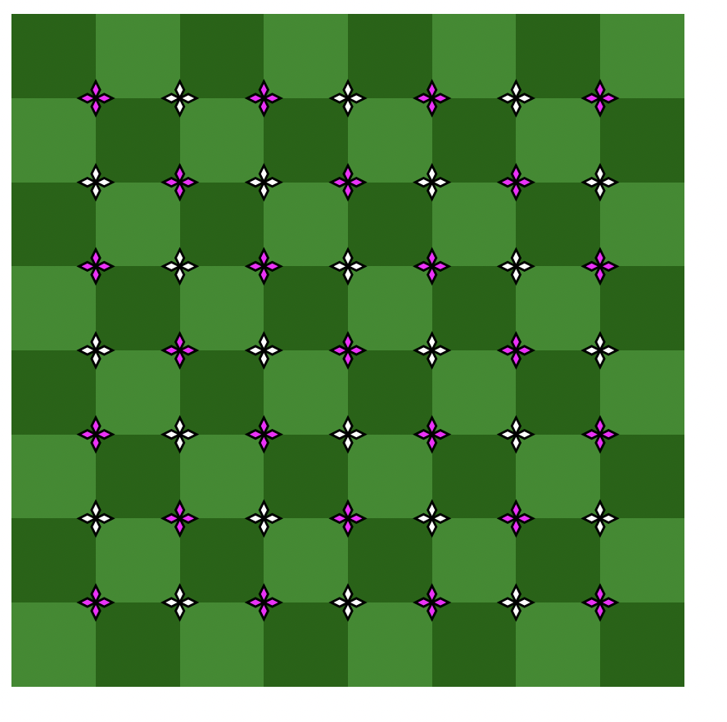
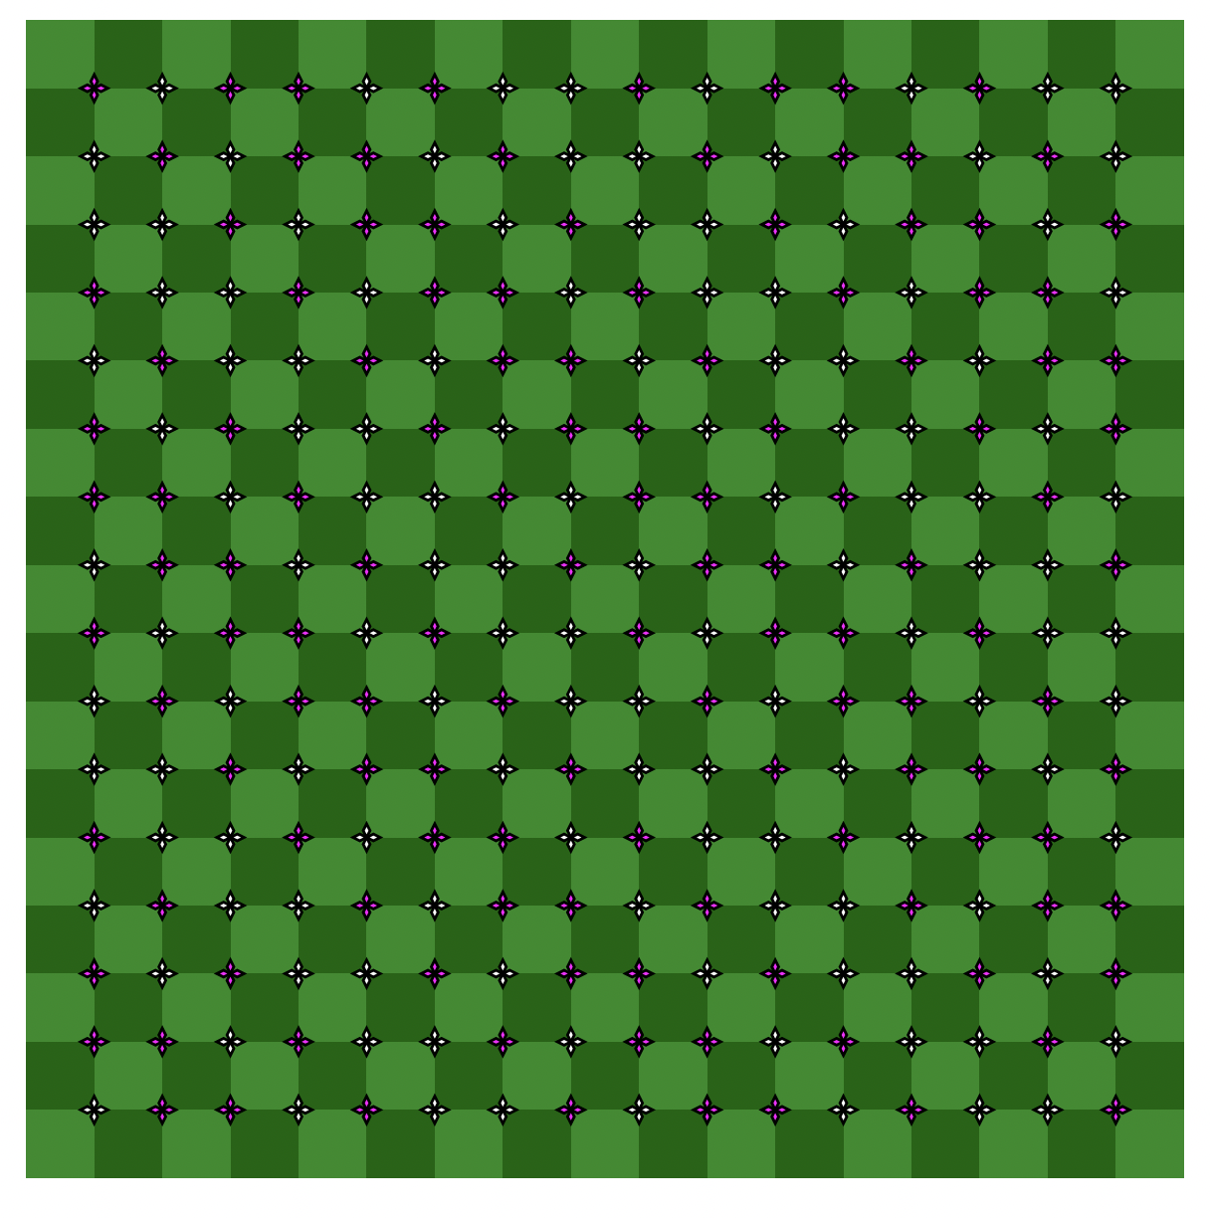
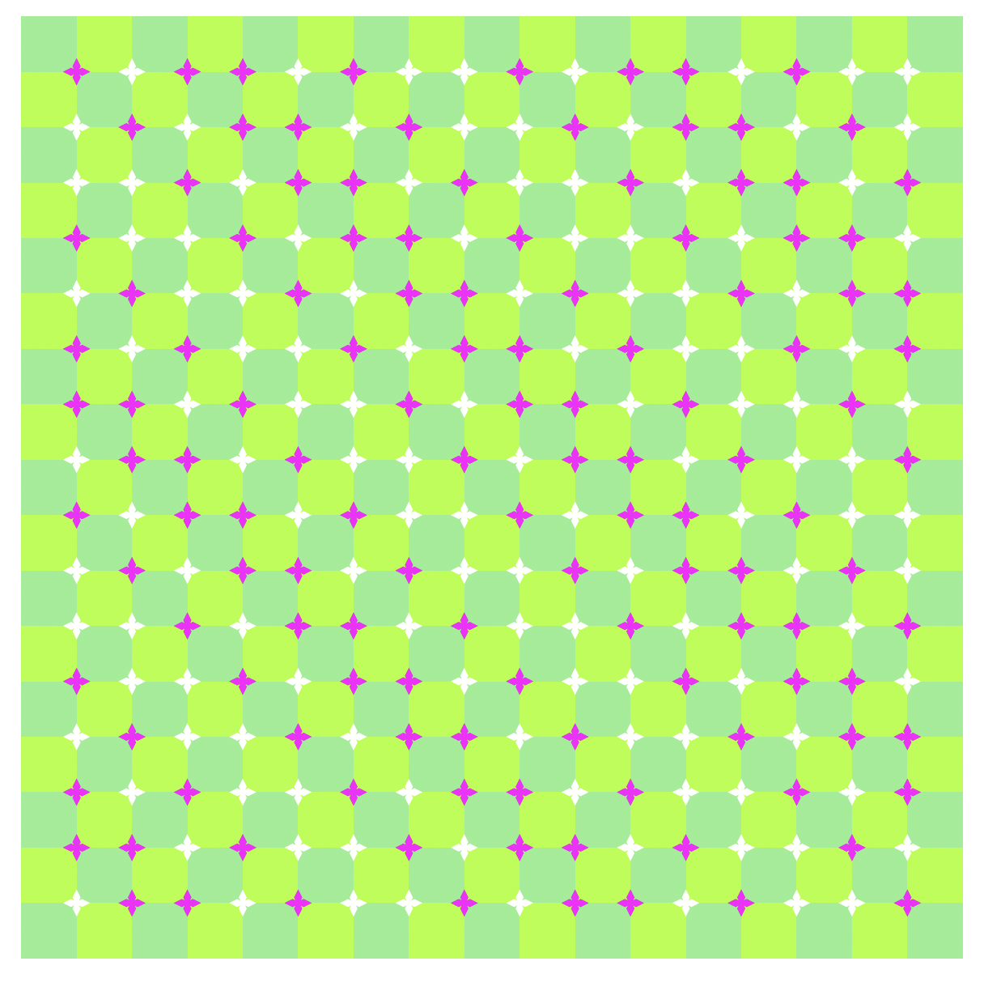
Iterative Process
Think about some of our computational thinking skills
Decompose, logic, validation, patterns
…
A few of my attempts to get GENAI to create the illusion

Slide 42
Target
GENAI – iterative approach

Slide 43
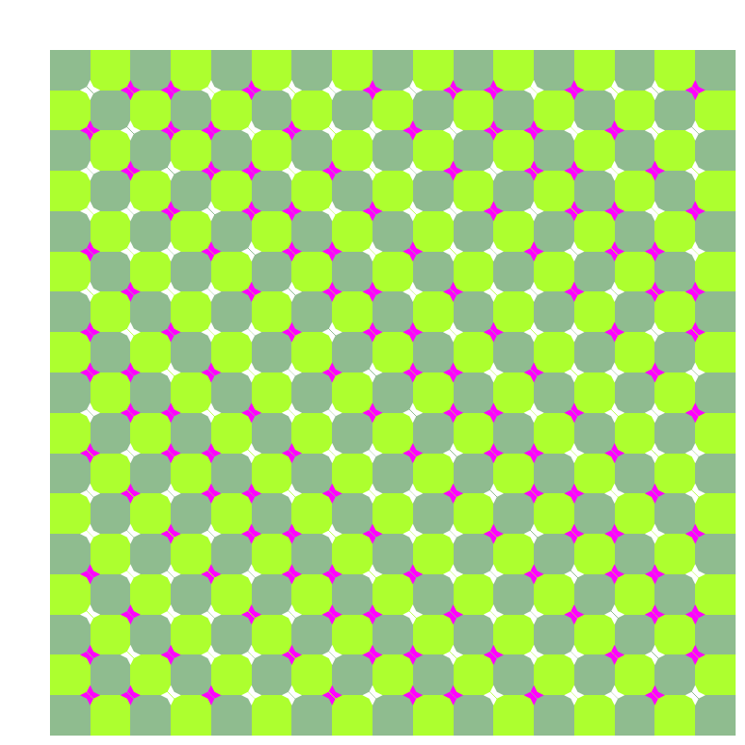
Target
Hand written code
Full disclosure the solution was originally coded then later prompted a GenAI to make a solution
It is certainly one reason why the GenAI one looks like the coded one – the prompts to GenAI telling it to do things
was a mimic of a lot of the analysis that we were done providing what is known as context for the AI the code

Slide 44
Try at Home
Use Turtle Draw to create a triangle
Use Turtle draw to create an X shape
Use Turtle draw to create a block letter of your first initial in your name
Jump in and modify the example code from today - make it do something different
Change the color in the primrose grid
Make it larger
Draw more spokes in the Hering Illustration
Draw horizontal parallel lines instead of vertical
Other ideas / tinkering
Make sure GenAI is off, this is code you write
#possibleexamcodingquestion
Tinker and/or be creative

