Slide 1
CS 1910
Computer Science I
Variables, Literals and Types

Slide 2
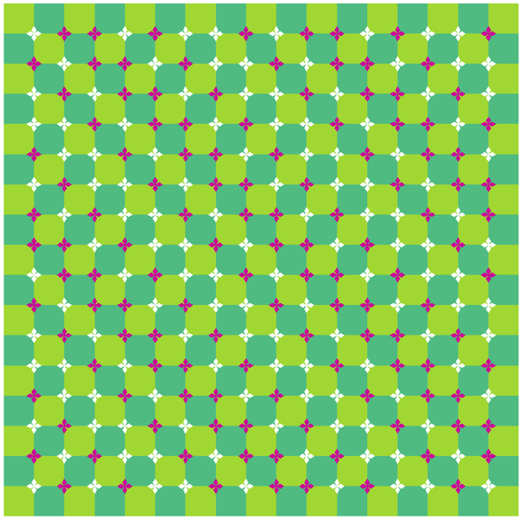
Try at Home Recap
Turtle Draw – initial in name
Tinkering with the prior code – any interesting outcomes?
GenAI for the wavey illusion
Success or fail?
What was your strategy?
How many iterations?
How did you debug?
Find errors/shortcomings and fix them?

Slide 3
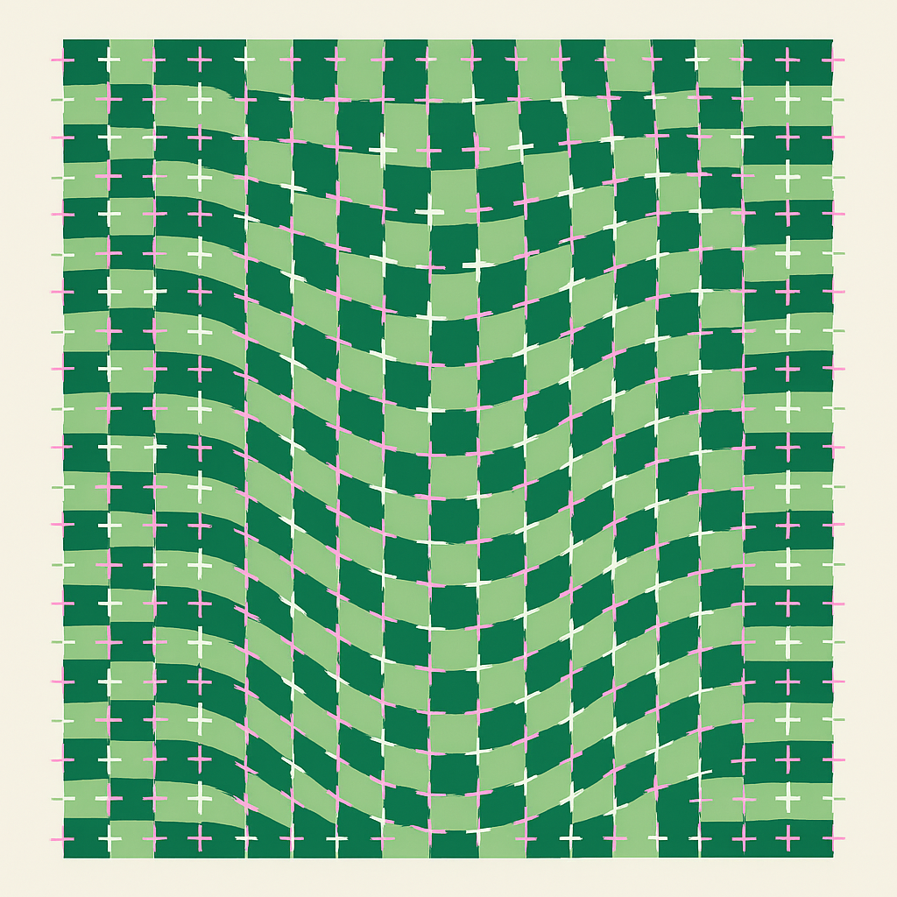
My 1st ATTEMPt
Prompt:
I want you to generate the code for an optical illusion. The illusion is a wavy grid of boxes alternating with a light green and a dark green. There are 17 small squares along both sides of the square grid. At each intersection between the squares is a small cross along the gridlines with the cross extending about 1/6th across the line into the square. The crosses are either pink or white. the first intersection of grid lines has a white cross. Then there is two pink crosses. Then a single white cross. then a single pink cross. Then there are two white crosses. then a pink cross. then a white cross. Then two pink crosses. and then that pattern repeats until you are at the end of the intersection points with a pink cross. On the second line there is a Pink, white, 2 pink, white, pink, two white and so on. This pattern then repeats. Please generate the picture for me, and then python code to generate it.
Blue is the context provided to the AI, while the red is the task I am giving it to do.

Slide 4
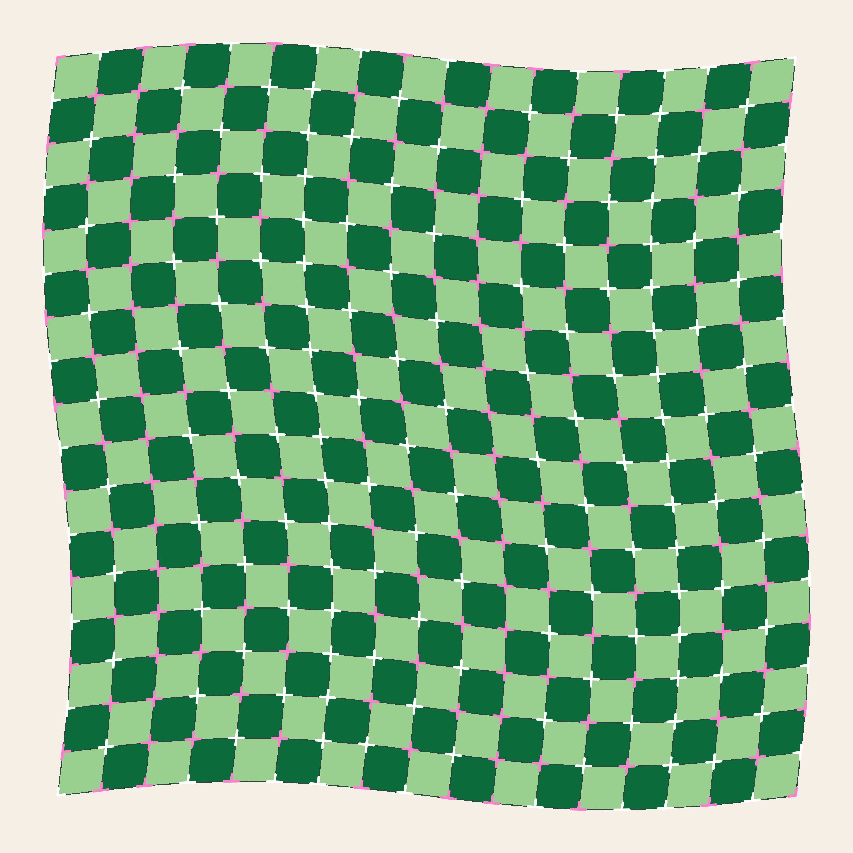
My 2nd ATTEMPt
Prompt:
Some of your crosses are not at the intersections of the gridlines, but are instead in the middle of the lines. Make sure that the centre of the cross is at the intersection, with the perpendicular pieces of the cross going exactly along the gridlines. I want you to generate the code for an optical illusion. The illusion is a wavy grid of boxes alternating with a light green and a dark green. There are 17 small squares along both sides of the square grid. At each intersection between the squares is a small cross along the gridlines with the cross extending about 1/6th across the line into the square. The crosses are either pink or white. the first intersection of grid lines has a white cross. Then there is two pink crosses. Then a single white cross. then a single pink cross. Then there are two white crosses. then a pink cross. then a white cross. Then two pink crosses. and then that pattern repeats until you are at the end of the intersection points with a pink cross. On the second line there is a Pink, white, 2 pink, white, pink, two white and so on. This pattern then repeats. Please generate the picture for me, and then python code to generate it. Check to make sure that all of the crosses are actually on the intersections of the gridlines. Blue is the context provided to the AI, while the red is the task I am giving it to do.
Purple is feedback based on the first attempt. That will add it to the context that the AI will refer to. Then the instructions again, then the task, and then a set of validation instructions to have it check its work. It gets a lot closer!

Slide 5
Code Examples
Today’s code examples are found here:
https://colab.research.google.com/github/cdspower-upei/2026W-CS1910-Students/blob/main/Lectures/L03/L03-Examples.ipynb

Slide 6
Pseudo code (revisited)
Outline the logic and structure using plain language (with some structure)
Supports programming constructs
Blocks
Repetition
Decisions
Variables
Code that belongs to a specific scope
Ability to repeat certain instructions for a specified duration
Code that is executed only when criteria are met
Save data to memory, abstract programs for readability

Slide 7
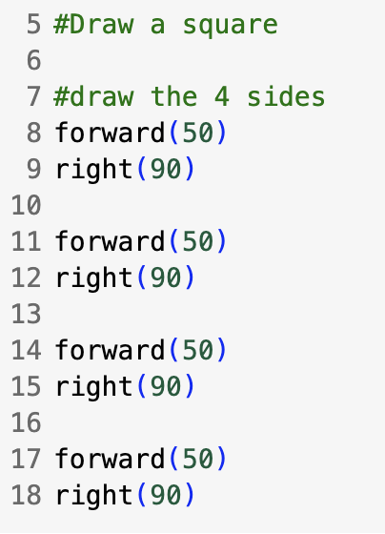

Square Code
Consider we want to apply computational thinking to
the draw a square task from last class.
Decomposition:
draw straight lines with specific length
rotate
Patterns:
4 sides with exact same characteristics
Abstraction:
Right now we have very specific values for how far to draw and turn.
If we have to change those values, we have to change them in many places.
We can abstract those values:
Draw – it goes a length of a line (50)
Turn – it rotates a particular angle (90)
Because it is always that we need a number that we reuse, with a name, we can create a variable to store the value and reuse it
Is there anything else we might do this with?

Slide 8
REFINING Pseudocode (draw a square)
Even though we have some python code to draw a square – we can go back to pseudocode and iterate
Iteration – repeating problem solving to improve some quality of our solution
Start with draw a line and rotate (that’s a basic decomposed aspect of drawing a square)
Use variables to represent specific values (a basic abstraction of the shape – side length and rotation angle)
Program to draw a line with specific length and rotate a specific angle:
Start
SET angle = 90
SET length = 50
Initialize Turtle
forward(length)
rotate (angle)
END
Variables, SET them first
USE them later
Block
use indentation to denote they belong together
When things belong together in a block we say they have the same scope scope

Slide 9
PSEUDOCode (Draw a Square)
Draw a Square
Do this 4 times …
Start
SET angle = 90
SET length = 50
Initialize Turtle
forward(length)
rotate (angle)
END
Note:
We DO NOT need to repeat setting up the variables 4 times
Each line and rotate uses the same values
We really only need to initialize Turtle once
Doing these again and again is inefficient – if we can save steps that is important in computing
Draw a line and rotate
For a square we repeat this
4 times

Slide 10
PSEUDOCode (Draw a Square)
Start
SET angle = 90
SET length = 50
Initialize Turtle
FOR i = 1 to 4:
forward(length)
rotate (angle)
END
New Block (indentation)
Indicates this code belongs to the
Repetition
Repetition
Do the block that follows
for i=1,2,3,4

Slide 11
Loop Unroll
Programs that use repetition can be “unrolled” into sequential form
Start
SET angle = 90
SET length = 50
Initialize Turtle
i = 1
forward(length)
rotate (angle)
i =2
forward(length)
rotate (angle)
i = 3
forward(length)
rotate (angle)
i = 4
forward(length)
rotate (angle)
END
Start
SET angle = 90
SET length = 50
Initialize Turtle
FOR i = 1 to 4:
forward(length)
rotate (angle)
END
Equivalent programs
Note the indent – only stuff under FOR is in scope for the repetition

Slide 12
Program Flow
Decision to continue loop or stop
Looping Structure
Sequential Program Flow
Code executed inside the loop
Code executed after exiting loop
F
T
X
Notes:
Remember to emphasize that the colours indicate different scope – the decision point when it is true has us enter a new scope.

Slide 13
PSEUDOCode to Python
Pseudocode
Python
Start
SET angle = 90
SET length = 50
Initialize Turtle
FOR i = 1 to 4:
forward(length)
rotate (angle)
END
from ColabTurtle.Turtle import *
angle = 90
length = 50
initializeTurtle()
for i in range(4):
forward(length)
right(angle)
Python variables
Actually goes from
i = 0, 1, 2, 3
Up to but not including the
number specified
Python for loop
Programming nuance: counting often starts at zero and often goes up to but not including the end

Slide 14
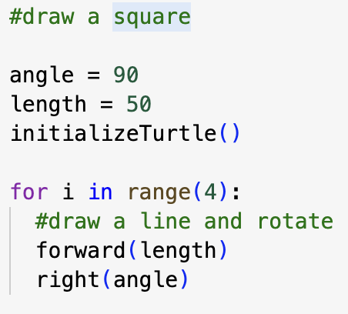
Comparison
Consider we want to adjust the size of the square. In our second program we only update 1 variable as opposed to 4 different lines of code
↑ readability
↑ maintenance
↑ conciseness
↑ generalization
Values typed directly into a program (eg., the number 50) are called literals, we also say they are hardcoded values
In general, we do not want hardcoded values because it is hard to maintain.

Slide 15
Find a Partner
7 minutes
Closed shape with all angles and side lengths equal
eg., pentagon, hexagon, dodecagon, square
What if we wanted to draw a triangle?
What if we wanted to draw a different regular polygon?
Task 1: Give pseudocode to draw a triangle
First question – what do you have that you can reuse?
Second question – what do you need to solve the problem?
How many sides are in a triangle?
What is the interior angle for an equilateral triangle?
Task 2:
Give pseudocode to draw any regular polygon
Hint: Revisit the idea of abstracting the shape
Introduce a new variable called sides
If sides is 6 your code should draw a hexagon
If you finish early, reuse the code in previous slides to try to convert your pseudocode to python

Slide 16
Drawing Shapes
Triangle
Regular Polygon
Start
SET angle = 120
SET length = 50
Initialize Turtle
FOR i = 1 to 3:
forward(length)
rotate (angle)
END
Start
SET sides = 5
SET angle = 360 / sides
SET length = 50
Initialize Turtle
FOR i = 1 to sides:
forward(length)
rotate (angle)
END
sides

Slide 17
Python POlygon
from ColabTurtle.Turtle import *
#draw a regular polygon
sides = 5
angle = 360 / sides
length = 40
initializeTurtle()
for i in range(sides):
#draw a line and rotate
forward(length)
right(angle)
Start
SET sides = 5
SET angle = 360 / sides
SET length = 40
Initialize Turtle
FOR i = 1 to sides:
forward(length)
rotate (angle)
END

Slide 18
Variables
Variable: Symbolic names that refer to objects or values stored in memory of a computer
Example:
length = 50
Good Programmer Habit:
Read the assignment operator as “GETS”
The above python line reads as: length “gets” 50
length is the name of a variable referencing a place in computer memory where a programmer can find a value (hiding detail of the memory - abstraction)
Value that length ‘gets’ as its value to store. Now whenever a programmer types the variable length it will return 50 from memory to use
50 is a literal that is assigned to the variable
Assignment operator – means “assign length value 50” not equals

Slide 19
Variables
Must be assigned (appear on the left side of the assignment operator (=) before they are used
Can be reassigned new values
Must follow specific naming conventions
Have a defined scope
Remember our indentation – it works in Python too
A variable is defined in the block (indented region of code) and are only accessible from there
Advanced concept: Scopes can be nested. Assume Block A defines a variable length, and a Block B nested under it. Block B can also see that variable. But after B ends we lose all of its variables that it defines. (More on this later)

Slide 20
Naming Conventions
Must start with a letter or an underscore ( _ - usually available by holding shift + minus key)
Cannot start with a number or any other symbol
Can only contain alphanumeric characters (A-z, 0-9) and underscores
Are case sensitive (length is different from Length or LENGTH)
Cannot be a reserved keyword – what’s that?
A keyword that is already used by Python in its definition

Slide 21
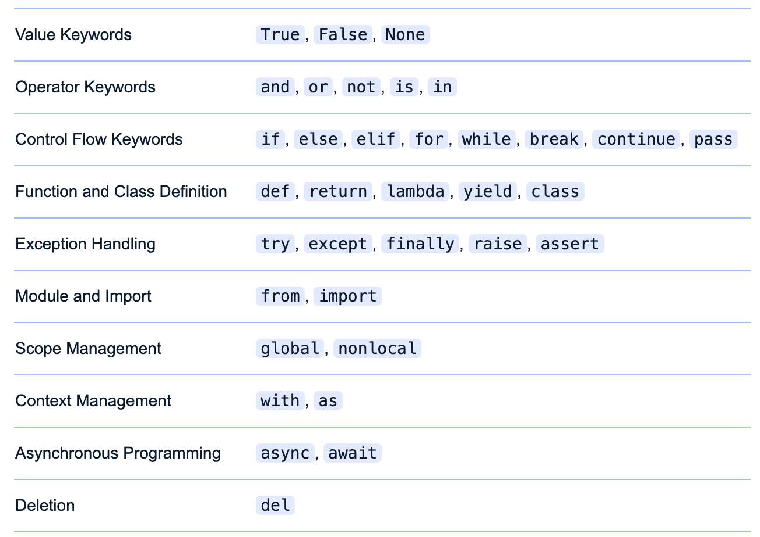
Python Keywords

Slide 22
Python Variable Name Conventions and Best Practices
Readability: Names should be clear, descriptive, and easy to understand.
Example: salary instead of x
One exception – programmers will often use single letter variables for counting things in repetitions (remember our FOR – it used the letter i)
Consistency: Maintain a consistent naming style throughout your codebase.
Typically lowercase with words separated by underscores
Example: first_name
Avoid ambiguity: Do not use names that could be easily confused with other variables, functions, or keywords, and may cause errors.
Try to avoid things like: int, max, abs (all built in function names)

Slide 23
More naming Conventions
Our python code to draw a square could use this
Use a trailing underscore to avoid collisions with keywords or builtins
eg. max_
Single underscore (by itself) can be used to signify a throw-away variable
E.g., for _ in range(4): #no plans to use _ in the loop
ALL_CAPS with underscores denotes CONSTANTS (variables that are stored in memory but shouldn’t be modified by programmers)
E.g., KGS_TO_LBS = 2.20462
Single leading underscore indicates a private variable (covered in CS 1920)

Slide 24
Self-Check
Which of the following are valid python variable names?
Which of them are poor choices and why?
int | my-name | local | Try
NAME | Long^Game | Global | False
3xtra | _view | LongGame | num_of_visitors
P | P0t4t0 | 4ever | try_again

Slide 25
Self Check
What is a variable in python?
a reserved word
a data type
a location in memory to store data
a function

Slide 26
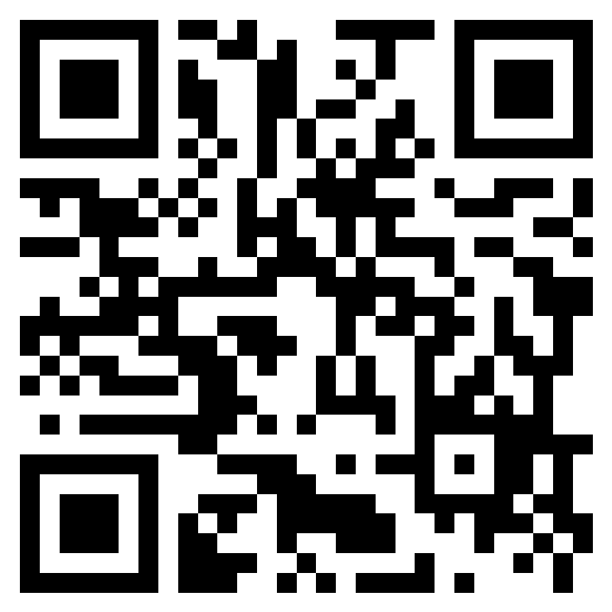
Class Participation Pause
2026W CS1910 03 In-Class Participation Computational Thinking – Fill out form

Slide 27
Python Data Types
Allow you to represent different types of data
Basic data types:
int = integer numbers (e.g., 10)
float = floating point numbers (e.g., 3.14)
str = character strings (e.g., “Hello”)
bool = boolean values (e.g., True / False)
None = a special type that represents the absence of a value (more on this later)
Variables have an underlying type – you can find out what type a variable is by using the following: type(name_of_variable)
Advanced Concept: type(…) is a built-in function in Python
There are less common types (e.g complex, bytes, bytearray)
Examples of literals

Slide 28
Int
Integers are whole numbers
Includes positive and negative numbers
Python has no maximum or minimum integer
Built-in function int() tries to convert other types to int values
int(“1”), int(1.75), int(True), int(False)
Returns class ‘int’
my_int = 42
type(my_int)
Can be used in Expressions: other_int = my_int * 10 + 2

Slide 29
float
Float represent floating point numbers
Includes positive and negative numbers
float(‘inf’) represents positive infinity
Built-in function float() tries to convert other types to float values
float(“1”), float(1), float(“1.75”), float(True), float(False)
my_float= 42.0
type(my_float)
Can be used in expressions: e.g., my_float = my_float * 2.7
class ‘float’

Slide 30
Strings
my_string = “HELLO”
Character
H | E | L | L | O
0 | 1 | 2 | 3 | 4
Index Position
Represents character strings
String literals are enclosed in double “ ” or single ‘ ’ quotes
Individual characters in a string can be referenced using square brackets [ ]
“Hello”[2] “L”
Built-in function len( )can be used to determine the length of a string
Example: len(“hello”)gives 5
“” represents the empty string, it has length 0
Strings have type str
str() can be used to convert other types into strings

Slide 31
BooL
Short for boolean (named after English Mathematician George Boole)
Represent True or False values
False is typically represented in memory by 0,
True typically represented in memory 1
Control program flow
Allows for computers to make decisions
If true, then do something,
Else, then it is false, so do something else

Slide 32
Literals
In programming literals are values that are directly represented within the source
50 means the number (integer) 50
“Hello” is a string literal
4.2 is a floating point literal because it has a decimal
True False are both Boolean literals and reserved keywords
Hello (without the quotes) is not a literal, the python interpreter will see this as a variable name

Slide 33
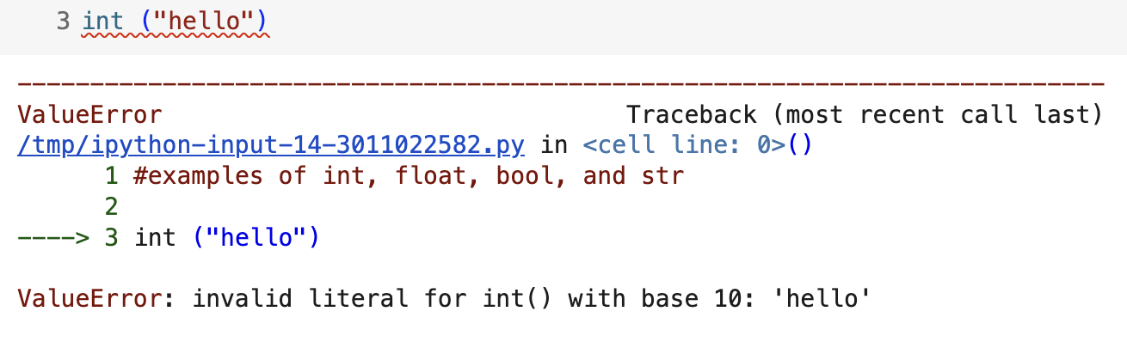
Value Errors
You can convert between types using
int()
float()
bool()
str()
If you pass a value to those functions that cannot be converted, then it will create a Value Error
Don’t panic – you just need to workout what type of value you need

Slide 34
Type Test
In the accompanying code examples try the type conversion test
https://colab.research.google.com/github/cdspower-upei/2026W-CS1910-Students/blob/main/Lectures/L03/L03-Examples.ipynb
Guess the result and the uncomment and run each line individually (and then re-comment). See how many your get correct.

Slide 35
Try at Home
Complete the turtle program from last day to draw the Hering illusion
Increase the number of spokes from 4 to some number such that the illusion becomes visible
Use variables and loops using models from this slide deck
Alter the turtle program that draws a polygon to use a variable named _ in the for loop instead of i
Given code to draw a letter E, alter the code to use variables to make it more readable (see Colab examples)

Slide 36
HomeWork 2
https://colab.research.google.com/github/cdspower-upei/2026W-CS1910-Students/blob/main/Homework/HW02/HW-02.ipynb

