Slide 1
Expressions
CS1910
Computer Science I

Slide 2
Questions
Questions from last day
Add/Drop Reminder – January 23 is last day for dropping a course
Homework reminder – Homework 1 due Friday, Homework 2 next Friday

Slide 3
Code Examples
https://colab.research.google.com/github/cdspower-upei/2026W-CS1910-Students/blob/main/Lectures/L04/L04_Examples.ipynb

Slide 4
Expressions
Combinations of literal values, variables, operators and function calls that the python interpreter evaluates to produce a single value
Primarily compute and return results
Examples of Types of expressions
Arithmetic expressions ( + - * / // **, …)
Comparison expressions (> < >= <= ==, …)
Logical expressions (and or not )
Function call expression (abs( ), len( ), …)

Slide 5
Arithmetic Expressions
Follows mathematical operator precedence (BEDMAS)
Left to right evaluation
Supports: + - * / // % **
Be mindful of the return type for the expression
Generally, if ints and floats are both involved then the result is “elevated” to float
String concatenation is supported with +

Slide 6
Self Check
What do the following arithmetic expressions evaluate to?
(Be mindful of your return types)
int(“5” + “5”) + int(“5”) + int(“5”)
3 // 5 * 12345
“hello” + “world”
77 / 10 + 77 % 10
“hello” + str(8/2)
5 + 4.2 + 0.8
8 / 2
7.0 % 2
Python supports modulus with floating point numbers

Slide 7
Assignment Operators
Recall from last day that variables are assigned a value using =
Example: a = 29
Select Other Assignment Operators:
+= Addition Assignment (add and then assign)
-= Subtraction Assignment
/= Division Assignment
//= Floor Division Assignment
*= Multiplication Assignment
%= Modulus Assignment

Slide 8
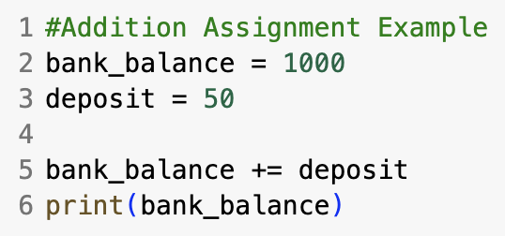
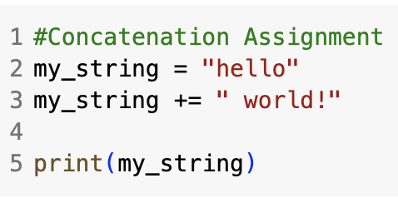
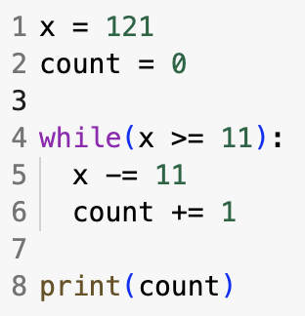
Assignment Operators Examples
More on while loops later, essentially executes the indented code until the clause is False
Predictions on what this outputs?

Slide 9
Pair Problem Solving / Discussion
Problem 1:
How can we determine if a number is even or odd?
Difficulty Estimate: fairly straight-forward
Notes:
my_int % 2 == 0 #T == even

Slide 10
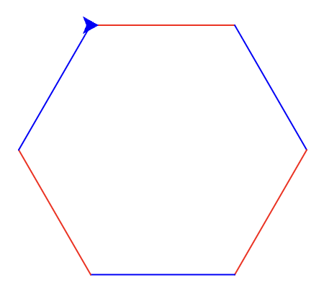
Pair Problem Solving / Discussion
Note: We aren’t using if statements just yet
Problem 2:
How can we turtle draw a hexagon so that the sides alternate red and blue?
Difficulty Estimate: same as previous

Slide 11
Colored Hexagon
2 ways to change the Turtle’s color:
color(“red”)
color(r, g, b) e.g., color(255, 0, 0)
string
Integer values between 0 and 255
3 integers

Slide 12
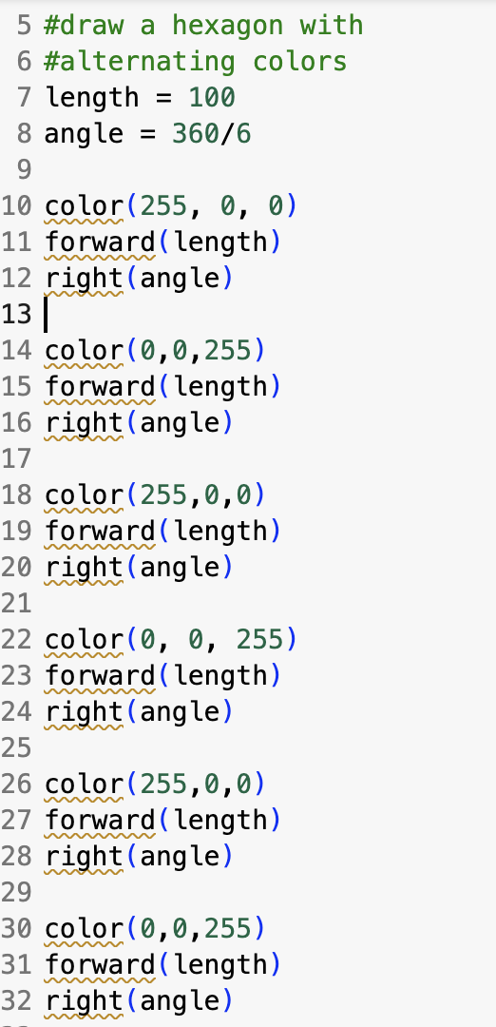
Colored Triangle
This code ”works” but it hasn’t taken full advantage of our computational thinking skills
There are a few variables (abstraction) but no patterns (we repeat the same code in a bunch of places) - this is not good for code maintenance nor readability
Can we take advantage of patterns?
Change Color to BLUE

Slide 13
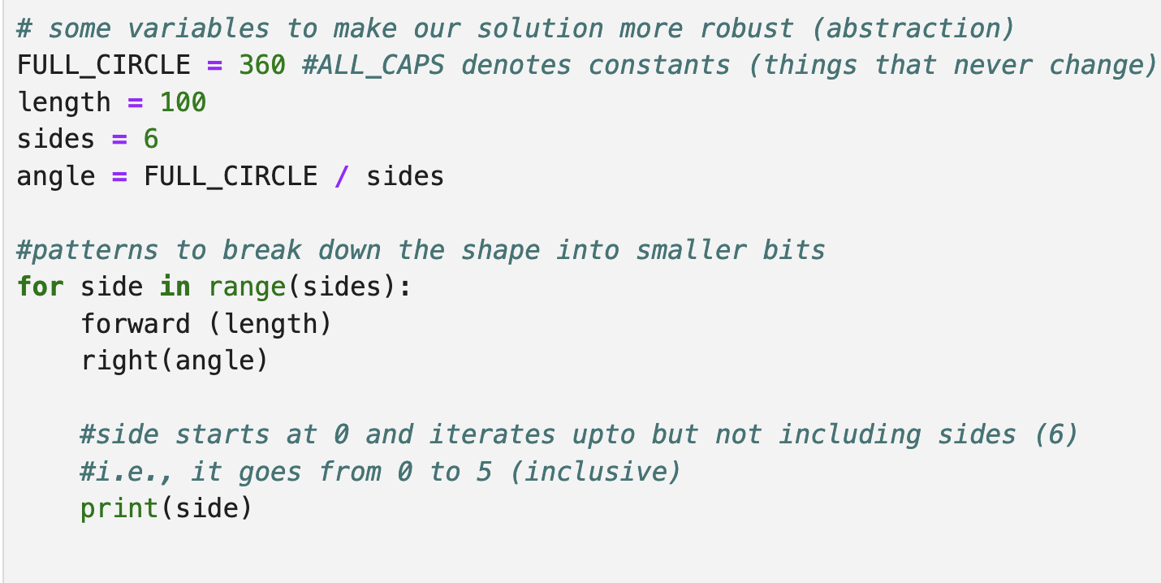
Pattern Recognition
From last day we know the pattern for the shape:

Slide 14
Questions to Ask
What are we trying to achieve?
What do we know?
What information is missing?
Can we break it down into smaller parts?
What are the patterns?
Can we represent it differently?
Have we solved it before?

Slide 15
Questions to Ask
What are we trying to achieve?
Draw red, blue, red blue – but actually …We are trying to track if it is red and blue.
What do we know?
6 sides, 120 degree turn … and … first side is red.
We know that red and blue are represented with combinations of 0 and 255.
Can we break it down into smaller parts?
We need to know if the first number r should be 0 or 255. We know g is 0. We need to know if the number b should be 0 or 255.

Slide 16
What are the patterns?
The colors have a pattern too that we can use.
Consider that the first side is the top side and call it
Side 1 – Red
Side 2 – Blue
Side 3 – Red …
Odd numbered sides are red
Even numbered sides are blue
Pattern recognition:
Essentially the problem “Decomposes” drawing each side and keeping a count of the side we are on so we can determine if it is even or odd

Slide 17
Can we Represent it Differently?
“Odd” sides are (255, 0, 0) <- RED
“Even” sides are (0, 0, 255) <- BLUE
Can we develop a formula that converts a side number like 2 into (0,0,255)?
Notes:
Answers to questions:
What are we trying to achieve? Draw red, blue, red blue - We are trying to track if it is red and blue. What does that mean really?
What do we know? We know that red and blue are represented with combinations of 0 and 255.
Can we break it down into smaller parts? : Can we set the numbers to the right numbers?
Decompose: What are we trying to achieved? We need to know if the first number r should be 0 or 255. We know g is 0. We need to know if the number b should be 0 or 255.
What are the patterns? Atl

Slide 18
Have we solved it before?
We need to detect if something is even or odd. How did we do that?
Modulo operator helps us with that – but that gives us 0 (even) and 1 (odd)
We need …
(255,0,0)
(0,0,255)
(255,0,0)
(0,0,255)

Slide 19
Have we solved it before?
Logic: We need the following:
If side is odd -1 remainder - then r is 255 and the rest are 0.
Else if side is even – 0 remainder – then b is 255 and the rest are 0. (255,0,0)
How do we get 0 and 1? We did that before:
Count the sides in a loop with a variable – side_count
side_count % 2 * 255 – produces 0 or 255

Slide 20
Decomposition
We have identified simple patterns and decomposed our problem into:
drawing each side (forward and rotate)
while using the count of side to set the color.

Slide 21
Colored HexaGON
We did this previously
Pattern
The shape is just forward and rotate by 360 / 6 for each of the 6 sides
But the color?
A CONSTANT (should never change)
Use ALL_CAPS to denote constants
Pseudocode:
START
SET FULL_CIRCLE = 360
SET length = 100
SET sides = 6
SET angle = FULL_CIRCLE / sides
For side_count = 0 to sides-1:
SET the color = ( …)
forward length
rotate right angle
Small counting adjustment to start counting from 0
There are other ways to do this, but today we develop a solution using expressions

Slide 22
Setting Colors
SET green = 0
For side_count = 0 to sides-1:
SET red = (side + 1) % 2 * 255
SET blue = side % 2 * 255
color(red, green, blue)
forward length
rotate right angle

Slide 23
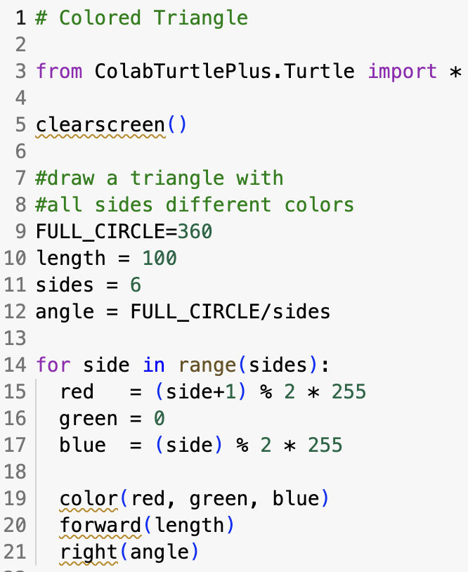
Colored Hexagon Solution

Slide 24
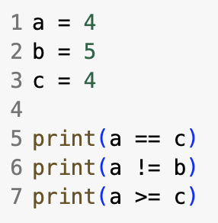
Comparison Expressions
Expressions involving a comparison operator
Evaluate to True or False
> greater than
< less than
== equal to
!= not equal to
>= greater than or equal to
<= Less than or equal to
What is the output?

Slide 25
Logical Expressions
Truth Table for logical operators
X | Y | X and Y | X or Y | not(X) | not(Y)
T | T | T | T | F | F
T | F | F | T | F | T
F | T | F | T | T | F
F | F | F | F | T | T
and mimics multiply, while or mimics addition
Operator precedence: Parenthesis first, then NOT then AND then OR

Slide 26
Mimic of Multiply and Add (kind of)
X | Y | X AND Y | 1×1?
1 | 1 | 1 | 1×1 = 1
1 | 0 | 0 | 1×0 = 0
0 | 1 | 0 | 0×1 = 0
0 | 0 | 0 | 0×0 = 0
X | Y | X OR Y | 1+1?
1 | 1 | 1 | 1+1 → but OR caps at 1
1 | 0 | 1 | 1+0 = 1
0 | 1 | 1 | 0+1 = 1
0 | 0 | 0 | 0+0 = 0

Slide 27
True/False in Expressions
BEGIN
SET numerator = 10
SET denominator = 0
improper_fraction = denominator > 0
print(improper_fraction)
END
False

Slide 28
True/False in Expressions
BEGIN
SET numerator = 10
SET denominator = 0
improper_fraction = denominator > 0 and (numerator/denominator) > 1
print(improper_fraction)
END
But wait … it has to evaluate the divide by 0 and will fail – why doesn’t it fail when we run it?
False
True

Slide 29
Short Circuits
Once a result is known python stops processing the logical expression
Example: result = True or False
Example: False and True
Processing left to right the result is known after processing the left operand, no need to proceed the result is already True
Processing left to right the result is known after processing the left operand, no need to proceed, the result is already False

Slide 30
True/False in Expressions
BEGIN
SET numerator = 10
SET denominator = 0
improper_fraction = denominator > 0 and (numerator/denominator) > 1
print(improper_fraction)
END
If denominator is zero this expression stops evaluating
No need to run

Slide 31
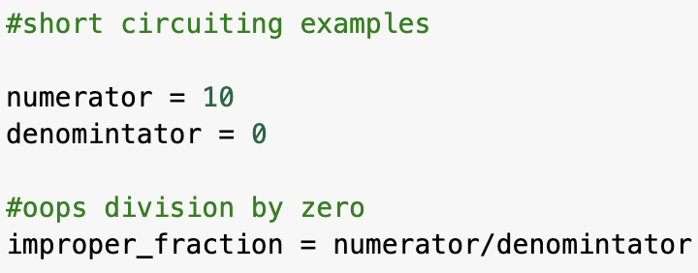
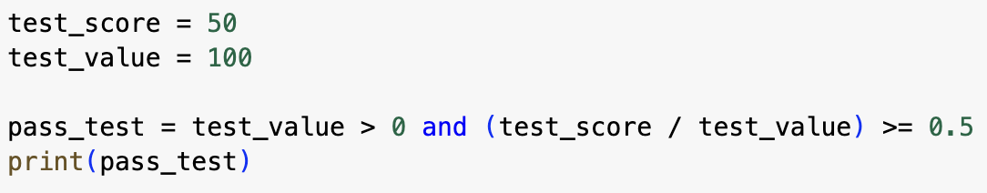
Short Circuits
In Python dividing by zero will crash a program (ZeroDivisionError)
If test_value is zero this expression stops evaluating

Slide 32
Self-Check
What is the result of the following logical expression?

Slide 33
Self-Check
#midtermquestion
What is the result of the following logical expression?
Hint: use short circuiting
If it helps you can think of the Ors like addition and the And’s like multiplication

Slide 34
Python Notes
Combining operators can be misleading
Consider: 3 < 5 == True
Python translates this to: 3 < 5 and 5 == True
Convenient for:
b_grade = 70 < grade and grade < 80
70 < grade < 80
Programmers never write x == True
Just write x
pass_course = testgrades > 50 == True
pass_course = testgrades > 50
Handy compressed format

Slide 35
Function Call Expressions
All functions in Python return a value
The function is evaluated, and a value comes back in the place where the function is called
Many functions return None (which really means they haven’t returned anything)
Examples:
sq_root = math.sqrt(9 + 16)
positive_value = abs(any_value)
ph_num_jenny = str(867) + “-” + str(5309)
max_ = 10
max_ = max(max_, 12)
More on functions and built-in functions later

Slide 36
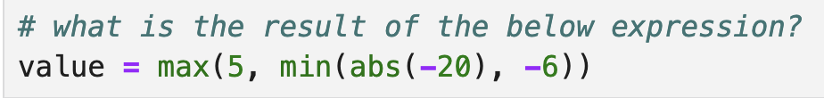
Self-check

Slide 37
Self-check
Answer: 5

Slide 38

Try at Home
What do programmers write in place of x == False?
Write a program to compute the area of a circle
Write a program to average 5 numbers
In trigonometry (cos x)² + (sin x)² = 1
Write a program to prove this is true for x = 42
Use math.cos and math.sin (don’t forget to import math)

Slide 39
Try at Home (advanced)
During the US Open Tennis Tournament all the players descend on the city of NY. They stay in hotels. Tennis players are notoriously superstitious. They will pay a premium if the digits in the room number of their hotel room add up to 1 or they add up to a multi digit number that then sums to 1.
For example: Room 100 has 3 digits: 1, 0, and 0. These add up to 1 (1+0+0). But also consider 532: These add up to 10 but then 10 has digits that sum to 1. So tennis players will pay a premium to stay in room 100 and/or room 532.
Assume all hotel rooms have 3 digits in their room number. Write a program to output the sum of the digits of the room number as a single digit.
Your program should output 1 if the room number is 532 and 9 if the room number is 999.
Hint: make use of // and %

