Slide 1
Input/Output Built-in Functions
CS1910
Computer Science 1

Slide 2
Questions
Questions from last day
How did Labs go?

Slide 3
Hotel Room Question
Sum of the individual digits in a 3 digit number
How to get the first digit (ones digit)?
How to access the second digit?

Slide 4
Code Examples
https://colab.research.google.com/github/cdspower-upei/2026W-CS1910-Students/blob/main/Lectures/L05/L05_examples.ipynb

Slide 5
Printing
In Python the built-in print method can be used to print values to the console
Print automatically converts an int to string
print(“hello”)
print(3)
hello = “Hi!”
print(hello)
Convert the integer 3 to a string and then print it
print(str(3))
print(“hello” + 3)
print(“hello” + str(3))
Error can’t add string and int
“hello3”

Slide 6
Escape Sequences
Certain characters are challenging to represent in a string
For these we can represent the character using an escape sequence.
A special character combo that stands in for the challenging character
In Python we use a backslash \ followed by a character to indicate an escape sequence
Example: How to represent a newline within a string?
\n represents a newline “Hello\nWorld” translates to
Hello
World

Slide 7
Example Escape Sequences
Cursor positioning escape sequences:
\b = Backspace
\t = Tab
\n = Newline
\r = Carriage return
Character used in syntax escape sequences
\” – produces a double quote
\’ – produces a single quote
\\ - produces a \

Slide 8
Self Check
What is the output for the following?
print("\"\\Hello\n\tWorld!\\\"")

Slide 9
Self Check
What is the output for the following?
print("\"\\Hello\n\tWorld!\\\"")
"\Hello
World!\"

Slide 10
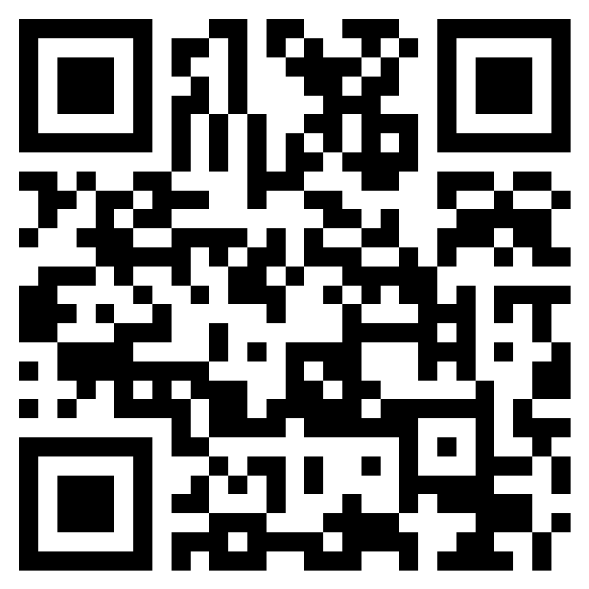
Class Participation
2026W CS1910 05 In-Class Participation Expressions – Fill out form

Slide 11
Formatted Strings F-StRings
Allow you to embed variables and expressions into strings
Preface the string with an f and then use curly braces { } to indicate an expression or variable that should be inserted into the string
Example
x = 10
y = 5
result_str = f"The sum of {x} and {y} is {x+y} or what is stored in z which is {z}"

Slide 12
Format Specifiers
Control the presentation of values such as number of decimal places for floating point values or alignment
price = 123.4567
formatted_price = f"Price: ${price:.2f}" # Two decimal places
print(formatted_price)
number = 7
padded_number = f"Number: {number:03d}" # Pad with leading zeros to 3 digits
print(padded_number)

Slide 13
Self-Check
Consider you have files named as follows:
file001.txt, file002.txt, … file999.txt
Given an integer variable file_num (between 1 and 999) construct the appropriate file name (string) as per above.

Slide 14
Self-Check
Consider you have files named as follows:
file001.txt, file002.txt, … file999.txt
Given an integer variable file_num (between 1 and 999) construct the appropriate file name (string) as per above.
file_name = f“file{file_num:03d}.txt”

Slide 15
input
User input from the keyboard can be accepted using the input() function
The function accepts a prompt that is displayed to the console
name = input(“Enter your name:”)
All input is returned as a string
If numbers are intended as input they will have to be converted to integers or floats explicitly
age = input(“Enter your age”)
age_int = int(age)
print(f”On your next birthday you will turn {age_int + 1}”)
Convert to int
string

Slide 16
Self Check
What is the output?
age = input(“Enter your age”)
print(f”On your next birthday you will turn {age + 1}”
Notes:
This is an important self-check to do in class – most will say that it prints the sentence with the number. But it actually errors out because the input pulls in a str that needs to be converted.

Slide 17
Computational Thinking Group Exercise
How to build a program to read numbers from the user (forever) and after each number print out the largest number seen yet
We are not yet looking for python code
Decomposition
Abstraction
Pattern Recognition
Algorithm Design
Validation
What does the program output if the input sequence is: 1, 2, 3, 1, 2 , 3 ?

Slide 18
Computational Thinking Group Exercise
How to build a program to read numbers from the user (forever) and after each number print out the largest number seen yet
We are not yet looking for python code
Decomposition
Abstraction
Pattern Recognition
Algorithm Design
Validation
What are the essential tasks?
Get input
Convert input to int
Keep track of largest
Printing
Require a variable to store the largest
and the most recent (current)
A loop that runs forever
each time ask for input
potentially update the largest seen
Initialize a variable
Loop forever
Ask for input
Update the variable
Print the variable
simple cases
negative numbers
Invalid inputs?

Slide 19
Converting input to Int
Recall that input is read in as a String.
We have to convert it to an integer.
“3” is not 3
current_value_str = input(“Enter a value”)
current_value = int (current_value_str)

Slide 20
Keeping track of the largest?
2 Variables
Most recently entered value
Max ever seen (so far)
How to update max_value so it contains the maximum between itself and current_value?
Can you come up with a single expression:
max_value = …
Give them names:
current_value
max_value
Given the problem do we need any other variables? i.e., do we need to keep track of anything else?

Slide 21
Keeping track of the largest?
2 Variables
Most recently entered value
Max ever seen (so far)
How to update max_value so it contains the maximum between itself and current_value?
Can you come up with a single expression:
max_value = max(current_value, max_value)
Give them names:
current_value
max_value
Given the problem do we need any other variables? i.e., do we need to keep track of anything else?
We have everything

Slide 22
Max Input Group Exercise
Pseudo-Code
START
Initialize a variable max_value to smallest possible value
Start infinite loop
Get user input into current_value as an int
Assign max_value to the larger of max_value or current_value
Print max_value

Slide 23
Find a Partner
Write a program to ask the user to enter 3 floating point numbers and then print the average.
The user should enter them one after the other (not all on the same input)
Make use of the += (add and assign operator) as part of your solution.

Slide 24
Volunteers
Some volunteers to share their solutions to the average of 3 numbers problem
On the board or with a share to google colab

Slide 25

Readability Pause
It is important to write code that is easy to understand, interpret and read

Slide 26
Variable Names
We have mentioned a few rules about python names w.r.t variables
But there are also best practices
1. Choose meaningful descriptive names
Avoid single letters most of the time,
Use pot_hole_case (aka snake_case)when using multiple word variable names
2. Be consistent – choose a style and stick to it

Slide 27
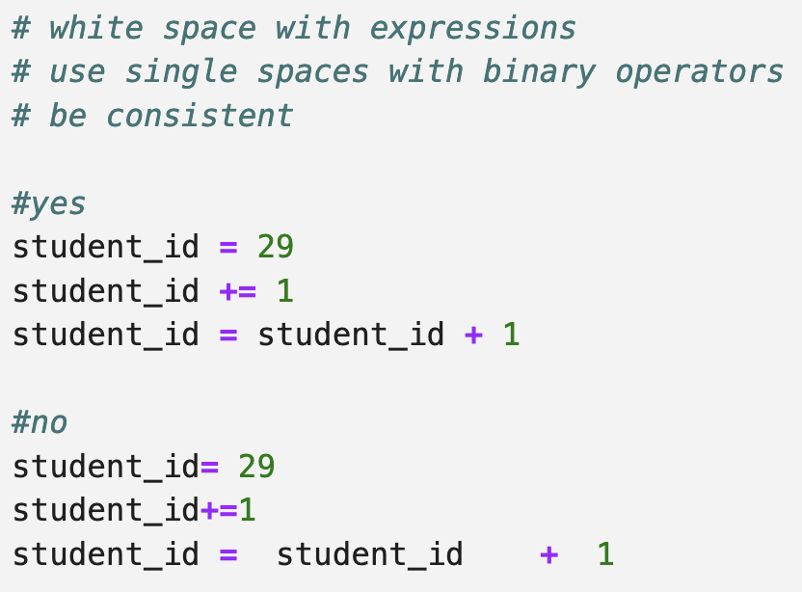
White Space
Surround binary operators with a single white space character

Slide 28
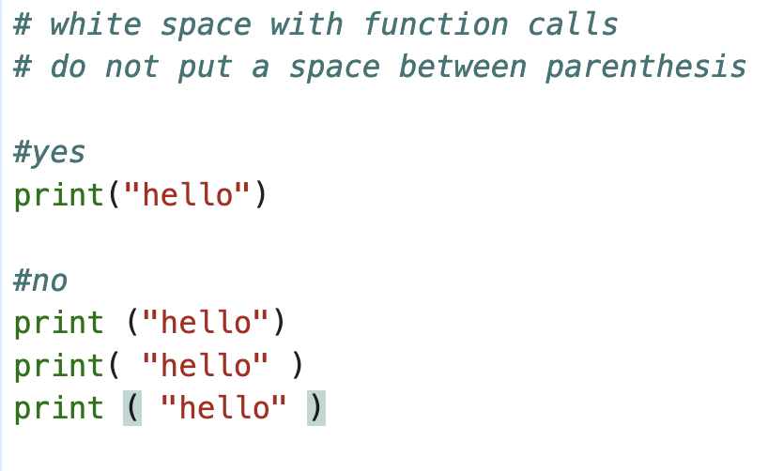
White Space
Avoid spaces with function call expressions

Slide 29
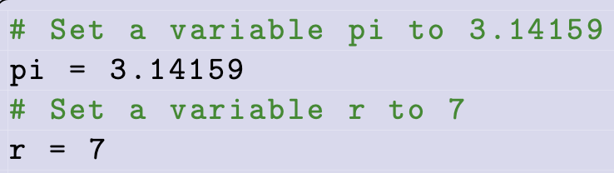
Comments
Avoid using comments to support poorly written code
The comments provides no added benefit
Document the context of the program
Help other programs understanding programming choices
Not a commentary on what lines of code do
Well written code should be self-documenting (good choice of variables, consistent naming and whitespace clear and concise

Slide 30
Functions
Last day we introduced function expressions
A function call returns a value in the place of the call
It might be None (a special value representing nothing)
Functions are a form of abstraction
Generalize a program or procedure based on inputs (called arguments)
In terms of program flow so far we have programs that ”flow” from the first statement (top) to the bottom
When a function is called the program executes the code belonging to the function before continuing “down” to the next code in the program
Some functions accept arguments that are passed to them
E.g max(5, 10)
Arguments passed to the max function

Slide 31
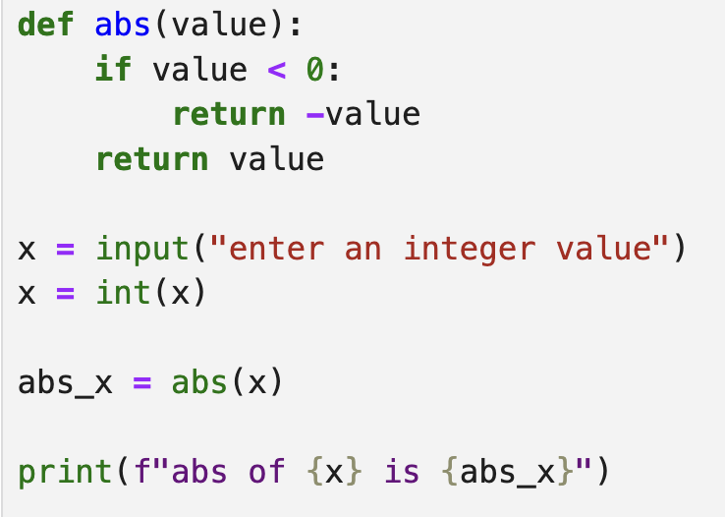
Program Flow Example
This is our own version of the built-in abs
We’ll write our own
Functions later in the course
A function must be defined before it is used
This is why we import math to use math functions
Built-in functions (like abs) do not need to be imported (they are already visible)
First line of program execution
Direction of program flow
Each line in this program calls a method. The program flow will jump to that method and execute its code before continuing

Slide 32
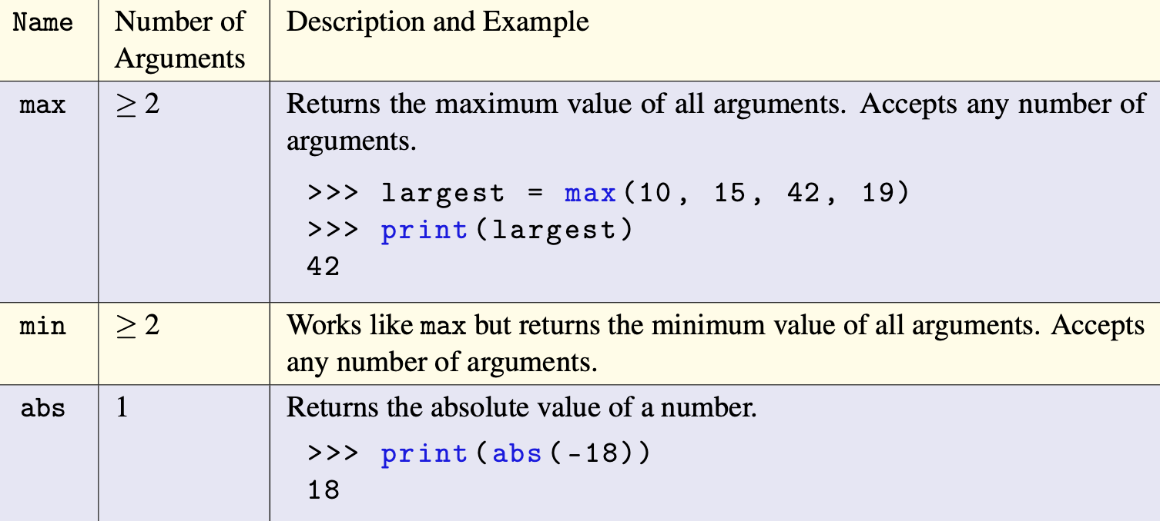
More Built-ins

Slide 33
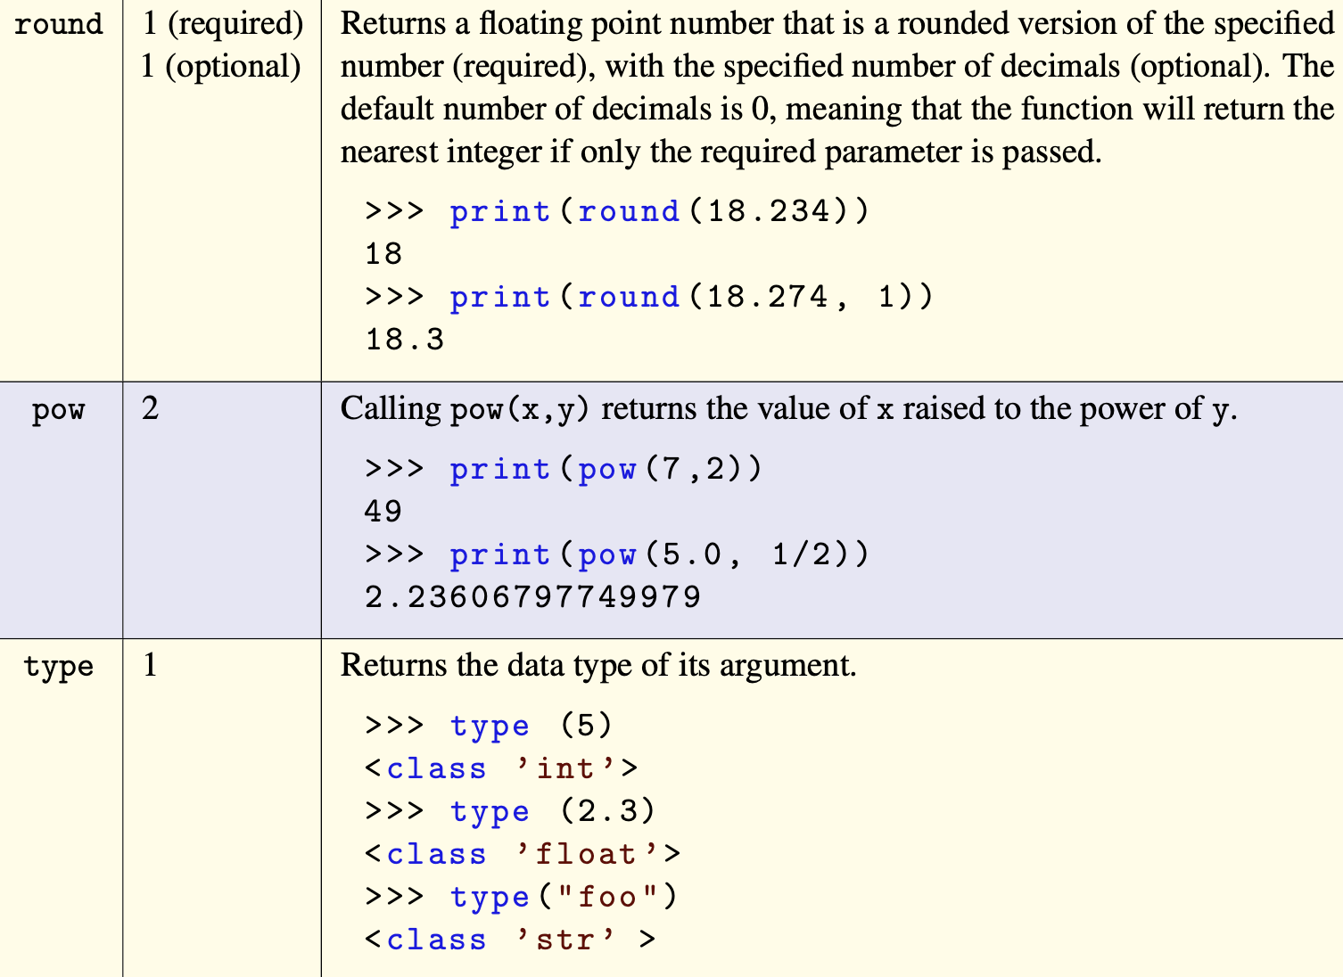
More Built-ins

Slide 34
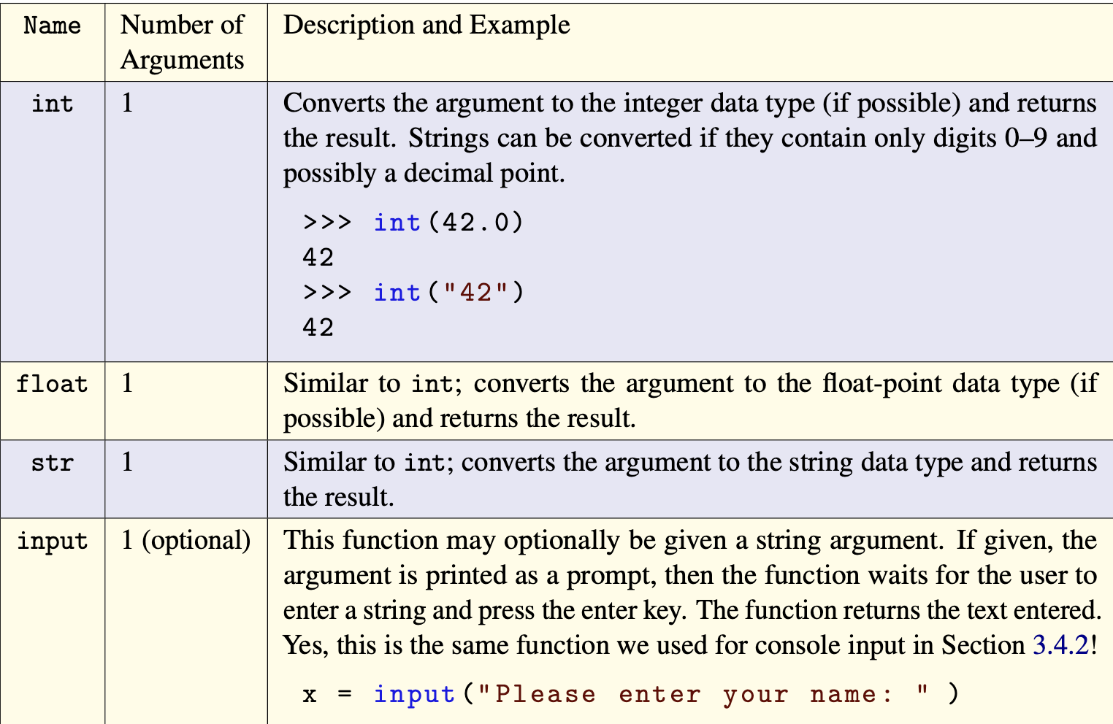
More Built-ins

Slide 35
SELF-CHECK
What is the result?
float(str(f"{max(5,min(5,max(5,1)))}.25")) + int(5.25)

Slide 36
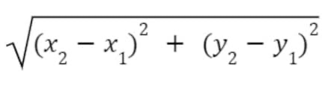
Euclidean Distance
Suppose we have 2 points (x1, y1) (x2, y2) we want to output the distance between the 2 points where distance is given by the below formula:
d =

Slide 37
Try at Home
Prompt the user to enter their first name and then last name, output whichever has more letters in it. Hint use the len built-in function
Create an adding machine to read 2 numbers from the user and then output their sum
Change the Euclidean distance program to instead use Manhattan Distance
https://simple.wikipedia.org/wiki/Manhattan_distance

Slide 38
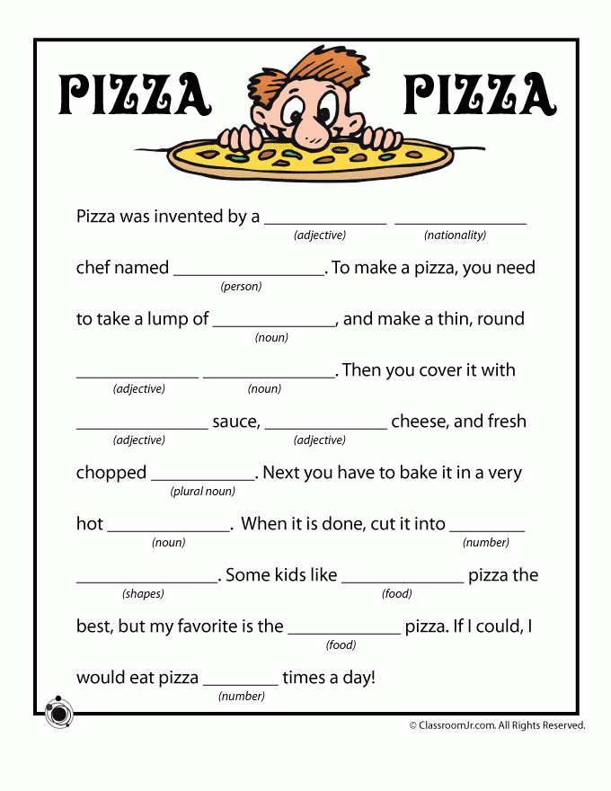
Try at Home
Build a Mad-Libs program, Prompt the user to input each of the blanks in the story to the right. After they have entered all the blanks output the story with the blanks filled in with their answers.
Read the output, hilarity ensues.

