Slide 1
DECISIONS (If/Then/Else)
CS1910
Computer Science I

Slide 2
Questions
Questions from last day?

Slide 3
Code Examples
https://colab.research.google.com/github/cdspower-upei/2026W-CS1910-Students/blob/main/Lectures/L06/L06-Examples.ipynb

Slide 4
Boolean
Recall that Boolean values are either True or False
Boolean expressions evaluate to a Boolean value
Logical Operators
and
or
not
Relational (comparison) Operators
==
>=
<=
!=
>
<

Slide 5
Quick Hitters
What is the result of the expression
42 != 42
42 <= 42
“A” < “A” or “BB” < “BBB”
1 – 1 > 0 and -2 > 0
len(“ABC”) > 0 and not len(“ABC”) < 2
*Logical operators have a lower precedence than Relational operators

Slide 6
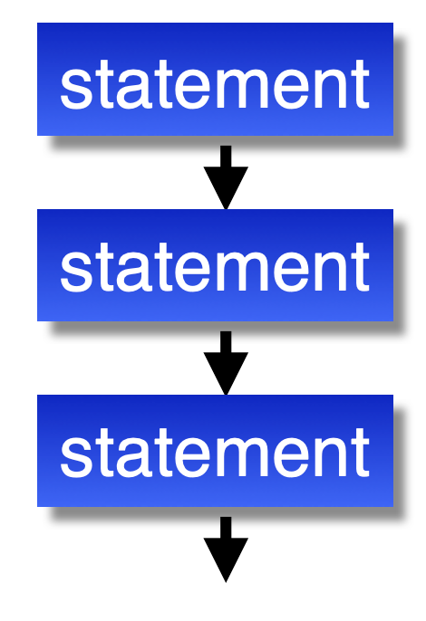
Flow of Control
Typically the flow of our programs has been a sequence of statements executed in order
There are statements that alter this order:
Conditional Statements
Repetition Statements

Slide 7
Conditional Statements
Uses a Boolean expression to determine which statements are executed next (or not executed at all)
Programmers use these to program decision logic
Main types of Conditional Statements:
if Statement
if-else Statement
If-elif-else Statement

Slide 8
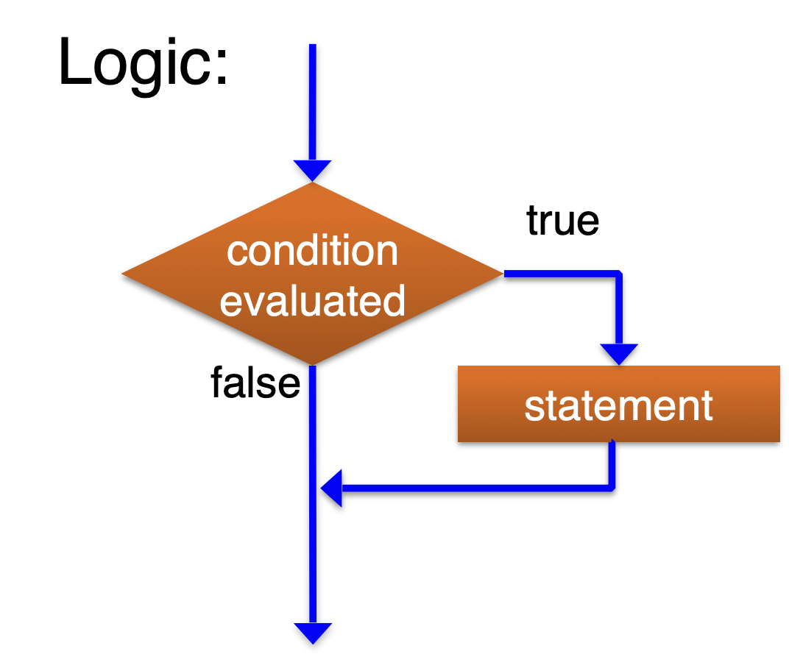
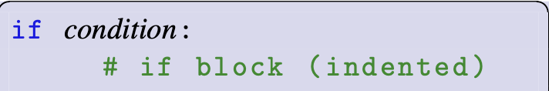
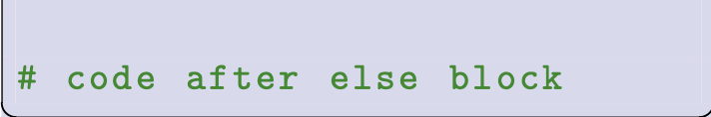
If statement
Code that runs when the condition is True
Must be indented in a code block
Boolean expression or value
End of indentation indicates end of the if block

Slide 9
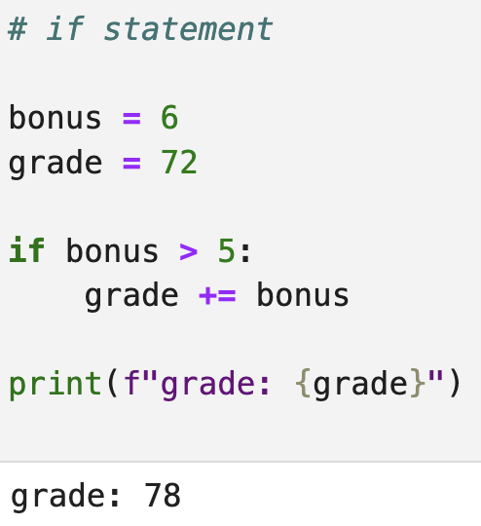
Example

Slide 10
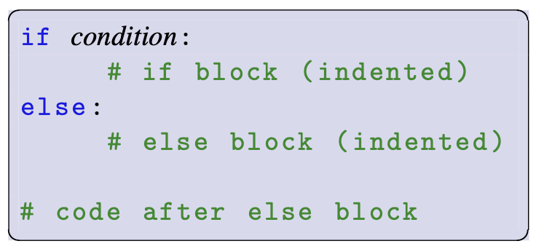
If-Else statement
Boolean expression or value
Code that runs when the condition is True
Must be indented in a code block
The else is optional
Code block that executes if the condition is False

Slide 11
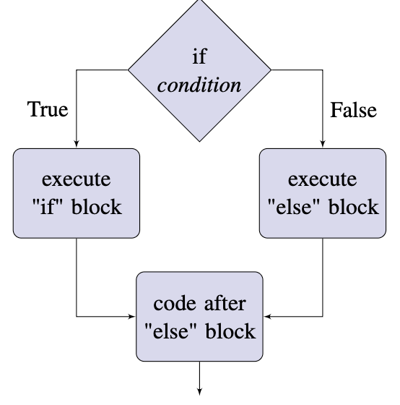
If-Else statement

Slide 12
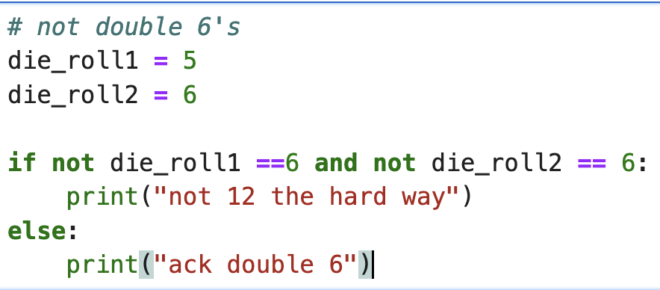
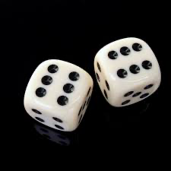
Self-Check
We want to detect that someone hasn’t rolled double 6’s:
What’s the output?

Slide 13
Self-Check
We want to detect that someone hasn’t rolled double 6’s:
ack double 6
Why?
Can you fix the logic?

Slide 14
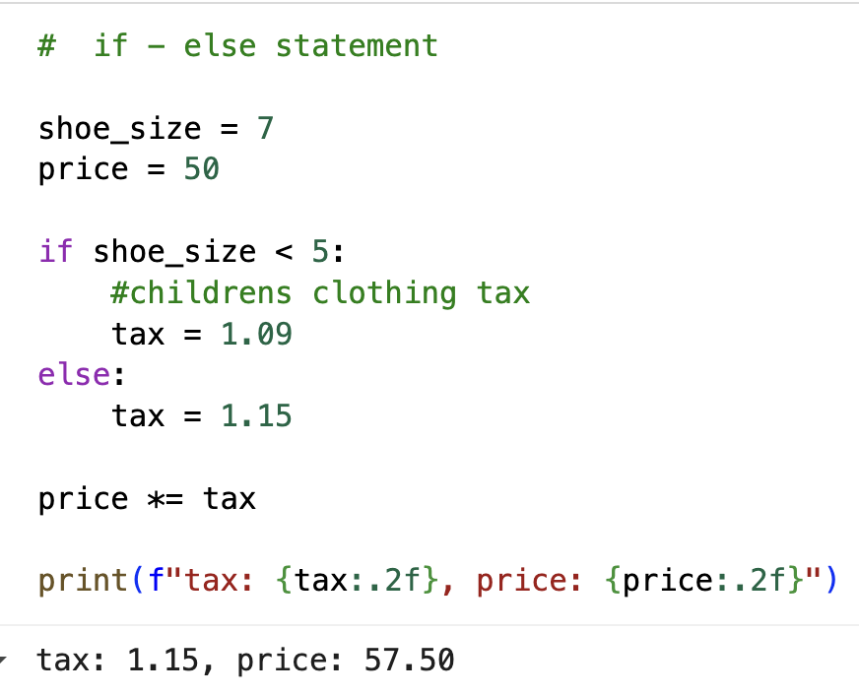
Example

Slide 15
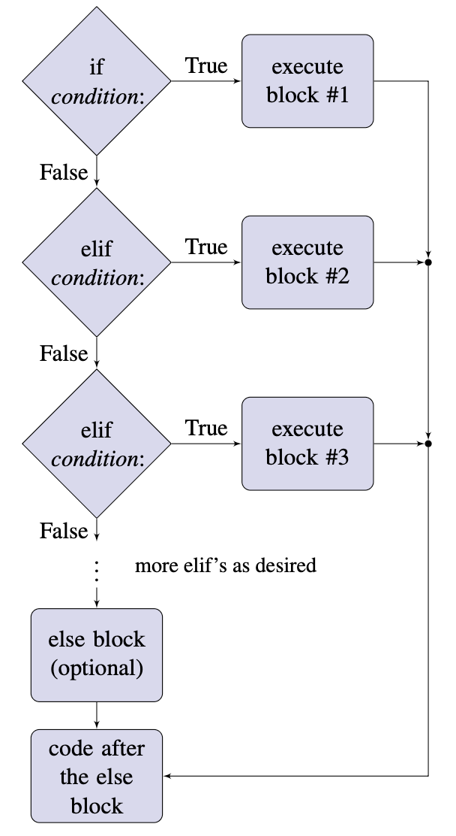
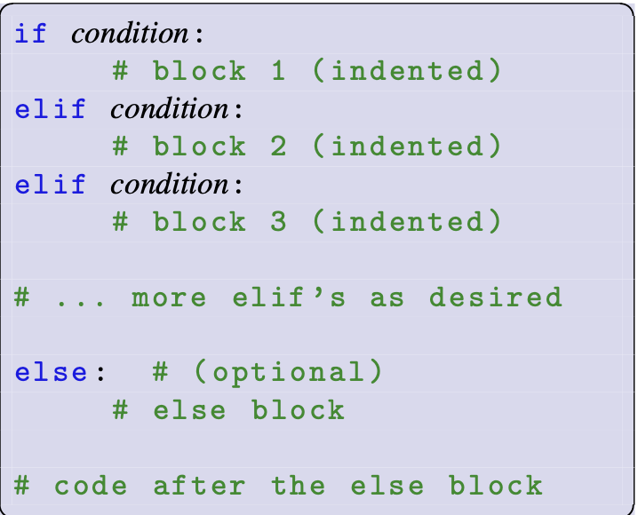
If-elif-Else statement
Only one of these code blocks is executed

Slide 16
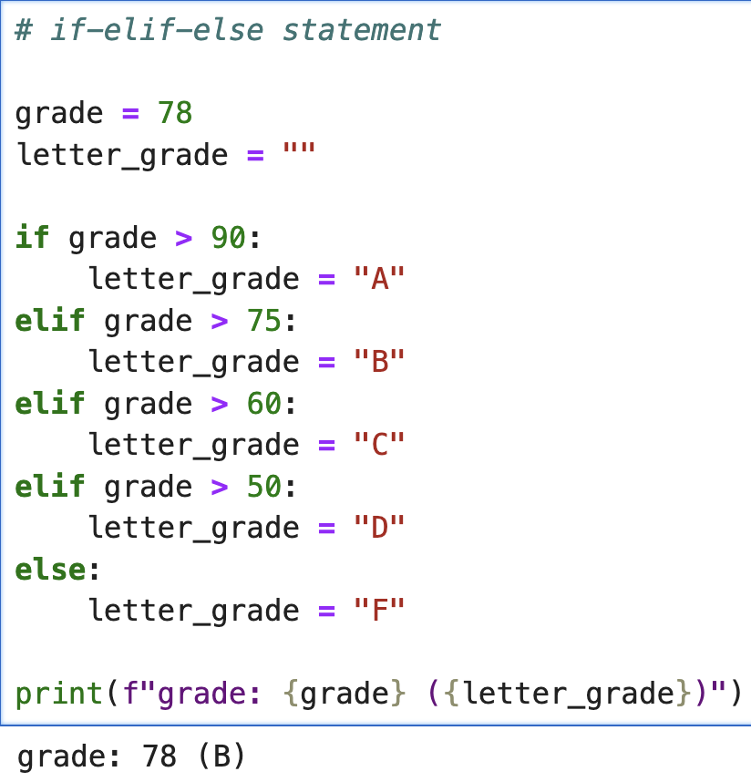
Example

Slide 17
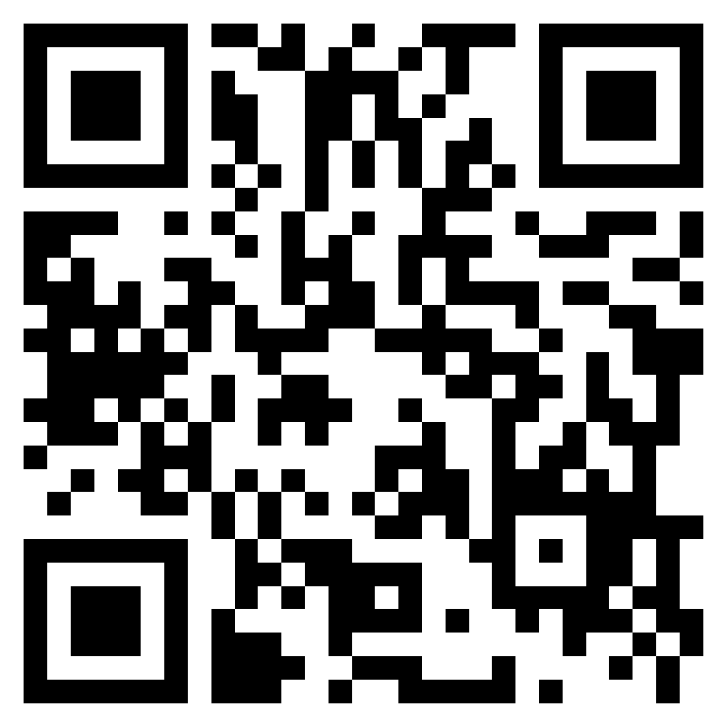
Class Participation
2026W CS1910 05 In-Class Participation Input/Output and Built-ins – Fill out form
Check-in about last class on Input/Output and Built-in Functions

Slide 18
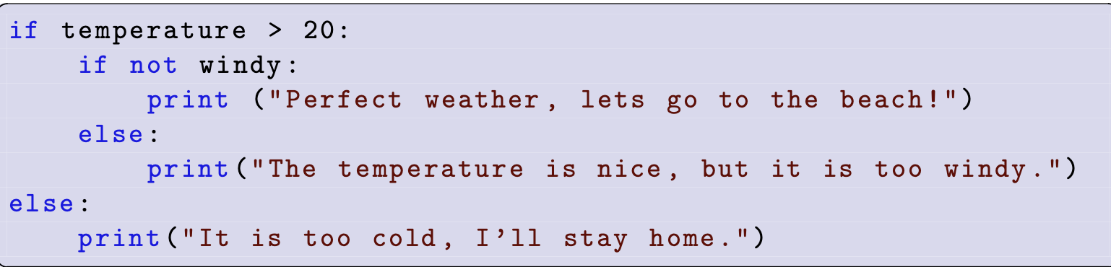
Nested Conditional Statements
Any of the code blocks associated with if, elif or else can also contain a conditional statement (an if …)
We call these nested conditionals or nested if statements
The nested if (inside an if code block) gets its own indented code block
Code block at new
indentation level

Slide 19

Find a Partner
Complete the bank balance example
A customer wants to withdraw money from their account
If they try to withdraw more money than they have you should print an error saying insufficient funds, unless the customer has overdraft protection in which case they are allowed to carry a negative balance.
After the transaction print the balance (regardless as to whether it happened or not

Slide 20

Find a Partner
Complete the Basketball example
In the WNBA
if you are fouled while taking a shot and your shot does not go in, you get the equivalent number of free throws as your shot was worth (2 for a 2 pointer and 3 for a 3 pointer).
If your shot does go in (and you were fouled) you get the appropriate amount of points plus 1 additional free throw.
If you miss your shot and no foul occurs you get no points
If you make your shot and no foul occurs you get the appropriate number of points

Slide 21

Find a Partner
Brain storm another real-world example where we might have complex logic or nested if statements to model it in software

Slide 22

Comparisons PAuse
A few notes about comparisons

Slide 23
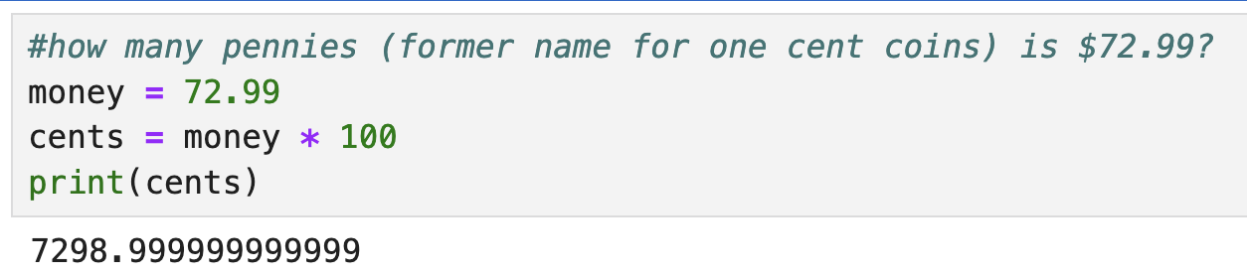
Floating Point Values
Usually we do not use == to compare floating point values
Floating point numbers can be challenging to fully represent in a discrete finite binary system
Just like 1/3 is challenging to represent in decimal, various fractions are challenging in binary (such as 0.1) as they produce long or repeating sequences
This leads to rounding errors and makes it unreliable to compare directly two floating point numbers
Example:

Slide 24
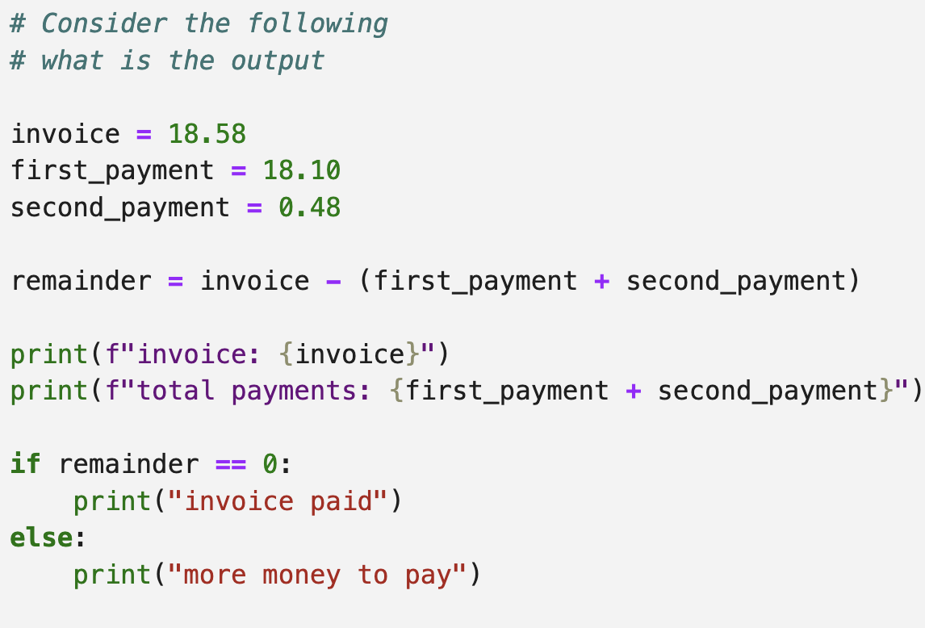
What is the output?

Slide 25
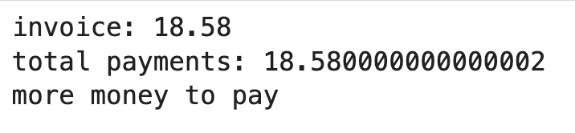
What is the output?
Whoops! That’s not right!

Slide 26
Comparing Floats
2 Solutions to avoid direct comparisons
Use a threshold
Use a library

Slide 27
Threshold
Rather than writing float_variable_1 == float_variable_2
Subtract and compare against a small threshold of acceptance
float_variable_1 – float_variable_2 < threshold
GOTCHA ... Use ABS to avoid issues with negatives
threshold = 0.0000001
abs(float_variable_1 – float_variable_2) < threshold

Slide 28
Math.isclose
The math library has a method isclose that determines if 2 floating point numbers are really close
Has a default tolerance of 9 decimal places but can be configured
math.isclose(float_variable_1, float_variable_2)

Slide 29
Comparing Floats
Fix the code to avoid directly
comparing floating points

Slide 30
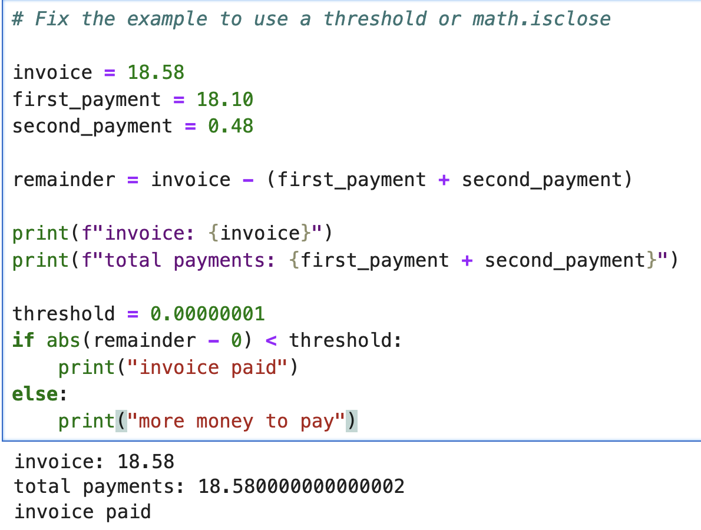
Comparing Floats
Fix the code to avoid directly
comparing floating points

Slide 31
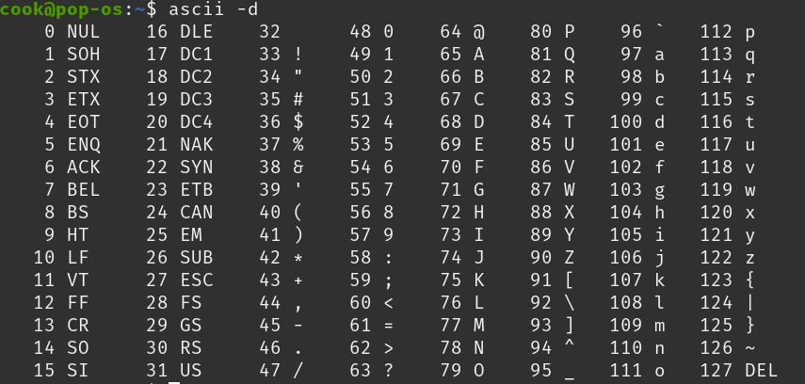
Comparing Strings
Characters are represented as numbers (binary numbers)
For example “A” is character 65,
Strings are compared by their binary code (ordinal number)
“A” comes before ”Z” which comes before “a”
(65) (90) (97)

Slide 32
ord
The python built-in function ord(character) can be used to retrieve the ordinal number for a specified character
Example: ord(“A”) ←returns 65

Slide 33
Self Check
What is the output of the following comparisons?
“BBB” < “aaa”
“a” == “A”
“9” > “8”

Slide 34
Self Check
What is the output of the following comparisons?
“BBB” < “aaa” True
“a” == “A” False
“9” > “8” True

Slide 35
Try at Home
Write a program to ask for the user’s age. For those less than 18 output “Minor” otherwise output “Age of Majority”
Program to read an integer from the user and print whether it is zero, negative or positive
Program to compute and compare Area of Rectangles
Write code to determine if 2 rectangles have the same area:
Rectangle 1 dimensions: 2.49 x 2.49
Rectangle 2 dimensions: 1.0 x 6.2001
There is a small inconsistency in a number comparison program. What is the inconsistency, given an example input that exposes it and then fix it.

