Slide 1
Repetitions (Loops)
CS1910
Computer Science I

Slide 2
Questions
Questions from last day?

Slide 3

Code Examples
https://colab.research.google.com/github/cdspower-upei/2026W-CS1910-Students/blob/main/Lectures/L07/L07_Examples.ipynb

Slide 4
Repetitions
We have seen and been using Repetitions since early in the course but not specifically in Python
Repetitions (AKA) loops allow us to execute code multiple times
When paired with concepts from computational thinking: decomposition and patterns
It allows us to write elegant efficient solutions that are easy to read and maintain
With a bit of experience

Slide 5
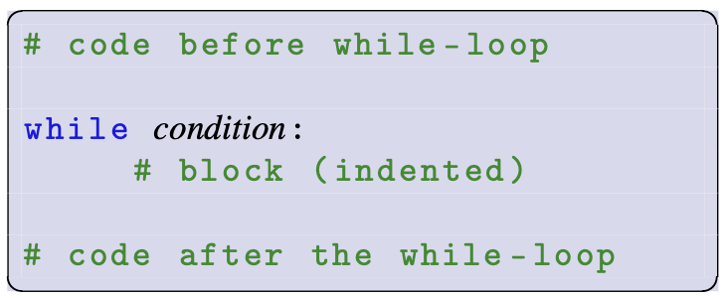
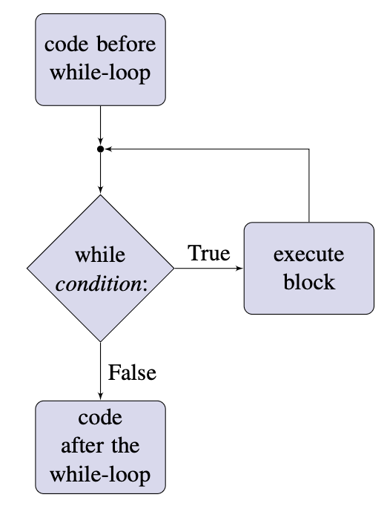
While Loops
Controlled by a Boolean expression, execute specific code until the condition is False

Slide 6
Quick Hitter
What is the minimum number of times the code inside a while loop must execute?

Slide 7
Quick Hitter
What is the minimum number of times the code inside a while loop must execute?
No times! The condition might be initially False

Slide 8
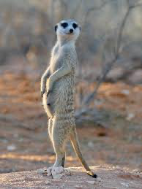
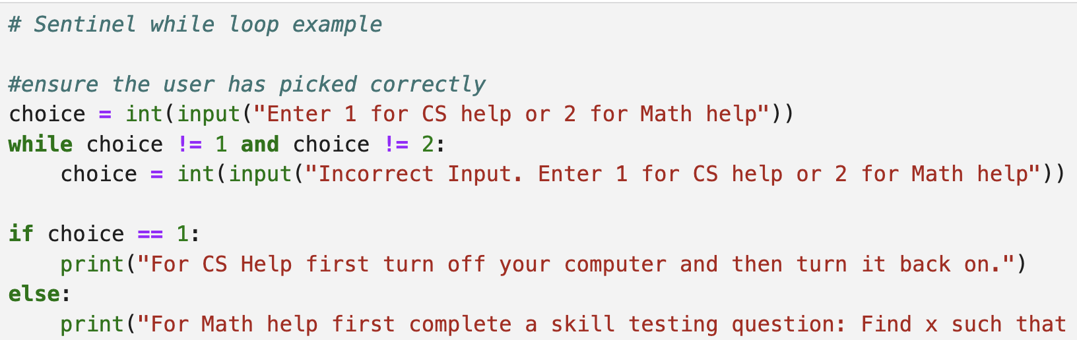
WHILE LooPs
Credit: Wikipedia
A sentinel is something that watches for a specific occurrence
Example: SENTINEL Loop
After the while loop we know that choice must be either 1 or 2

Slide 9
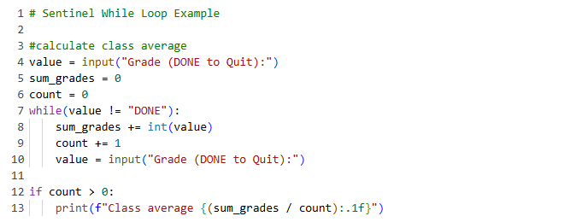
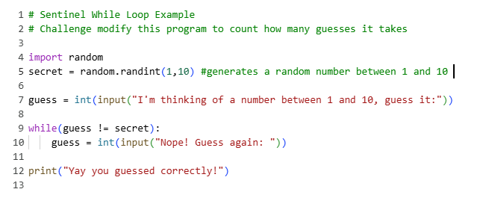
While Loop Examples

Slide 10
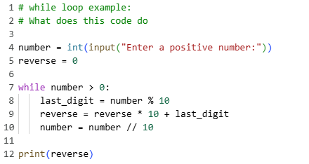
Tracing a While Loop

Slide 11
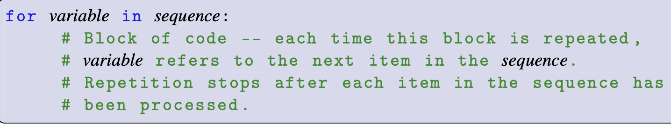
For Loops

Slide 12
Range
Range a sequence of integers starting from some integer start, continuing up to but not including some ending integer stop, advancing step integers at a time
Built-in python function:
range(stop)
range(start, stop[,step])
The stop value is not included (exclusive of the stop)
Used to with for loops to execute an exact number of times (counting loop)
Start defaults to 0 and step to 1
Step is optional, if omitted it defaults to 1

Slide 13
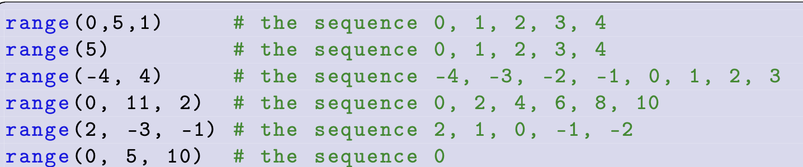
Range Examples

Slide 14
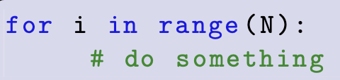
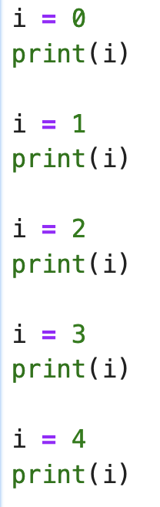

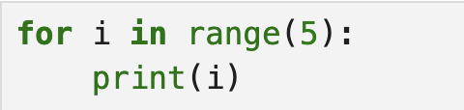
For Loops with Range
For Loop with Range
Equivalent without loops
OUTPUT
Remember: The end value passed to range is excluded
The loop executes 5 times

Slide 15
Conventions
Typically, we avoid single letter variable names
However, it is quite common to use i, j, and k, ... As the counting variable in a for loop
It is always a good idea to ask yourself if another name is more appropriate
You may see the use of an _ as the variable name for use in a for loop
This is a valid variable name but it indicates that the counting variable for the loop is not used in the loop.
i.e., you want to do something a specific amount of times but there is no regard for which iteration it is

Slide 16
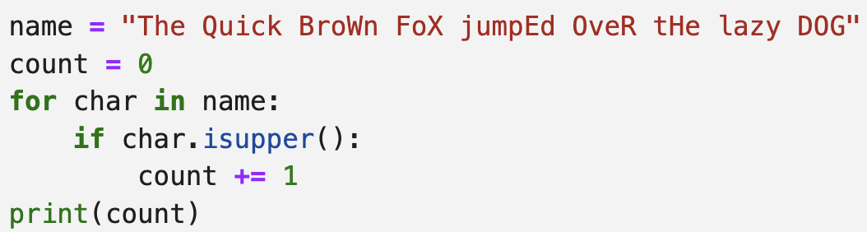
Sequences and for Loops
The only sequence so far (aside from the built-in range) we have seen is a string
A for loop can process each of the letters in a string

Slide 17
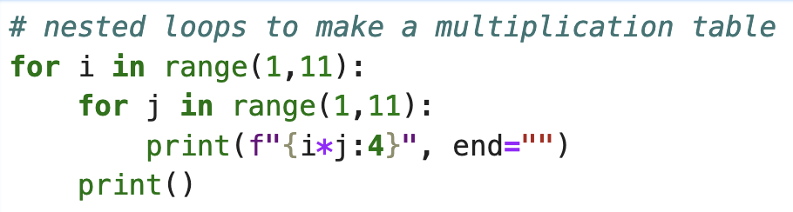
NESTeD Loops
When loops are nested a few lines of code can create complex iterations
Belongs to outer loop
Pad with 4 spaces
Instead of newline after the print use empty string

Slide 18

Class Participation Pause
2026W CS1910 06 In-Class Participation Conditionals – Fill out form

Slide 19
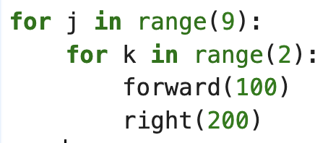
Nested Loops with Turtle Draw
What shape does this create?

Slide 20

Nested loops with turtle draw

Slide 21
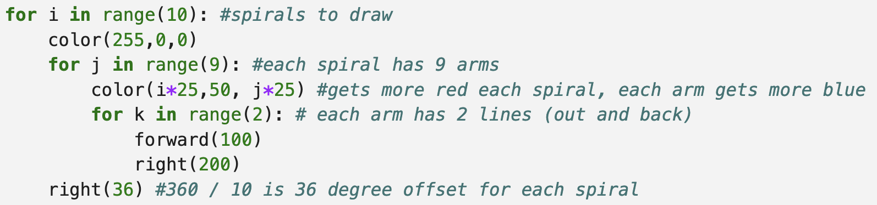
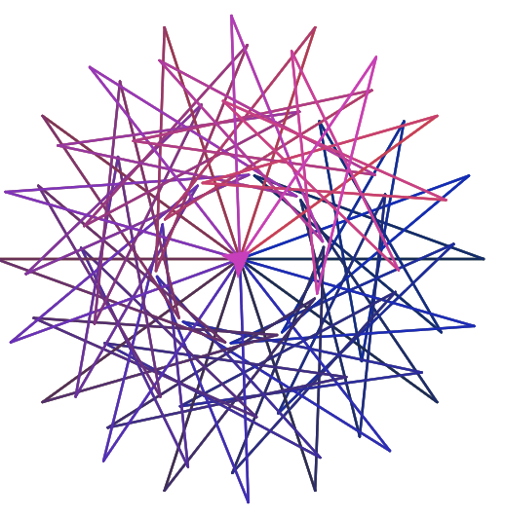
Triple nested Loop

Slide 22
Beware
Infinite loops are loops that run forever
(sometimes by design … a web server listens for connections forever)
Often because we have a bug … forgotten to increment a counter, broken logic, etc
Indentation is critical
Code blocks are denoted by indentation levels
Variables can be declared and assigned inside code blocks (decision or repetition)
Is this efficient, is there a case where the variable is not declared because it was inside a loop and the loop didn’t run

Slide 23
Find a Partner
Warm-up:
Modify the random guess While loop example so that it counts how many guesses the user took to get it right. Print out how many guesses
Challenge:
Modify the random guess While loop example so that after they have guessed correctly it asks them if they want to play again. If they do not want to play again it outputs their average number of guesses to correctly complete the game.
Think about:
If you played the game one thousand times what do you expect the average number of guesses to be?

Slide 24
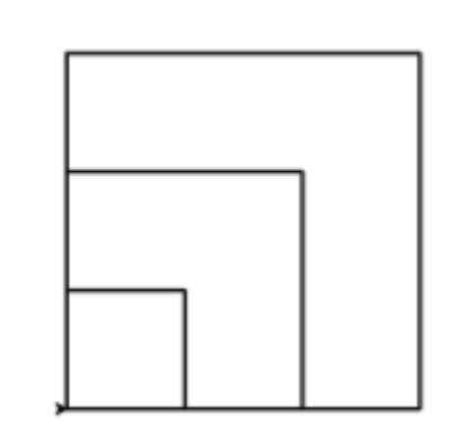
Find A Partner
Use colabturtleplus to draw the nested square shape
1. Decomposition
- what are the basic operations we need to do?
- don’t forget our previous work drawing a single square
2. Patterns:
- what are the patterns (or patterns within patterns)
3. Algorithm
Outline in pseudo code your algorithm
4. Lastly – move onto the code

Slide 25
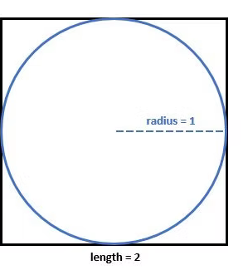
Throwing Darts
Thinking exercise
Cool simulation
Suppose you have a dart board with radius 1 and you place a square with side length 2 directly behind the dart board.
Consider that your pet monkey throws darts at the board with equal chance it lands anywhere within the square
How many darts would land inside the circle?
What percentage of the area is covered by circle?

Slide 26
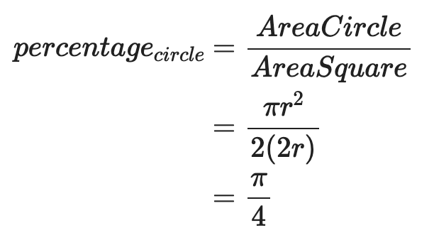
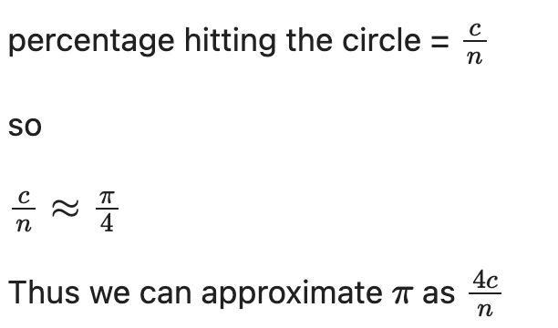
Simulating PI
Remember the monkey throws darts with equal chance of landing anywhere in the square
Darts hitting the circle
Total darts

Slide 27
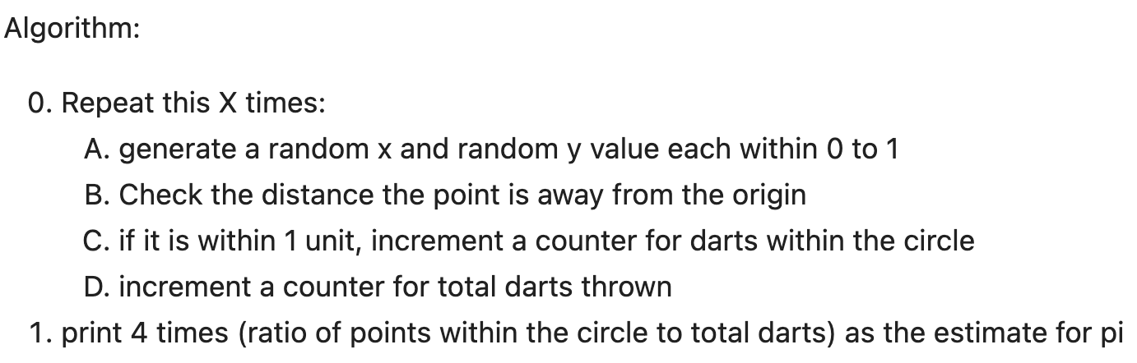
Algorithm to Simulate PI

Slide 28
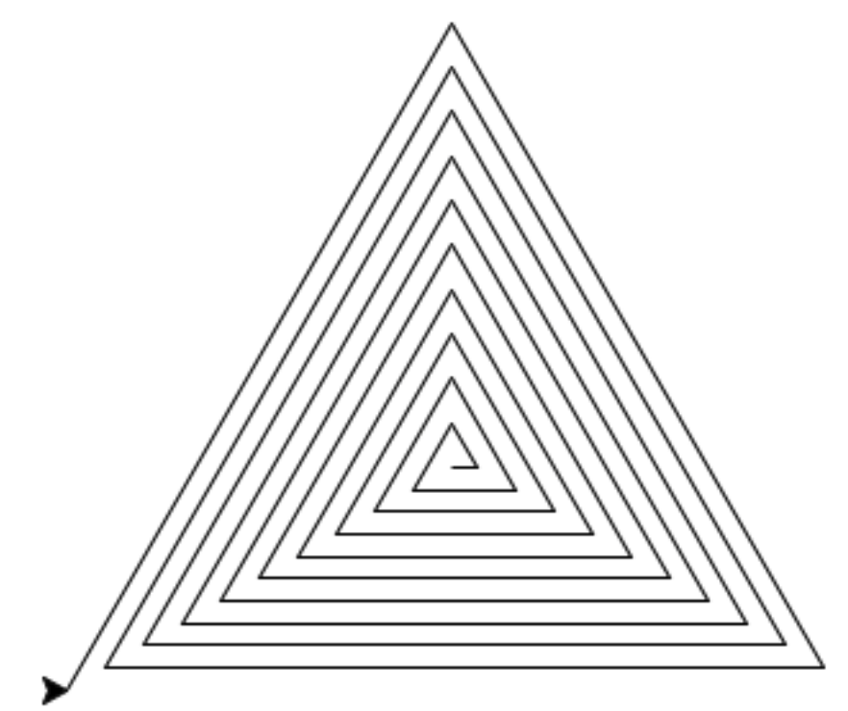
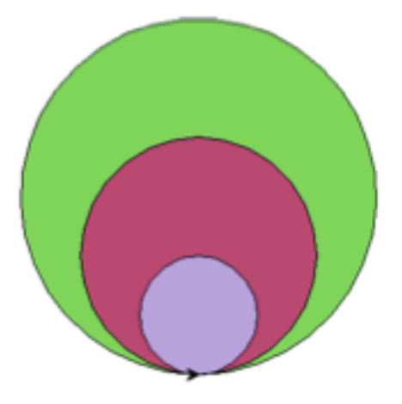
Try at Home
Walk through the Sentinel Loops in the Try At Home Sentinels block.
Modify the guess game:
Make it so the guesses are random as well and are not user input.
Count how many guesses it takes to get it right.
Simulate 100 games.
Track and print the average number of guesses needed to win the game.
Complete the code to simulate pi.
Use loops to draw a nested circle.
Use loops to draw a triangle spiral

