Slide 1
FUNCTIONS
CS1910
Computer Science I

Slide 2
Example Code
https://github.com/cdspower-upei/2026W-CS1910-Students/blob/main/Lectures/L08/L08-Functions-Examples.ipynb

Slide 3
Functions
We have been using functions since the start of the course
Examples: input(…), print(…), len(…), abs(…)
We can write our own functions
This is another form of abstraction
Recall from Computational Thinking
Abstraction is a mechanism to filter out specifics and generalize a process
The print method allows us to display information on a console but we don’t really know how it works
It accepts various common data types, lengths of output, etc

Slide 4
Functions
Group a set of command into a single reusable block of code
The code can be parameterized
i.e., it can accept details provided as variables
Simplifies code
Aids understanding, readability and maintenance
Increases efficiency
Hides complexity

Slide 5
Functions
Can “return” or produce values
Variables declared within a function belong to the function (their scope is restricted to within the function
Variable names within a function do not obscure or collide with those from other areas of your code
When we call a function we may pass an argument to the function, but in the function definition we call those parameters

Slide 6
Cohesion
The degree to which the code within a function (or grouped in general) fits together and contributes to a single purpose (singular responsibility)
High cohesion: code within a function accomplishes one task
Leads to easier testing, higher maintainability and higher readability and reuse
Low cohesion: code within a function accomplishes many tasks or unrelated tasks
Leads to more brittle solution, less reuse and less ability to maintain and understand
Our goal
Determining where to introduce functions and how to define them to improve cohesion
is a skill that can be improved with practice

Slide 7
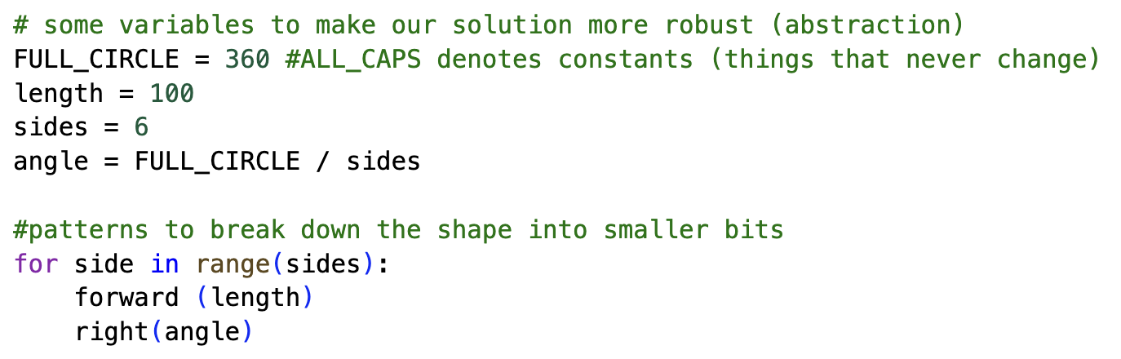
Example: Draw a Polygon
Recall from our prior class examples drawing a regular polygon
We used aspects of computational thinking to create a beautiful program:
If I want to draw different shapes I need to change these variables
If I want to draw 2 shapes I need to cut and paste this code multiple times

Slide 8
Draw a polygon
Reuse the code by wrapping it into a function
Parameterize the solution so we can draw different shapes by specifying what we want when we do the drawing
Parameters that that function accepts
Pseudo Code:
FUNCTION polygon (sides, length)
angle = 360 / sides
for side in 0 to sides:
forward(length)
right(angle)
END FUNCTION
polygon(6, 20) #draw a 6-sided polygon with side length 20
polygon(10, 6) #draw a 10-sided polygon with side length 6
Arguments passed to the function (take the place of the respective parameters)
Defining the function in pseudo-code
Calling the function

Slide 9
Draw a polygon
similar code without functions
Pseudo Code:
FUNCTION polygon (sides, length)
angle = 360 / sides
for side in 0 to sides:
forward(length)
right(angle)
END FUNCTION
polygon(6, 20)
polygon(10, 6)
sides = 6
length = 20
angle = 360 / sides
for side in 0 to sides:
forward(length)
right(angle)
Repeated code is something to watch for (Patterns) to indicate that functions can offer an improvement
Repeated code is double the maintenance
sides = 10
length = 6
angle = 360 / sides
for side in 0 to sides:
forward(length)
right(angle)

Slide 10
Example: Calculate the area of a rectangle
Math formula: area = length x width
Pseudo Code:
FUNCTION rectangle_area (length, width)
area = length * width
RETURN area
END FUNCTION
length = 10
area1 = rectangle_area(length,20)
area2 = rectangle_area(5,6)
Send this value back to the calling site
This variable is unrelated to the length parameter
Calling site

Slide 11
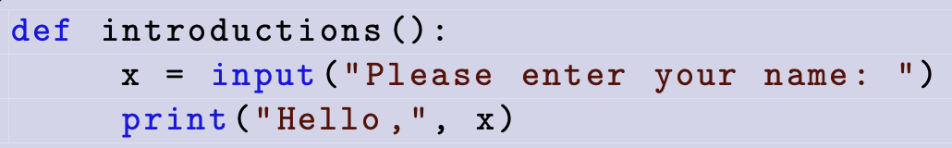
Python Function Syntax
Function definitions start with the def keyword
Parameter list
colon
Indented code block indicates the code that belongs to the function

Slide 12
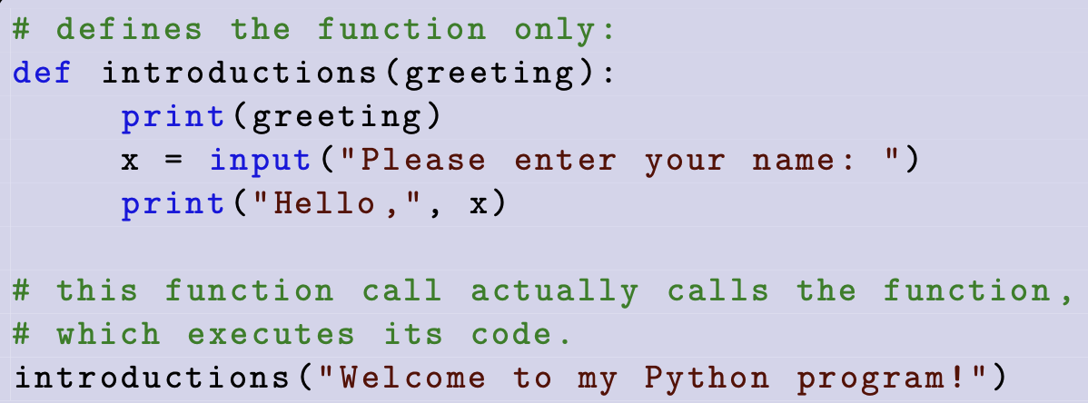
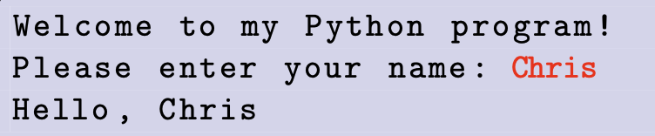
Function with Parameters

Slide 13
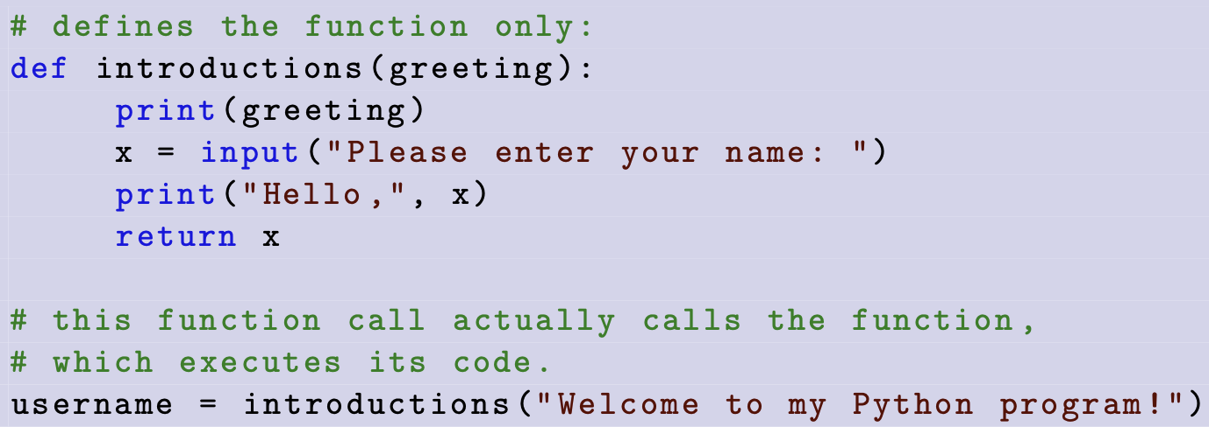
Function with Return Value
*Functions that do not have a return statement will return the value None

Slide 14
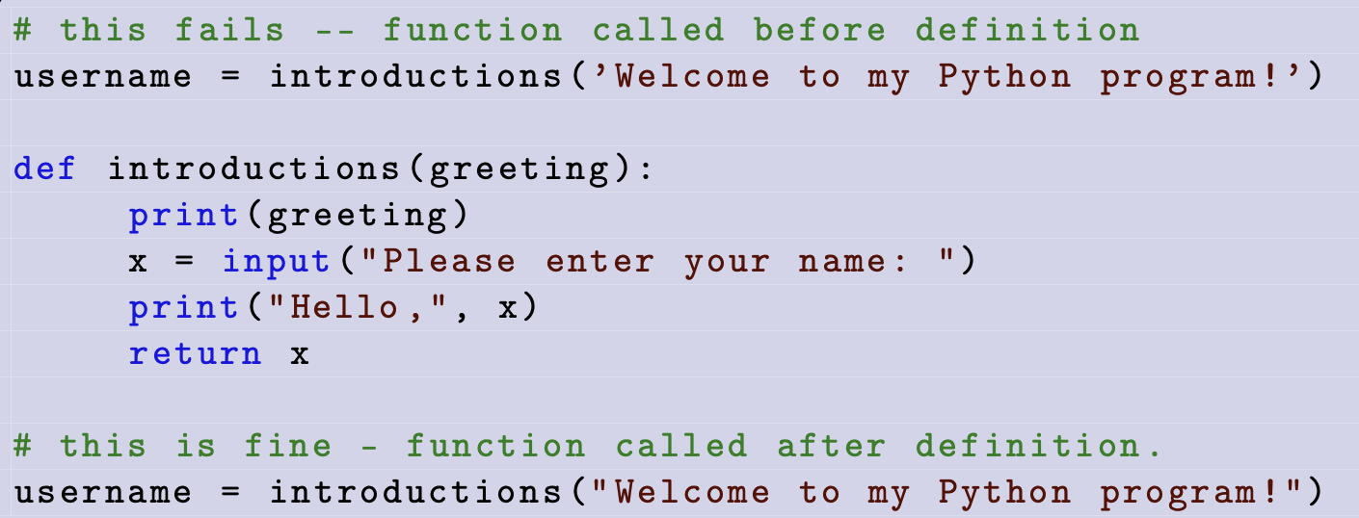
Define then Call
A function must be defined before it is called
*Note that colab can produce some anomalies if you rerun code cells
Or edit code cells that are above other cells after those lower cells have been run

Slide 15
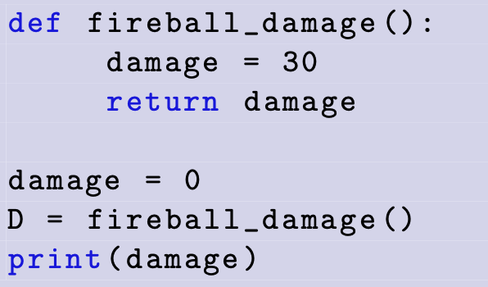
Self-Check
What is the output?

Slide 16
Self-Check
This variable lives inside the function only
(its scope is just within the function block)
What is the output?
0

Slide 17
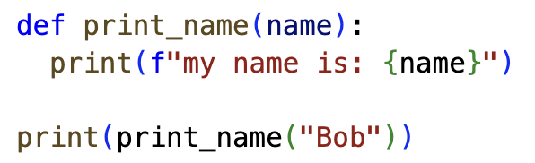
Class Participation
What is wrong with the code?

Slide 18
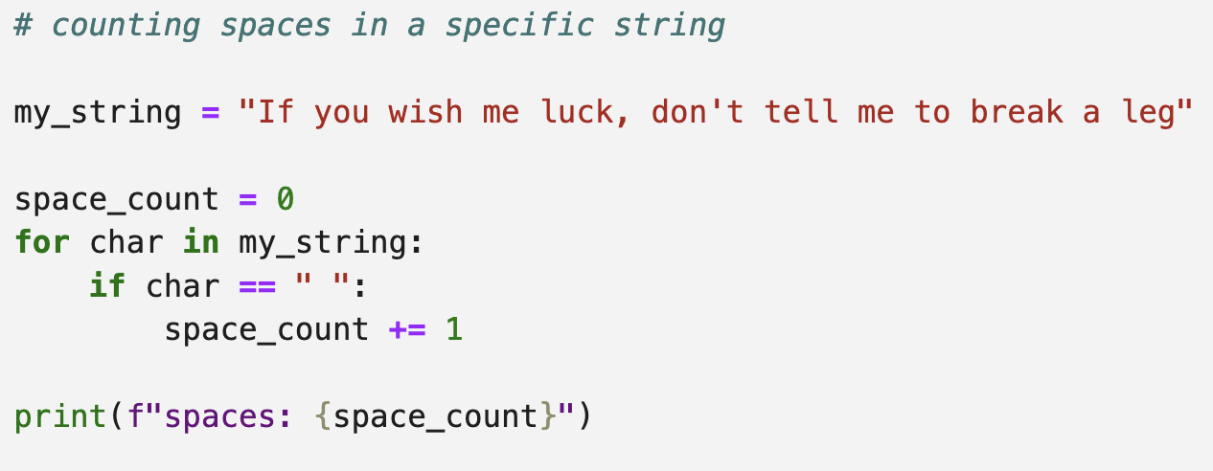
Generalizing Code
Consider the following code to find spaces in a string

Slide 19
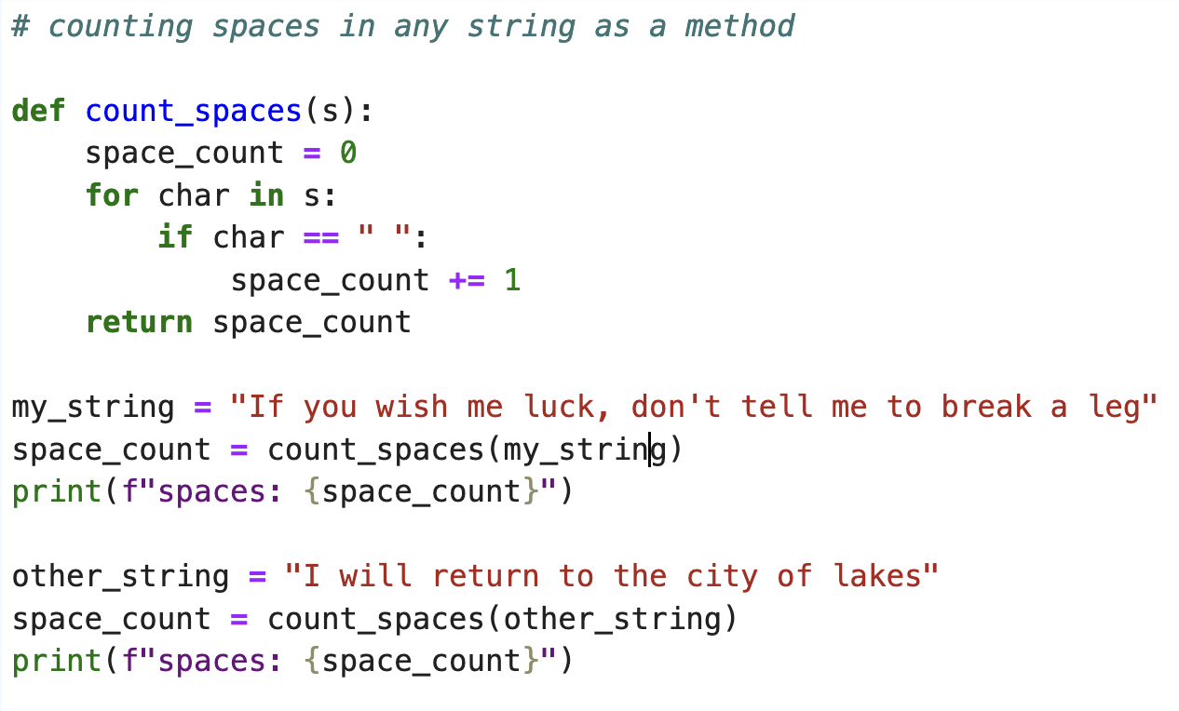
Generalizing
Count spaces in any string

Slide 20
Generalizing
Generalization is the process of modifying a function / algorithm so that it can solve a wider range of problems
Can we further generalize our counting spaces solution?

Slide 21
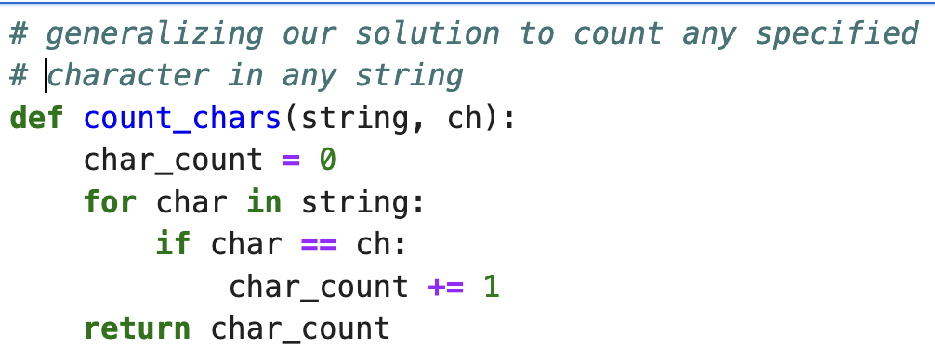
Generalizing
Count any character in any string

Slide 22
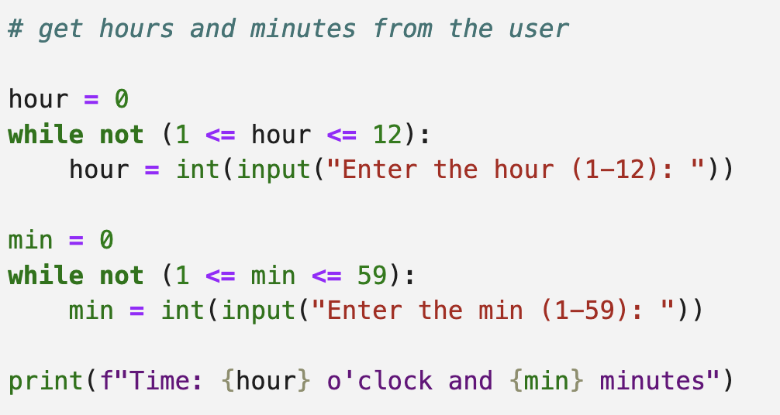
Find A Partner
Consider the following code
What patterns do you see?
Can you use functions to improve it?

Slide 23
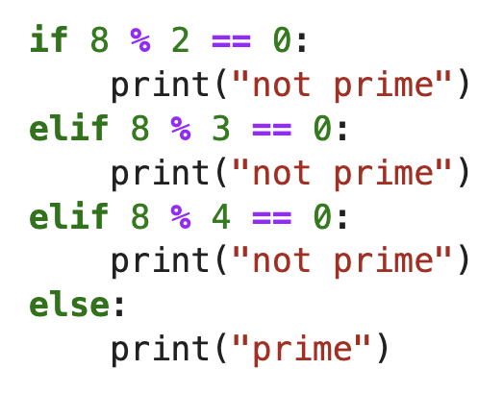
More Find a Partner
Find all prime numbers between 25 and 75
The following code can print out if 8 is prime or not:
Improve this approach through functions to generalize a solution

Slide 24
Documenting Functions
Triple quotes denote a docstring “”” or ’’’
Docstrings are used for general purpose documentation to other programmers who may want to make use of your code (as opposed to comments that might explain inner workings of code)
A docstring should be used on all methods to outline what the method does and how to use it
Each parameter should be documented
The return value and type should be documented

Slide 25
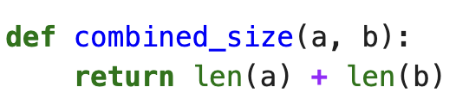
Documenting Functions
Imagine if we had to read the implementation of function to understand how to use them …
Other programmers should be able to read a few lines of documentation to understand what your function does and what type of arguments you can pass to it
Without reading the code someone might expect this to work with integers or floating point values
Reading the code to determine how to use something, is not a reasonable ask (nor desired)
Akin to disassembling your microwave and examining the circuitry to know how to heat up your food

Slide 26
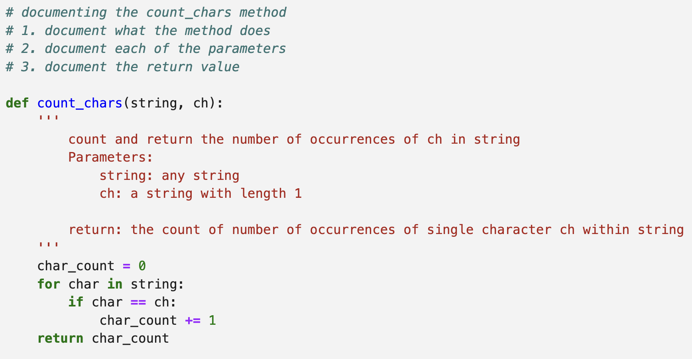
Documentation

Slide 27
Type Hints
We can add a form of documentation called a hint to our methods (to any variable actually)
Indicate what type of variable is expected when using a function (or what the return value is) int, float, str, etc
Use the semi-colon after the variable name to indicate a type hint
For this course we mostly focus on built-in types like int, bool, float, str, etc
More advanced forms of type hinting are available

Slide 28
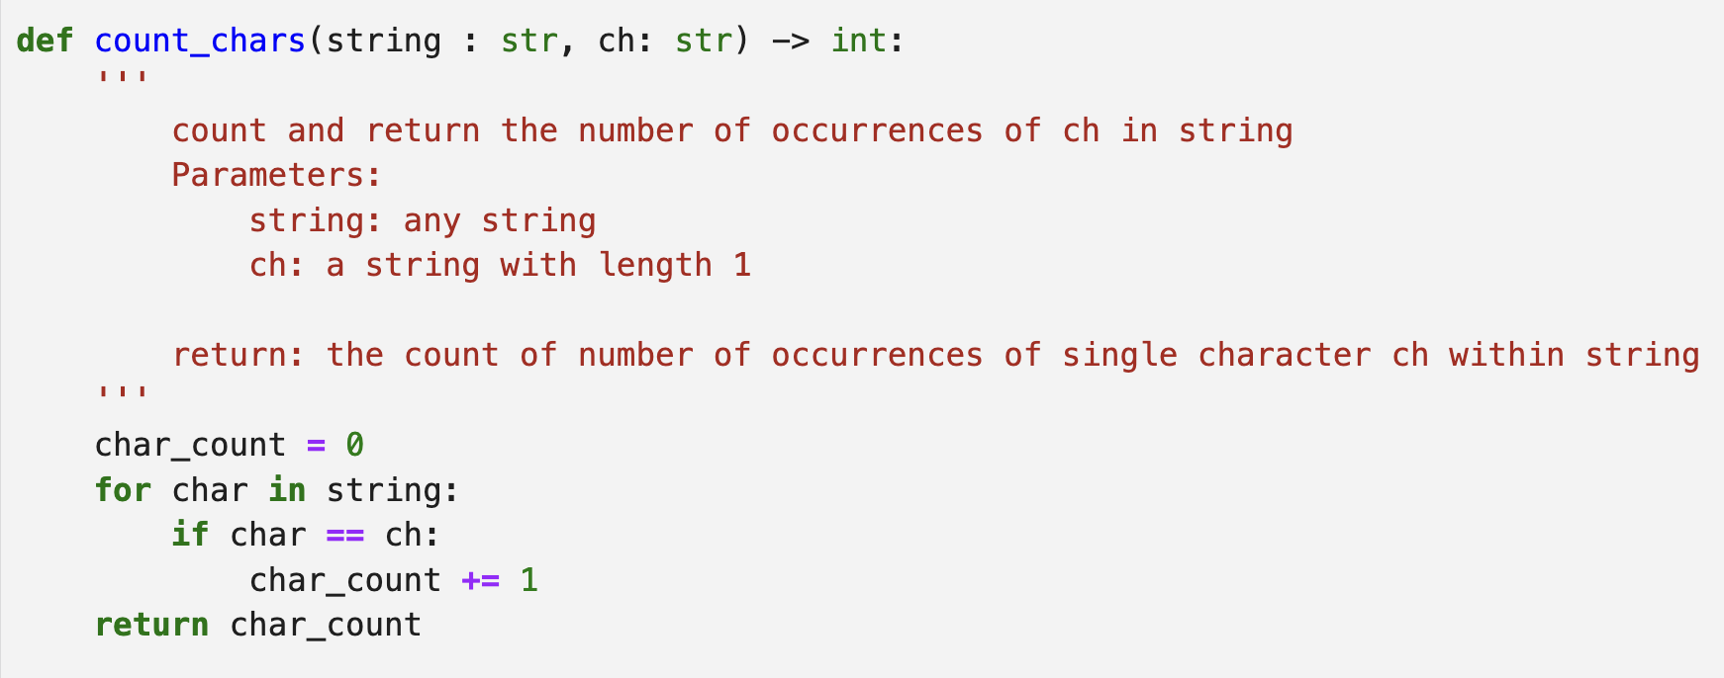
Ex: Type hints
Type hints
Return type

Slide 29
Default Arguments
Default arguments allow users to use your function without supplying some of the arguments.
In the case that an argument is omitted its default value is used
Default arguments must be placed at the end of the argument list
Once a default argument is intended all the rest of the arguments are left off as well
Improve function flexibility by allowing them to be called with fewer arguments

Slide 30
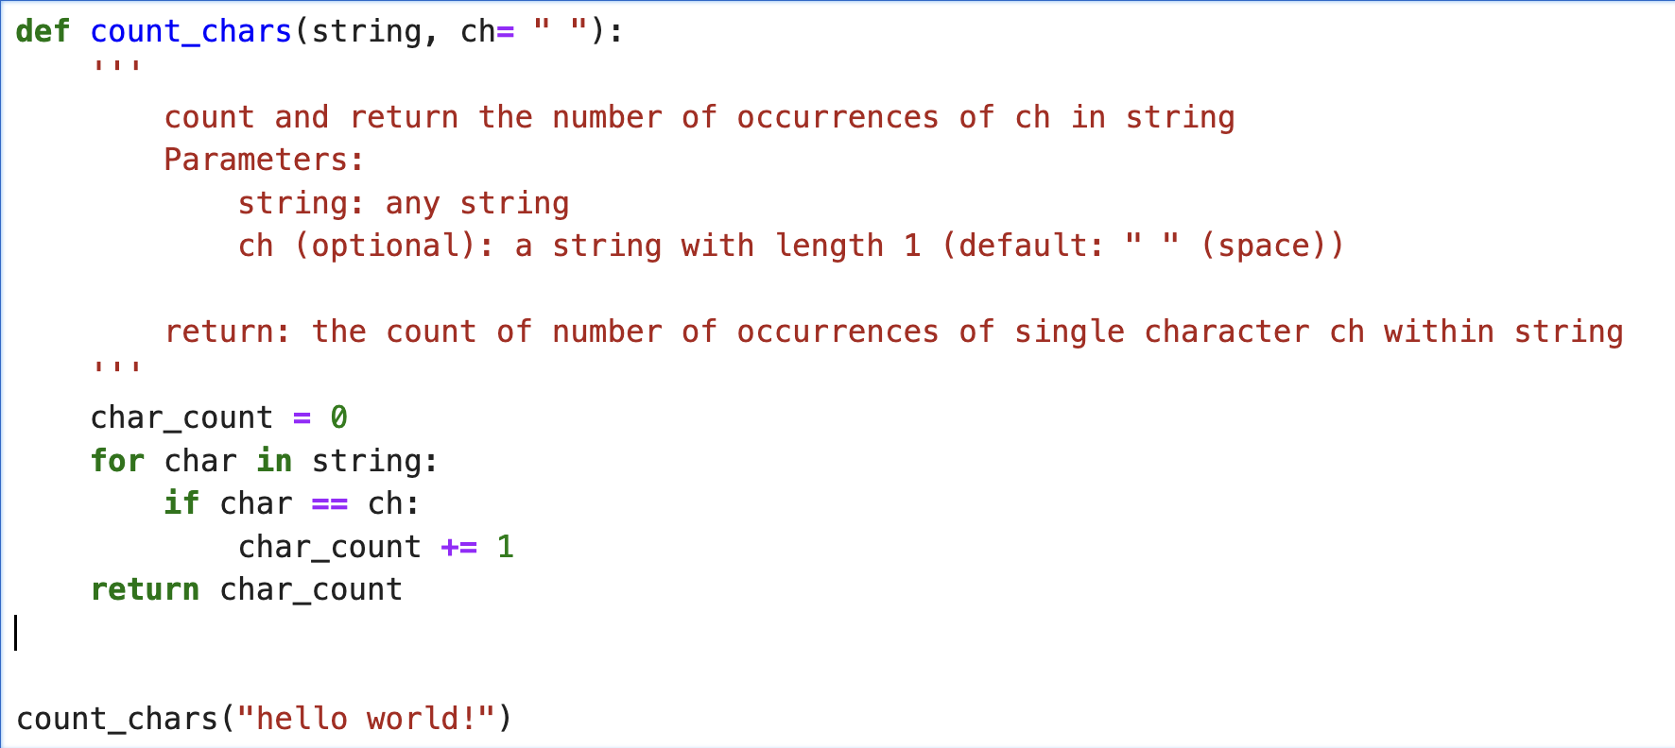
Default Arguments
If ch is not supplied as an argument “ ” is used

Slide 31
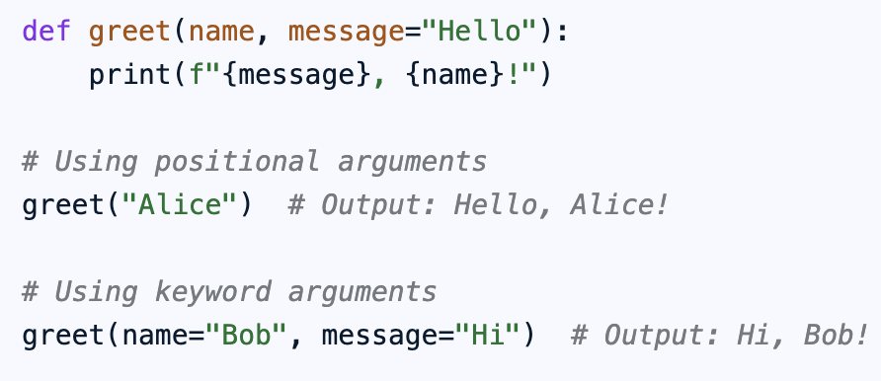
Keyword Arguments
So far we have used what is called position arguments in our function calls
We supply the arguments left to right that match the parameters left to right (implicitly)
We can also supply arguments using the explicit parameter name of the argument

Slide 32
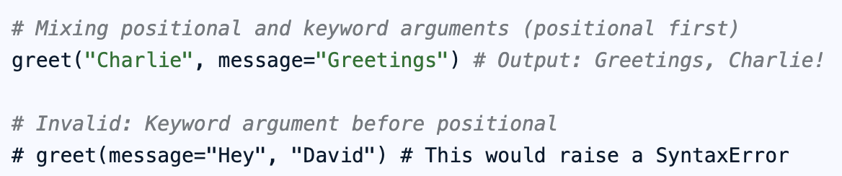
Keyword Arguments
Can improve readability
For long argument lists explicitly stating the parameter names can aid readability
Can improve flexibility with default arguments
By explicitly naming some arguments you can leave others to default values with increased flexibility
Can be combined with positional arguments
BUT positional arguments must come first

Slide 33
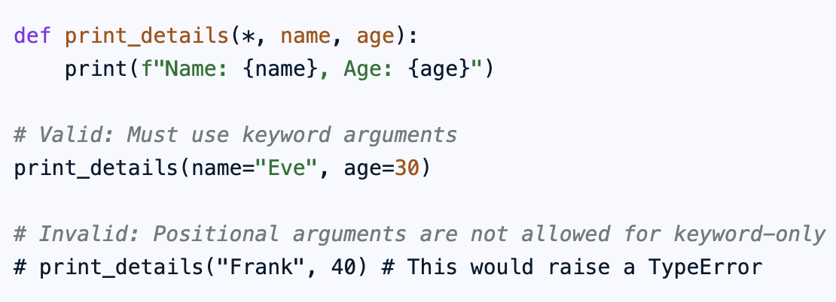
Keyword Arguments
Can force the use of keyword arguments by placing an asterisk in the function definition

Slide 34
Try at Home
Convert our old turtle draw program to draw a square into a method (how can it be generalized?)
Write a method that returns a reversed version of a string, i.e., if the input is "Madam" it will return "madaM"
Write a method that converts an integer between 0 and 10 to the appropriate word for that value, e.g., 1 converts to "one”
Write a program to repeatedly ask the user to input single letters (“A”, “B”, “C”,etc) but stop the program when the user enters a letter that they entered previously. Use methods with high cohesion.
No list or dictionary required: concatenate the letters in a string

Slide 35
More Try at Home
Write a method to ask the user to enter ‘Y’ or ‘N’, return their choice
Find an old example from class, determine where and/or if methods could be used to improve the example
Create a method to determine the middle number from 3 numbers passed as arguments to the method, it should return the middle number. Use keyword arguments when calling the method

