Slide 1
SEQUENCES
CS1910
Computer Science I

Slide 2
Code Examples
https://colab.research.google.com/github/cdspower-upei/2026W-CS1910-Students/blob/main/Lectures/L09/L09-Sequences-Examples.ipynb

Slide 3
Sequence
Compound data type consisting of one of more pieces of data in a specific order
An example sequence is a string
my_string = “HELLO”
Multiple pieces of data in a specific order

Slide 4
Indexing
Each data item in a sequence has a position (aka an offset)
The position is denoted using an integer
This string has 5 characters, the first character is at offset 0 the last character is at offset 4
Starting our counts from 0 takes some practice / getting used to
Character
H | E | L | L | O
0 | 1 | 2 | 3 | 4
Offset Position

Slide 5
Indexes
To access a character from a string you can use square brackets [ ]
Example:
my_string[1]
# accesses my_string at offset 1 (or the letter ”E”)
Although we say this accesses a character or letter from the string, what is returned is also a string (just a string with one character)
Again, note that offset 1 is the 2nd character position or E (not H)
my_string
Character
H | E | L | L | O
0 | 1 | 2 | 3 | 4
Offset Position

Slide 6
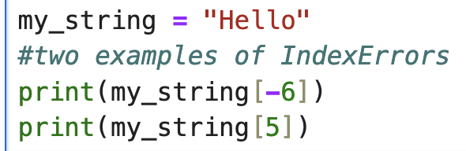
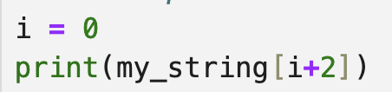
Indexes
Offsets can be negative
-1 is the last letter in a string it is preceded by
-2 is 2nd last letter in a string and so on
IndexError: string index out of range
Error produced if you try to access an index position that is off the end of the string
Example:
Indexes can also be expressions:
Must be an integer

Slide 7
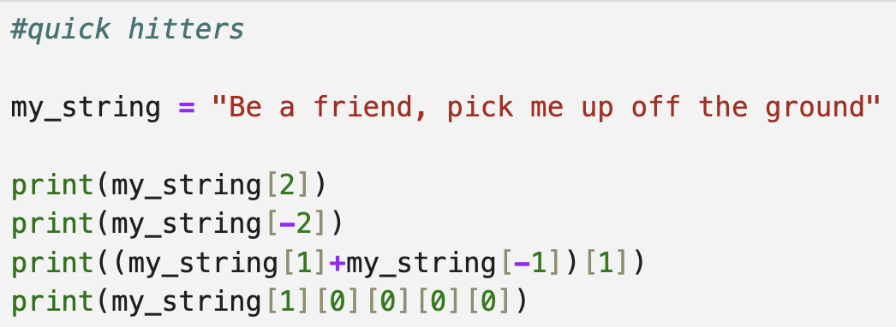
quickHitters

Slide 8

quickHitters
Single letter string is still a string so [ ] index can be apply to it, and to that and, …

Slide 9
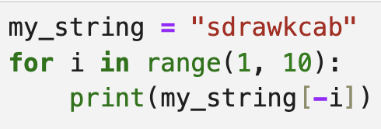
Self-Check
What is the output?

Slide 10
Self-Check
What is the output?
backwards

Slide 11
Slicing
Selecting zero of more items of a sequence and forming them into a new sequence
Uses the slicing operator :
Slices are inclusive of the lower bound but exclusive of the upper bound
Include a step size (optional)
slice = my_string[start:end:step]
Returns characters between start up to but not including end taking a step size of step

Slide 12
Slicing Step Size
A second colon and 3rd integer specifies a step size
Allows every 2nd or 3rd or other .. Character to be selected
#Slicing Examples s = "Blueberry" # Every other character from the whole string # start at index 0, go to len(s), step by 2 print(s[0:len(s):2]) # 'Buebr' # Every third character between offsets 2 (inclusive) and 7 (exclusive) print(s[2:7:3]) # 'ee'

Slide 13
Slicing Defaults
General form: seq[start:stop:step]
Defaults:
start defaults to 0 (or len(seq)-1 if step is negative)
stop defaults to len(seq) (or -1 conceptually for negative steps)
step defaults to 1stop is exclusive.
Negative step walks backwards (handy for reversals: seq[::-1]).
t = "Charlottetown" # Reverse the whole string print(t[::-1]) # 'nwotte tl o tralhC' (no spaces in the actual output: 'nwottetolrahC') # Every second character in reverse, starting from the last character down to index 3 (exclusive) print(t[:3:-2]) # takes indices len(t)-1, len(t)-3, ... down to > 3

Slide 14
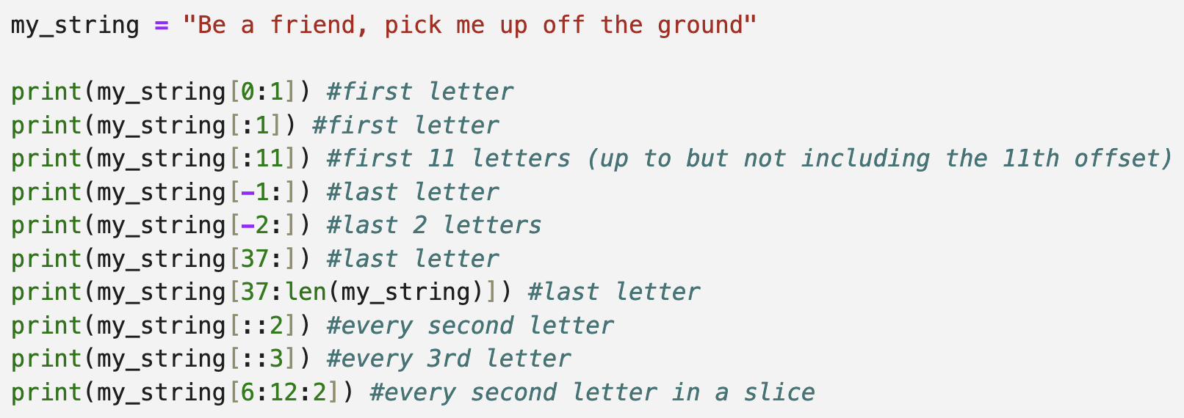
Slicing Examples

Slide 15
Find A Partner
In one-on-one basketball games, there are often the following rules:
Games go to 11 but you must win by 2
If the game is tied 10-10 then the first person to gain an advantage of 2 points is the winner
Each shot is either worth 1 or 2 points
Consider that the record of a one-on-on basketball game are given as a single string with the order of the points scored. The form is the player (A or B) who scored the points followed by an integer giving the number of points they scored.
For example:
A2A2A2A1A2A1B2B2B2B2B2B2
The above gives a game in which player A scores the first 10 points but then player B scores the next 12 thus winning the game (first to 11 (win by 2))

Slide 16
Find A Partner
Write a program that given a record of a one-on-one basketball game prints out the winner of the game
Start with Computational Thinking
Decompose the problem
Identify Patterns
Abstraction
Filter out the unnecessary details
Validation
How can you tell if your program is working correctly
Notes:
Possible Hint: The score is an unnecessary detail

Slide 17
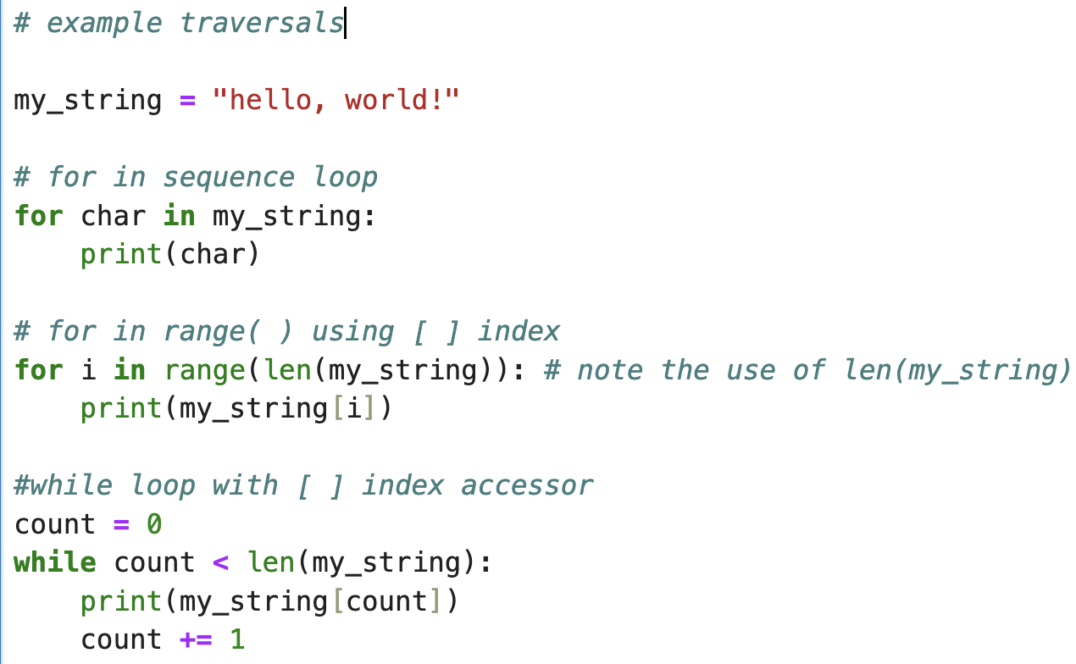
Traversal
Traversing (or systematically visiting) each character in a string can be done with a for loop
What happens if we forget the count += 1 line ?

Slide 18
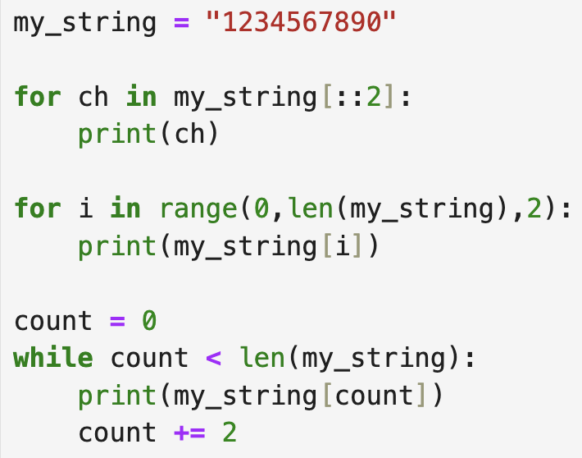
Self-check
1
2
3
Which of these traversals will print out every second letter in my_string

Slide 19
Self-check
Which of these traversals will print out every second letter in my_string
They all print every second letter

Slide 20
Strings are Immutable
#String immutability - the [] cannot appear on the left side of an assignment greeting = "Hello, world!" # Attempt to replace the first character by assigning into an index greeting[0] = "Y“
TypeError Traceback (most recent call last)
Cell In[1], line 4
2 greeting = "Hello, world!"
3 # Attempt to replace the first character by assigning into an index
----> 4 greeting[0] = "Y"
TypeError: 'str' object does not support item assignment
You can create a new string with new contents but you cannot change the letters inside an existing string
#String immutability - the [] cannot appear on the left side of an assignment greeting = "Hello, world!" # Attempt to replace the first character by assigning into an index greeting = “Jello world“
Printing greeting[0] would now print a ‘J’ as opposed to an ‘H’

Slide 21
String Methods
A sample of useful string methods
See code examples
upper() return a copy of the string that is converted to UPPER CASE
find(other) return the first index position of a given other string
in operator returns True if a given string is found and False otherwise
strip() returns a string with white space removed from start and end
replace(old, new) returns a new string with all occurrences of old replaced by new

Slide 22
String Comparison
Recall from previous classes that comparison of strings is based on the ordinal value associated with the characters. Capital letters come before lower case.
word = input("Enter a word related to PEI: ") if word < "Charlottetown": print("Your word, " + word + ", comes before Charlottetown.") elif word > "Charlottetown": print("Your word, " + word + ", comes after Charlottetown.") else: print("A perfect match—Charlottetown!")

Slide 23
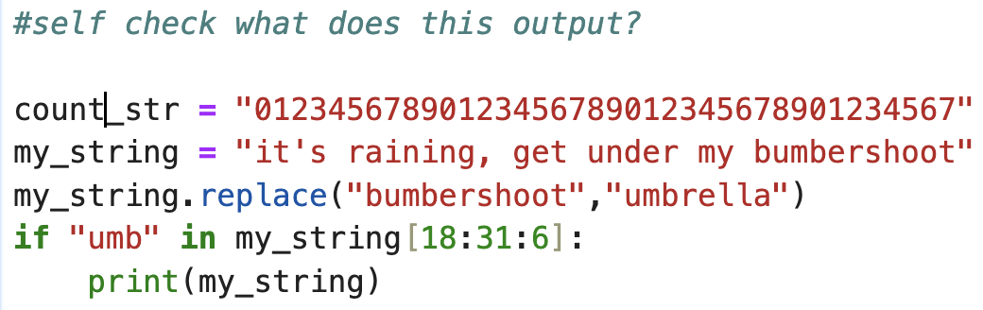
Self-check
Remember strings are immutable

Slide 24
Try at Home
Write a program that prints all of the letters that are in common between two strings
Write a program that beats the “Simon says game”
Print all of the letters from a string in reverse order – use a while loop – use a for sequence loop
Each letter on their own line

