Slide 1
Problem Solving and Debugging
CS1910
Computer Science I

Slide 2
Example Code
cdspower-upei/2026W-CS1910-Students/blob/main/Lectures/L10/L09-Problem-Solving-Examples.ipynb

Slide 3
Problem Solving
Computer Science is fundamentally about solving problems
We use computers and programming to automate solutions
How do we get from a problem idea to working code
A structured problem-solving process

Slide 4
4 Stage Problem Solving Model
Analyze the Problem
(Understand)
Generate Alternatives
(Design)
Implement
(Coding)
Evaluate
(Testing and Validation)
Common mistake: Making this the starting point

Slide 5
Computational Thinking
Recall
Aspects of computational thinking apply directly to steps in the problem solving process
Computational Thinking
Decompose
Pattern Recognition
Abstraction
Algorithms
Validation
Understand (Analysis)
Design (Generate alternatives)
Implement (Coding)
Evaluate (Testing and Validation)

Slide 6
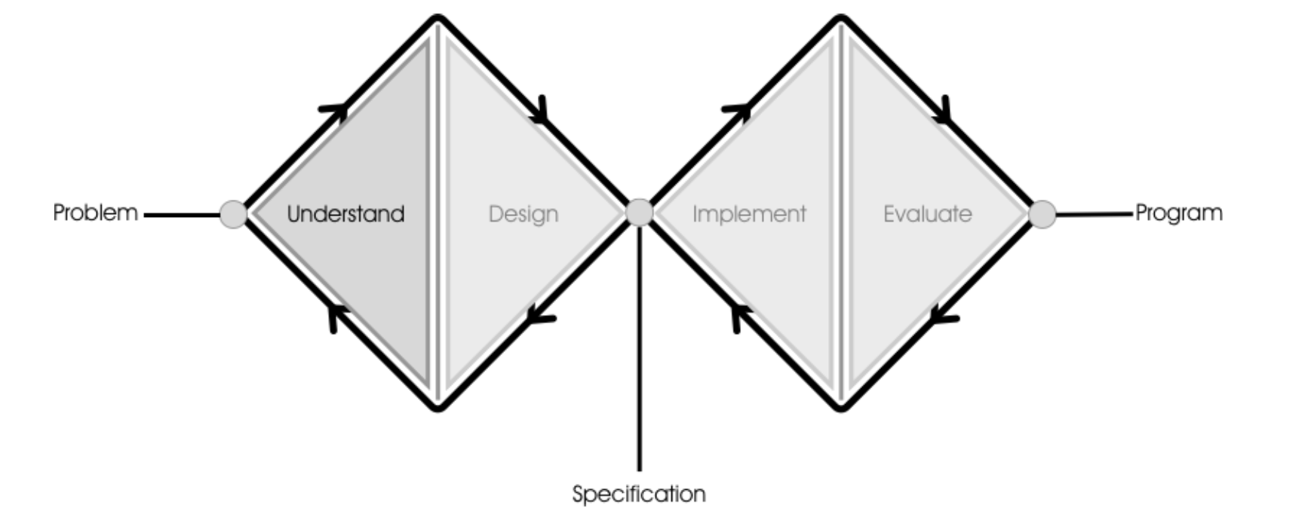
Double Diamond

Slide 7
Understand
Asking questions to improve your understanding of the problem
What is the desired outcome? (requirements)
What information do I have that I can use?
What information do I need?
Can you develop your own examples of inputs and their corresponding output?
Can you simulate or hand calculate simple cases?
Are there special cases?
Is there redundant information?
Are any parts of the problem contradictory?
Are there parts of the problem that are ambiguous?
Can we break the problem into parts?

Slide 8
Design
This is where you create/find alternatives for solving your problem – more questions:
Have you solved a problem like this before?
Has anyone else solved a problem like this?
Are there more general problems that are similar
Are there more specific problems that are similar
Can we develop pseudo code or flow charts
We iterate on these questions to generate a pool of potential solutions
You may discover that you do not understand everything and need to return to the understanding step to broaden your perspective
Once you have a list of potential solutions you ask a different set of questions of each solution:
What assumptions am I making?
Can I break this problem into smaller parts?
What data do I need and how will I store it?
Which design is easiest to maintain?
How do the designs differ in clarity, time, and space?
Does the solution scale to very large or very small values?
The answers to the above help you choose a solution that has the most benefits to solving your problem
That chosen solution becomes your specification

Slide 9
Find A Partner
Recall our 1 on 1 basketball problem
A game goes up to 11 points, the first person to 11 wins (but you must win by 2)
The scoring in the game is specified in the order that the points were scored between player A and B, each basket is worth 1 or 2 points
Example: “A2B2A2A2A1A1A1A2”
We want to know who won the game: A or B
Most students in the class designed a solution that required variables to count each person’s scores along the whole of the game
Consider the left half of the diamond:
Understand and Design
Notes:
Most students in the class designed a solution that required variables to count each person’s scores along the whole of the game

Slide 10
Find a Partner
Understanding the basketball problem:
What are we being asked?
What is redundant?
Can we decompose the problem into smaller aspects?
Did you try building other examples, other than what was given?
Designing a solution:
Decompose into smaller tasks
How to store or represent data
Existing solutions or patterns?
Consider pros and cons

Slide 11
Implement
Coding may uncover issues with the design
What part of the design is unclear once I start coding?
Did I discover a missing step, condition, or data?
Be prepared to revisit your solution
If something feels hard to implement, can I simplify the design (refactoring)?
What is the smallest change to make the code and design align?
Consider efficiency
Am I doing unnecessary work (repeated loops, repeated calculations)?
Is there a clearer data structure that reduces steps? (CS2920)
Does the code align with the solution?
Do function names and variable names reflect the steps in my plan?
Does each function do one clear job from the design? (Cohesion)
Practical checks while coding
Can I run and test each small piece right after I write it?
Do I have simple, normal, and edge-case inputs to try quickly?
Is my code readable by someone else or by me in the future?
Is duplicated code extracted into a helper?

Slide 12
Implementation (here is one I did earlier!)
def get_winner(scoring_sequence): score_a = 0 score_b = 0 index = 0 while index < len(scoring_sequence): current_player = scoring_sequence[index] points_scored = int(scoring_sequence[index + 1]) if current_player == "A": score_a = score_a + points_scored else: score_b = score_b + points_scored # BUG: stops as soon as someone reaches 11 (does not check 2-point lead) if score_a >= 11 or score_b >= 11: if score_a > score_b: return "A" else: return "B" index = index + 2 # End of sequence: pick the higher score if score_a > score_b: return "A" else: return "B"

Slide 13
Evaluation
Validation
Does the program solve the problem I was asked to solve?
Does the program meet the requirements?
Correctness
Does the program produce the expected output for normal cases?
Do I have at least: 1 normal case, 1 edge case, 1 error case?
What edge cases might break it (empty input, maximum size, duplicates)?
Robustness
Does the program handle bad or unexpected input gracefully?
Are error messages clear and helpful?
Notes:
Reflection & next steps
What one improvement would have the biggest impact right now?
What would I change if I had more time?
What did I learn that will change how I design next time?

Slide 14
Evaluation Test Cases
Normal Cases: Happen frequently
Normal Case 1: A player wins on last basket going from 10 to 11 and the other player is at 9 or lower (win by 2)
Does not matter if it is 11-0, 11-5, or 11-9, all are examples of that case – Can have A1 repeated 11 times
Normal Case 2: A player wins on last basket going from 10 to 12 and the other players is at 10 or below
Does not matter if it is 12-0, 12-5 or 12-10, all are examples of the same case. 0 Can have B2 repeated 6 times.
Edge Cases: Happen seldomly or in specific situations
Edge case: Extended play (called a deuce like in tennis):
Score of A-B is10–10, then a player A scores 1 point. Score is now 11-10.
Alternatives of test cases (Design of test cases)
A scores 1 more point (A1) – A wins
B scores 3 more points one at a time (B1B1B1) – B wins
B scores 1 point and then 2 points (B1B2) – B wins
B scores 1, creating a tie, and then we are back in another example of a tie

Slide 15
Test Cases Translate to Python
# Build the test data # 11–0 for A normal_case_a = "A1" * 11 # 12–0 for B normal_case_b = "B2" * 6 # 10–10 → 11–10 → 11–13 (B should win) deuce_case = ("A1B1" * 10) + "A1" + "B1B1B1" #A win with 11 points print("Buggy on normal_case_a? (expect A):", get_winner(normal_case_a)) #B wins with 12 points print("Buggy on normal_case_b? (expect B):", get_winner(normal_case_b)) #B wins with 13 points print("Buggy on deuce_case? (expect B):", get_winner(deuce_case)) # Prints A!

Slide 16
Test Cases Run the cases
# Build the test data # 11–0 for A normal_case_a = "A1" * 11 # 12–0 for B normal_case_b = "B2" * 6 # 10–10 → 11–10 → 11–13 (B should win) deuce_case = ("A1B1" * 10) + "A1" + "B1B1B1" #A win with 11 points print("Buggy on normal_case_a? (expect A):", get_winner(normal_case_a)) #B wins with 12 points print("Buggy on normal_case_b? (expect B):", get_winner(normal_case_b)) #B wins with 13 points print("Buggy on deuce_case? (expect B):", get_winner(deuce_case)) # Prints A!
Buggy on normal_case_a (expect A): A
Buggy on normal_case_b (expect B): B
Buggy on deuce_case (expect B): A
Oh no! Our last test case has failed!
Now what?
Well .. we have a bug … so now we need to debug our code
This is returning from Evaluation and iterating back to Implementation
It is possible that we didn’t understand the problem and have to go back to the beginning – but let’s see if we can figure out where we went wrong

Slide 17
Types of errors
Syntax errors
Identified by the interpreter
Example: a forgotten ‘:’ at the end of a function declaration
Experience helps us interpret and rectify the syntax errors produced by the interpreter
def divide_by(x,y) Cell In[5], line 1 return x/y def get_winner(scoring_sequence)
print(divide_by(3,4)) ^
print(divide_by(10,0)) SyntaxError: expected ':'

Slide 18
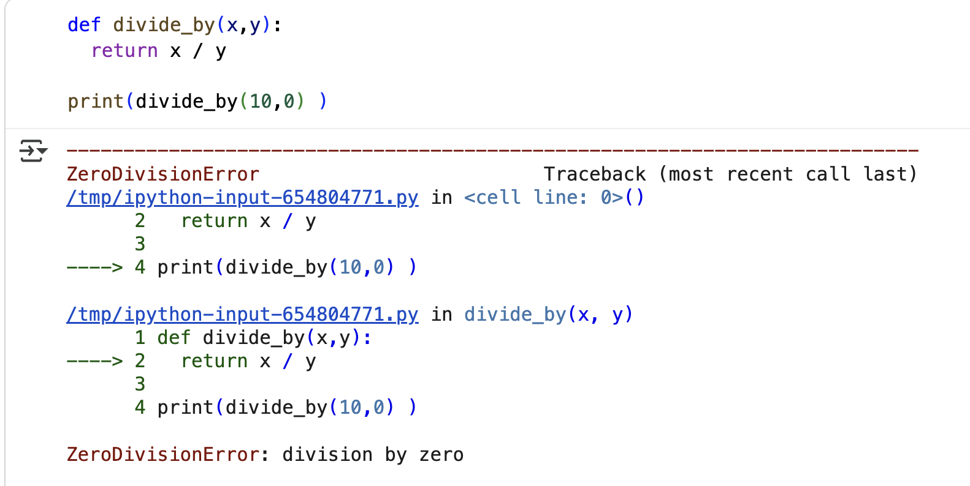
Runtime Error
Runtime Errors
Occur when something goes wrong while the program is running
Typically come with a stack trace and a message indicating the error
Picture a stack of plates:
Each time a function is called the system state is saved including the line number to return and puts it’s “plate” on top of the last function call in the stack
When a function finishes, it returns to the line it was called from and removes itself from the top of the stack of plates
When a run time error happens it dumps out all of the plates starting at the bottom most plate for you to see what was called so you can identify where it had the error happen

Slide 19
Semantic Error
We currently have a semantic errors
The program produces the incorrect results
Can be difficult to track down
The program runs (no syntax problems), runs all the way to the end (no errors thrown at run time), but produces the wrong result and we have no further information to help us

Slide 20
Debugging
In all error cases, we need to debug our program:
Syntax error: Fix the syntax
Runtime and Semantic: Find out what is happening that is going wrong
Debugging is a reactive process to a fault in a program
Identify the reason for the fault
Repair the fault
The complexity of this process is varied
For small programs it might be quite simple
For larger programs the process may be very complex

Slide 21
Debugging Techniques
Debugging by inspection
Sometimes we can look at the code and spot an issue
Print out values that we suspect should be something and determine why they might not be what we expect
Often, we have an error because some data was computed or stored incorrectly at an earlier point and by printing it out, we can determine where (and hopefully why) it has deviated
Can be successful – but if you find that you have tried it, and not found useful information, it can turn into guesswork that is just wasting time
Hand tracing code
Simulate the action of the code on paper, track the variables and their expected values and compare against what we are seeing
Integrated Debuggers
Programs that allow us to inspect the “state” of the program while it is running
Pause the program at certain lines and advance line by line through the code

Slide 22
Debugging Techniques
Debugging by inspection
Sometimes we can look at the code and spot an issue
Print out values that we suspect should be something and determine why they might not be what we expect
Often times we have an error because some data was computed or stored incorrectly at an earlier point and by printing it out we can determine where (and hopefully why) it has deviated
Hand tracing code
Simulate the action of the code on paper, track the variables and their expected values and compare against what we are seeing
Integrated Debuggers
Programs that allow us to inspect the “state” of the program while it is running
Pause the program at certain lines and advance line by line through the code

Slide 23
Debugging by Printing
#Print off information each time scoring is recorded to see sequence print("Event:", current_player + str(points_scored), "| Before:", before_a, "-", before_b, "| After:", score_a, "-", score_b) # Watch the first time someone hits 11+ if score_a >= 11 or score_b >= 11: lead = score_a - score_b if score_a >= score_b else score_b - score_a print("Reached 11+; lead is", lead, "→ returning NOW (this is the bug)") if score_a > score_b: return "A" else: return "B"

Slide 24
Identify the Bug
Here is the printout – we have learned that the problem (as suspected) is happening when someone has 11-10 for the first time.
Event: A1 | Before: 0 - 0 | After: 1 - 0
Event: B1 | Before: 1 - 0 | After: 1 - 1
Event: A1 | Before: 1 - 1 | After: 2 - 1
Event: B1 | Before: 2 - 1 | After: 2 - 2
Event: A1 | Before: 2 - 2 | After: 3 - 2
Event: B1 | Before: 3 - 2 | After: 3 - 3
Event: A1 | Before: 3 - 3 | After: 4 - 3
Event: B1 | Before: 4 - 3 | After: 4 - 4
Event: A1 | Before: 4 - 4 | After: 5 - 4
Event: B1 | Before: 5 - 4 | After: 5 - 5
Event: A1 | Before: 5 - 5 | After: 6 - 5
Event: B1 | Before: 6 - 5 | After: 6 - 6
Event: A1 | Before: 6 - 6 | After: 7 - 6
Event: B1 | Before: 7 - 6 | After: 7 - 7
Event: A1 | Before: 7 - 7 | After: 8 - 7
Event: B1 | Before: 8 - 7 | After: 8 - 8
Event: A1 | Before: 8 - 8 | After: 9 - 8
Event: B1 | Before: 9 - 8 | After: 9 - 9
Event: A1 | Before: 9 - 9 | After: 10 - 9
Event: B1 | Before: 10 - 9 | After: 10 - 10
Event: A1 | Before: 10 - 10 | After: 11 - 10
Reached 11+; lead is 1 → returning NOW (this is the bug)

Slide 25
Correct the bug
def get_winner_fixed(scoring_sequence): score_a = 0 score_b = 0 index = 0 while index < len(scoring_sequence): current_player = scoring_sequence[index] points_scored = int(scoring_sequence[index + 1]) if current_player == "A": score_a = score_a + points_scored else: score_b = score_b + points_scored # Logic correction: must reach at least 11 AND lead by 2 lead_for_a = score_a - score_b lead_for_b = score_b - score_a if (score_a >= 11 or score_b >= 11) and (lead_for_a >= 2 or lead_for_b >= 2): if score_a > score_b: return "A" else: return "B" index = index + 2 # If no 2-point lead by 11 occurred in the sequence, choose the higher score if score_a > score_b: return "A" else: return "B"

Slide 26
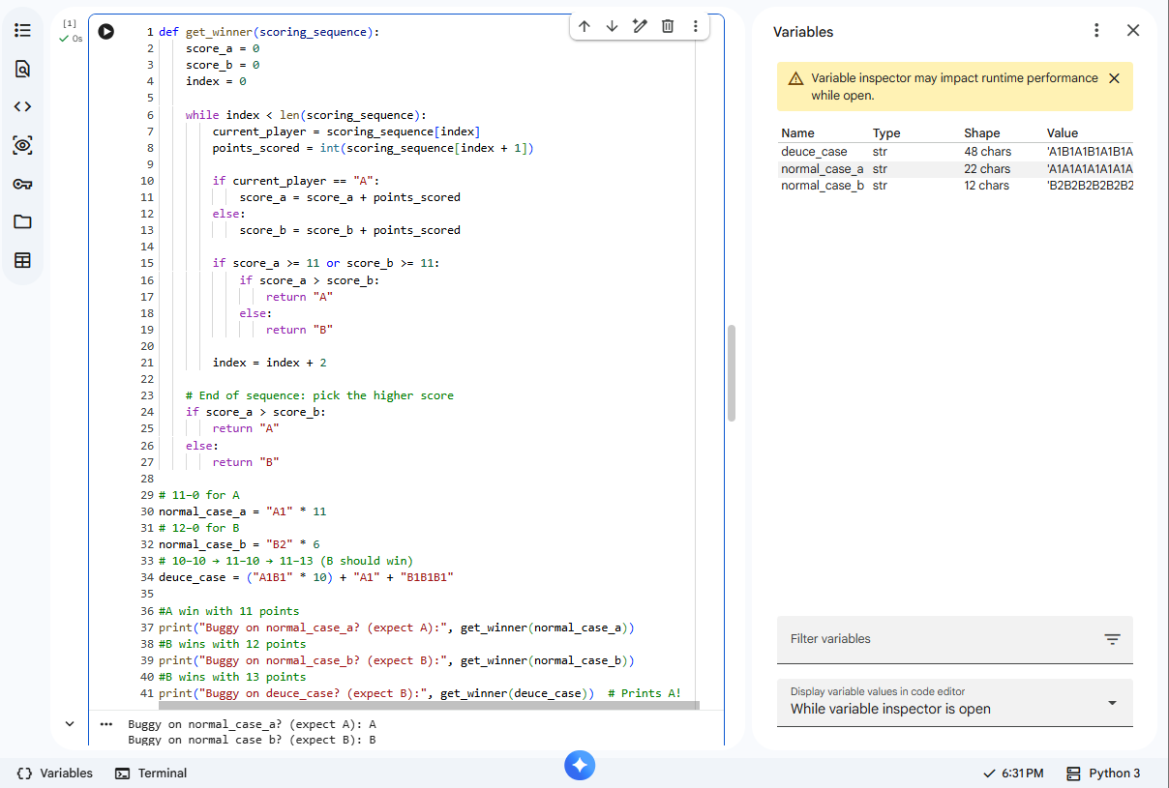
Google CoLab State Information
Colab comes equipped with a variable inspector
This allows you to inspect the state of variables as you run your program
If a program pauses, then you can see the variables as they are populated at that moment

Slide 27
Google CoLab State Information
Colab comes equipped with a variable inspector
This allows you to inspect the state of variables as you run your program
If a program pauses, then you can see the variables as they are populated at that moment

Slide 28
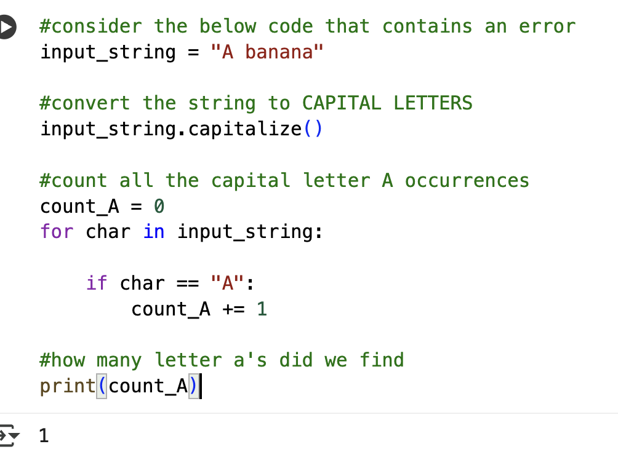
Partner Work
Find a partner
Practice showing how to find a bug
Print out variables to showcase where the error occurs
Open the Variable tab to see if that helps diagnose the issue
Goal: practice using these methods and show how they might help

Slide 29
Class Participation
In the partner work example was the error:
Runtime Error
Semantic Error
Syntax Error
Gross Error

Slide 30
debugger
A program that allows you to inspect and control the execution of your program is called a debugger
Most programming environments come with a debugger built in
Common debugger commands:
Pause the program at a particular line of code (breakpoint)
Navigate through the code manually
Display values of a particular variable or other information

Slide 31
Colab Debugger
Some debuggers have nice graphical interfaces (buttons, etc)
Colab has a basic debugger provided through the python environment (pdb = python debugger)
For this course we only use a couple commands:
breakpoint() (pause the program at a particular point)
print(…) print out information
c = continue to the next breakpoint or program end
q = quit the debugger

Slide 32
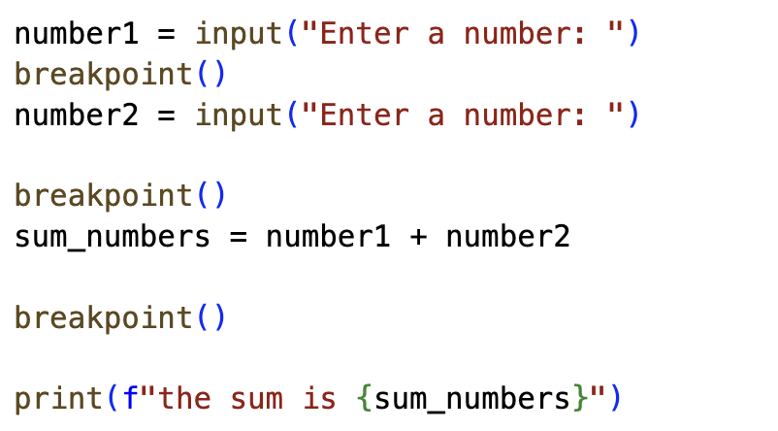
Debugger
Program will pause at this line and enter debug mode
Type c to continue to next breakpoint
Or print out data

Slide 33
PDB demo

Slide 34
Try at home
Ensure if you re-wrote the midterm you would be able to correctly answer all questions

Slide 35
Self-Check
Consider the following code:
#Bug Code Example number1 = input("Enter a number:") number2 = input("Enter another number:") sum_numbers = number1+number2 print(f"Sum of numbers: {sum_numbers}")
What type of error will I encounter?
Think about your test data …
Notes:
What type of error does the code contain?
Semantic? Syntax? Runtime?
What happens if I don’t put in numbers?

Slide 37
Additional Case Study

Slide 38
More Find A Partner: The Ants Go Marching
Consider that ants march on a stick
They travel in one direction but if they bump into another ant both ants reverse their direction and walk the other way
If they reach the end of the stick they fall off
Ants travel at 1cm/s and the stick is 9 cm long
What is the minimum or maximum amount of time until the stick has no ants on it
Input: the number of ants on the stick and the starting location for each ant

Slide 39
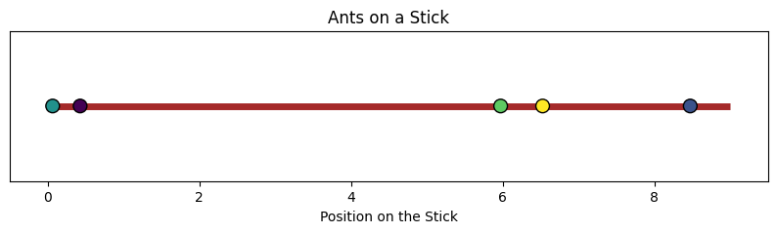
Ants go marching
Input: the number of ants on the stick and the starting location for each ant
Expected output: The minimum and maximum possible time for the stick to empty

Slide 40
Ants on a Stick
Notes:
Mention that if the Ants bounces or “jump” over each other it makes no difference
Smaller tasks: parse the input, iterate over each ant, calculate their longest and shortest, keep track of a maximum and minimum variable

Slide 41
Try at Home
Parity
In Computer Science a bit is something that has 2 states (on and off). We represent bits with either 0 or 1
A bit string is a string containing only 0s and 1s e.g., “0100110”
Parity is a count of the number of 1’s in a bit string if there is an even number we say the bit string has even parity.
Suppose we always like our bit strings to have even parity.
Given a bit string your task is to concatenate a character to the end of the bit string but ensure the parity of the bit string you create is always even
The solution is not the goal here. Follow the problem-solving process

